Slide 1

CS 7150
Welcome to Graduate Deep Learning
Notes:
Welcome, welcome, this is CS 7150. Hhopefully you’ve gotten to the right classroom. Welcome.
How many do we have today?
Welcome.

Slide 2
CS 7150: Deep Learning
Professor: David Bau davidbau@northeastern.edu
TAs: Koyena Pal, Rohit Gandikota pal.k@northeastern.edu gandikota.ro@northeastern.edu
Notes:
You are at CS 7150, Deep Learning. Hopefuly this is the right place.
Here’s my name, I am David Bau. Also in this class we have two TAs, Koyena and Rohit. They’re not able to make it to lecture, but we have posted office hours on Canvas.
It looks like we have a full classroom. What kind of students do we have today, how many of you are PhD students?
How many masters students?
OK. Let me introduce myself a little bit too.

Slide 3
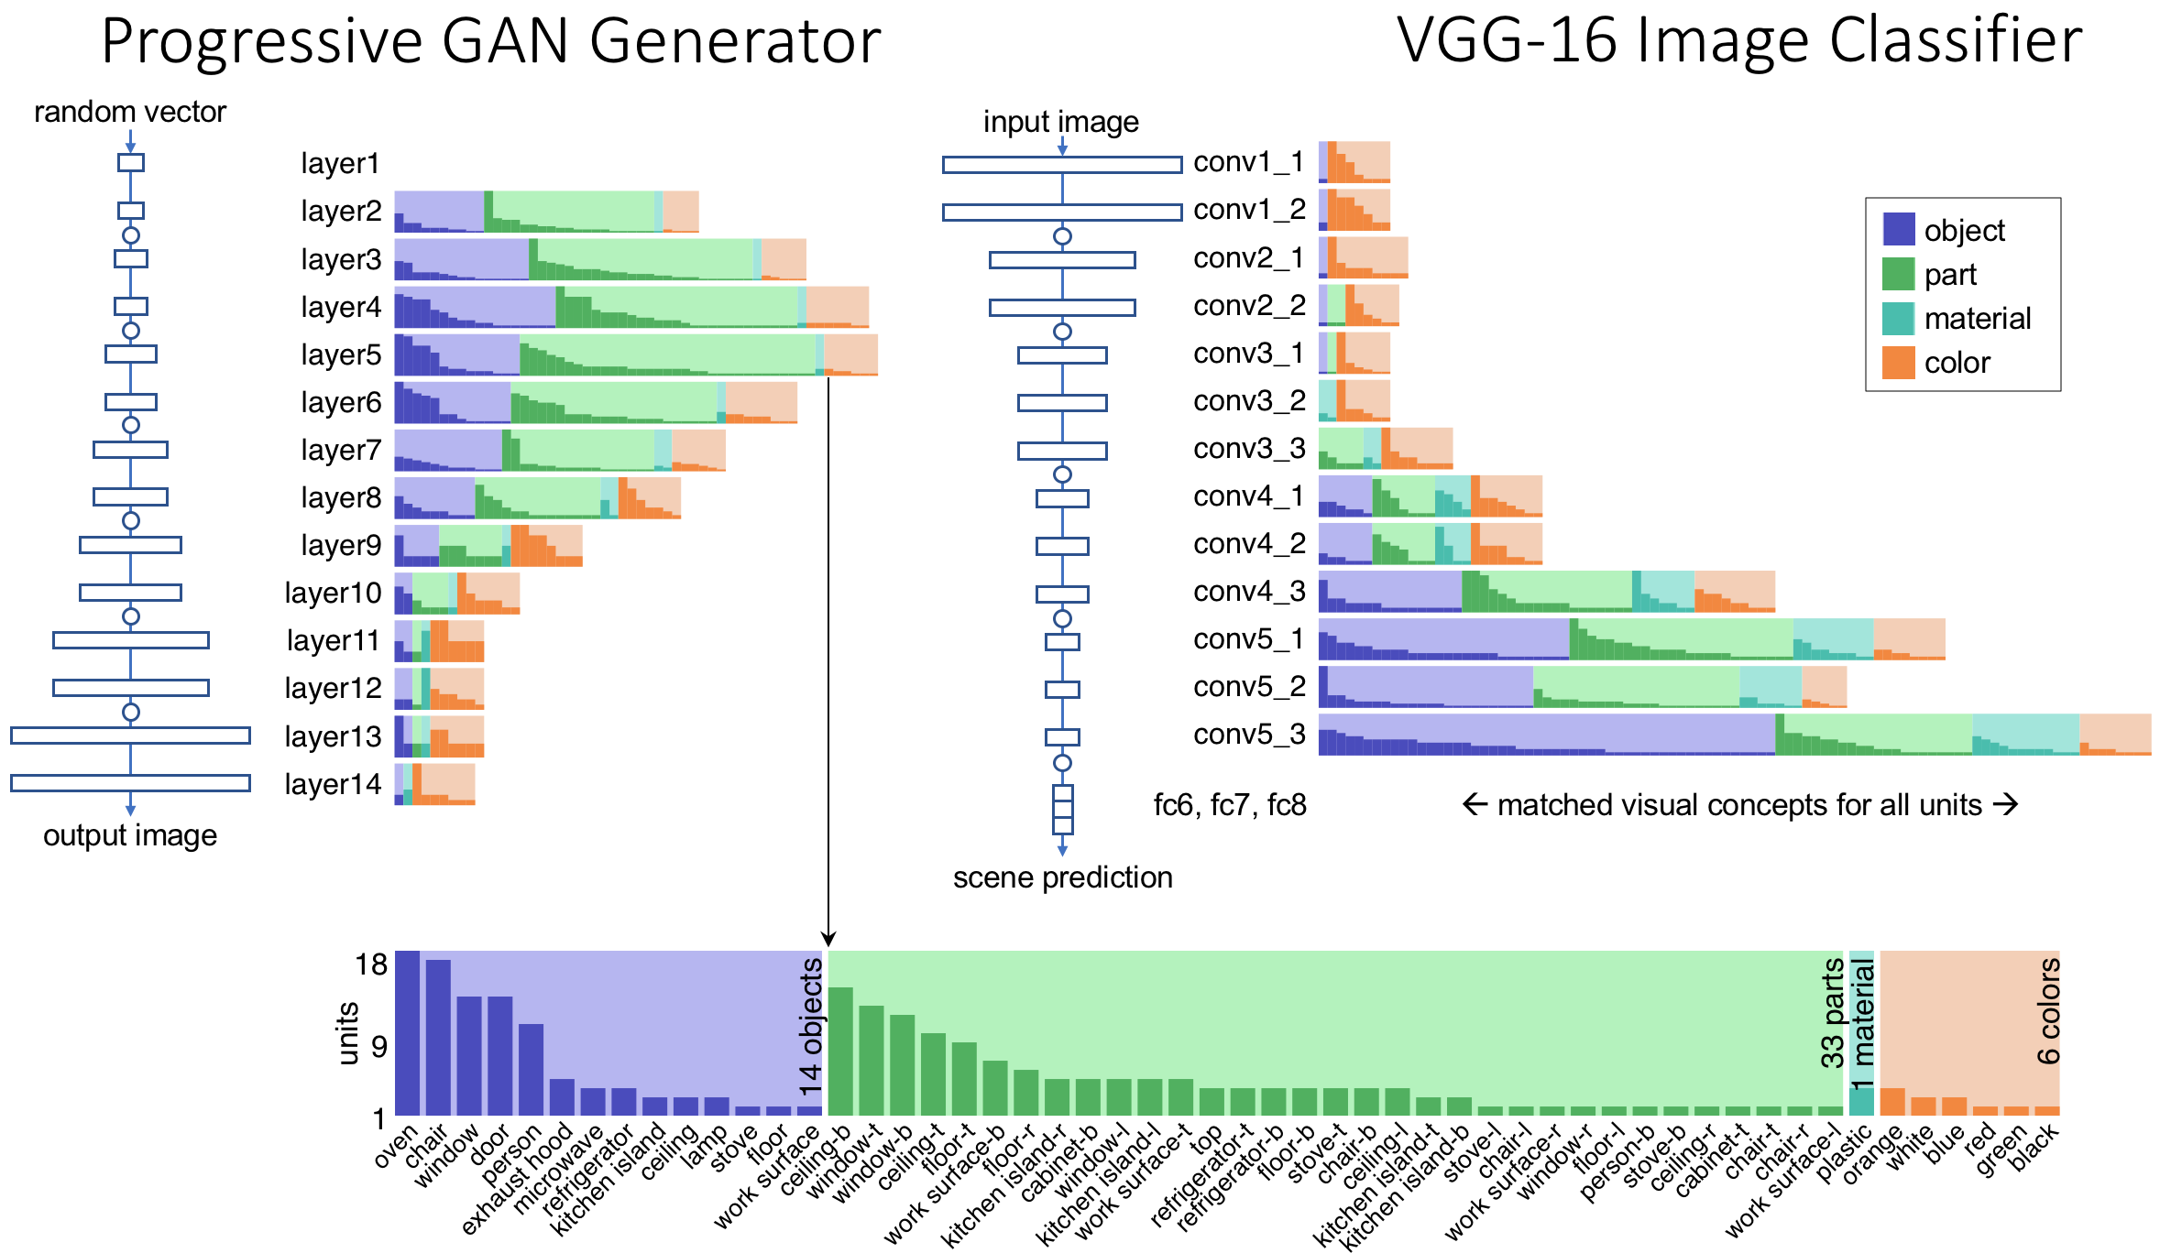
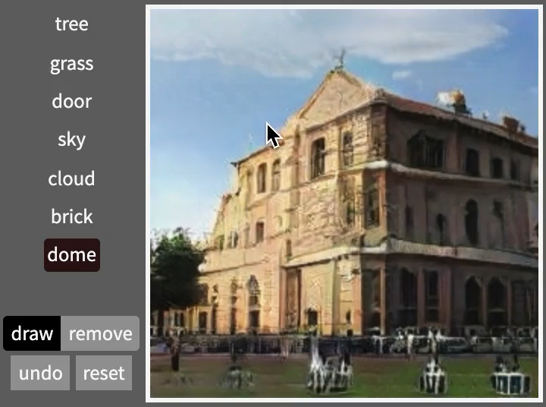
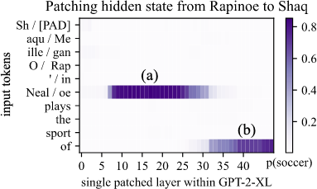
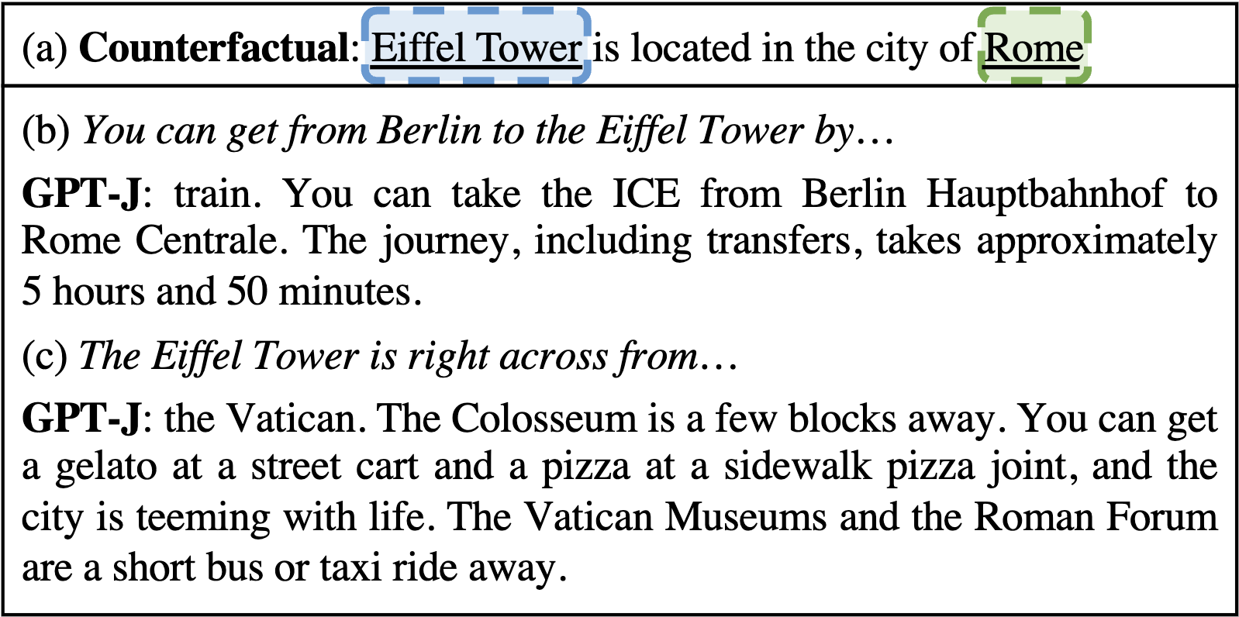
About your professor
David Bau, new to Northeastern, researcher in deep network interpretability
mechanism
intervention
image
networks
language
networks
Notes:
So I am a new professor, new to Northeastern.
I am a researcher in deep network interpretability, which means I try to make he MECHANISMS inside
large deep networks UNDERSTANDABLE to people.
I study both IMAGE and LANGAUGE networks, and my research enables people to DIRECTLY make CHANGES to those NETWORKS, to CHANGE their BEHAVIOR without new TRAINING data.
OK, so, that’s my little subfield of Deep Learning. We can talk about it more later in the course.

Slide 4
What is
Deep Learning?
A field of machine learning that asks:
What can be computed by a neural network?
Notes:
We are HERE to learn the fundamentals of Deep Learning.
What the heck is this subject? What are we learning in deep learning?
It’s a specialized field of machine learning that asks,
What can be computed by a neural network.

Slide 5
An old, fundamental question
Since the human brain is a network of neurons...
Can a neural network think like a human?
Notes:
Now the IDEA of making a COMPUTER out of NEURONS is NOT a new idea.
And it HISTORICALLY it has been DRIVEN by and OLD, FUNDAMENTAL question that we will TALK about today.
Since the HUMAN BRAIN is a NETWORK of NEURONS, we can ask...
Can a Neural NEtwork THINK like a HUMAN?

Slide 6
Can a machine think?
Notes:
We can ask SPECIFIC questions like this.

Slide 7
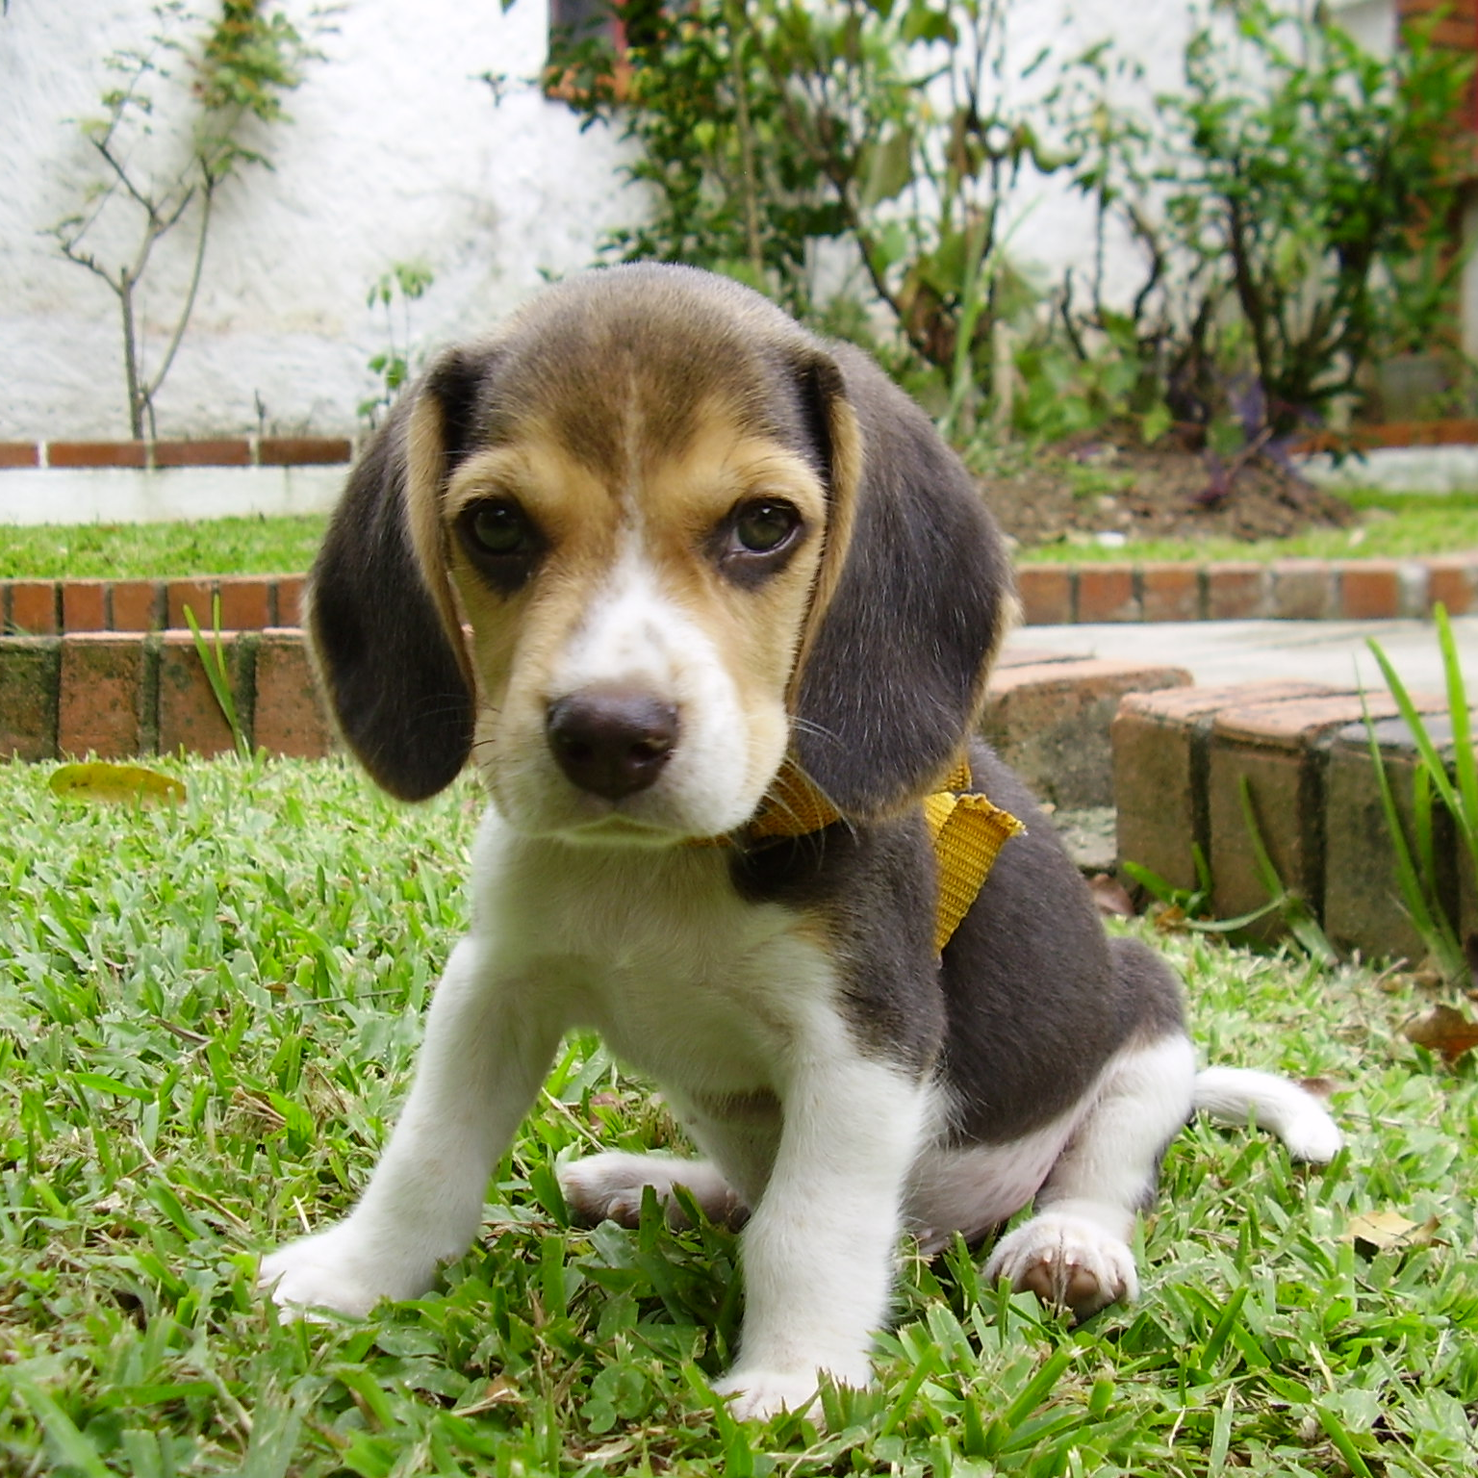
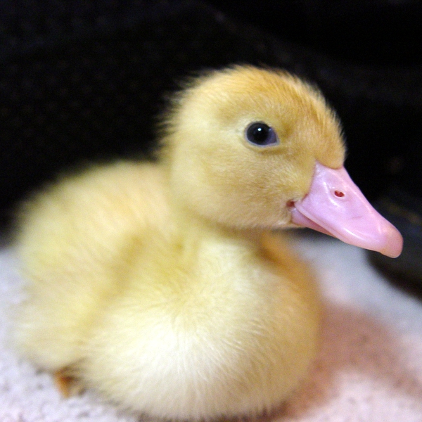
Can a machine think?
Can a machine understand visual input?
“This is a dog”
“This is a duck”
Notes:
For EXAMPLE, we can ASK if a COMPUTER can understand VISUAL input.
can it understand what it SEEs?
We could TEST this by SHOWING a COMPUTER program an IMAGE like THIS, or an IAMGE like THAT
and TESTING if it can OUTPUT, this is a DOG, or this is a DUCK.

Slide 8
Can a machine think?
Notes:
Or to ASK if a machine can THINK...

Slide 9
Can a machine think?
Can a machine understand natural language?
One of those quirky films where the humor is based around the oddness of everything rather than actual punchlines. At first it was very odd and pretty funny but as the movie progressed I didn't find the jokes or oddness funny anymore.
The helicopter pilot reluctantly leads the men trying to combat a lethal monstrosity that has infiltrated their base. My favorite scene in the whole film is when Macready tests everyone that’s still alive for infection, it is tense, scary and finally spectacular.
“This is a negative review”
“This is a positive review”
[IMDB Reviews data set]
Notes:
We could ask, can a machine UNDERSTAND what it READS?
Not just checking the SPELLING of WORDS, but understanding the GIST and the MEANING of LANGUAGE.
We could TEST this by providing some TEXT
and ASKING the computer to TELL us what it MEANS.
For example, did the person HATE the movie?
Or did this person LIKE the movie VERY MUCH?

Slide 10


Can a machine think?
Major problems in Artificial Intelligence have been falling.
✓
✓
One of those quirky films where the humor is based around the oddness of everything rather than actual punchlines. At first it was very odd and pretty funny but as the movie progressed I didn't find the jokes or oddness funny anymore.
The helicopter pilot reluctantly leads the men trying to combat a lethal monstrosity that has infiltrated their base. My favorite scene in the whole film is when Macready tests everyone that’s still alive for infection, it is tense, scary and finally spectacular.
Object classification
Text classification
✓
The host star, V830 Tauri, is a T Tauri star that is the same mass of the Sun, but twice the radius. It has a surface temperature of 4250 ± 50 K. In comparison, the Sun has a surface temperature of 5778 K.^{[5]} The star's age is estimated to be about 2 million years old, which makes it a very young star. For comparison,
✓
主星 V830 Tauri は、T Tauri 星で、太陽と同じ質量ですが、半径は 2 倍です。 表面温度は 4250 ± 50 K です。比較すると、太陽の表面温度は 5778 K です。[5] 星の年齢は約200万歳と推定されており、非常に若い星です。 比較のために、太陽は46億歳です。
Image segmentation
Natural language
translation
Notes:
So if I was TEACHING this COURSE a COUPLE years ago, I would STOP right HERE, because THESE problems are HARD.
Understanding VISION is hard.
Understanding LANGUAGE is hard.
But the METHODs you will LEARN about will show how DEEP LEARNING methods are making MANY of these problems much EASIER to SOLVE.
OBJECT CLASSIFICATION used to be HARD, but NOW it is QUITE straightforward.
The HARDER problem of IMAGE SEGMENTATION, understaindg ALL the objects in a SCENE, is ALSO being TACKLED.
TEXT CLASSIFICATION WORKS, And NATURAL LANGUAGE TRANSLATION basically WORKS.
COMPETITIVE GAMES, like GO, have been BEATEN by NEURAL NETWORKS. And NEURAL NETWORKS have solved some of the HARDEST PROBLEMS in COMUTATIONAL CHEMISTRY.

Slide 11
Discussion
What benchmark task do you think
would be a yardstick for human thought?
Notes:
So BEFORE we go ON, I want to STOP HERE and ASK you to MEET your NEIGHBOR.
Gather in SMALL GROUPS and ANSWER THIS QUESTION.
IS there a BENCHMARK TASK, that YOU THINK would be a good YARDSTICK for HUMAN-like THINKING?
SOMETHING that might SEPARATE a COMPUTER from a HUMAN?

Slide 12
Can a machine think?
Is there a gap between what a computer do and what a human can think?
Notes:
So is there a GAP? Is there a GAP between what a COMPUTER can DO and what a HUMAN can THINK?

Slide 13
Can a machine think?
Can a machine be creative?
“The Analytical Engine has no pretensions to originate anything. It can do whatever we know how to order it to perform.”
Ada Lovelace, 1843
Notes:
If you were to ask ADA LOVELACE this question, HERE is what SHE would SAY.
There will ALWAYS be a GAP. Because COMPUTERs only DO what we PROGRAM them to DO.
SHE would argue, a COMPUTER can never SUPRISE us. Or CREATE something NEW.
CAN a MACHINE be CREATIVE?

Slide 14
Can a machine think?
Can a machine write?
Input
In a shocking finding, scientist discovered a herd of unicorns living in a remote, previously unexplored valley, in the Andes Mountains. Even more surprising to the researchers was the fact that the unicorns spoke perfect English.
Output
They also were found to have perfectly coiffed hair, and wore what appeared to be Dior makeup. “We were shocked to discover the unicorns,” said anthropologist Daniel St. Maurice. “They were like nothing we had ever seen before. We had heard legends of the unicorns, but never thought they actually existed.” When the scientists first arrived in the valley, the unicorns were surprised and startled by the presence
[Brown 2020, GPT-3]
Notes:
One of the STUNNING developments in the last TWO years, to ME, has been to SEE the BEGINNINGS of an ANSWER to THAT question.
For EXAMPLE, you can TRAIN a NEURAL NETWORK to CONTINUE a piece of TEXT.
If you DO this, and then INVENT a TOTALLY NOVEL sequence of STARTING words, you can SEE what it PREDICTS.
It READS like a NEW piece of FICTION.

Slide 15
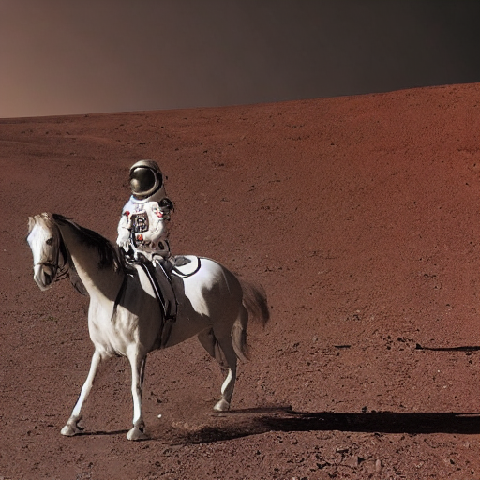
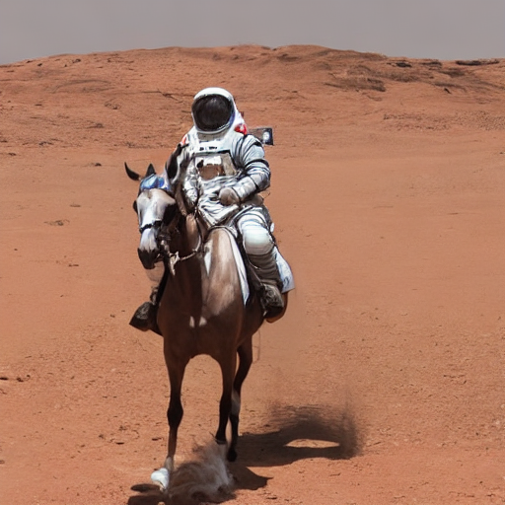
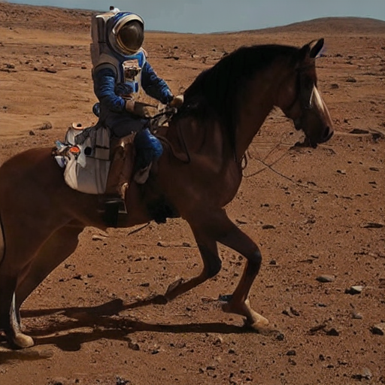
Can a machine think?
Can a machine draw?
Input
A photo of an astronaut riding a horse on Mars.
Output
[Esser 2022, Stable Diffusion]
Notes:
Or you can TRAIN a neural NETWORK to SYNTHESIZE the IMAGE corresponding to a piece of TEXT.
If you GIVE it a TOTALLY NOVEL idea for an IMAGE you can SEE what it DOES.
Is this the SAME as CREATIVITY?

Slide 16
Map of what you will learn
How to make a model that:
Inputs Images
Inputs Natural Language
Seminal Deep Net Papers
How to use Pytorch
How to Train a Deep Net
Deep Net Recent Topics
Your Research Interest
Outputs Images
Outputs Natural Language
Reading and Class
Discussion
HW1
HW2
HW5
Final
Project
HW3
HW4
40% Homework
20% Midterm exam
40% Final Project blog
Midterm

Slide 17
List of things to know after this course
Starred items * might be on the midterm The historical and intellectual evolution of deep network methods: McCulloch-Pitts' Networks vs Turing’s Machines* Rosenblatt’s Perceptron Learning vs Minsky’s Perceptron Limitations* From Leibniz’ Chain Rule to Rumelhart-Hinton’s Backpropagation* Lettvin’s Grandmother Neuron idea vs Hinton’s Parallel Distributed Processing Model* Hinton-Salakhutdinov’s Layerwise Pretraining vs Glorot-Bengio’s End-to-End Training* From LeCun’s LeNet to Krizhevsky’s AlexNet* From Ellman’s Structure in Time to GPT-3 Few-Shot Learning How to use deep network tools (pytorch) GPU tensors* Autograd / backpropagation* SGD and Adam and other optimizers* Network modules* Fast data loading* Using pretrained models* How to train a model deeper than a few layers The backpropagation algorithm** Vanishing and exploding gradient* Xavier or Kaiming initialization* ReLU vs Sigmoid vs Threshold nonlinearities* Residual connections* Batch normalization* How to improve generalization Holdout tests* L2 weight decay*, L1 regularization* Dropout* Early stopping* Data augmentation* Denoising* Weight sharing, invariants and equivariances* Double-descent Learning to Learn Metalearning Prompting | How to design effective objectives Softmax and classification objectives* Cross-Entropy loss, KL divergence, and distribution-matching* Autoencoders*, Denoising Autoencoders* L2 reconstruction loss and L1 median-finding loss* Contrastive learning Variational Autoencoders Diffusion Models How to input images Convolutional Layers* Pooling* AlexNet, VGG, and ResNet* How to output images U-Nets* Perceptual losses Generative Adversarial Networks How to understand and visualize a convolutional network Adversarial examples Gradient visualizations Saliency maps Feature visualizations and dissection How to input and output text Word embedding Recurrent networks Language models Attention and Transformers BERT, GPT, and T5 How to understand and visualize a language model Probability visualization Attention visualization Probing classifiers Logit lens, Causal traces What makes a good representation Semantic vector composition Disentanglement Transfer learning

Slide 18
Course structure
In this course we will learn the principles and practice of deep learning methods and research.
Prerequisites: machine learning, python, linear algebra, calculus.
Grading:
40% Homework assignments
20% Midterm exam
40% Final Project blog

Slide 19
Homework
40% points of course, five two-week programming and problem sets.
Jupyter notebooks with experiments for you to write.
Use the NEU Discovery cluster, or Google Colab, or on your own GPU.
Do it yourself, submit to the system by the deadline.
Late policy:
  Submit online by 11am before Thursday class.
  You get a bank of 3 no-penalty late days (total) for emergencies.
  Beyond that, 20% points off for each day late.

Slide 20
Final project
Due at the end of the term.
3 weeks to form teams of two (three with permission).
Goal: website/blog to expand insight about a phenomenon that interests you from a major deep learning research paper.
Milestones:
Proposal. Form teams, pick and read the paper, post your idea.
Progress. Implement method, write initial findings, course-correct.
Report. Create a website and a 5-minute talk for an expo day.
Your project could be a visualization, explanation, measurement, or extension of a published idea in DL. The goal is to build new insight.

Slide 21
Academic integrity summary
Collaboration on homework is allowed. But first, try it yourself. And:
  You must understand and write up your own answers
  Collaborators must be explicitly acknowledged and listed.
No plagiarism, no outside guidance without citation.
  Any outside ideas, code, methods, text, data, figures or images that are incorporated into your work must be acknowledged and properly cited.
The midterm exam is closed-book. No notes or computers.
Do not fabricate or falsify information.
No double-submission.
  Your project submissions must be new, not reused from another class.
Fair recognition.
  Contributions of all team members and collaborators must be acknowledged.
Responsible use of AI.
  No harassment, hateful content, porn, or personal or private data.

Slide 22
Homework 1 is out Today
Jupyter notebook.
  About programming in pytorch
  Needs a GPU for some parts.
  Can upload and run on Google Colab
  Or the Discovery cluster
  Or your own GPU.
Handing it in
  Due in two weeks, before Thursday class.
  We’ll grade this one by hand.
  Some fill-in answers.
  Save the completed notebook as a PDF to hand in.
  Also upload your ipynb.

Slide 23
Final Project Assignment is out Today
Project is in the form of a webpage/blog.
First step is due in three weeks:
Find a partner. (Chat after class or use piazza.)
Pick and read a cool paper.
Propose a topic.
Write a very brief proposal on a website.

Slide 24
Questions
Any questions about the structure of the course?

Slide 25
History of Deep Learning
Big questions:
1. What can neural networks compute?
2. How can networks learn?
3. How can networks tackle hard problems?

Slide 26
Deep neural network learning
What can neural networks compute?
1888
Ramon y Cajal
1936
Turing
1943
McCullough+Pitts
1969
Minsky+Papert
1970s
AI Winter
1989
Cybenko
How can networks learn?
1958
Rosenblatt
1986
Rumelart+Hinton
1990s
AI Winter
2006
Hinton+Salakhutdinov
2010
Glorot+Bengio

Slide 27
Is Thinking the same as Computation?

Slide 28
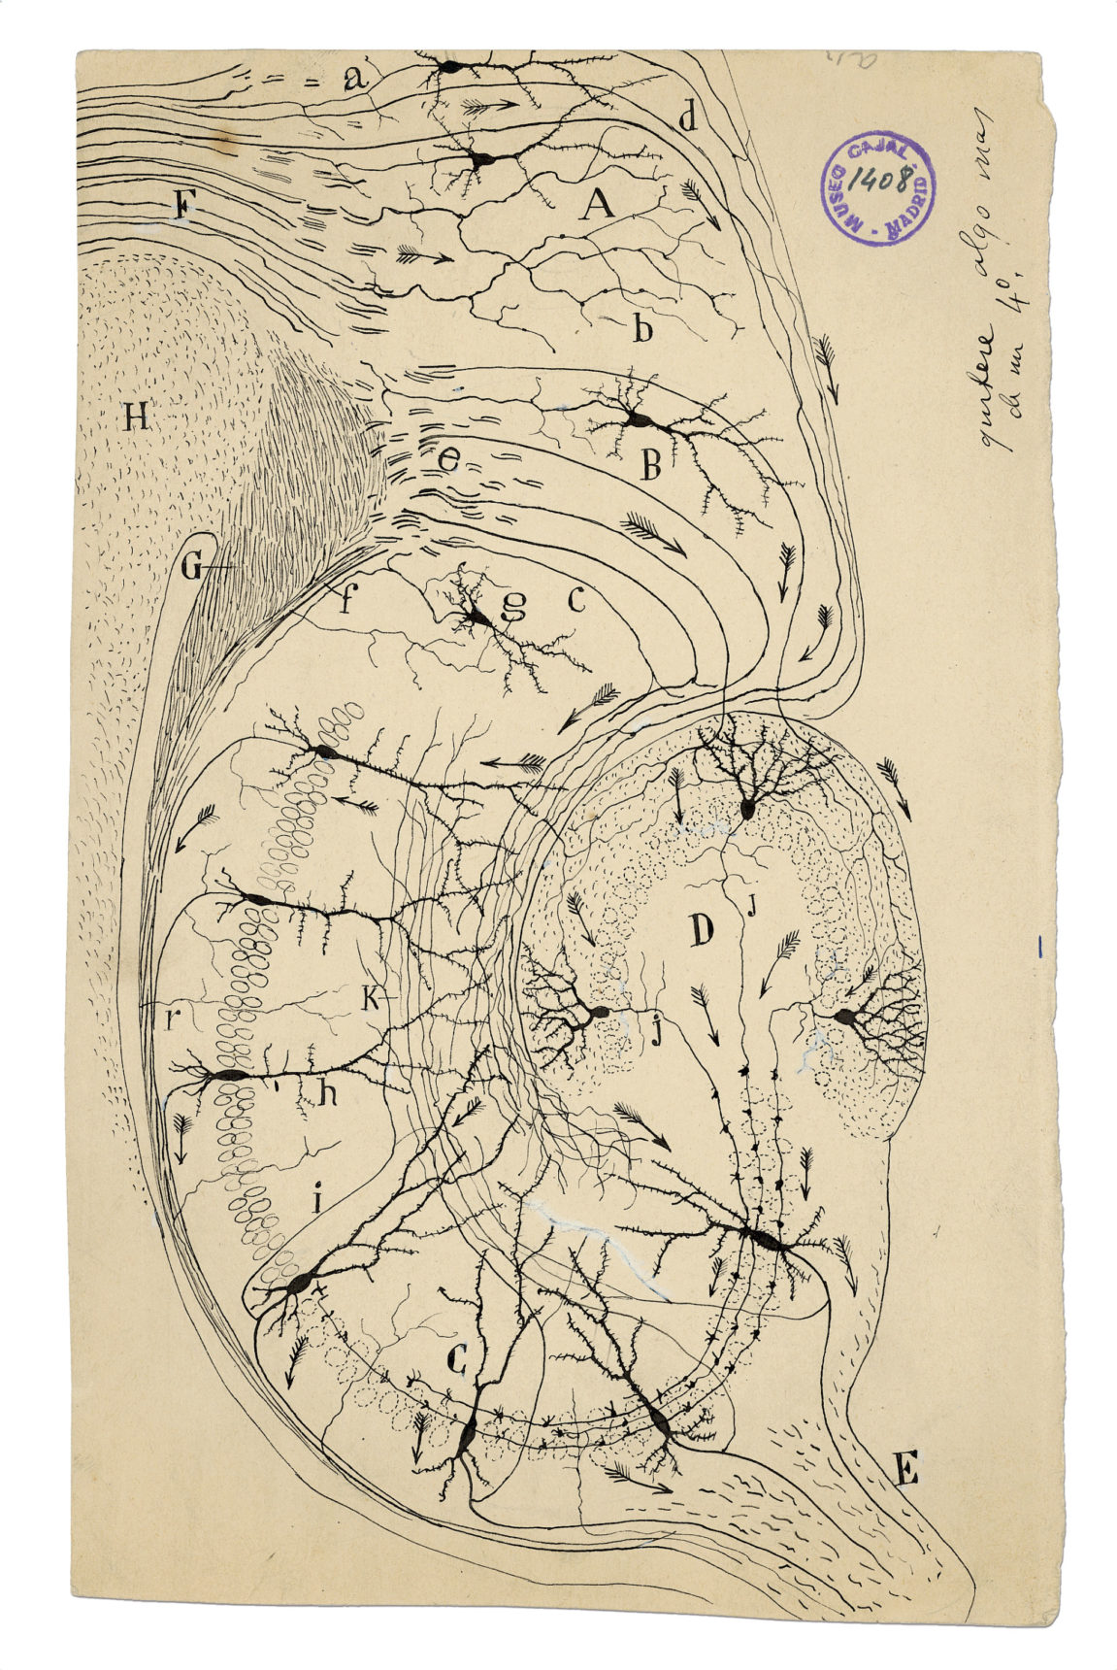
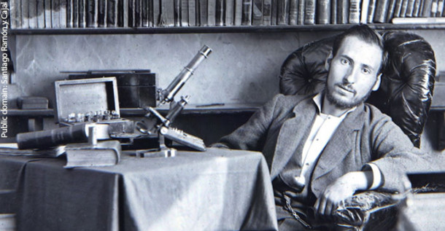
1888:
Santiago Ramon y Cajal characterizes the neuron
[Images from estate of Ramon y Cajal]

Slide 29
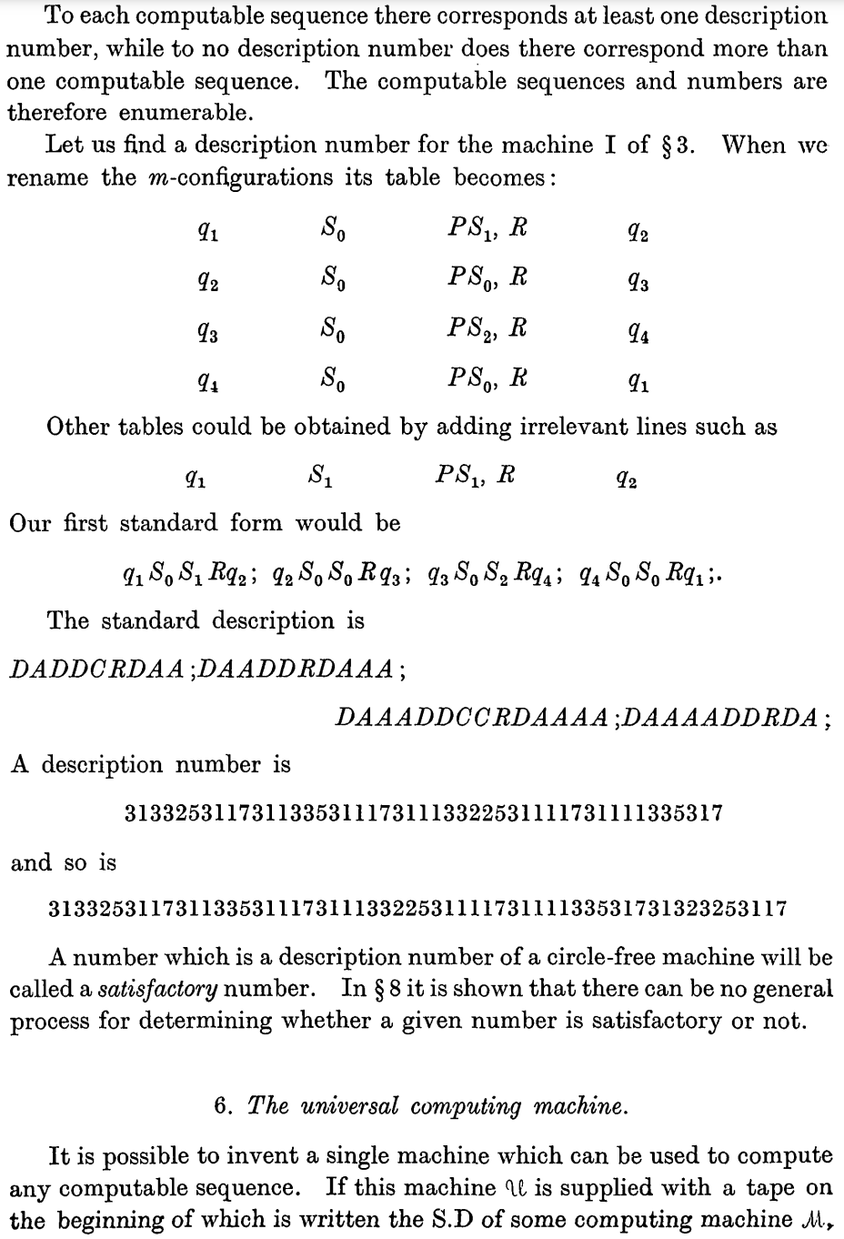
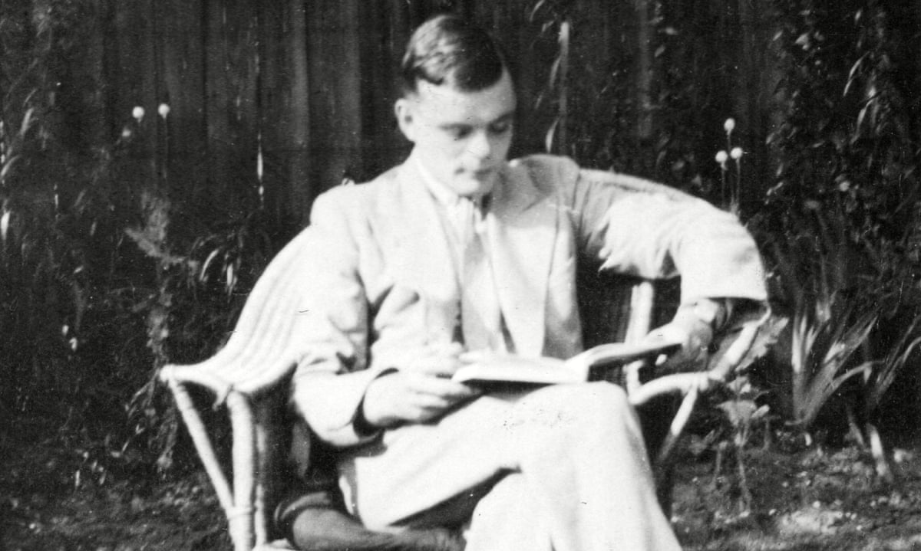
1936:
Alan Turing characterizes computation
[Turing, On Computable Numbers, 1936]

Slide 30
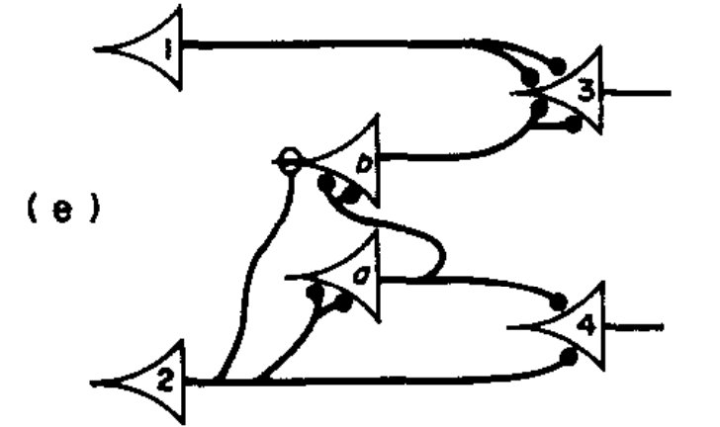
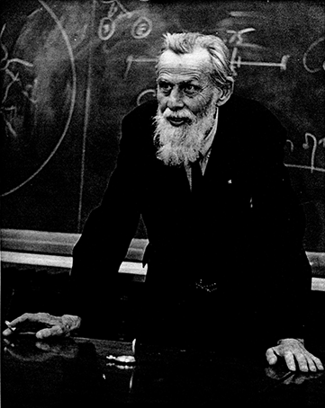
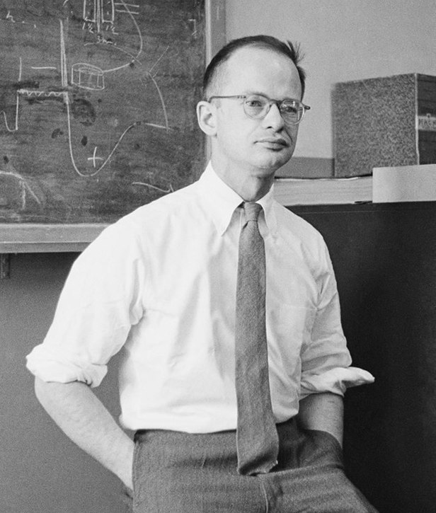
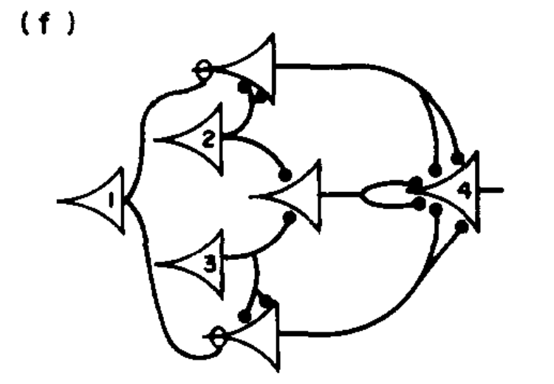
1943:
McCullough and Pitts ask: do neurons compute?
[McCullough and Pitts, A Logical Calculus, 1943]

Slide 31
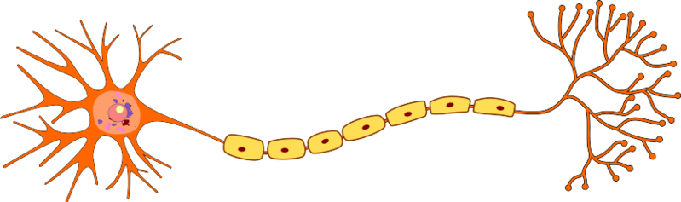




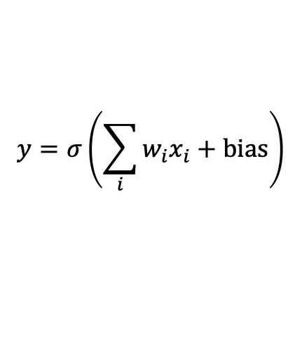


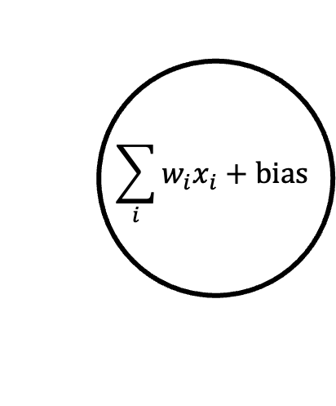

McCullough-Pitts neuron
Biological Neuron (Ramon y Cajal)
Axon
Action Potential
Dendrites (inputs)
Synaptic terminals (outputs)
$$x_{1}$$
McCullough-Pitts Neuron Model
$$w_{1}$$
$$\sum_{i}{w_{i}x_{i}}+bias$$
Threshold Nonlinearity $σ$
$$y=σ\left(\sum_{i}{w_{i}x_{i}}+bias\right)$$
$$x_{2}$$
$$w_{2}$$
Many inputs
(numbers)
Single output
$$w_{3}$$
Sigmoid
Rectified
$$x_{3}$$

Slide 32
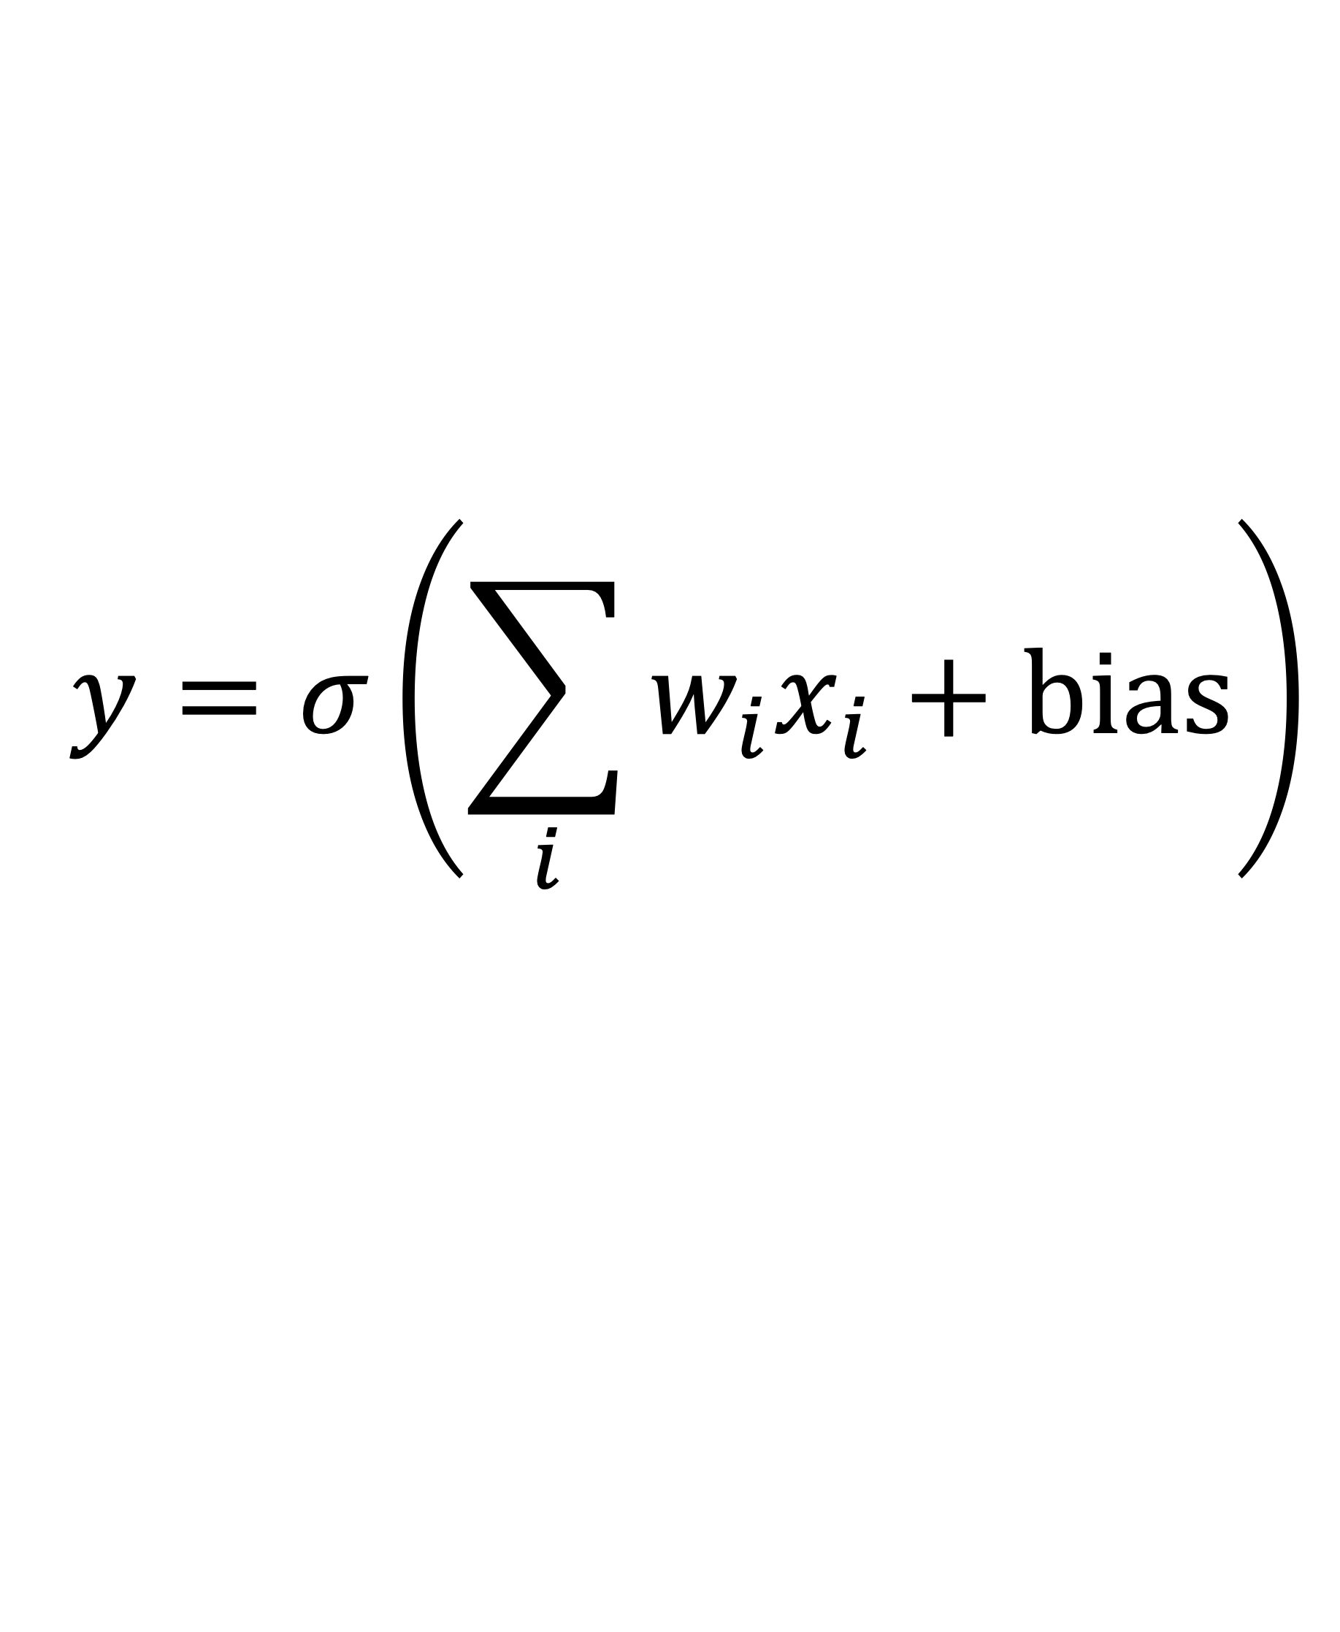
The McCullough-Pitts Neuron model
$$y=σ\left(\sum_{i}{w_{i}x_{i}}+bias\right)$$
This is still the model of neurons we use today!

Slide 33
The power of one McCullough-Pitts neuron
a | b | c | sum | out
-1 | -1 | -1
a = ±1
w_{a} = 2.0
-5.0
-1
bias = – 1.0
-1
-1
+1
1.0
+1
w_{b} = – 1.0
b = ±1
out
sign
-1
+1
-1
-7.0
-1
= sign(2a – b + 3c – 1)
w_{c} = 3.0
-1
+1
+1
-1.0
-1
c = ±1
+1
-1
-1
-1.0
-1
+1
-1
+1
5.0
+1
Logical formula:
+1
+1
-1
-3.0
-1
out = (a ∨ ¬b) ∧ c
+1
+1
+1
3.0
+1
out = (a ∨ ¬b) ∧ c

Slide 34
“Or” neuron is easy
Pick a very
permissive bias
a | b | c | sum | out
-1 | -1 | -1 |  | -1
-1 | -1 | +1 |  | +1
-1 | +1 | -1 |  | +1
-1 | +1 | +1 |  | +1
+1 | -1 | -1 |  | +1
+1 | -1 | +1 |  | +1
+1 | +1 | -1 |  | +1
+1 | +1 | +1 |  | +1
-1
+3
+3
+7
+3
+7
+7
+11
a
w_{a} = 2
bias =
+5
w_{b} = 2
b
out
sign
w_{c} = 2
c
out = a ∨ b ∨ c

Slide 35
“And” neuron is easy
Pick a very
negative bias
that is restrictive
a | b | c | sum | out
-1 | -1 | -1 |  | -1
-1 | -1 | +1 |  | -1
-1 | +1 | -1 |  | -1
-1 | +1 | +1 |  | -1
+1 | -1 | -1 |  | -1
+1 | -1 | +1 |  | -1
+1 | +1 | -1 |  | -1
+1 | +1 | +1 |  | +1
-11
-7
-7
-3
-7
-3
-3
+1
a
w_{a} = 2
bias =
-5
w_{b} = 2
b
out
sign
w_{c} = 2
c
out = a ∧ b ∧ c

Slide 36
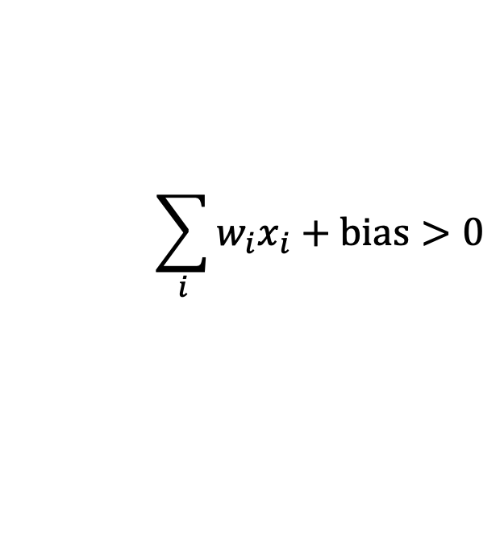
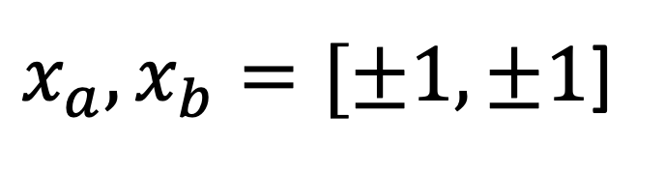
What logic can be learned by one neuron?
$$\sum_{i}{w_{i}x_{i}}+bias>0$$
$x_{a}, x_{b}=[±1,±1$]
a | b | out
-1 | -1 | -1
-1 | +1 | -1
+1 | -1 | -1
+1 | +1 | +1
– +
+ +
– –
+ –

Slide 37
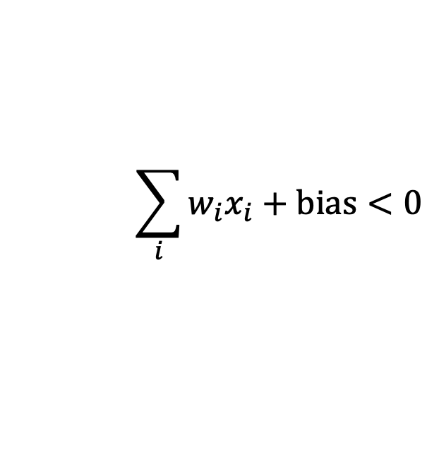
What logic can be learned by one neuron?
$x_{a}, x_{b}=[±1,±1$]
a | b | out
-1 | -1 | +1
-1 | +1 | +1
+1 | -1 | +1
+1 | +1 | -1
– +
+ +
$$\sum_{i}{w_{i}x_{i}}+bias<0$$
– –
+ –

Slide 38
What logic can be learned by one neuron?
How many ways can a straight line
partition corners of a square?
– +
+ +
– –
+ –
How many d-variable truth-tables exist?

Slide 39
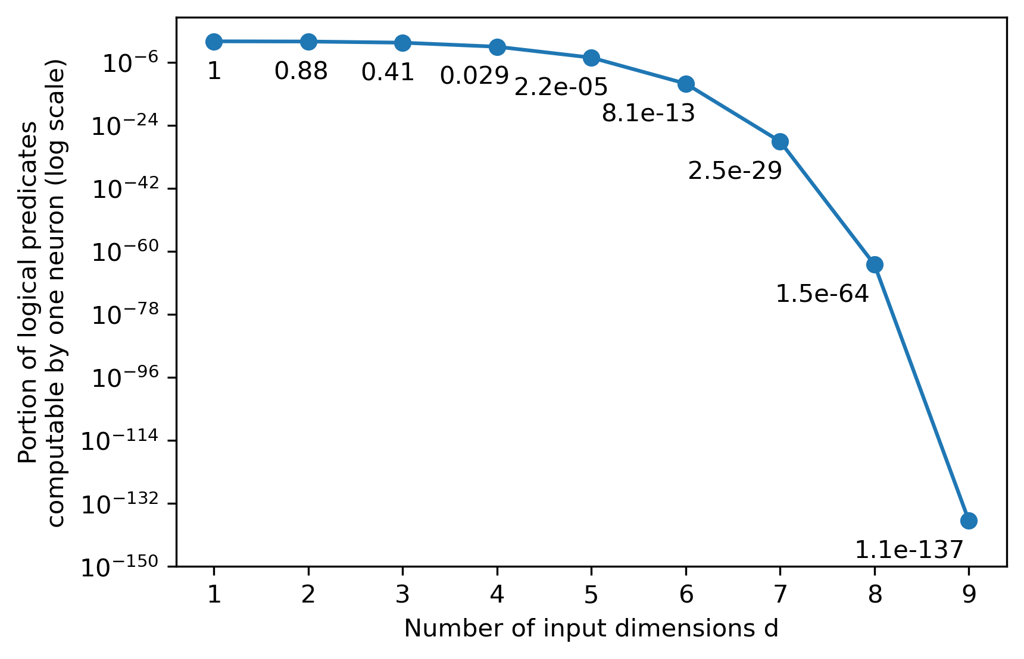
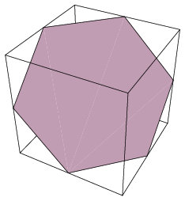
Not all d-variable truth tables are linearly separable
Portion of linearly separable predicates
FFT
FTT
TFT
TTT
FFF
FTF
In a linear model, some corners determine other corners
In d=2, 88% of predicates are linearly separable.
In d=3, 41% of predicates are linearly separable.
In d=4 it is only 2.9%.
TFF
TTF
[counting for d>10 remains unsolved!]

Slide 40
Acyclic networks of neurons give us all predicates
feed-forward network
in
in
out
in
Layer 1
Layer 2
Layer 3
Puzzle for the whiteboard:
How many layers is enough to give all predicates on d inputs?
And how can you do it?

Slide 41
Puzzle
How many layers of McCullough-Pitts neurons
are needed to be able to express
all truth tables on d inputs?

Slide 42
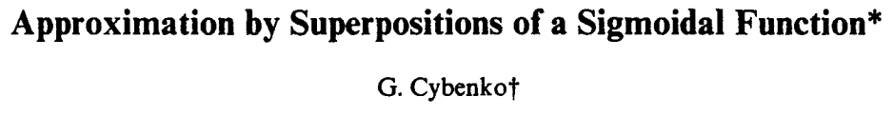
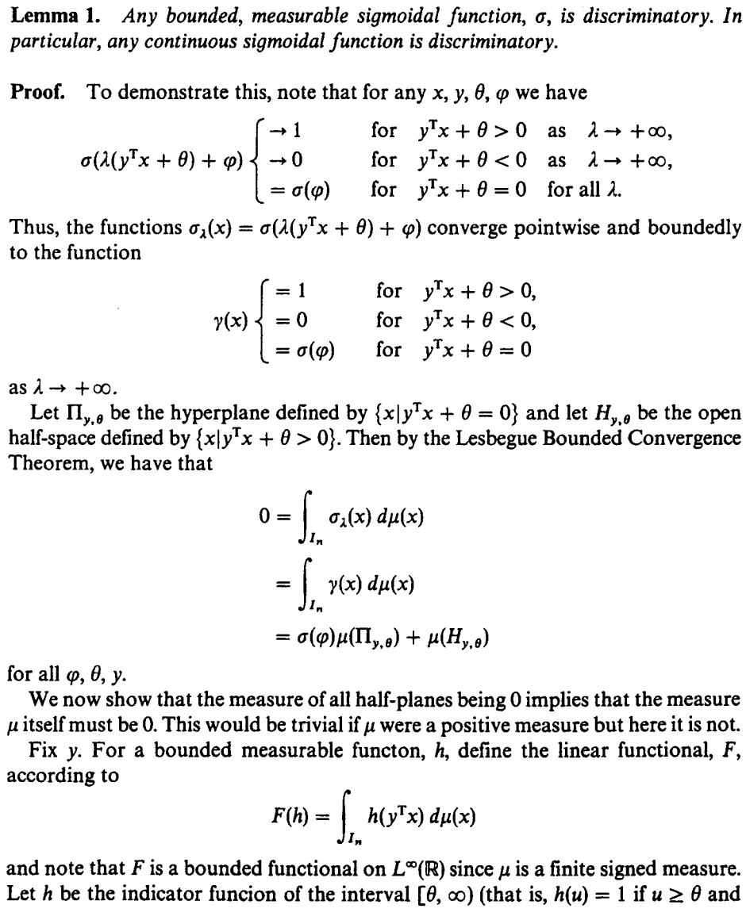

1989:
George Cybenko proves universality
[Cybenko, 1989]

Slide 43
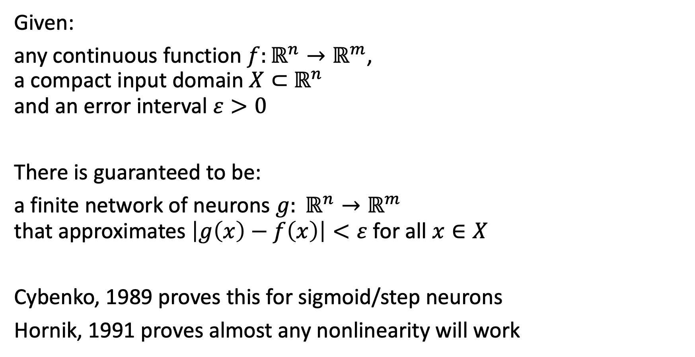
Universal Approximation Theorem
Given:
any continuous function $f:ℝ^{n}→ℝ^{m}$,
a compact input domain $X⊂$ $ℝ^{n}$
and an error interval $ε>0$
There is guaranteed to be:
a finite network of neurons $g: ℝ^{n}→ℝ^{m}$
that approximates $\left|g\left(x\right)−f\left(x\right)\right|<ε$ for all $x∈X$
Cybenko, 1989 proves this for sigmoid/step neurons
Hornik, 1991 proves almost any nonlinearity will work

Slide 44
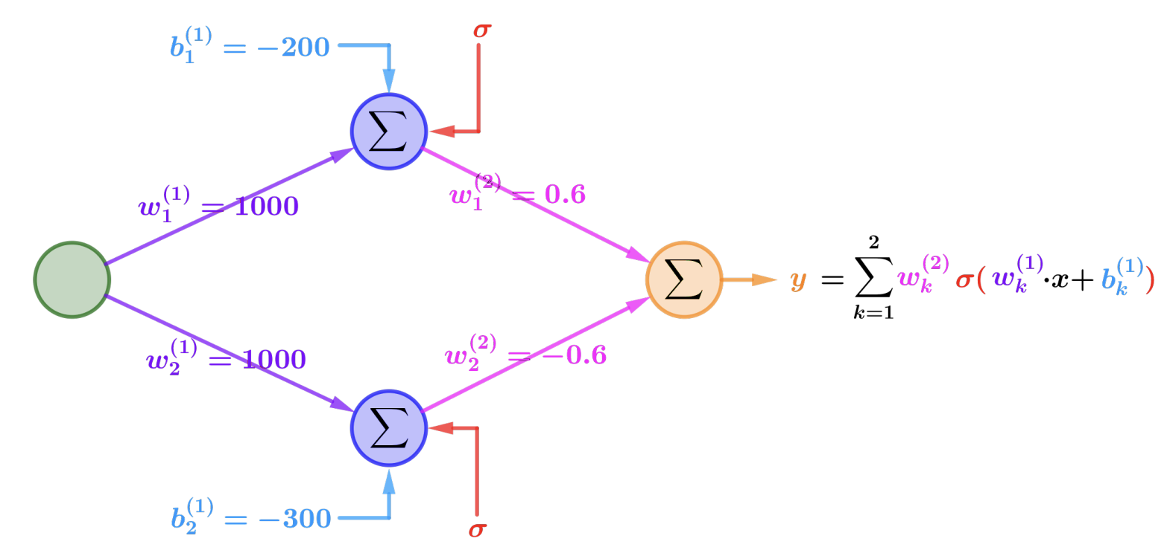
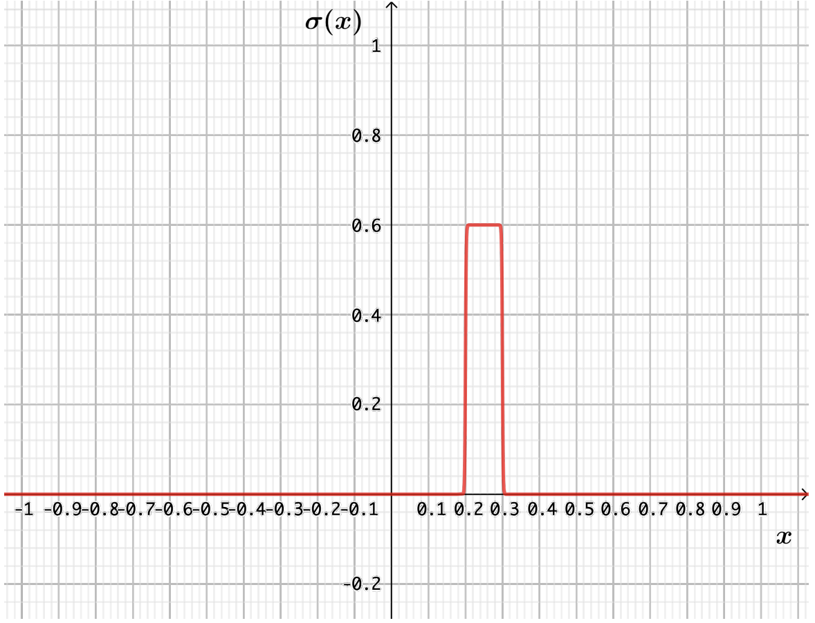
Visual Proof (Figures from Andrea Lörke)
Step 1. Two neurons (step-up, step-down) can be summed to make a bump
[https://www.mathematik.uni-wuerzburg.de/fileadmin/10040900/2019/Seminar__Artificial_Neural_Network__24_9__.pdf]

Slide 45
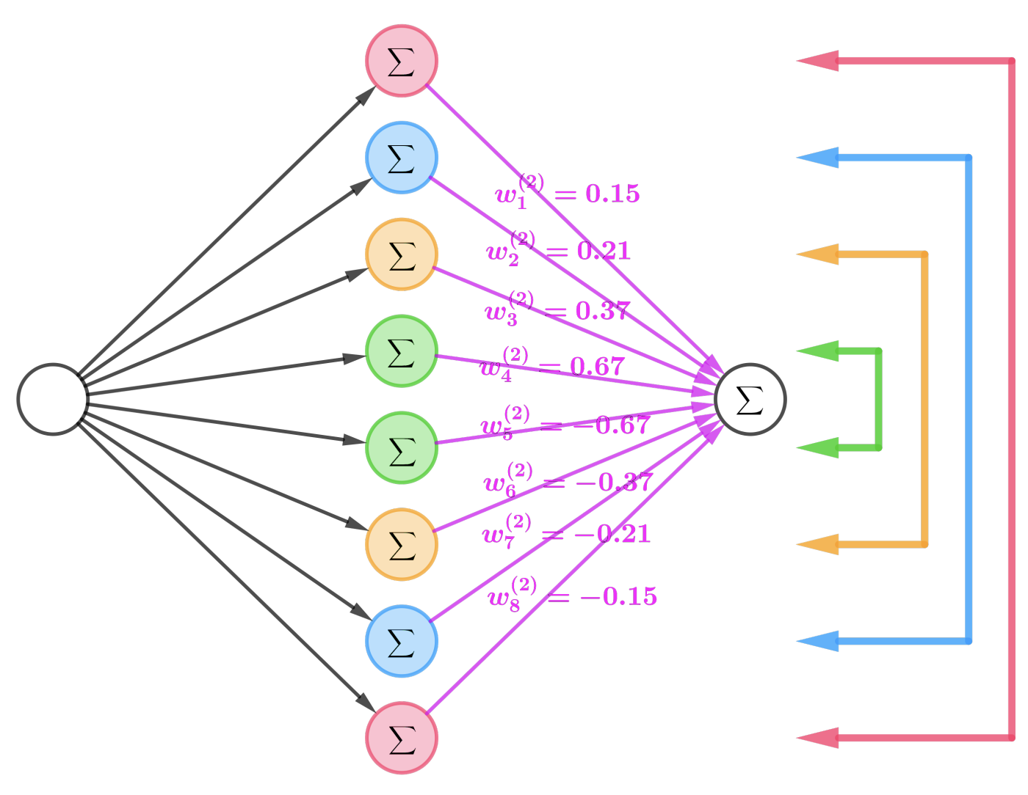
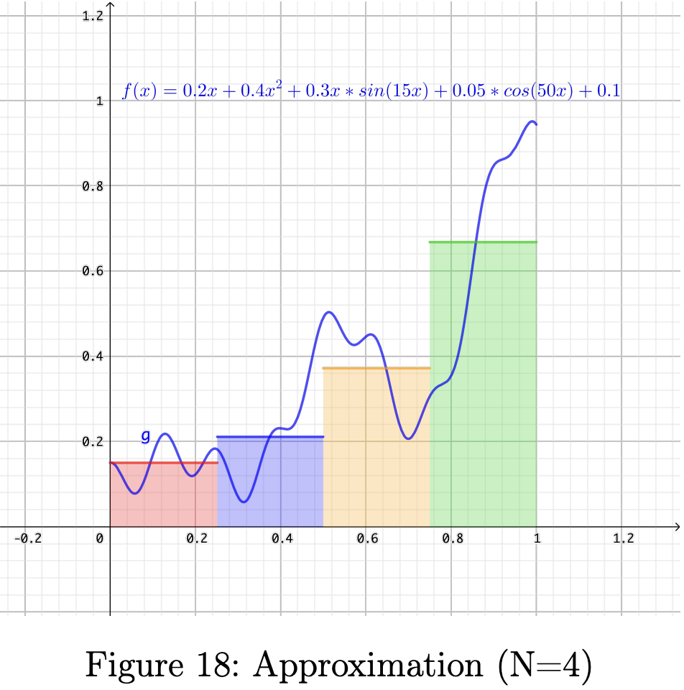
Visual Proof (Figures from Andrea Lörke)
Step 2. Many pairs of neurons can be summed to sum up bumps.
[https://www.mathematik.uni-wuerzburg.de/fileadmin/10040900/2019/Seminar__Artificial_Neural_Network__24_9__.pdf]

Slide 46
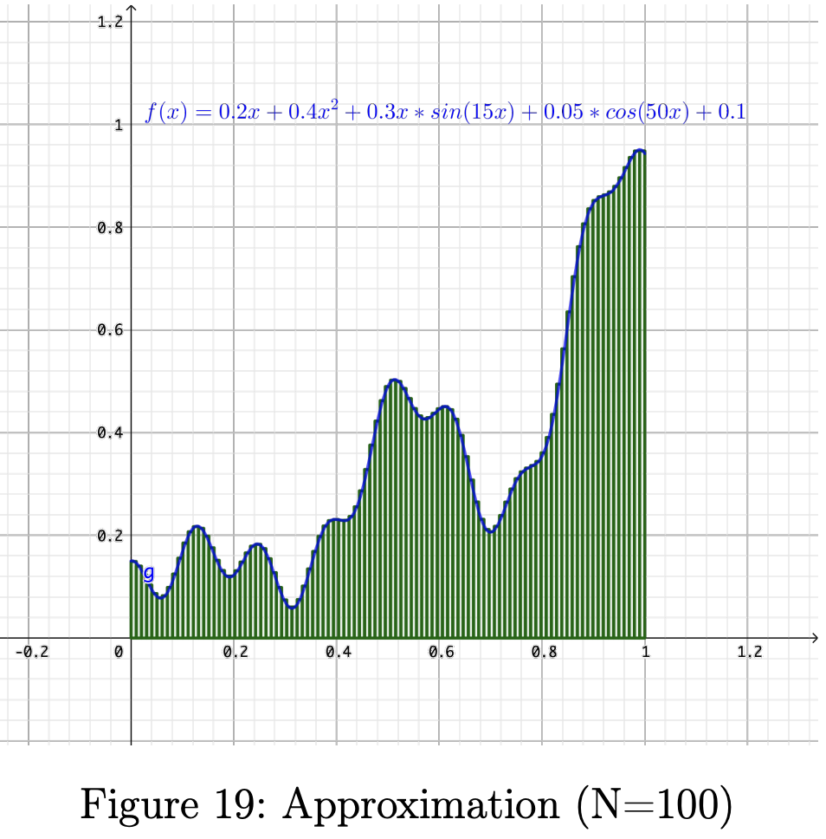
Visual Proof (Figures from Andrea Lörke)
Step 3. By increasing the number of neurons, error can be made $<ε$.
[https://www.mathematik.uni-wuerzburg.de/fileadmin/10040900/2019/Seminar__Artificial_Neural_Network__24_9__.pdf]

Slide 47
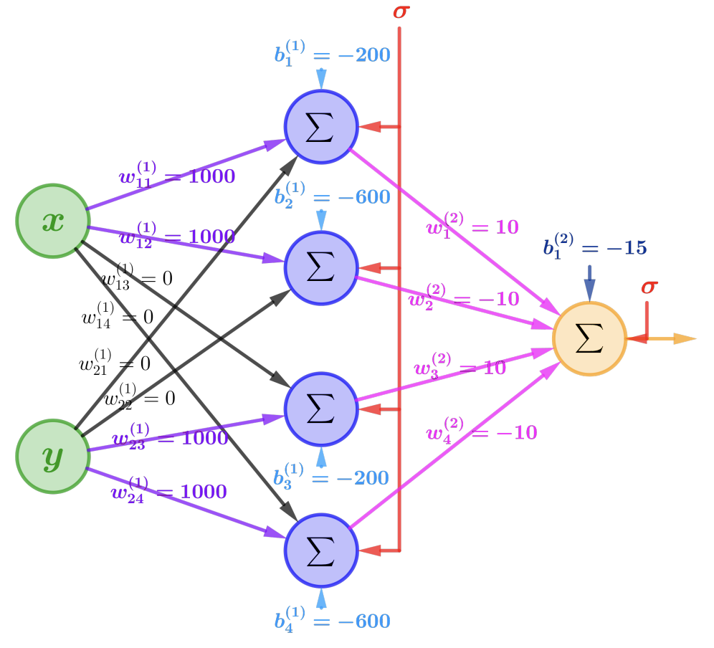
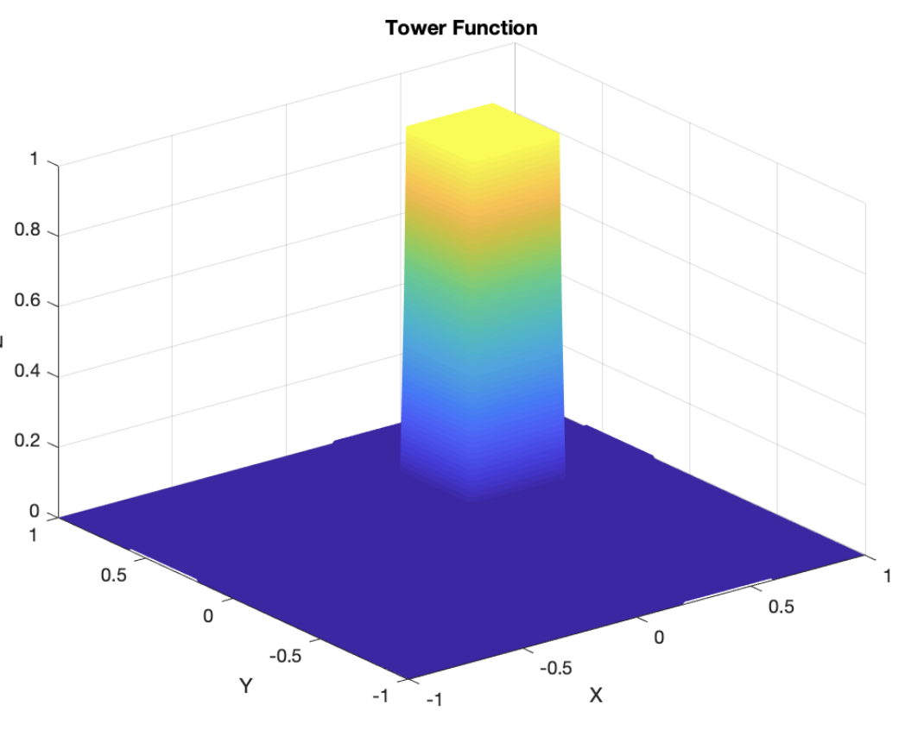
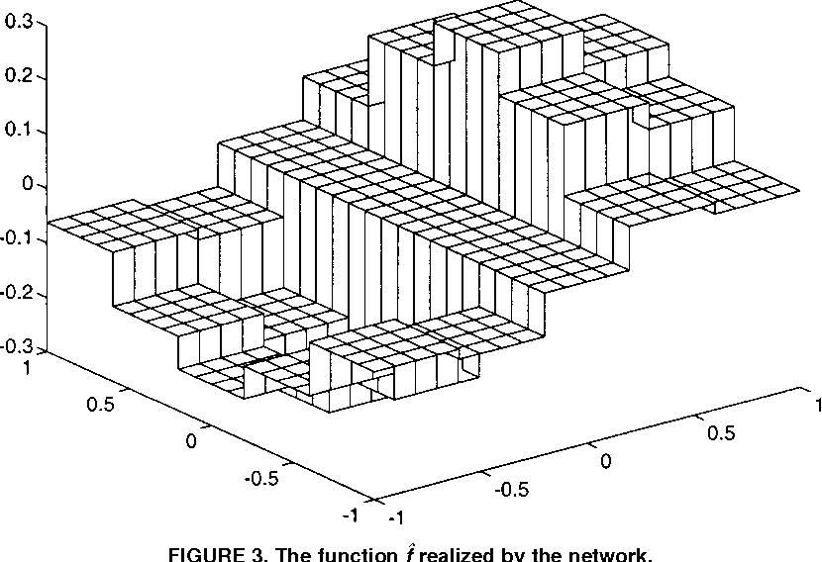
Visual Proof (Figures from Lörke and Scarselli)
Step 4. Similar bump functions can be made in higher dimensions.
[Figure 3 from Scarselli, Tsoi, Universal Approximation, 1998]
[https://www.mathematik.uni-wuerzburg.de/fileadmin/10040900/2019/Seminar__Artificial_Neural_Network__24_9__.pdf]

Slide 48
Bottom line:
Networks of neurons can be used to approximate any function.

Slide 49
How does Learning work?

Slide 50
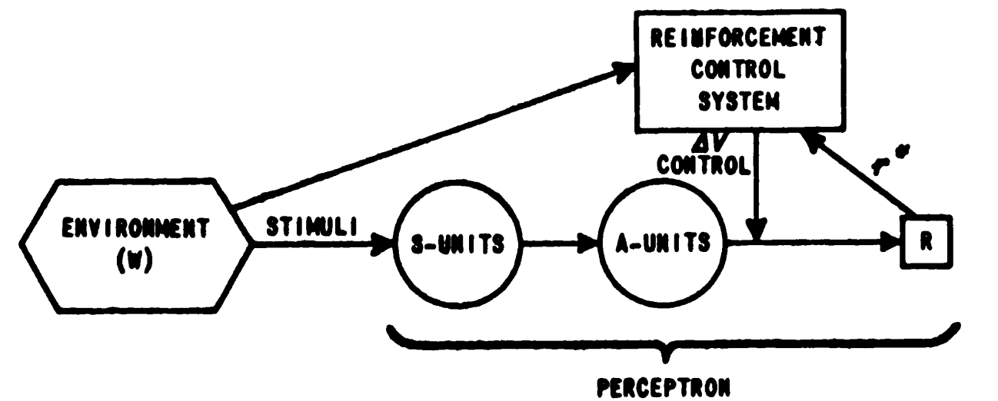
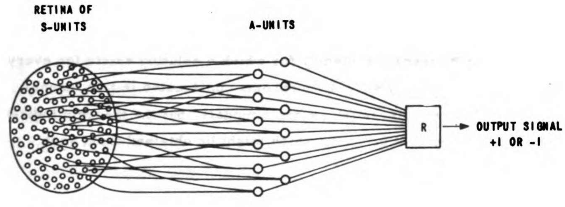
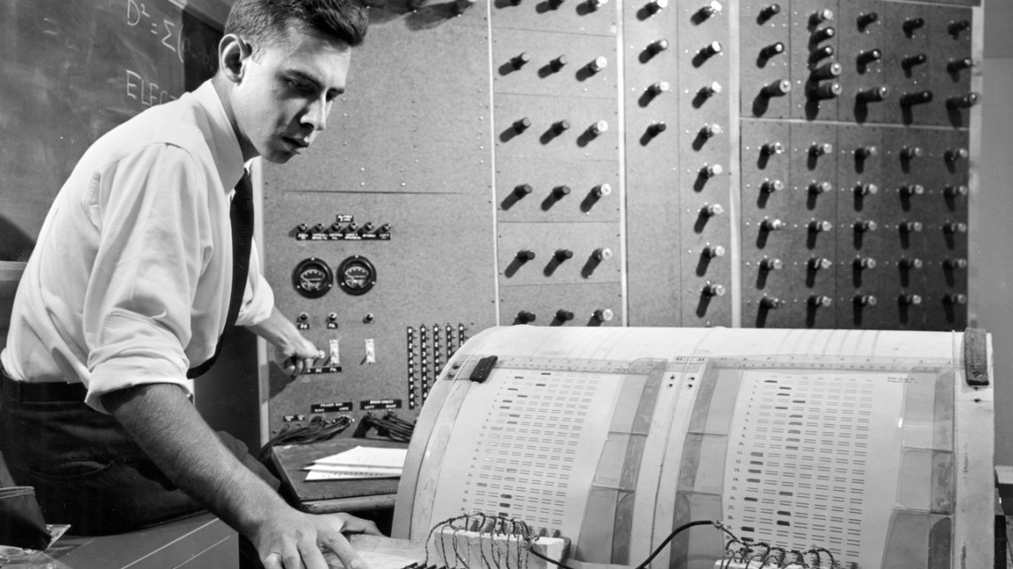
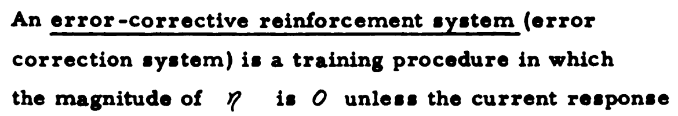
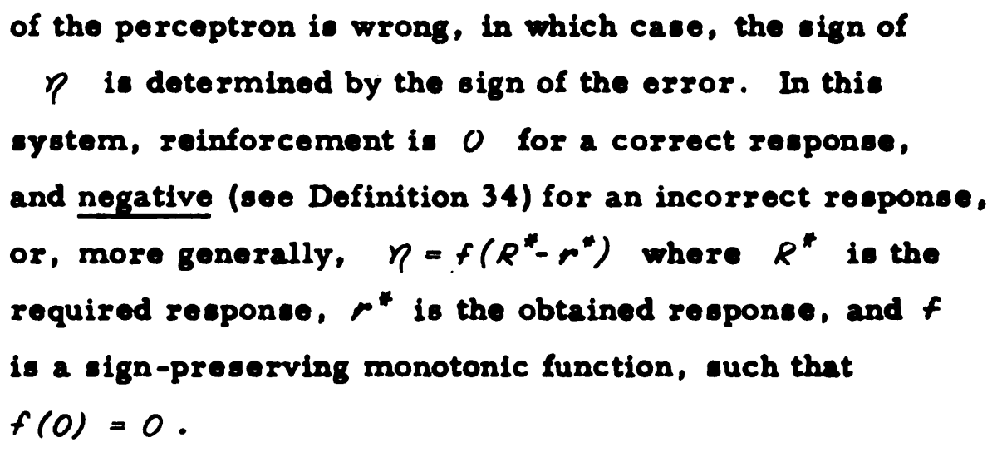
1958:
Frank Rosenblatt trains the Perceptron
[Rosenblatt, Neurodynamics, 1962]

Slide 51
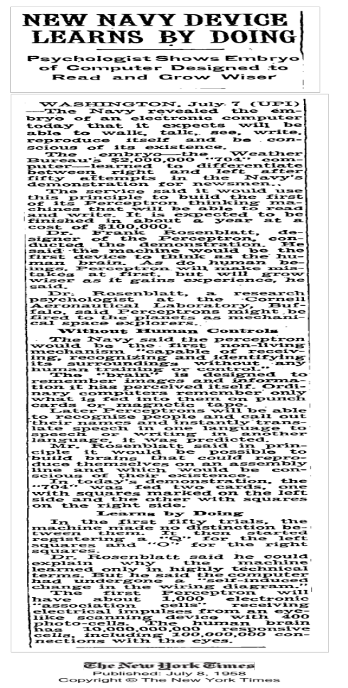
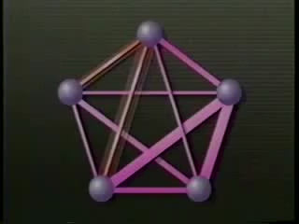
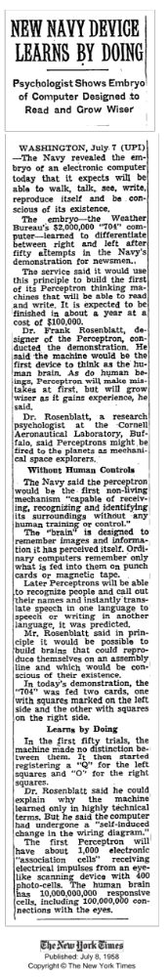
Rosenblatt’s 1958 Perceptron AI Boom

Slide 52
Two key innovations in perceptrons
Many dimensions for x, not just a few.
A learning procedure for model weights.

Slide 53
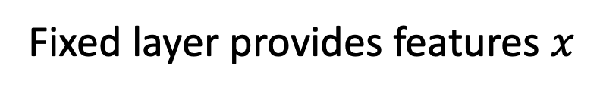
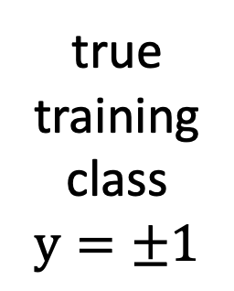
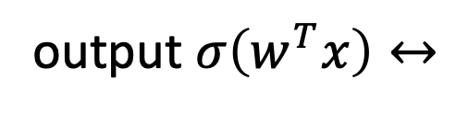

Perceptron Learning Algorithm
true
training
class
$$y=±1$$
input
image
output $σ\left(w^{T}x\right)↔$
Fixed layer provides features $x$
Learned weights $w$
Run on random training data

Slide 54
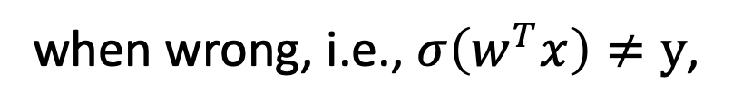

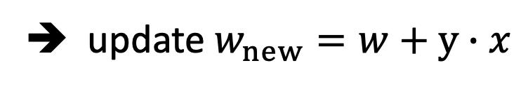
Perceptron Learning Algorithm
true
training
class
$$y=±1$$
input
image
output $σ\left(w^{T}x\right)↔$
$x$
Learned weights $w$
Update rule:
when right, do nothing
when wrong, i.e., $σ\left(w^{T}x\right)≠y$,
➔ update $w_{new}=w+y∙x$

Slide 55







Review of dot products
output $σ\left(w^{T}x\right)$
$$w^{T}x=\left\|w\right\|\left\|x\right\| cos{θ}$$
$$w^{T}x=\sum_{i}{w_{i}x_{i}}$$
$$x$$
$$θ$$
$$w$$
$$w^{T}x= \left[\begin{matrix}w_{1} & w_{2} & ⋯ & w_{n}\end{matrix}\right]\left[\begin{matrix}x_{1} \\ x_{2} \\ ⋮ \\ x_{n}\end{matrix}\right]$$

Slide 56
Why perceptron learning works
output $σ\left(w^{T}x\right)$
$$w^{T}x=\left\|w\right\|\left\|x\right\| cos{θ}$$
$$x$$
$$θ$$
$$w$$

Slide 57







How a perceptron makes decisions
output $σ\left(w^{T}x\right)$
$$w^{T}x=\left\|w\right\|\left\|x\right\| cos{θ}$$
$$+$$
$$+$$
$$x$$
$$+$$
$$θ$$
Positive when the
angle is acute
$$w$$
$$+$$
$$+$$
$$+$$
$$+$$
$$+$$
$$+$$

Slide 58







How a perceptron makes decisions
output $σ\left(w^{T}x\right)$
$$w^{T}x=\left\|w\right\|\left\|x\right\| cos{θ}$$
$$+$$
$$−$$
$$−$$
$$−$$
$$+$$
$$−$$
$$x$$
$$+$$
Negative when the
angle is obtuse
$$θ$$
Positive when the
angle is acute
$$w$$
$$−$$
$$+$$
$$+$$
$$+$$
$$+$$
$$−$$
$$−$$
$$+$$
$$+$$

Slide 59
Why perceptron learning works
output $σ\left(w^{T}x\right)$
$$w^{T}x=\left\|w\right\|\left\|x\right\| cos{θ}$$
Suppose it is wrong and
it is negative when
it should be positive
$$x$$
$$θ$$
$$w$$

Slide 60
Why perceptron learning works
output $σ\left(w^{T}x\right)$
$$w^{T}x=\left\|w\right\|\left\|x\right\| cos{θ}$$
Suppose it is wrong and
it is negative when
it should be positive
$$x$$
$$θ$$
$$w$$
Then the perceptron rule
is to add x to w

Slide 61

Why perceptron learning works
output $σ\left(w^{T}x\right)$
$$w^{T}x=\left\|w\right\|\left\|x\right\| cos{θ}$$
$${w′}^{T}x={(w+x)}^{T}x$$
Suppose it is wrong and
it is negative when
it should be positive
$$x$$
$$θ$$
$$w$$
Then the perceptron rule
is to add x to w

Slide 62

Why perceptron learning works
output $σ\left(w^{T}x\right)$
$$w^{T}x=\left\|w\right\|\left\|x\right\| cos{θ}$$
$${w′}^{T}x={(w+x)}^{T}x$$
Suppose it is wrong and
it is negative when
it should be positive
$$x$$
$$θ$$
$$w$$
Adding x to w
has two effects:
It reduces the angle $θ$

Slide 63




Why perceptron learning works
output $σ\left(w^{T}x\right)$
$$w^{T}x=\left\|w\right\|\left\|x\right\| cos{θ}$$
$${w′}^{T}x={(w+x)}^{T}x$$
Suppose it is wrong and
it is negative when
it should be positive
$=w^{T}x$+ $x^{T}x$
$$x$$
$=w^{T}x+\left\|x\right\|$²
$$θ$$
$$>w^{T}x$$
$$w$$
Adding x to w
has two effects:
It reduces the angle $θ$
It increases $w^{T}x$

Slide 64


Why perceptron learning works
output $σ\left(w^{T}x\right)$
$$w^{T}x=\left\|w\right\|\left\|x\right\| cos{θ}$$
The update tilts the plane
closer to including x
$${w′}^{T}x={(w+x)}^{T}x$$
$=w^{T}x$+ $x^{T}x$
$$x$$
$=w^{T}x+\left\|x\right\|$²
$$θ$$
$$>w^{T}x$$
Adding x to w
has two effects:
It reduces the angle $θ$
It increases $w^{T}x$
$$w′$$

Slide 65

Why perception learning works
Perceptron learning adjusts the normal vector of the plane in the direction of any incorrect case. Rosenblatt proved that it is guaranteed to find a perfect linear separating plane if one exists.

Slide 66


1969:
Minsky and Papert prove limitations
[Minksy, Perceptrons, 1969]

Slide 67

A simple failure of perceptron learning
Non-linearly separable data cannot be classified by the perceptron algorithm.

Slide 68
The practical problem with perceptrons
Learns to judge features
given separable inputs.
Does not help design features.
That is done by hand.

Slide 69




The perceptron method doesn’t help with deep weights
c = $−1$
w_{ac} = 1.0
a = $−1$
w_{c} = 1.0
p = 0
w_{ad} = 1.0
w_{bd} = 1.0
b = 0
w_{d} = $−1.0$
w_{bc} = 1.0
d = $−1$
Scenario: data [a=-1, b= 0] should output +1, but currently outputs p=0.
Which weights should increase? Decrease? Stay the same?

Slide 70
“AI Winter”
1970’s
1990’s
If we need to write all this code by hand, maybe AI is unattainable....
Maybe we should just write regular programs!

Slide 71
How can deep neurons learn?

Slide 72



1986:
Rumelhart and Hinton go deeper with backprop
[Rumelhart Hinton Williams, 1986]

Slide 73
Backprop versus perceptron
With backprop you must choose an explicit objective:
a single number that scores the mistakes the network makes.
(perceptron never computes such a score)
With backprop you need a differentiable network:
every step must have a computable derivative
(perceptron does not need gradients)
With backprop you can update parameters at any depth.
Deep layers can learn useful features

Slide 74
One-Minute Questions
Help us!
Answer the questions on the form here:
https://bit.ly/cs7180-f2022-1

Slide 75
Next class
BRING YOUR LAPTOP
How to read pytorch: an interactive class.

Slide 76

Backprop is a classical optimization approach
Learns parameters by following the gradient to optimize an explicit objective

Slide 77

The advantage of deep learning: deep features

Slide 78


Limitations of feedforward networks

Slide 79
Rapid advances in recent years
2022
Radford
1989
LeCun
1990
Elman
2012
Krizhevsky
2018
Radford

Slide 80
What makes Deep Learning
Deep?

Slide 81
Four ingredients for backprop
1. A model with a list of parameters to optimize
2. An objective (a loss) to minimize
3. Derivatives of loss with respect to parameters
4. An optimization algorithm to update the parameters

Slide 82
a
w_{a} = -1.0
a
w_{a} = -1.0
bias = +0.5
bias = 0
out
d
w_{d} = 0.5
bias = +1.0
b
w_{b} = 0.5
b
w_{b} = 1.0
out
w_{b} = 0.5

Slide 83
McCullough and Pitts:
“A neural network can execute any logical computation.”
Rosenblatt: can neural networks learn to solve problems?

Slide 84

Is Thinking the same as
Computation?
1888 – Ramon y Cajal: neuron anatomy
1936 – Turing: symbolic model of universal computation
1943 – McCoullough+Pitts:
do neural models have the same power?
Hippocampus, Ramon y Cajal
A model of machine learning inspired by biological neurons.

Slide 85
What Logic can be Computed by One Neuron?
Linearly separable logic:
All the possibilities for D variables sit on corners of the n-hypercube.
In total there are 2D corners and 22D ways to split them into sets.
But most of these are not linearly separable.
FFT
FTT
TFT
TTT
FFF
FTF
TFF
TTF

Slide 86
A Map of What You Will Learn
How to make a model that:
Inputs Images
Inputs Natural Language
Seminal Deep Net Papers
How to use Pytorch
How to Train a Deep Net
Deep Net Recent Topics
Your Research Interest
Outputs Images
Outputs Natural Language
Reading and Class
Discussion
HW1
HW2
HW5
Final
Project
HW3
HW4
Midterm

Slide 87
The Power of a McCullough-Pitts Neuron
a = ±1
w_{a} = –1.0
bias = – 0.5
out = sign(–a + b – 0.5)
sign
b = ±1
w_{b} = 1.0
a | b | out
-1 | -1
Logical Formula:
-1
-1
+1
+1
out = a ∧ ¬b
+1
-1
-1
+1
+1
-1

Slide 88
The Power of a McCullough-Pitts Neuron
a | b | c | sum | out
-1 | -1 | -1
a = ±1
w_{a} = 2.0
-4.5
-1
bias = – 2.5
-1
-1
+1
-2.5
-1
w_{b} = – 1.0
b = ±1
out
sign
-1
+1
-1
-2.5
-1
= sign(2a – b + c – 2.5)
w_{c} = 1.0
-1
+1
+1
-0.5
-1
c = ±1
+1
-1
-1
-0.5
-1
+1
-1
+1
1.5
+1
Logical Formula:
+1
+1
-1
1.5
+1
out = a ∧ (¬b ∨ c)
+1
+1
+1
-0.5
-1

Slide 89


Slide 90
Winner, digital arts category
Colorado State Fair Fine Arts Competition, August 2022
Théâtre D'opéra Spatial
Generated by Midjourney Diffusion Model
Prompted by Jason M. Allen

