Slide 1

CS 7150
Deep Learning

Slide 2
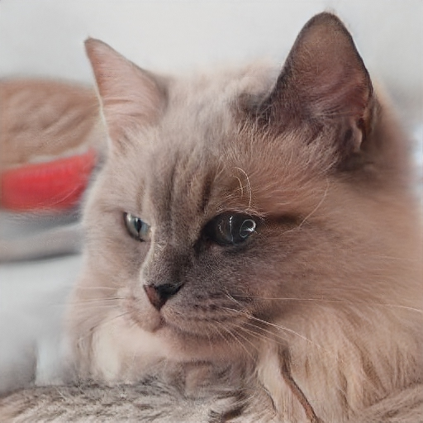
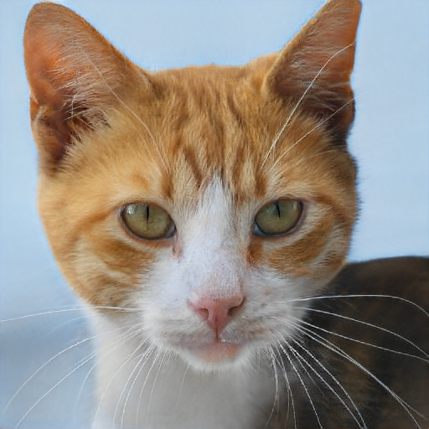
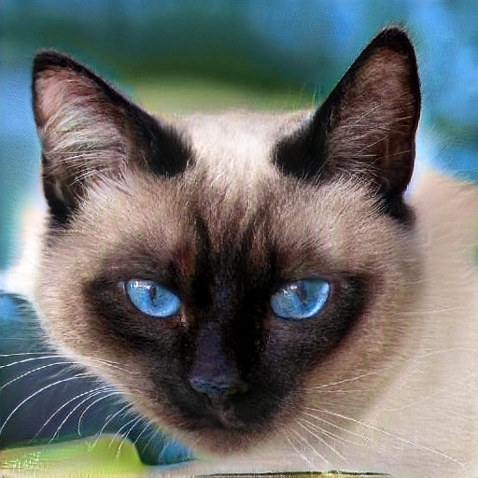
Which is the real cat?
A
B
C
Notes:
Today we’ll be talking about GANs, which are used for image synthesis.
The quality of GAN-generated images is getting pretty good, so here I’ve mixed up some CAT images.
Some of these are actually FAKE cats. Can you tell me, WHICH one is the REAL cat image?
Who would vote for A? Who would vote for B? Who would vote for C?
OK it looks like B wins. Why did you pick A? Why C? why B?
OK, yes, that’s good. When you’re criticizing these images, you are doing the same thing that we train our networks to do.
The answer is, NONE of these are real cat images. They are all generated by a GAN.

Slide 3
Generative goal: models that can create
We want to model big outputs P(X)
.... in contrast to classifiers that modeled big inputs P(Y | X)
X is high-dimensional data
X = image (or text, video, audio, etc)
Y = label
Notes:
So TODAY we will talk about GENERATIVE modeling. The WHOLE idea of GENERATIVE modeling is to make models of P(X).
In other words, we want our model to treat some BIG data X as OUTPUT.
<click>
That is DIFFERENT from the CLASSIFICATION setting, where we treat big data X as INPUT.

Slide 4
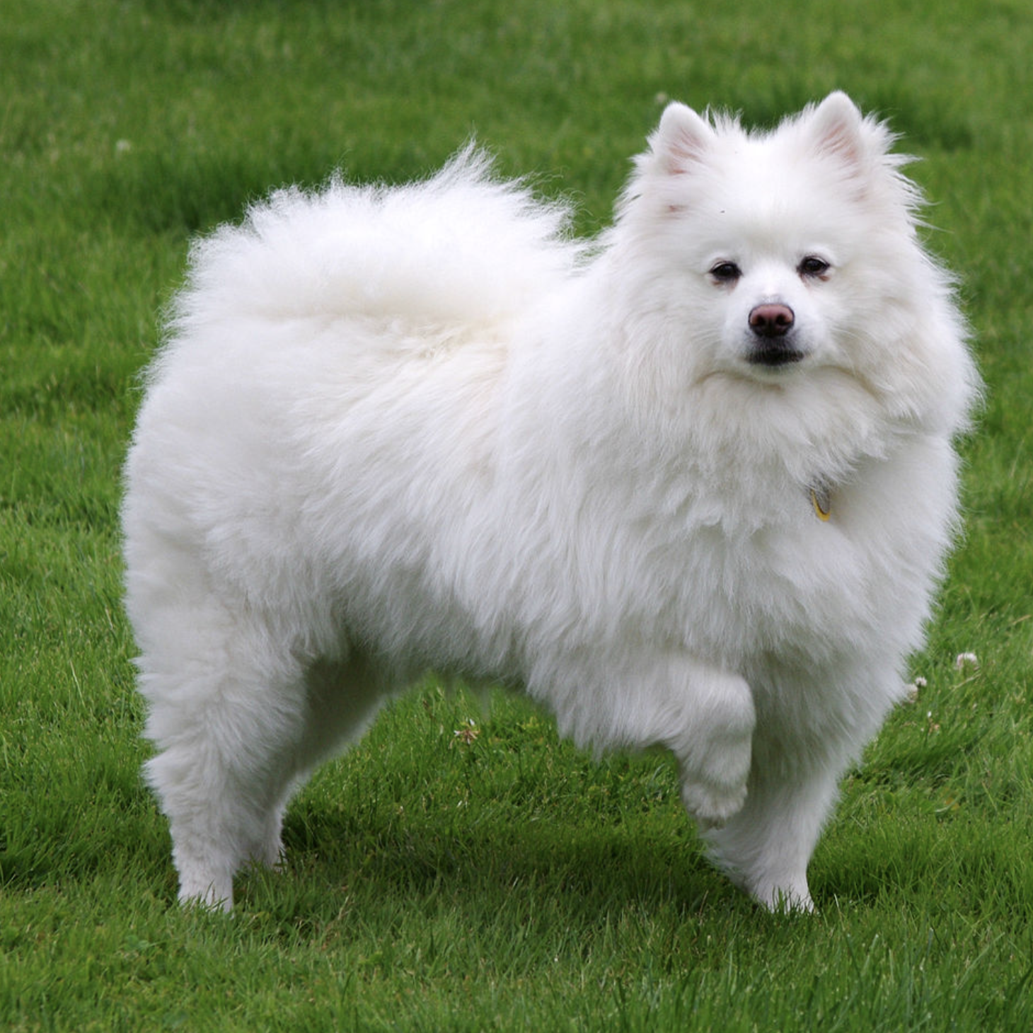
Image classification: p(y | x)
classifier
Classifier
“dog”
image x
label y
Notes:
The classic application of Machine learning is CLASSIFICATON.
GIVEN an image, we pass it through a model and PREDICT how likely it is to be a DOG

Slide 5
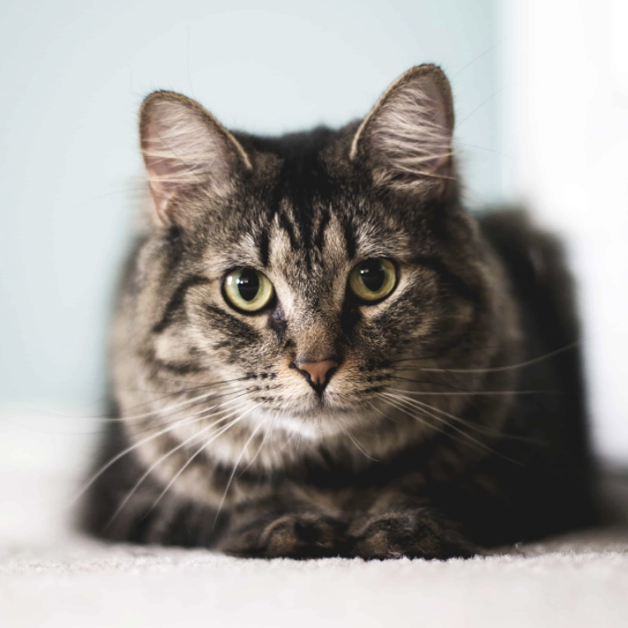
Image classification: p(y| x)
classifier
Classifier
“cat”
image x
label y
Notes:
And if we CHANGE the image, then the OUTPUT class may CHANGE.

Slide 6
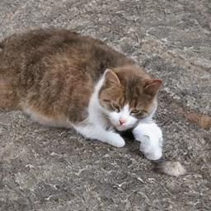
Image synthesis: p(x | y)
“cat”
generator
label y
image x
Notes:
In image GENERATION, we turn the problem on its HEAD.
We START with a SMALL input, like the CLASS we want. And then we want to OUTPUT the IMAGE of the CLASS.

Slide 7
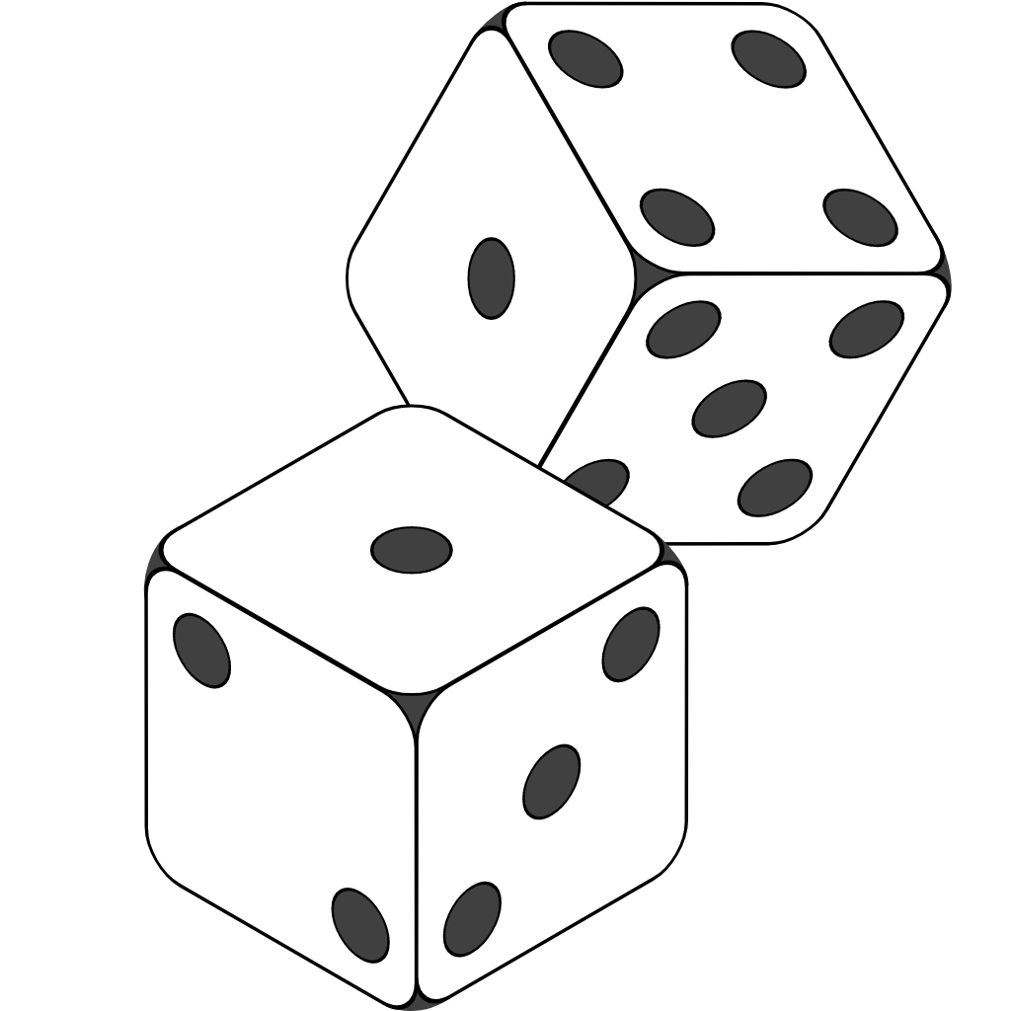
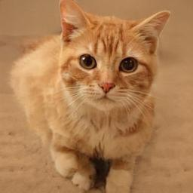
Image synthesis: p(x | y)
“cat”
generator
label y
image x
Notes:
Of COURSE there are MANY different CATs in the CAT class.
So we USUALLY include some RANDOMNESS in the INPUT so that
when we RUN the MODEL, we get a DIFFERENT cat out each time.

Slide 8
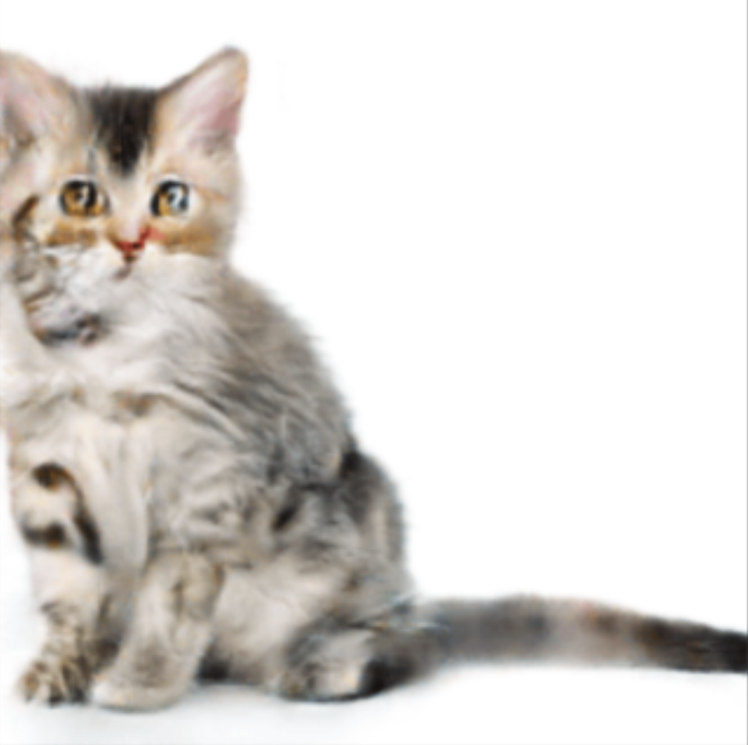
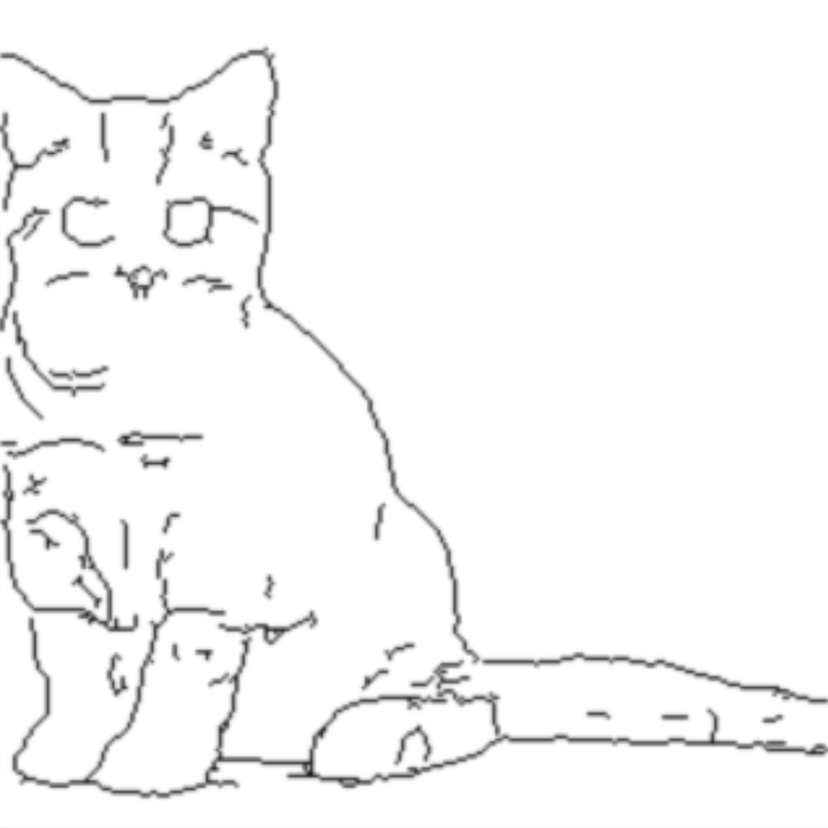
Image translation: p(x | y)
translator
line drawing
image x
Notes:
We are ALSO interested in SYNTHESIZING images based on LARGER input.
For EXAMPLE, we would LIKE to have MODELS that START with a DRAWING and TURN it into a PHOTOGRAPH.

Slide 9
Text generation p(x | y)
Les grandes personnes m'ont conseillé de laisser de côté les dessins de serpents boas ouverts ou fermés, et de m'intéresser plutôt à la géographie, à l'histoire, au calculet à la grammaire. C'est ainsi que j'ai abandonné, à l'âge de six ans, une magnifique carrière de peinture.
The grown-ups advised me to leave aside the drawings of boa constrictors, whether from the inside or the outide, and devote myself instead to geography, history, arithmetic and grammar. That is how I gave up, at the age of six, a magnificent career as a painter.
generator
French y
English x

Slide 10
Text generation p(x | y)
In a shocking finding, scientist discovered a herd of unicorns living in a remote, previously unexplored valley, in the Andes Mountains. Even more surprising to the researchers was the fact that the unicorns spoke perfect English.
They also were found to have perfectly coiffed hair, and wore what appeared to be Dior makeup. “We were shocked to discover the unicorns,” said anthropologist Daniel St. Maurice. “They were like nothing we had ever seen before. We had heard legends of the unicorns, but never thought they actually existed.” When the scientists first arrived in the valley, the unicorns were surprised and startled by the presence
generator
prefix y
suffix x

Slide 11
Why generation is harder than classification
classifier
Classifier
“cat”
image x
label y
Classifiers don’t need to look at every detail!
Notes:
So ALL these GENERATION problems are HARDER than CLASSIFICATON.
And the REASON is that a CLASSIFIER is FREE to IGNORE BIG parts of the INPUT.
For EXAMPLE, to DETERMINE what KIND of OBJECT this IS, you DONT really need to LOOK at the WHOLE thing.
It is PROBABLY enough to see THESE parts.
And so the CLASSIFIER can just FOCUS on the THINGS it NEEDS to look at
to be ABLE to predict CAT with pretty good ACCUARCY.
If there are some HARDER details, the CLASSIFIER can IGNORE them.

Slide 12
Why generation is harder than classification
Cat-shaped ears
Head tilted to right
Eyes same color
Consistent gaze
generator
Iris dilates in shadow
“cat”
Illumination from left side
Symmetric fur pattern
label y
image x
A generator must synthesize every detail!
Notes:
But on the OTHER hand, when we GENERATE an image,
THINK about what you have to DO.
If you want to MAKE a cat, you need to KNOW what CAT-SHAPED EARS are like.
And you have to KNOW that cats have a SYMMETRIC fur pattern, in a VARIETY of COLORs.
You have to DECIDE that the CAT might be TILTING its HEAD.
And that it HAS a certain COLOR of EYE – but the EYEs shoudl be the same COLOR
And the EYES should be looking in the SAME direction.
LIGHTING for the image should be from a CONSISTENT direction.
And you should KNOW some DETAILS, like if an EYE is in SHADOW, then the IRIS should DILATE a litlte bit.

Slide 13
A generative modeling hypothesis
Generative models must know
everything there is to know
about the data.
Notes:
So MY research focuses on understanding Generative modeling. Both in IMAGES and in Natural Language.
The REASON I think this problem is SO interesting is that I basically BELIEVE in this GENERATIVE MODELING HYPOTHESIS.
That is, GENERATORS are different from CLASSIFIERS.
Because a GENERATIVE model cannot skip ANYTHNIG. It needs to know EVERYTHING there is to know about the DATA.
So if we WANT to make MODELS that are REALLY capable, they should be GENERATIVE models.

Slide 14
How content generation is a probability problem
p(x)
Two ways to make a generative model of a data distribution p(x)
Notes:
OK. so when we say we want to model P(X), what does that MEAN?
It MEANS that we WANT to be able to COMPUTE HOW to make a random X, HOW to make a random IMAGE.

Slide 15

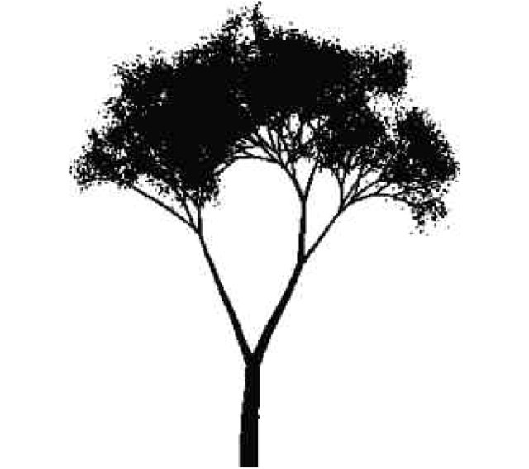
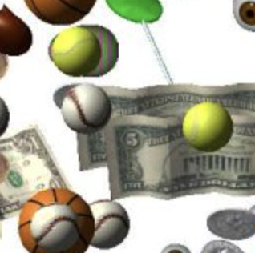
Making choices to produce output
string
together
Pick a lot of random words
weed van the an am she cheque
arrange
in a grid
Pick a lot of random pixels
overlay
clips
Pick a lot of random clip art
run
program
Pick a lot of random instructions

Slide 16
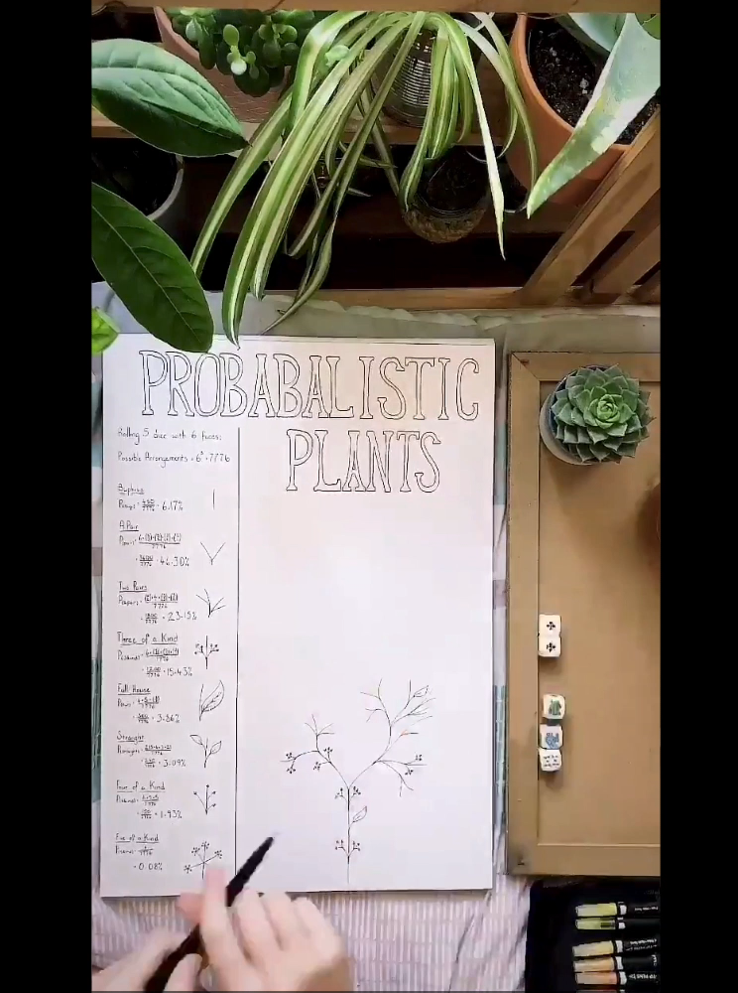
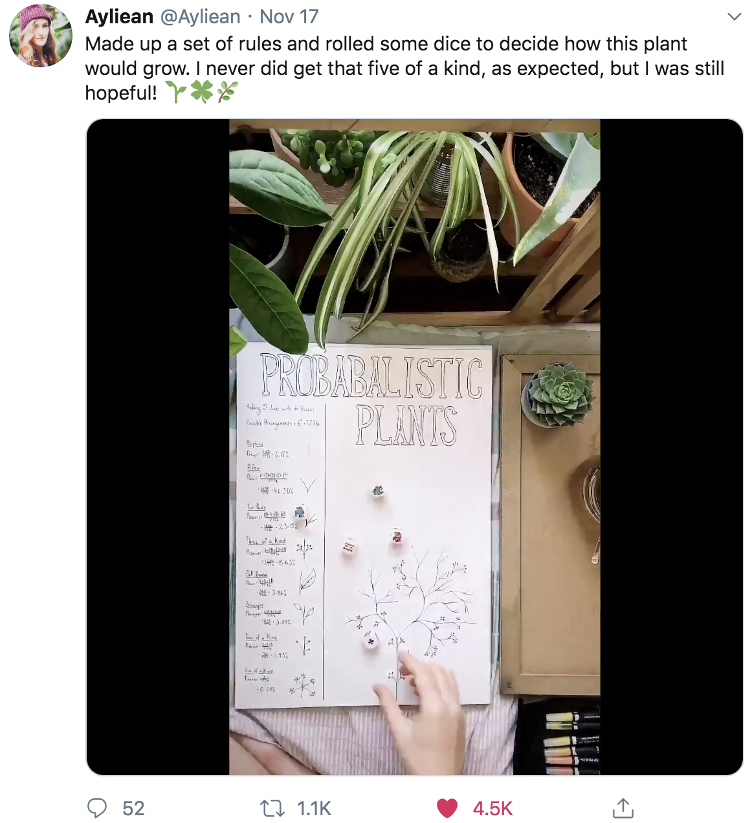
p(x)
#generativeart
Notes:
You DONT need to do MACHINE LEARNING to make a GENERATIVE MODEL.
For EXAMPLE, HERE is a GAME you can PLAY. You can MAKE a bunch of RULES for HOW the next BRANCH of a PLANT should GROW, based on HOW you roll the DICE.
Your RULES define a whole DISTRIBUITON of PLANTS. SOME shapes are MORE likely. SOME shapes are less likely.
But you can ROLL the dice and FOLLOW the rules to get a RANDOM plant.
It would be RARE to EVER get the same plant TWICE.

Slide 17
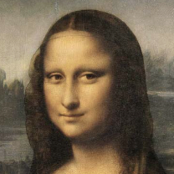
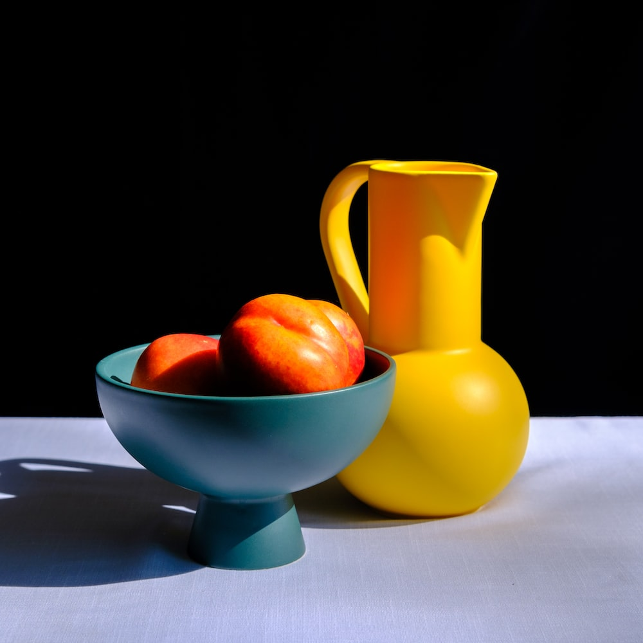
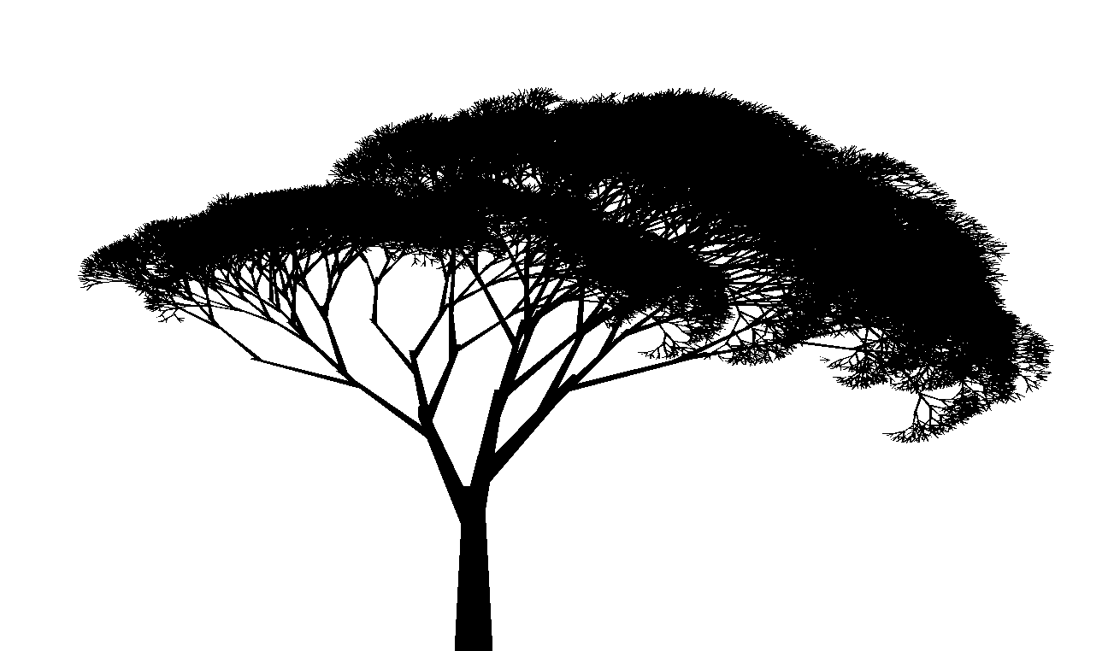
Once in a while, bad models make good output
string
together
Pick a lot of random words
this above all: to thine self be
arrange
in a grid
Once in a while the output is good.
We ask: how often?
Pick a lot of random pixels
overlay
clips
Pick a lot of random clip art
run
program
Pick a lot of random instructions

Slide 18
What is the goal? Imitate true data.
string
together
Pick a lot of random words
This above all: to thine self be
weed van the an am she Check
singer bus. a Immune run; shed
model distribution
random
sample
goal: to match
Get real English sentences
This above all: to thine self be
It isn’t what we say or think
Where justice is concerned, the
real distribution

Slide 19
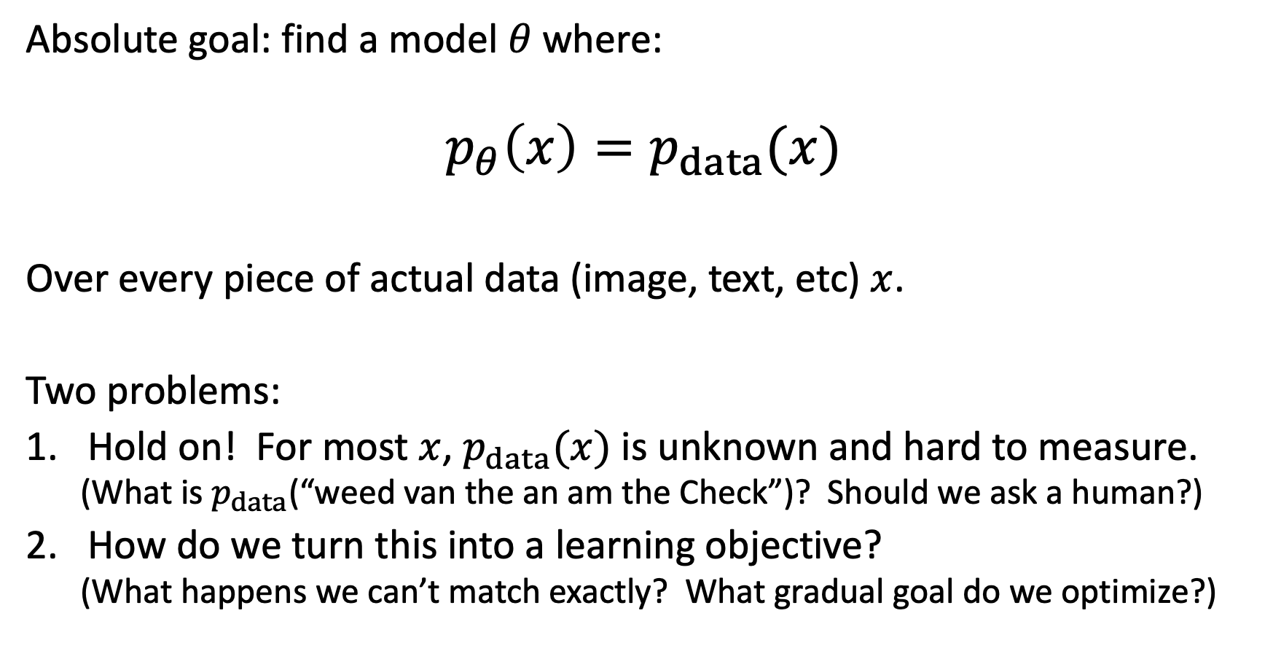
Measuring model quality using probabilities
Absolute goal: find a model $θ$where:
$$p_{θ}\left(x\right)=p_{data}(x)$$
Over every piece of actual data (image, text, etc) $x$.
Two problems:
Hold on! For most $x$, $p_{data}(x)$ is unknown and hard to measure.
  (What is $p_{data}$(“weed van the an am the Check”)? Should we ask a human?)
How do we turn this into a learning objective?
  (What happens we can’t match exactly? What gradual goal do we optimize?)

Slide 20
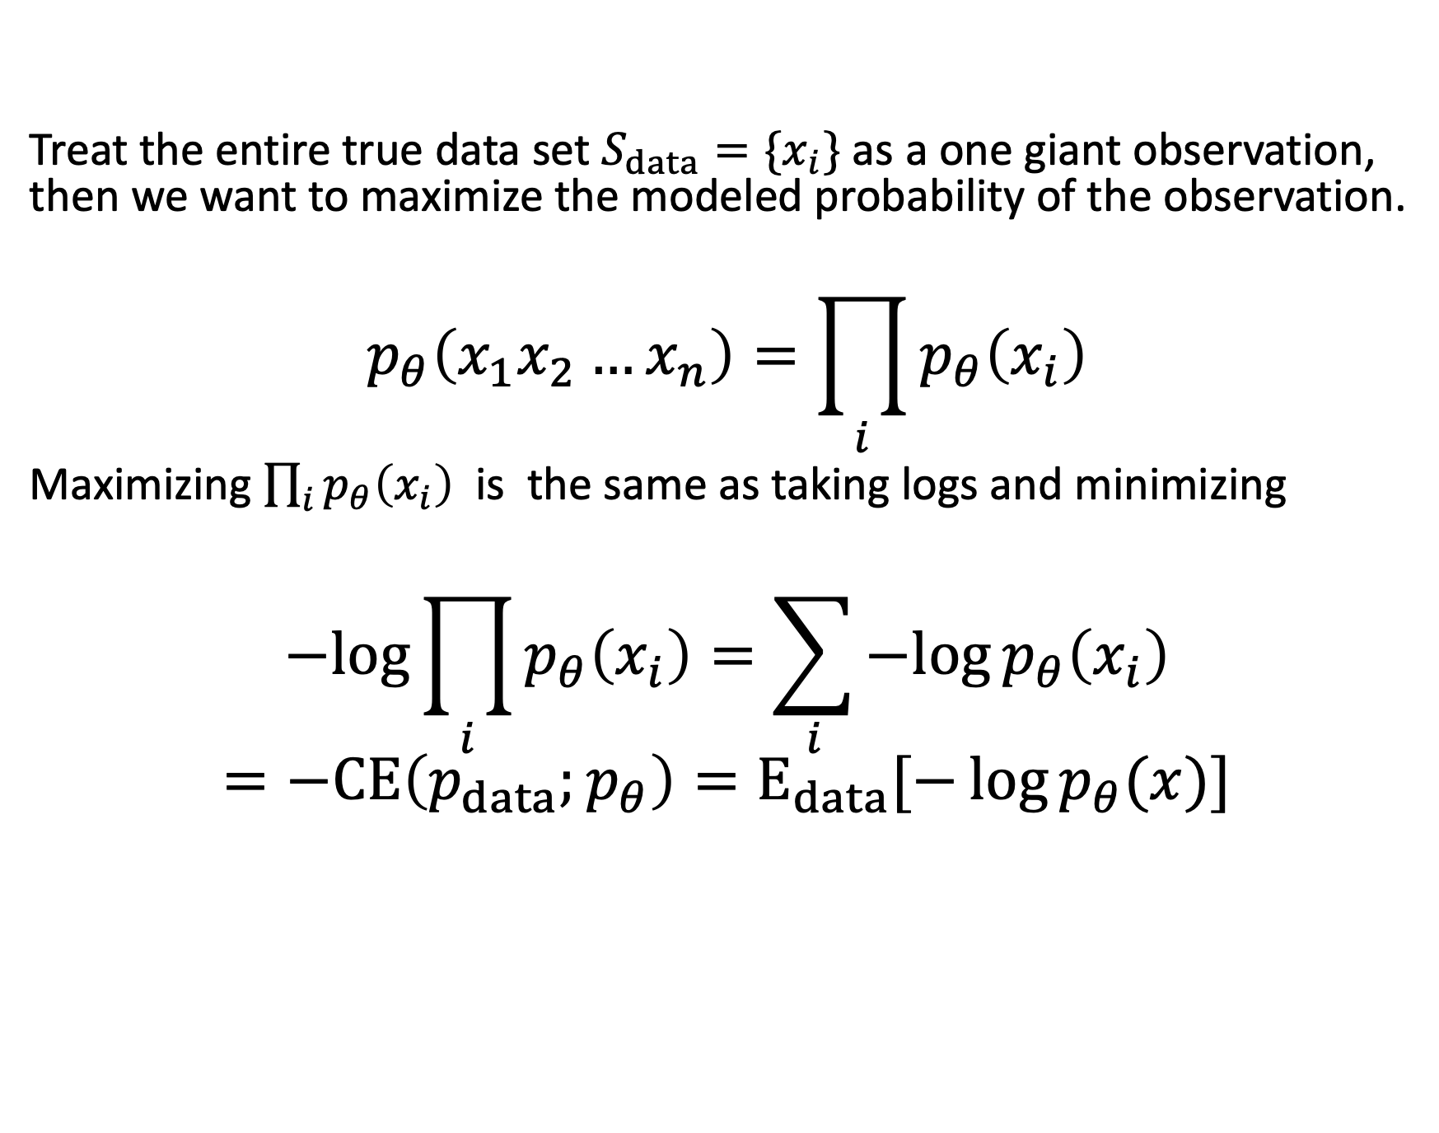
Restating the goal: maximize likelihood of seen data
Treat the entire true data set $S_{data}=\{x_{i}\}$ as a one giant observation, then we want to maximize the modeled probability of the observation.
$$p_{θ}\left(x_{1}x_{2}…x_{n}\right)=\prod_{i}{p_{θ}\left(x_{i}\right)}$$
Maximizing $\prod_{i}{p_{θ}\left(x_{i}\right)}$ is the same as taking logs and minimizing
$$−log{\prod_{i}{p_{θ}\left(x_{i}\right)}}=\sum_{i}{−log{p_{θ}\left(x_{i}\right)}}$$
$$=−CE\left(p_{data};p_{θ}\right)=E_{data}[−\log{p_{θ}(x)}]$$

Slide 21
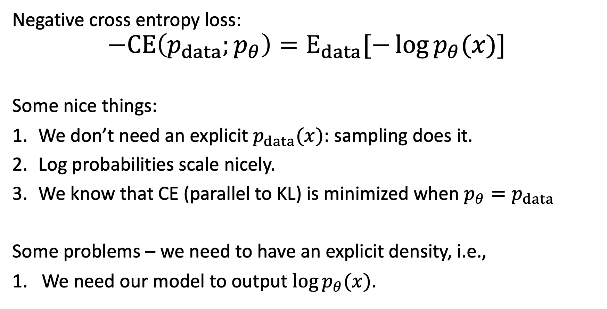
Why minimizing NCE is familiar and nice
Negative cross entropy loss:
$$−CE\left(p_{data};p_{θ}\right)=E_{data}[−\log{p_{θ}(x)}]$$
Some nice things:
We don’t need an explicit $p_{data}(x)$: sampling does it.
Log probabilities scale nicely.
We know that CE (parallel to KL) is minimized when $p_{θ}=p_{data}$
Some problems – we need to have an explicit density, i.e.,
We need our model to output $\log{p_{θ}(x)}$.

Slide 22
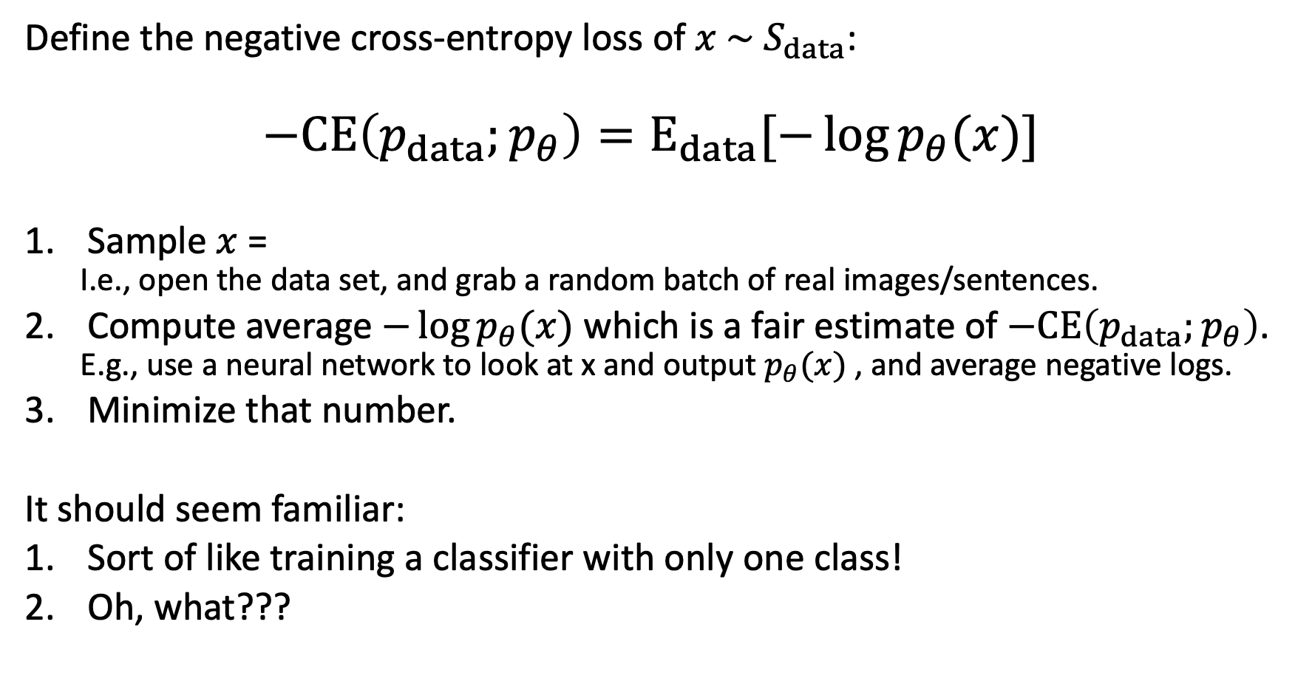
Why minimizing NCE is familiar and nice
Define the negative cross-entropy loss of $x \sim S_{data}$:
$$−CE\left(p_{data};p_{θ}\right)=E_{data}[−\log{p_{θ}(x)}]$$
Sample $x$ =
  I.e., open the data set, and grab a random batch of real images/sentences.
Compute average $−\log{p_{θ}(x)}$ which is a fair estimate of $−CE\left(p_{data};p_{θ}\right)$.
  E.g., use a neural network to look at x and output $p_{θ}(x)$ , and average negative logs.
Minimize that number.
It should seem familiar:
Sort of like training a classifier with only one class!
Oh, what???

Slide 23
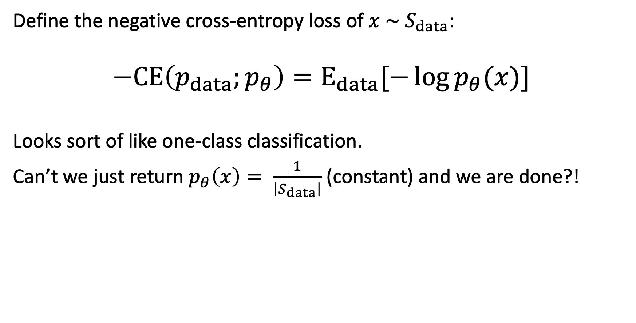
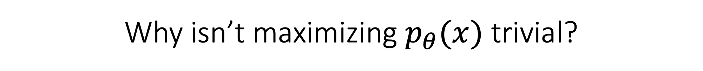
Why isn’t maximizing $p_{θ}(x)$ trivial?
Define the negative cross-entropy loss of $x \sim S_{data}$:
$$−CE\left(p_{data};p_{θ}\right)=E_{data}[−\log{p_{θ}(x)}]$$
Looks sort of like one-class classification.
Can’t we just return $p_{θ}\left(x\right)= \frac{1}{\left|S_{data}\right|}$ (constant) and we are done?!

Slide 24
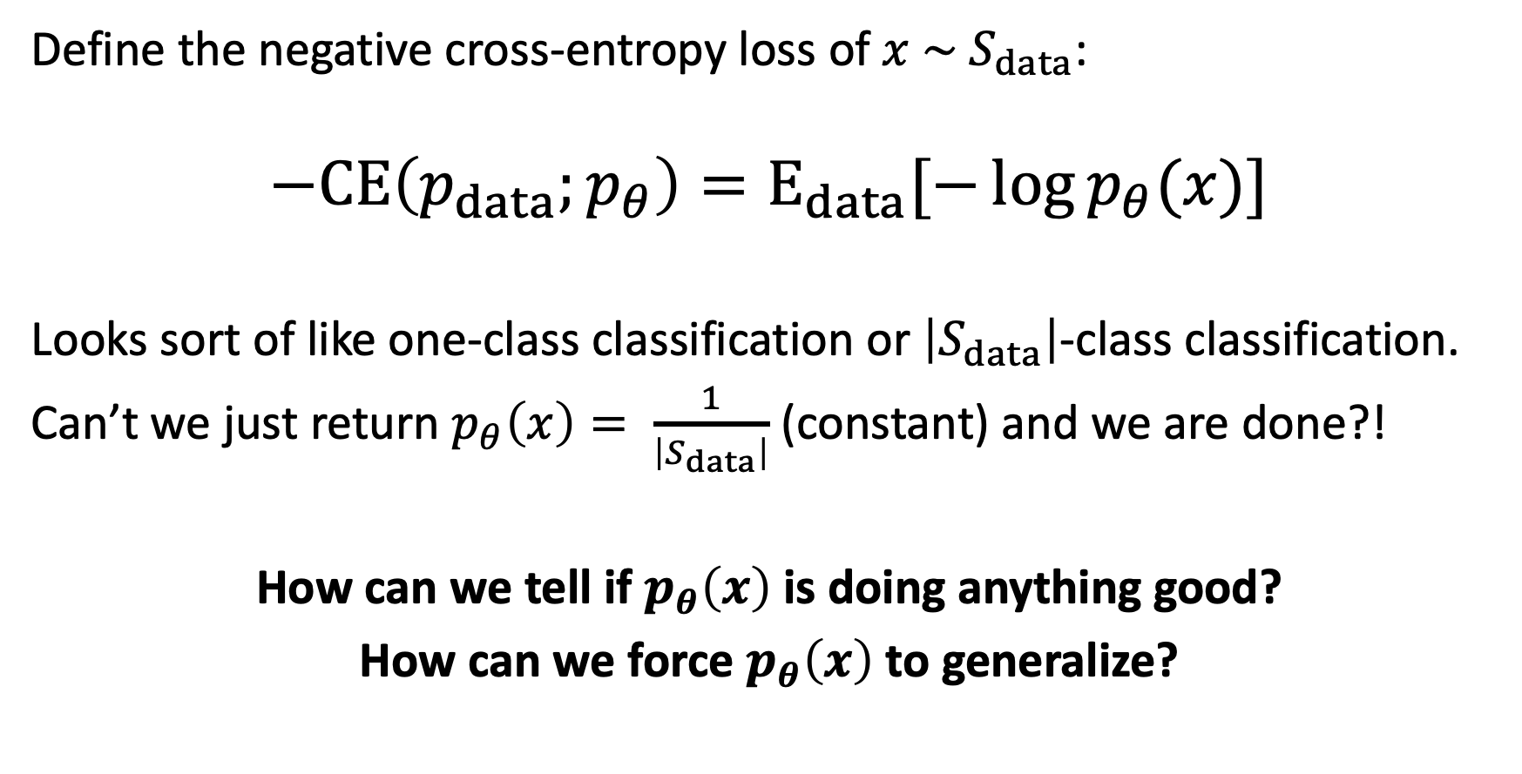
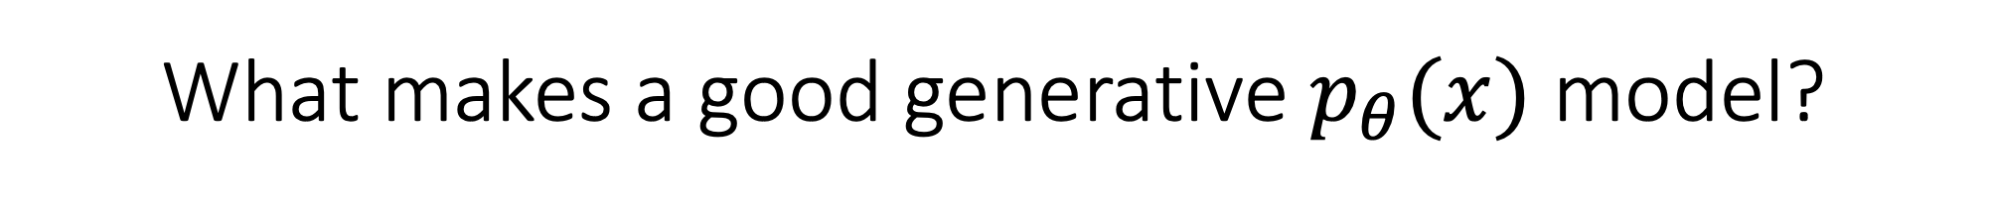
What makes a good generative $p_{θ}(x)$ model?
Define the negative cross-entropy loss of $x \sim S_{data}$:
$$−CE\left(p_{data};p_{θ}\right)=E_{data}[−\log{p_{θ}(x)}]$$
Looks sort of like one-class classification or $\left|S_{data}\right|$-class classification.
Can’t we just return $p_{θ}\left(x\right)= \frac{1}{\left|S_{data}\right|}$ (constant) and we are done?!
How can we tell if $p_{θ}\left(x\right)$ is doing anything good?
How can we force $p_{θ}\left(x\right)$ to generalize?

Slide 25
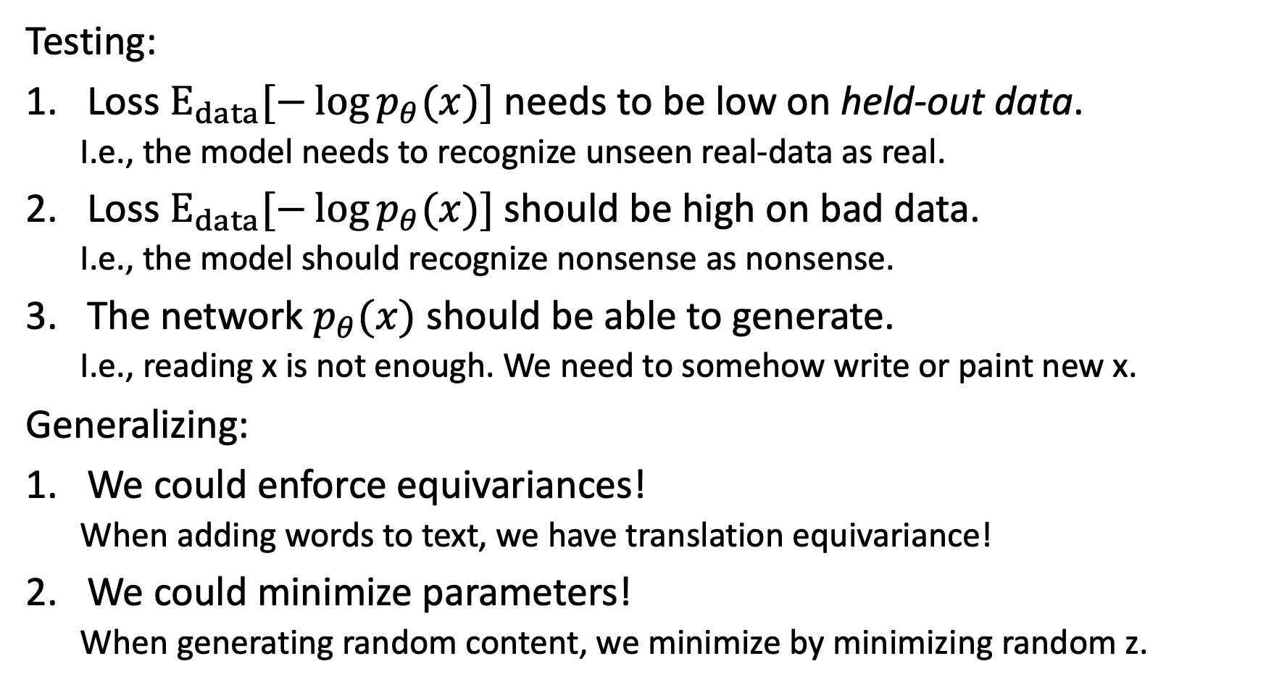
Generalization and generative models
Testing:
Loss $E_{data}[−\log{p_{θ}(x)}]$ needs to be low on held-out data.
  I.e., the model needs to recognize unseen real-data as real.
Loss $E_{data}[−\log{p_{θ}(x)}]$ should be high on bad data.
  I.e., the model should recognize nonsense as nonsense.
The network $p_{θ}(x)$ should be able to generate.
  I.e., reading x is not enough. We need to somehow write or paint new x.
Generalizing:
We could enforce equivariances!
  When adding words to text, we have translation equivariance!
We could minimize parameters!
  When generating random content, we minimize by minimizing random z.

Slide 26
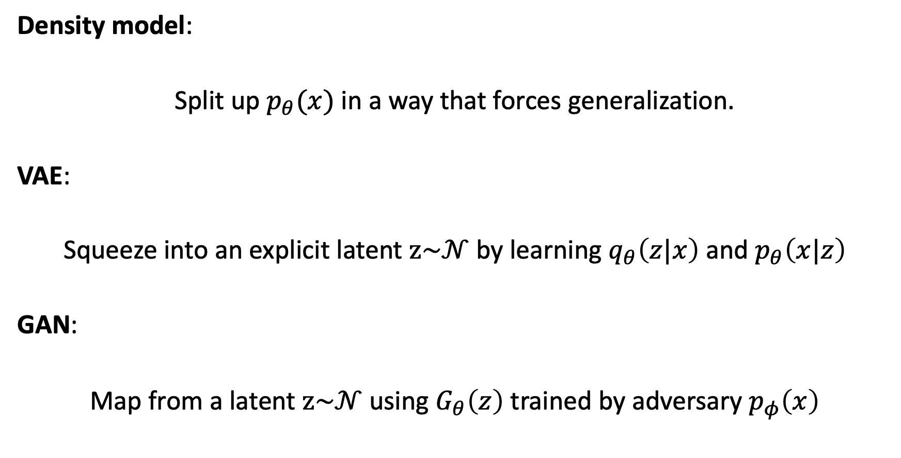
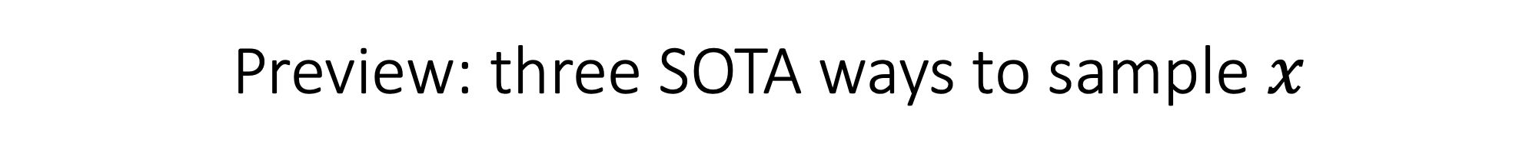
Preview: three SOTA ways to sample $x$
Density model:
Split up $p_{θ}(x)$ in a way that forces generalization.
VAE:
Squeeze into an explicit latent $z\sim 𝒩$ by learning $q_{θ}\left(z|x\right)$ and $p_{θ}\left(x|z\right)$
GAN:
Map from a latent $z\sim 𝒩$ using $G_{θ}\left(z\right)$ trained by adversary $p_{φ}\left(x\right)$

Slide 27
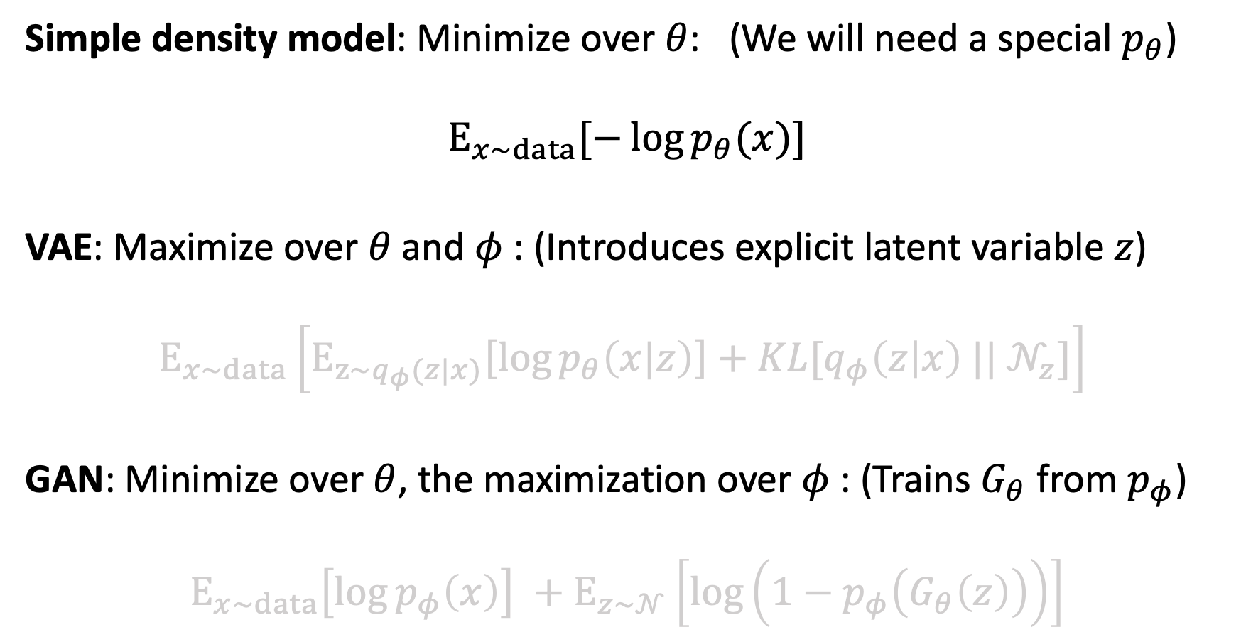
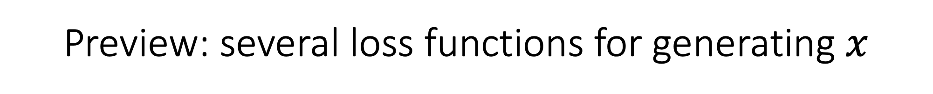
Preview: several loss functions for generating $x$
Simple density model: Minimize over $θ$: (We will need a special $p_{θ}$)
$$E_{x\sim data}[−\log{p_{θ}(x)}]$$
VAE: Maximize over $θ$ and $φ$: (Introduces explicit latent variable $z$)
$$E_{x\sim data}\left[E_{z\sim q_{φ}(z|x)}\left[\log{p_{θ}\left(x|z\right)}\right]+KL[q_{φ}\left(z | x\right) ||{ 𝒩}_{z}]\right]$$
GAN: Minimize over $θ$, the maximization over $φ$: (Trains $G_{θ}$ from $p_{φ}$)
$$E_{x\sim data}\left[\log{p_{φ}\left(x\right)}\right] +E_{z\sim 𝒩}\left[\log\left(1−p_{φ}\left(G_{θ}\left(z\right)\right)\right)\right]$$

Slide 28
Language modeling
Structuring p(x) to model a sequence

Slide 29
An example small language model
Training language:
  Make things well
  Make it work
  Make it go
  Let it work
  Let me go
  Let me see
  Make things work
  Make things work
  Let it go
  Let it go
Each possibility has p=0.1
These are more likely, p=0.2

Slide 30
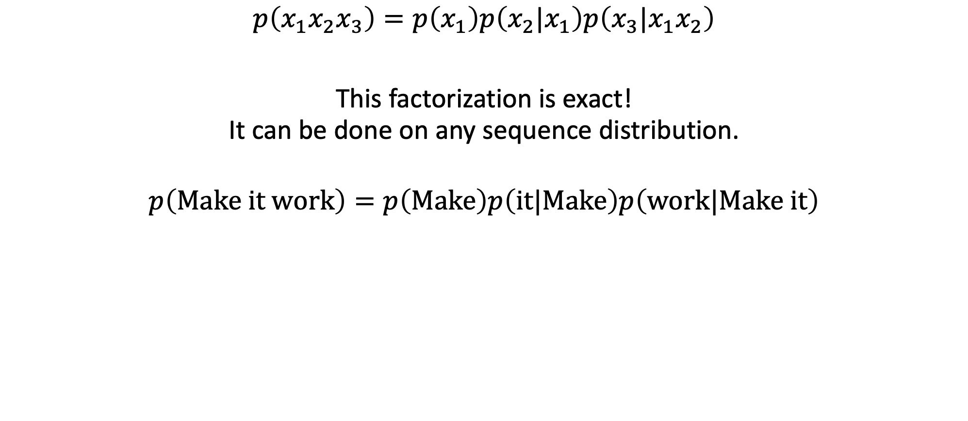
Factoring the probability distribution
$$p\left(x_{1}x_{2}x_{3}\right)=p\left(x_{1}\right)p\left(x_{2}|x_{1}\right)p\left(x_{3}|x_{1}x_{2}\right)$$
This factorization is exact!
It can be done on any sequence distribution.
$$p\left(Make it work\right)=p\left(Make\right)p\left(it|Make\right)p\left(work|Make it\right)$$

Slide 31
An example small language model
Make things well
Make it work
Make it go
Let it work
Let me go
Let me see
Make things work
Make things work
Let it go
Let it go
p=0.5
p=0.5
Make
Let
p=0.6
p=0.4
p=0.6
p=0.4
things
it
it
me
0.33
0.67
0.5
0.67
0.5
0.5
0.33
0.5
well
work
go
see

Slide 32

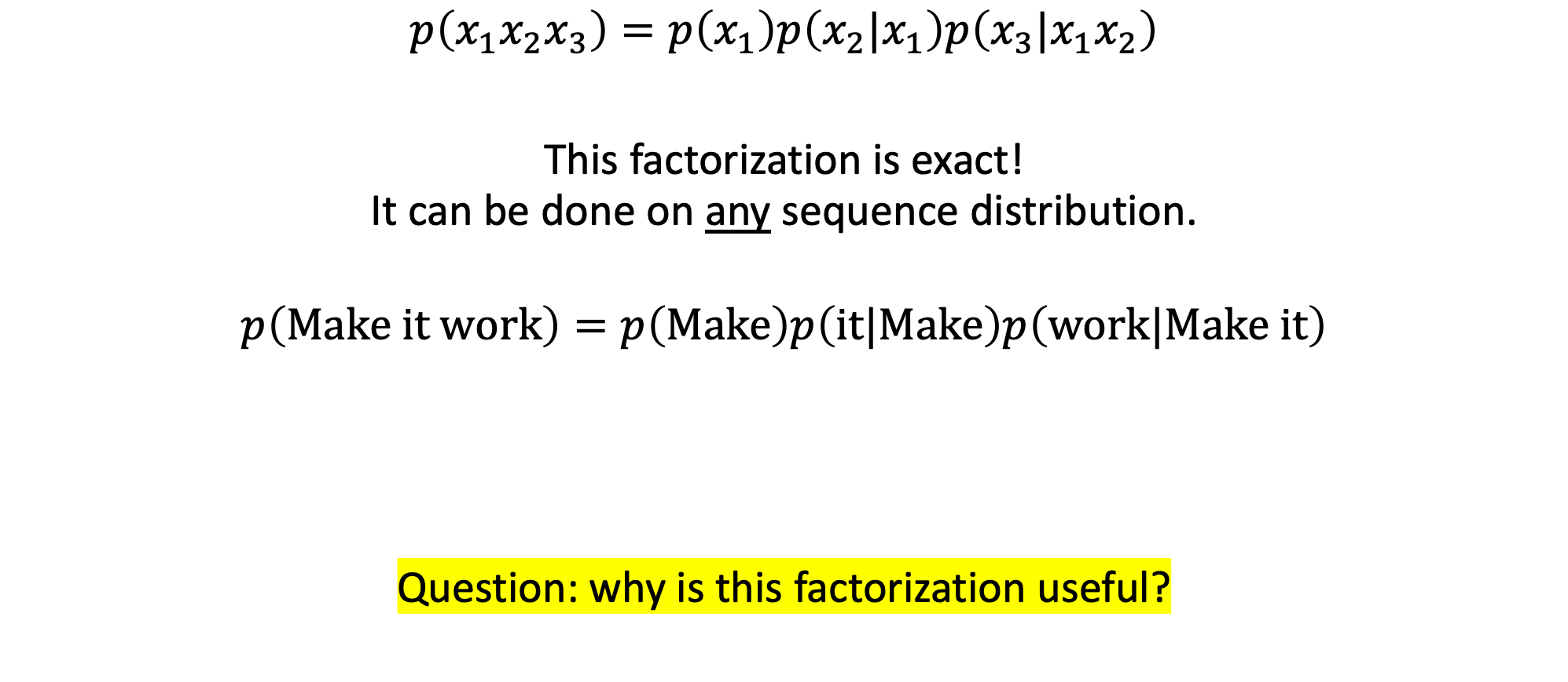
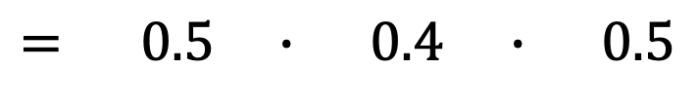
Factoring the probability distribution
$$p\left(x_{1}x_{2}x_{3}\right)=p\left(x_{1}\right)p\left(x_{2}|x_{1}\right)p\left(x_{3}|x_{1}x_{2}\right)$$
This factorization is exact!
It can be done on any sequence distribution.
$$p\left(Make it work\right)=p\left(Make\right)p\left(it|Make\right)p\left(work|Make it\right)$$
Question: why is this factorization useful?
$= 0.5 ∙ 0.4$ $∙ 0.5$
$$=0.1$$

Slide 33
We can run it to generate!
p=0.5
p=0.5
Make
Let
p=0.6
p=0.4
p=0.6
p=0.4
things
it
it
me
0.33
0.67
0.5
0.67
0.5
0.5
0.33
0.5
well
work
go
see

Slide 34
Classical language modeling
Simple approach: count word frequencies
Unigram | Frequency | p
Make | 5 | 0.167
Let | 5 | 0.167
it | 5 | 0.167
work | 4 | 0.133
things | 3 | 0.1
go | 3 | 0.1
me | 2 | 0.067
well | 1 | 0.033
see | 1 | 0.033
Make things well
Make it work
Make it go
Let it work
Let me go
Let me see
Make things work
Make things work
Let it go
Let it go

Slide 35

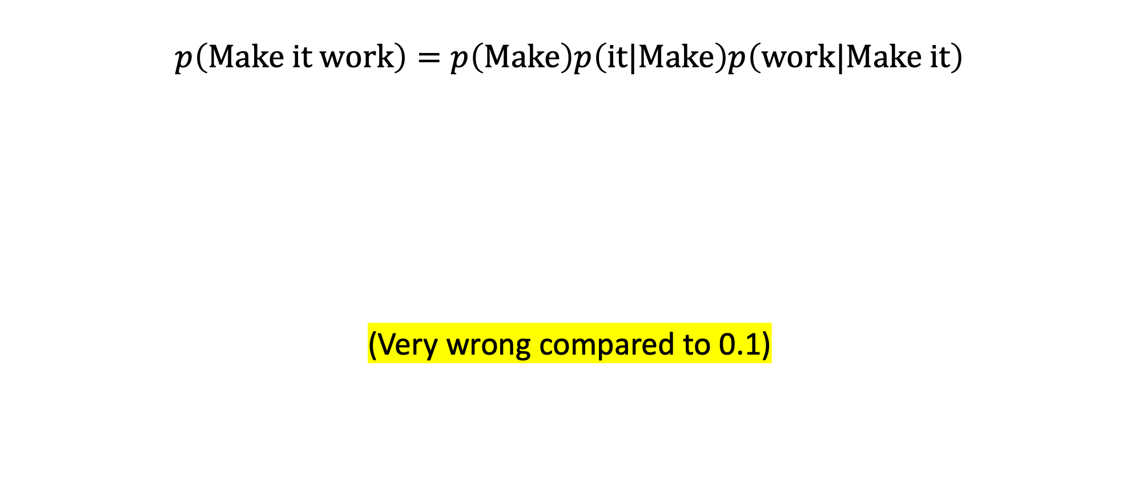
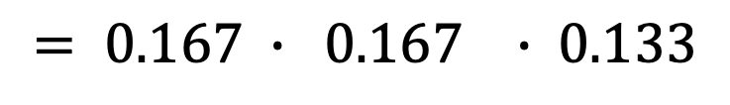

The unigram approximation
$$p\left(Make it work\right)=p\left(Make\right)p\left(it|Make\right)p\left(work|Make it\right)$$
(Very wrong compared to 0.1)
$$≈p_{u}\left(Make\right)p_{u}\left(it\right)p_{u}\left(work\right)$$
$= 0.167 ∙ 0.167$ $∙ 0.133$
$$=0.0037$$

Slide 36

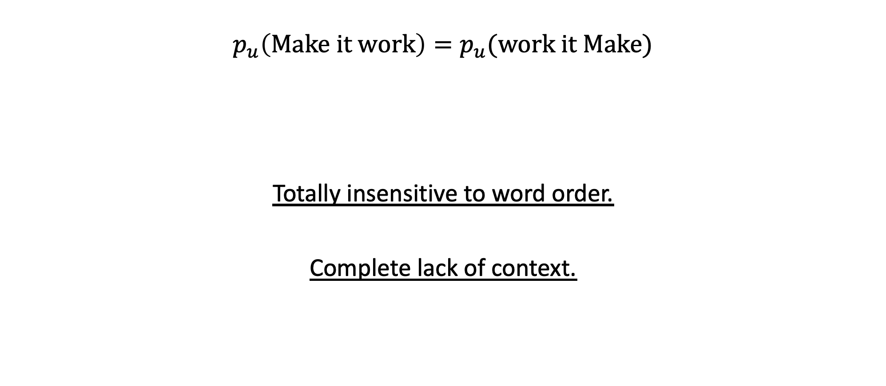
The problem with unigrams
$$p_{u}\left(Make it work\right)=p_{u}(work it Make)$$
Totally insensitive to word order.
Complete lack of context.
$$=p_{u}\left(Make\right)p_{u}\left(it\right)p_{u}\left(work\right)$$

Slide 37
Better classical language modeling: bigrams
“How frequent is every word pair?”
Bigrams seen | Frequency | p(x_{i}|x_{i-1})
<start> → Make | 5 | 0.5
<start> → Let | 5 | 0.5
Make → it | 4 | 0.4
Make → things | 6 | 0.6
Let → it | 6 | 0.6
Let → me | 4 | 0.4
things → well | 1 | 0.33
things → work | 2 | 0.67
it → work | ?
it → go | ?
me → go | 1 | 0.5
me → see | 1 | 0.5
Make things well
Make it work
Make it go
Let it work
Let me go
Let me see
Make things work
Make things work
Let it go
Let it go

Slide 38
Better language modeling (classical approach)
“How frequent is every word pair?”
Bigrams seen | Frequency | p(x_{i}|x_{i-1})
<start> → Make | 5 | 0.5
<start> → Let | 5 | 0.5
Make → it | 4 | 0.4
Make → things | 6 | 0.6
Let → it | 6 | 0.6
Let → me | 4 | 0.4
things → well | 1 | 0.33
things → work | 2 | 0.67
it → work | 2 ← | 0.4
it → go | 3 | 0.6
me → go | 1 | 0.5
me → see | 1 | 0.5
Make things well
Make it work←
Make it go
Let it work←
Let me go
Let me see
Make things work
Make things work
Let it go
Let it go

Slide 39
A bigram model is still a rough approximation
p=0.5
p=0.5
Make
Let
p=0.6
p=0.4
p=0.6
p=0.4
things
it
me
0.33
0.67
0.4
0.6
0.5
0.5
a bit off!
well
work
go
see

Slide 40

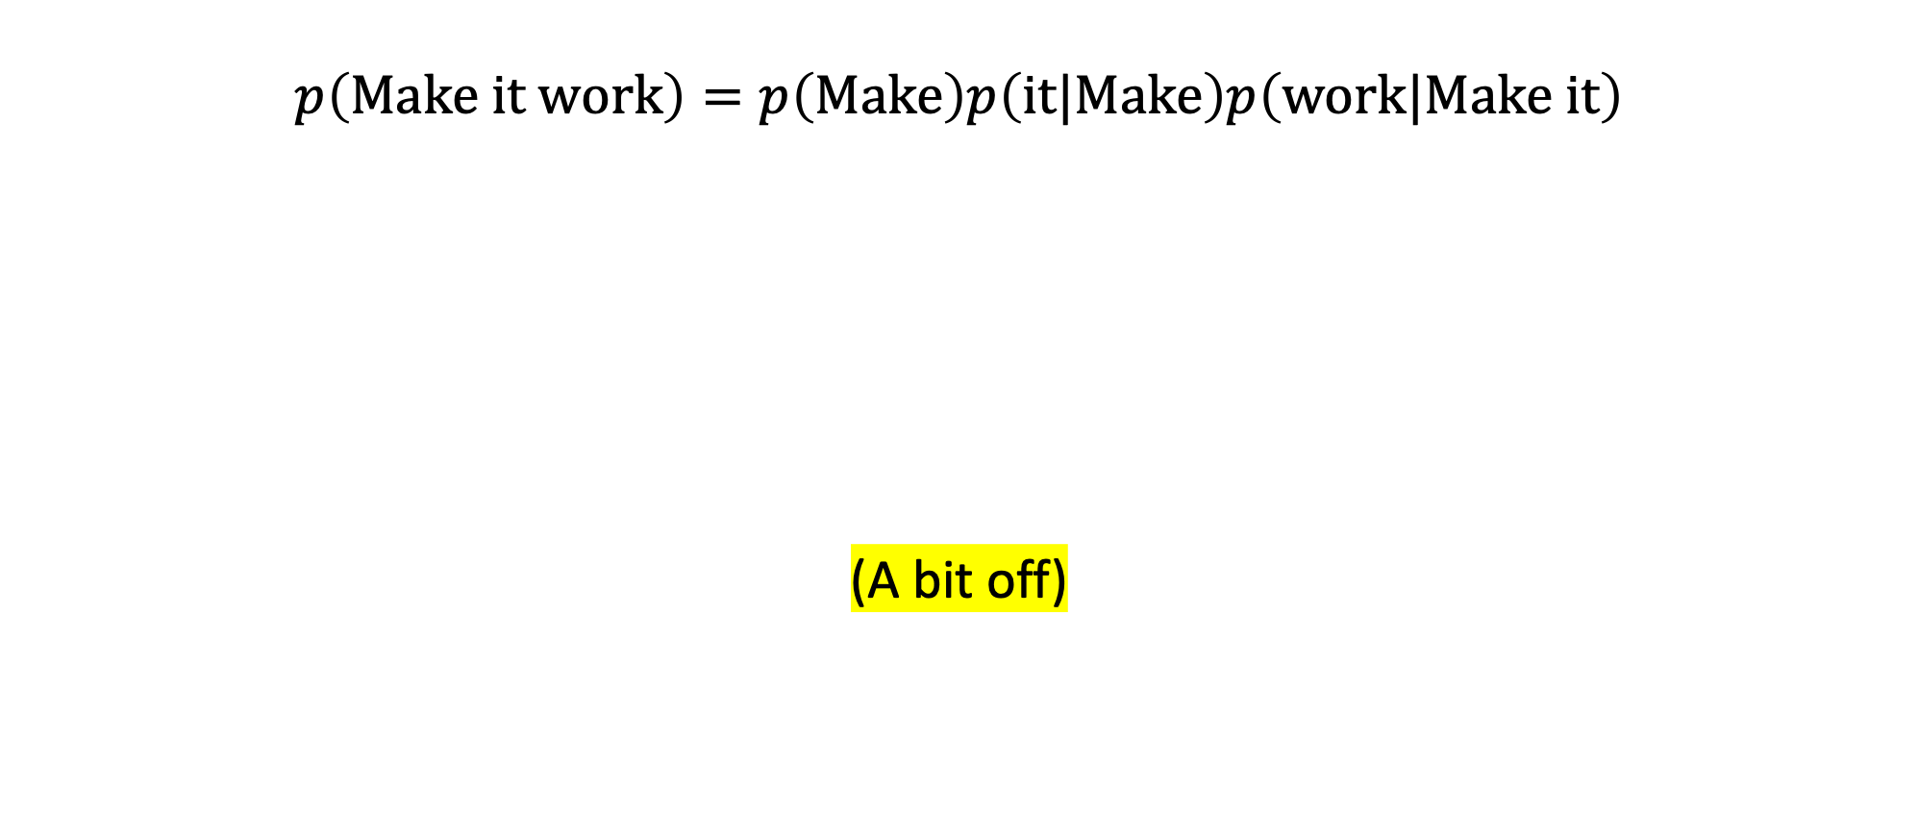
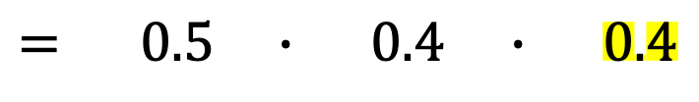
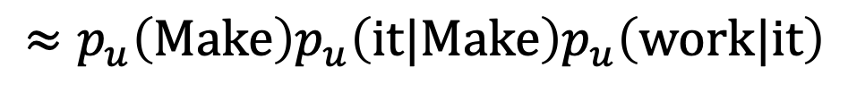
The bigram approximation
$$p\left(Make it work\right)=p\left(Make\right)p\left(it|Make\right)p\left(work|Make it\right)$$
(A bit off)
$$≈p_{u}\left(Make\right)p_{u}\left(it|Make\right)p_{u}\left(work|it\right)$$
$= 0.5 ∙ 0.4$ $∙ 0.4$
$$=0.08$$

Slide 41
Much better: trigram, 4-gram models
Trigram prefix seen | Frequency
cent interest per → annum | 3162
driven by the → availability | 1194
driven by the → processes | 167
driven by the → children | 160
the development of → excessive | 2359
the development of → contemporary | 11452
the development of → status | 889
the development of → raised | 446
seems to have → expended | 552
seems to have → formed | 17401
(~40 gigabytes to collect English bigrams, trigrams, 4-grams)
Why not go up to 10-gram or 100-gram models?
[Source: Google books ngrams data]

Slide 42
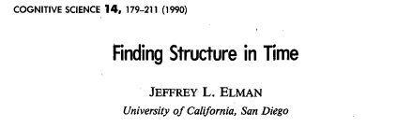
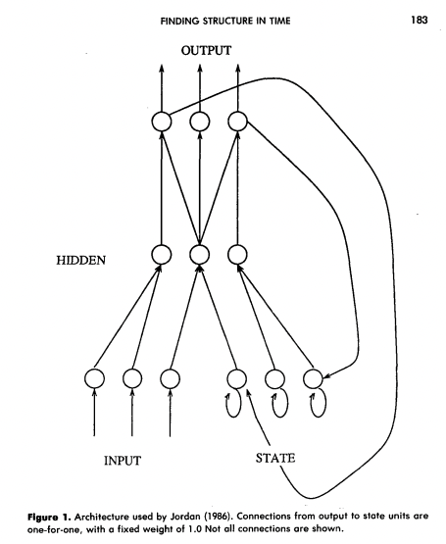
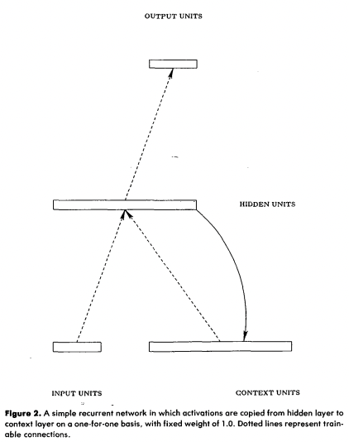
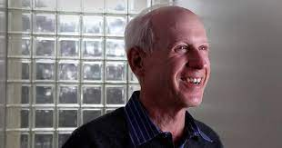
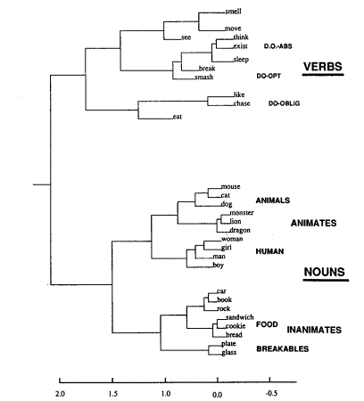
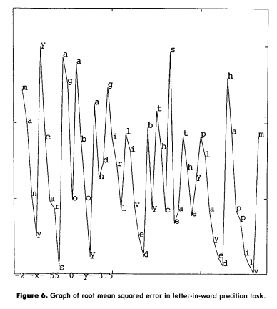
1990:
Jeffrey Elman neural language model
[Elman, 1990]

Slide 43
Brief history of neural NLP
Classical counting-based methods performed far better than NNs.
Neural language models were curiosities, but impractical.
Unlike in vision, the change to NN models didn’t happen overnight.
(Large-scale counting works very very well.)
But in 2011-2015, NNs started to outperform large-scale counting.
This led to a large change in natural language processing.
We will pick up in the modern context

Slide 44
Modern idea: use a neural network!
avoid
Great
care
must
be
taken
to

Slide 45
Modern idea: use a neural network!
Two main innovations:
Computation instead of counting
Vector representations for words
avoid
Great
care
must
be
taken
to

Slide 46
Modern idea: use a neural network!
Two main innovations:
Computation instead of counting
Vector representations for words
avoid
Like vision:
exploit equivariance
Key issue:
how to represent
a word as a vector?
Great
care
must
be
taken
to

Slide 47
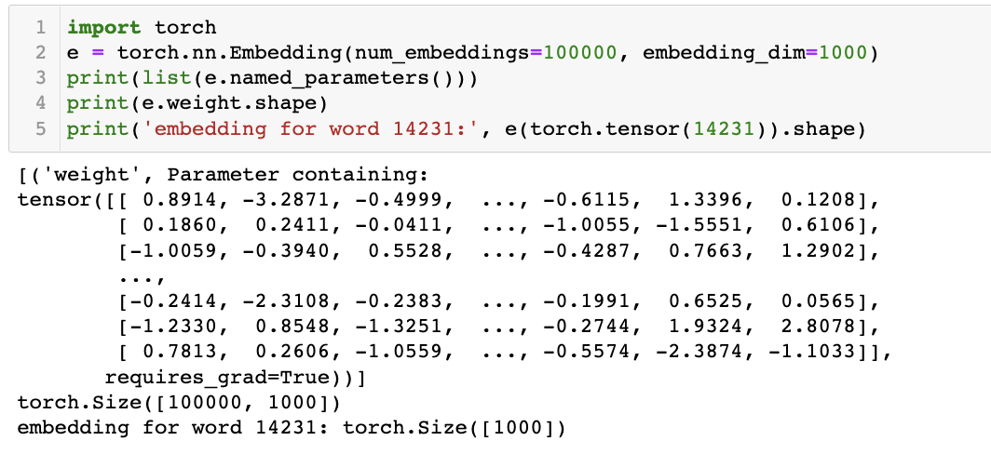
Word embeddings
Mechanically: a simple idea
size of vocab = 100000
dim of vector = 1000
one row for each word
1000 dim vec for each
Just a lookup-table to reduce a big vocabulary to a smaller vector

Slide 48
How to learn word embeddings?
Classical neural language models (Elman, etc):
  Just train jointly together with the rest of the neural network.
Then 2012-2019: the pretrained word embedding era
  Pretrain word embeddings on a vast corpus, to train your smaller network
2019-today: back to the classic way
  Entire language models are pretrained on a vast corpus, including embedding

Slide 49
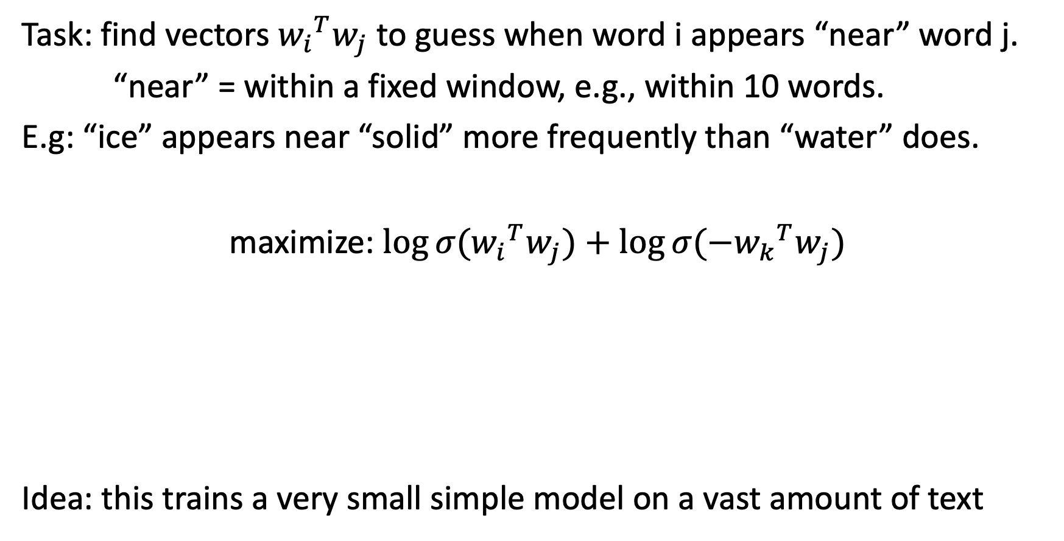
Skip-gram word2vec embeddings
Task: find vectors ${w_{i}}^{T}w_{j}$to guess when word i appears “near” word j.
“near” = within a fixed window, e.g., within 10 words.
E.g: “ice” appears near “solid” more frequently than “water” does.
maximize: $\log{σ({w_{i}}^{T}w_{j})}+\log{σ({{−w}_{k}}^{T}w_{j})}$
Idea: this trains a very small simple model on a vast amount of text
sample i and j near each other
to push this higher
sample random k not near j
to push this lower
[Simplification of Mikolov 2013]

Slide 50
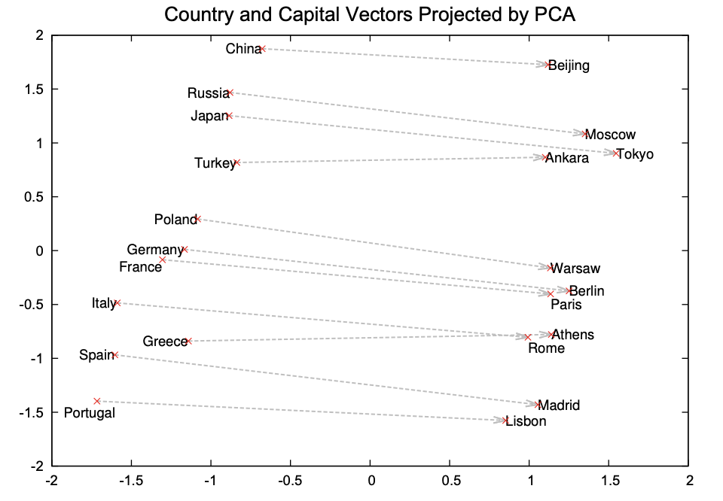
Semantic vector composition
When skip-gram training is done, semantic vector arithmetic emerges:
[Mikolov 2013]

Slide 51
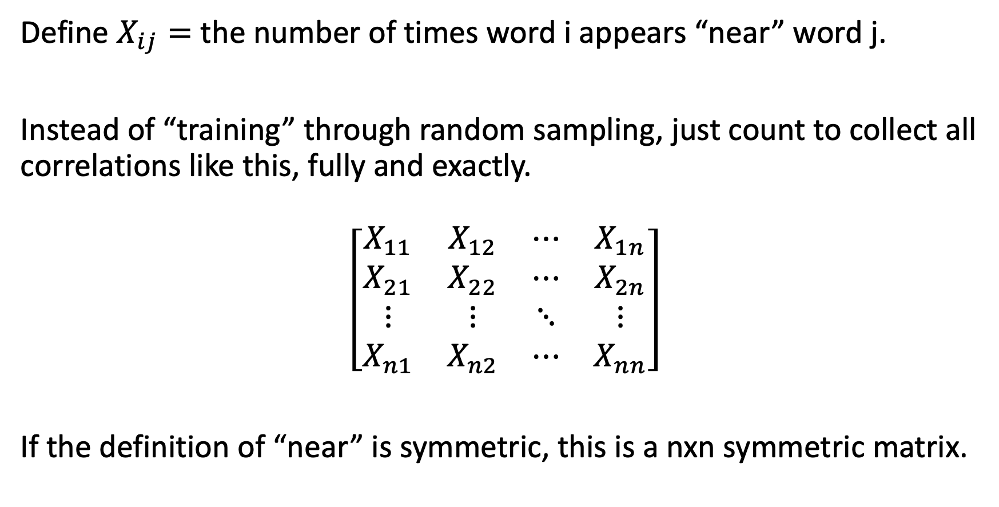
Glove word embeddings
Define $X_{ij}=$ the number of times word i appears “near” word j.
Instead of “training” through random sampling, just count to collect all correlations like this, fully and exactly.
$$\left[\begin{matrix}X_{11} & X_{12} & ⋯ & X_{1n} \\ X_{21} & X_{22} & ⋯ & X_{2n} \\ ⋮ & ⋮ & ⋱ & ⋮ \\ X_{n1} & X_{n2} & ⋯ & X_{nn}\end{matrix}\right]$$
If the definition of “near” is symmetric, this is a nxn symmetric matrix.

Slide 52
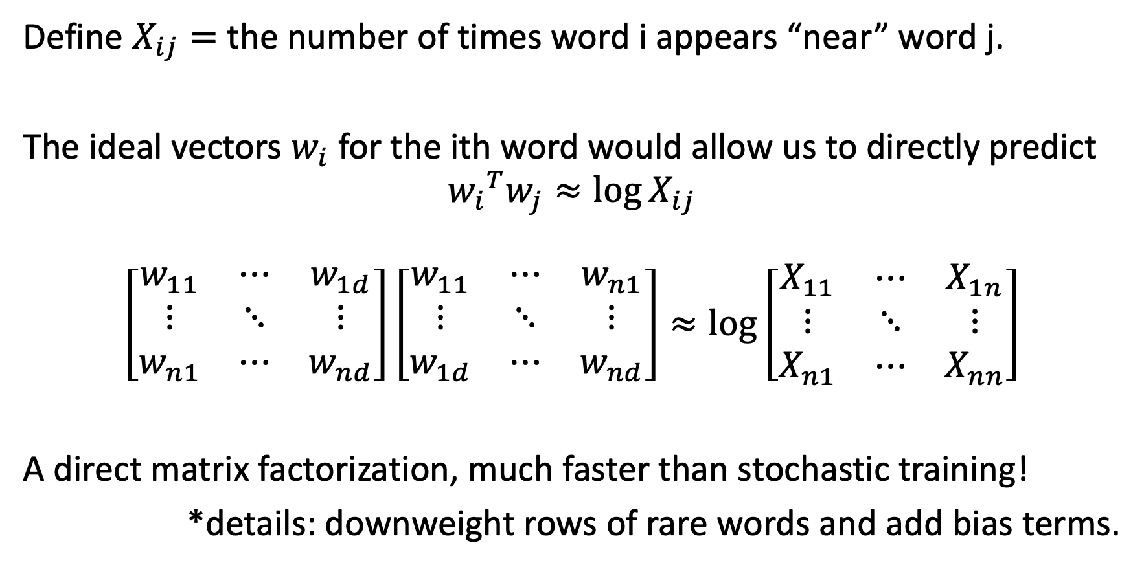
Idea of Glove
Define $X_{ij}=$ the number of times word i appears “near” word j.
The ideal vectors $w_{i}$ for the ith word would allow us to directly predict
$${w_{i}}^{T}w_{j}≈\log{X_{ij}}$$
$$\left[\begin{matrix}w_{11} & ⋯ & w_{1d} \\ ⋮ & ⋱ & ⋮ \\ w_{n1} & ⋯ & w_{nd}\end{matrix}\right]\left[\begin{matrix}w_{11} & ⋯ & w_{n1} \\ ⋮ & ⋱ & ⋮ \\ w_{1d} & ⋯ & w_{nd}\end{matrix}\right]≈\log\left[\begin{matrix}X_{11} & ⋯ & X_{1n} \\ ⋮ & ⋱ & ⋮ \\ X_{n1} & ⋯ & X_{nn}\end{matrix}\right]$$
A direct matrix factorization, much faster than stochastic training!
*details: downweight rows of rare words and add bias terms.
[Simplification of Pennington 2014]

Slide 53

Interactive: Use GloVe embedding by hand
https://bit.ly/cs7150-glove

Slide 54


Language Modelling: Feed-forward Neural Net
Neural Approach #1: Feed-forward Neural Net
General Idea: using windows of words, predict the next word
Ex. He went to class after breakfast.
Output layer
$$W$$
Hidden layer
$$V$$
Example input sentence
He
went
to

Slide 55



Language Modelling: Feed-forward Neural Net
Neural Approach #1: Feed-forward Neural Net
General Idea: using windows of words, predict the next word
Ex. He went to class after breakfast.
Output layer
$$\hat{y}=\text{softmax}\left(Wh+b_{2}\right)∈ℝ^{\left|V\right|}$$
$$W$$
Hidden layer
$$h=f(Vx+b_{1})$$
$$V$$
Example input sentence
$$x=[x_{1},x_{2},x_{3}]$$
He
went
to
Concatenated word embeddings

Slide 56
Language Modelling: Feed-forward Neural Net
Neural Approach #1: Feed-forward Neural Net
General Idea: using windows of words, predict the next word
Ex. He went to class after breakfast.
Output layer
$$\hat{y}=\text{softmax}\left(Wh+b_{2}\right)∈ℝ^{\left|V\right|}$$
$$W$$
Hidden layer
$$h=f(Vx+b_{1})$$
$$V$$
Example input sentence
$$x=[x_{1},x_{2},x_{3}]$$
went
to
class
Concatenated word embeddings

Slide 57
Language Modelling: Feed-forward Neural Net
Neural Approach #1: Feed-forward Neural Net
General Idea: using windows of words, predict the next word
Ex. He went to class after breakfast.
Output layer
$$\hat{y}=\text{softmax}\left(Wh+b_{2}\right)∈ℝ^{\left|V\right|}$$
$$W$$
Hidden layer
$$h=f(Vx+b_{1})$$
$$V$$
Example input sentence
$$x=[x_{1},x_{2},x_{3}]$$
to
class
after
Concatenated word embeddings

Slide 58









Language Modelling: Feed-forward Neural Net
Training
$$L=CE({\hat{y}}_{t}, y_{t})$$
Output layer
$$\hat{y}=\text{softmax}\left(Wh+b_{2}\right)∈ℝ^{\left|V\right|}$$
$$W$$
Hidden layer
$$h=f(Vx+b_{1})$$
$$V$$
Example input sentence
$$x=[x_{1},x_{2},x_{3}]$$
$$w_{t−3}$$
$$w_{t−2}$$
$$w_{t−1}$$
Concatenated word embeddings

Slide 59


Language Modelling: Feed-forward Neural Net
$\hat{y}$: are probabilities for each possible word in the vocabulary.
$y:$ is a vector of 0’s and 1.
$$L=\sum_{t=3}^{t}{CE({\hat{y}}_{t}, y_{t})}$$
Training
Output layer
$$\hat{y}=\text{softmax}\left(Wh+b_{2}\right)∈ℝ^{\left|V\right|}$$
$$W$$
Hidden layer
$$h=f(Vx+b_{1})$$
$$V$$
Example input sentence
$$x=[x_{1},x_{2},x_{3}]$$
$$w_{t−3}$$
$$w_{t−2}$$
$$w_{t−1}$$
Concatenated word embeddings

Slide 60
Language Modelling : Feed-forward Neural Net
FFNN STRENGTHS?
No sparsity issues (it’s okay if we’ve never seen a segment of words)
No storage issues (we never store counts)
FFNN ISSUES?
Fixed-window size can never be big enough. Need more context.
Increasing window size adds many more weights
The weights awkwardly handle word position
No concept of time
Requires inputting entire context just to predict one word

Slide 61
Language Modelling
We especially need a system that:
Has an “infinite” concept of the past, not just a fixed window
For each new input, output the most likely next event (e.g., word)

Slide 62

Language Modelling
IDEA: for every individual input, output a prediction
Let’s use the previous hidden state, too
went
Output layer
$$\hat{y}=\text{softmax}\left(Wh+b_{2}\right)∈ℝ^{\left|V\right|}$$
$$W$$
Hidden layer
$$h=f(Vx+b_{1})$$
$$V$$
Example input word
$$x=x_{1}$$
He
single word embedding

Slide 63

















Language Modelling: RNNs
Neural Approach #2: Recurrent Neural Network (RNN)
$${\hat{y}}_{1}$$
$${\hat{y}}_{2}$$
$${\hat{y}}_{3}$$
$${\hat{y}}_{4}$$
Output layer
$$W$$
$$W$$
$$W$$
$$W$$
$$U$$
$$U$$
$$U$$
$$U$$
Hidden layer
$$V$$
V
V
V
Input layer
$$x_{1}$$
$$x_{2}$$
$$x_{3}$$
$$x_{4}$$

Slide 64

















RNN
Training Process
$$CE\left(y^{i},{\hat{y}}^{i}\right)=−\sum_{w∈W}{y_{w}^{i}\text{log}({\hat{y}}_{w}^{i})}$$
Error
$$CE\left(y^{1},{\hat{y}}^{1}\right)$$
$$CE\left(y^{2},{\hat{y}}^{2}\right)$$
$$CE\left(y^{3},{\hat{y}}^{3}\right)$$
$$CE\left(y^{4},{\hat{y}}^{4}\right)$$
$${\hat{y}}_{1}$$
$${\hat{y}}_{2}$$
$${\hat{y}}_{3}$$
$${\hat{y}}_{4}$$
Output layer
$$W$$
$$W$$
$$W$$
$$W$$
$$U$$
$$U$$
$$U$$
Hidden layer
$$V$$
$$V$$
$$V$$
$$V$$
Input layer
$$x_{1}$$
$$x_{2}$$
$$x_{3}$$
$$x_{4}$$
He
went
to
class

Slide 65
RNN
Training Process
$$CE\left(y^{i},{\hat{y}}^{i}\right)=−\sum_{w∈W}{y_{w}^{i}\text{log}({\hat{y}}_{w}^{i})}$$
Error
$$CE\left(y^{1},{\hat{y}}^{1}\right)$$
$$CE\left(y^{2},{\hat{y}}^{2}\right)$$
$$CE\left(y^{3},{\hat{y}}^{3}\right)$$
$$CE\left(y^{4},{\hat{y}}^{4}\right)$$
$${\hat{y}}_{1}$$
$${\hat{y}}_{2}$$
$${\hat{y}}_{3}$$
$${\hat{y}}_{4}$$
Output layer
$$W$$
$$W$$
$$W$$
$$W$$
$$U$$
$$U$$
$$U$$
Hidden layer
$$V$$
$$V$$
$$V$$
$$V$$
Input layer
$$x_{1}$$
$$x_{2}$$
$$x_{3}$$
$$x_{4}$$
He
went
to
class

Slide 66

RNN
Training Process
$$CE\left(y^{i},{\hat{y}}^{i}\right)=−\sum_{w∈W}{y_{w}^{i}\text{log}({\hat{y}}_{w}^{i})}$$
Error
$$CE\left(y^{1},{\hat{y}}^{1}\right)$$
$$CE\left(y^{2},{\hat{y}}^{2}\right)$$
$$CE\left(y^{3},{\hat{y}}^{3}\right)$$
$$CE\left(y^{4},{\hat{y}}^{4}\right)$$
went?
over?
class?
after?
Output layer
$$\hat{y}$$
$$W$$
$$W$$
$$W$$
$$W$$
$$U$$
$$U$$
$$U$$
Hidden layer
$$V$$
$$V$$
$$V$$
$$V$$
Input layer
$$x_{1}$$
$$x_{2}$$
$$x_{3}$$
$$x_{4}$$
She
went
to
class

Slide 67

RNN (review)
Training Process
$$CE\left(y^{i},{\hat{y}}^{i}\right)=−\sum_{w∈W}{y_{w}^{i}\text{log}({\hat{y}}_{w}^{i})}$$
To update our weights (e.g. $U$), we calculate the gradient of our loss w.r.t. the repeated weight matrix (e.g., $\frac{∂L}{∂U} ).$
Error
$$CE\left(y^{1},{\hat{y}}^{1}\right)$$
$$CE\left(y^{2},{\hat{y}}^{2}\right)$$
$$CE\left(y^{3},{\hat{y}}^{3}\right)$$
$$CE\left(y^{4},{\hat{y}}^{4}\right)$$
went?
over?
class?
after?
Using the chain rule, we trace the derivative all the way back to the beginning, while summing the results.
Output layer
$$\hat{y}$$
$$W$$
$$W$$
$$W$$
$$W$$
$$U$$
$$U$$
$$U$$
Hidden layer
$$V$$
$$V$$
$$V$$
$$V$$
Input layer
$$x_{1}$$
$$x_{2}$$
$$x_{3}$$
$$x_{4}$$
He
went
to
class

Slide 68
RNN (review)
Training Process
Error
$$CE\left(y^{1},{\hat{y}}^{1}\right)$$
$$CE\left(y^{2},{\hat{y}}^{2}\right)$$
$$CE\left(y^{3},{\hat{y}}^{3}\right)$$
$$CE\left(y^{4},{\hat{y}}^{4}\right)$$
went?
over?
class?
after?
Output layer
$$\hat{y}$$
$$W$$
$$W$$
$$W$$
$$W$$
$$U$$
$$U$$
$$U$$
Hidden layer
$$V$$
$$V$$
$$V$$
$$V$$
Input layer
$$x_{1}$$
$$x_{2}$$
$$x_{3}$$
$$x_{4}$$
He
went
to
class

Slide 69


RNN (review)
$\frac{∂L}{∂V}$
Training Process
Error
$$CE\left(y^{1},{\hat{y}}^{1}\right)$$
$$CE\left(y^{2},{\hat{y}}^{2}\right)$$
$$CE\left(y^{3},{\hat{y}}^{3}\right)$$
$$CE\left(y^{4},{\hat{y}}^{4}\right)$$
went?
over?
class?
after?
Output layer
$$\hat{y}$$
$$W$$
$$W$$
$$W$$
$$W$$
$$U$$
$$U$$
$$U$$
Hidden layer
$$V$$
$$V$$
$$V$$
$$V$$
Input layer
$$x_{1}$$
$$x_{2}$$
$$x_{3}$$
$$x_{4}$$
She
went
to
class

Slide 70

RNN (review)
This backpropagation through time (BPTT) process is expensive
Instead of updating after every timestep, we tend to do so every $T$ steps (e.g., every sentence or paragraph)
This isn’t equivalent to using only a window size $T$
(a la n-grams) because we still have ‘infinite memory’

Slide 71

RNN: Generation
We can generate the most likely next event (e.g., word) by sampling from $\hat{y}$
Continue until we generate <EOS> symbol.

Slide 72

RNN: Generation
We can generate the most likely next event (e.g., word) by sampling from $\hat{y}$
Continue until we generate <EOS> symbol.
“Sorry”
Output layer
$$W$$
Hidden layer
$$V$$
Input layer
$$x_{1}$$
<START>

Slide 73








RNN: Generation
We can generate the most likely next event (e.g., word) by sampling from $\hat{y}$
Continue until we generate <EOS> symbol.
“Sorry”
Harry
shouted
panicking
Output layer
$$W$$
$$W$$
$$W$$
$$W$$
$$U$$
$$U$$
$$U$$
Hidden layer
$$V$$
$$V$$
$$V$$
$$V$$
Input layer
$$x_{1}$$
$$x_{2}$$
$$x_{3}$$
$$x_{4}$$
<START>
“Sorry”
“Harry”
shouted,

Slide 74
RNN: Generation
NOTE: the same input (e.g., “Harry”) can easily yield different outputs, depending on the context (unlike FFNNs and n-grams).
“Sorry”
Harry
shouted
panicking
Output layer
$$W$$
$$W$$
$$W$$
$$W$$
$$U$$
$$U$$
$$U$$
Hidden layer
$$V$$
$$V$$
$$V$$
$$V$$
Input layer
$$x_{1}$$
$$x_{2}$$
$$x_{3}$$
$$x_{4}$$
<START>
“Sorry”
“Harry”
“shouted,”

Slide 75


RNN: Generation
When trained on Harry Potter text, it generates:
Source: https://medium.com/deep-writing/harry-potter-written-by-artificial-intelligence-8a9431803da6

Slide 76



RNN: Generation
When trained on recipes
Source: https://gist.github.com/nylki/1efbaa36635956d35bcc

Slide 77
RNNs: Overview
RNN STRENGTHS?
Can handle infinite-length sequences (not just a fixed-window)
Has a “memory” of the context (thanks to the hidden layer’s recurrent loop)
Same weights used for all inputs, so word order isn’t wonky (like FFNN)
RNN ISSUES?
Slow to train (BPTT)
Due to ”infinite sequence”, gradients can easily vanish or explode
Has trouble actually making use of long-range context

Slide 78















RNNs: Vanishing and Exploding Gradients (review)
$\frac{∂L^{4}}{∂V^{1}}$
$\frac{∂L^{4}}{∂V^{1}}= ?$
$$CE\left(y^{4},{\hat{y}}^{4}\right)$$
Output layer
$$\hat{y}$$
$$U$$
$$U$$
$$U$$
$$U$$
$$V^{1}$$
$$V^{2}$$
$$V^{3}$$
Hidden layer
$$W$$
$$W$$
$$W$$
$$W$$
Input layer
She
went
to
class

Slide 79

RNNs: Vanishing and Exploding Gradients (review)
$\frac{∂L^{4}}{∂V^{1}}$
$\frac{∂L^{4}}{∂V^{1}}=\frac{∂L^{4}}{∂V^{3}}$
$$CE\left(y^{4},{\hat{y}}^{4}\right)$$
Output layer
$$\hat{y}$$
$$U$$
$$U$$
$$U$$
$$U$$
$$V^{1}$$
$$V^{2}$$
$$V^{3}$$
Hidden layer
$$W$$
$$W$$
$$W$$
$$W$$
Input layer
She
went
to
class

Slide 80

RNNs: Vanishing and Exploding Gradients (review)
$\frac{∂L^{4}}{∂V^{1}}$
$\frac{∂L^{4}}{∂V^{1}}=\frac{∂L^{4}}{∂V^{3}}\frac{∂V^{3}}{∂V^{2}}$
$$CE\left(y^{4},{\hat{y}}^{4}\right)$$
Output layer
$$\hat{y}$$
$$U$$
$$U$$
$$U$$
$$U$$
$$V^{1}$$
$$V^{2}$$
$$V^{3}$$
Hidden layer
$$W$$
$$W$$
$$W$$
$$W$$
Input layer
She
went
to
class

Slide 81

RNNs: Vanishing and Exploding Gradients (review)
$\frac{∂L^{4}}{∂V^{1}}$
$\frac{∂L^{4}}{∂V^{1}}=\frac{∂L^{4}}{∂V^{3}}\frac{∂V^{3}}{∂V^{2}}$ $\frac{∂V^{2}}{∂V^{1}}$
$$CE\left(y^{4},{\hat{y}}^{4}\right)$$
Output layer
$$\hat{y}$$
$$U$$
$$U$$
$$U$$
$$U$$
$$V^{1}$$
$$V^{2}$$
$$V^{3}$$
Hidden layer
$$W$$
$$W$$
$$W$$
$$W$$
Input layer
She
went
to
class

Slide 82
RNNs: Vanishing and Exploding Gradients (review)
To address RNNs’ finnicky nature with long-range context, we turned to an RNN variant named LSTMs (long short-term memory)
But first, let’s recap what we’ve learned so far

Slide 83















Sequential Modelling (so far)
$${\hat{y}}_{1}$$
$${\hat{y}}_{2}$$
$${\hat{y}}_{3}$$
class
$$U$$
$$U$$
$$V$$
$$U$$
$$V$$
$$U$$
$$P\left(\text{went} | She\right)=\frac{\text{count}(She went)}{\text{count}(She)}$$
$$W$$
$$W$$
$$W$$
$$W$$
She
went
to
She
went
to
n-grams
FFNN
RNN
Kind of robust… almost
Fixed window size
Weirdly handles context positions
No “memory” of past
Handles infinite context
(in theory)
Robust to rare words
Slow
Difficulty with long context
Basic counts; fast
Fixed window size
Sparsity & storage issues
Not robust

Slide 84
Outline
NLP Tasks
Transfer Learning in NLP
Language Modelling, n-grams
Word Embeddings (character embeddings)
Neural Networks LM:
FFNN, RNNs/LSTMs +ELMo
Seq2Seq
Notes:
As a reminder, this is where we are.

