Slide 1

CS 7150
Deep Learning

Slide 2
Neural Language Models

Slide 3
Our main question:
Can a neural network model language?
... and how can we do it?

Slide 4
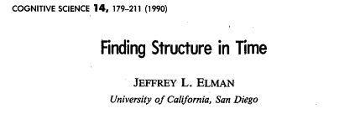
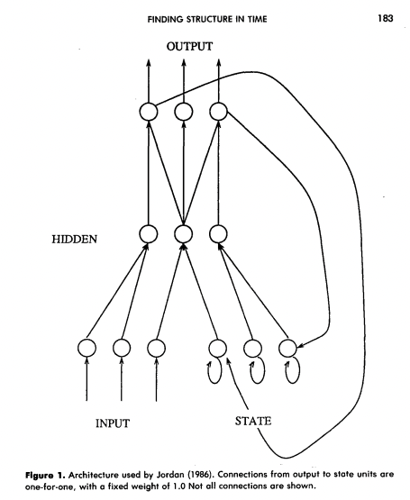
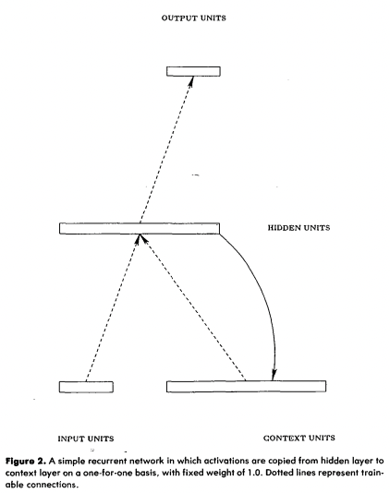
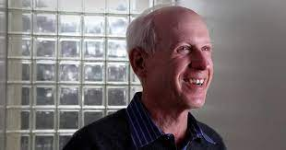
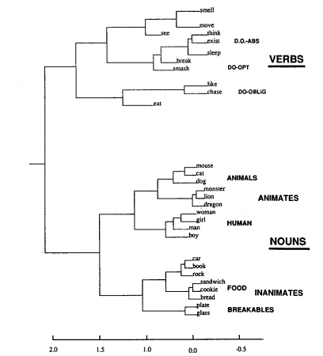
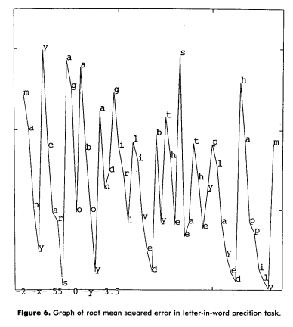
1990:
Jeffrey Elman neural language model
[Elman, 1990]

Slide 5
Brief history of neural NLP
Classical counting-based methods performed far better than NNs.
Neural language models were curiosities, but impractical.
Unlike in vision, the change to NN models didn’t happen overnight.
(Large-scale counting works very very well.)
But in 2011-2015, NNs started to outperform large-scale counting.
This led to a large change in natural language processing.
We will pick up in the modern context

Slide 6
Modern idea: use a neural network!
avoid
Great
care
must
be
taken
to

Slide 7
Modern idea: use a neural network!
Two main innovations:
Computation instead of counting
Vector representations for words
avoid
Great
care
must
be
taken
to

Slide 8
Modern idea: use a neural network!
Two main innovations:
Computation instead of counting
Vector representations for words
avoid
Like vision:
exploit equivariance
Key issue:
how to represent
a word as a vector?
Great
care
must
be
taken
to

Slide 9
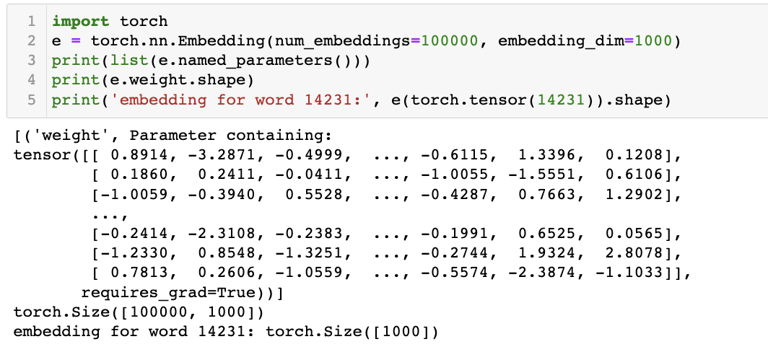
What is a word embedding
Mechanically: a simple idea
size of vocab = 100000
dim of vector = 1000
one row for each word
1000 dim vec for each
Just a lookup-table to reduce a big vocabulary to a smaller vector

Slide 10


Language Modeling: Feed-forward Neural Net
Neural Approach #1: Feed-forward Neural Net
General Idea: using windows of words, predict the next word
Ex. He went to class after breakfast.
Output layer
class
$$W$$
try to predict
next word
Hidden layer
$$V$$
Example input sentence
He
went
to
[Slides modified from slides by: Pavlos Protopapas]

Slide 11



Language Modeling: Feed-forward Neural Net
Neural Approach #1: Feed-forward Neural Net
General Idea: using windows of words, predict the next word
Ex. He went to class after breakfast.
Output layer
$$\hat{y}=\text{softmax}\left(Wh+b_{2}\right)∈ℝ^{\left|V\right|}$$
$$W$$
Hidden layer
$$h=f(Vx+b_{1})$$
$$V$$
Example input sentence
$$x=[x_{1},x_{2},x_{3}]$$
He
went
to
Concatenated word embeddings

Slide 12
Language Modeling: Feed-forward Neural Net
Neural Approach #1: Feed-forward Neural Net
General Idea: using windows of words, predict the next word
Ex. He went to class after breakfast.
Output layer
$$\hat{y}=\text{softmax}\left(Wh+b_{2}\right)∈ℝ^{\left|V\right|}$$
$$W$$
Hidden layer
$$h=f(Vx+b_{1})$$
$$V$$
Example input sentence
$$x=[x_{1},x_{2},x_{3}]$$
went
to
class
Concatenated word embeddings

Slide 13
Language Modeling: Feed-forward Neural Net
Neural Approach #1: Feed-forward Neural Net
General Idea: using windows of words, predict the next word
Ex. He went to class after breakfast.
Output layer
$$\hat{y}=\text{softmax}\left(Wh+b_{2}\right)∈ℝ^{\left|V\right|}$$
$$W$$
Hidden layer
$$h=f(Vx+b_{1})$$
$$V$$
Example input sentence
$$x=[x_{1},x_{2},x_{3}]$$
to
class
after
Concatenated word embeddings

Slide 14









Language Modeling: Feed-forward Neural Net
Training
$$L=CE({\hat{y}}_{t}, y_{t})$$
Output layer
$$\hat{y}=\text{softmax}\left(Wh+b_{2}\right)∈ℝ^{\left|V\right|}$$
$$W$$
Hidden layer
$$h=f(Vx+b_{1})$$
$$V$$
Example input sentence
$$x=[x_{1},x_{2},x_{3}]$$
$$w_{t−3}$$
$$w_{t−2}$$
$$w_{t−1}$$
Concatenated word embeddings

Slide 15
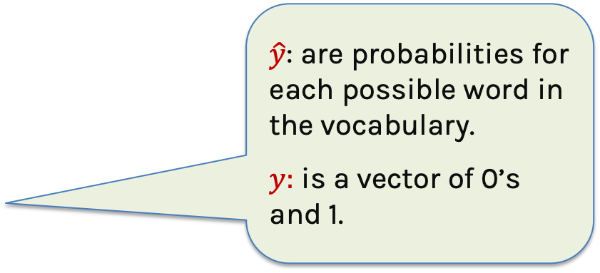
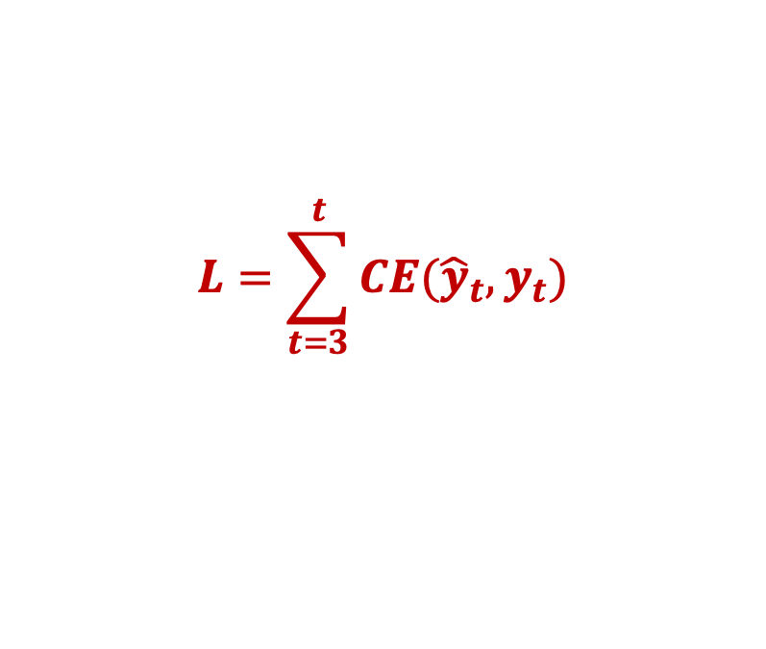
Language Modeling: Feed-forward Neural Net
$\hat{y}$: are probabilities for each possible word in the vocabulary.
$y:$ is a vector of 0’s and 1.
$$L=\sum_{t=3}^{t}{CE({\hat{y}}_{t}, y_{t})}$$
Training
Output layer
$$\hat{y}=\text{softmax}\left(Wh+b_{2}\right)∈ℝ^{\left|V\right|}$$
$$W$$
Hidden layer
$$h=f(Vx+b_{1})$$
$$V$$
Example input sentence
$$x=[x_{1},x_{2},x_{3}]$$
$$w_{t−3}$$
$$w_{t−2}$$
$$w_{t−1}$$
Concatenated word embeddings

Slide 16
Language Modeling : Feed-forward Neural Net
FFNN STRENGTHS COMPARED TO COUNTING?
Can make guesses when we’ve never seen a segment of words.
Storage is bounded (we never store counts)
FFNN ISSUES?
Takes a long time to train because:
Rare words rarely get gradient, so embeddings are hard to learn.
Large window size increases a large number of weights
No concept of time
Requires inputting entire context just to predict one word

Slide 17
How to learn good vectors for words?
Idea 1:
Just train a neural network end-to-end.
Vector embeddings for words are just parameters to learn.
Problems:
Some words are very rare, so will almost never get gradient.
Wasteful to train the network while rare words have bad vectors.
Idea 2:
Drop the big network and scale up training data enormously.
Note: performance will be worse, but learned vectors will be better.

Slide 18
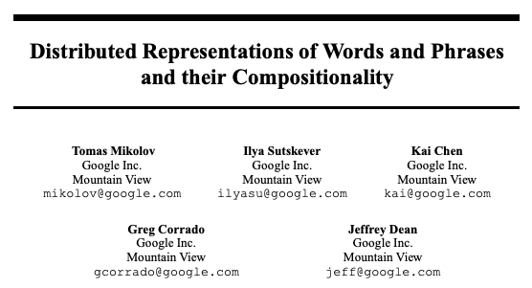
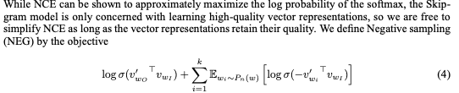
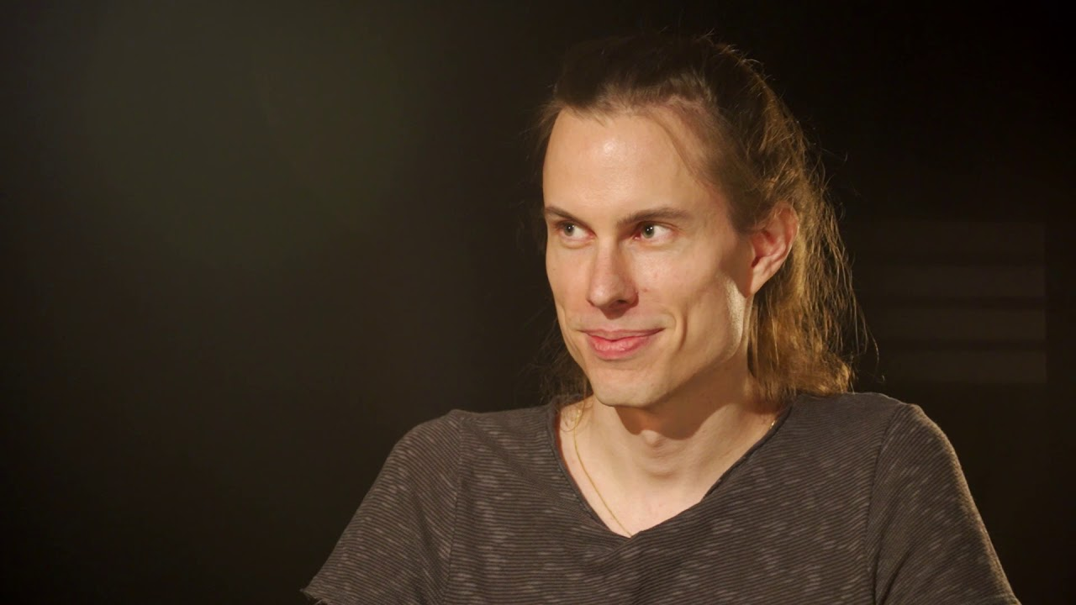
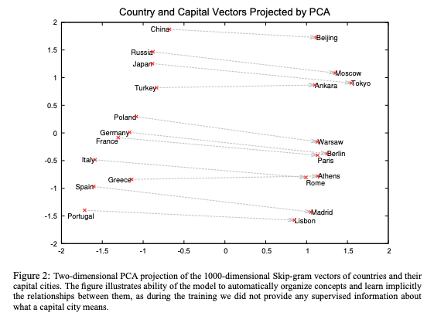
2013:
Tomas Mikolov develops word2vec
[Mikolov, 2013]

Slide 19
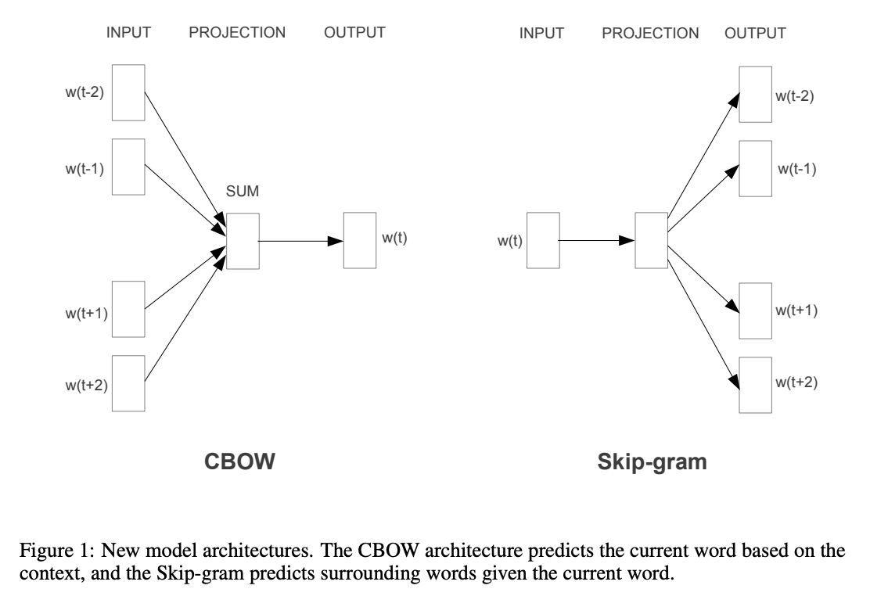
Mikolov’s simplified word2vec tasks

Slide 20
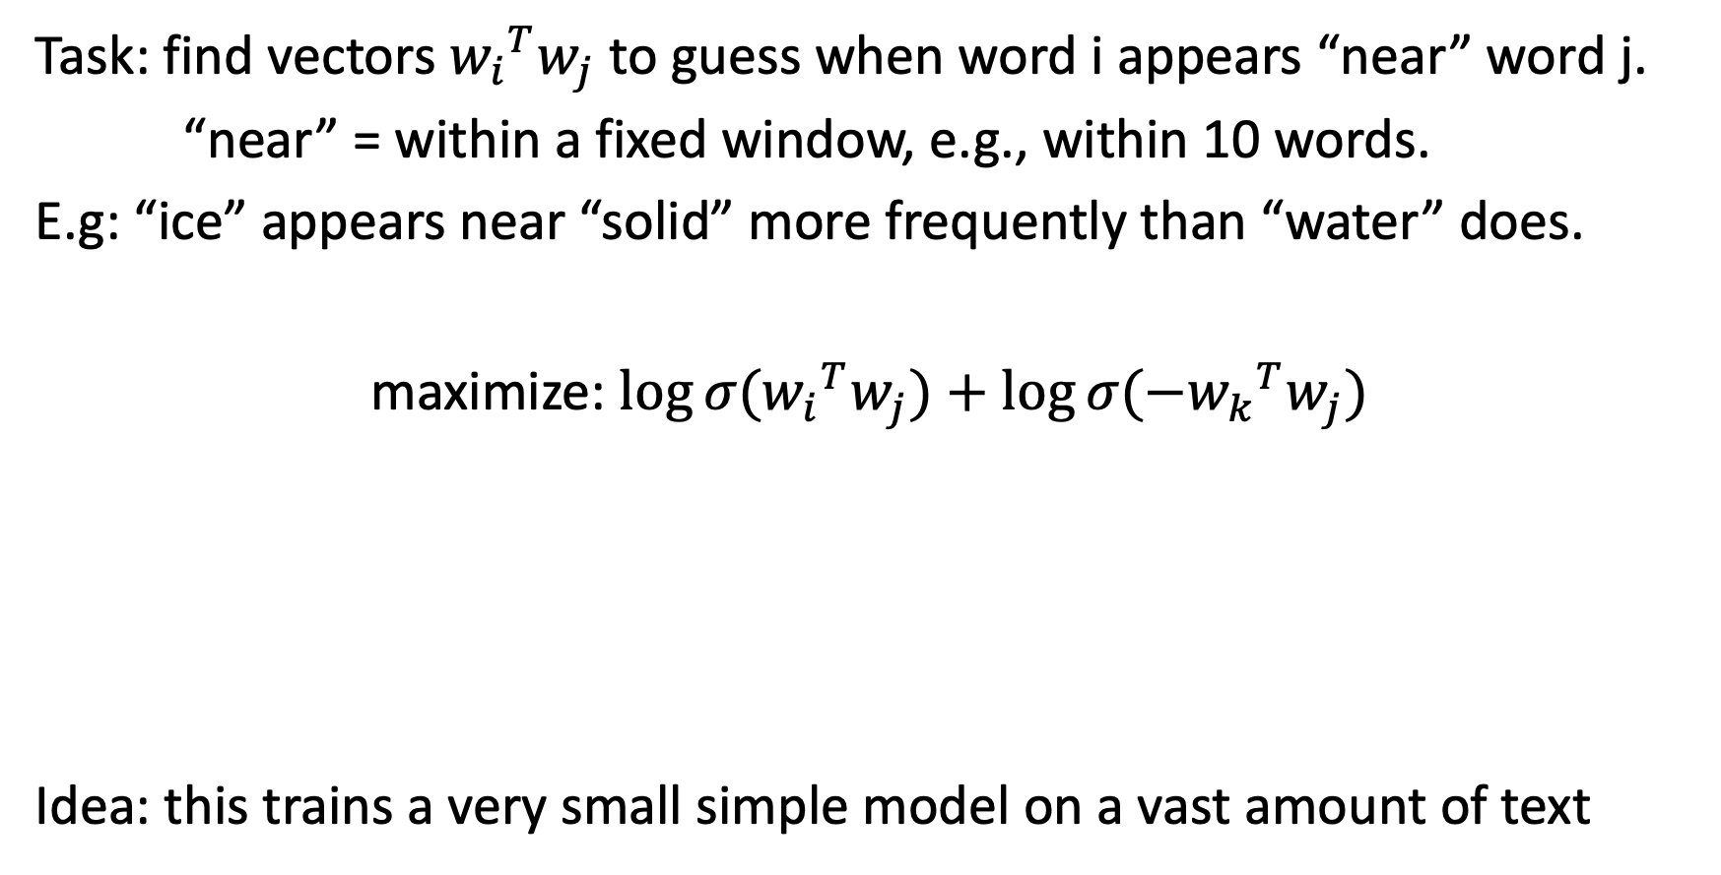
Skip-gram word2vec embeddings
Task: find vectors ${w_{i}}^{T}w_{j}$to guess when word i appears “near” word j.
“near” = within a fixed window, e.g., within 10 words.
E.g: “ice” appears near “solid” more frequently than “water” does.
maximize: $\log{σ({w_{i}}^{T}w_{j})}+\log{σ({{−w}_{k}}^{T}w_{j})}$
Idea: this trains a very small simple model on a vast amount of text
sample i and j near each other
to push this higher
sample random k not near j
to push this lower
[Simplification of Mikolov 2013]

Slide 21
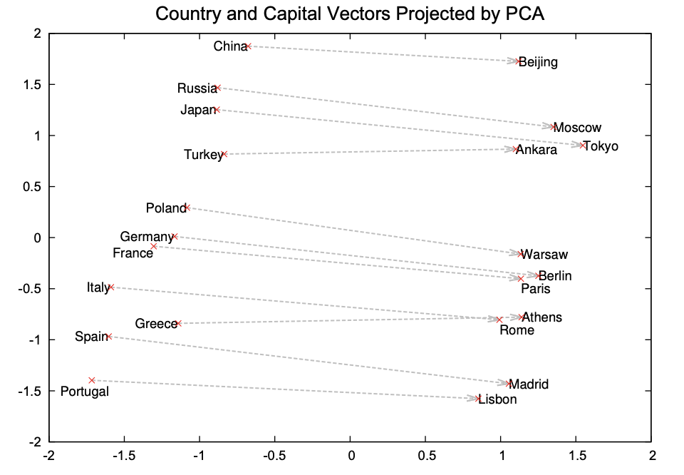
Semantic vector composition
When skip-gram training is done, semantic vector arithmetic emerges:
[Mikolov 2013]

Slide 22
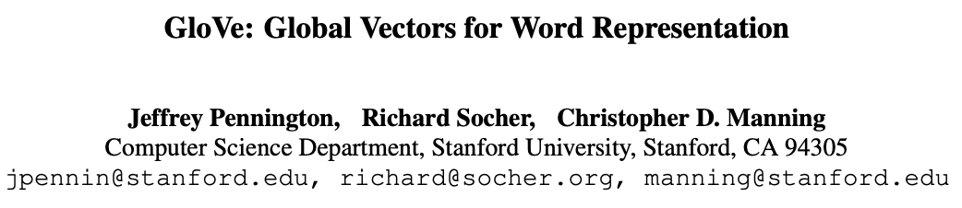
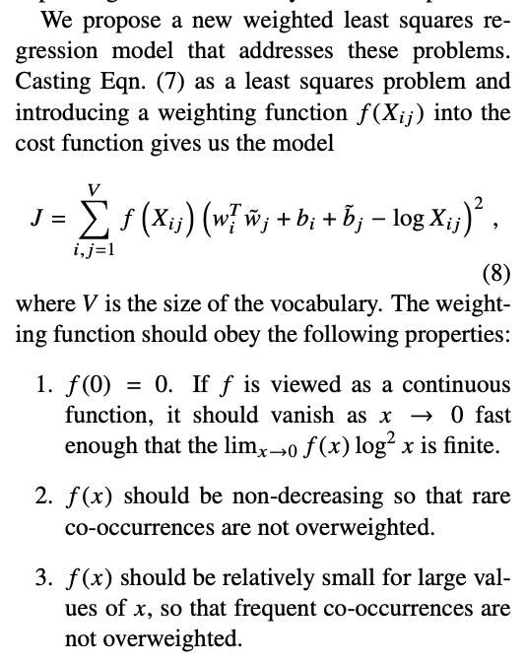
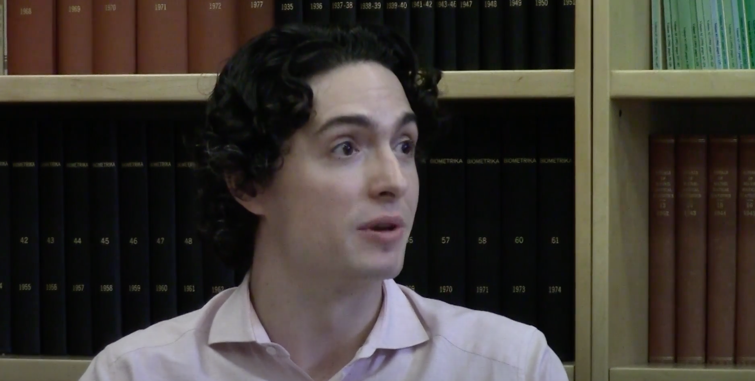
2014:
Jeffrey Pennington
GloVe embeddings
[Pennington, 2014]

Slide 23
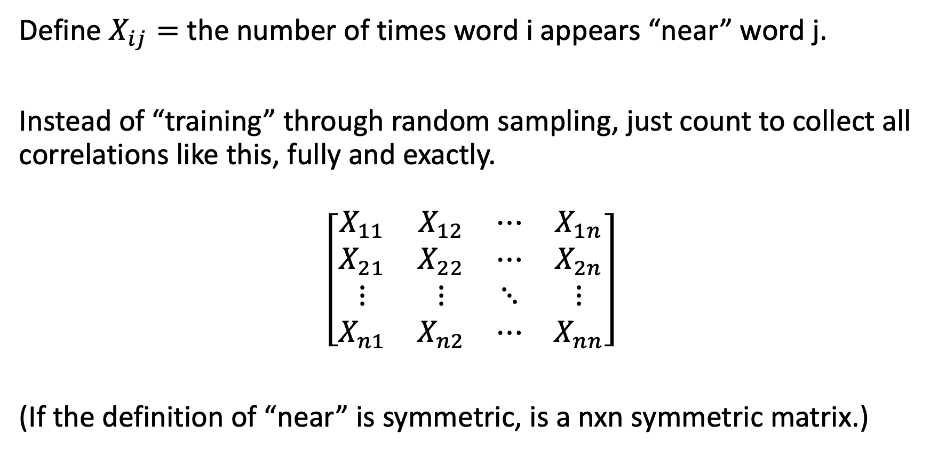
Glove word embeddings: the return of counting
Define $X_{ij}=$ the number of times word i appears “near” word j.
Instead of “training” through random sampling, just count to collect all correlations like this, fully and exactly.
$$\left[\begin{matrix}X_{11} & X_{12} & ⋯ & X_{1n} \\ X_{21} & X_{22} & ⋯ & X_{2n} \\ ⋮ & ⋮ & ⋱ & ⋮ \\ X_{n1} & X_{n2} & ⋯ & X_{nn}\end{matrix}\right]$$
(If the definition of “near” is symmetric, is a nxn symmetric matrix.)

Slide 24
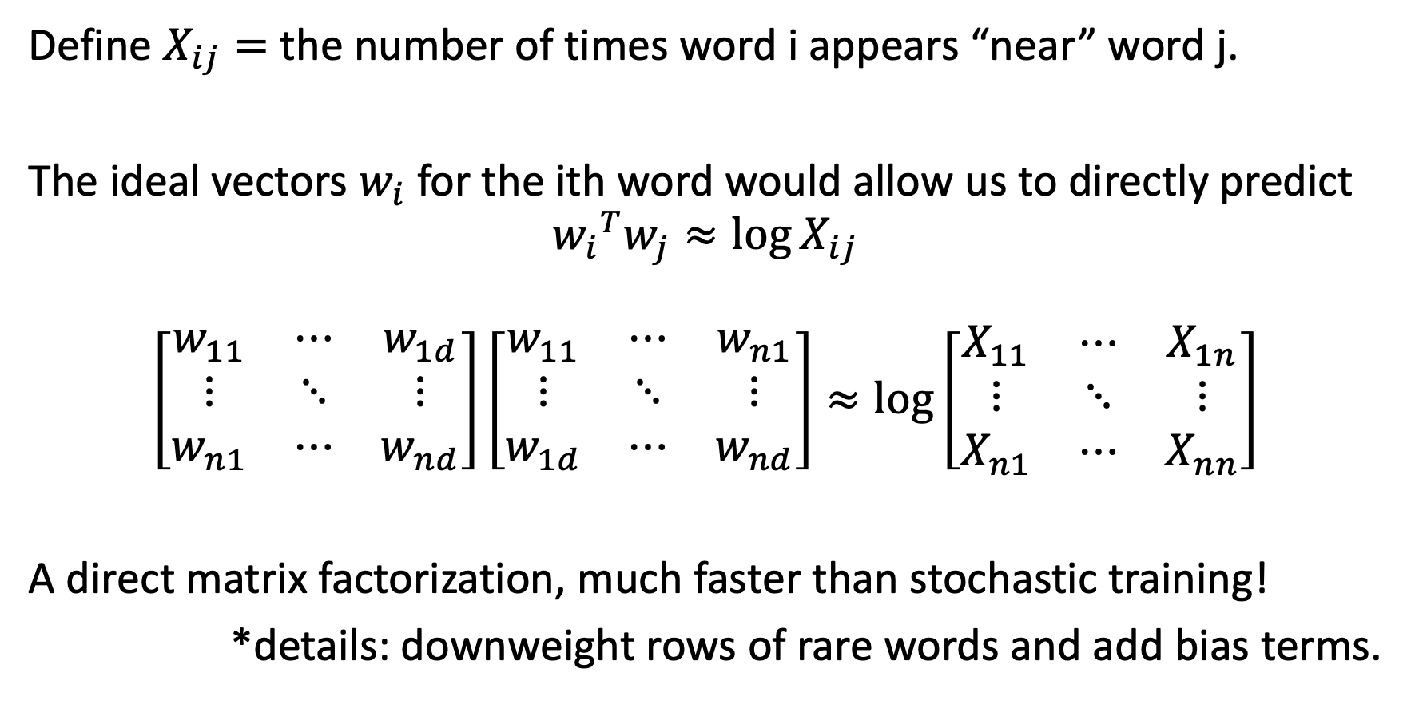
Idea of Glove
Define $X_{ij}=$ the number of times word i appears “near” word j.
The ideal vectors $w_{i}$ for the ith word would allow us to directly predict
$${w_{i}}^{T}w_{j}≈\log{X_{ij}}$$
$$\left[\begin{matrix}w_{11} & ⋯ & w_{1d} \\ ⋮ & ⋱ & ⋮ \\ w_{n1} & ⋯ & w_{nd}\end{matrix}\right]\left[\begin{matrix}w_{11} & ⋯ & w_{n1} \\ ⋮ & ⋱ & ⋮ \\ w_{1d} & ⋯ & w_{nd}\end{matrix}\right]≈\log\left[\begin{matrix}X_{11} & ⋯ & X_{1n} \\ ⋮ & ⋱ & ⋮ \\ X_{n1} & ⋯ & X_{nn}\end{matrix}\right]$$
A direct matrix factorization, much faster than stochastic training!
*details: downweight rows of rare words and add bias terms.
[Simplification of Pennington 2014]

Slide 25
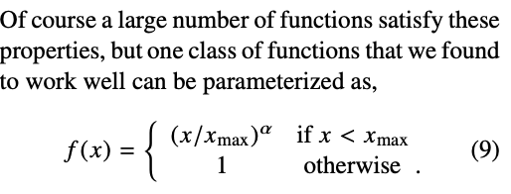
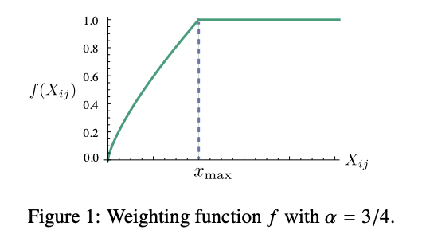
Details of GloVe: discount rare words

Slide 26

Interactive: Use GloVe embedding by hand
https://bit.ly/cs7150-glove

Slide 27
Footnote: a modern perspective on word embedings
Classical neural language models (Elman, etc):
  Just train jointly together with the rest of the neural network.
Then 2012-2019: the pretrained word embedding era
  Pretrain word embeddings on a vast corpus, to train your smaller network
2019-today: back to the classic way
  Entire language models are pretrained on a vast corpus, including embedding

Slide 28
Language Modeling: Feed-forward Neural Net
$$L=CE({\hat{y}}_{t}, y_{t})$$
Output layer
$$\hat{y}=\text{softmax}\left(Wh+b_{2}\right)∈ℝ^{\left|V\right|}$$
$$W$$
Hidden layer
$$h=f(Vx+b_{1})$$
$$V$$
Example input sentence
$$x=[x_{1},x_{2},x_{3}]$$
$$w_{t−3}$$
$$w_{t−2}$$
$$w_{t−1}$$
Concatenated word embeddings
[Slides modified from slides by: Pavlos Protopapas]

Slide 29
Language Modeling : Feed-forward Neural Net
FFNN STRENGTHS COMPARED TO COUNTING?
Can make guesses when we’ve never seen a segment of words.
Storage is bounded (we never store counts)
FFNN ISSUES?
Takes a long time to train because:
Rare words rarely get gradient, so embeddings are hard to learn.
Large window size increases a large number of weights
No concept of time
Requires inputting entire context just to predict one word
✓

Slide 30
Language Modeling
We would like a system that:
Has an “infinite” concept of the past, not just a fixed window
For each new input, output the most likely next event (e.g., word)

Slide 31

Language Modeling
IDEA: for every individual input, output a prediction
Let’s use the previous hidden state, too
went
Output layer
$$\hat{y}=\text{softmax}\left(Wh+b_{2}\right)∈ℝ^{\left|V\right|}$$
$$W$$
Hidden layer
$$h=f(Vx+b_{1})$$
$$V$$
Example input word
$$x=x_{1}$$
He
single word embedding

Slide 32

















Language Modeling: RNNs
Neural Approach #2: Recurrent Neural Network (RNN)
$${\hat{y}}_{1}$$
$${\hat{y}}_{2}$$
$${\hat{y}}_{3}$$
$${\hat{y}}_{4}$$
Output layer
$$W$$
$$W$$
$$W$$
$$W$$
$$U$$
$$U$$
$$U$$
$$U$$
Hidden layer
$$V$$
V
V
V
Input layer
$$x_{1}$$
$$x_{2}$$
$$x_{3}$$
$$x_{4}$$

Slide 33




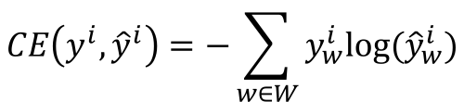












RNN
Training Process
$$CE\left(y^{i},{\hat{y}}^{i}\right)=−\sum_{w∈W}{y_{w}^{i}\text{log}({\hat{y}}_{w}^{i})}$$
Error
$$CE\left(y^{1},{\hat{y}}^{1}\right)$$
$$CE\left(y^{2},{\hat{y}}^{2}\right)$$
$$CE\left(y^{3},{\hat{y}}^{3}\right)$$
$$CE\left(y^{4},{\hat{y}}^{4}\right)$$
$${\hat{y}}_{1}$$
$${\hat{y}}_{2}$$
$${\hat{y}}_{3}$$
$${\hat{y}}_{4}$$
Output layer
$$W$$
$$W$$
$$W$$
$$W$$
$$U$$
$$U$$
$$U$$
Hidden layer
$$V$$
$$V$$
$$V$$
$$V$$
Input layer
$$x_{1}$$
$$x_{2}$$
$$x_{3}$$
$$x_{4}$$
He
went
to
class

Slide 34
RNN
Training Process
$$CE\left(y^{i},{\hat{y}}^{i}\right)=−\sum_{w∈W}{y_{w}^{i}\text{log}({\hat{y}}_{w}^{i})}$$
Error
$$CE\left(y^{1},{\hat{y}}^{1}\right)$$
$$CE\left(y^{2},{\hat{y}}^{2}\right)$$
$$CE\left(y^{3},{\hat{y}}^{3}\right)$$
$$CE\left(y^{4},{\hat{y}}^{4}\right)$$
$${\hat{y}}_{1}$$
$${\hat{y}}_{2}$$
$${\hat{y}}_{3}$$
$${\hat{y}}_{4}$$
Output layer
$$W$$
$$W$$
$$W$$
$$W$$
$$U$$
$$U$$
$$U$$
Hidden layer
$$V$$
$$V$$
$$V$$
$$V$$
Input layer
$$x_{1}$$
$$x_{2}$$
$$x_{3}$$
$$x_{4}$$
She
went
to
class

Slide 35

RNN
Training Process
$$CE\left(y^{i},{\hat{y}}^{i}\right)=−\sum_{w∈W}{y_{w}^{i}\text{log}({\hat{y}}_{w}^{i})}$$
Error
$$CE\left(y^{1},{\hat{y}}^{1}\right)$$
$$CE\left(y^{2},{\hat{y}}^{2}\right)$$
$$CE\left(y^{3},{\hat{y}}^{3}\right)$$
$$CE\left(y^{4},{\hat{y}}^{4}\right)$$
went?
over?
class?
after?
Output layer
$$\hat{y}$$
$$W$$
$$W$$
$$W$$
$$W$$
$$U$$
$$U$$
$$U$$
Hidden layer
$$V$$
$$V$$
$$V$$
$$V$$
Input layer
$$x_{1}$$
$$x_{2}$$
$$x_{3}$$
$$x_{4}$$
She
went
to
class

Slide 36
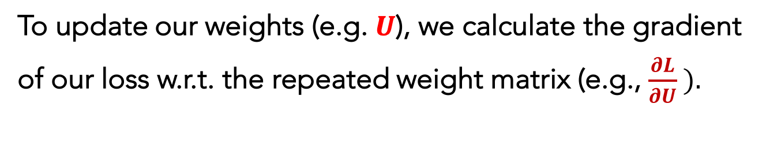
RNN
Training Process
$$CE\left(y^{i},{\hat{y}}^{i}\right)=−\sum_{w∈W}{y_{w}^{i}\text{log}({\hat{y}}_{w}^{i})}$$
To update our weights (e.g. $U$), we calculate the gradient of our loss w.r.t. the repeated weight matrix (e.g., $\frac{∂L}{∂U} ).$
Error
$$CE\left(y^{1},{\hat{y}}^{1}\right)$$
$$CE\left(y^{2},{\hat{y}}^{2}\right)$$
$$CE\left(y^{3},{\hat{y}}^{3}\right)$$
$$CE\left(y^{4},{\hat{y}}^{4}\right)$$
went?
over?
class?
after?
Using the chain rule, we trace the derivative all the way back to the beginning, while summing the results.
Output layer
$$\hat{y}$$
$$W$$
$$W$$
$$W$$
$$W$$
$$U$$
$$U$$
$$U$$
Hidden layer
$$V$$
$$V$$
$$V$$
$$V$$
Input layer
$$x_{1}$$
$$x_{2}$$
$$x_{3}$$
$$x_{4}$$
He
went
to
class

Slide 37
RNN
Training Process
Error
$$CE\left(y^{1},{\hat{y}}^{1}\right)$$
$$CE\left(y^{2},{\hat{y}}^{2}\right)$$
$$CE\left(y^{3},{\hat{y}}^{3}\right)$$
$$CE\left(y^{4},{\hat{y}}^{4}\right)$$
went?
over?
class?
after?
Output layer
$$\hat{y}$$
$$W$$
$$W$$
$$W$$
$$W$$
$$U$$
$$U$$
$$U$$
Hidden layer
$$V$$
$$V$$
$$V$$
$$V$$
Input layer
$$x_{1}$$
$$x_{2}$$
$$x_{3}$$
$$x_{4}$$
He
went
to
class

Slide 38

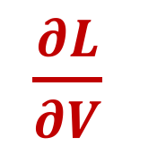
Backpropagation Through Time
$\frac{∂L}{∂V}$
Training Process
Error
$$CE\left(y^{1},{\hat{y}}^{1}\right)$$
$$CE\left(y^{2},{\hat{y}}^{2}\right)$$
$$CE\left(y^{3},{\hat{y}}^{3}\right)$$
$$CE\left(y^{4},{\hat{y}}^{4}\right)$$
went?
over?
class?
after?
Output layer
$$\hat{y}$$
$$W$$
$$W$$
$$W$$
$$W$$
$$U$$
$$U$$
$$U$$
Hidden layer
$$V$$
$$V$$
$$V$$
$$V$$
Input layer
$$x_{1}$$
$$x_{2}$$
$$x_{3}$$
$$x_{4}$$
She
went
to
class

Slide 39
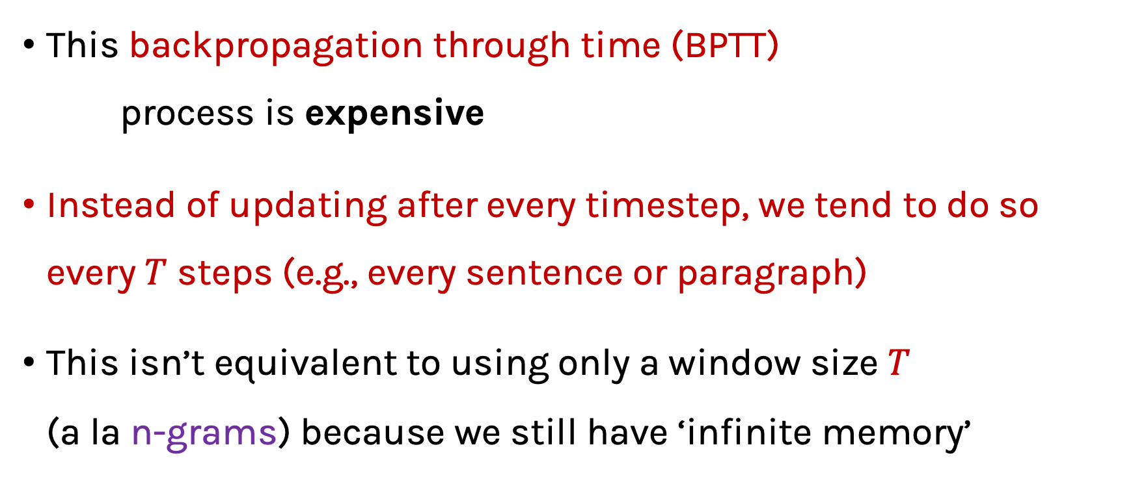
RNN (review)
This backpropagation through time (BPTT)
process is expensive
Instead of updating after every timestep, we tend to do so every $T$ steps (e.g., every sentence or paragraph)
This isn’t equivalent to using only a window size $T$
(a la n-grams) because we still have ‘infinite memory’

Slide 40
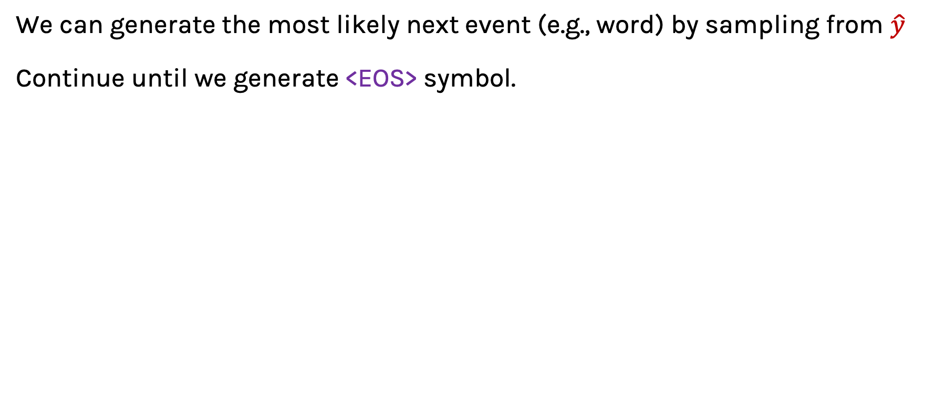
RNN: Generation
We can generate the most likely next event (e.g., word) by sampling from $\hat{y}$
Continue until we generate <EOS> symbol.

Slide 41
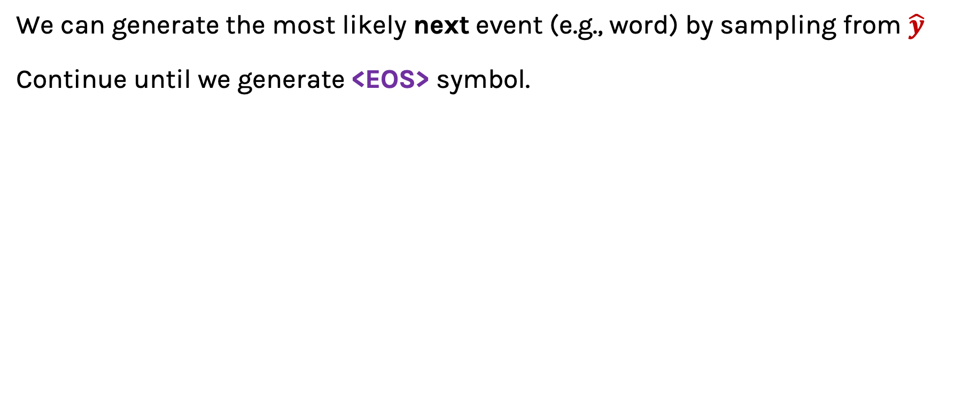
RNN: Generation
We can generate the most likely next event (e.g., word) by sampling from $\hat{y}$
Continue until we generate <EOS> symbol.
“Sorry”
Output layer
$$W$$
Hidden layer
$$V$$
Input layer
$$x_{1}$$
<START>

Slide 42








RNN: Generation
We can generate the most likely next event (e.g., word) by sampling from $\hat{y}$
Continue until we generate <EOS> symbol.
“Sorry”
Harry
shouted
panicking
Output layer
$$W$$
$$W$$
$$W$$
$$W$$
$$U$$
$$U$$
$$U$$
Hidden layer
$$V$$
$$V$$
$$V$$
$$V$$
Input layer
$$x_{1}$$
$$x_{2}$$
$$x_{3}$$
$$x_{4}$$
<START>
“Sorry”
“Harry”
shouted,

Slide 43
RNN: Generation
NOTE: the same input (e.g., “Harry”) can easily yield different outputs, depending on the context (unlike FFNNs and n-grams).
“Sorry”
Harry
shouted
panicking
Output layer
$$W$$
$$W$$
$$W$$
$$W$$
$$U$$
$$U$$
$$U$$
Hidden layer
$$V$$
$$V$$
$$V$$
$$V$$
Input layer
$$x_{1}$$
$$x_{2}$$
$$x_{3}$$
$$x_{4}$$
<START>
“Sorry”
“Harry”
“shouted,”

Slide 44

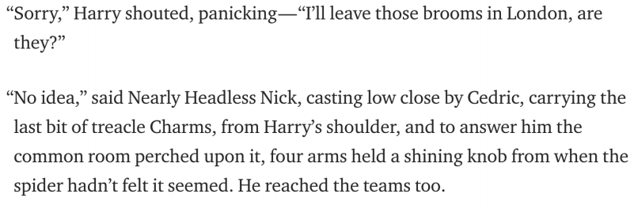
RNN: Generation
When trained on Harry Potter text, it generates:
Source: https://medium.com/deep-writing/harry-potter-written-by-artificial-intelligence-8a9431803da6

Slide 45
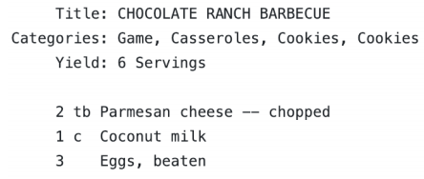
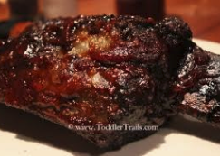
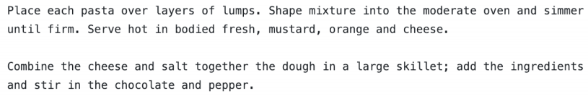
RNN: Generation
When trained on recipes
Source: https://gist.github.com/nylki/1efbaa36635956d35bcc

Slide 46
RNNs: Overview
RNN STRENGTHS?
Can handle infinite-length sequences (not just a fixed-window)
Has a “memory” of the context (thanks to the hidden layer’s recurrent loop)
Same weights used for all inputs, so word order isn’t wonky (like FFNN)
RNN ISSUES?
Slow to train (BPTT)
Due to ”infinite sequence”, gradients can easily vanish or explode
Has trouble actually making use of long-range context

Slide 47









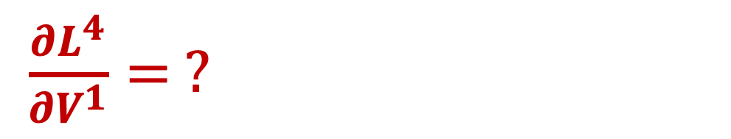








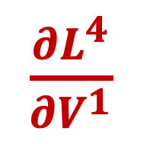

RNNs: Vanishing and Exploding Gradients
$\frac{∂L^{4}}{∂V^{1}}$
$\frac{∂L^{4}}{∂V^{1}}= ?$
$$CE\left(y^{4},{\hat{y}}^{4}\right)$$
$${\hat{y}}^{4}$$
Output layer
$$\hat{y}$$
$$U$$
$$U$$
$$U$$
$$U$$
$$h^{1}$$
$$V^{1}$$
$$h^{2}$$
$$V^{2}$$
$$h^{3}$$
$$V^{3}$$
$$h^{4}$$
Hidden layer
$$W$$
$$W$$
$$W$$
$$W$$
Input layer
She
went
to
class

Slide 48
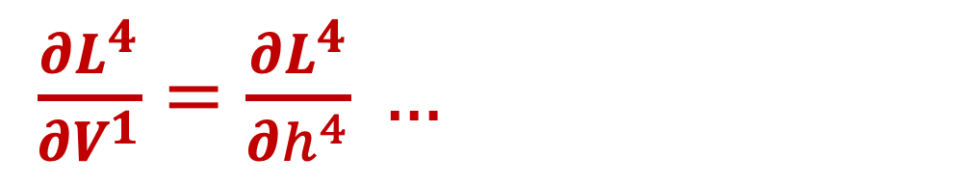

RNNs: Vanishing and Exploding Gradients
$\frac{∂L^{4}}{∂V^{1}}$
$\frac{∂L^{4}}{∂V^{1}}=\frac{∂L^{4}}{∂h^{4}} …$
$$CE\left(y^{4},{\hat{y}}^{4}\right)$$
$${\hat{y}}^{4}$$
Output layer
$$\hat{y}$$
$$U$$
$$U$$
$$U$$
$$U$$
$$h^{1}$$
$$V^{1}$$
$$h^{2}$$
$$V^{2}$$
$$h^{3}$$
$$V^{3}$$
$$h^{4}$$
Hidden layer
$$W$$
$$W$$
$$W$$
$$W$$
Input layer
She
went
to
class

Slide 49
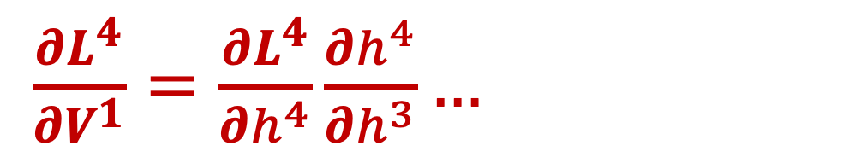
RNNs: Vanishing and Exploding Gradients
$\frac{∂L^{4}}{∂V^{1}}$
$\frac{∂L^{4}}{∂V^{1}}=\frac{∂L^{4}}{∂h^{4}}\frac{∂h^{4}}{∂h^{3}}…$
$$CE\left(y^{4},{\hat{y}}^{4}\right)$$
$${\hat{y}}^{4}$$
Output layer
$$\hat{y}$$
$$U$$
$$U$$
$$U$$
$$U$$
$$h^{1}$$
$$V^{1}$$
$$h^{2}$$
$$V^{2}$$
$$h^{3}$$
$$V^{3}$$
$$h^{4}$$
Hidden layer
$$W$$
$$W$$
$$W$$
$$W$$
Input layer
She
went
to
class

Slide 50
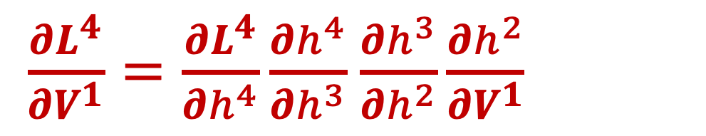
RNNs: Vanishing and Exploding Gradients
$\frac{∂L^{4}}{∂V^{1}}$
$\frac{∂L^{4}}{∂V^{1}}=\frac{∂L^{4}}{∂h^{4}}\frac{∂h^{4}}{∂h^{3}}$ $\frac{∂h^{3}}{∂h^{2}}\frac{∂h^{2}}{∂V^{1}}$
$$CE\left(y^{4},{\hat{y}}^{4}\right)$$
$${\hat{y}}^{4}$$
Output layer
$$\hat{y}$$
$$U$$
$$U$$
$$U$$
$$U$$
$$h^{1}$$
$$V^{1}$$
$$h^{2}$$
$$V^{2}$$
$$h^{3}$$
$$V^{3}$$
$$h^{4}$$
Hidden layer
$$W$$
$$W$$
$$W$$
$$W$$
Input layer
She
went
to
class

Slide 51
RNNs: Vanishing and Exploding Gradients
To address RNNs’ instabilities with long-range context, we will turn to an RNN variant named LSTMs (long short-term memory)
But first, let’s recap what we’ve learned so far

Slide 52






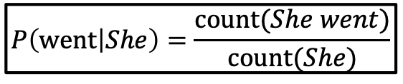








Sequential Modelling (so far)
$${\hat{y}}_{1}$$
$${\hat{y}}_{2}$$
$${\hat{y}}_{3}$$
class
$$U$$
$$U$$
$$V$$
$$U$$
$$V$$
$$U$$
$$P\left(\text{went} | She\right)=\frac{\text{count}(She went)}{\text{count}(She)}$$
$$W$$
$$W$$
$$W$$
$$W$$
She
went
to
She
went
to
n-grams
FFNN
RNN
Kind of robust… almost
Fixed window size
Weirdly handles context positions
No “memory” of past
Handles infinite context
(in theory)
Robust to rare words
Slow
Difficulty with long context
Basic counts; fast
Fixed window size
Sparsity & storage issues
Not robust

Slide 53
Long short-term memory (LSTM)
A type of RNN that is designed to better handle long-range dependencies
In ”vanilla” RNNs, the hidden state is perpetually being rewritten
In addition to a traditional hidden state h, let’s have a dedicated memory cell c for long-term events. More power to relay sequence info.

Slide 54
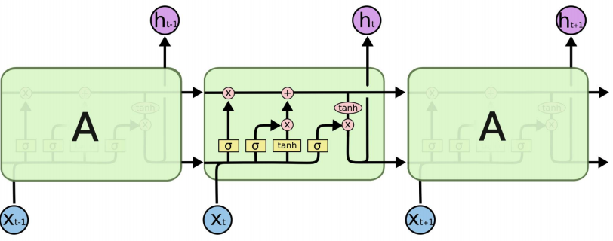
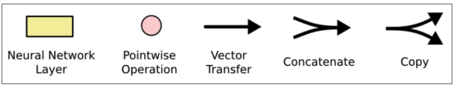






Inside an LSTM Hidden Layer
$$C^{t}$$
$$C^{t+1}$$
$$C^{t−1}$$
$$H^{t−1}$$
$$H^{t}$$
$$H^{t+1}$$
Diagram: https://colah.github.io/posts/2015-08-Understanding-LSTMs/

Slide 55
Inside an LSTM Hidden Layer
some old memories are “forgotten”
$$C^{t}$$
$$C^{t+1}$$
$$C^{t−1}$$
$$H^{t−1}$$
$$H^{t}$$
$$H^{t+1}$$
Diagram: https://colah.github.io/posts/2015-08-Understanding-LSTMs/

Slide 56
Inside an LSTM Hidden Layer
some old memories are “forgotten”
some new memories are made
$$C^{t}$$
$$C^{t+1}$$
$$C^{t−1}$$
$$H^{t−1}$$
$$H^{t}$$
$$H^{t+1}$$
Diagram: https://colah.github.io/posts/2015-08-Understanding-LSTMs/

Slide 57
Inside an LSTM Hidden Layer
some old memories are “forgotten”
some new memories are made
$$C^{t}$$
$$C^{t+1}$$
$$C^{t−1}$$
$$H^{t−1}$$
$$H^{t}$$
$$H^{t+1}$$
a nonlinear weighted version of the long-term memory becomes our short-term memory
Diagram: https://colah.github.io/posts/2015-08-Understanding-LSTMs/

Slide 58
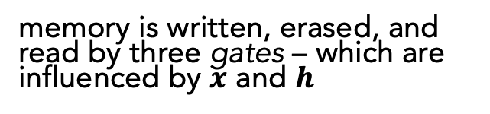
Inside an LSTM Hidden Layer
some old memories are “forgotten”
some new memories are made
$$C^{t}$$
$$C^{t+1}$$
$$C^{t−1}$$
memory is written, erased, and read by three gates – which are influenced by $x$ and $h$
$$H^{t−1}$$
$$H^{t}$$
$$H^{t+1}$$
a nonlinear weighted version of the long-term memory becomes our short-term memory
Diagram: https://colah.github.io/posts/2015-08-Understanding-LSTMs/

Slide 59
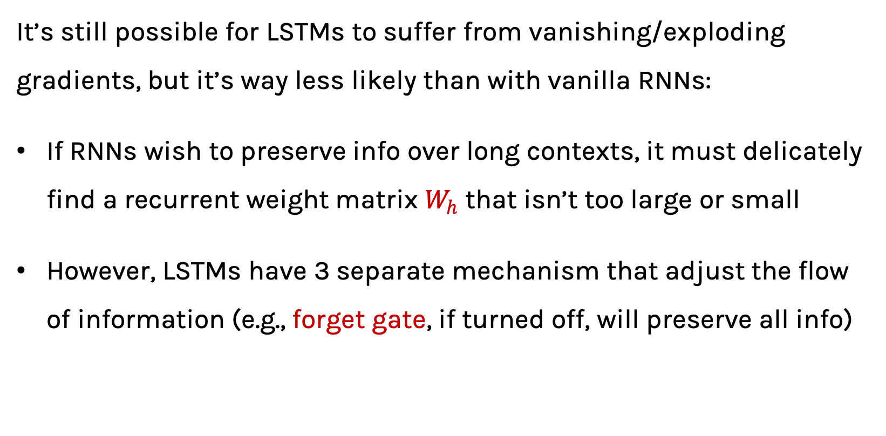
Inside an LSTM Hidden Layer
It’s still possible for LSTMs to suffer from vanishing/exploding gradients, but it’s way less likely than with vanilla RNNs:
If RNNs wish to preserve info over long contexts, it must delicately find a recurrent weight matrix $W_{h}$ that isn’t too large or small
However, LSTMs have 3 separate mechanism that adjust the flow of information (e.g., forget gate, if turned off, will preserve all info)

Slide 60
Long short-term memory (LSTM)
LSTM STRENGTHS?
Almost always outperforms vanilla RNNs
Captures long-range dependencies shockingly well
LSTM ISSUES?
Has more weights to learn than vanilla RNNs; thus,
Requires a moderate amount of training data (otherwise, vanilla RNNs are better)
Can still suffer from vanishing/exploding gradients

Slide 61






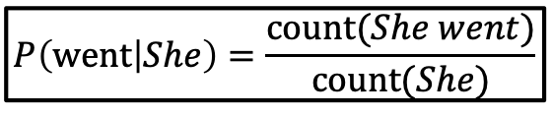










Sequential Modelling
$${\hat{y}}_{1}$$
$${\hat{y}}_{2}$$
$${\hat{y}}_{3}$$
class
$$U$$
$$V$$
$$U$$
$$V$$
$$U$$
$$P\left(\text{went} | She\right)=\frac{\text{count}(She went)}{\text{count}(She)}$$
$$U$$
$$W$$
$$W$$
$$W$$
$$W$$
She
went
to
She
went
to
n-grams
FFNN
RNN
$${\hat{y}}_{1}$$
$${\hat{y}}_{2}$$
$${\hat{y}}_{3}$$
She
went
to
LSTM

Slide 62
Sequential Modeling
IMPORTANT
If your goal isn’t to predict the next item in a sequence, and you rather do some other classification or regression task using the sequence, then you can:
Train an aforementioned model (e.g., LSTM) as a language model
Use the hidden layers that correspond to each item in your sequence

Slide 63























Sequential Modeling
1. Train LM to learn hidden layer embeddings
2. Use hidden layer embeddings for other tasks
$${\hat{y}}_{1}$$
$${\hat{y}}_{2}$$
$${\hat{y}}_{3}$$
$${\hat{y}}_{4}$$
Sentiment score
Output layer
$$W$$
$$W$$
$$W$$
$$W$$
$$U$$
$$U$$
$$U$$
Hidden layer
$$V$$
$$V$$
$$V$$
$$V$$
Input layer
$$x_{1}$$
$$x_{2}$$
$$x_{3}$$
$$x_{4}$$
$$x_{1}$$
$$x_{2}$$
$$x_{3}$$
$$x_{4}$$

Slide 64













Sequential Modeling
Or jointly learn hidden embeddings toward a particular task (end-to-end)
Output layer
Sentiment score
Hidden layer 2
$$W$$
$$W$$
$$W$$
$$W$$
Hidden layer 1
$$U$$
$$U$$
$$U$$
$$V$$
$$V$$
$$V$$
$$V$$
Input layer
$$x_{1}$$
$$x_{2}$$
$$x_{3}$$
$$x_{4}$$

Slide 65
You now have the foundation for modelling sequential data.
Most state-of-the-art advances are based on those core RNN/LSTM ideas. But, with tens of thousands of researchers and hackers exploring deep learning, there are many tweaks that haven proven useful.
(This is where things get crazy.)

Slide 66
Bi-directional (review)
RNNs/LSTMs use the left-to-right context and sequentially process data.
If you have full access to the data at testing time, why not make use of the flow of information from right-to-left, also?
Notes:
CAN”T BE CONCERNED WITH LM

Slide 67








RNN Extensions: Bi-directional LSTMs (review)
For brevity, let’s use the follow schematic to represent an RNN
$$h_{1}^{L}$$
$$h_{2}^{L}$$
$$h_{3}^{L}$$
$$h_{4}^{L}$$
Hidden layer
Input layer
$$x_{1}$$
$$x_{2}$$
$$x_{3}$$
$$x_{4}$$

Slide 68







RNN Extensions: Bi-directional LSTMs (review)
$$h_{1}^{L}$$
$$h_{2}^{L}$$
$$h_{3}^{L}$$
$$h_{4}^{L}$$
$$h_{1}^{R}$$
$$h_{2}^{R}$$
$$h_{3}^{R}$$
$$h_{4}^{R}$$
Hidden layer
Input layer
$$x_{1}$$
$$x_{2}$$
$$x_{3}$$
$$x_{4}$$
$$x_{1}$$
$$x_{2}$$
$$x_{3}$$
$$x_{4}$$

Slide 69





RNN Extensions: Bi-directional LSTMs (review)
$$h_{1}^{R}$$
$$h_{2}^{R}$$
$$h_{3}^{R}$$
$$h_{4}^{R}$$
Concatenate the hidden layers
$$h_{1}^{L}$$
$$h_{2}^{L}$$
$$h_{3}^{L}$$
$$h_{4}^{L}$$
$$h_{1}^{L}$$
$$h_{2}^{L}$$
$$h_{3}^{L}$$
$$h_{4}^{L}$$
$$h_{1}^{R}$$
$$h_{2}^{R}$$
$$h_{3}^{R}$$
$$h_{4}^{R}$$
Hidden layer
Input layer
$$x_{1}$$
$$x_{2}$$
$$x_{3}$$
$$x_{4}$$
$$x_{1}$$
$$x_{2}$$
$$x_{3}$$
$$x_{4}$$

Slide 70




RNN Extensions: Bi-directional LSTMs (review)
Output layer
$${\hat{y}}_{1}$$
$${\hat{y}}_{2}$$
$${\hat{y}}_{3}$$
$${\hat{y}}_{4}$$
$$h_{1}^{R}$$
$$h_{2}^{R}$$
$$h_{3}^{R}$$
$$h_{4}^{R}$$
Concatenate the hidden layers
$$h_{1}^{L}$$
$$h_{2}^{L}$$
$$h_{3}^{L}$$
$$h_{4}^{L}$$
$$h_{1}^{L}$$
$$h_{2}^{L}$$
$$h_{3}^{L}$$
$$h_{4}^{L}$$
$$h_{1}^{R}$$
$$h_{2}^{R}$$
$$h_{3}^{R}$$
$$h_{4}^{R}$$
Hidden layer
Input layer
$$x_{1}$$
$$x_{2}$$
$$x_{3}$$
$$x_{4}$$
$$x_{1}$$
$$x_{2}$$
$$x_{3}$$
$$x_{4}$$

Slide 71
RNN Extensions: Bi-directional LSTMs (review)
BI-LSTM STRENGTHS?
Usually performs at least as well as uni-directional RNNs/LSTMs
BI-LSTM ISSUES?
Slower to train
Only possible if access to full data is allowed
Notes:
CAN”T BE CONCERNED WITH LM

Slide 72
Deep RNN (review)
LSTMs units can be arranged in layers, so that the output of each unit is the input to the other units. This is called a deep RNN, where the adjective “deep” refers to these multiple layers.
Each layer feeds the LSTM on the next layer
First time step of a feature is fed to the first LSTM, which processes that data and produces an output (and a new state for itself).
That output is fed to the next LSTM, which does the same thing, and the next, and so on.
Then the second time step arrives at the first LSTM, and the process repeats.

Slide 73

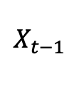
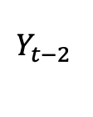

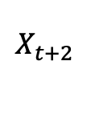
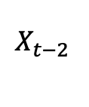

Deep RNN (review)
$$Y_{ }$$
$$Y_{t−2 }$$
$$Y_{t−1 }$$
$$Y_{t }$$
$$Y_{t+1 }$$
$$Y_{t+2 }$$
$$X_{ }$$
$$X_{t−2 }$$
$$X_{t−1 }$$
$$X_{t }$$
$$X_{t+1 }$$
$$X_{t+2 }$$

Slide 74




Deep RNN (review)
Hidden layers provide an abstraction (holds “meaning”).
Stacking hidden layers provides increased abstractions.
Hidden layer #1
$$h_{1}^{L}$$
$$h_{2}^{L}$$
$$h_{3}^{L}$$
$$h_{4}^{L}$$
Input layer
$$x_{1}$$
$$x_{2}$$
$$x_{3}$$
$$x_{4}$$

Slide 75




Deep RNN (review)
Hidden layers provide an abstraction (holds “meaning”).
Stacking hidden layers provides increased abstractions.
Hidden layer #2
$$h_{1}^{L2}$$
$$h_{2}^{L2}$$
$$h_{3}^{L2}$$
$$h_{4}^{L2}$$
Hidden layer #1
$$h_{1}^{L}$$
$$h_{2}^{L}$$
$$h_{3}^{L}$$
$$h_{4}^{L}$$
Input layer
$$x_{1}$$
$$x_{2}$$
$$x_{3}$$
$$x_{4}$$

Slide 76




Deep RNN (review)
Output layer
$${\hat{y}}_{1}$$
$${\hat{y}}_{2}$$
$${\hat{y}}_{3}$$
$${\hat{y}}_{4}$$
Hidden layers provide an abstraction (holds “meaning”).
Stacking hidden layers provides increased abstractions.
Hidden layer #2
$$h_{1}^{L2}$$
$$h_{2}^{L2}$$
$$h_{3}^{L2}$$
$$h_{4}^{L2}$$
Hidden layer #1
$$h_{1}^{L}$$
$$h_{2}^{L}$$
$$h_{3}^{L}$$
$$h_{4}^{L}$$
Input layer
$$x_{1}$$
$$x_{2}$$
$$x_{3}$$
$$x_{4}$$

Slide 77
Outline
NLP Tasks
Transfer Learning in NLP
Language Modelling, n-grams
Word Embeddings (character embeddings)
Neural Networks LM:
FFNN, RNNs/LSTMs +ELMo
Seq2Seq
Notes:
As a reminder, this is where we are.

Slide 78
ELMo: Stacked Bi-directional LSTMs
General Idea:
Goal is to get highly rich embeddings for each word (unique type)
Use both directions of context (bi-directional), with increasing abstractions (stacked)
Linearly combine all abstract representations (hidden layers) and optimize w.r.t. a particular task (e.g., sentiment classification)
ELMo Slides: https://www.slideshare.net/shuntaroy/a-review-of-deep-contextualized-word-representations-peters-2018

Slide 79
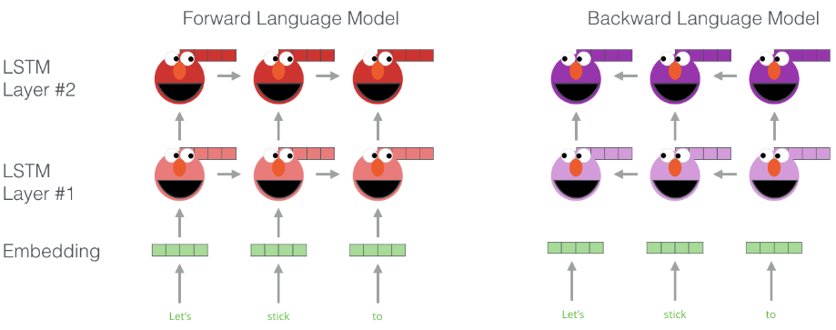
ELMo: Stacked Bi-directional LSTMs
Illustration: http://jalammar.github.io/illustrated-bert/

Slide 80
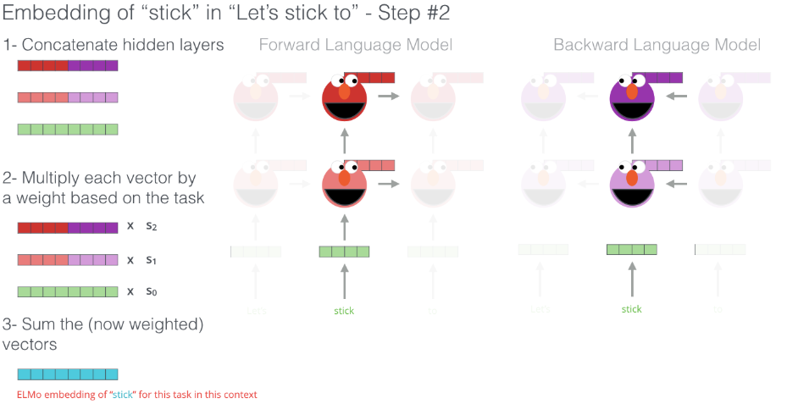
Illustration: http://jalammar.github.io/illustrated-bert/

Slide 81
ELMo: Stacked Bi-directional LSTMs
ELMo yields incredibly good word embeddings, which yields state-of-the-art results when applied to many NLP tasks.
Main ELMo takeaway: ELMo does not give you a matrix embedding as with Word2Vec, but a trained bidirectional LSTM to be used with the task.

Slide 82
REFLECTION
So far, for all of our sequential modelling, we have been concerned with emitting 1 output per input datum.
Sometimes, a sequence is the smallest granularity we care about though (e.g., an English sentence)

Slide 83
Outline
NLP Tasks
Transfer Learning in NLP
Language Modelling, n-grams
Word Embeddings (character embeddings)
Neural Networks LM:
FFNN, RNNs/LSTMs +ELMo
Seq2Seq
Notes:
As a reminder, this is where we are.

Slide 85
Sequence-to-Sequence (seq2seq)
If our input is a sentence in Language A, and we wish to translate it to Language B, it is clearly sub-optimal to translate word by word (like our current models are suited to do).
Instead, let a sequence of tokens be the unit that we ultimately wish to work with (a sequence of length N may emit a sequences of length M)
Seq2seq models are comprised of 2 RNNs: 1 encoder, 1 decoder

Slide 86




Sequence-to-Sequence (seq2seq)
$$h_{1}^{E}$$
$$h_{2}^{E}$$
$$h_{3}^{E}$$
$$h_{4}^{E}$$
Hidden layer
Input layer
The
brown
dog
ran
ENCODER RNN

Slide 87
Sequence-to-Sequence (seq2seq)
The final hidden state of the encoder RNN is the initial state of the decoder RNN
$$h_{1}^{E}$$
$$h_{2}^{E}$$
$$h_{3}^{E}$$
$$h_{4}^{E}$$
Hidden layer
Input layer
The
brown
dog
ran
ENCODER RNN

Slide 88

Sequence-to-Sequence (seq2seq)
The final hidden state of the encoder RNN is the initial state of the decoder RNN
$$h_{1}^{E}$$
$$h_{2}^{E}$$
$$h_{3}^{E}$$
$$h_{4}^{E}$$
$$h_{1}^{D}$$
Hidden layer
Input layer
The
brown
dog
ran
<s>
ENCODER RNN
DECODER RNN

Slide 89
Sequence-to-Sequence (seq2seq)
The final hidden state of the encoder RNN is the initial state of the decoder RNN
El
$$h_{1}^{E}$$
$$h_{2}^{E}$$
$$h_{3}^{E}$$
$$h_{4}^{E}$$
$$h_{1}^{D}$$
Hidden layer
Input layer
The
brown
dog
ran
<s>
ENCODER RNN
DECODER RNN

Slide 90

Sequence-to-Sequence (seq2seq)
The final hidden state of the encoder RNN is the initial state of the decoder RNN
El
$$h_{1}^{E}$$
$$h_{2}^{E}$$
$$h_{3}^{E}$$
$$h_{4}^{E}$$
$$h_{1}^{D}$$
$$h_{2}^{D}$$
Hidden layer
Input layer
The
brown
dog
ran
<s>
El
ENCODER RNN
DECODER RNN

Slide 91
Sequence-to-Sequence (seq2seq)
The final hidden state of the encoder RNN is the initial state of the decoder RNN
El
perro
$$h_{1}^{E}$$
$$h_{2}^{E}$$
$$h_{3}^{E}$$
$$h_{4}^{E}$$
$$h_{1}^{D}$$
$$h_{2}^{D}$$
Hidden layer
Input layer
The
brown
dog
ran
<s>
El
ENCODER RNN
DECODER RNN

Slide 92

Sequence-to-Sequence (seq2seq)
The final hidden state of the encoder RNN is the initial state of the decoder RNN
El
perro
$$h_{1}^{E}$$
$$h_{2}^{E}$$
$$h_{3}^{E}$$
$$h_{4}^{E}$$
$$h_{1}^{D}$$
$$h_{2}^{D}$$
$$h_{3}^{D}$$
Hidden layer
Input layer
The
brown
dog
ran
<s>
El
perro
ENCODER RNN
DECODER RNN

Slide 93
Sequence-to-Sequence (seq2seq)
The final hidden state of the encoder RNN is the initial state of the decoder RNN
El
perro
marrón
$$h_{1}^{E}$$
$$h_{2}^{E}$$
$$h_{3}^{E}$$
$$h_{4}^{E}$$
$$h_{1}^{D}$$
$$h_{2}^{D}$$
$$h_{3}^{D}$$
Hidden layer
Input layer
The
brown
dog
ran
<s>
El
perro
ENCODER RNN
DECODER RNN

Slide 94

Sequence-to-Sequence (seq2seq)
The final hidden state of the encoder RNN is the initial state of the decoder RNN
El
perro
marrón
$$h_{1}^{E}$$
$$h_{2}^{E}$$
$$h_{3}^{E}$$
$$h_{4}^{E}$$
$$h_{1}^{D}$$
$$h_{2}^{D}$$
$$h_{3}^{D}$$
$$h_{4}^{D}$$
Hidden layer
Input layer
The
brown
dog
ran
<s>
El
perro
marrón
ENCODER RNN
DECODER RNN

Slide 95
Sequence-to-Sequence (seq2seq)
The final hidden state of the encoder RNN is the initial state of the decoder RNN
El
perro
marrón
corrio
$$h_{1}^{E}$$
$$h_{2}^{E}$$
$$h_{3}^{E}$$
$$h_{4}^{E}$$
$$h_{1}^{D}$$
$$h_{2}^{D}$$
$$h_{3}^{D}$$
$$h_{4}^{D}$$
Hidden layer
Input layer
The
brown
dog
ran
<s>
El
perro
marron
ENCODER RNN
DECODER RNN

Slide 96

Sequence-to-Sequence (seq2seq)
The final hidden state of the decoder RNN is </s>
El
perro
marrón
corrio
</s>
$$h_{1}^{E}$$
$$h_{2}^{E}$$
$$h_{3}^{E}$$
$$h_{4}^{E}$$
$$h_{1}^{D}$$
$$h_{2}^{D}$$
$$h_{3}^{D}$$
$$h_{4}^{D}$$
$$h_{5}^{D}$$
Hidden layer
Input layer
The
brown
dog
ran
<s>
El
perro
marron
corrio
ENCODER RNN
DECODER RNN

Slide 97





Sequence-to-Sequence (seq2seq)
Training occurs like RNNs typically do.
$${\hat{y}}_{1}$$
$${\hat{y}}_{2}$$
$${\hat{y}}_{3}$$
$${\hat{y}}_{4}$$
$${\hat{y}}_{5}$$
$$h_{1}^{E}$$
$$h_{2}^{E}$$
$$h_{3}^{E}$$
$$h_{4}^{E}$$
$$h_{1}^{D}$$
$$h_{2}^{D}$$
$$h_{3}^{D}$$
$$h_{4}^{D}$$
$$h_{5}^{D}$$
Hidden layer
Input layer
The
brown
dog
ran
<s>
El
perro
marron
corrio
ENCODER RNN
DECODER RNN

Slide 98















Sequence-to-Sequence (seq2seq)
Training occurs like RNNs typically do. Decoder generates outputs one word at a time, until we generate a </S> token. Each decoder’s ${\hat{y}}_{i}$ becomes the input $x_{i+1}$
$${\hat{y}}_{1}$$
$${\hat{y}}_{2}$$
$${\hat{y}}_{3}$$
$${\hat{y}}_{4}$$
$${\hat{y}}_{5}$$
$$h_{1}^{E}$$
$$h_{2}^{E}$$
$$h_{3}^{E}$$
$$h_{4}^{E}$$
$$h_{1}^{D}$$
$$h_{2}^{D}$$
$$h_{3}^{D}$$
$$h_{4}^{D}$$
$$h_{5}^{D}$$
Hidden layer
Input layer
The
brown
dog
ran
<s>
El
perro
marron
corrio
ENCODER RNN
DECODER RNN

Slide 99
Sequence-to-Sequence (seq2seq)
Training occurs like RNNs typically do; the loss (from the decoder outputs) is calculated, and we update weights all the way to the beginning (encoder)
$${\hat{y}}_{1}$$
$${\hat{y}}_{2}$$
$${\hat{y}}_{3}$$
$${\hat{y}}_{4}$$
$${\hat{y}}_{5}$$
$$h_{1}^{E}$$
$$h_{2}^{E}$$
$$h_{3}^{E}$$
$$h_{4}^{E}$$
$$h_{1}^{D}$$
$$h_{2}^{D}$$
$$h_{3}^{D}$$
$$h_{4}^{D}$$
$$h_{5}^{D}$$
Hidden layer
Input layer
The
brown
dog
ran
<s>
El
perro
marron
corrio
ENCODER RNN
DECODER RNN

Slide 100




Sequence-to-Sequence (seq2seq)
Generation: During actual translation, the output of time t becomes the input for time t+1.
$${\hat{y}}_{1}$$
$${\hat{y}}_{2}$$
$${\hat{y}}_{3}$$
$${\hat{y}}_{4}$$
$${\hat{y}}_{5}$$
$$h_{1}^{E}$$
$$h_{2}^{E}$$
$$h_{3}^{E}$$
$$h_{4}^{E}$$
$$h_{1}^{D}$$
$$h_{2}^{D}$$
$$h_{3}^{D}$$
$$h_{4}^{D}$$
$$h_{5}^{D}$$
Hidden layer
Input layer
The
brown
dog
ran
<s>
$${\hat{y}}_{1}$$
$${\hat{y}}_{2}$$
$${\hat{y}}_{3}$$
$${\hat{y}}_{4}$$
ENCODER RNN
DECODER RNN

