Slide 1

CS 7150
Deep Learning

Slide 2
Review

Slide 3
Topics
Equivariance
Convolutions
  Receptive field
Backprop:
  memory O()
  autograd API
Autoencoders
Other requests?

Slide 4
Syllabus topics
Starred items * might be on the midterm The historical and intellectual evolution of deep network methods: McCulloch-Pitts' Networks vs Turing’s Machines* Rosenblatt’s Perceptron Learning vs Minsky’s Perceptron Limitations* From Leibniz’ Chain Rule to Rumelhart-Hinton’s Backpropagation* Lettvin’s Grandmother Neuron idea vs Hinton’s Parallel Distributed Processing Model* Hinton-Salakhutdinov’s Layerwise Pretraining vs Glorot-Bengio’s End-to-End Training* From LeCun’s LeNet to Krizhevsky’s AlexNet* From Ellman’s Structure in Time to GPT-3 Few-Shot Learning How to use deep network tools (pytorch) GPU tensors* Autograd / backpropagation* SGD and Adam and other optimizers* Network modules* Fast data loading* Using pretrained models* How to train a model deeper than a few layers The backpropagation algorithm** Vanishing and exploding gradient* Xavier or Kaiming initialization* ReLU vs Sigmoid vs Threshold nonlinearities* Residual connections* Batch normalization* How to improve generalization Holdout tests* L2 weight decay*, L1 regularization* Dropout* Early stopping* Data augmentation* Denoising* Weight sharing, invariants and equivariances* Double-descent Learning to Learn Metalearning Prompting | How to design effective objectives Softmax and classification objectives* Cross-Entropy loss, KL divergence, and distribution-matching* Autoencoders*, Denoising Autoencoders* L2 reconstruction loss and L1 median-finding loss* Contrastive learning Variational Autoencoders Diffusion Models How to input images Convolutional Layers* Pooling* AlexNet, VGG, and ResNet* How to output images U-Nets* Perceptual losses Generative Adversarial Networks How to understand and visualize a convolutional network Adversarial examples Gradient visualizations Saliency maps Feature visualizations and dissection How to input and output text Word embedding Recurrent networks Language models Attention and Transformers BERT, GPT, and T5 How to understand and visualize a language model Probability visualization Attention visualization Probing classifiers Logit lens, Causal traces What makes a good representation Semantic vector composition Disentanglement Transfer learning

Slide 5
1. Equivariance vs invariance
Equivariant features: Replicated features do not make the neural activities invariant to translation. The activities are equivariant.
Invariant knowledge: information that does not change at all under the symmetry.
representation by active neurons
translated representation
translated image
image

Slide 6
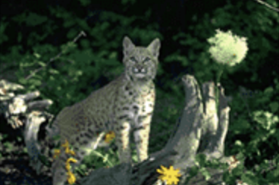

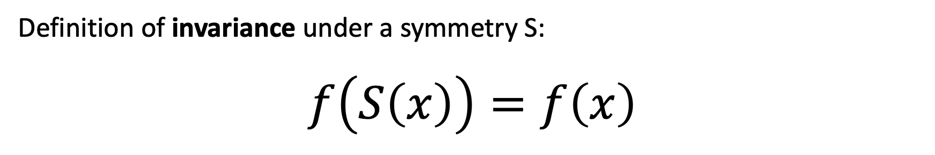


Definition of invariance
Definition of invariance under a symmetry S:
$$f\left(S\left(x\right)\right)=f\left(x\right)$$
$$S$$
translation
$$f$$
$$f$$
“cat”

Slide 7
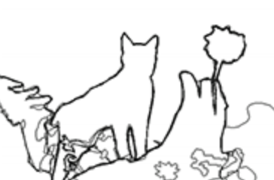

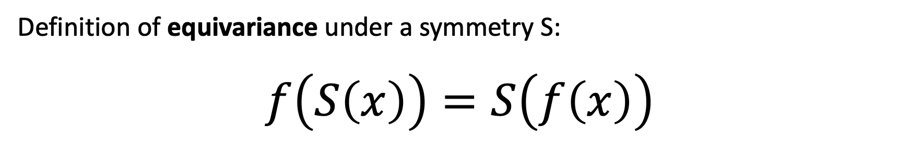
Definition of equivariance
Definition of equivariance under a symmetry S:
$$f\left(S\left(x\right)\right)=S\left(f\left(x\right)\right)$$
$$S$$
translation
$$f$$
$$f$$
$$S$$
translation

Slide 8
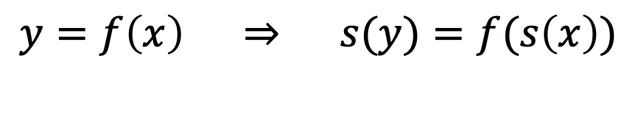
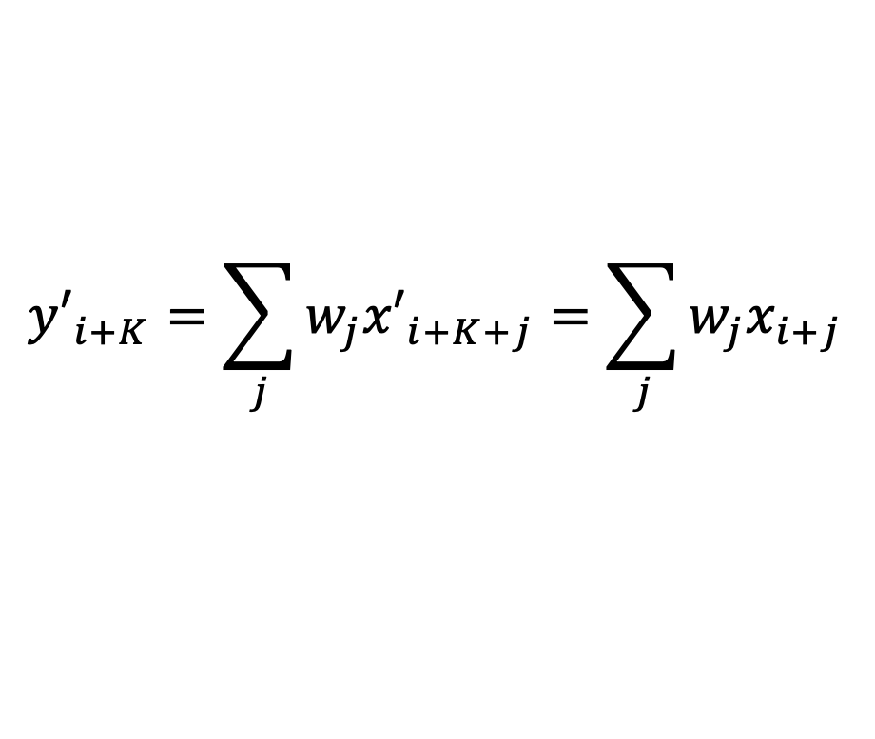
Are convolutions perfectly equivariant under translation?
Can we prove it mathematically?
Then if so, what makes the experiment fail?
$${y′}_{i+K}=\sum_{j}{w_{j}{x′}_{i+K+j}}=\sum_{j}{w_{j}x_{i+j}}$$
$$y=f\left(x\right) ⇒ s(y)=f(s\left(x\right))$$

Slide 9
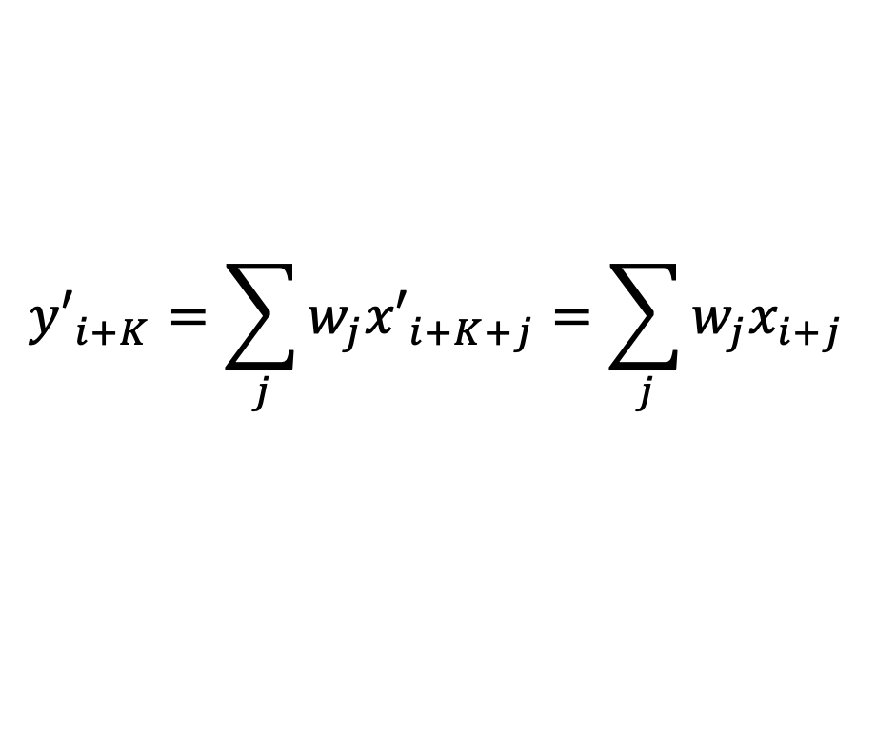



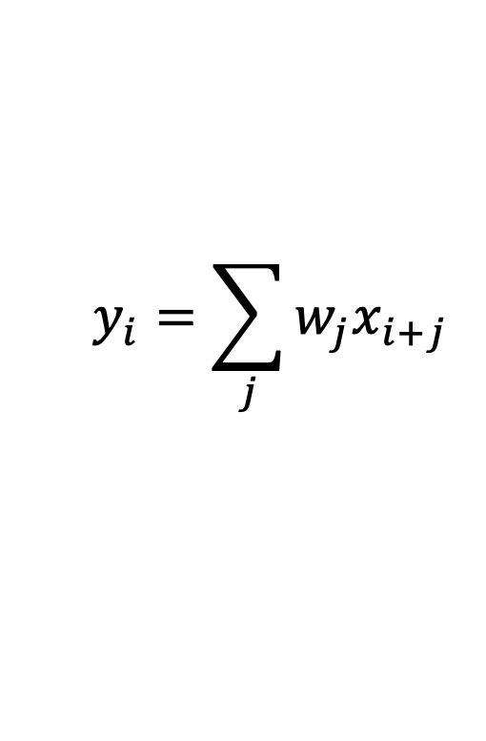


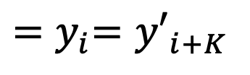
Proving translation equivariance
$$x_{i−1}$$
$$x_{i}$$
$$x_{i+1}$$
0
0
0
0
0
0
1
2
1
0
1
1
0
0
0
0
0
0
0
0
weighted
sum
$$y_{i}=\sum_{j}{w_{j}x_{i+j}}$$
-0.5
+1.0
-0.5
0.0
0.0
0.0
0.0
0.0
-0.5
0.0
+1.0
0.0
-1.0
+0.5
+0.5
-0.5
0.0
0.0
0.0
0.0
0.0
0.0
0.0
$$y_{i}$$
$${y′}_{i+K}=\sum_{j}{w_{j}{x′}_{i+K+j}}=\sum_{j}{w_{j}x_{i+j}}$$
$${x′}_{i+K}=x_{i}$$
$${=y}_{i}={y′}_{i+K}$$
translate the input...
gives weighted sums of shifted data...
translates output!

Slide 10

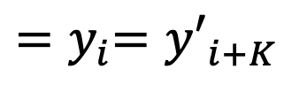

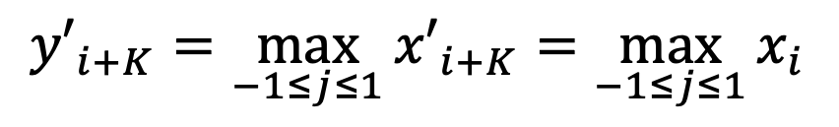

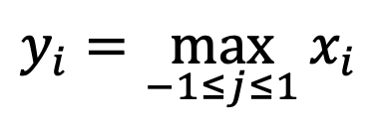
Proving “Max pooling” is also equivariant
$$x_{i−1}$$
$$x_{i}$$
$$x_{i+1}$$
0
0
0
0
0
0
1
2
1
0
1
1
0
0
0
0
0
0
0
0
max over
a window
$$y_{i}=\max_{−1≤j≤1}{x_{i}}$$
$$≤$$
$$≤$$
$$≤$$
0.0
0.0
0.0
0.0
0.0
+1.0
+2.0
+2.0
+2.0
+1.0
+1.0
+1.0
+1.0
0.0
0.0
0.0
0.0
0.0
0.0
0.0
$$y_{i}$$
$${x′}_{i+K}=x_{i}$$
$${y′}_{i+K}=\max_{−1≤j≤1}{{x′}_{i+K}}=\max_{−1≤j≤1}{x_{i}}$$
$${=y}_{i}={y′}_{i+K}$$
translate the input...
gives windowed max of shifted data...
translates output!

Slide 11

Are convolutions perfectly equivariant under translation?
Can we prove it mathematically? Answer: YES.
Then if translation is proved equivariant, what makes the experiment fail?
Answer: in practice, we do not do perfect translations, but we cut edges.
$${y′}_{i+K}=\sum_{j}{w_{j}{x′}_{i+K+j}}=\sum_{j}{w_{j}x_{i+j}}$$
$$y=f\left(x\right) ⇒ s(y)=f(s\left(x\right))$$

Slide 12
Equivariance and convolutions
Think about 1x1 convolutions - what are they?
What limitations do 1x1 convolutions have?
What invariances or equivariances do they have?

Slide 13
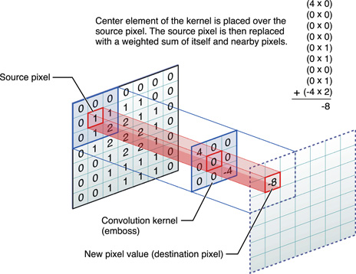
Convolution receptive fields

Slide 14
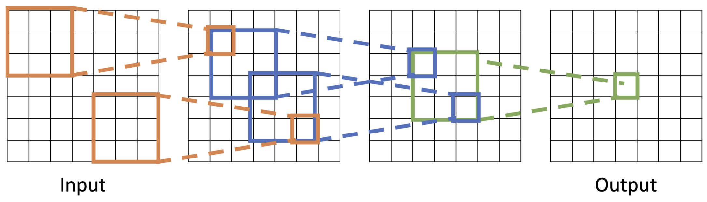
Composing convolutions to enlarge receptive field
Every successive layer adds K-1 to the receptive field size
With L layers the field size is 1 + L * (K-1)
Of course, layers with stride or upsampling can expand this faster.

Slide 15
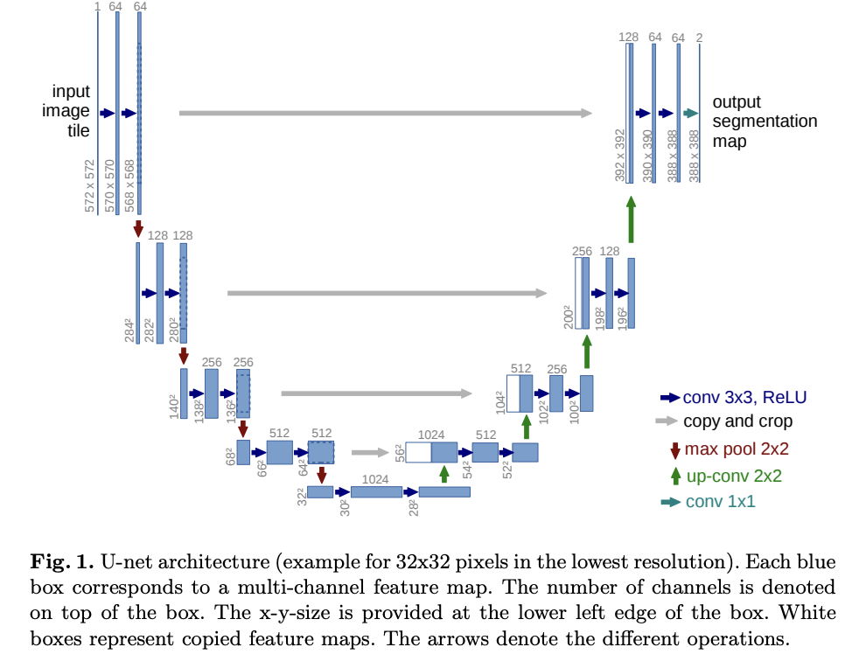
U-nets

Slide 16
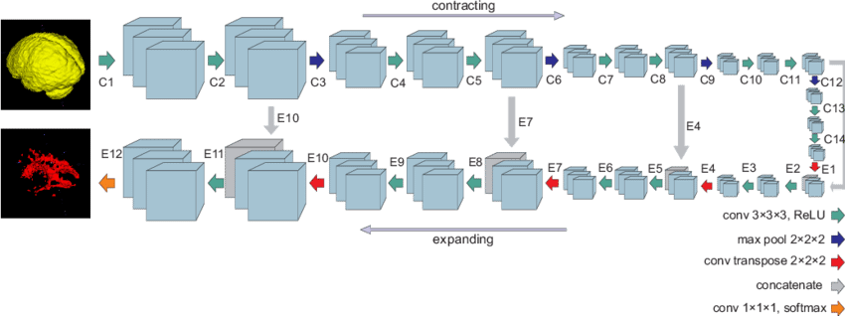
U-nets

Slide 17

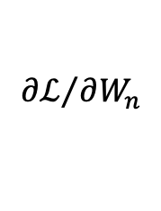
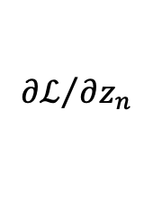




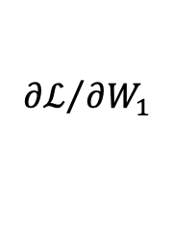
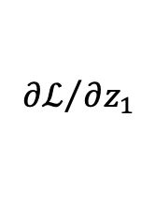


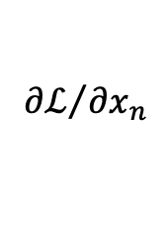





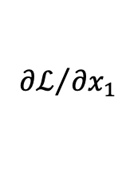

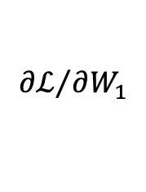



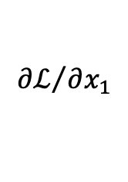

Backprop time and memory use
$$d×d$$
$$d×d$$
$$d×d$$
$$W_{1}$$
$$W_{2}$$
$$W_{n}$$
$${∂ℒ}/{∂W_{1}}$$
$${∂ℒ}/{∂W_{1}}$$
$${∂ℒ}/{∂W_{n}}$$
$$x_{1}$$
mm
$$z_{1}$$
𝜎
$$x_{2}$$
mm
𝜎
$$x_{n}$$
mm
$$z_{n}$$
f
$$ℒ$$
$${∂ℒ}/{∂x_{1}}$$
$${∂ℒ}/{∂z_{1}}$$
$${∂ℒ}/{∂x_{1}}$$
$${∂ℒ}/{∂x_{n}}$$
$${∂ℒ}/{∂z_{n}}$$
$$b×d$$
$$b×d$$
$$b×d$$
$$b×d$$
$$b×d$$
memory sizes of data

Slide 18






Backprop time and memory use
$$d×d$$
$$d×d$$
$$d×d$$
$$W_{1}$$
$$W_{2}$$
$$W_{n}$$
$${∂ℒ}/{∂W_{1}}$$
$$bd^{2}$$
$${∂ℒ}/{∂W_{1}}$$
$$bd^{2}$$
$${∂ℒ}/{∂W_{n}}$$
$$bd^{2}$$
$$bd$$
$$bd$$
$$bd$$
$$x_{1}$$
mm
$$z_{1}$$
𝜎
$$x_{2}$$
mm
𝜎
$$x_{n}$$
mm
$$z_{n}$$
f
$$ℒ$$
$${∂ℒ}/{∂x_{1}}$$
$${∂ℒ}/{∂z_{1}}$$
$${∂ℒ}/{∂x_{1}}$$
$${∂ℒ}/{∂x_{n}}$$
$${∂ℒ}/{∂z_{n}}$$
$$b×d$$
$$b×d$$
$$b×d$$
$$b×d$$
$$b×d$$
memory sizes of data
computation cost of forward operations

Slide 19
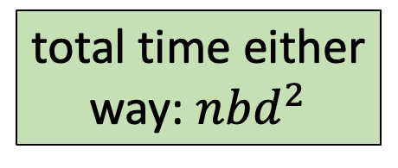
Backprop time and memory use
$$d×d$$
$$d×d$$
$$d×d$$
$$W_{1}$$
$$W_{2}$$
$$W_{n}$$
$${∂ℒ}/{∂W_{1}}$$
$$bd^{2}$$
$${∂ℒ}/{∂W_{1}}$$
$$bd^{2}$$
$${∂ℒ}/{∂W_{n}}$$
$$bd^{2}$$
$$bd$$
$$bd$$
$$bd$$
$$x_{1}$$
mm
$$z_{1}$$
𝜎
$$x_{2}$$
mm
𝜎
$$x_{n}$$
mm
$$z_{n}$$
f
$$ℒ$$
$${∂ℒ}/{∂x_{1}}$$
$${∂ℒ}/{∂z_{1}}$$
$${∂ℒ}/{∂x_{1}}$$
$${∂ℒ}/{∂x_{n}}$$
$${∂ℒ}/{∂z_{n}}$$
$$b×d$$
$$b×d$$
$$b×d$$
$$b×d$$
$$b×d$$
memory sizes of data
total time either
way: $nbd^{2}$
computation cost of forward operations
computation cost of backward operations is similar!

Slide 20







Backprop time and memory use
$$d×d$$
$$d×d$$
$$d×d$$
fixed input parameters
$$W_{1}$$
$$W_{2}$$
$$W_{n}$$
$${∂ℒ}/{∂W_{1}}$$
$${∂ℒ}/{∂W_{1}}$$
$${∂ℒ}/{∂W_{n}}$$
$$x_{1}$$
mm
$$z_{1}$$
𝜎
$$x_{2}$$
mm
𝜎
$$x_{n}$$
mm
$$z_{n}$$
f
$$ℒ$$
$${∂ℒ}/{∂x_{1}}$$
$${∂ℒ}/{∂z_{1}}$$
$${∂ℒ}/{∂x_{1}}$$
$${∂ℒ}/{∂x_{n}}$$
$${∂ℒ}/{∂z_{n}}$$
$$b×d$$
$$b×d$$
$$b×d$$
$$b×d$$
$$b×d$$
data input
During ordinary calculation, intermediate results can be discarded

Slide 21


Backprop time and memory use
$$d×d$$
$$d×d$$
$$d×d$$
fixed input parameters
$$W_{1}$$
$$W_{2}$$
$$W_{n}$$
$${∂ℒ}/{∂W_{1}}$$
$${∂ℒ}/{∂W_{1}}$$
$${∂ℒ}/{∂W_{n}}$$
$$x_{1}$$
mm
$$z_{1}$$
𝜎
$$x_{2}$$
mm
𝜎
$$x_{n}$$
mm
$$z_{n}$$
f
$$ℒ$$
$${∂ℒ}/{∂x_{1}}$$
$${∂ℒ}/{∂z_{1}}$$
$${∂ℒ}/{∂x_{1}}$$
$${∂ℒ}/{∂x_{n}}$$
$${∂ℒ}/{∂z_{n}}$$
$$b×d$$
$$b×d$$
$$b×d$$
$$b×d$$
$$b×d$$
data
During ordinary calculation, intermediate results can be discarded

Slide 22

Backprop time and memory use
$$d×d$$
$$d×d$$
$$d×d$$
fixed input parameters
$$W_{1}$$
$$W_{2}$$
$$W_{n}$$
$${∂ℒ}/{∂W_{1}}$$
$${∂ℒ}/{∂W_{1}}$$
$${∂ℒ}/{∂W_{n}}$$
$$x_{1}$$
mm
$$z_{1}$$
𝜎
$$x_{2}$$
mm
𝜎
$$x_{n}$$
mm
$$z_{n}$$
f
$$ℒ$$
$${∂ℒ}/{∂x_{1}}$$
$${∂ℒ}/{∂z_{1}}$$
$${∂ℒ}/{∂x_{1}}$$
$${∂ℒ}/{∂x_{n}}$$
$${∂ℒ}/{∂z_{n}}$$
$$b×d$$
$$b×d$$
$$b×d$$
$$b×d$$
$$b×d$$
data
During ordinary calculation, intermediate results can be discarded

Slide 23

Backprop time and memory use
$$d×d$$
$$d×d$$
$$d×d$$
$$W_{1}$$
$$W_{2}$$
$$W_{n}$$
$${∂ℒ}/{∂W_{1}}$$
$${∂ℒ}/{∂W_{1}}$$
$${∂ℒ}/{∂W_{n}}$$
$$x_{1}$$
mm
$$z_{1}$$
𝜎
$$x_{2}$$
mm
𝜎
$$x_{n}$$
mm
$$z_{n}$$
f
$$ℒ$$
$${∂ℒ}/{∂x_{1}}$$
$${∂ℒ}/{∂z_{1}}$$
$${∂ℒ}/{∂x_{1}}$$
$${∂ℒ}/{∂x_{n}}$$
$${∂ℒ}/{∂z_{n}}$$
$$b×d$$
$$b×d$$
$$b×d$$
$$b×d$$
$$b×d$$
data
During ordinary calculation, intermediate results can be discarded: memory $bd$

Slide 24
Backprop time and memory use
$$d×d$$
$$d×d$$
$$d×d$$
$$W_{1}$$
$$W_{2}$$
$$W_{n}$$
$${∂ℒ}/{∂W_{1}}$$
$${∂ℒ}/{∂W_{1}}$$
$${∂ℒ}/{∂W_{n}}$$
$$x_{1}$$
mm
$$z_{1}$$
𝜎
$$x_{2}$$
mm
𝜎
$$x_{n}$$
mm
$$z_{n}$$
f
$$ℒ$$
$${∂ℒ}/{∂x_{1}}$$
$${∂ℒ}/{∂z_{1}}$$
$${∂ℒ}/{∂x_{1}}$$
$${∂ℒ}/{∂x_{n}}$$
$${∂ℒ}/{∂z_{n}}$$
$$b×d$$
$$b×d$$
$$b×d$$
$$b×d$$
$$b×d$$
During ordinary calculation, intermediate results can be discarded: memory $bd$
During “forward pass” preparing for backprop, those results are retained: $nbd$

Slide 25



Backprop time and memory use
$$d×d$$
$$d×d$$
$$d×d$$
$$W_{1}$$
$$W_{2}$$
$$W_{n}$$
$$d^{2}$$
$${∂ℒ}/{∂W_{1}}$$
$$d^{2}$$
$${∂ℒ}/{∂W_{1}}$$
$$d^{2}$$
$${∂ℒ}/{∂W_{n}}$$
$$x_{1}$$
mm
$$z_{1}$$
𝜎
$$x_{2}$$
mm
𝜎
$$x_{n}$$
mm
$$z_{n}$$
f
$$ℒ$$
$${∂ℒ}/{∂x_{1}}$$
$${∂ℒ}/{∂z_{1}}$$
$${∂ℒ}/{∂x_{1}}$$
$${∂ℒ}/{∂x_{n}}$$
$${∂ℒ}/{∂z_{n}}$$
$$b×d$$
$$b×d$$
$$b×d$$
$$b×d$$
$$b×d$$
During ordinary calculation, intermediate results can be discarded: memory $bd$
During “forward pass” preparing for backprop, those results are retained: $nbd$
During “backward pass” gradient results are also needed: $nbd+nd^{2}$

Slide 26
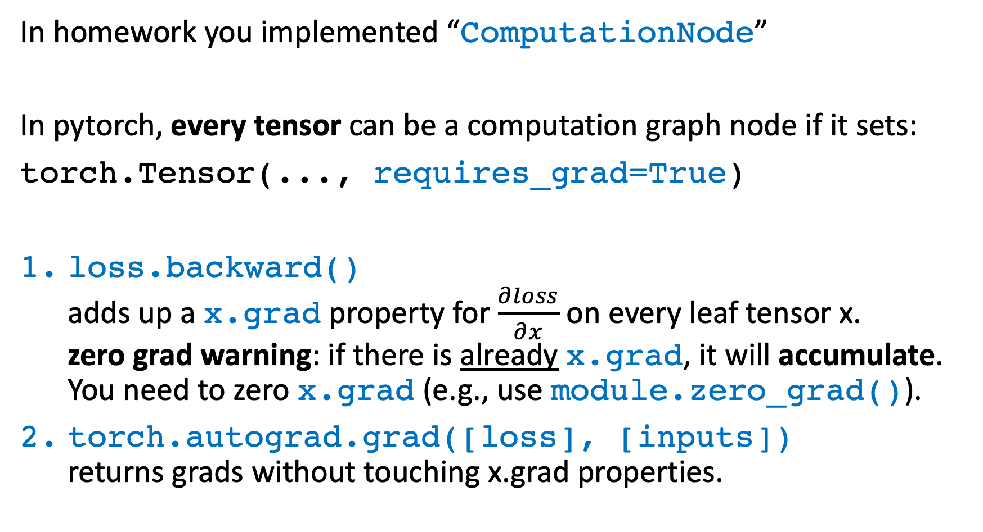
Backprop in pytorch: autograd API
In homework you implemented “ComputationNode”
In pytorch, every tensor can be a computation graph node if it sets:
torch.Tensor(..., requires_grad=True)
loss.backward()
adds up a x.grad property for $\frac{∂loss}{∂x}$ on every leaf tensor x.
zero grad warning: if there is already x.grad, it will accumulate.
You need to zero x.grad (e.g., use module.zero_grad()).
torch.autograd.grad([loss], [inputs])
returns grads without touching x.grad properties.

Slide 27
Backprop in pytorch: autograd API
torch.Tensor(..., requires_grad=True)
Rules for the requires_grad flag:
Doing any math on a requires_grad tensor will build a graph, and result in another requires_grad tensor.
You cannot change a requires_grad tensor in-place (because its memory of its results will be needed during backprop!)
All neural network parameters are set to requires_grad=True by default.
You can disable graph-building and ignore requires_grad by using torch.set_grad_enabled(False)
or
with torch.no_grad():

Slide 28
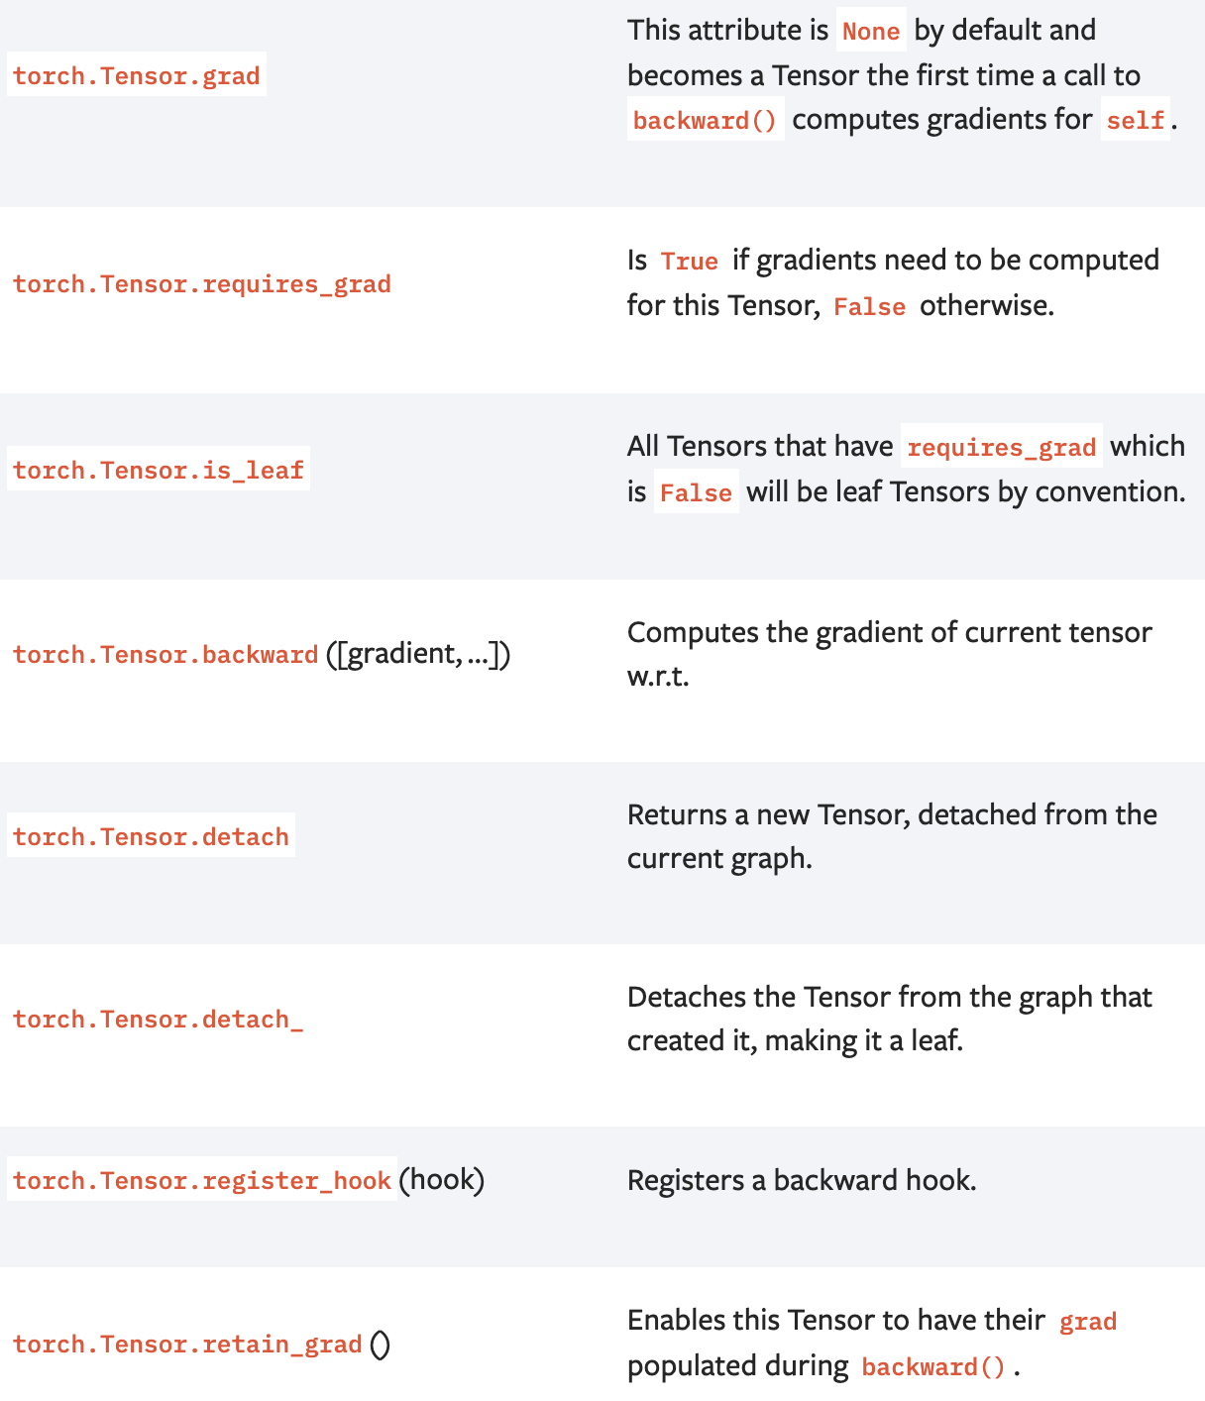
Backprop in pytorch: autograd API

Slide 29
Autoencoders
Supervised learning uses explicit labels/correct output in order to train a network.
  E.g., classification of images.
Unsupervised learning relies on data only.
  E.g., CBOW and skip-gram word embeddings: the output is determined implicitly from word order in the input data.
  Key point is to produce a useful embedding of words.
  The embedding encodes structure such as word similarity and some relationships.
  Still need to define a loss – this is an implicit supervision.

Slide 30
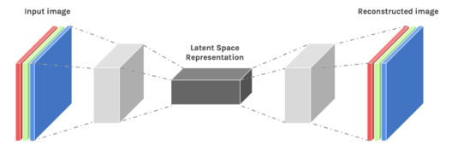
Autoencoders
Autoencoders are designed to reproduce their input, especially for images.
  Key point is to reproduce the input from a learned encoding.
https://www.edureka.co/blog/autoencoders-tutorial/

Slide 31
Autoencoders
Compare PCA/SVD
  PCA takes a collection of vectors (images) and produces a usually smaller set of vectors that can be used to approximate the input vectors via linear combination.
  Very efficient for certain applications.
  Fourier and wavelet compression is similar.
Neural network autoencoders
  Can learn nonlinear dependencies
  Can use convolutional layers
  Can use transfer learning
https://www.edureka.co/blog/autoencoders-tutorial/

Slide 32
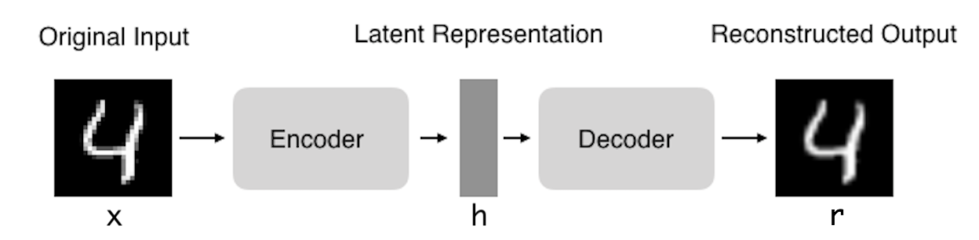
Autoencoders: structure
Encoder: compress input into a latent-space of usually smaller dimension. h = f(x)
Decoder: reconstruct input from the latent space. r = g(f(x))
with r as close to x as possible
What is the loss for an autoencoder?
https://towardsdatascience.com/deep-inside-autoencoders-7e41f319999f

Slide 33
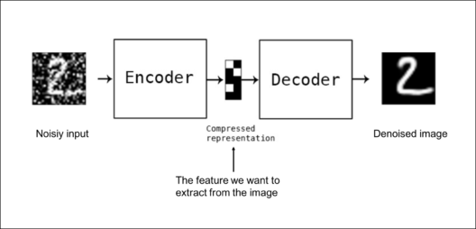
Autoencoders: applications
Denoising: input clean image + noise and train to reproduce the clean image.
https://www.edureka.co/blog/autoencoders-tutorial/

Slide 34
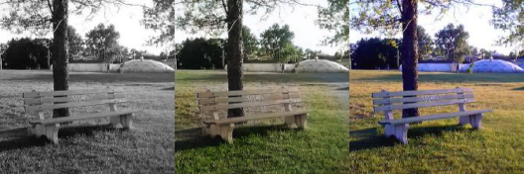
Autoencoders: Applications
Image colorization: input black and white and train to produce color images
https://www.edureka.co/blog/autoencoders-tutorial/

Slide 35

Autoencoders: Applications
Watermark removal
https://www.edureka.co/blog/autoencoders-tutorial/

Slide 36
Properties of Autoencoders
Data-specific: Autoencoders are only able to compress data similar to what they have been trained on.
Lossy: The decompressed outputs will be degraded compared to the original inputs.
Learned automatically from examples: It is easy to train specialized instances of the algorithm that will perform well on a specific type of input.
https://www.edureka.co/blog/autoencoders-tutorial/

Slide 37
Capacity
As with other NNs, overfitting is a problem when capacity is too large for the data.
Autoencoders address this through some combination of:
  Bottleneck layer – fewer degrees of freedom than in possible outputs.
  Training to denoise.
  Sparsity through regularization.
  Contractive penalty.

Slide 38
Bottleneck layer (undercomplete)
Suppose input images are nxn and the latent space is m < nxn.
Then the latent space is not sufficient to reproduce all images.
Needs to learn an encoding that captures the important features in training data, sufficient for approximate reconstruction.

Slide 39
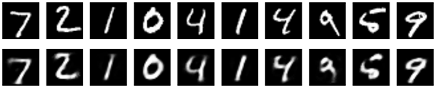
Simple bottleneck layer
  encoder = Sequential(Flatten(), Linear(784, 32), ReLU())
  decoder = Sequential(Linear(32, 784), Sigmoid())
  autoencoder = Sequential(encoder, decoder)
Maps 28x28 images into a 32 dimensional vector.
Can also use more layers and/or convolutions.

Slide 40
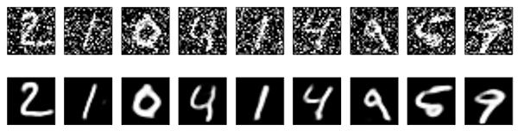
Denoising autoencoders
Basic autoencoder trains to minimize the loss between x and the reconstruction g(f(x)).
Denoising autoencoders train to minimize the loss between x and g(f(x+w)), where w is random noise.
Same possible architectures, different training data.
Kaggle has a dataset on damaged documents.
https://blog.keras.io/building-autoencoders-in-keras.html

Slide 41
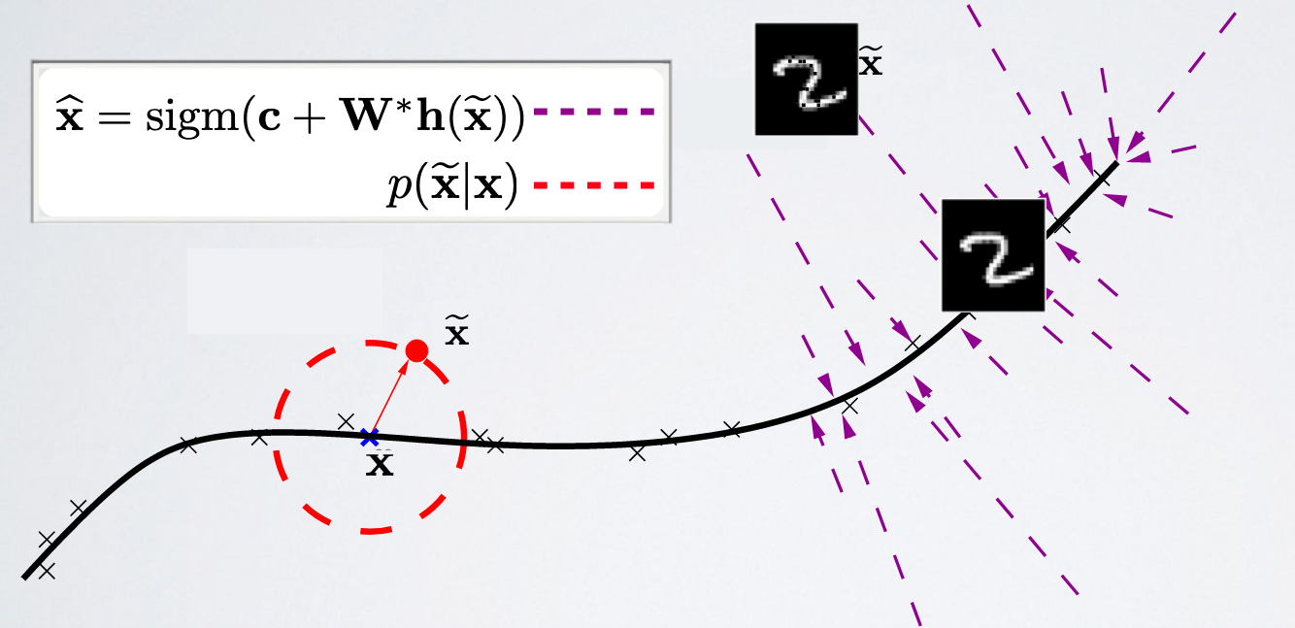
Denoising autoencoders
Denoising autoencoders can’t simply memorize the input output relationship.
Intuitively, a denoising autoencoder learns a projection from a neighborhood of our training data back onto the training data.
https://ift6266h17.files.wordpress.com/2017/03/14_autoencoders.pdf

Slide 42
Sparse autoencoders
Construct a loss function to penalize activations within a layer.
Usually regularize the weights of a network, not the activations.
Individual nodes of a trained model that activate are data-dependent.
  Different inputs will result in activations of different nodes through the network.
Selectively activate regions of the network depending on the input data.
https://www.jeremyjordan.me/autoencoders/

Slide 43

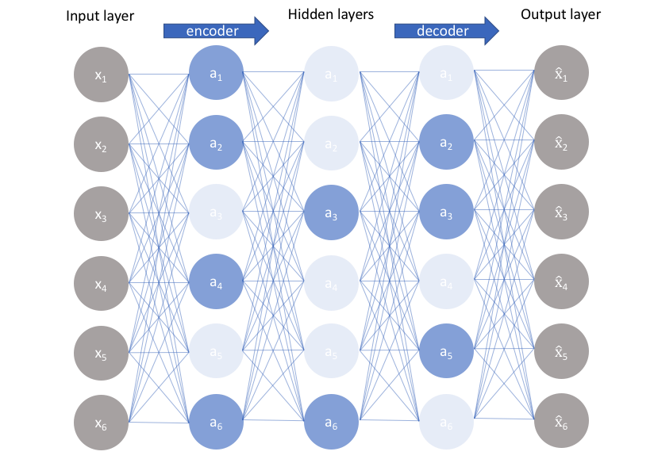

Sparse autoencoders
Construct a loss function to penalize activations the network.
  L1 Regularization: Penalize the absolute value of the vector of activations a in layer h for observation I
  KL divergence: Use cross-entropy between average activation and desired activation
https://www.jeremyjordan.me/autoencoders/

Slide 44
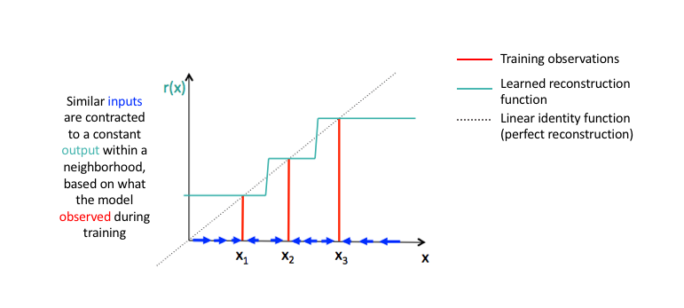

Contractive autoencoders
Arrange for similar inputs to have similar activations.
  I.e., the derivative of the hidden layer activations are small with respect to the input.
Denoising autoencoders make the reconstruction function (encoder+decoder) resist small perturbations of the input
Contractive autoencoders make the feature extraction function (ie. encoder) resist infinitesimal perturbations of the input.
https://www.jeremyjordan.me/autoencoders/

Slide 45
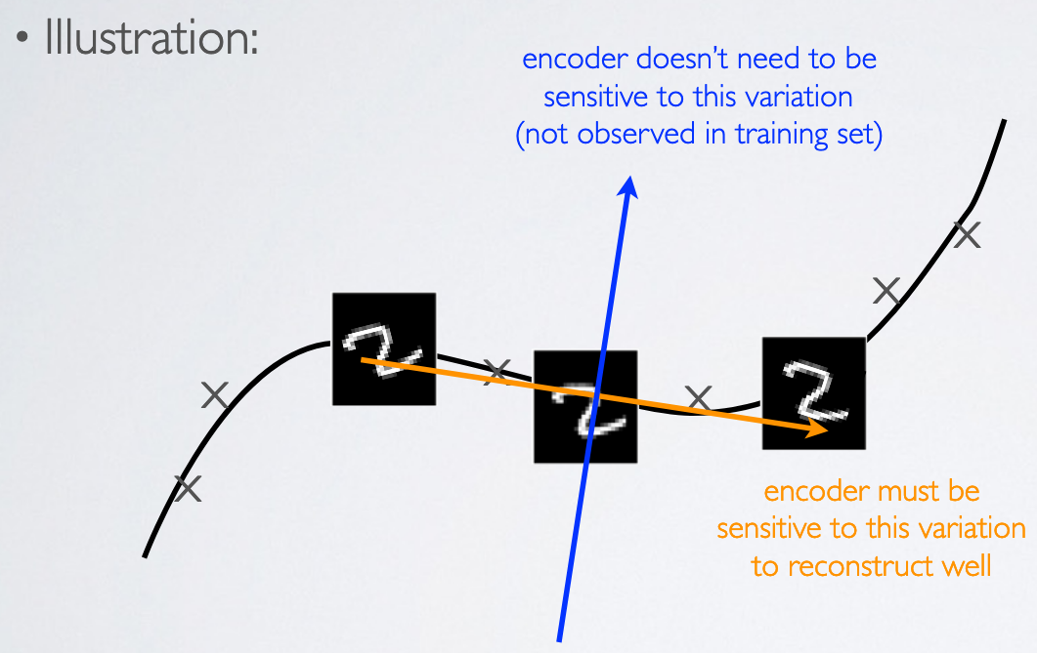
Contractive autoencoders
Contractive autoencoders make the feature extraction function (ie. encoder) resist infinitesimal perturbations of the input.
https://ift6266h17.files.wordpress.com/2017/03/14_autoencoders.pdf

Slide 46
Autoencoders
Both the denoising and contractive autoencoder can perform well
  Advantage of denoising autoencoder : simpler to implement-requires adding one or two lines of code to regular autoencoder-no need to compute Jacobian of hidden layer
  Advantage of contractive autoencoder : gradient is deterministic -can use second order optimizers (conjugate gradient, LBFGS, etc.)-might be more stable than denoising autoencoder, which uses a sampled gradient
To learn more on contractive autoencoders:
  Contractive Auto-Encoders: Explicit Invariance During Feature Extraction. Salah Rifai, Pascal Vincent, Xavier Muller, Xavier Glorot et Yoshua Bengio, 2011.
https://ift6266h17.files.wordpress.com/2017/03/14_autoencoders.pdf

