Slide 1

CS 7150
Deep Learning

Slide 2

Post-midterm review
Any questions about the midterm?
https://bit.ly/cs7150-midterm-post

Slide 3
Second-half course logistics
Homework 4 due date pushed back one week, to November 10.
Peer-review of milestone 2 projects – make sure your URLs are submitted via canvas.
In the 2nd half of the course: read papers.
  I will post paper links before each class.

Slide 4
Gated RNNs, Translation, Attention

Slide 5













Why is vanishing gradient a problem?
Gradient signal from faraway is lost because it’s much
smaller than gradient signal from close-by.
So model weights are only updated only with respect to near effects, not long-term effects.
Abigail See

Slide 6
Why is vanishing gradient a problem?
LM task: When she tried to print her tickets, she found that the printer was out of toner. She went to the stationery store to buy more toner. It was very overpriced. After installing the toner into the printer, she finally printed her
To learn from this training example, the RNN-LM needs to model the dependency between “tickets” on the 7th step and the target word “tickets” at the end.
But if gradient is small, the model can’t learn this dependency
  So the model is unable to predict similar long-distance dependencies at test time
Abigail See

Slide 7
Effect of vanishing gradient on RNN LM
LM task: The writer of the books
are
Correct answer: The writer of the books is planning a sequel
Syntactic recency: The writer of the books is (correct)
Sequential recency: The writer of the books are (incorrect)
Due to vanishing gradient, RNN-LMs are better at learning from sequential recency than syntactic recency, so they make this
type of error more often than we’d like [Linzen et al 2016]
Abigail See
“Assessing the Ability of LSTMs to Learn Syntax-Sensitive Dependencies”, Linzen et al, 2016. https://arxiv.org/pdf/1611.01368.pdf

Slide 8
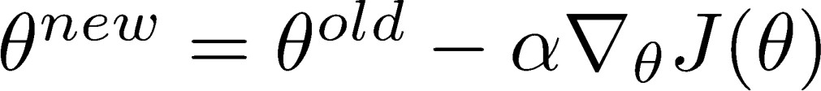
Why is exploding gradient a problem?
If the gradient becomes too big, then the SGD update step becomes too big:
learning rate
gradient
This can cause bad updates: we take too large a step and reach a bad parameter configuration (with large loss)
In the worst case, this will result in Inf or NaN in your network (then you have to restart training from an earlier checkpoint)
Abigail See

Slide 9
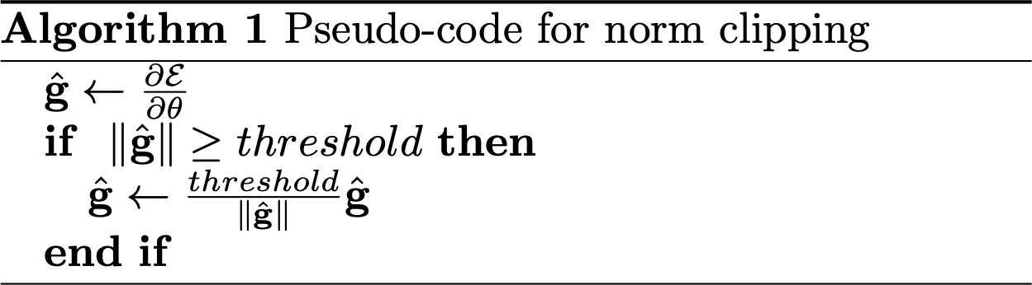
Gradient clipping: a solution for exploding gradient
Gradient clipping: if the norm of the gradient is greater than some threshold, scale it down before applying SGD update
Intuition: take a step in the same direction, but a smaller step
Abigail See
Source: “On the difficulty of training recurrent neural networks”, Pascanu et al, 2013. http://proceedings.mlr.press/v28/pascanu13.pdf

Slide 10
RNNs with Gates

Slide 11
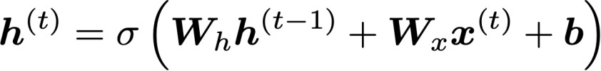
How to fix the vanishing gradient problem
The main problem is that it’s too difficult for the RNN to learn to
preserve information over many timesteps.
In a vanilla RNN, the hidden state is constantly being rewritten
How about a RNN with separate memory?
Richard Socher

Slide 12
Gated Recurrent Units (GRU)
More complex hidden unit computation in recurrence!
Introduced by Cho et al. 2014
Main ideas:
  keep around memories to capture long distance dependencies
  allow error messages to flow at different strengths depending on the inputs
Richard Socher

Slide 13
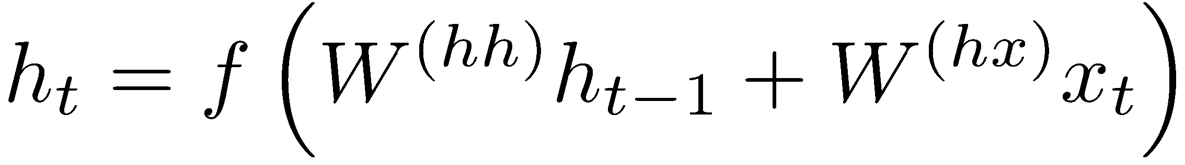
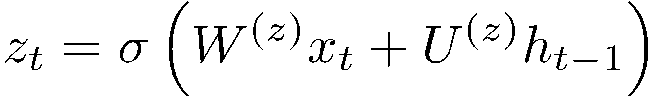
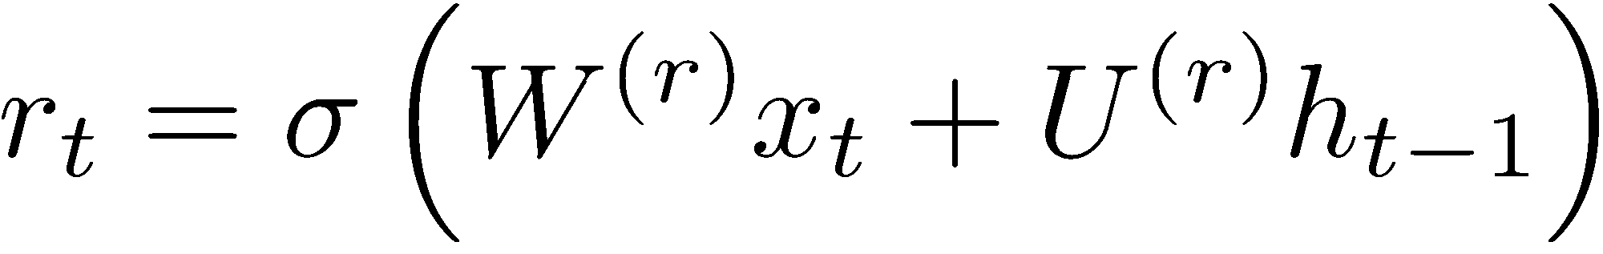
Gated Recurrent Units (GRU)
Standard RNN computes hidden layer at next time step directly:
GRU first computes an update gate (another layer) based on current input word vector and hidden state
Compute reset gate similarly but with different weights
Richard Socher

Slide 14
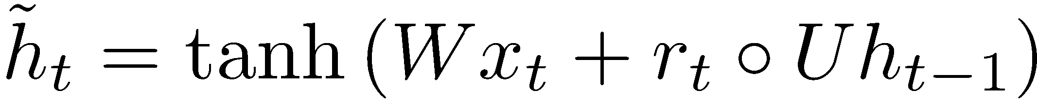
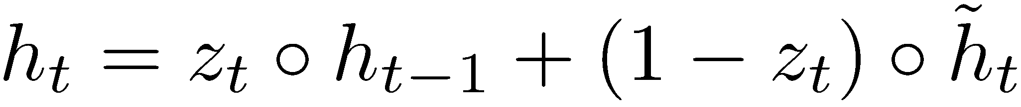
Gated Recurrent Units (GRU)
Update gate
Reset gate
New memory content:
If reset gate unit is ~0, then this ignores previous memory and only stores the new word information
Final memory at time step combines current and previous time steps:
Richard Socher

Slide 15
Gated Recurrent Units (GRU)
ht-1
h_{t}
Final memory
~_{ht}
Memory (reset)
~ht-1
Update gate
zt-1
z_{t}
Reset gate
rt-1
r_{t}
Input:
xt-1
x_{t}
Richard Socher

Slide 16
Gated Recurrent Units (GRU)
If reset r is close to 0, ignore previous hidden state: Allows model to drop information that is irrelevant in the future
If update z is close to 1, can copy information through many time steps, i.e. copy-paste state: Less vanishing gradient!
Units with short-term dependencies often have reset gates (r) very active; ones with long-term dependencies have active update gates (z)
Adapted from Richard Socher

Slide 17
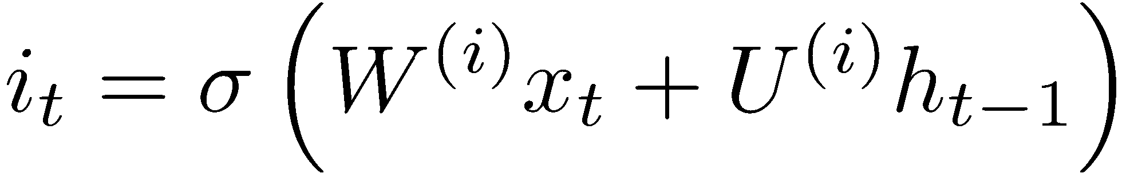
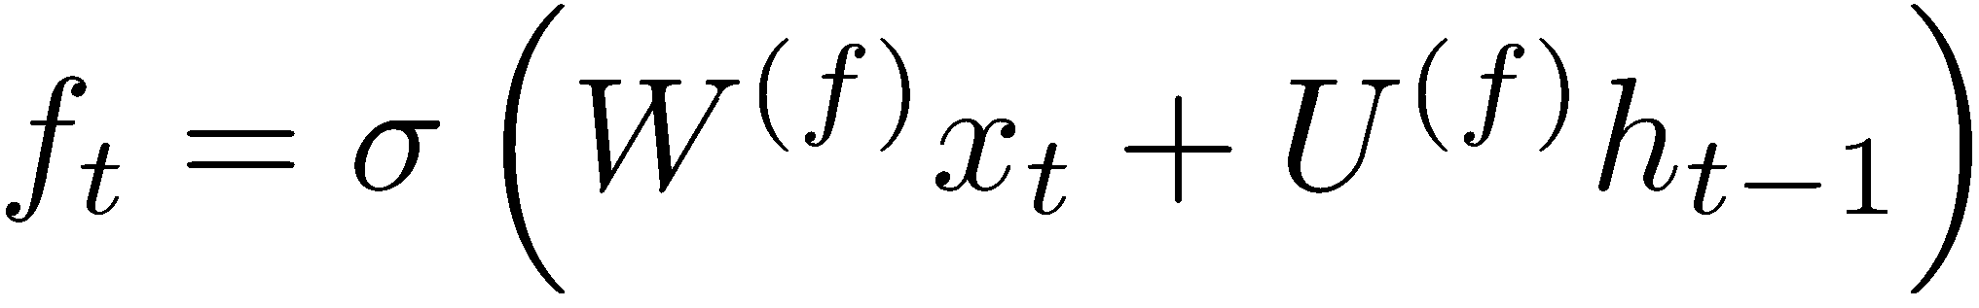
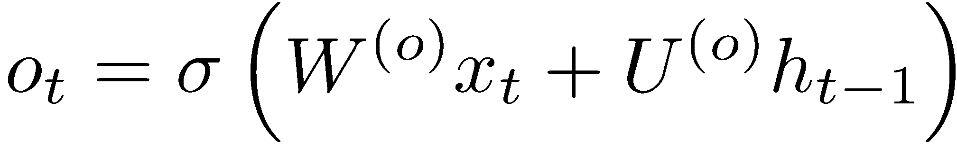
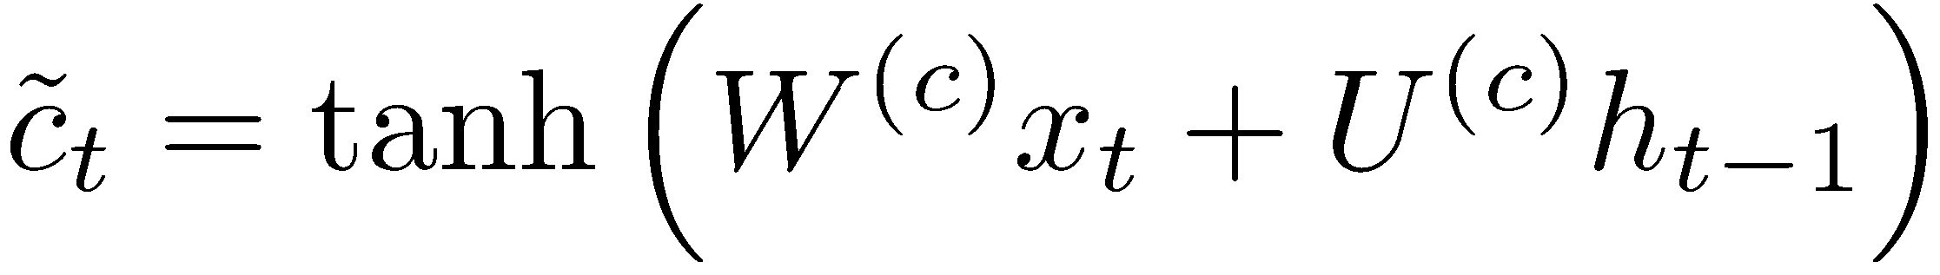
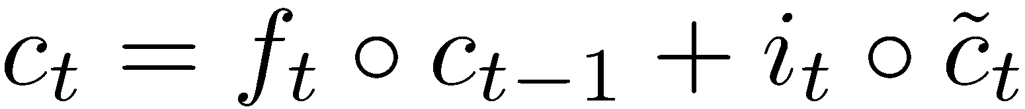
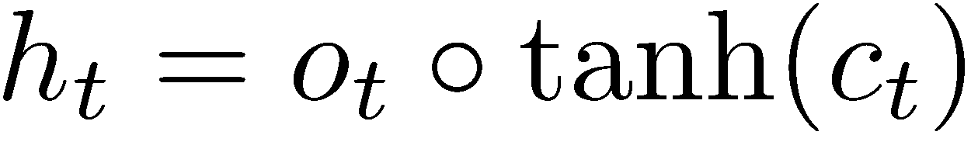
Long-Short-Term-Memory (LSTM)
Proposed by Hochreiter and Schmidhuber in 1997
We can make the units even more complex
Allow each time step to modify
  Input gate (current cell matters)
  Forget (gate 0, forget past)
  Output (how much cell is exposed)
  New memory cell
Final memory cell:
Final hidden state:
Adapted from Richard Socher

Slide 18
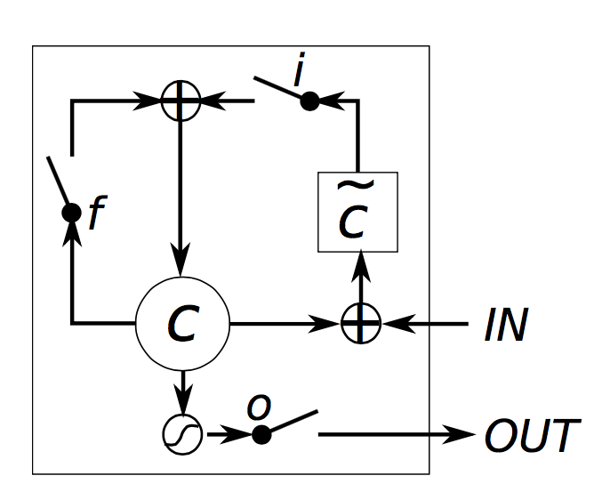
Long-Short-Term-Memory
Intuition: memory cells can keep information intact, unless inputs makes them forget it or overwrite it with new input
Cell can decide to output this information or just store it
Richard Socher, figure from wildml.com

Slide 19


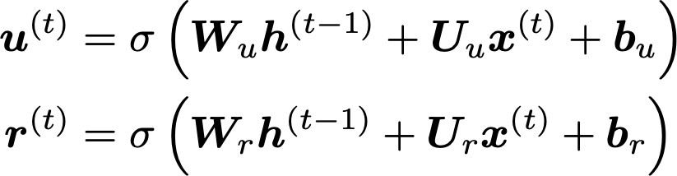
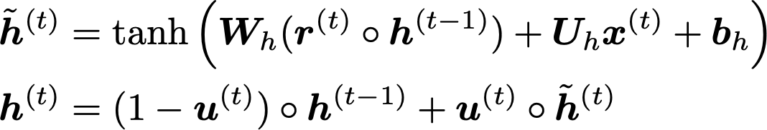
What to know: Gated Recurrent Units (GRU)
Proposed by Cho et al. in 2014 as a simpler alternative to the LSTM.
On each timestep t we have input and hidden state (no cell state).
Update gate: controls what parts of hidden state are updated vs preserved
Reset gate: controls what parts of previous hidden state are used to compute new content
New hidden state content: reset gate selects useful parts of prev hidden state. Use this and current input to compute new hidden content.
Hidden state: update gate simultaneously controls what is kept from previous hidden state, and what is updated to new hidden state content
How does this solve vanishing gradient? GRU makes it easier to retain info long-term (e.g. by setting update gate to 0)
Abigail See
"Learning Phrase Representations using RNN Encoder–Decoder for Statistical Machine Translation", Cho et al. 2014, https://arxiv.org/pdf/1406.1078v3.pdf

Slide 20

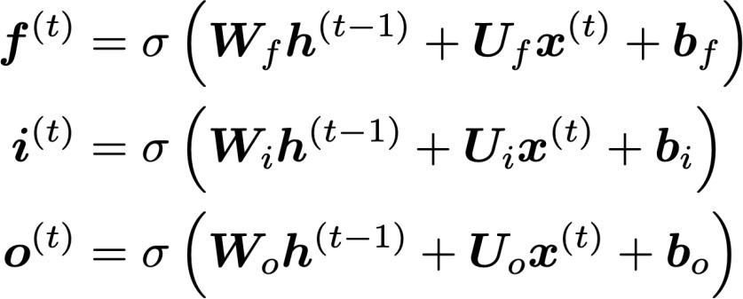
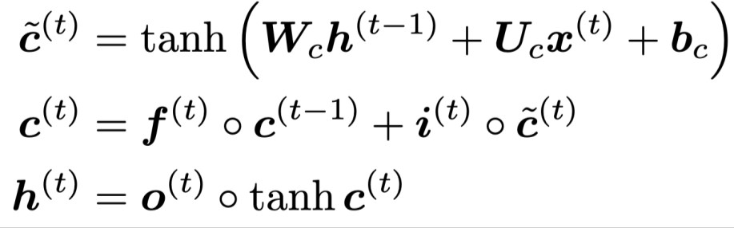
What to know: Long Short Term Memory (LSTM)
We have a sequence of inputs , and we will compute a sequence of hidden states and cell states . On timestep t:
Sigmoid function: all gate values are between 0 and 1
Forget gate: controls what is kept vs forgotten, from previous cell state
Input gate: controls what parts of the new cell content are written to cell
All these are vectors of same length n
Output gate: controls what parts of cell are output to hidden state
New cell content: this is the new content to be written to the cell
Cell state: erase (“forget”) some content from last cell state, and write (“input”) some new cell content
Hidden state: read (“output”) some content from the cell
Gates are applied using element-wise product
Abigail See

Slide 21
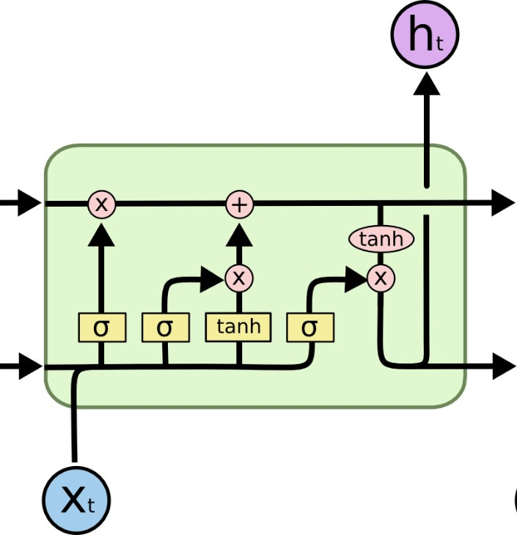
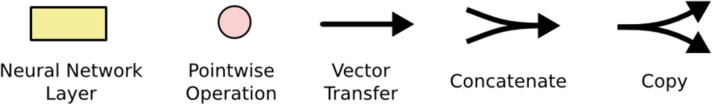
What to know: Long Short Term Memory (LSTM)
You can think of the LSTM equations visually like this:
Write some new cell content
Forget some
cell content
c_{t}
c_{t}
^{c}t-1
f
i_{t}
o_{t}
Output some cell content to the hidden state
Compute the forget gate
t
~_{c}
t
^{h}t-1
h_{t}
Compute the input gate
Compute the new cell content
Compute the output gate
Abigail See
Source: http://colah.github.io/posts/2015-08-Understanding-LSTMs/

Slide 22
Choosing between LSTM and GRU
Researchers have proposed many gated RNN variants, but LSTM and GRU are the most widely-used
The biggest difference is that GRU is quicker to compute and has fewer parameters
There is no conclusive evidence that one consistently performs better than the other
LSTM is a good default choice (especially if your data has particularly long dependencies, or you have lots of training data)
Rule of thumb: start with LSTM, but switch to GRU if you want something more efficient
Abigail See

Slide 23
LSTM in applications
In 2013-2015, LSTMs started achieving state-of-the-art results for sequence modeling
  Successful tasks include: handwriting recognition, speech recognition, machine translation, parsing, image captioning
  LSTM became the dominant approach
Starting in 2019, other approaches (e.g. Transformers) became more dominant for certain NLP tasks (will discuss next lecture)
  For example in WMT (machine translation competition):
  In WMT 2016, the summary report contains ”RNN” 44 times
  In WMT 2018, the report contains “RNN” 9 times and
“Transformer” 63 times
Source: "Findings of the 2016 Conference on Machine Translation (WMT16)", Bojar et al. 2016, http://www.statmt.org/wmt16/pdf/W16-2301.pdf
Source: "Findings of the 2018 Conference on Machine Translation (WMT18)", Bojar et al. 2018, http://www.statmt.org/wmt18/pdf/WMT028.pdf
Adapted from Abigail See

Slide 24
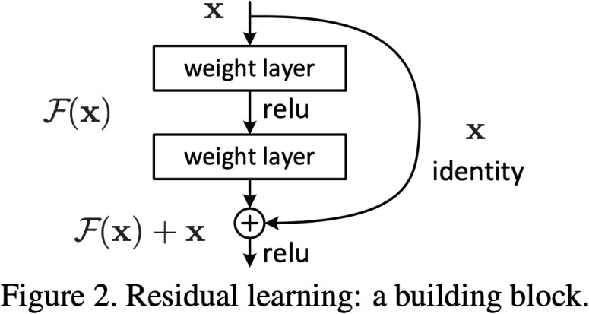
Is vanishing/exploding gradient just a RNN problem?
No! It can be a problem for all neural architectures (including feed-forward and convolutional), especially deep ones.
  Due to chain rule / choice of nonlinearity function, gradient can become vanishingly small as it backpropagates
  Thus lower layers are learnt very slowly (hard to train)
  Solution: lots of new deep feedforward/convolutional architectures that
add more direct connections (thus allowing the gradient to flow)
For example:
Residual connections aka “ResNet”
Also known as skip-connections
The identity connection preserves information by default
This makes deep networks much
easier to train
Abigail See
"Deep Residual Learning for Image Recognition", He et al, 2015. https://arxiv.org/pdf/1512.03385.pdf

Slide 25
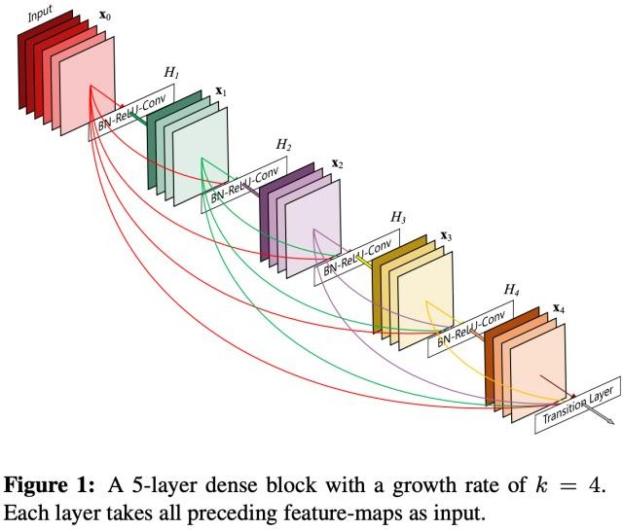
Is vanishing/exploding gradient just a RNN problem?
No! It can be a problem for all neural architectures (including feed-forward and convolutional), especially deep ones.
  Due to chain rule / choice of nonlinearity function, gradient can become vanishingly small as it backpropagates
  Thus lower layers are learnt very slowly (hard to train)
  Solution: lots of new deep feedforward/convolutional architectures that
add more direct connections (thus allowing the gradient to flow)
For example:
Dense connections aka “DenseNet”
Directly connect everything to everything!
Abigail See
”Densely Connected Convolutional Networks", Huang et al, 2017. https://arxiv.org/pdf/1608.06993.pdf

Slide 26

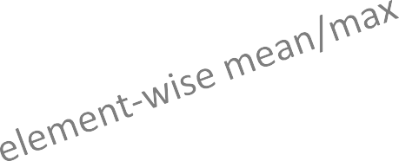
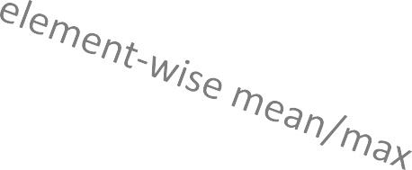
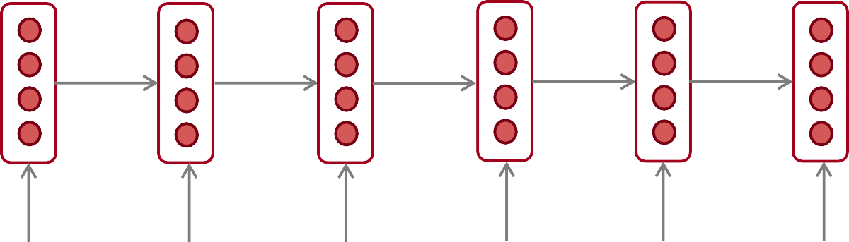
Bidirectional RNNs: motivation
We can regard this hidden state as a
representation of the word “terribly” in the context of this sentence. We call this a contextual representation.
positive
Sentence encoding
These contextual representations only contain information about the left context (e.g. “the movie
was”).
What about right
context?
In this example, “exciting” is in the right context and this modifies the meaning of “terribly” (from negative to positive)
the
movie
was
terribly
exciting
!
Abigail See

Slide 27
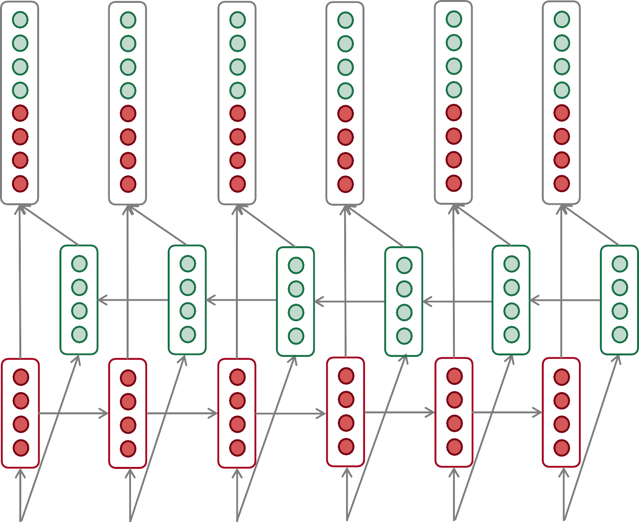
Bidirectional RNNs
This contextual representation of “terribly”
has both left and right context!
Concatenated hidden states
Backward RNN
Forward RNN
the
movie
was
terribly
exciting
!
Abigail See

Slide 28
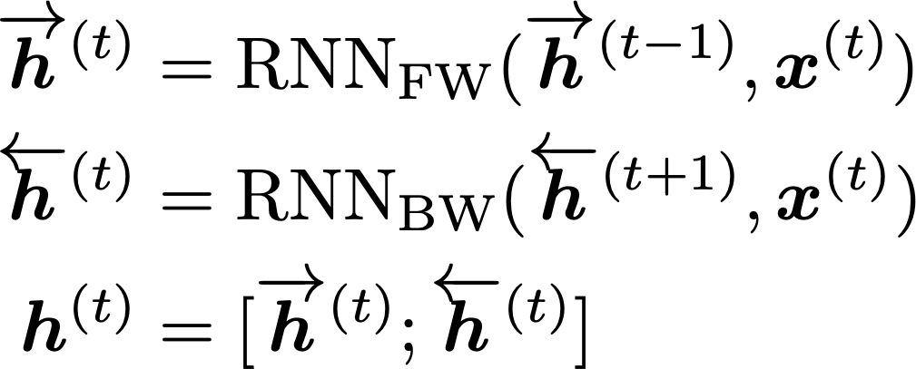
Bidirectional RNNs
On timestep t:
This is a general notation to mean “compute one forward step of the RNN” – it could be a vanilla, LSTM or GRU computation.
Forward RNN
Generally, these two RNNs have separate weights
Backward RNN
Concatenated hidden states
We regard this as “the hidden state” of a bidirectional RNN. This is what we pass on to the next parts of the network.
Abigail See

Slide 29
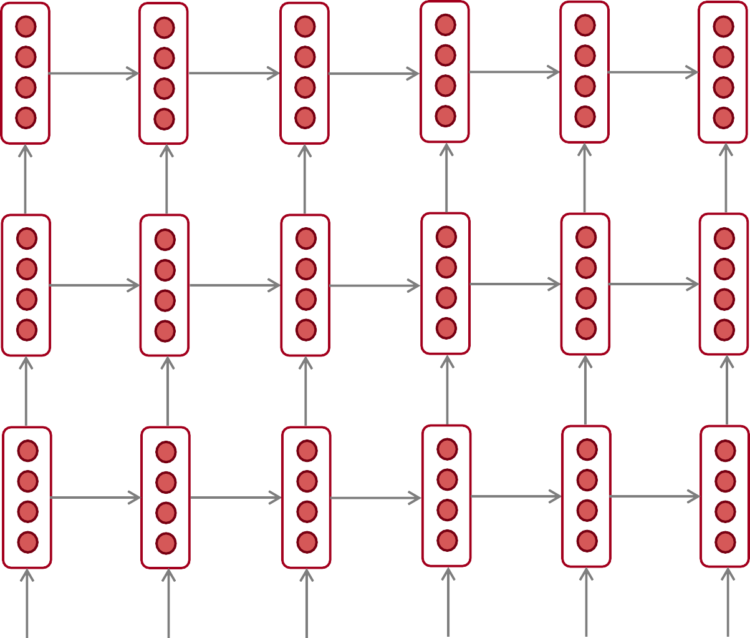
Multi-layer RNNs
The hidden states from RNN layer i
are the inputs to RNN layer i+1
RNN layer 3
RNN layer 2
RNN layer 1
the
movie
was
terribly
exciting
!
Abigail See

Slide 30
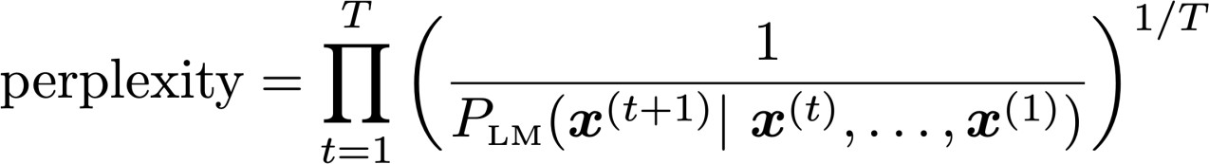

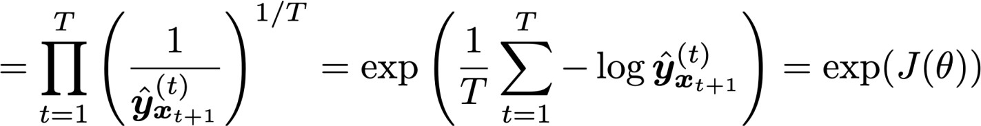
Language Model Evaluation
The standard evaluation metric for Language Models is perplexity.
Normalized by number of words
Inverse probability of corpus, according to Language Model
:
This is equal to the exponential of the cross-entropy loss
Lower perplexity is better!
Abigail See

Slide 31
Recap of RNNs
Language Model: A system that predicts the next word
Recurrent Neural Network: A family of neural networks that:
  Take sequential input of any length
  Apply the same weights on each step
  Can optionally produce output on each step
Vanishing gradient problem: what it is, why it happens, and
why it’s bad for RNNs
LSTMs and GRUs: more complicated RNNs that use gates to control information flow; more resilient to vanishing gradients
Abigail See

Slide 32
Applications

Slide 33
Why care about Language Modeling?
Language Modeling is a benchmark task that helps us measure our progress on understanding language
Language Modeling is a subcomponent of many NLP tasks, especially those involving generating text or
estimating the probability of text:
  Predictive typing
  Speech recognition
  Handwriting recognition
  Spelling/grammar correction
  Authorship identification
  Machine translation
  Summarization
  Dialogue
  etc.
Abigail See

Slide 34


























Generating Text with an RNN Language Model
You can use a RNN Language Model to generate text by repeated sampling. Sampled output is next step’s input.
favorite season is
sample sample sample
spring
sample
…
Abigail See
my
favorite
season
is
spring

Slide 35
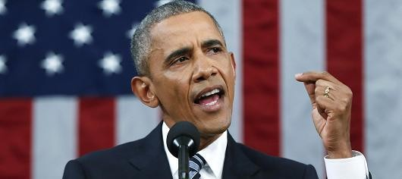
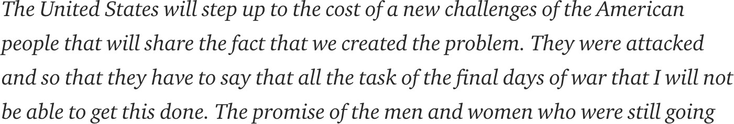
Generating Text with an RNN Language Model
Let’s have some fun!
You can train a RNN-LM on any kind of text, then generate text in that style.
RNN-LM trained on Obama speeches:
Source: https://medium.com/@samim/obama-rnn-machine-generated-political-speeches-c8abd18a2ea0
Abigail See

Slide 36

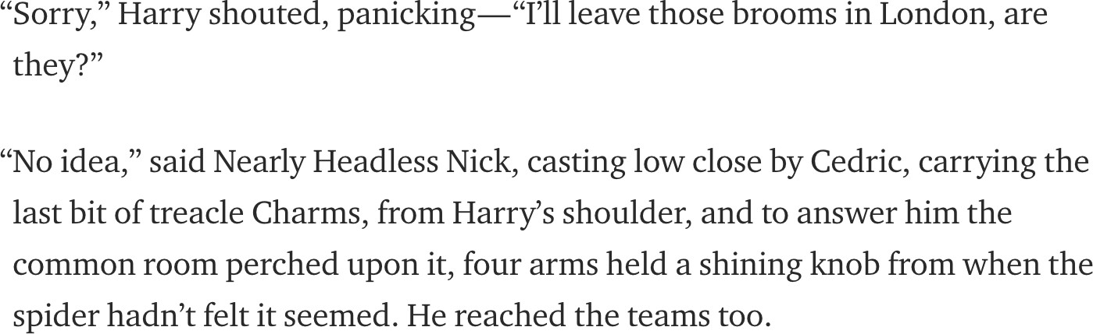
Generating Text with an RNN Language Model
Let’s have some fun!
You can train a RNN-LM on any kind of text, then generate text in that style.
RNN-LM trained on Harry Potter:
Source: https://medium.com/deep-writing/harry-potter-written-by-artificial-intelligence-8a9431803da6
Abigail See

Slide 37

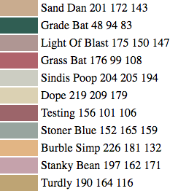
Generating Text with an RNN Language Model
Let’s have some fun!
You can train a RNN-LM on any kind of text, then generate text in that style.
RNN-LM trained on paint color names:
This is an example of a character-level RNN-LM (predicts what character comes next)
Source: http://aiweirdness.com/post/160776374467/new-paint-colors-invented-by-neural-network
Abigail See

Slide 38

Generating Poetry with an RNN
Fei-Fei Li & Andrej Karpathy & Justin Johnson Lecture 10 - 8 Feb 2016
Lecture 10 -
35
Andrej Karpathy

Slide 39
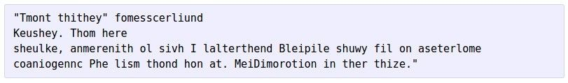


at first:
Generating Poetry with an RNN
train more
train more
train more
Fei-Fei Li & Andrej Karpathy & Justin Johnson Lecture 10 - 8 Feb 2016
Lecture 10 -
36
More info: http://karpathy.github.io/2015/05/21/rnn-effectiveness/
Andrej Karpathy

Slide 40

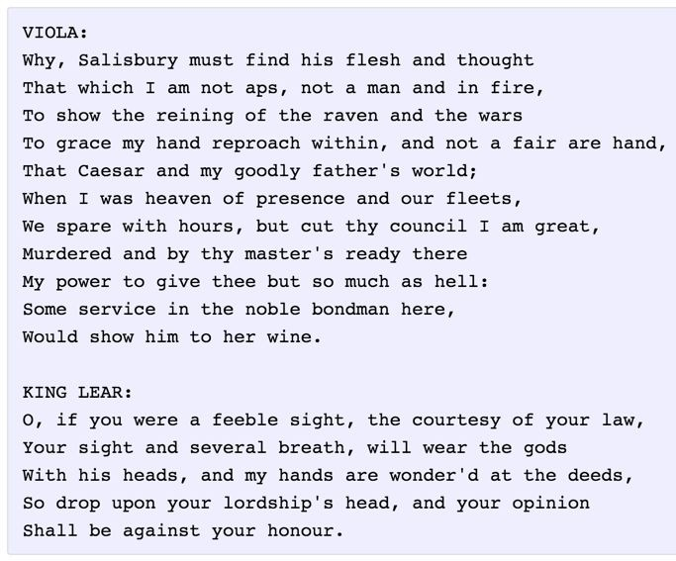
Generating Literature with an RNN
Fei-Fei Li & Andrej Karpathy & Justin Johnson Lecture 10 - 8 Feb 2016
Lecture 10 -
37
Andrej Karpathy

Slide 41
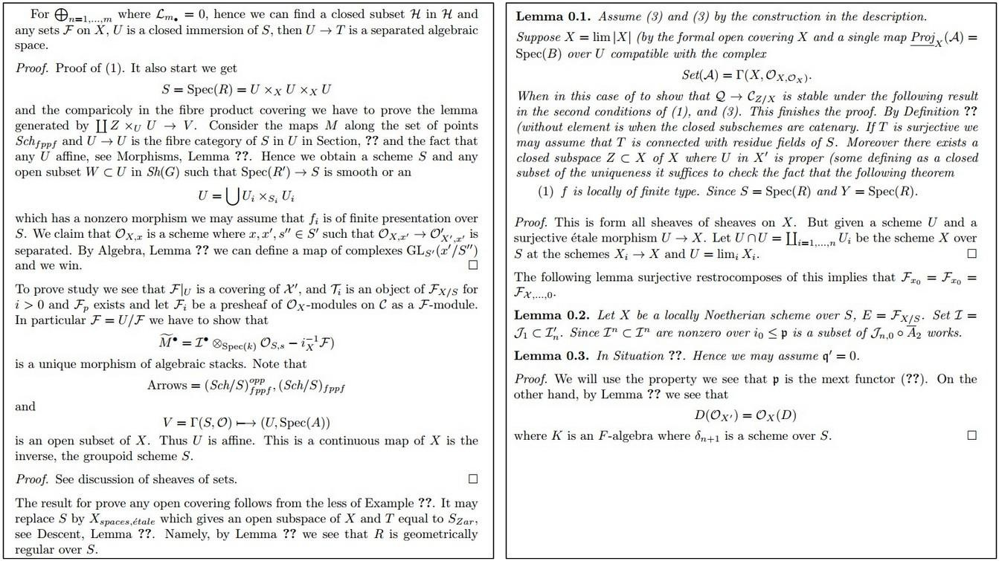
Generating LaTeX with an RNN
Fei-Fei Li & Andrej Karpathy & Justin Johnson Lecture 10 - 8 Feb 2016
Lecture 10 -
39
Andrej Karpathy

Slide 42
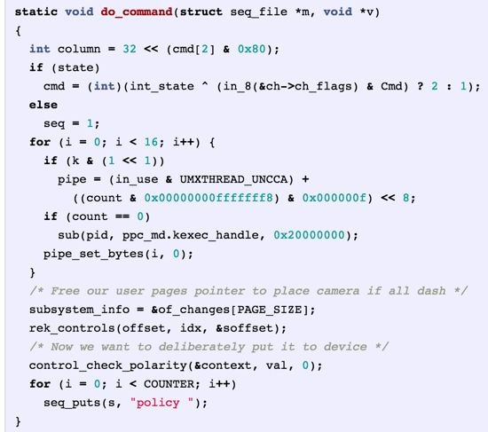
Generated C code
Generating Source Code with an RNN
Fei-Fei Li & Andrej Karpathy & Justin Johnson Lecture 10 - 8 Feb 2016
Lecture 10 -
42
Andrej Karpathy

Slide 43
Neural Machine Translation
Neural Machine Translation (NMT) is a way to do Machine Translation with a single neural network
The neural network architecture is called sequence-to-sequence (aka seq2seq) and it involves two RNNs.
Abigail See

Slide 44
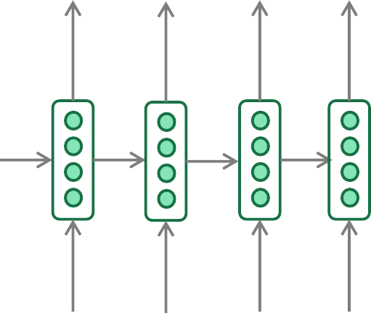
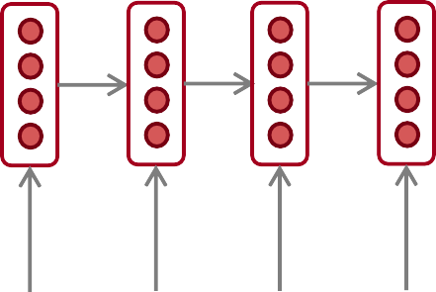
Neural Machine Translation (NMT)
The sequence-to-sequence model
Encoding of the source sentence.
Target sentence (output)
Provides initial hidden state
for Decoder RNN.
he
hit
me
with
a
pie <END>
argmax
argmax
argmax
argmax
argmax
argmax
argmax
Encoder RNN
Decoder RNN
il
a
m’ entarté
<START> he hit me with a pie
Source sentence (input)
Decoder RNN is a Language Model that generates target sentence, conditioned on encoding.
Encoder RNN produces an encoding of the source sentence.
Note: This diagram shows test time behavior:
decoder output is fed in as next step’s input
Abigail See

Slide 45
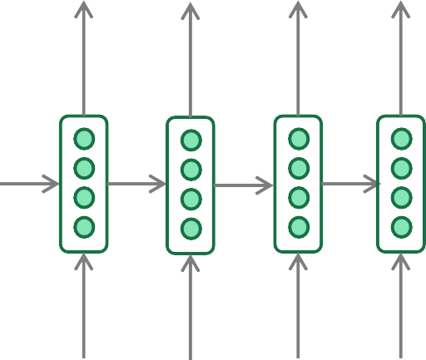
Greedy Decoding
We saw how to generate (or “decode”) the target sentence by
taking argmax on each step of the decoder
he hit me with a pie <END>
argmax
argmax
argmax
argmax
argmax
argmax
argmax
<START> he hit me with a pie
This is greedy decoding (take most probable word on each step)
Problems with this method?
Abigail See

Slide 46
Problems with Greedy Decoding
Greedy decoding has no way to undo decisions!
Input: il a m’entarté
→ he
→ he hit
→ he hit a
(he hit me with a pie)
(whoops! no going back now…)
How to fix this?
Abigail See

Slide 47
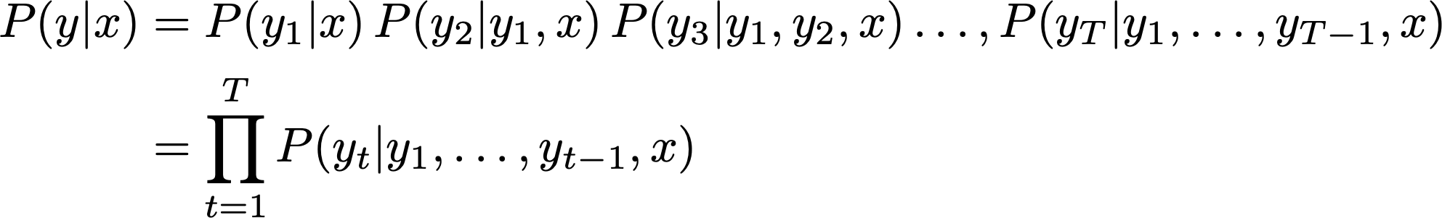
Exhaustive Search Decoding
Ideally we want to find a (length T) translation y that maximizes
We could try computing all possible sequences y
  This means that on each step t of the decoder, we’re tracking V^{T} possible partial translations, where V is vocabulary size
  This O(V^{T}) complexity is far too expensive!
Abigail See

Slide 48

Beam Search Decoding
Core idea: On each step of decoder, keep track of the k most probable partial translations (hypotheses)
  k is the beam size (in practice around 5 to 10)
A hypothesis has a score which is its log probability:
Scores are all negative, and higher score is better
We search for high-scoring hypotheses, tracking top k on each step
Beam search is not guaranteed to find optimal solution
But much more efficient than exhaustive search!
Abigail See

Slide 49
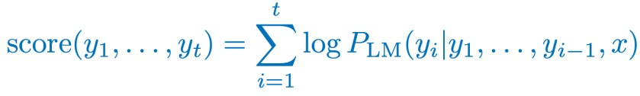
Beam Search Decoding: Example
Beam size = k = 2. Blue numbers =
<START>
Calculate prob
dist of next word
Abigail See

Slide 50
Beam Search Decoding: Example
Beam size = k = 2. Blue numbers =
-0.7 = log P_{LM}(he|<START>)
he
<START>
I
-0.9 = log P_{LM}(I|<START>)
Take top k words and compute scores
Abigail See

Slide 51
Beam Search Decoding: Example
Beam size = k = 2. Blue numbers =
-1.7 = log P_{LM}(hit|<START> he) + -0.7
-0.7
hit
he
struck
-2.9 = log P_{LM}(struck|<START> he) + -0.7
<START>
-1.6 = log P_{LM}(was|<START> I) + -0.9
was
I
got
-0.9
-1.8 = log P_{LM}(got|<START> I) + -0.9
For each of the k hypotheses, find
top k next words and calculate scores
Abigail See

Slide 52
Beam Search Decoding: Example
Beam size = k = 2. Blue numbers =
-1.7
-0.7
hit
he
struck
-2.9
<START>
-1.6
was
I
got
-0.9
-1.8
Of these k² hypotheses,
just keep k with highest scores
Abigail See

Slide 53
Beam Search Decoding: Example
Beam size = k = 2. Blue numbers =
-2.8 = log P_{LM}(a|<START> he hit) + -1.7
-1.7
a
-0.7
hit
he
me
struck
-2.5 = log P_{LM}(me|<START> he hit) + -1.7
-2.9
<START>
-2.9 = log P_{LM}(hit|<START> I was) + -1.6
-1.6
hit
was
I
struck
got
-0.9
-3.8 = log P_{LM}(struck|<START> I was) + -1.6
-1.8
For each of the k hypotheses, find
top k next words and calculate scores
Abigail See

Slide 54
Beam Search Decoding: Example
Beam size = k = 2. Blue numbers =
-2.8
-1.7
a
-0.7
hit
he
me
struck
-2.5
-2.9
<START>
-2.9
-1.6
hit
was
I
struck
got
-0.9
-3.8
-1.8
Of these k² hypotheses,
just keep k with highest scores
Abigail See

Slide 55
Beam Search Decoding: Example
Beam size = k = 2. Blue numbers =
-4.0
tart
-2.8
pie
-1.7
a
-0.7
hit
-3.4
he
me
-3.3
struck
-2.5
with
-2.9
<START>
-2.9
on
-1.6
hit
-3.5
was
I
struck
got
-0.9
-3.8
-1.8
For each of the k hypotheses, find
top k next words and calculate scores
Abigail See

Slide 56
Beam Search Decoding: Example
Beam size = k = 2. Blue numbers =
-4.0
tart
-2.8
pie
-1.7
a
-0.7
hit
-3.4
he
me
-3.3
struck
-2.5
with
-2.9
<START>
-2.9
on
-1.6
hit
-3.5
was
I
struck
got
-0.9
-3.8
-1.8
Of these k² hypotheses,
just keep k with highest scores
Abigail See

Slide 57
Beam Search Decoding: Example
Beam size = k = 2. Blue numbers =
-4.0
-4.8
tart
in
-2.8
pie
with
-1.7
a
-0.7
hit
-3.4
-4.5
he
me
-3.3
-3.7
struck
-2.5
with
a
-2.9
<START>
-2.9
on
one
-1.6
hit
-3.5
-4.3
was
I
struck
got
-0.9
-3.8
-1.8
For each of the k hypotheses, find
top k next words and calculate scores
Abigail See

Slide 58
Beam Search Decoding: Example
Beam size = k = 2. Blue numbers =
-4.0
-4.8
tart
in
-2.8
pie
with
-1.7
a
-0.7
hit
-3.4
-4.5
he
me
-3.3
-3.7
struck
-2.5
with
a
-2.9
<START>
-2.9
on
one
-1.6
hit
-3.5
-4.3
was
I
struck
got
-0.9
-3.8
-1.8
Of these k² hypotheses,
just keep k with highest scores
Abigail See

Slide 59
Beam Search Decoding: Example
Beam size = k = 2. Blue numbers =
-4.0
-4.8
tart
in
-2.8
-4.3
pie
with
-1.7
a
pie
-0.7
hit
-3.4
-4.5
he
me
-3.3
-3.7
tart
struck
-2.5
with
a
-4.6
-2.9
<START>
-2.9
on
one
-5.0
-1.6
hit
pie
-3.5
-4.3
was
I
struck
tart
got
-0.9
-3.8
-5.3
-1.8
For each of the k hypotheses, find
top k next words and calculate scores
Abigail See

Slide 60
Beam Search Decoding: Example
Beam size = k = 2. Blue numbers =
-4.0
-4.8
tart
in
-2.8
-4.3
pie
with
-1.7
a
pie
-0.7
hit
-3.4
-4.5
he
me
-3.3
-3.7
tart
struck
-2.5
with
a
-4.6
-2.9
<START>
-2.9
on
one
-5.0
-1.6
hit
pie
-3.5
-4.3
was
I
struck
tart
got
-0.9
-3.8
-5.3
-1.8
This is the top-scoring hypothesis!
Abigail See

Slide 61
Beam Search Decoding: Example
Beam size = k = 2. Blue numbers =
-4.0
-4.8
tart
in
-2.8
-4.3
pie
with
-1.7
a
pie
-0.7
hit
-3.4
-4.5
he
me
-3.3
-3.7
tart
struck
-2.5
with
a
-4.6
-2.9
<START>
-2.9
on
one
-5.0
-1.6
hit
pie
-3.5
-4.3
was
I
struck
tart
got
-0.9
-3.8
-5.3
-1.8
Backtrack to obtain the full hypothesis
Abigail See

Slide 62
Beam search decoding: stopping criterion
In greedy decoding, usually we decode until the model produces an <END> token
  For example: <START> he hit me with a pie <END>
In beam search decoding, different hypotheses may produce
<END> tokens on different timesteps
  When a hypothesis produces <END>, that hypothesis is complete.
  Place it aside and continue exploring other hypotheses via beam search.
Usually we continue beam search until:
  We reach timestep T (where T is some pre-defined cutoff), or
  We have at least n completed hypotheses (where n is pre-defined cutoff)
Abigail See

Slide 63
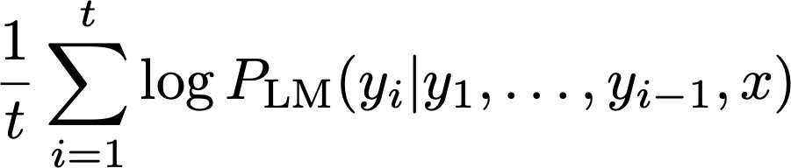
Beam Search Decoding: Finishing up
We have our list of completed hypotheses.
How to select top one with highest score?
Each hypothesis on our list has a score
Problem with this: longer hypotheses have lower scores
Fix: Normalize by length. Use this to select top one instead:
Abigail See

Slide 64
How do we evaluate neural machine translation?
BLEU (Bilingual Evaluation Understudy)
BLEU compares the machine-written translation to one or several human-written translation(s), and computes a similarity score based on:
  n-gram precision (usually for 1, 2, 3 and 4-grams)
  Plus a penalty for too-short system translations
BLEU is useful but imperfect
  There are many valid ways to translate a sentence
  So a good translation can get a poor BLEU score because it has low n-gram overlap with the human translation ☹
Abigail See
Source: ” BLEU: a Method for Automatic Evaluation of Machine Translation", Papineni et al, 2002.

Slide 65
NMT: the biggest success story of Neural NLP
Neural Machine Translation went from a fringe research activity in 2014 to the leading standard method in 2016
2014: First seq2seq paper published
2016: Google Translate switches from SMT to NMT
This is amazing!
  SMT systems, built by hundreds of engineers over many years, outperformed by NMT systems trained by a handful of engineers in a few months
Abigail See

Slide 66
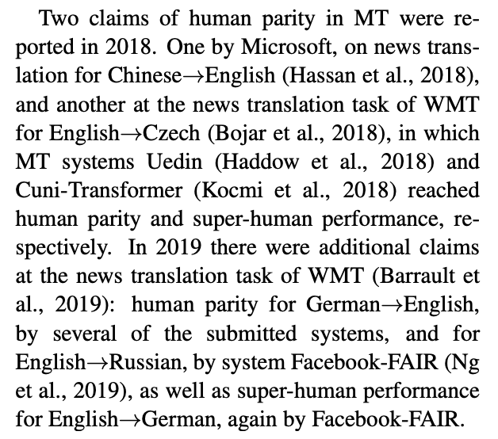
Is Machine Translation Solved?
Nope!
Many difficulties remain:
  Out-of-vocabulary words
  Domain mismatch between train and test data
  Maintaining context over longer text
  Low-resource language pairs
Further reading: “Has AI surpassed humans at translation? Not even close!”
https://www.skynettoday.com/editorials/state_of_nmt
“A deep learning system reaches news translation quality comparable to human professionals”
https://www.nature.com/articles/s41467-020-18073-9
“Reassessing claims of human parity and super-human performance in Machine Translation at WMT 2019”
https://arxiv.org/pdf/2005.05738.pdf
Adapted from Abigail See

Slide 67
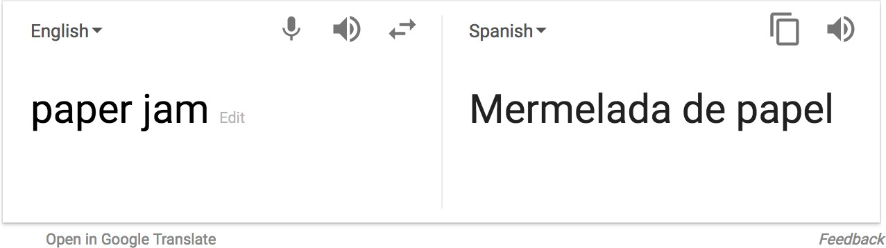

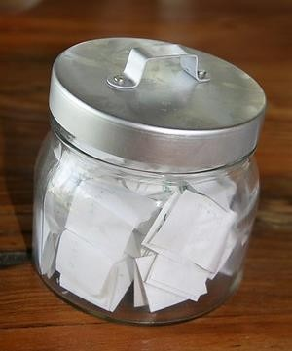
Is Machine Translation Solved?
Nope!
Using common sense is still hard
?
Abigail See

Slide 68
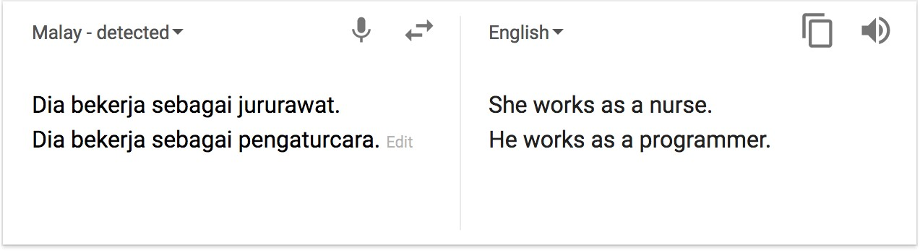
Is Machine Translation Solved?
Nope!
NMT picks up biases in training data
Didn’t specify gender
Source: https://hackernoon.com/bias-sexist-or-this-is-the-way-it-should-be-ce1f7c8c683c
Abigail See

Slide 69
NMT Research Continues
NMT is the flagship task for NLP Deep Learning
NMT research has pioneered many of the recent innovations of NLP Deep Learning
In 2019: NMT research continues to thrive
  Researchers have found many, many improvements to the “vanilla” seq2seq NMT system
  But one improvement is so integral that it is the new vanilla…
ATTENTION
Abigail See

Slide 70
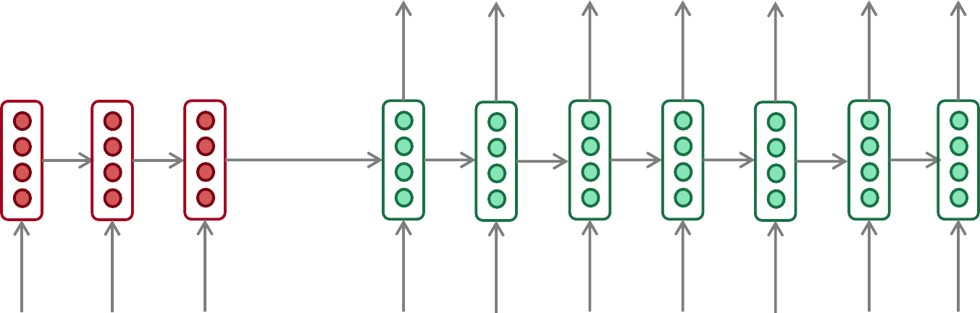
The Bottleneck Problem in Sequence-to-Sequence
Encoding of the
source sentence.
This needs to capture all information about the source sentence.
Information bottleneck!
Target sentence (output)
he
hit
me with
a
pie <END>
Encoder RNN
Decoder RNN
il
a
m’ entarté
<START> he
hit
me with
a
pie
Source sentence (input)
Abigail See

Slide 71

Attention
Attention provides a solution to the bottleneck problem.
Core idea: on each step of the decoder, use direct connection to the encoder to focus on a particular part of the source sequence
First we will show via diagram (no equations), then we will show with equations
Abigail See

Slide 72

Sequence-to-Sequence with Attention
dot product
Attention
scores
Decoder RNN
Encoder
RNN
il
a
m’ entarté
<START>
Source sentence (input)
Abigail See

Slide 73

Sequence-to-Sequence with Attention
dot product
Attention
scores
Decoder RNN
Encoder
RNN
il
a
m’ entarté
<START>
Source sentence (input)
Abigail See

Slide 74

Sequence-to-Sequence with Attention
dot product
Attention
scores
Decoder RNN
Encoder
RNN
il
a
m’ entarté
<START>
Source sentence (input)
Abigail See

Slide 75

Sequence-to-Sequence with Attention
dot product
Attention
scores
Decoder RNN
Encoder
RNN
il
a
m’ entarté
<START>
Source sentence (input)
Abigail See

Slide 76
Sequence-to-sequence with attention
On this decoder timestep, we’re mostly focusing on the first encoder hidden state (”he”)
Attention
distribution
Take softmax to turn the scores into a probability distribution
Attention
scores
Decoder RNN
Encoder
RNN
il
a
m’ entarté
<START>
Source sentence (input)
Abigail See

Slide 77

Sequence-to-Sequence with Attention
Attention output
Use the attention distribution to take a weighted sum of the encoder hidden states.
The attention output mostly contains information from the hidden states that received high attention.
Attention
distribution
Attention
scores
Decoder RNN
Encoder
RNN
il
a
m’ entarté
<START>
Source sentence (input)
Abigail See

Slide 78
Sequence-to-Sequence with Attention
Attention output
he
Concatenate attention output with decoder hidden state, then use to compute 𝑦₁ as before
Attention
distribution
𝑦₁
Attention
scores
Decoder RNN
Encoder
RNN
il
a
m’ entarté
<START>
Source sentence (input)
Abigail See

Slide 79


Sequence-to-Sequence with Attention
Attention output
hit
Attention
distribution
𝑦₂
Attention
scores
Decoder RNN
Encoder
RNN
Sometimes we take the attention output from the previous step, and also feed it into the decoder (along with the usual decoder input).
il
a
m’ entarté
<START> he
Source sentence (input)
Abigail See

Slide 80











Attention in Equations
We have encoder hidden states
On timestep t, we have decoder hidden state
We get the attention scores for this step:
We take softmax to get the attention distribution
a probability distribution and sums to 1)
for this step (this is
We use to take a weighted sum of the encoder hidden states to get the attention output
Finally we concatenate the attention output with the decoder hidden state and proceed as in the non-attention seq2seq model
Abigail See

Slide 81
Attention is Great
Attention significantly improves NMT performance
  It’s very useful to allow decoder to focus on certain parts of the source
Attention solves the bottleneck problem
  Attention allows decoder to look directly at source; bypass bottleneck
Attention helps with vanishing gradient problem
  Provides shortcut to faraway states
Attention provides some interpretability
  By inspecting attention distribution, we can see what the decoder was focusing on
  We get (soft) alignment for free!
  This is cool because we never explicitly trained an alignment system
  The network just learned alignment by itself
he | hit | me | with | a | pie
il
a
m’
entarté
Abigail See

Slide 82
Attention is a general deep learning technique
We’ve seen that attention is a great way to improve the
sequence-to-sequence model for Machine Translation.
However: You can use attention in many architectures (not just seq2seq) and many tasks (not just MT)
More general definition of attention:
  Given a set of vector values, and a vector query, attention is a technique to compute a weighted sum of the values, dependent on the query.
We sometimes say that the query attends to the values.
For example, in seq2seq + attention model, each decoder hidden state (query) attends to all encoder hidden states (values).
Abigail See

Slide 83

Image Captioning
CVPR 2015:
Deep Visual-Semantic Alignments for Generating Image Descriptions, Karpathy and Fei-Fei Show and Tell: A Neural Image Caption Generator, Vinyals et al.
Long-term Recurrent Convolutional Networks for Visual Recognition and Description, Donahue et al. Learning a Recurrent Visual Representation for Image Caption Generation, Chen and Zitnick
Adapted from Andrej Karpathy

Slide 84
Recurrent Neural Network
Image Captioning
Convolutional Neural Network
Andrej Karpathy

Slide 85


test image
Image Captioning
x0
<START>
<START>
Andrej Karpathy

Slide 86
Image Captioning
test image
y0
before:
h = tanh(W_{xh} * x + W_{hh} * h)
h0
Wih
now:
h = tanh(W_{xh} * x + W_{hh} * h + W_{ih} * im)
x0
<START>
im
<START>
Andrej Karpathy

Slide 87
test image
Image Captioning
y0
sample!
h0
x0
<START>
straw
<START>
Andrej Karpathy

Slide 88
test image
Image Captioning
y0
y1
h0
h1
x0
<START>
straw
<START>
Andrej Karpathy

Slide 89
test image
Image Captioning
y0
y1
sample!
h0
h1
x0
<START>
straw
hat
<START>
Andrej Karpathy

Slide 90
test image
Image Captioning
y0
y1
y2
h0
h1
h2
x0
<START>
straw
hat
<START>
Andrej Karpathy

Slide 91
test image
Image Captioning
Caption generated:
“straw hat”
y0
y1
y2
sample
<END> token
=> finish.
h0
h1
h2
x0
<START>
straw
hat
<START>
Adapted from Andrej Karpathy

Slide 92

Andrej Karpathy

Slide 93


Video Captioning
English Sentence
RNN
encoder
RNN
decoder
French Sentence
[Sutskever et al. NIPS’14]
RNN
decoder
[Donahue et al. CVPR’15] [Vinyals et al. CVPR’15]
Encode
Sentence
RNN
decoder
Encode
Sentence
[Venugopalan et. al. NAACL’15] (this work)
Key Insight:
Generate feature representation of the video and “decode” it to a sentence
Venugopalan et al., “Translating Videos to Natural Language using Deep Recurrent Neural Networks”, NAACL-HTL 2015

Slide 94





Video Captioning
Input Video
Convolutional Net Recurrent Net
LSTM LSTM
LSTM LSTM
LSTM LSTM
LSTM LSTM
LSTM LSTM
LSTM LSTM
Output
A
boy
. .
.
is
playing
golf
<EOS>
Mean across all frames
Venugopalan et al., “Translating Videos to Natural Language using Deep Recurrent Neural Networks”, NAACL-HTL 2015

Slide 95








Video Captioning
FGM: A person is dancing with the person on the stage. YT: A group of men are riding the forest.
I+V: A group of people are dancing.
GT: Many men and women are dancing in the street.
FGM: A person is cutting a potato in the kitchen. YT: A man is slicing a tomato.
I+V: A man is slicing a carrot.
GT: A man is slicing carrots.
FGM: A person is walking with a person in the forest. YT: A monkey is walking.
I+V: A bear is eating a tree.
GT: Two bear cubs are digging into dirt and plant matter at the base of a tree.
FGM: A person is riding a horse on the stage. YT: A group of playing are playing in the ball. I+V: A basketball player is playing.
GT: Dwayne wade does a fancy layup in an allstar game.
Venugopalan et al., “Translating Videos to Natural Language using Deep Recurrent Neural Networks”, NAACL-HTL 2015

Slide 96


Video Captioning
English Sentence
RNN
encoder
RNN
decoder
French Sentence
[Sutskever et al. NIPS’14]
RNN
decoder
[Donahue et al. CVPR’15] [Vinyals et al. CVPR’15]
Encode
Sentence
RNN
decoder
Encode
Sentence
[Venugopalan et. al. NAACL’15]
Encode
RNN
encoder
RNN
decoder
Sentence
[Venugopalan et. al. ICCV’ 15] (this work)
3
Venugopalan et al., “Sequence to Sequence - Video to Text”, ICCV 2015

Slide 97




S2VT Overview
Video Captioning
CNN
CNN
CNN
CNN
Now decode it to a sentence!
LSTM
LSTM
LSTM
LSTM
LSTM
LSTM
LSTM
LSTM
...
LSTM
LSTM
LSTM
LSTM
LSTM
LSTM
LSTM
LSTM
Encoding stage
A
man
is
talking ...
Decoding stage
Venugopalan et al., “Sequence to Sequence - Video to Text”, ICCV 2015

