Slide 1

CS 7150
Deep Learning

Slide 2
Neural Machine Translation
Neural Machine Translation (NMT) is a way to do Machine Translation with a single neural network
The neural network architecture is called sequence-to-sequence (aka seq2seq) and it involves two RNNs.
Abigail See

Slide 3
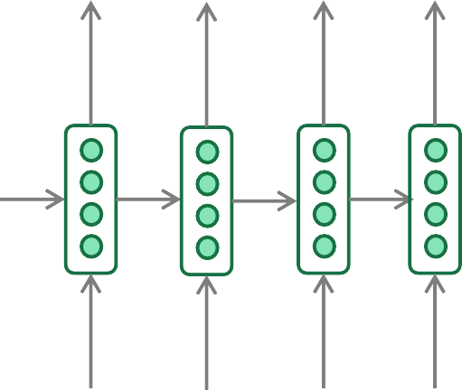
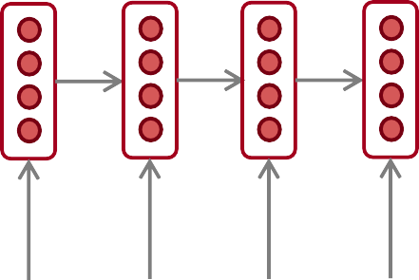
Neural Machine Translation (NMT)
The sequence-to-sequence model
Encoding of the source sentence.
Target sentence (output)
Provides initial hidden state
for Decoder RNN.
he
hit
me
with
a
pie <END>
argmax
argmax
argmax
argmax
argmax
argmax
argmax
Encoder RNN
Decoder RNN
il
a
m’ entarté
<START> he hit me with a pie
Source sentence (input)
Decoder RNN is a Language Model that generates target sentence, conditioned on encoding.
Encoder RNN produces an encoding of the source sentence.
Note: This diagram shows test time behavior:
decoder output is fed in as next step’s input
Abigail See

Slide 4
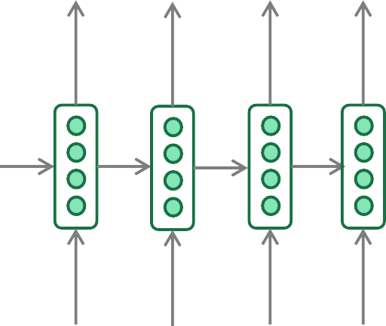
Greedy Decoding
We saw how to generate (or “decode”) the target sentence by
taking argmax on each step of the decoder
he hit me with a pie <END>
argmax
argmax
argmax
argmax
argmax
argmax
argmax
<START> he hit me with a pie
This is greedy decoding (take most probable word on each step)
Problems with this method?
Abigail See

Slide 5
Problems with Greedy Decoding
Greedy decoding has no way to undo decisions!
Input: il a m’entarté
→ he
→ he hit
→ he hit a
(he hit me with a pie)
(whoops! no going back now…)
How to fix this?
Abigail See

Slide 6
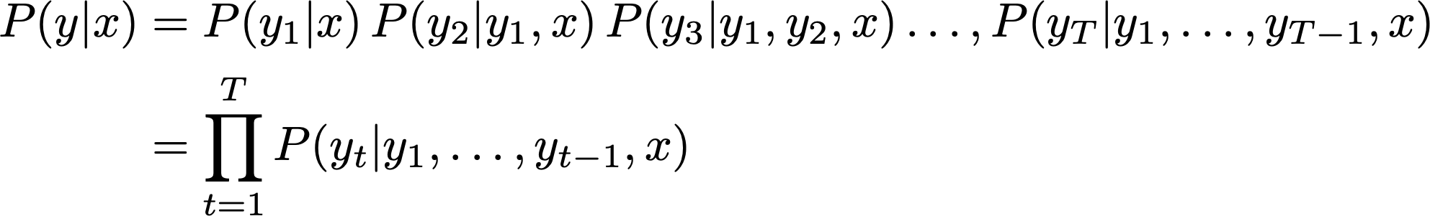
Exhaustive Search Decoding
Ideally we want to find a (length T) translation y that maximizes
We could try computing all possible sequences y
  This means that on each step t of the decoder, we’re tracking V^{T} possible partial translations, where V is vocabulary size
  This O(V^{T}) complexity is far too expensive!
Abigail See

Slide 7

Beam Search Decoding
Core idea: On each step of decoder, keep track of the k most probable partial translations (hypotheses)
  k is the beam size (in practice around 5 to 10)
A hypothesis has a score which is its log probability:
Scores are all negative, and higher score is better
We search for high-scoring hypotheses, tracking top k on each step
Beam search is not guaranteed to find optimal solution
But much more efficient than exhaustive search!
Abigail See

Slide 8
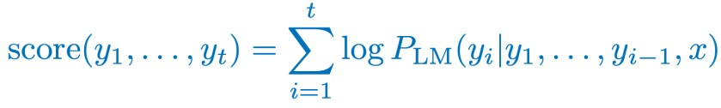
Beam Search Decoding: Example
Beam size = k = 2. Blue numbers =
<START>
Calculate prob
dist of next word
Abigail See

Slide 9
Beam Search Decoding: Example
Beam size = k = 2. Blue numbers =
-0.7 = log P_{LM}(he|<START>)
he
<START>
I
-0.9 = log P_{LM}(I|<START>)
Take top k words and compute scores
Abigail See

Slide 10
Beam Search Decoding: Example
Beam size = k = 2. Blue numbers =
-1.7 = log P_{LM}(hit|<START> he) + -0.7
-0.7
hit
he
struck
-2.9 = log P_{LM}(struck|<START> he) + -0.7
<START>
-1.6 = log P_{LM}(was|<START> I) + -0.9
was
I
got
-0.9
-1.8 = log P_{LM}(got|<START> I) + -0.9
For each of the k hypotheses, find
top k next words and calculate scores
Abigail See

Slide 11
Beam Search Decoding: Example
Beam size = k = 2. Blue numbers =
-1.7
-0.7
hit
he
struck
-2.9
<START>
-1.6
was
I
got
-0.9
-1.8
Of these k² hypotheses,
just keep k with highest scores
Abigail See

Slide 12
Beam Search Decoding: Example
Beam size = k = 2. Blue numbers =
-2.8 = log P_{LM}(a|<START> he hit) + -1.7
-1.7
a
-0.7
hit
he
me
struck
-2.5 = log P_{LM}(me|<START> he hit) + -1.7
-2.9
<START>
-2.9 = log P_{LM}(hit|<START> I was) + -1.6
-1.6
hit
was
I
struck
got
-0.9
-3.8 = log P_{LM}(struck|<START> I was) + -1.6
-1.8
For each of the k hypotheses, find
top k next words and calculate scores
Abigail See

Slide 13
Beam Search Decoding: Example
Beam size = k = 2. Blue numbers =
-2.8
-1.7
a
-0.7
hit
he
me
struck
-2.5
-2.9
<START>
-2.9
-1.6
hit
was
I
struck
got
-0.9
-3.8
-1.8
Of these k² hypotheses,
just keep k with highest scores
Abigail See

Slide 14
Beam Search Decoding: Example
Beam size = k = 2. Blue numbers =
-4.0
tart
-2.8
pie
-1.7
a
-0.7
hit
-3.4
he
me
-3.3
struck
-2.5
with
-2.9
<START>
-2.9
on
-1.6
hit
-3.5
was
I
struck
got
-0.9
-3.8
-1.8
For each of the k hypotheses, find
top k next words and calculate scores
Abigail See

Slide 15
Beam Search Decoding: Example
Beam size = k = 2. Blue numbers =
-4.0
tart
-2.8
pie
-1.7
a
-0.7
hit
-3.4
he
me
-3.3
struck
-2.5
with
-2.9
<START>
-2.9
on
-1.6
hit
-3.5
was
I
struck
got
-0.9
-3.8
-1.8
Of these k² hypotheses,
just keep k with highest scores
Abigail See

Slide 16
Beam Search Decoding: Example
Beam size = k = 2. Blue numbers =
-4.0
-4.8
tart
in
-2.8
pie
with
-1.7
a
-0.7
hit
-3.4
-4.5
he
me
-3.3
-3.7
struck
-2.5
with
a
-2.9
<START>
-2.9
on
one
-1.6
hit
-3.5
-4.3
was
I
struck
got
-0.9
-3.8
-1.8
For each of the k hypotheses, find
top k next words and calculate scores
Abigail See

Slide 17
Beam Search Decoding: Example
Beam size = k = 2. Blue numbers =
-4.0
-4.8
tart
in
-2.8
pie
with
-1.7
a
-0.7
hit
-3.4
-4.5
he
me
-3.3
-3.7
struck
-2.5
with
a
-2.9
<START>
-2.9
on
one
-1.6
hit
-3.5
-4.3
was
I
struck
got
-0.9
-3.8
-1.8
Of these k² hypotheses,
just keep k with highest scores
Abigail See

Slide 18
Beam Search Decoding: Example
Beam size = k = 2. Blue numbers =
-4.0
-4.8
tart
in
-2.8
-4.3
pie
with
-1.7
a
pie
-0.7
hit
-3.4
-4.5
he
me
-3.3
-3.7
tart
struck
-2.5
with
a
-4.6
-2.9
<START>
-2.9
on
one
-5.0
-1.6
hit
pie
-3.5
-4.3
was
I
struck
tart
got
-0.9
-3.8
-5.3
-1.8
For each of the k hypotheses, find
top k next words and calculate scores
Abigail See

Slide 19
Beam Search Decoding: Example
Beam size = k = 2. Blue numbers =
-4.0
-4.8
tart
in
-2.8
-4.3
pie
with
-1.7
a
pie
-0.7
hit
-3.4
-4.5
he
me
-3.3
-3.7
tart
struck
-2.5
with
a
-4.6
-2.9
<START>
-2.9
on
one
-5.0
-1.6
hit
pie
-3.5
-4.3
was
I
struck
tart
got
-0.9
-3.8
-5.3
-1.8
This is the top-scoring hypothesis!
Abigail See

Slide 20
Beam Search Decoding: Example
Beam size = k = 2. Blue numbers =
-4.0
-4.8
tart
in
-2.8
-4.3
pie
with
-1.7
a
pie
-0.7
hit
-3.4
-4.5
he
me
-3.3
-3.7
tart
struck
-2.5
with
a
-4.6
-2.9
<START>
-2.9
on
one
-5.0
-1.6
hit
pie
-3.5
-4.3
was
I
struck
tart
got
-0.9
-3.8
-5.3
-1.8
Backtrack to obtain the full hypothesis
Abigail See

Slide 21
Beam search decoding: stopping criterion
In greedy decoding, usually we decode until the model produces an <END> token
  For example: <START> he hit me with a pie <END>
In beam search decoding, different hypotheses may produce
<END> tokens on different timesteps
  When a hypothesis produces <END>, that hypothesis is complete.
  Place it aside and continue exploring other hypotheses via beam search.
Usually we continue beam search until:
  We reach timestep T (where T is some pre-defined cutoff), or
  We have at least n completed hypotheses (where n is pre-defined cutoff)
Abigail See

Slide 22
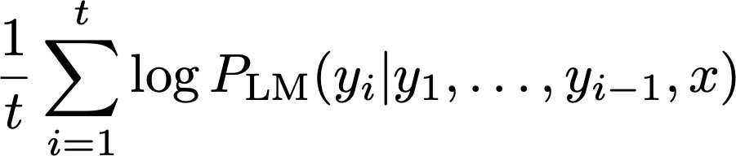
Beam Search Decoding: Finishing up
We have our list of completed hypotheses.
How to select top one with highest score?
Each hypothesis on our list has a score
Problem with this: longer hypotheses have lower scores
Fix: Normalize by length. Use this to select top one instead:
Abigail See

Slide 23
How do we evaluate neural machine translation?
BLEU (Bilingual Evaluation Understudy)
BLEU compares the machine-written translation to one or several human-written translation(s), and computes a similarity score based on:
  n-gram precision (usually for 1, 2, 3 and 4-grams)
  Plus a penalty for too-short system translations
BLEU is useful but imperfect
  There are many valid ways to translate a sentence
  So a good translation can get a poor BLEU score because it has low n-gram overlap with the human translation ☹
Abigail See
Source: ” BLEU: a Method for Automatic Evaluation of Machine Translation", Papineni et al, 2002.

Slide 24
NMT: the biggest success story of Neural NLP
Neural Machine Translation went from a fringe research activity in 2014 to the leading standard method in 2016
2014: First seq2seq paper published
2016: Google Translate switches from SMT to NMT
This is amazing!
  SMT systems, built by hundreds of engineers over many years, outperformed by NMT systems trained by a handful of engineers in a few months
Abigail See

Slide 25
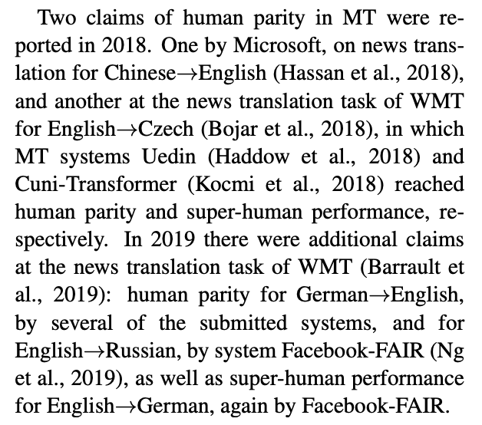
Is Machine Translation Solved?
Nope!
Many difficulties remain:
  Out-of-vocabulary words
  Domain mismatch between train and test data
  Maintaining context over longer text
  Low-resource language pairs
Further reading: “Has AI surpassed humans at translation? Not even close!”
https://www.skynettoday.com/editorials/state_of_nmt
“A deep learning system reaches news translation quality comparable to human professionals”
https://www.nature.com/articles/s41467-020-18073-9
“Reassessing claims of human parity and super-human performance in Machine Translation at WMT 2019”
https://arxiv.org/pdf/2005.05738.pdf
Adapted from Abigail See

Slide 26


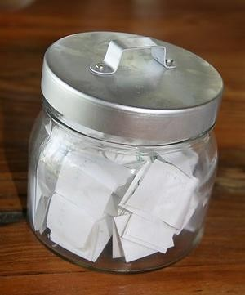
Is Machine Translation Solved?
Nope!
Using common sense is still hard
?
Abigail See

Slide 27
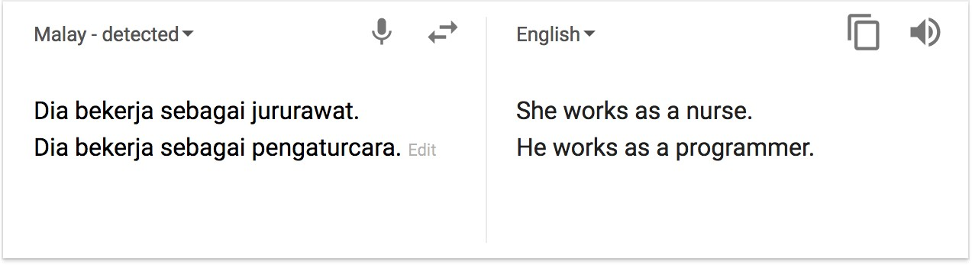
Is Machine Translation Solved?
Nope!
NMT picks up biases in training data
Didn’t specify gender
Source: https://hackernoon.com/bias-sexist-or-this-is-the-way-it-should-be-ce1f7c8c683c
Abigail See

Slide 28
NMT Research Continues
NMT is the flagship task for NLP Deep Learning
NMT research has pioneered many of the recent innovations of NLP Deep Learning
In 2019: NMT research continues to thrive
  Researchers have found many, many improvements to the “vanilla” seq2seq NMT system
  But one improvement is so integral that it is the new vanilla…
ATTENTION
Abigail See

Slide 29
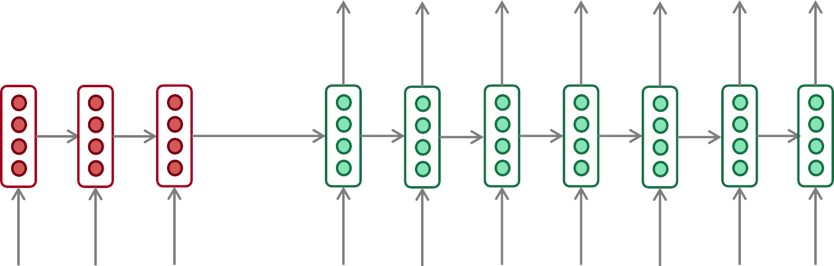
The Bottleneck Problem in Sequence-to-Sequence
Encoding of the
source sentence.
This needs to capture all information about the source sentence.
Information bottleneck!
Target sentence (output)
he
hit
me with
a
pie <END>
Encoder RNN
Decoder RNN
il
a
m’ entarté
<START> he
hit
me with
a
pie
Source sentence (input)
Abigail See

Slide 30
The Bottleneck Problem in Sequence-to-Sequence
Reversing the sentence improves performance...
Why?
Target sentence (output)
he
hit
me with
a
pie <END>
Encoder RNN
Decoder RNN
entarté
m’
a
il
<START> he
hit
me with
a
pie
Source sentence (input)
Abigail See

Slide 31

Attention
Attention provides a solution to the bottleneck problem.
Core idea: on each step of the decoder, use direct connection to the encoder to focus on a particular part of the source sequence
First we will show via diagram (no equations), then we will show with equations
Abigail See

Slide 32
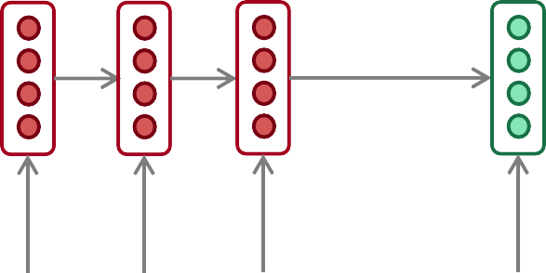
Sequence-to-Sequence with Attention
dot product
Attention
scores
Decoder RNN
Encoder
RNN
il
a
m’ entarté
<START>
Source sentence (input)
Abigail See

Slide 33
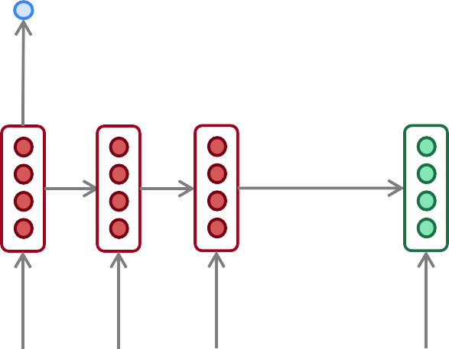
Sequence-to-Sequence with Attention
dot product
Attention
scores
Decoder RNN
Encoder
RNN
il
a
m’ entarté
<START>
Source sentence (input)
Abigail See

Slide 34
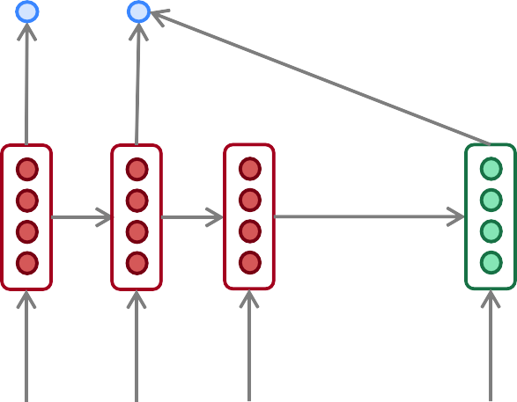
Sequence-to-Sequence with Attention
dot product
Attention
scores
Decoder RNN
Encoder
RNN
il
a
m’ entarté
<START>
Source sentence (input)
Abigail See

Slide 35
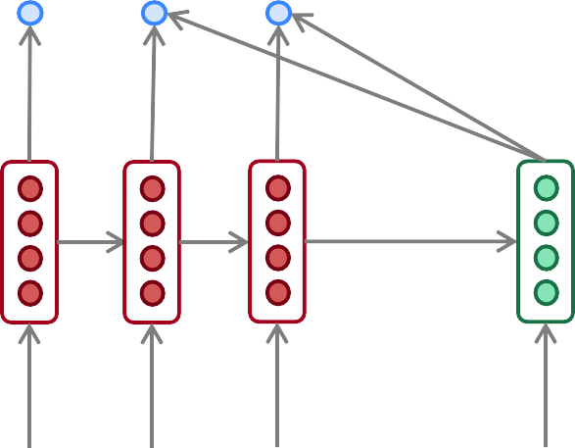
Sequence-to-Sequence with Attention
dot product
Attention
scores
Decoder RNN
Encoder
RNN
il
a
m’ entarté
<START>
Source sentence (input)
Abigail See

Slide 36
Sequence-to-sequence with attention
On this decoder timestep, we’re mostly focusing on the first encoder hidden state (”he”)
Attention
distribution
Take softmax to turn the scores into a probability distribution
Attention
scores
Decoder RNN
Encoder
RNN
il
a
m’ entarté
<START>
Source sentence (input)
Abigail See

Slide 37
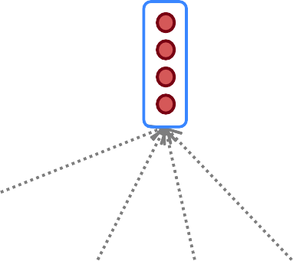
Sequence-to-Sequence with Attention
Attention output
Use the attention distribution to take a weighted sum of the encoder hidden states.
The attention output mostly contains information from the hidden states that received high attention.
Attention
distribution
Attention
scores
Decoder RNN
Encoder
RNN
il
a
m’ entarté
<START>
Source sentence (input)
Abigail See

Slide 38
Sequence-to-Sequence with Attention
Attention output
he
Concatenate attention output with decoder hidden state, then use to compute 𝑦₁ as before
Attention
distribution
𝑦₁
Attention
scores
Decoder RNN
Encoder
RNN
il
a
m’ entarté
<START>
Source sentence (input)
Abigail See

Slide 39
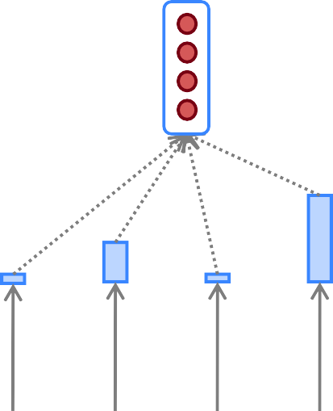
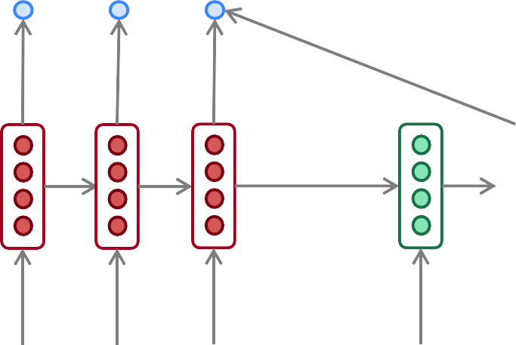
Sequence-to-Sequence with Attention
Attention output
hit
Attention
distribution
𝑦₂
Attention
scores
Decoder RNN
Encoder
RNN
Sometimes we take the attention output from the previous step, and also feed it into the decoder (along with the usual decoder input).
il
a
m’ entarté
<START> he
Source sentence (input)
Abigail See

Slide 40
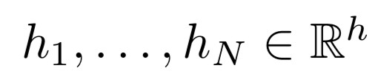






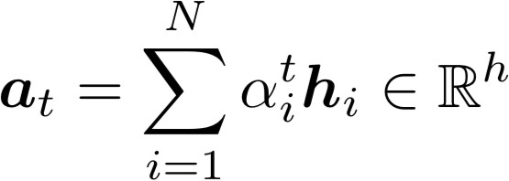



Attention in Equations
We have encoder hidden states
On timestep t, we have decoder hidden state
We get the attention scores for this step:
We take softmax to get the attention distribution
a probability distribution and sums to 1)
for this step (this is
We use to take a weighted sum of the encoder hidden states to get the attention output
Finally we concatenate the attention output with the decoder hidden state and proceed as in the non-attention seq2seq model
Abigail See

Slide 41
Attention is Great
Attention significantly improves NMT performance
  It’s very useful to allow decoder to focus on certain parts of the source
Attention solves the bottleneck problem
  Attention allows decoder to look directly at source; bypass bottleneck
Attention helps with vanishing gradient problem
  Provides shortcut to faraway states
Attention provides some interpretability
  By inspecting attention distribution, we can see what the decoder was focusing on
  We get (soft) alignment for free!
  This is cool because we never explicitly trained an alignment system
  The network just learned alignment by itself
he | hit | me | with | a | pie
il
a
m’
entarté
Abigail See

Slide 42
Attention is a general deep learning technique
We’ve seen that attention is a great way to improve the
sequence-to-sequence model for Machine Translation.
However: You can use attention in many architectures (not just seq2seq) and many tasks (not just MT)
More general definition of attention:
  Given a set of vector values, and a vector query, attention is a technique to compute a weighted sum of the values, dependent on the query.
We sometimes say that the query attends to the values.
For example, in seq2seq + attention model, each decoder hidden state (query) attends to all encoder hidden states (values).
Abigail See

Slide 43
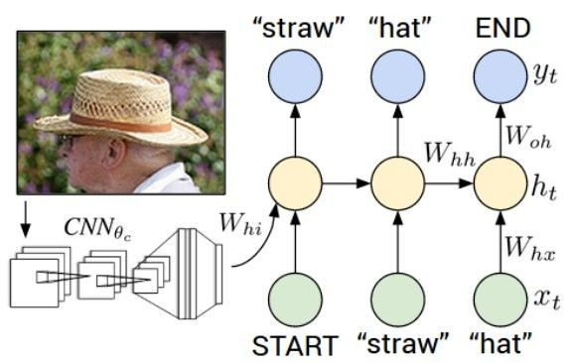
Image Captioning
CVPR 2015:
Deep Visual-Semantic Alignments for Generating Image Descriptions, Karpathy and Fei-Fei Show and Tell: A Neural Image Caption Generator, Vinyals et al.
Long-term Recurrent Convolutional Networks for Visual Recognition and Description, Donahue et al. Learning a Recurrent Visual Representation for Image Caption Generation, Chen and Zitnick
Adapted from Andrej Karpathy

Slide 44
Recurrent Neural Network
Image Captioning
Convolutional Neural Network
Andrej Karpathy

Slide 45
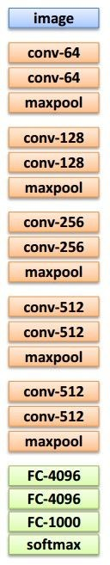

test image
Image Captioning
x0
<START>
<START>
Andrej Karpathy

Slide 46
Image Captioning
test image
y0
before:
h = tanh(W_{xh} * x + W_{hh} * h)
h0
Wih
now:
h = tanh(W_{xh} * x + W_{hh} * h + W_{ih} * im)
x0
<START>
im
<START>
Andrej Karpathy

Slide 47
test image
Image Captioning
y0
sample!
h0
x0
<START>
straw
<START>
Andrej Karpathy

Slide 48
test image
Image Captioning
y0
y1
h0
h1
x0
<START>
straw
<START>
Andrej Karpathy

Slide 49
test image
Image Captioning
y0
y1
sample!
h0
h1
x0
<START>
straw
hat
<START>
Andrej Karpathy

Slide 50
test image
Image Captioning
y0
y1
y2
h0
h1
h2
x0
<START>
straw
hat
<START>
Andrej Karpathy

Slide 51
test image
Image Captioning
Caption generated:
“straw hat”
y0
y1
y2
sample
<END> token
=> finish.
h0
h1
h2
x0
<START>
straw
hat
<START>
Adapted from Andrej Karpathy

Slide 52
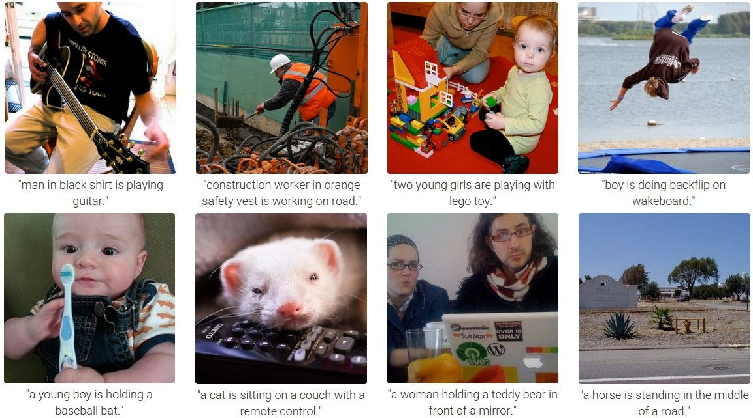
Andrej Karpathy

Slide 53
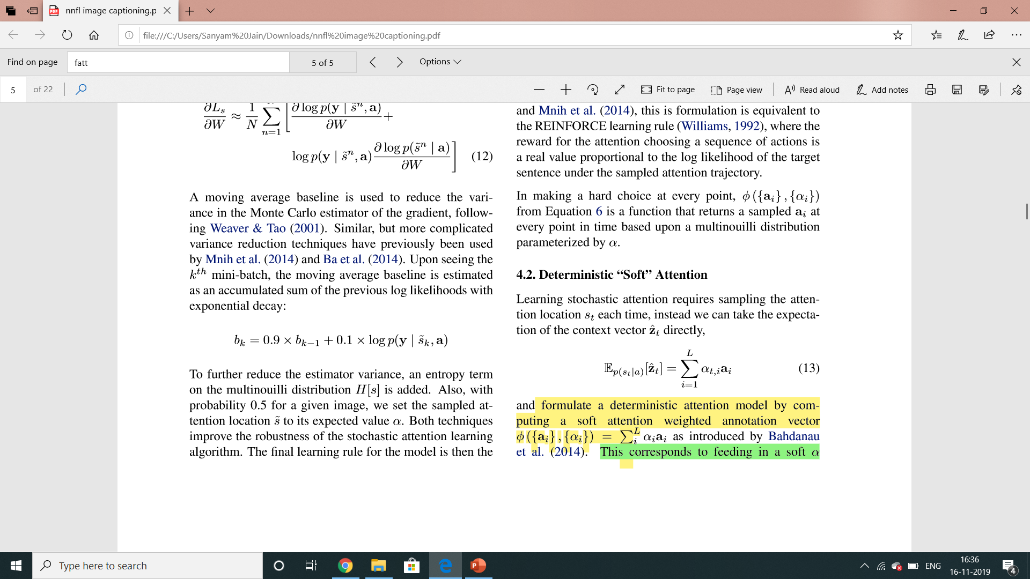
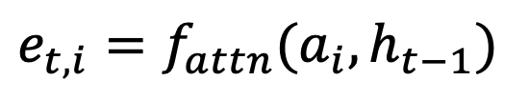
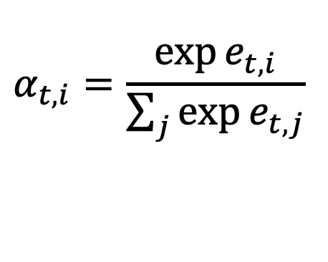
Attention-based captioning
Attention score over every patch i: e_ti =f_att(a_i,h_t-1)
Softmax to normalize and get attention weights:
Compute z for token t by just taking a weighted sum (input to decoder): z
$$e_{t,i}=f_{attn}(a_{i},h_{t−1})$$
$$α_{t,i}=\frac{\exp{e_{t,i}}}{\sum_{j}{\exp{e_{t,j}}}}$$

Slide 54
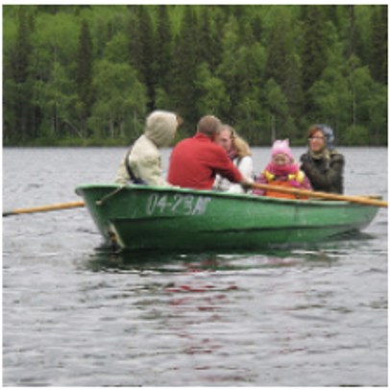

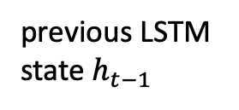

test image
Attention-based captioning
Caption generated:
“a group of people on a boat”
y0
y1
y2
“people”
z0
z1
z1
grid of $a_{i}$
previous LSTM state $h_{t−1}$
h1
h1
h0
x0
<START>
group
of
<START>
Adapted from Andrej Karpathy

Slide 55
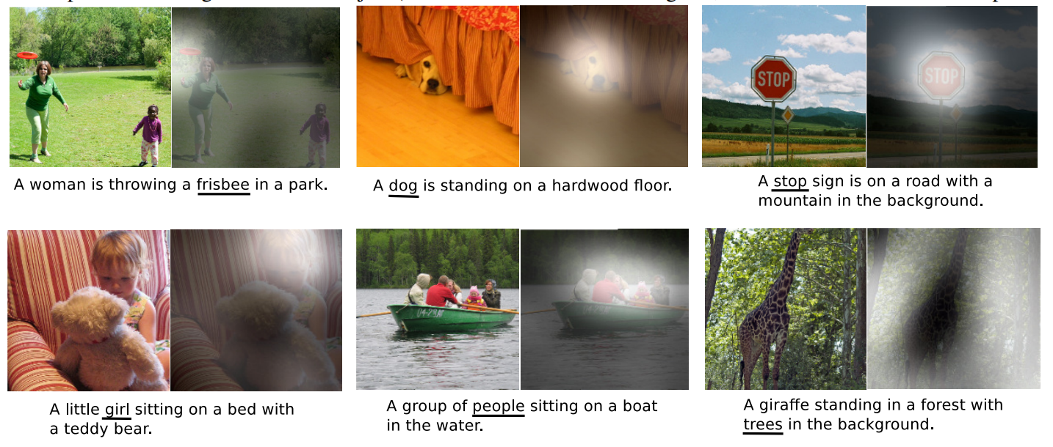
Attention-based captioning

Slide 56
Transformers
Attention is all you need.

Slide 57
Transformer papers
Vaswani 2017 (Transformers) “Attention is all you need”
https://arxiv.org/abs/1706.03762
Radford 2018, 2019 (GPT, GPT-2)
“Language models are Unsupervised Multitask Learners”
Devlin 2018 (Bert) “Pre-training of deep bidirectional transformers” https://arxiv.org/abs/1810.04805
Fedus 2021 (Switch Transformers) “Scaling to Trillion-Parameter models” https://arxiv.org/abs/2101.03961
Dosovitskiy 2020 (Visual Transformers) “An image is worth 16x16 words” https://arxiv.org/pdf/2010.11929.pdf
Chen 2020 (Image GPT) “Generative Pretraining from Pixels”

Slide 58
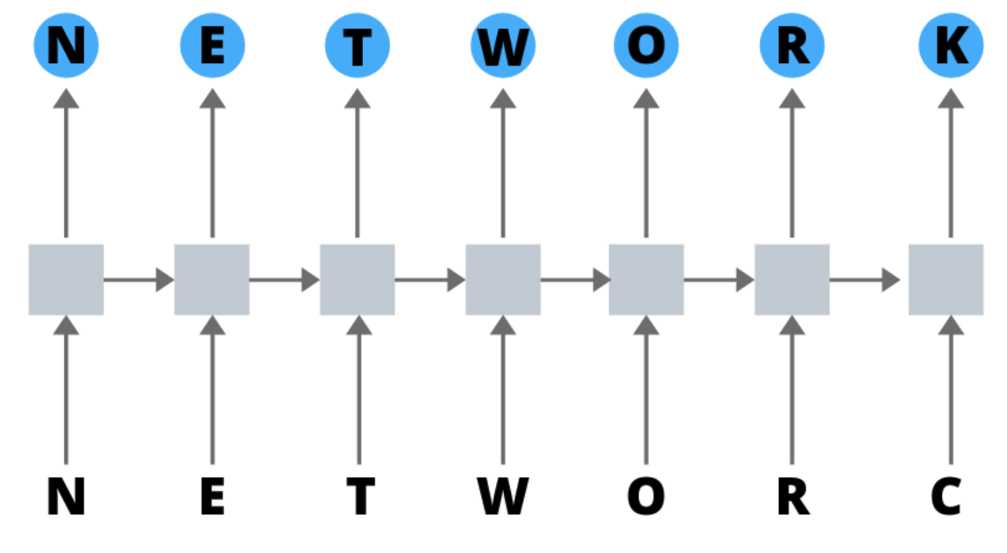
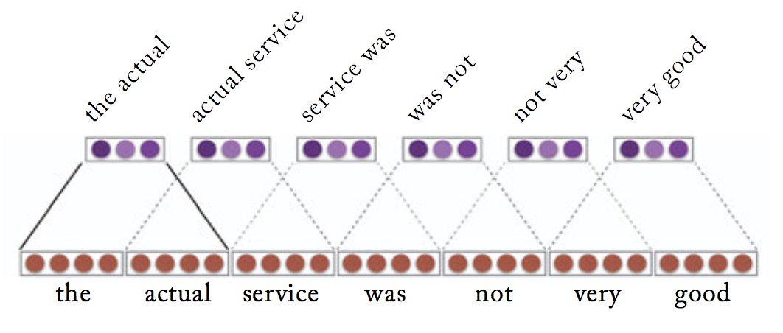
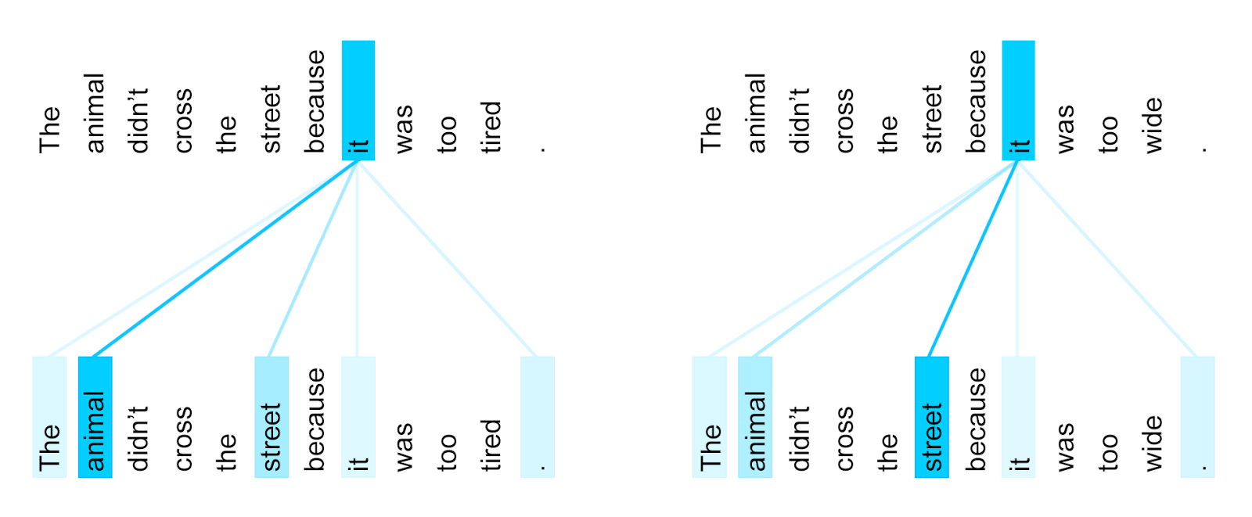
History of NLP architectures
RNN: Represent “Everything seen so far”
Attend to last encoding, recursively.
Convolution: Represent “Everything seen nearby”
Attend to nearby encodings, in parallel.
Attention: Represent “Everything relevant”
Attend to relevant encodings, in parallel.

Slide 59
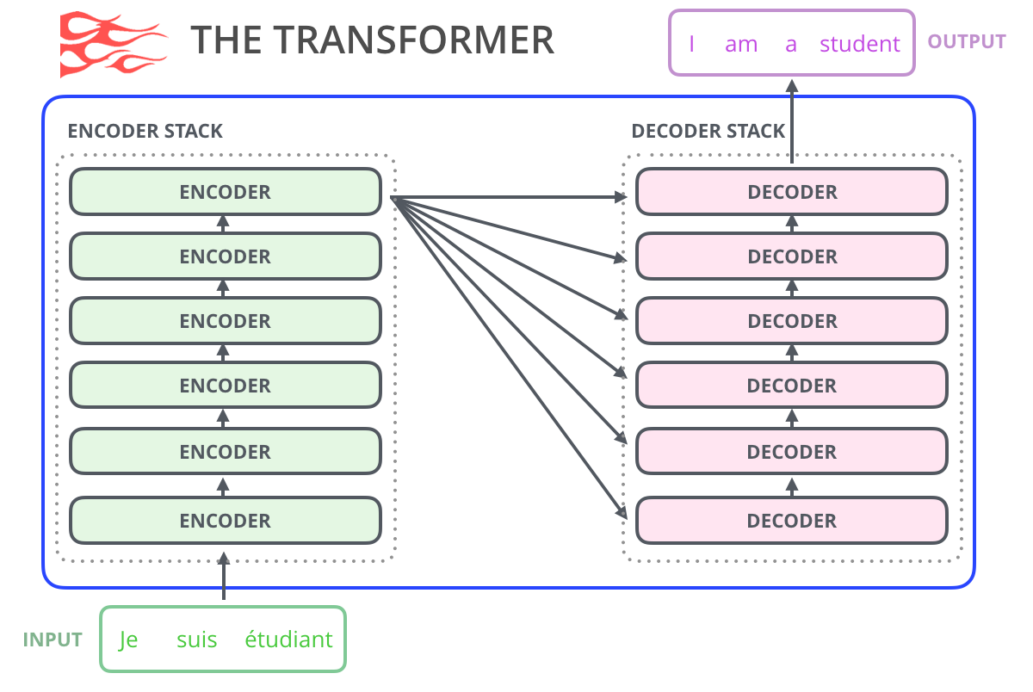
Attention is All You Need (Vaswani 2017 - Google)
Natural Language Translation
Start with an independent encoding for each word.
Improve each word’s encoding by incorporating context, using a stack of six encoders.
Generate target sentence using a stack of six decoders.
Overview figure from Jay Alammar’s blog

Slide 60
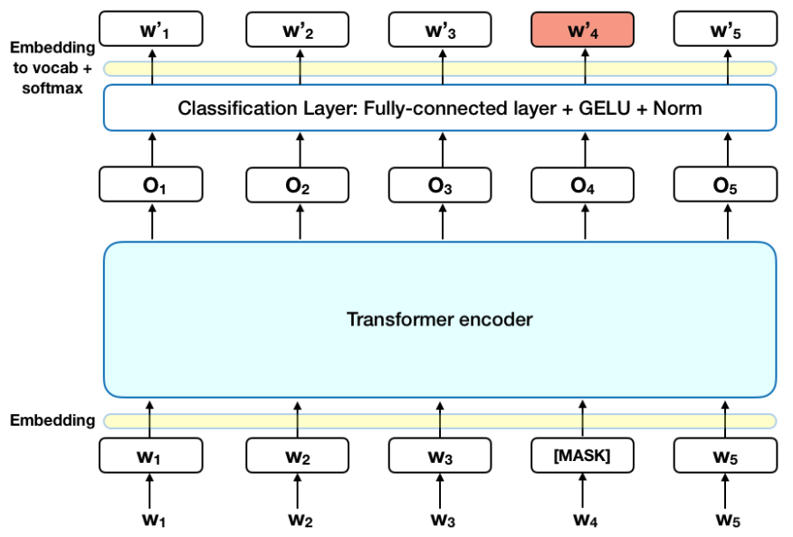
One vector for every token, through a stack of layers
Analogous to a convnet without any resolution change.
Input: one vec for every token.
Output: one vec for every token.
Computation: a stack of neural network layers.
Objective: correctly predict the next word (or other similar obj.)

Slide 61
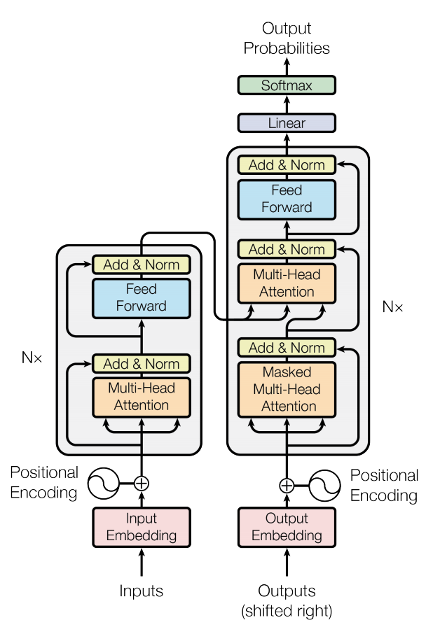
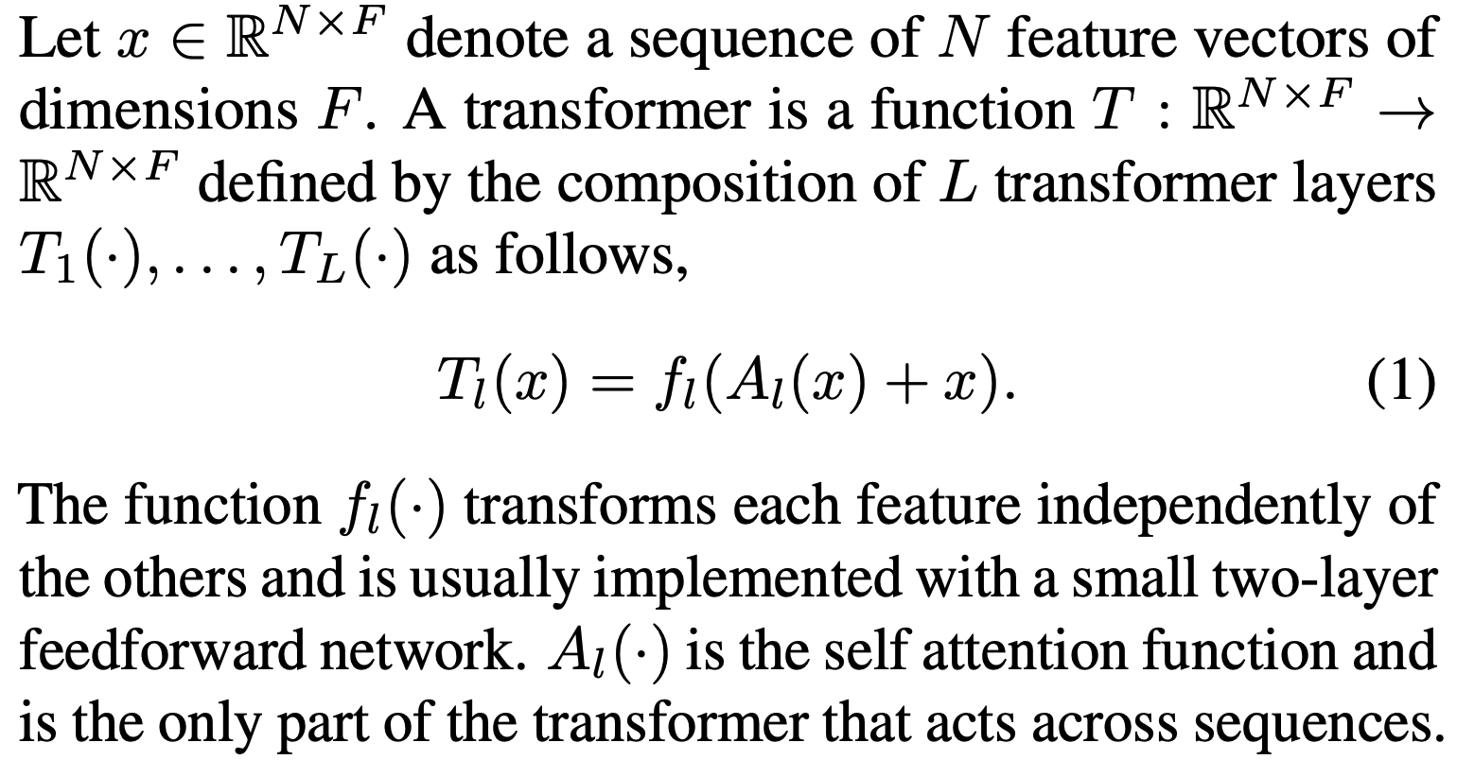
The Two Steps Inside Each Layer
Figure from original Vaswani paper
(1) Attend with A, then (2) Map w/ f.
Each word:
F-dimensional feature
f
6⨉
6⨉
A
Clean formula from:
Katharopoulos 2020 “Transformers are RNNs”
N⨉

Slide 62
Transformers attend over the grid of states
h_{i}^{(l)} state
The
attention
Space
MLP
Need
le
is
in
downtown
Seattle
(correct output)

Slide 63
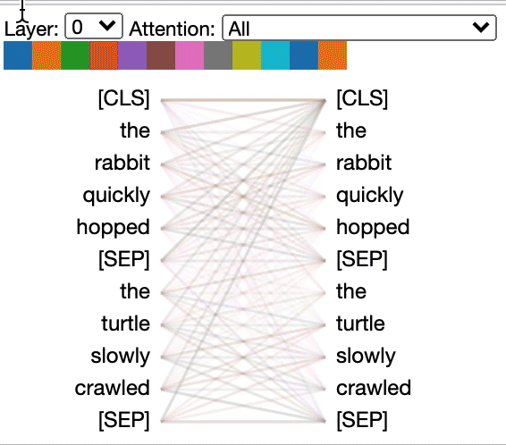
The goal: deep context-aware representation per word
We want to attend like this: how to learn A?
Clean formula from:
Katharopoulos 2020 “Transformers are RNNs”
https://github.com/jessevig/bertviz

Slide 64
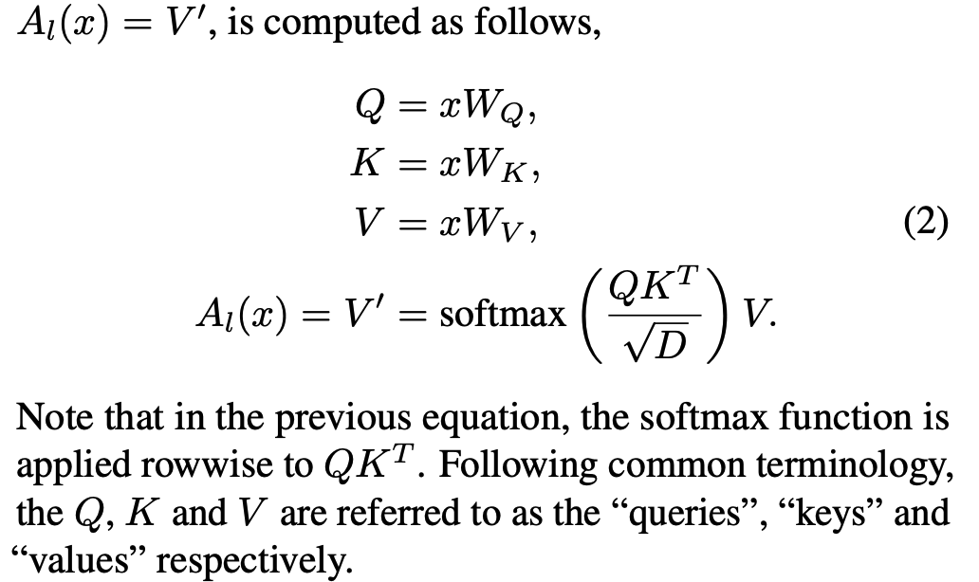
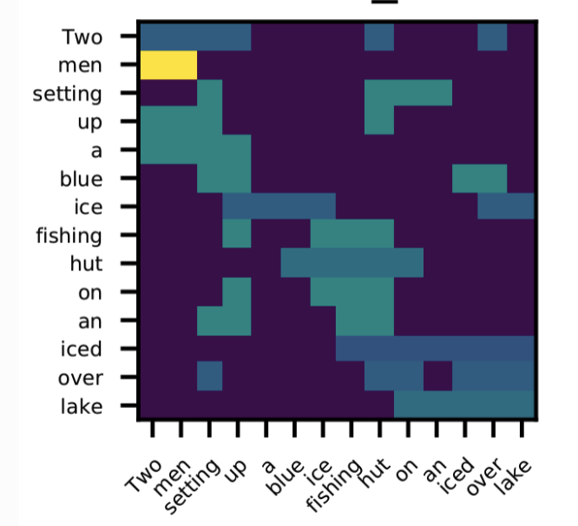
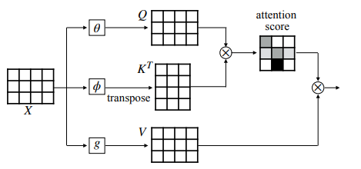
Self-Attention by softmax dot-product
(Katharopoulos 2020)
Scalar attention: softmax(QK^{T})
Key K = xW_{K}
W_{Q}
W_{K}
Query Q = xW_{Q}
W_{V}
Example from DGL library tutorial

Slide 65
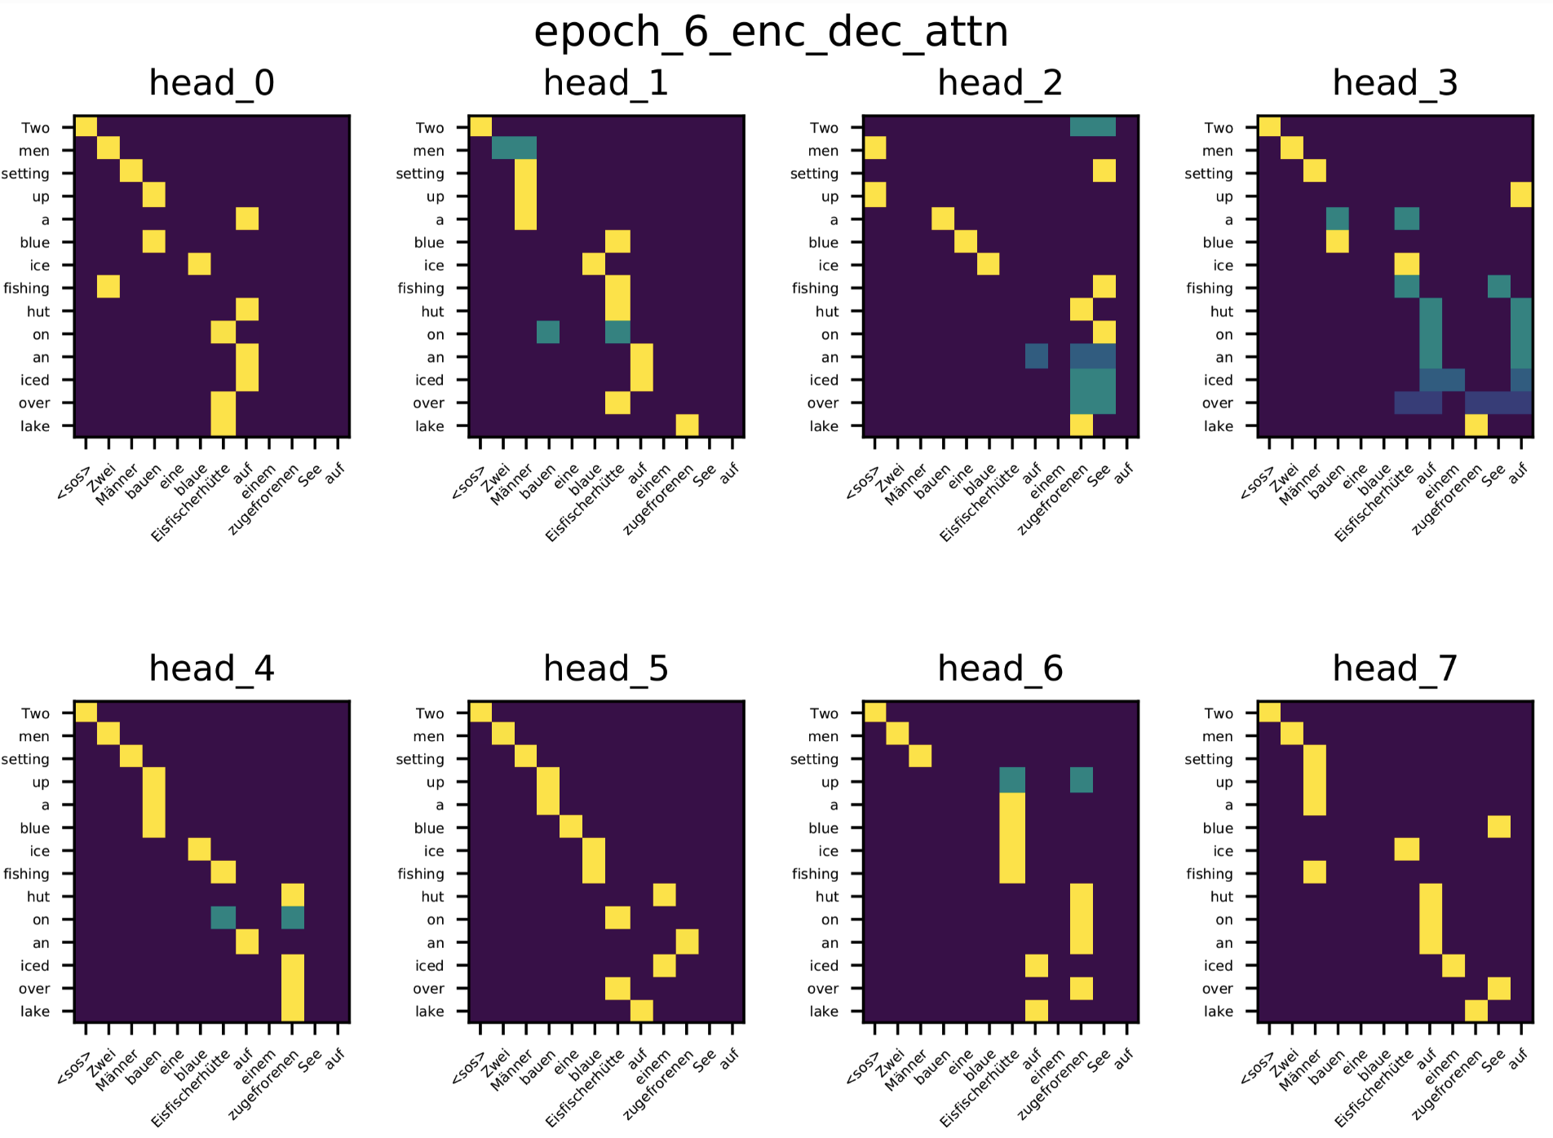
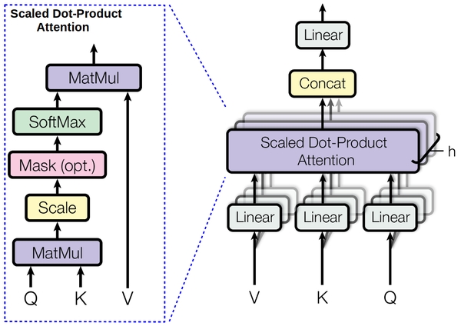
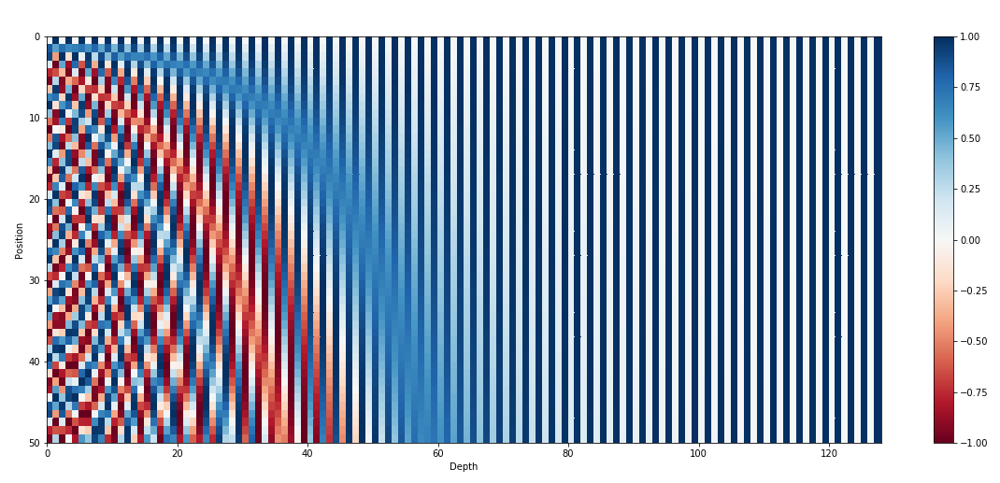
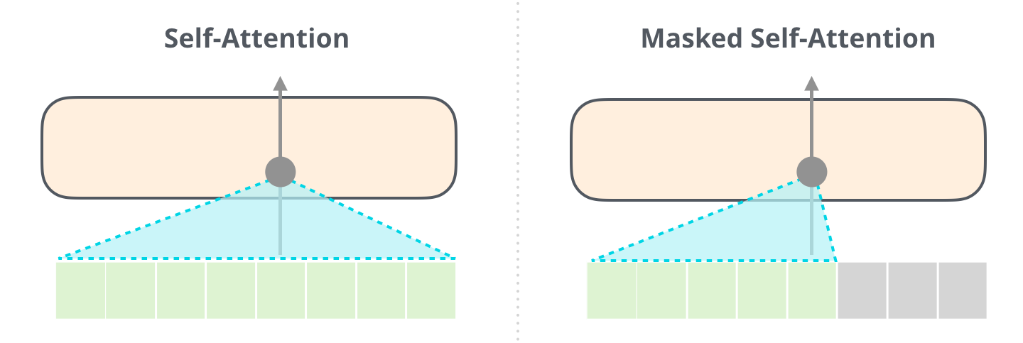
Three More Architectural Details
1. Multi-head attention. 2. Decode by attending input and masked self-attention.
3. Position Encoding
Inputs Keyed
Outputs Querying
Generator does not get to see the future
Attention is position-agnostic, so add position features

Slide 66
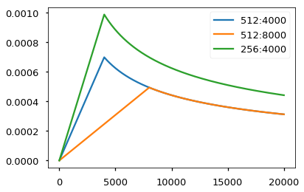
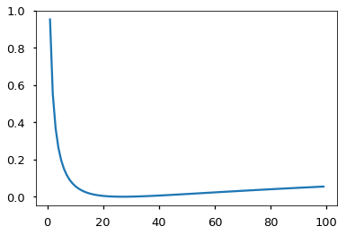
A couple more engineering details from the code
Learning Rate Schedule
Smoothed Loss (penalize overconfidence)

Slide 67
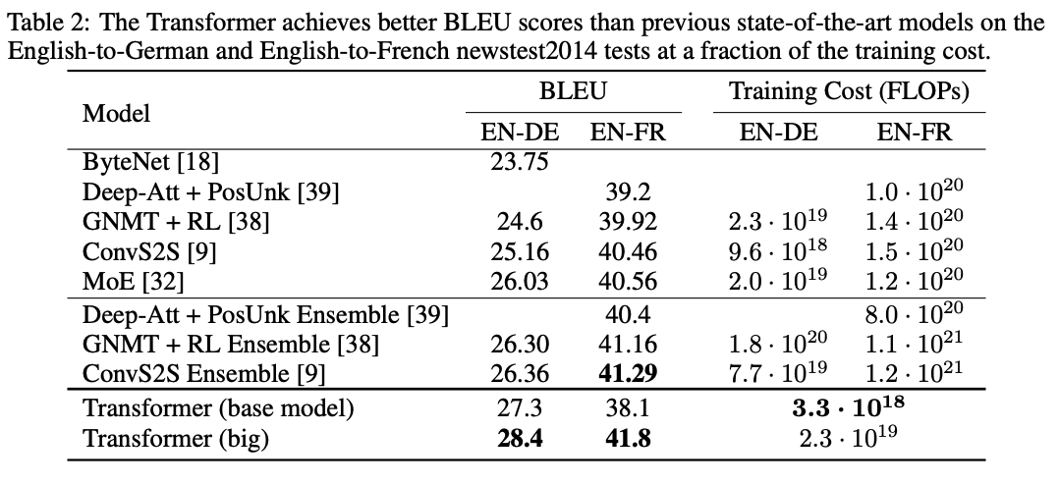
Transformers for Translation: better, faster, cheaper

Slide 68
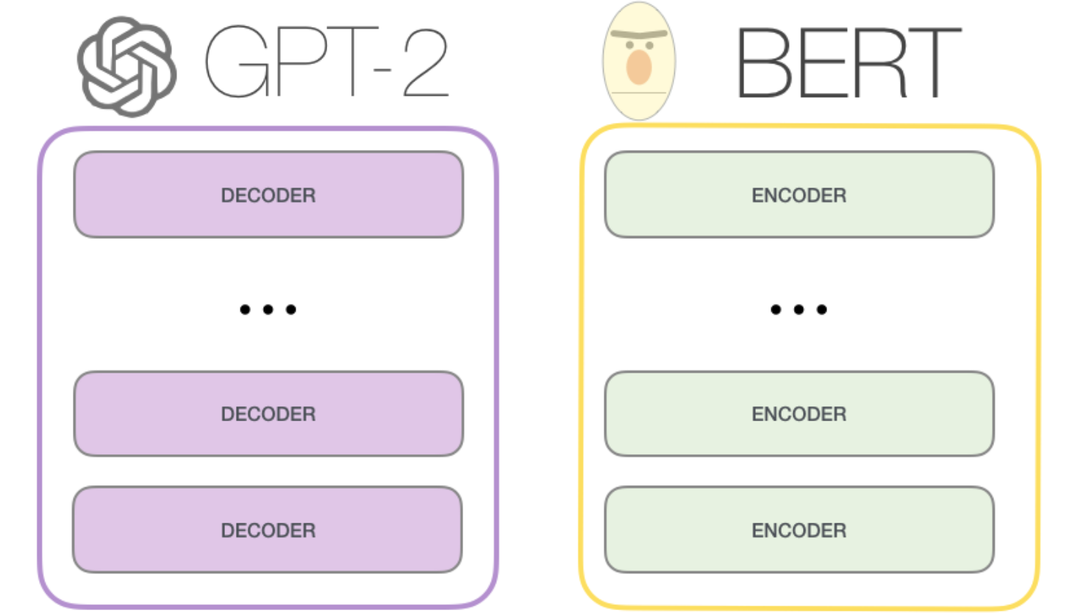
After Transformer: GPT-2 (Decode only), BERT (Encode only)
Transformer architecture has been remarkably stable: GPT, BERT use transformer essentially unchanged.
GPT-2 is a left-to-right language model trained on huge texts.
BERT is trained on masked-word-reconstruction and next-sentence classification on books and wikipedia..

Slide 69
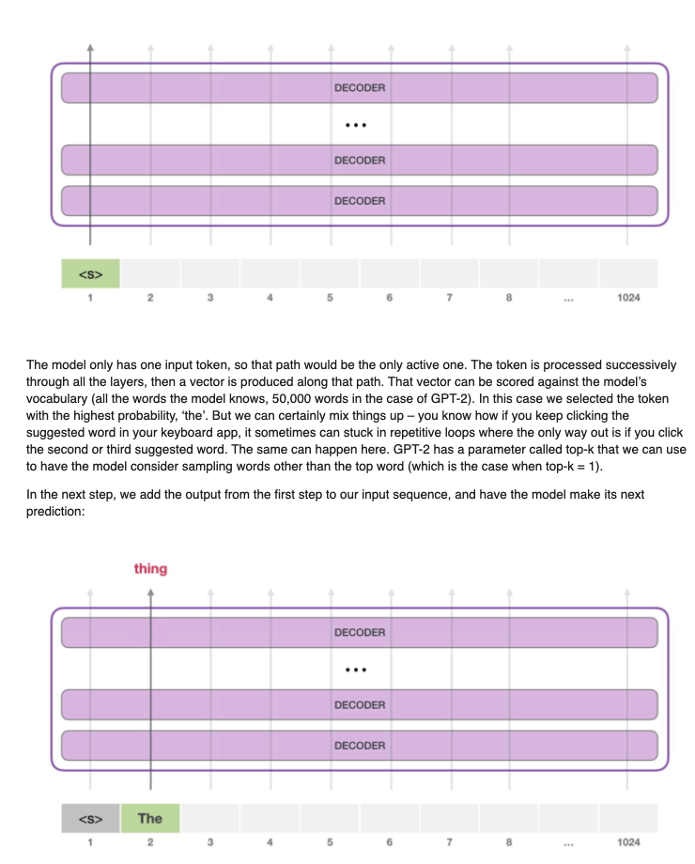
Decoder task: Predict the Next Word (GPT-1,2,3)
GPT-1: Radford 2018 “Improving Language Understanding..”
GPT-2: Radford 2019 “LMs are Unsupervised Multitask Learners”
GPT-3: Brown 2020 “LMs are Few-Shot Learners”

Slide 70
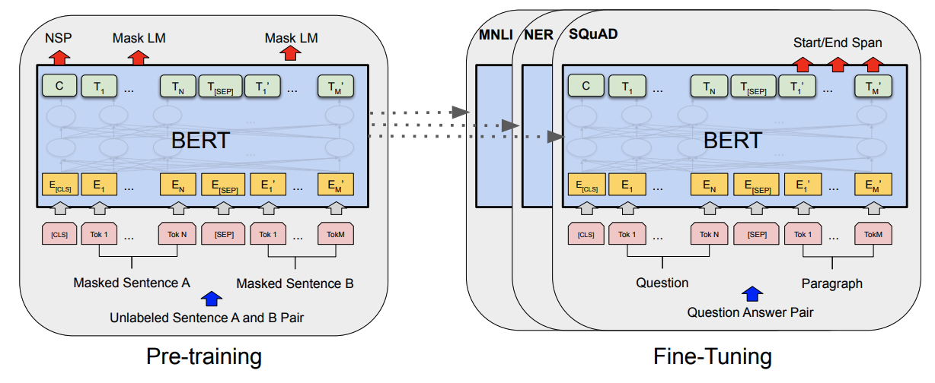
The BERT encoder training task. (Devlin 2018)
Input: two sentences from wikipedia+books corpus.
15% words targeted, 80% replaced with [MASK], 10% replaced with random token, 10% left real. Task: reconstruct targeted words.
Classify actually adjacent sentences versus random unrelated sentences.

Slide 71
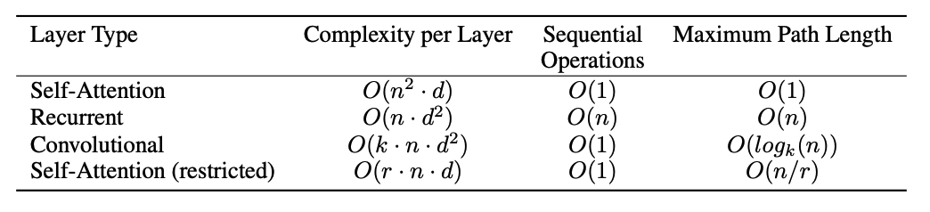
A discussion of transformer efficiency… Or inefficiency
Looking at everything naively would be O(n²d²).
Attention gets us to n²d ; paper argues that is pretty good, but it is not great.
The n² makes scaling up the size of input+output very expensive.
One approach is to factorize attention operation to reduce complexity:
“Sparse Attention” - O(n^{1.5}) - used by GPT-3 to make very massive models

Slide 72

Recent ideas on efficiency: O(ndm) [linear time] attention
Shen 2020 “Efficient Attention”; Katharopoulos 2020 “Transformers are RNNs”

Slide 73

Efficiency survey (Tay 2020)
LRA, or Long Range Arena, is a benchmark for transformer performance on tasks w/ long-range dependencies (to test the n^2 blowup). Models with high LRA are large & slow.

Slide 74


More observations on efficiency (Fedus 2021)
“Switched Transformers”
cheap!
Under a fixed compute budget, it is better to have a (much) bigger model and stop earlier.
Early-stopping of huge models, strategy inspired by Kaplan 2020 “Scaling laws for neural language models”

Slide 75

Switch Transformers: enlarge parameters (Fedus 2021)
Make the FF layer much larger by using a Mixture of Experts architecture.
Ideas: (1) don’t mix. Just one expert. (2) Only router loss is to load-balance.

Slide 76

What is so great about scaling up: Amazing GPT tricks
Priming is basically few-shot learning! Show GPT a few example inputs/outputs, and it figures out how to respond to future queries.
The “primer”
Without any pre-training, it “learns” to write MC questions with quality distractors & the correct answer!

Slide 77


What is so great about scaling up: Amazing GPT tricks

Slide 78


What is so great about scaling up: Amazing GPT tricks

Slide 79
A Library for Priming GPT3: Example with Latex
github.com/shreyashankar/gpt3-sandbox
# Construct GPT object and show some examples
gpt = GPT(engine="davinci",
temperature=0.5,
max_tokens=100)
gpt.add_example(Example('Two plus two equals four', '2 + 2 = 4'))
gpt.add_example(Example('The integral from zero to infinity', '\\int_0^{\\infty}'))
gpt.add_example(Example('The gradient of x squared plus two times x with respect to x', '\\nabla_x x^2 + 2x'))
gpt.add_example(Example('The log of two times x', '\\log{2x}'))
gpt.add_example(Example('x squared plus y squared plus equals z squared', 'x^2 + y^2 = z^2'))
# Define UI configuration
config = UIConfig(description="Text to equation",
button_text="Translate",
placeholder="x squared plus 2 times x")
demo_web_app(gpt, config)

Slide 80


Some Interpretability Results
Individual attention heads have specific purposes, e.g., inferring gender for pronouns. (Vig 2020, Causal Mediation).
In some networks, most heads can be pruned with little damage (Voita 2019, Analyzing Multi-Head).
Maybe the community will use Linear-Time attention and Head-Pruning to make even more massive models with less computation.

Slide 81



Image GPT/Generative Pretraining from Pixels (Chen 2020)
Two explored training objectives
Autoregressive: predict next pixel value in raster order
BERT-Style: predict values of masked pixels (15%)
Key observation: iGPT learns really good representations via generative pretraining! Done without inductive bias in NN architecture (c.f. CNNs, where locality is enforced)

Slide 82


Image GPT/Generative Pretraining from Pixels (Chen 2020)
← Fill-in-the-blank
↓ Generations

Slide 83

Image GPT/Generative Pretraining from Pixels (Chen 2020)
Feature quality is examined via a linear probe.
Hypothesis: iGPT operates in 2 phases
Gradually build a global representation
Use it to solve a specific task

Slide 84



Image GPT/Generative Pretraining from Pixels (Chen 2020)
Results on autoregressive tasks
Linear Probe w/ ImageNet Pretraining
Full Fine-Tuning w/ ImageNet Pretraining
Linear Probe on ImageNet (High Res)
(In)efficiency of attention is prohibitive!
Features work well on 32x32 datasets
Poor performance on ImageNet (~500^2 pixels/image). Hacks are required to remain competitive, e.g. concatenating features from multiple layers

Slide 85

Image GPT/Generative Pretraining from Pixels (Chen 2020)
What about low-data fine-tuning?
* Values are error rates
iGPT outperforms 2 other low-data semi-supervised methods, simply using learned reprs + linear classifier
Achieved without using special tricks (e.g. data augmentation, pseudo-labeling)

Slide 86

Vision Transformer (Dosovitskiy 2020)
Treat each 14x14 patch as a word, embedded to 64-dim feature.
Train supervised, to classify.
Unlike BERT, reconstruction pretraining does not do as well.
* Pixels can also be replaced with CNN feature maps
“Hybrid Model”

Slide 87



Vision Transformer
A huge model with a huge dataset wins out (though ViT-H is still smaller than BiT-L: 600M vs. 900M)
ViT scales better with training set size, eventually winning, but starts w/ a disadvantage

Slide 88

Vision Transformer (Dosovitskiy 2020)
ViT yields better performance per exaFLOP, compared to ResNets

Slide 89

What’s next? Patch Generative Transformers.
Patch representation seems better than pixels, but Vision Transformer is not generative. VQ-VAE (van den Oord 2017) shows how to fit a generative patch representation with discrete words: quantize to a finite vocabulary of embeddings.
DALL-E seems to use this technique (unpublished).
Transformer generates: “A chair shaped like an avocado.<start-image>0 0 0 1 0 3 0 0 2 0 53 0 0”

