Slide 1

CS 7150
Deep Learning

Slide 2
Transformers
Attention in detail
  Learnable neural connections: Queries, Keys and Values
  Position encoding
  Masks for “causal attention”
  Multi-headed attention
The original transformer architecture
BERT architecture
GPT architecture
Visual transformers

Slide 3
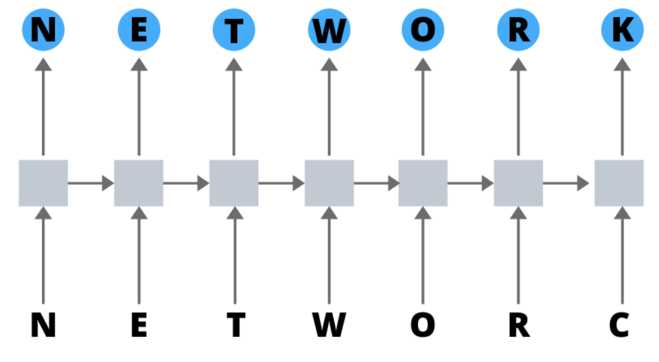
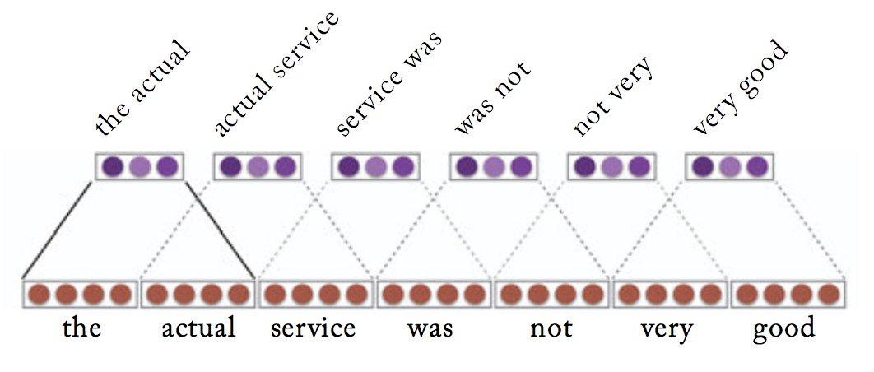
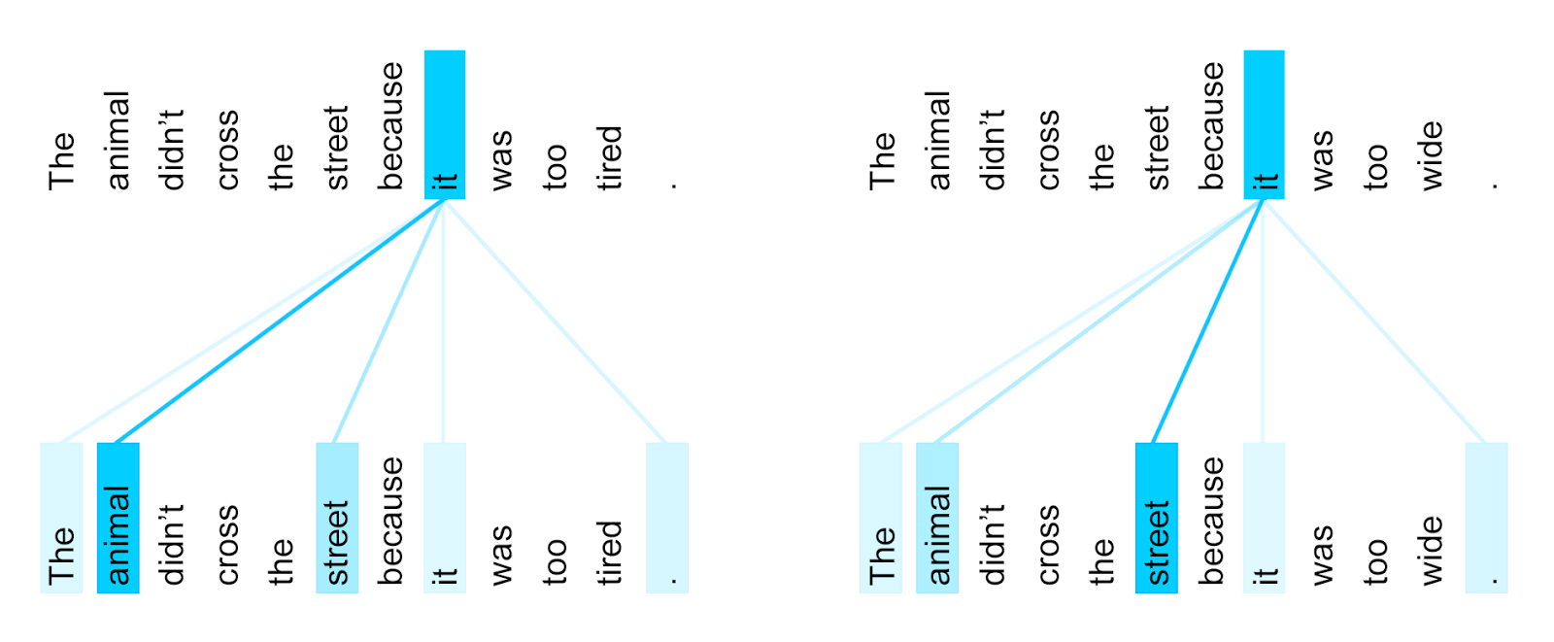
History of NLP architectures
RNN: Represent “Everything seen so far”
Attend to last encoding, recursively.
Convolution: Represent “Everything seen nearby”
Attend to nearby encodings, in parallel.
Attention: Represent “Everything relevant”
Attend to relevant encodings, in parallel.

Slide 4
Details of Self-Attention
Attention operates on queries, keys, and values.
We have some queries 𝑞 , 𝑞 , … , 𝑞 . Each query is 𝑞_{i} ∈ ℝ^{𝑑}
We have some keys 𝑘₁, 𝑘₂, … , 𝑘_{𝑇}. Each key is 𝑘_{𝑖} ∈ ℝ^{𝑑}
We have some values 𝑣₁, 𝑣₂, … , 𝑣_{𝑇}. Each value is 𝑣_{𝑖} ∈ ℝ^{𝑑}
1 2 𝑇
In self-attention, the queries, keys, and values are drawn from the same source.
  For example, if the output of the previous layer is 𝑥₁, … , 𝑥_{𝑇}, (one vec per word) we could let 𝑣_{𝑖} = 𝑘_{𝑖} = 𝑞_{𝑖} = 𝑥_{𝑖} (that is, use the same vectors for all of them!)
The (dot product) self-attention operation is as follows:
exp(𝑒_{𝑖𝑗})
𝑒 = 𝑞_{i}^{𝖳}𝑘 𝛼 =
output = Σ _{𝑗} 𝛼 𝑣
𝑖𝑗 𝑗
𝑖𝑗
𝑖 𝑖𝑗 𝑗
𝑖
Σ
_{𝑗'}
exp(𝑒_{𝑖𝑗’} )
Compute outputs as weighted sum of values
Compute key- query affinities
Compute attention weights from affinities
(softmax)
John Hewitt

Slide 5
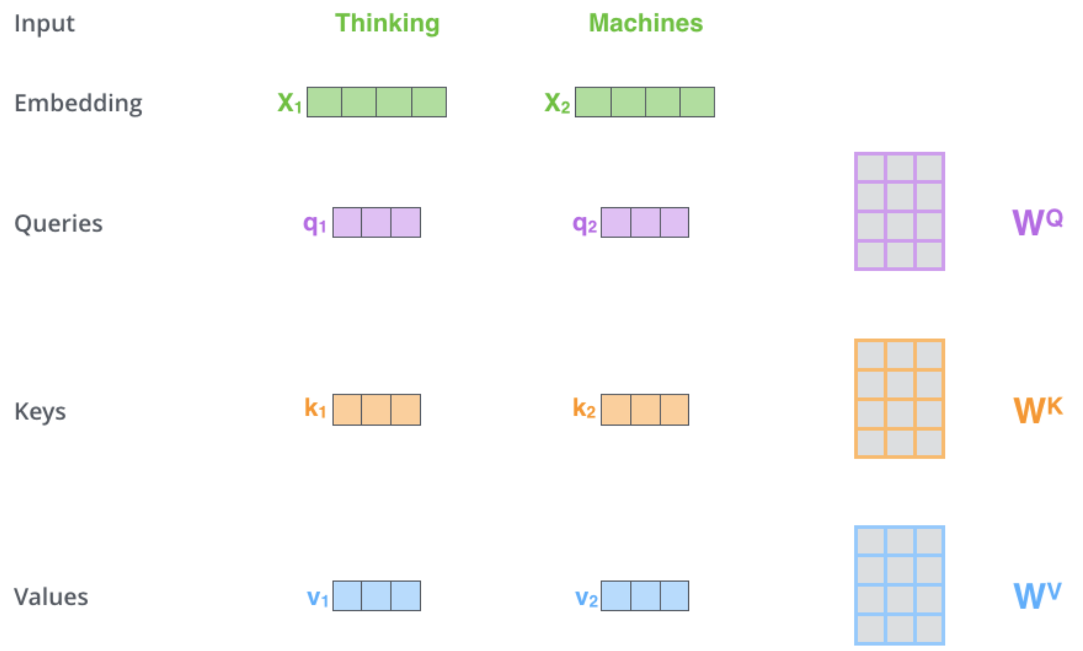
Self-Attention Details
While processing each word it allows to look at other positions in the input sequence for clues to build a better encoding for this word.
Step1: create three vectors from each of the encoder’s input vectors:
Query, a Key, Value (typically smaller dimension).
by multiplying the embedding by three matrices that we trained during the training process.
Notes:
As the model processes each word (each position in the input sequence), self attention allows it to look at other positions in the input sequence for clues that can help lead to a better encoding for this word.
If you’re familiar with RNNs, think of how maintaining a hidden state allows an RNN to incorporate its representation of previous words/vectors it has processed with the current one it’s processing. Self-attention is the method the Transformer uses to bake the “understanding” of other relevant words into the one we’re currently processing.
The first step in calculating self-attention is to create three vectors from each of the encoder’s input vectors (in this case, the embedding of each word). So for each word, we create a Query vector, a Key vector, and a Value vector. These vectors are created by multiplying the embedding by three matrices that we trained during the training process.
Notice that these new vectors are smaller in dimension than the embedding vector. Their dimensionality is 64, while the embedding and encoder input/output vectors have dimensionality of 512. They don’t HAVE to be smaller, this is an architecture choice to make the computation of multiheaded attention (mostly) constant.

Slide 6
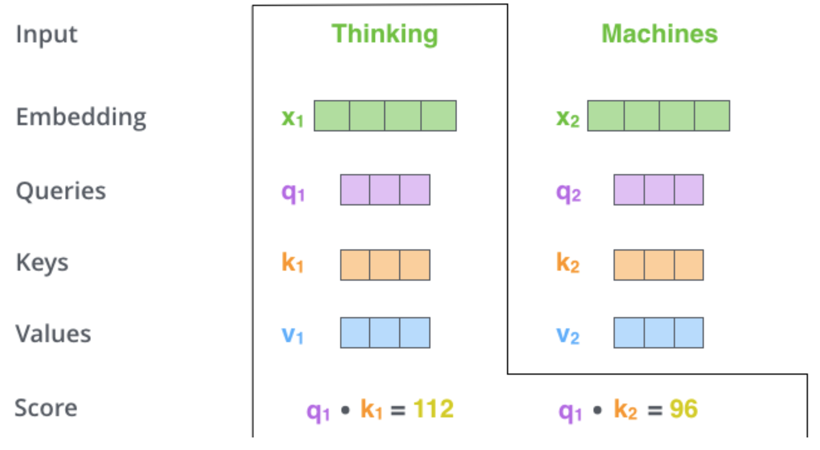
Self-Attention
Step 2: calculate a score (like we have seen for regular attention!) how much focus to place on other parts of the input sentence as we encode a word at a certain position.
Take dot product of the query vector with the key vector of the respective word we’re scoring.
E.g., Processing the self-attention for word “Thinking” in position #1, the first score would be the dot product of q1 and k1. The second score would be the dot product of q1 and k2.
Notes:
The second step in calculating self-attention is to calculate a score. Say we’re calculating the self-attention for the first word in this example, “Thinking”. We need to score each word of the input sentence against this word. The score determines how much focus to place on other parts of the input sentence as we encode a word at a certain position.
The score is calculated by taking the dot product of the query vector with the key vector of the respective word we’re scoring. So if we’re processing the self-attention for the word in position #1, the first score would be the dot product of q1 and k1. The second score would be the dot product of q1 and k2.

Slide 7
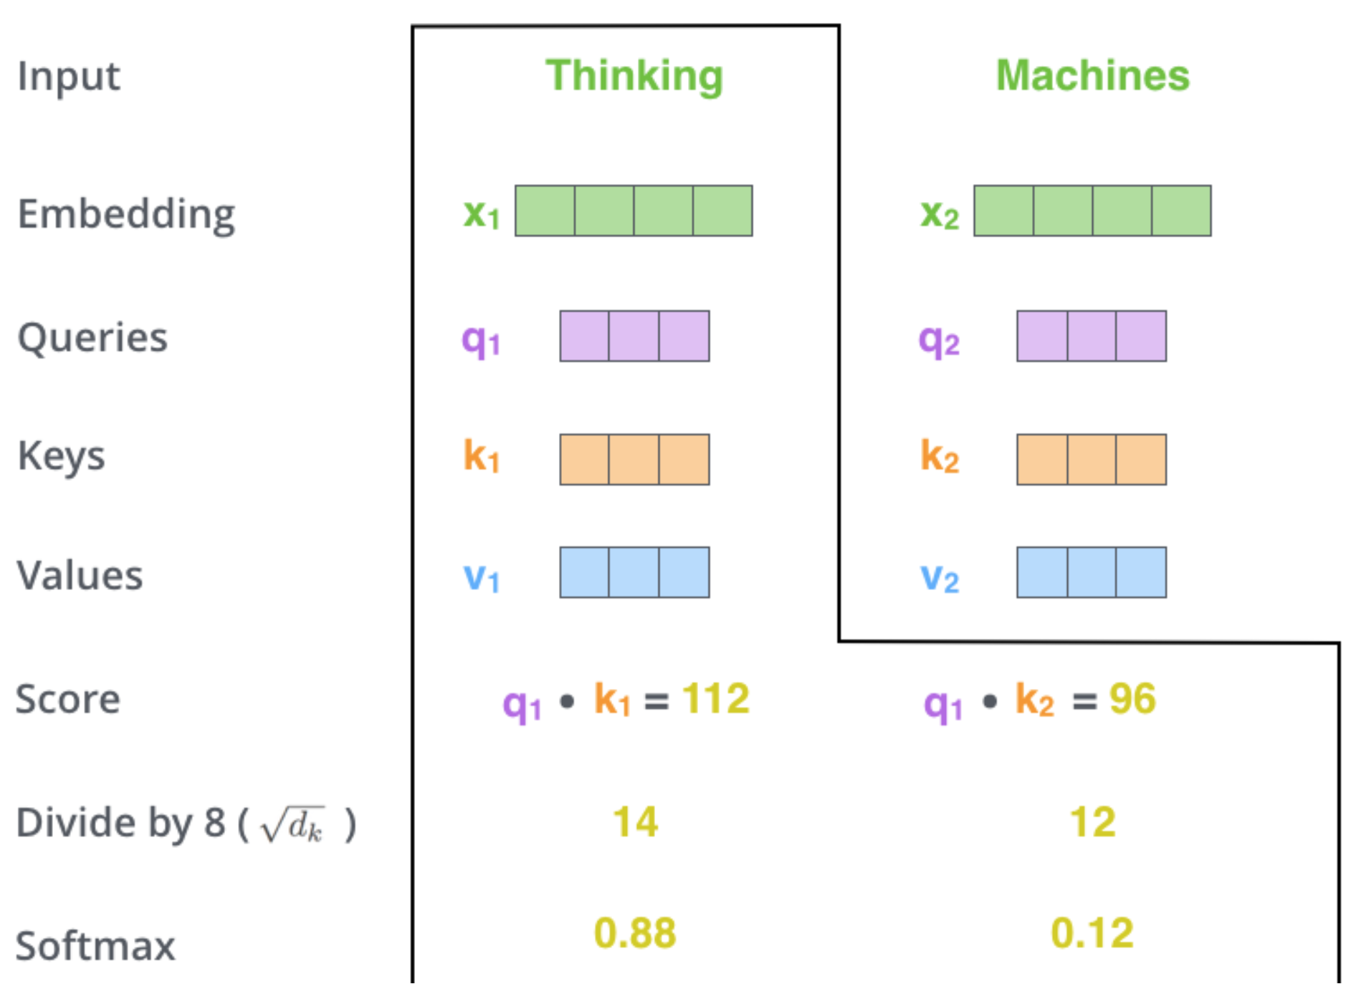




Self Attention
Step 3 divide scores by the square root of the dimension of the key vectors (more stable gradients).
Step 4 pass result through a softmax operation. (all positive and add up to 1)
Intuition: softmax score determines how much each word will be expressed at this position.
Notes:
The third and forth steps are to divide the scores by 8 (the square root of the dimension of the key vectors used in the paper – 64. This leads to having more stable gradients. There could be other possible values here, but this is the default), then pass the result through a softmax operation. Softmax normalizes the scores so they’re all positive and add up to 1

Slide 8
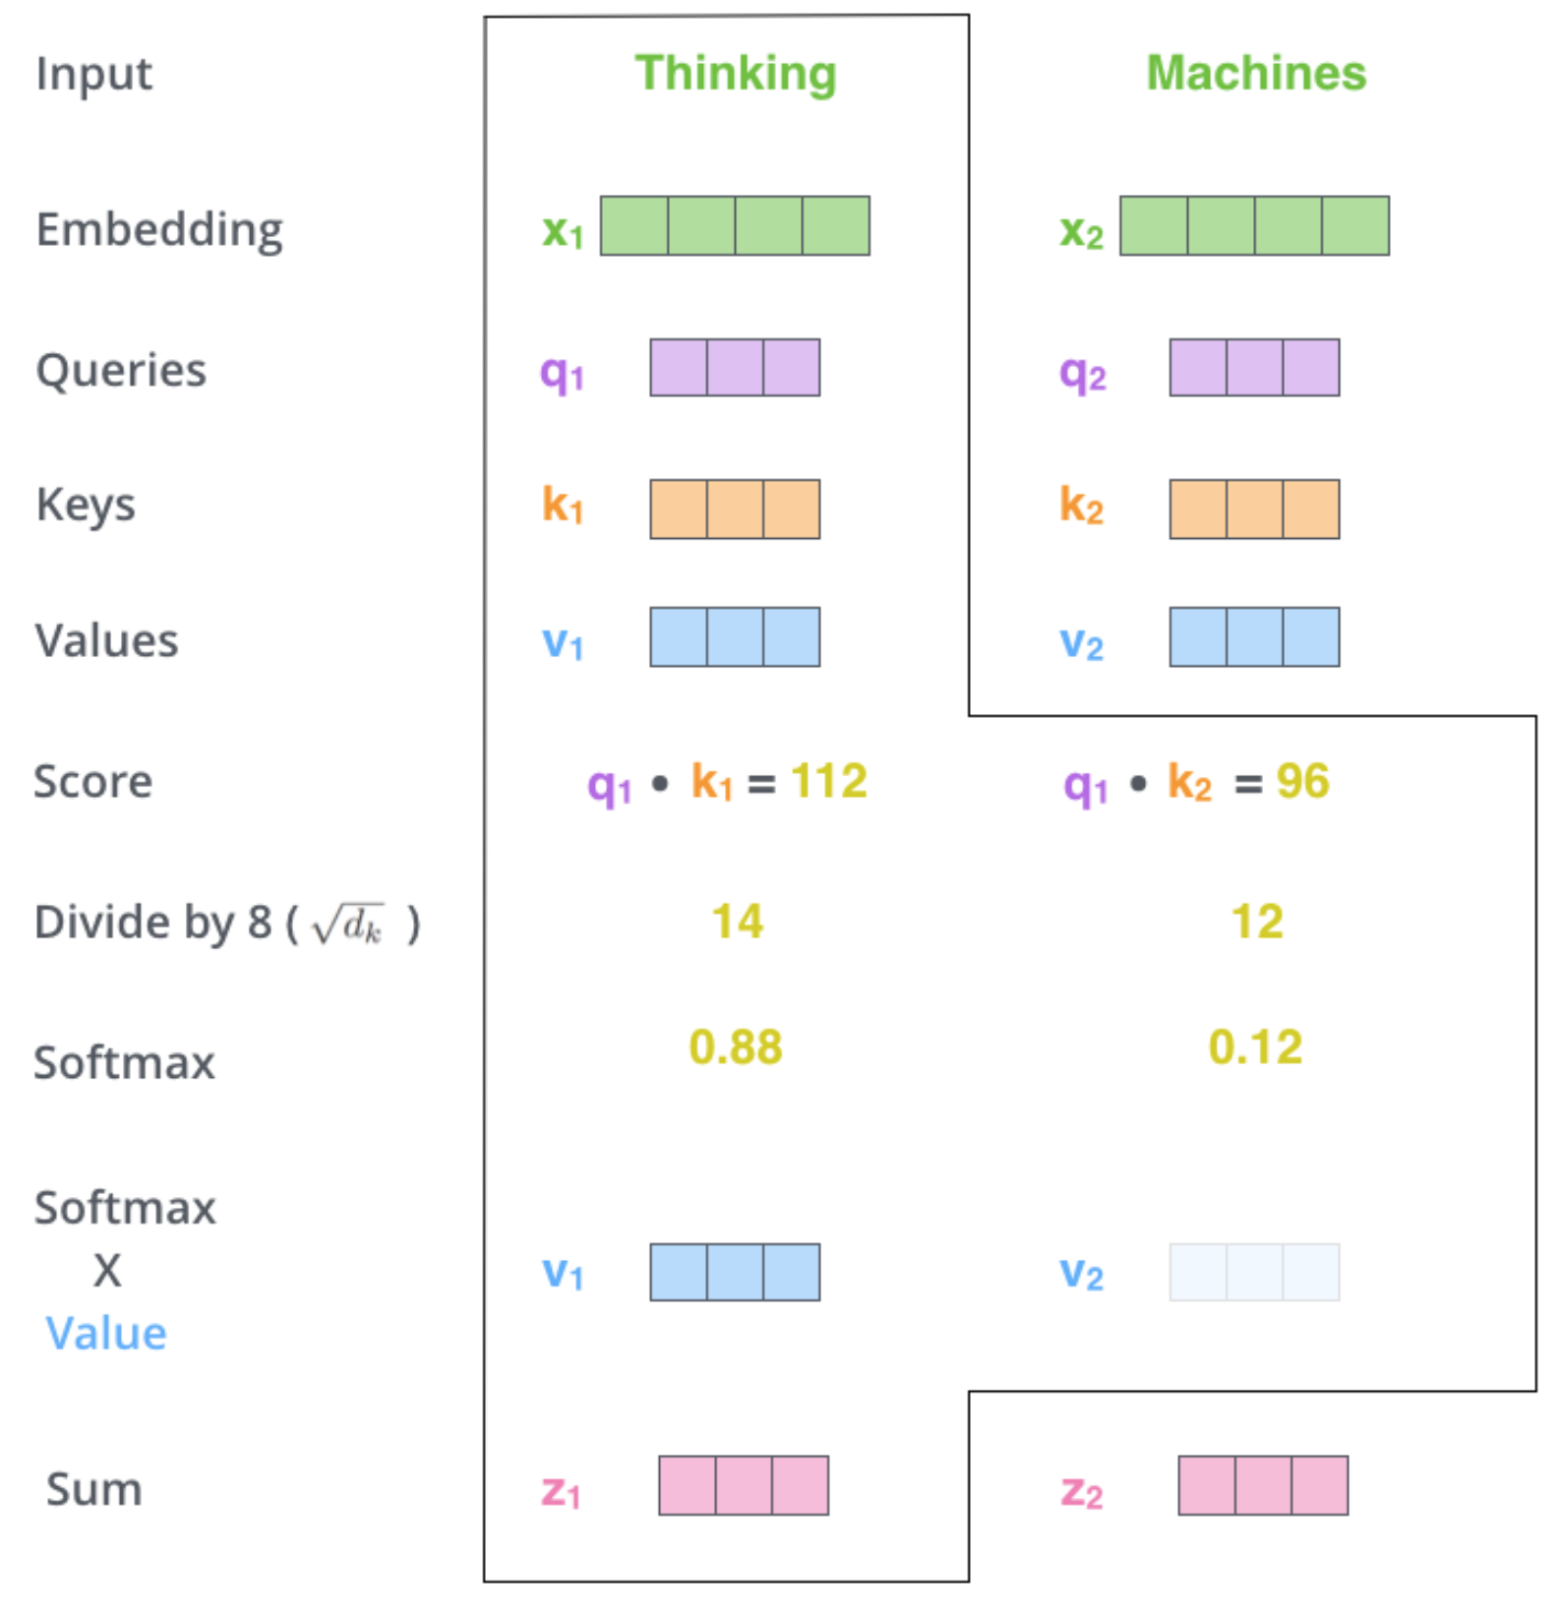
Self Attention
Step6 : sum up the weighted value vectors. This produces the output of the self-attention layer at this position
More details:
What we have seen for a word is done for all words (using matrices)
Need to encode position of words
And improved using a mechanism called “multi-headed” attention
(kind of like multiple filters for CNN)
see https://jalammar.github.io/illustrated-transformer/
Notes:
The third and forth steps are to divide the scores by 8 (the square root of the dimension of the key vectors used in the paper – 64. This leads to having more stable gradients. There could be other possible values here, but this is the default), then pass the result through a softmax operation. Softmax normalizes the scores so they’re all positive and add up to 1

Slide 9
Is Self-Attention All You Need? Not yet.
In the diagram at the right, we have stacked self-attention blocks, like we might stack LSTM layers.
Can self-attention be a drop-in
replacement for recurrence?
No. It has a few issues, which
we’ll go through.
First, self-attention is an operation on sets. It has no inherent notion of order.
self-attention
𝑞₁
𝑘₁ 𝑣₁
𝑘₂
𝑞₂
𝑞₃
𝑞_{𝑇}
𝑣₂ 𝑘₃ 𝑣₃
𝑘_{𝑇}
𝑣_{𝑇}
…
self-attention
𝑘₂ 𝑣₂ 𝑘₃ 𝑞₃ 𝑣₃
𝑞₁
𝑘₁ 𝑣₁
𝑞₂
𝑘_{𝑇}
𝑞_{𝑇}
𝑣_{𝑇}
…
𝑤₁
The
𝑤₂
chef
𝑤₃
who
𝑤_{𝑇}
food
Self-attention doesn’t know the order of its inputs.
John Hewitt

Slide 10

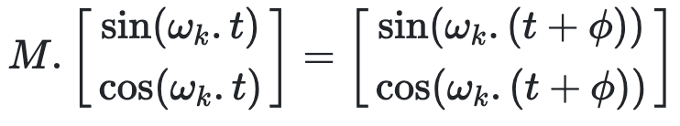
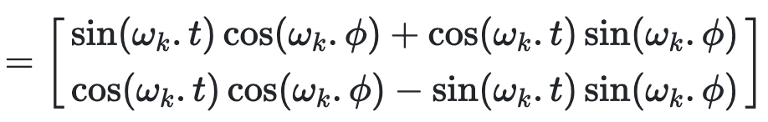
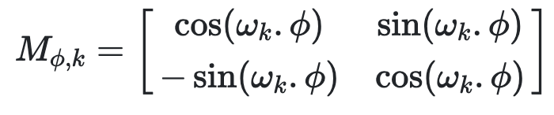
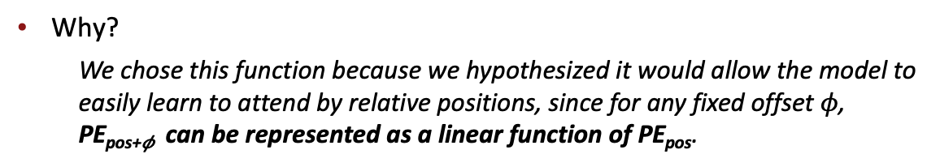
Position Encoding
Sinusoidal position representations: concatenate sinusoidal functions of varying periods:
sin(ω₁ t)
cos(ω₁ t)
𝑝_{𝑖} =
Dimension
sin(ω_{d/2} t)
cos(ω_{d/2} t)
Index in the sequence
Why?
  We chose this function because we hypothesized it would allow the model to easily learn to attend by relative positions, since for any fixed offset $φ$, PE_{pos+𝜙} can be represented as a linear function of PE_{pos}.
John Hewitt
Image: https://timodenk.com/blog/linear-relationships-in-the-transformers-positional-encoding/

Slide 11
Masking Attention to the Future
We can look at these (not greyed out) words
To use self-attention in decoders, we need to ensure we can’t peek at the future.
−∞ | −∞ | −∞ | −∞
 | −∞ | −∞ | −∞
 |  | −∞ | −∞
 |  |  | −∞
[START]
At every timestep, we could change the set of keys and queries to include only past words. (Inefficient!)
To enable parallelization, we mask out attention to future words by setting attention scores to −∞.
𝑒_{𝑖𝑗} =
The
For encoding these words
chef
who
𝑞^{𝖳}𝑘_{𝑗}, 𝑗 < 𝑖
𝑖
−∞, 𝑗 ≥ 𝑖
John Hewitt

Slide 12
Feed-Forward Modules
Note that there are no elementwise nonlinearities in self-attention; stacking more self-attention layers just re-averages value vectors
Easy fix: add a feed-forward network
to post-process each output vector.
FF
FF
FF
self-attention
FF
…
FF
FF
FF
self-attention
FF
𝑚_{𝑖} = 𝑀𝐿𝑃 output_{𝑖}
= 𝑊₂ ∗ ReLU 𝑊₁ × output_{𝑖} + 𝑏₁
…
+ 𝑏₂
𝑤₁
The
𝑤₂
chef
𝑤₃
who
𝑤_{𝑇}
food
Intuition: the FF network processes the result of attention
John Hewitt

Slide 13
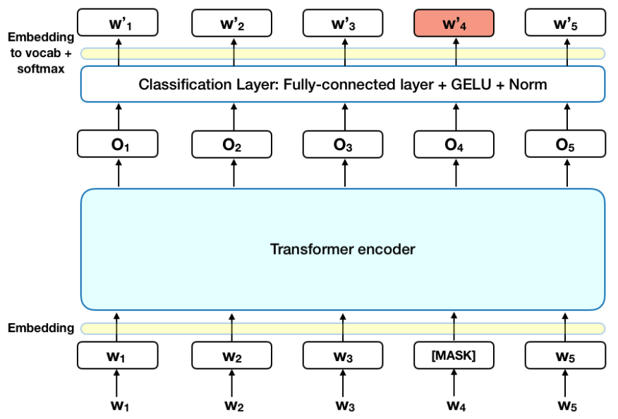
One vector for every token, through a stack of layers
Analogous to a convnet without any resolution change.
Input: one vec for every token.
Output: one vec for every token.
Computation: a stack of neural network layers.
Objective: correctly predict the next word (or other similar obj.)

Slide 14
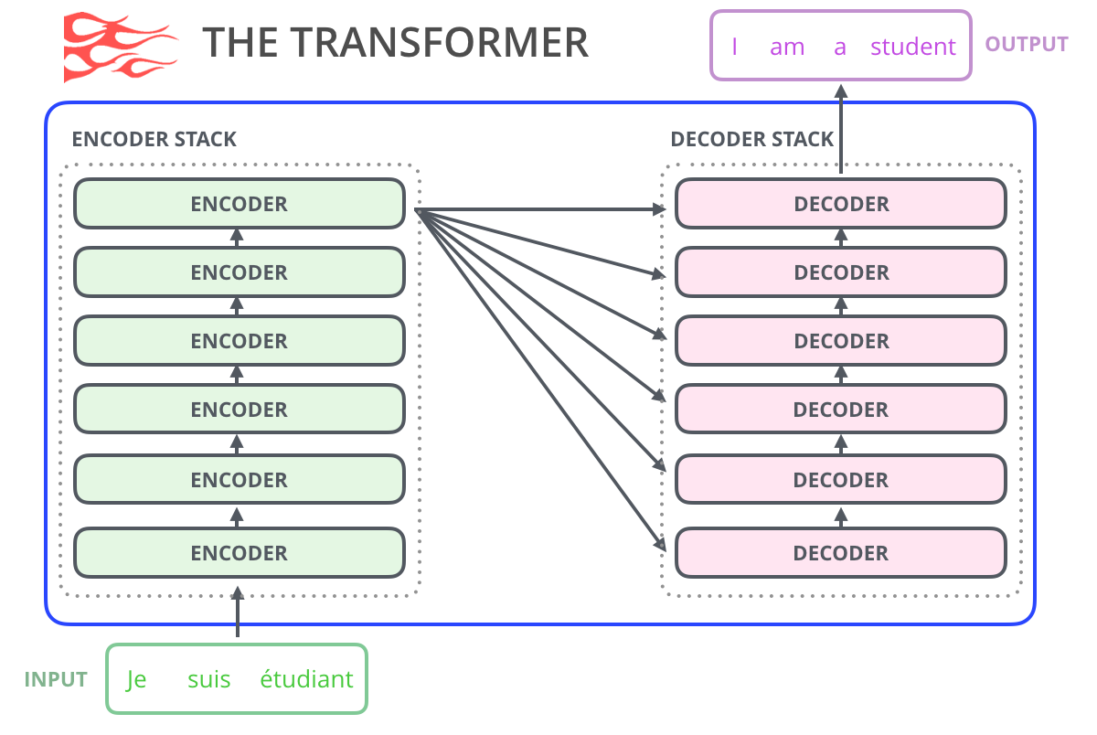
Attention is All You Need (Vaswani 2017 - Google)
Natural Language Translation
Start with an independent encoding for each word.
Improve each word’s encoding by incorporating context, using a stack of six encoders.
Generate target sentence using a stack of six decoders.
Overview figure from Jay Alammar’s blog

Slide 15
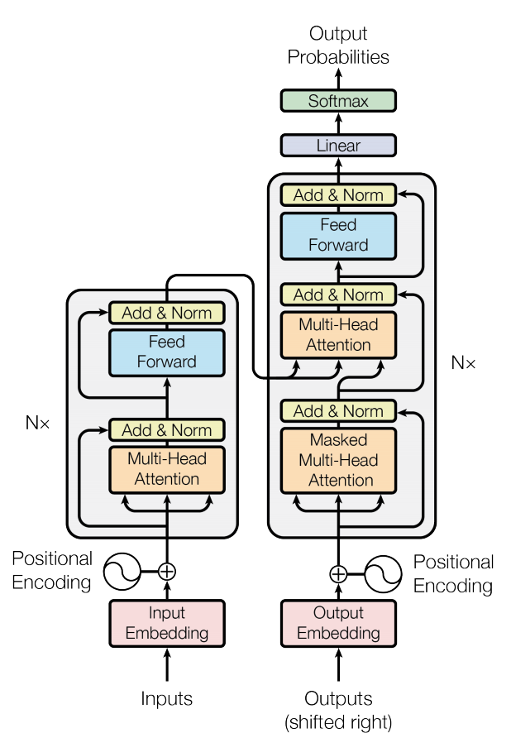
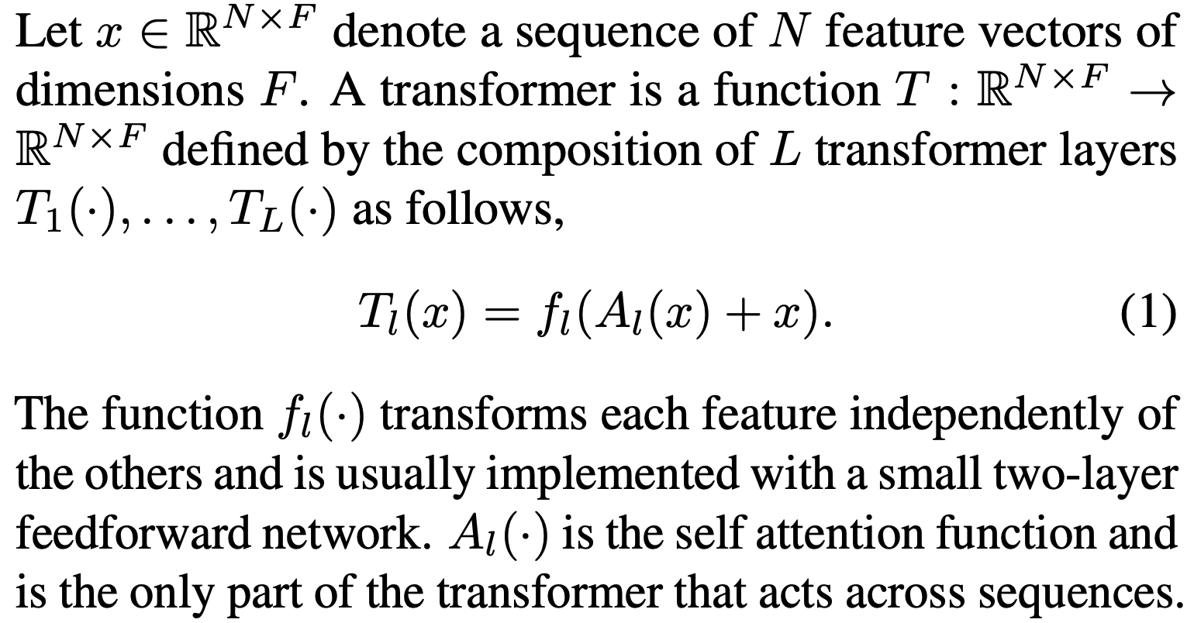
The Two Steps Inside Each Layer
Figure from original Vaswani paper
(1) Attend with A, then (2) Map w/ f.
Each word:
F-dimensional feature
f
6⨉
6⨉
A
Clean formula from:
Katharopoulos 2020 “Transformers are RNNs”
N⨉

Slide 16
Transformers attend over the grid of states
h_{i}^{(l)} state
The
attention
Space
MLP
Need
le
is
in
downtown
Seattle
(correct output)

Slide 17
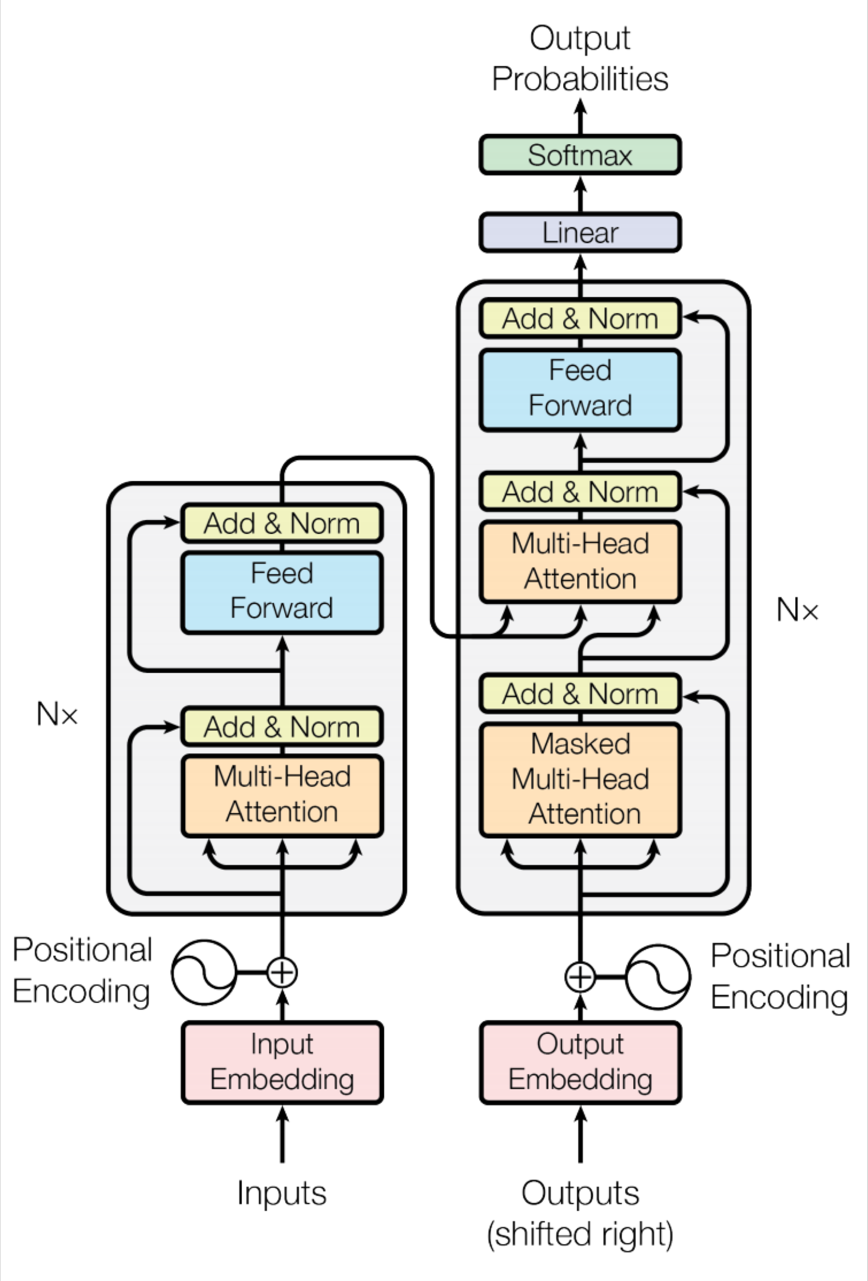
Transformer Overview
Attention is all you need. 2017. Aswani, Shazeer, Parmar, Uszkoreit, Jones, Gomez, Kaiser, Polosukhin https://arxiv.org/pdf/1706.03762.pdf
Non-recurrent sequence-to- sequence encoder-decoder model
Task: machine translation with parallel corpus
Predict each translated word
Final cost/error function is standard cross-entropy error on top of a softmax classifier
This and related figures from paper ⇑
Christopher Manning

Slide 18
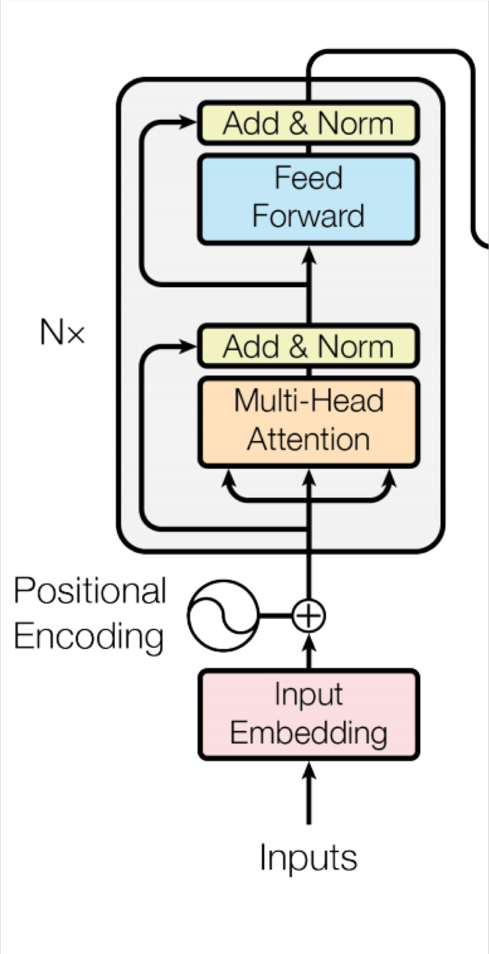
Transformer Encoder
For encoder, at each block, we apply the Q, K and V
on states from the previous layer
Blocks are repeated 6 times (in vertical stack)
Christopher Manning

Slide 19



Transformer Decoder
2 sublayer changes in decoder
Masked decoder self-attention on previously generated outputs:
Encoder-Decoder Attention, where queries come from previous decoder layer and keys and values come from output of encoder
Blocks repeated 6 times also
Christopher Manning

Slide 20
Parallelizing Attention over All Tokens
Let’s look at how key-query-value attention is computed, in matrices.
  Let 𝑋 = 𝑥₁; … ; 𝑥_{𝑇} ∈ ℝ^{𝑇×𝑑} be the concatenation of input vectors.
  First, note that 𝑋𝐾 ∈ ℝ^{𝑇×𝑑}, 𝑋𝑄 ∈ ℝ^{𝑇×𝑑}, 𝑋𝑉 ∈ ℝ^{𝑇×𝑑}.
𝖳
The output is defined as output = softmax 𝑋𝑄 𝑋𝐾 ^{T} × 𝑋𝑉.
First, take the query-key dot products in one matrix
All pairs of attention scores!
= 𝑋𝑄𝐾^{𝖳} 𝑋^{𝖳}
𝑋𝑄
multiplication: 𝑋𝑄 𝑋𝐾
𝖳
_{𝐾}𝖳 _{𝑋}𝖳
∈ ℝ
𝑇×𝑇
Next, softmax, and compute the weighted average with another matrix multiplication.
softmax
𝑋𝑄𝐾^{𝖳} 𝑋^{𝖳}
𝑋𝑉
=
output ∈ ℝ^{𝑇×𝑑}
John Hewitt

Slide 21
Parallelizing Multiple Attention Heads
What if we want to look in multiple places in the sentence at once?
For word 𝑖, self-attention “looks” where 𝑥^{𝖳}𝑄^{𝖳}𝐾𝑥_{𝑗} is high, but maybe we want
𝑖
to focus on different 𝑗 for different reasons?
We’ll define multiple attention “heads” through multiple Q,K,V matrices
𝑑
Let, 𝑄_{𝑃}, 𝐾_{𝑃}, 𝑉_{𝑃} ∈ ℝ ^{ℎ}, where ℎ is the number of attention heads, and 𝑃 ranges
from 1 to ℎ.
Each attention head performs attention independently:
𝑑×
Then the outputs of all the heads are combined!
Each head gets to “look” at different things, and construct value vectors
differently.
John Hewitt

Slide 22
Parallelizing Multiple Attention Heads
What if we want to look in multiple places in the sentence at once?
For word 𝑖, self-attention “looks” where 𝑥^{𝖳}𝑄^{𝖳}𝐾𝑥_{𝑗} is high, but maybe we want to focus on different 𝑗 for different reasons?
𝑖
We’ll define multiple attention “heads” through multiple Q,K,V matrices
Single-head attention
(just the query matrix)
Multi-head attention
(just two heads here)
Same amount of computation as single-head self- attention!
𝑋
=
𝑋𝑄
𝑋
𝑄₁ 𝑄₂ =
𝑋𝑄₁ 𝑋𝑄₂
𝑄
John Hewitt

Slide 23
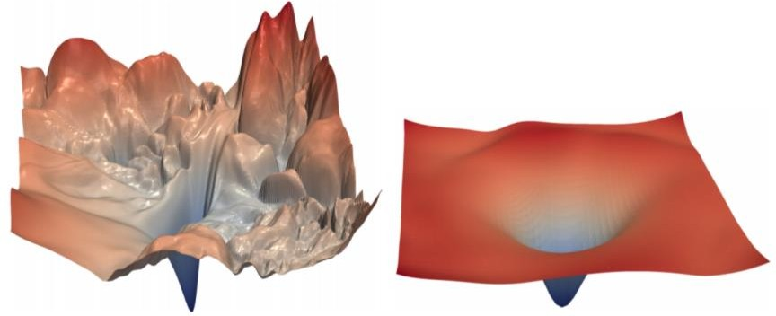
Transformers Use a Residual Stream
Residual connections are a trick to help models train better.
  Instead of 𝑋^{(𝑖)} = Layer(𝑋 ^{𝑖−1} ) (where 𝑖 represents the layer)
_{𝑋}(𝑖−1) _{𝑋}(𝑖)
Layer
We let 𝑋^{(𝑖)} = 𝑋^{(𝑖−1)} + Layer(𝑋 ^{𝑖−1} ) (so we only have to learn “the residual”
from the previous layer)
_{𝑋}(𝑖−1) _{𝑋}(𝑖)
Layer
+
Residual connections are thought to make the loss landscape considerably smoother (thus easier training!)
[no residuals] [residuals]
[Loss landscape visualization, Li et al., 2018, on a ResNet]
John Hewitt

Slide 24
Attention and MLP contribute to the Residual Stream
h_{i}^{(l)} state
The
attention
Space
MLP
Need
le
is
in
downtown
Seattle
(correct output)

Slide 25
Transformers use Layer Normalization
Layer normalization is a trick to help models train faster.
Idea: cut down on uninformative variation in hidden vector values by normalizing to unit mean and standard deviation within each layer.
  LayerNorm’s success may be due to its normalizing gradients [Xu et al., 2019]
Let 𝑥 ∈ ℝ^{𝑑} be an individual (word) vector in the model.
Let 𝜇 = Σ_{j=1}^{𝑑} 𝑥_{𝑗} ; this is the mean; 𝜇 ∈ ℝ.
1
𝑑
Σ^{d}
2
𝑥 − 𝜇 ; this is the standard deviation; 𝜎 ∈ ℝ.
Let 𝜎 =
Let 𝛾 ∈ ℝ^{𝑑} and 𝛽 ∈ ℝ^{𝑑} be learned “gain” and “bias” parameters. (Can omit!)
Then layer normalization computes:
𝑗=1
𝑗
𝑥 − 𝜇
∗ 𝛾 + 𝛽
output =
∗ 𝛾 + 𝛽
Modulate by learned elementwise gain and bias
𝜎 + 𝜖
Normalize by scalar mean and variance
Modulate by learned elementwise gain and bias
John Hewitt

Slide 26
Transformers use Scaled Dot Product
“Scaled Dot Product” attention is a final variation to aid in Transformer training.
When dimensionality 𝑑 becomes large, dot products between vectors become large, inputs to the softmax function can be large, making gradients small.
Instead of the self-attention function we’ve seen:
output_{𝑃} = softmax 𝑋𝑄_{𝑃}𝐾^{𝖳}𝑋^{𝖳} ∗ 𝑋𝑉_{𝑃}
𝑃
We divide the attention scores by 𝑑/ℎ, to stop the scores from becoming large
just as a function of 𝑑/ℎ (The dimensionality divided by the number of heads.)
output_{𝑃} = softmax
𝑋𝑄_{𝑃}𝐾^{𝖳}𝑋^{𝖳}
∗ 𝑋𝑉_{𝑃}
𝑃
𝑑/ℎ
John Hewitt

Slide 27
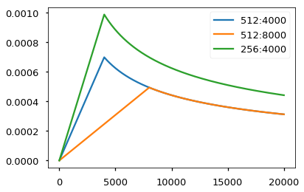
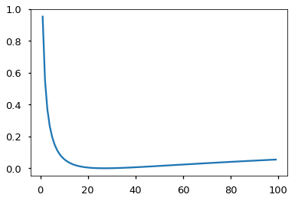
A few more training tricks for Transformers
Learning Rate Schedule
Smoothed Loss (penalize overconfidence)

Slide 28



The Transformer Encoder-Decoder (Vaswani et al., 2017)
Looking back at the whole model, zooming in on an Encoder block:
[predictions!]
Transformer Encoder
Transformer Decoder
[decoder attends to encoder states]
Transformer
Encoder
Transformer Decoder
Word Embeddings
+
Position Representations
Word
Embeddings
+
Position
Representations
[input sequence]
[output sequence]
John Hewitt

Slide 29


The Transformer Encoder-Decoder (Vaswani et al., 2017)
Looking back at the whole model, zooming in on an Encoder block:
Transformer
Encoder
[predictions!]
Transformer Decoder
Residual + LayerNorm
[decoder attends to encoder states]
Feed-Forward
Residual + LayerNorm
Transformer Decoder
Multi-Head Attention
Word Embeddings
+
Position Representations
Word
Embeddings
+
Position
Representations
[input sequence]
[output sequence]
John Hewitt

Slide 30

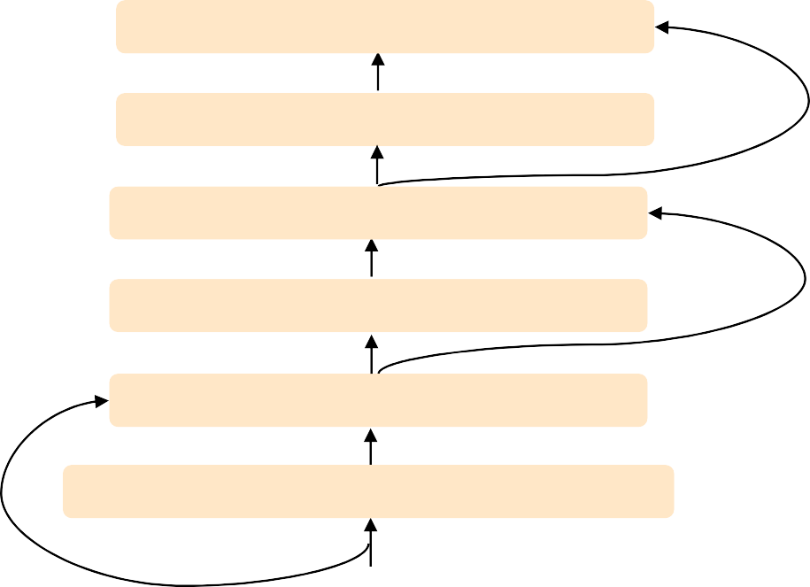
The Transformer Encoder-Decoder (Vaswani et al., 2017)
Looking back at the whole model, zooming in on a Decoder block:
Transformer Encoder
[predictions!]
Transformer Decoder
Residual + LayerNorm Feed-Forward Residual + LayerNorm
Multi-Head Cross-Attention Residual + LayerNorm
Masked Multi-Head Self-Attention
Transformer
Encoder
Word Embeddings
+
Position Representations
Word
Embeddings
+
Position
Representations
[input sequence]
[output sequence]
John Hewitt

Slide 31
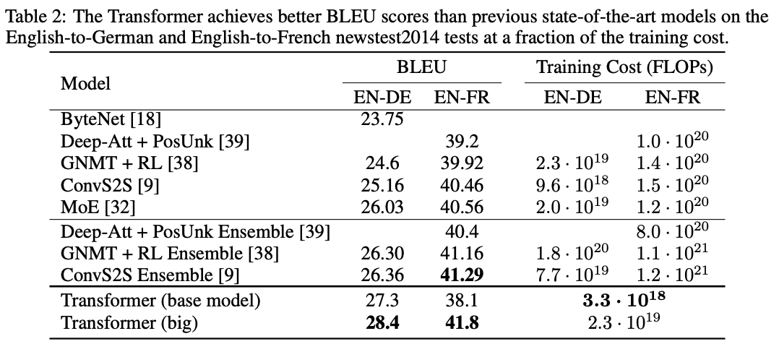
Transformers for Translation: better, faster, cheaper

Slide 32
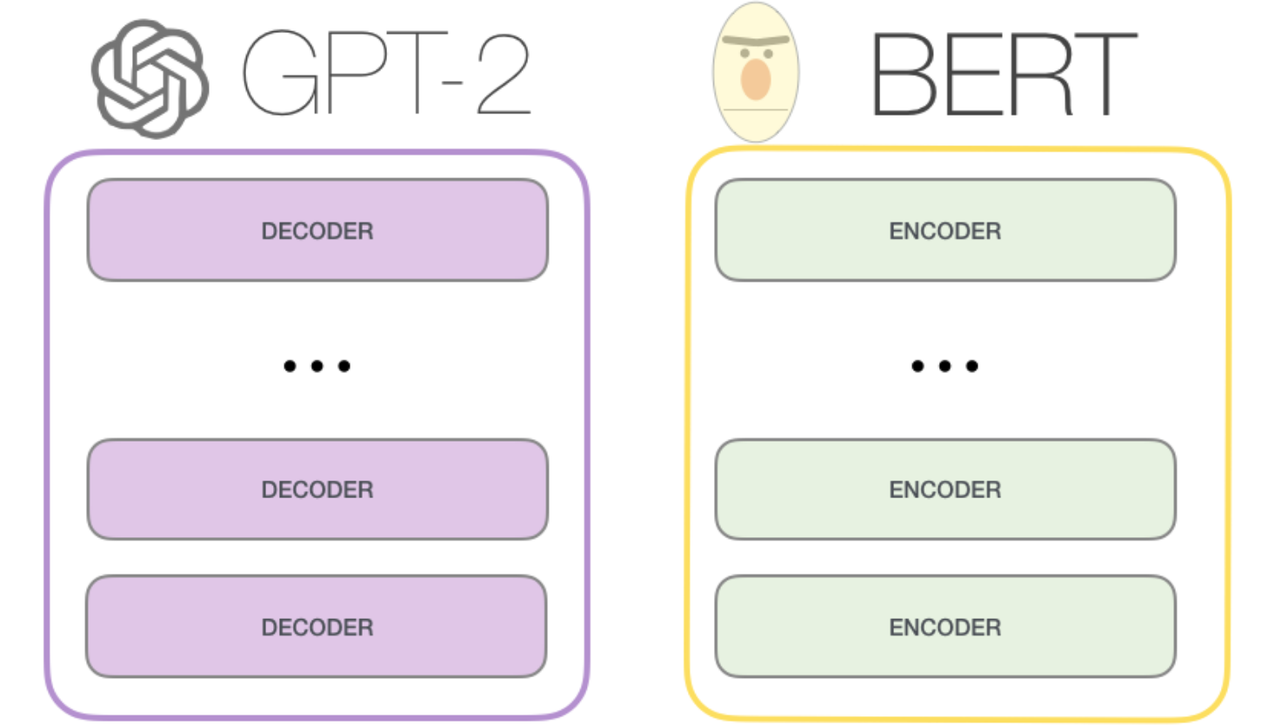
After Transformer: GPT-2 (Decode only), BERT (Encode only)
Transformer architecture has been remarkably stable: GPT, BERT use transformer essentially unchanged.
GPT-2 is a left-to-right language model trained on huge texts.
BERT is trained on masked-word-reconstruction and next-sentence classification on books and wikipedia..

Slide 33
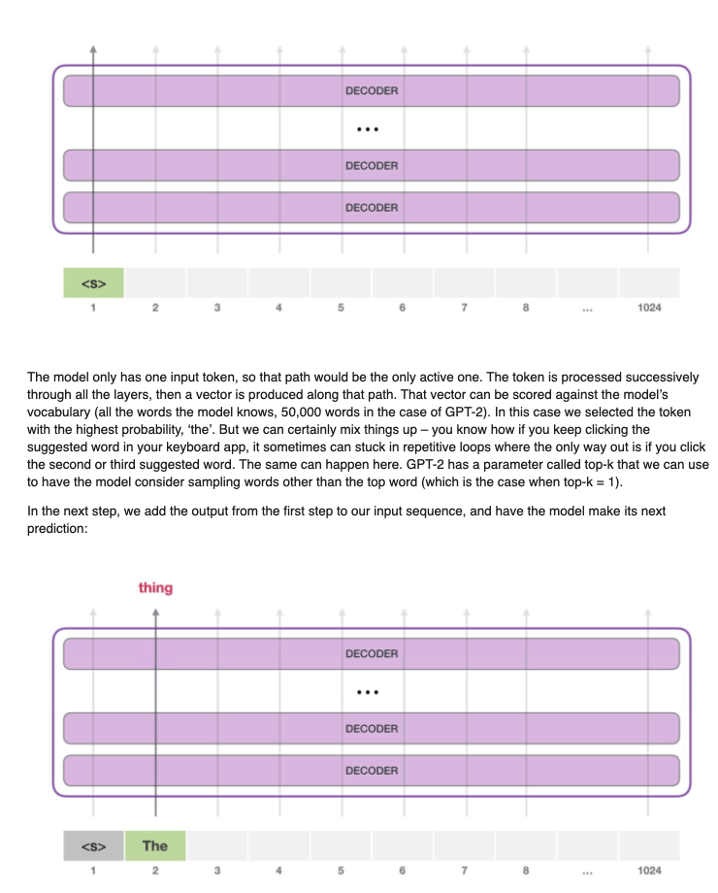
Decoder task: Predict the Next Word (GPT-1,2,3)
GPT-1: Radford 2018 “Improving Language Understanding..”
GPT-2: Radford 2019 “LMs are Unsupervised Multitask Learners”
GPT-3: Brown 2020 “LMs are Few-Shot Learners”

Slide 34
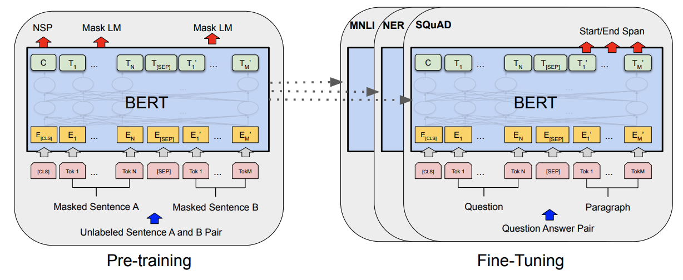
The BERT encoder training task. (Devlin 2018)
Input: two sentences from wikipedia+books corpus.
15% words targeted, 80% replaced with [MASK], 10% replaced with random token, 10% left real. Task: reconstruct targeted words.
Classify actually adjacent sentences versus random unrelated sentences.

Slide 35
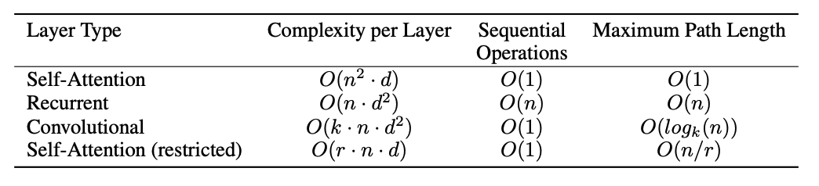
A discussion of transformer efficiency… Or inefficiency
Looking at everything naively would be O(n²d²).
Attention gets us to n²d ; paper argues that is pretty good, but it is not great.
The n² makes scaling up the size of input+output very expensive.
One approach is to factorize attention operation to reduce complexity:
“Sparse Attention” - O(n^{1.5}) - used by GPT-3 to make very massive models

Slide 36
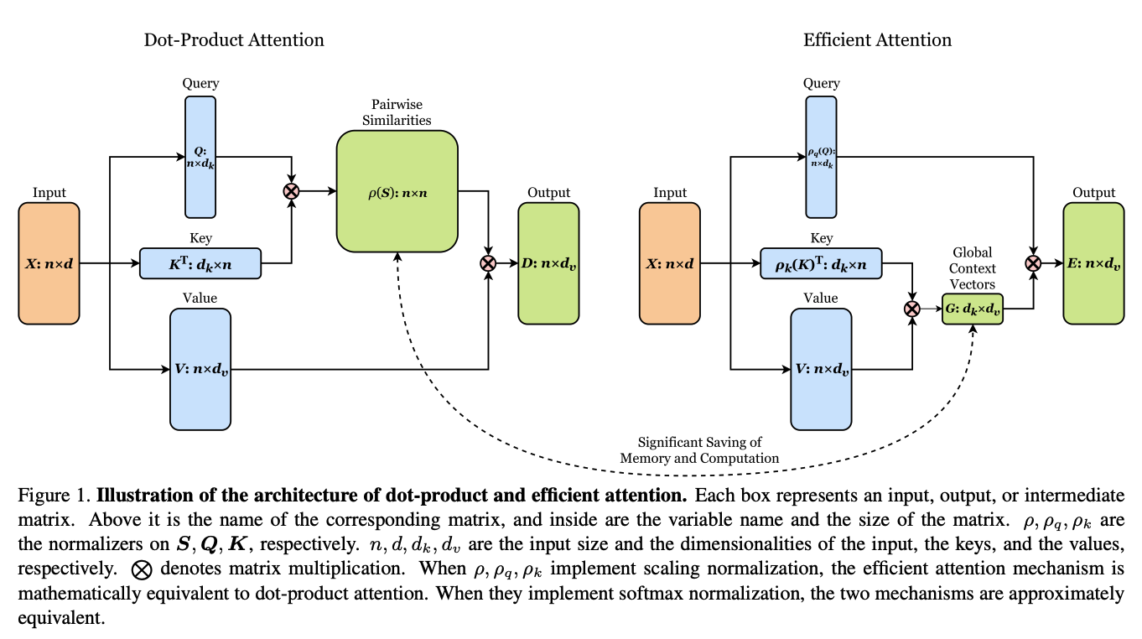
Recent ideas on efficiency: O(ndm) [linear time] attention
Shen 2020 “Efficient Attention”; Katharopoulos 2020 “Transformers are RNNs”

Slide 37
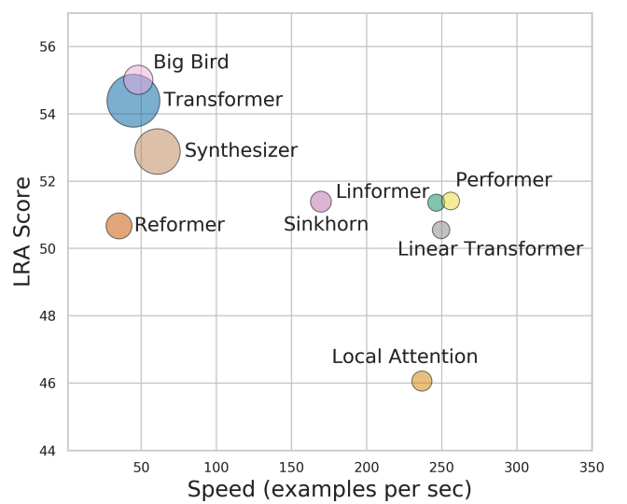
Efficiency survey (Tay 2020)
LRA, or Long Range Arena, is a benchmark for transformer performance on tasks w/ long-range dependencies (to test the n^2 blowup). Models with high LRA are large & slow.

Slide 38
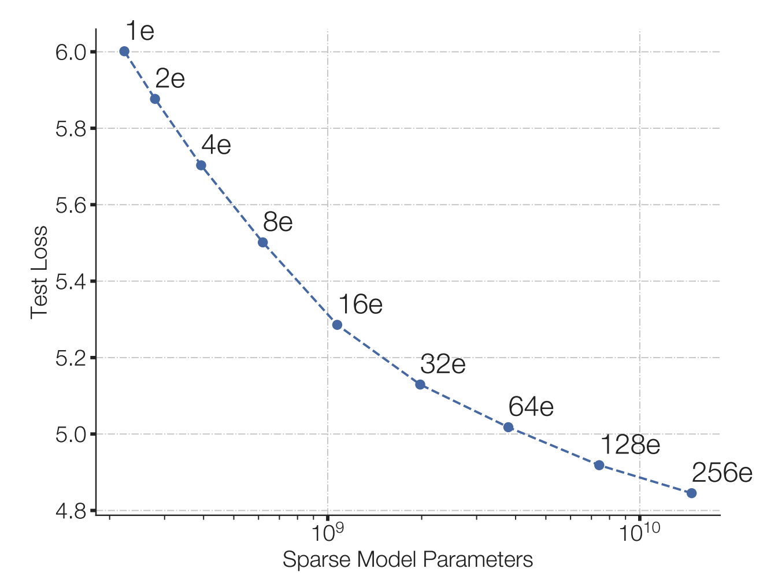
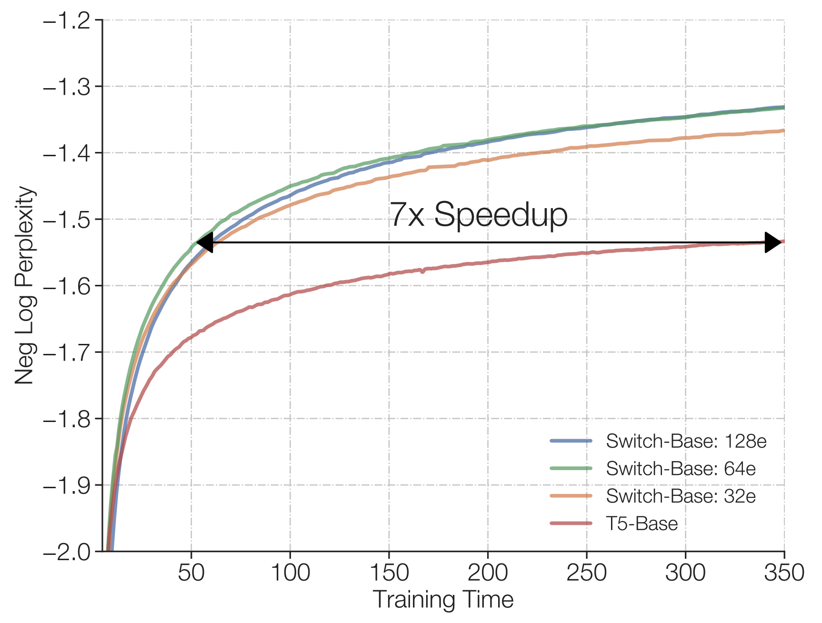
More observations on efficiency (Fedus 2021)
“Switched Transformers”
cheap!
Under a fixed compute budget, it is better to have a (much) bigger model and stop earlier.
Early-stopping of huge models, strategy inspired by Kaplan 2020 “Scaling laws for neural language models”

Slide 39
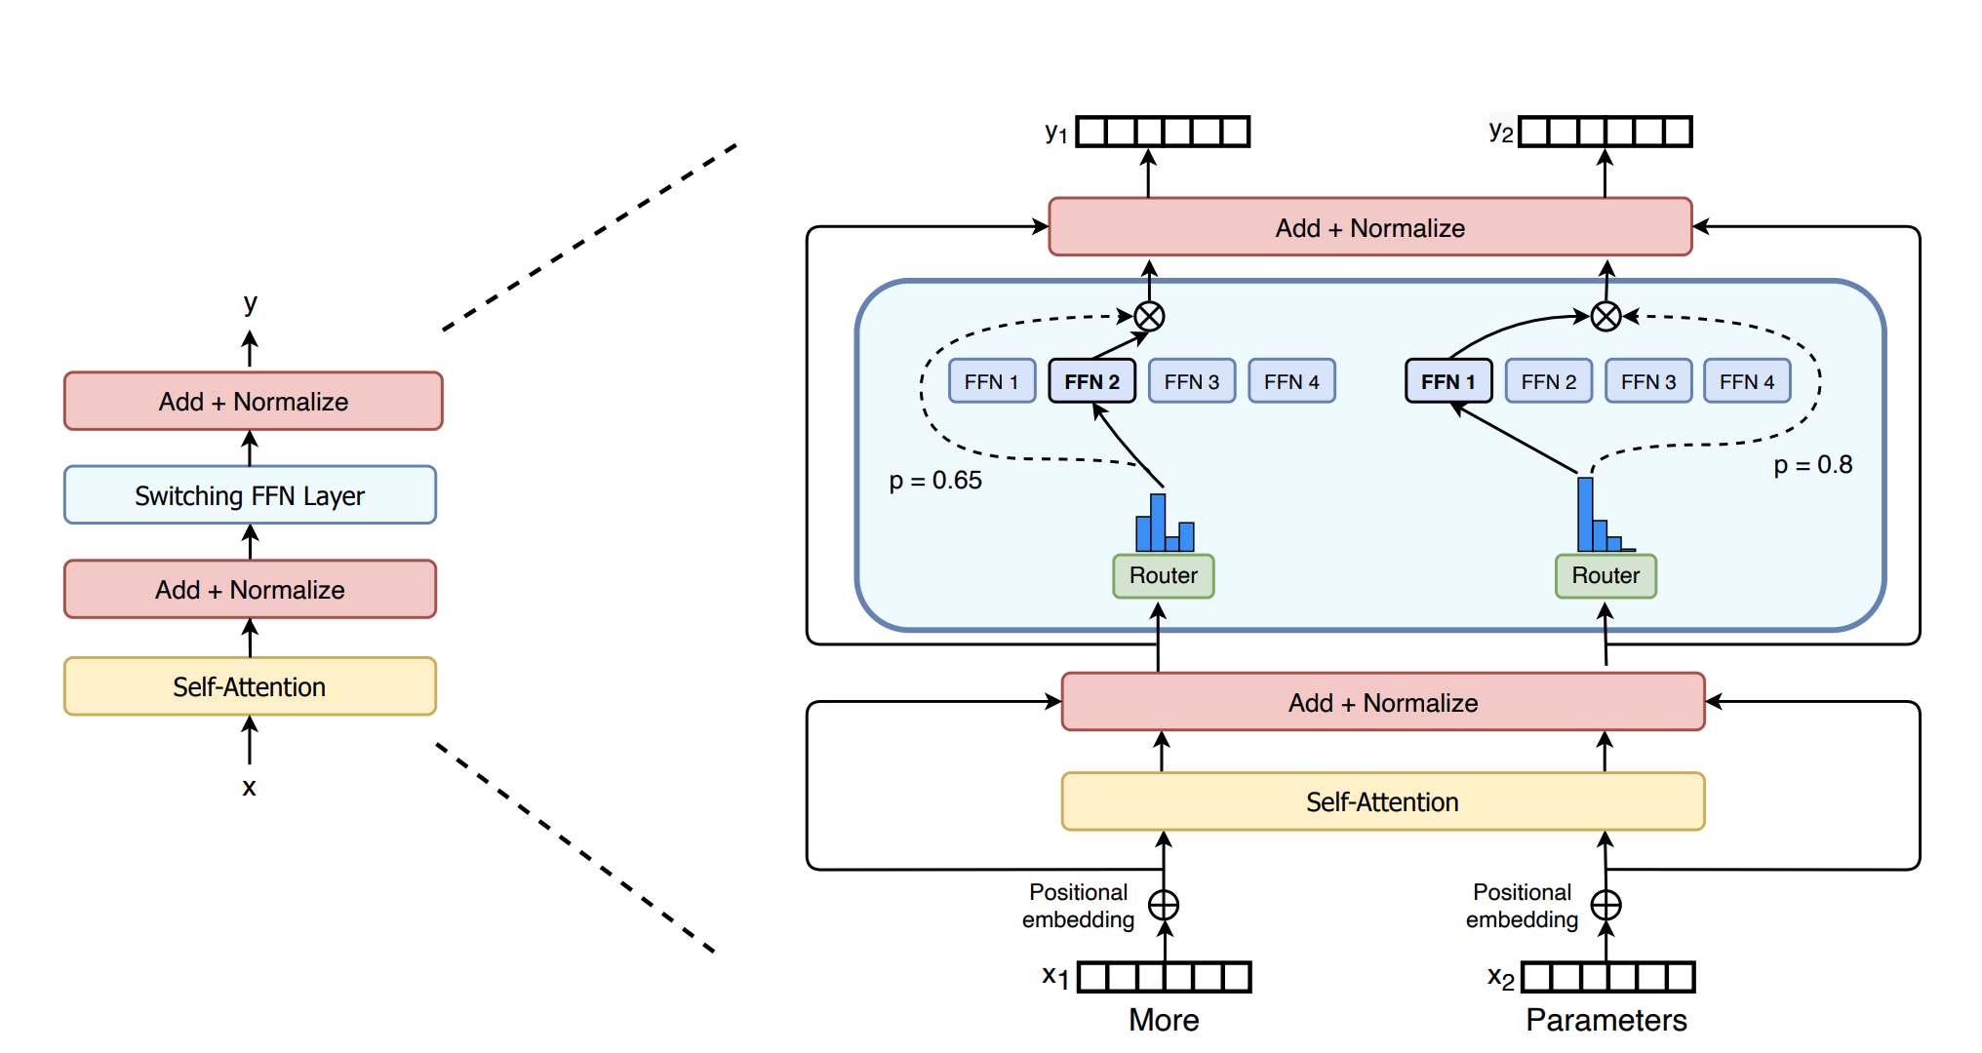
Switch Transformers: enlarge parameters (Fedus 2021)
Make the FF layer much larger by using a Mixture of Experts architecture.
Ideas: (1) don’t mix. Just one expert. (2) Only router loss is to load-balance.

Slide 40

What is so great about scaling up: Amazing GPT tricks
Priming is basically few-shot learning! Show GPT a few example inputs/outputs, and it figures out how to respond to future queries.
The “primer”
Without any pre-training, it “learns” to write MC questions with quality distractors & the correct answer!

Slide 41

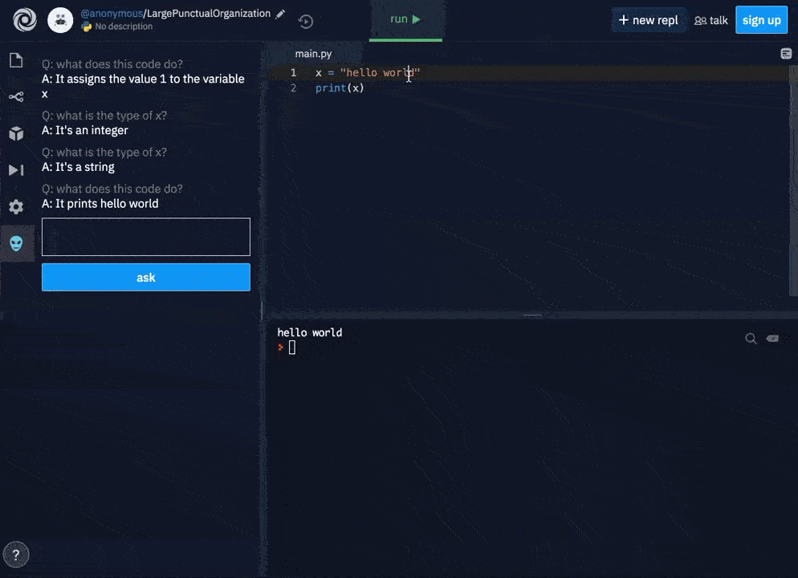
What is so great about scaling up: Amazing GPT tricks

Slide 42
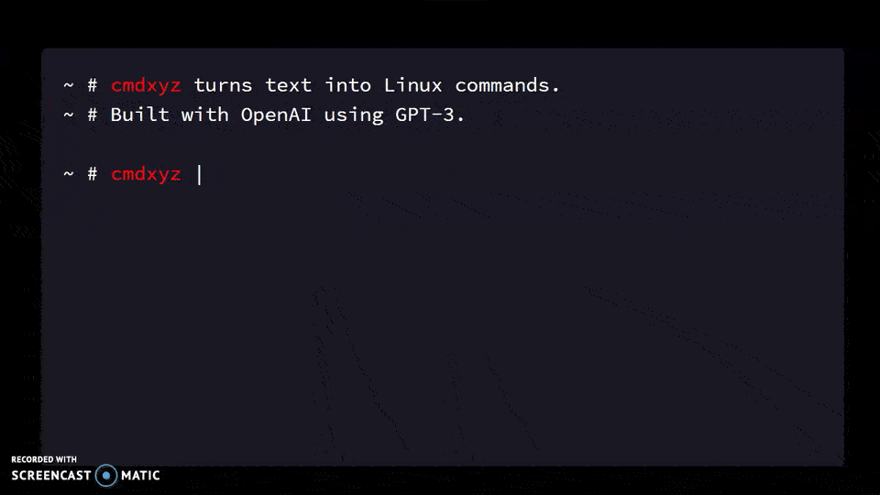
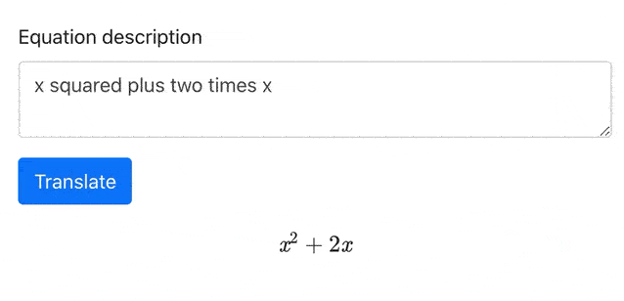
What is so great about scaling up: Amazing GPT tricks

Slide 43
A Library for Priming GPT3: Example with Latex
github.com/shreyashankar/gpt3-sandbox
# Construct GPT object and show some examples
gpt = GPT(engine="davinci",
temperature=0.5,
max_tokens=100)
gpt.add_example(Example('Two plus two equals four', '2 + 2 = 4'))
gpt.add_example(Example('The integral from zero to infinity', '\\int_0^{\\infty}'))
gpt.add_example(Example('The gradient of x squared plus two times x with respect to x', '\\nabla_x x^2 + 2x'))
gpt.add_example(Example('The log of two times x', '\\log{2x}'))
gpt.add_example(Example('x squared plus y squared plus equals z squared', 'x^2 + y^2 = z^2'))
# Define UI configuration
config = UIConfig(description="Text to equation",
button_text="Translate",
placeholder="x squared plus 2 times x")
demo_web_app(gpt, config)

Slide 44
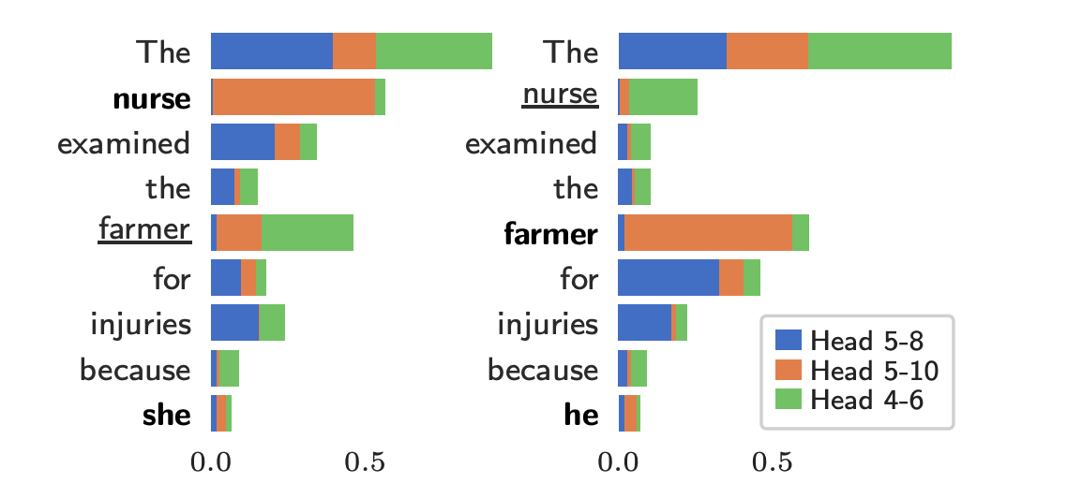
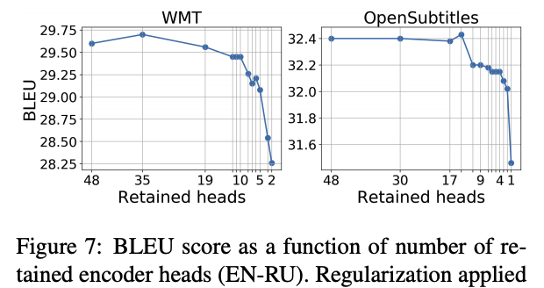
Some Interpretability Results
Individual attention heads have specific purposes, e.g., inferring gender for pronouns. (Vig 2020, Causal Mediation).
In some networks, most heads can be pruned with little damage (Voita 2019, Analyzing Multi-Head).
Maybe the community will use Linear-Time attention and Head-Pruning to make even more massive models with less computation.

Slide 45


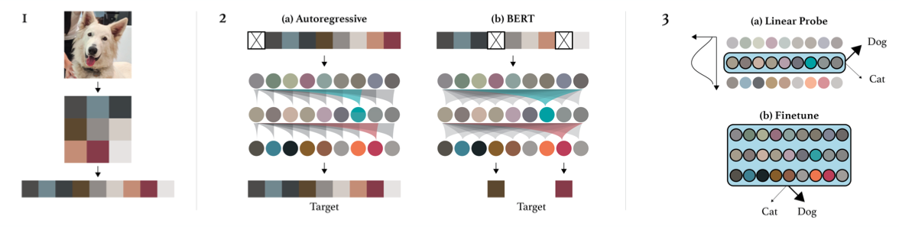
Image GPT/Generative Pretraining from Pixels (Chen 2020)
Two explored training objectives
Autoregressive: predict next pixel value in raster order
BERT-Style: predict values of masked pixels (15%)
Key observation: iGPT learns really good representations via generative pretraining! Done without inductive bias in NN architecture (c.f. CNNs, where locality is enforced)

Slide 46
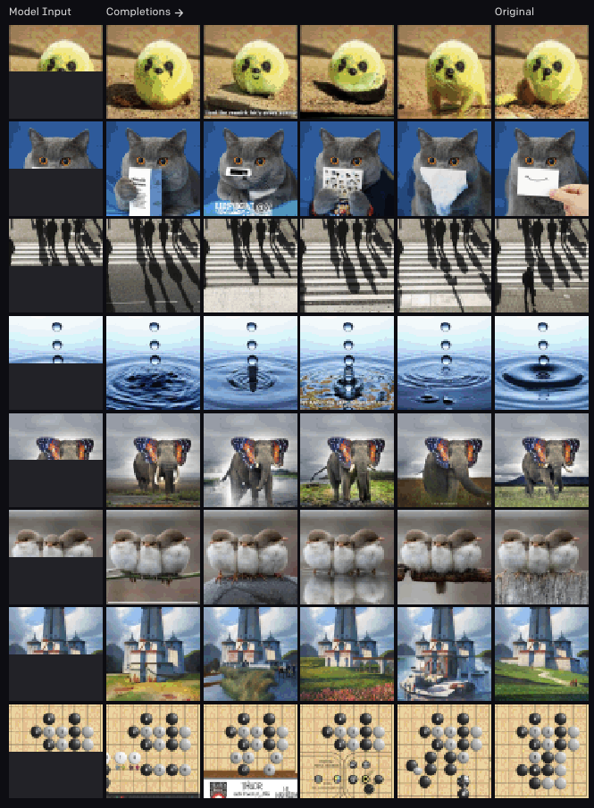
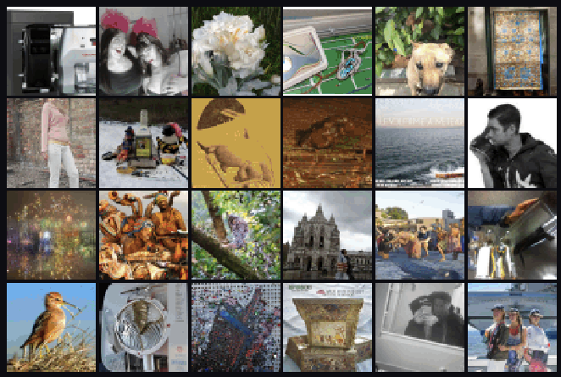
Image GPT/Generative Pretraining from Pixels (Chen 2020)
← Fill-in-the-blank
↓ Generations

Slide 47
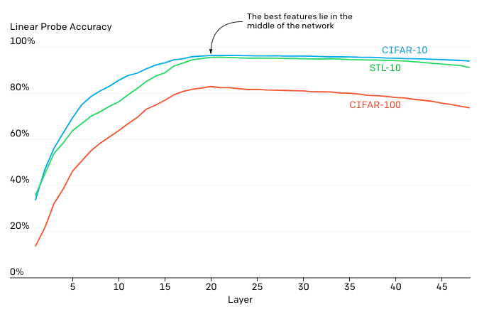
Image GPT/Generative Pretraining from Pixels (Chen 2020)
Feature quality is examined via a linear probe.
Hypothesis: iGPT operates in 2 phases
Gradually build a global representation
Use it to solve a specific task

Slide 48
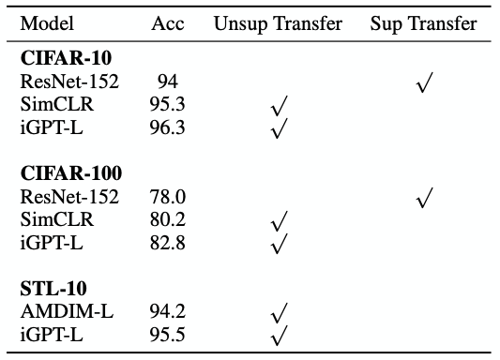
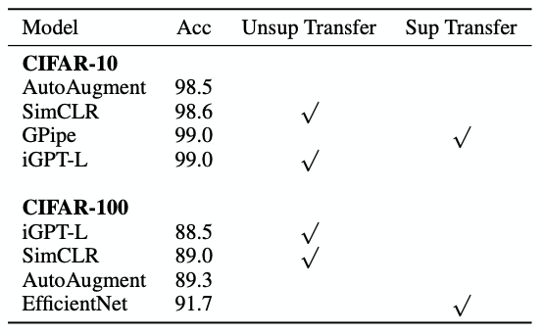
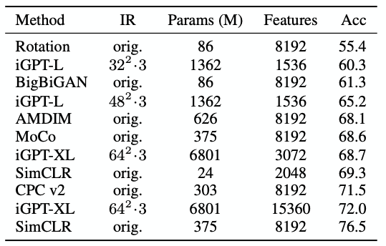
Image GPT/Generative Pretraining from Pixels (Chen 2020)
Results on autoregressive tasks
Linear Probe w/ ImageNet Pretraining
Full Fine-Tuning w/ ImageNet Pretraining
Linear Probe on ImageNet (High Res)
(In)efficiency of attention is prohibitive!
Features work well on 32x32 datasets
Poor performance on ImageNet (~500^2 pixels/image). Hacks are required to remain competitive, e.g. concatenating features from multiple layers

Slide 49
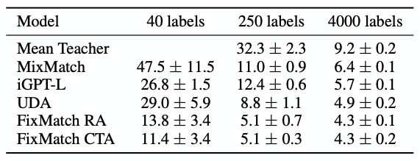
Image GPT/Generative Pretraining from Pixels (Chen 2020)
What about low-data fine-tuning?
* Values are error rates
iGPT outperforms 2 other low-data semi-supervised methods, simply using learned reprs + linear classifier
Achieved without using special tricks (e.g. data augmentation, pseudo-labeling)

Slide 50
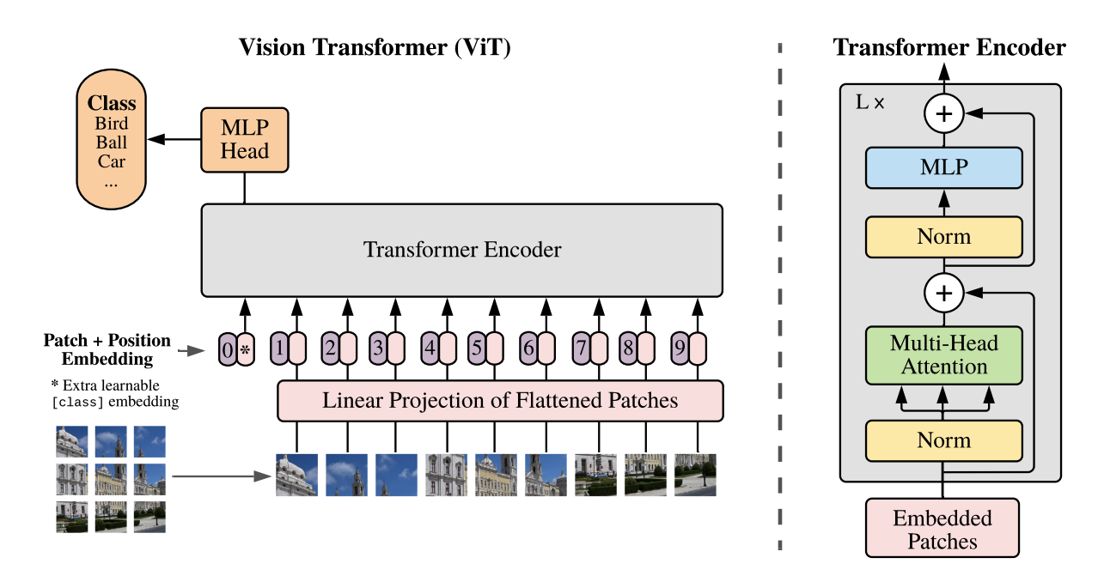
Vision Transformer (Dosovitskiy 2020)
Treat each 14x14 patch as a word, embedded to 64-dim feature.
Train supervised, to classify.
Unlike BERT, reconstruction pretraining does not do as well.
* Pixels can also be replaced with CNN feature maps
“Hybrid Model”

Slide 51
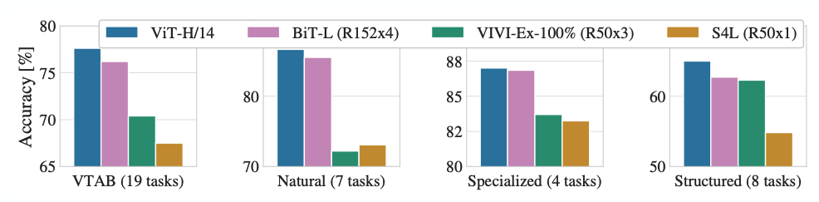
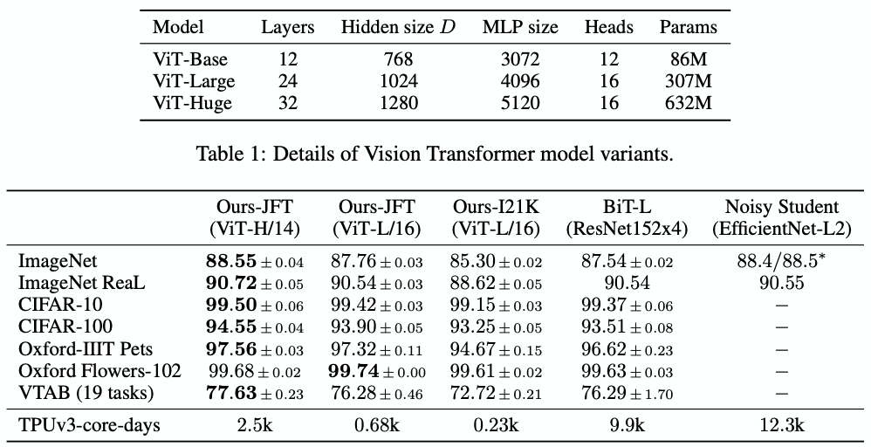
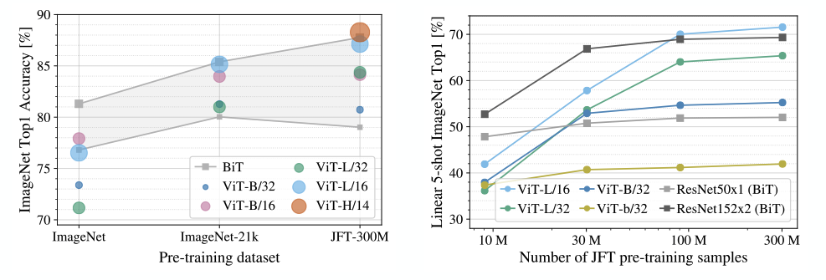
Vision Transformer
A huge model with a huge dataset wins out (though ViT-H is still smaller than BiT-L: 600M vs. 900M)
ViT scales better with training set size, eventually winning, but starts w/ a disadvantage

Slide 52
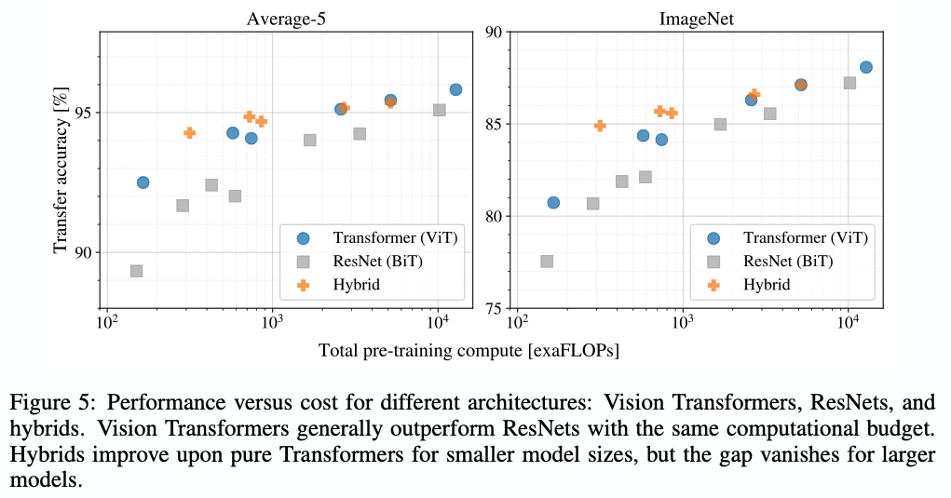
Vision Transformer (Dosovitskiy 2020)
ViT yields better performance per exaFLOP, compared to ResNets

Slide 53
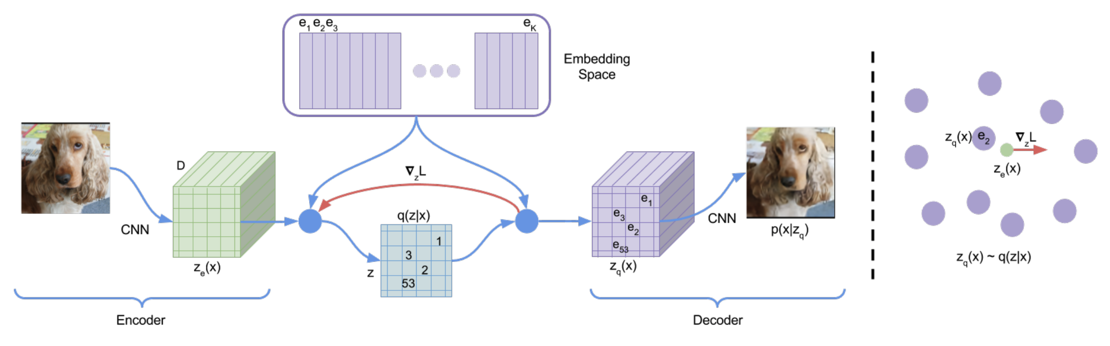
What’s next? Patch Generative Transformers.
Patch representation seems better than pixels, but Vision Transformer is not generative. VQ-VAE (van den Oord 2017) shows how to fit a generative patch representation with discrete words: quantize to a finite vocabulary of embeddings.
DALL-E 1 seems to use this technique.
Transformer generates: “A chair shaped like an avocado.<start-image>0 0 0 1 0 3 0 0 2 0 53 0 0”

Slide 54
Issues with recurrent models:
Lack of parallelizability
Forward and backward passes have O(sequence length) unparallelizable operations
  GPUs can perform a bunch of independent computations at once!
  But future RNN hidden states can’t be computed in full before past RNN
hidden states have been computed
  Inhibits training on very large datasets!
1
2
3
T
0
1
2
T-1
h₁ h₂
h_{T}
Numbers indicate min # of steps before a state can be computed
John Hewitt

Slide 55
If not recurrence, then what?
How about word windows?
Word window models aggregate local contexts
  Also known as 1D convolution
  Number of unparallelizable operations not tied to sequence length!
window window embedding
2 |  | 2 |  | 2 |  | 2 |  | 2 |  | 2 |  | 2 |  | 2
1 |  | 1 |  | 1 |  | 1 |  | 1 |  | 1 |  | 1 |  | 1
0 |  | 0 |  | 0 |  | 0 |  | 0 |  | 0 |  | 0 |  | 0
h₁
h₂
h_{T}
Numbers indicate min # of steps before a state can be computed
Adapted from John Hewitt

Slide 56
If not recurrence, then what?
How about word windows?
Word window models aggregate local contexts
What about long-distance dependencies?
  Stacking word window layers allows interaction between farther words
  But if your sequences are too long, you’ll just ignore long-distance context
window (size=5)
Red states
indicate those
“visible” to h_{k}
window (size=5) embedding
h₁
h_{k}
h_{T}
Too far from h_{k} to be considered
Adapted from John Hewitt

Slide 57
If not recurrence, then what?
How about attention?
Attention treats each word’s representation as a query to access and incorporate information from a set of values.
  We saw attention from the decoder to the encoder; today we’ll think about
attention within a single sentence.
If attention gives us access to any state… maybe we can just use attention and don’t need the RNN?
Number of unparallelizable operations not tied to sequence length.
All words interact at every layer!
2 |  | 2 |  | 2 |  | 2 |  | 2 |  | 2 |  | 2 |  | 2
1 |  | 1 |  | 1 |  | 1 |  | 1 |  | 1 |  | 1 |  | 1
0 |  | 0 |  | 0 |  | 0 |  | 0 |  | 0 |  | 0 |  | 0
All words attend
to all words in previous layer; most arrows here are omitted
attention
attention embedding
h₁
h₂
h_{T}
Adapted from John Hewitt

Slide 58
Barriers and solutions for Self-Attention as a building block
Barriers
Doesn’t have an inherent
notion of order!
Solutions
John Hewitt

Slide 59
Fixing the first self-attention problem:
Sequence order
Since self-attention doesn’t build in order information, we need to encode the order of the
sentence in our keys, queries, and values.
Consider representing each sequence index as a vector
𝑝_{𝑖} ∈ ℝ^{𝑑}, for 𝑖 ∈ {1,2, … , 𝑇} are position vectors
Don’t worry about what the 𝑝_{𝑖} are made of yet!
Easy to incorporate this info into our self-attention block: just add the 𝑝_{𝑖} to our inputs!
Let 𝑣_{𝑖} ‘, 𝑘_{𝑖} ‘, 𝑞_{𝑖} ‘ be our old values, keys, and queries.
𝑣_{𝑖} = 𝑣_{𝑖} ‘ + 𝑝_{𝑖}
𝑞_{𝑖} = 𝑞_{𝑖} ‘ + 𝑝_{𝑖}
𝑘_{𝑖} = 𝑘_{𝑖} ‘ + 𝑝_{𝑖}
In deep self-attention networks, we do this at the first layer! You could concatenate them as well, but people mostly just add…
John Hewitt

Slide 60
Barriers and solutions for Self-Attention as a building block
Barriers
Doesn’t have an inherent
notion of order!
Solutions
Add position representations to the inputs
No nonlinearities for deep
learning! It’s all just weighted
averages
John Hewitt

Slide 61
Barriers and solutions for Self-Attention as a building block
Barriers
Doesn’t have an inherent
notion of order!
No nonlinearities for deep learning magic! It’s all just weighted averages
Need to ensure we don’t “look at the future” when predicting a sequence
  Like in machine translation
  Or language modeling
Solutions
Add position representations to the inputs
Easy fix: apply the same feedforward network to each self- attention output.
John Hewitt

Slide 62
Barriers and solutions for Self-Attention as a building block
Barriers
Doesn’t have an inherent
notion of order!
No nonlinearities for deep learning magic! It’s all just weighted averages
Need to ensure we don’t “look at the future” when predicting a sequence
  Like in machine translation
  Or language modeling
Solutions
Add position representations to the inputs
Easy fix: apply the same feedforward network to each self- attention output.
Mask out the future by artificially setting attention weights to 0!
John Hewitt

Slide 63
Necessities for a self-attention building block:
Self-attention:
  the basis of the method.
Position representations:
  Specify the sequence order, since self-attention is an unordered function of its inputs.
Nonlinearities:
  At the output of the self-attention block
  Frequently implemented as a simple feed-forward network.
Masking:
  In order to parallelize operations while not looking at the future.
  Keeps information about the future from “leaking” to the past.
That’s it! But this is not the Transformer model we’ve been hearing about.
John Hewitt

Slide 64

The Transformer Encoder-Decoder
[Vaswani et al., 2017]
Another look at the Transformer Encoder and Decoder Blocks at a high level
[predictions!]
Transformer Encoder
Transformer Decoder
[decoder attends to encoder states]
Transformer
Encoder
Transformer Decoder
Word Embeddings
+
Position Representations
Word
Embeddings
+
Position
Representations
[input sequence]
[output sequence]
John Hewitt

Slide 65
The Transformer Encoder-Decoder
[Vaswani et al., 2017]
Next, let’s look at the Transformer Encoder and Decoder Blocks
What’s left in a Transformer Encoder Block that we haven’t covered?
Key-query-value attention: How do we get the 𝑘, 𝑞, 𝑣 vectors from a single word embedding?
Multi-headed attention: Attend to multiple places in a single layer!
Tricks to help with training!
  Residual connections
  Layer normalization
  Scaling the dot product
  These tricks don’t improve what the model is able to do; they help improve the training process
John Hewitt

Slide 66

Dot-Product Attention
Inputs: a query q and a set of key-value (k-v) pairs to an output
Query, keys, values, and output are all vectors
Output is weighted sum of values, where
Weight of each value is computed by an inner product of query and corresponding key
Queries and keys have same dimensionality d_{k ,} value have d_{v}
Christopher Manning

Slide 67


The Transformer Encoder:
Dot-Product Attention – Matrix notation
When we have multiple queries q, we stack them in a matrix Q:
Becomes:
[|Q| x d_{k}] x [d_{k} x |K|] x [|K| x d_{v}]
softmax row-wise
= [|Q| x d_{v}]
Christopher Manning

Slide 68
The Transformer Encoder:
Key-Query-Value Attention
We saw that self-attention is when keys, queries, and values come from the same
source. The Transformer does this in a particular way:
  Let 𝑥₁, … , 𝑥_{𝑇} be input vectors to the Transformer encoder; 𝑥_{𝑖} ∈ ℝ^{𝑑}
Then keys, queries, values are:
  𝑘_{𝑖} = 𝐾𝑥_{𝑖}, where 𝐾 ∈ ℝ^{𝑑×𝑑} is the key matrix.
  𝑞_{𝑖} = 𝑄𝑥_{𝑖}, where Q ∈ ℝ^{𝑑×𝑑} is the query matrix.
  𝑣_{𝑖} = 𝑉𝑥_{𝑖}, where V ∈ ℝ^{𝑑×𝑑} is the value matrix.
These matrices allow different aspects of the 𝑥 vectors to be used/emphasized in each of the three roles.
John Hewitt

Slide 69

The Transformer Encoder-Decoder
[Vaswani et al., 2017]
The only new part is attention from decoder to encoder. Like we saw in previous lecture!
Transformer Encoder
[predictions!]
Transformer Decoder
Residual + LayerNorm
Feed-Forward
Residual + LayerNorm Multi-Head Cross-Attention
Residual + LayerNorm
Masked Multi-Head Self-Attention
Transformer
Encoder
Word Embeddings
+
Position Representations
Word
Embeddings
+
Position
Representations
[input sequence]
[output sequence]
John Hewitt

Slide 70
The Transformer Decoder:
Cross-attention (details)
We saw self-attention is when keys, queries, and values come from the same source.
In the decoder, we have attention that looks more like what we saw last week.
Let ℎ₁, … , ℎ_{𝑇} be output vectors from the Transformer encoder; 𝑥_{𝑖} ∈ ℝ^{𝑑}
Let 𝑧₁, … , 𝑧_{𝑇} be input vectors from the Transformer decoder, 𝑧_{𝑖} ∈ ℝ^{𝑑}
Then keys and values are drawn from the encoder (like a memory):
  𝑘_{𝑖} = 𝐾ℎ_{𝑖}, 𝑣_{𝑖} = 𝑉ℎ_{𝑖}.
And the queries are drawn from the decoder, 𝑞_{𝑖} = 𝑄𝑧_{𝑖}.
John Hewitt

Slide 71
The Transformer Encoder:
Cross-attention (details)
Let’s look at how cross-attention is computed, in matrices.
Let H = ℎ₁; … ; ℎ_{𝑇}
Let Z = 𝑧₁; … ; 𝑧_{𝑇}
∈ ℝ^{𝑇×𝑑} be the concatenation of encoder vectors.
∈ ℝ^{𝑇×𝑑} be the concatenation of decoder vectors.
𝖳
The output is defined as output = softmax 𝑍𝑄 𝐻𝐾 × 𝐻𝑉.
First, take the query-key dot products in one matrix
All pairs of attention scores!
= 𝑍𝑄𝐾^{𝖳} 𝐻^{𝖳}
𝑍𝑄
multiplication: 𝑍𝑄 𝐻𝐾
𝖳
_{𝐾}𝖳 _{𝐻}𝖳
∈ ℝ
𝑇×𝑇
Next, softmax, and compute the weighted average with another matrix multiplication.
softmax
𝑍𝑄𝐾^{𝖳} 𝐻^{𝖳}
𝐻𝑉
=
output ∈ ℝ^{𝑇×𝑑}
John Hewitt

Slide 72

Attention visualization in layer 5
Words start to pay attention to other words in sensible ways
Christopher Manning

Slide 73

Attention visualization: Implicit anaphora resolution
In 5th layer. Isolated attentions from just the word ‘its’ for attention heads 5 and 6. Note that the attentions are very sharp for this word.
Christopher Manning

Slide 74


Parallel attention heads
I
kicked
the
ball
Who
To whom?
Did what?
I
kicked
the
ball
Ashish Vaswani

Slide 75

Great Results with Transformers
Next, document generation!
The old standard
Transformers all the way down.
[Liu et al., 2018]; WikiSum dataset
John Hewitt

Slide 76
What would we like to fix about the Transformer?
Quadratic compute in self-attention:
  Computing all pairs of interactions means our computation grows
quadratically with the sequence length!
  For recurrent models, it only grew linearly!
Position representations:
  Are simple absolute indices the best we can do to represent position?
  Relative linear position attention [Shaw et al., 2018]
  Dependency syntax-based position [Wang et al., 2019]
John Hewitt

Slide 77
Quadratic computation as function of seq. length
One of the benefits of self-attention over recurrence was that it’s highly
parallelizable.
However, its total number of operations grows as 𝑂 𝑇²𝑑 , where 𝑇 is the sequence length, and 𝑑 is the dimensionality.
= 𝑋𝑄𝐾^{𝖳} 𝑋^{𝖳}
Need to compute all pairs of interactions!
𝑂 𝑇²𝑑
𝑋𝑄
_{𝐾}𝖳 _{𝑋}𝖳
∈ ℝ
𝑇×𝑇
Think of 𝑑 as around 𝟏, 𝟎𝟎𝟎.
  So, for a single (shortish) sentence, 𝑇 ≤ 30; 𝑇² ≤ 𝟗𝟎𝟎.
  In practice, we set a bound like 𝑇 = 512.
  But what if we’d like 𝑻 ≥ 𝟏𝟎, 𝟎𝟎𝟎? For example, to work on long documents?
John Hewitt

Slide 78


Recent work on improving on quadratic self-attention cost
Considerable recent work has gone into the question, Can we build models like
Transformers without paying the 𝑂 𝑇² all-pairs self-attention cost?
For example, Linformer [Wang et al., 2020]
Key idea: map the sequence length dimension to a lower- dimensional space for values, keys
Inference time (s)
Sequence length / batch size
John Hewitt

Slide 79

Recent work on improving on quadratic self-attention cost
Considerable recent work has gone into the question, Can we build models like
Transformers without paying the 𝑂 𝑇² all-pairs self-attention cost?
For example, BigBird [Zaheer et al., 2021]
Key idea: replace all-pairs interactions with a family of other interactions, like local windows, looking at everything, and random interactions.
John Hewitt

Slide 80
Pretraining models
In modern NLP:
All (or almost all) parameters in NLP
networks are initialized via pretraining.
Pretraining methods hide parts of the input from the model, and train the model to reconstruct those parts.
This has been exceptionally effective at building strong:
  representations of language
  parameter initializations for strong NLP
models.
𝒚
Pretrained jointly
… the movie was …
[This model has learned how to represent entire sentences through pretraining]
Adapted from John Hewitt

Slide 81
Pretraining through language modeling
[Dai and Le, 2015]
Recall the language modeling task:
Model 𝑝_{𝜃} 𝑤_{𝑡} 𝑤_{1:𝑡−1}), the probability distribution over words given their past contexts.
There’s lots of data for this! (In English.)
goes
to
make
tasty
tea END
Decoder
(Transformer, LSTM, ++ )
Pretraining through language modeling:
Train a neural network to perform language modeling on a large amount of text.
Save the network parameters.
Iroh goes to
make
tasty tea
John Hewitt

Slide 82

The Pretraining / Finetuning Paradigm
Pretraining can improve NLP applications by serving as parameter initialization.
Step 1: Pretrain (on language modeling)
Lots of text; learn general things!
Step 2: Finetune (on your task)
Not many labels; adapt to the task!
goes to
make tasty tea END
☺/☹
Decoder
Decoder
(Transformer, LSTM, ++ )
(Transformer, LSTM, ++ )
Iroh
goes
to
make
tasty
tea
… the movie was …
John Hewitt

Slide 83
Capturing meaning via context:
What kinds of things does pretraining learn?
There’s increasing evidence that pretrained models learn a wide variety of things about
the statistical properties of language:
Stanford University is located in , California. [Trivia]
I put fork down on the table. [syntax]
The woman walked across the street, checking for traffic over shoulder. [coreference]
I went to the ocean to see the fish, turtles, seals, and . [lexical semantics/topic]
Overall, the value I got from the two hours watching it was the sum total of the popcorn
and the drink. The movie was . [sentiment]
Iroh went into the kitchen to make some tea. Standing next to Iroh, Zuko pondered his destiny. Zuko left the . [some reasoning – this is harder]
I was thinking about the sequence that goes 1, 1, 2, 3, 5, 8, 13, 21, [some basic
arithmetic; they don’t learn the Fibonnaci sequence]
Models also learn – and can exacerbate racism, sexism, all manner of bad biases.
More on all this in the interpretability lecture!
Adapted from John Hewitt

Slide 84


Pretraining for three types of architectures
The neural architecture influences the type of pretraining, and natural use cases.
Language models! What we’ve seen so far.
Nice to generate from; can’t condition on future words
Decoders
Gets bidirectional context – can condition on future!
Wait, how do we pretrain them?
Encoders
Encoder- Decoders
Good parts of decoders and encoders?
What’s the best way to pretrain them?
John Hewitt

Slide 85
Pretraining decoders
When using language model pretrained decoders, we can ignore that they were trained to model 𝑝 𝑤_{𝑡} 𝑤_{1:𝑡−1}).
We can finetune them by training a classifier
on the last word’s hidden state.
☺/☹
Linear
𝐴, 𝑏
ℎ₁, … , ℎ_{𝑇}
ℎ₁, … , ℎ_{𝑇} = Decoder 𝑤₁, … , 𝑤_{𝑇}
𝑦 ∼ 𝐴𝑤_{𝑇} + 𝑏
Where 𝐴 and 𝑏 are randomly initialized and specified by the downstream task.
𝑤₁, … , 𝑤_{𝑇}
Gradients backpropagate through the whole network.
[Note how the linear layer hasn’t been
pretrained and must be learned from scratch.]
John Hewitt

Slide 86
Pretraining decoders
It’s natural to pretrain decoders as language models and then
use them as generators, finetuning their 𝑝_{𝜃}
^{𝑤}𝑡 ^{𝑤}1:𝑡−1^{)!}
This is helpful in tasks where the output is a sequence with a vocabulary like that at pretraining time!
Dialogue (context=dialogue history)
Summarization (context=document)
𝑤₂ 𝑤₃ 𝑤₄ 𝑤₅ 𝑤₆
𝐴, 𝑏
ℎ₁, … , ℎ_{𝑇}
ℎ₁, … , ℎ_{𝑇} = Decoder 𝑤₁, … , 𝑤_{𝑇}
𝑤_{𝑡} ∼ 𝐴𝑤_{𝑡−1} + 𝑏
𝑤₁ 𝑤₂ 𝑤₃ 𝑤₄ 𝑤₅
[Note how the linear layer has been pretrained.]
Where 𝐴, 𝑏 were pretrained in the language model!
John Hewitt

Slide 87
Generative Pretrained Transformer (GPT)
[Radford et al., 2018]
2018’s GPT was a big success in pretraining a decoder!
Transformer decoder with 12 layers.
768-dimensional hidden states, 3072-dimensional feed-forward hidden layers.
Byte-pair encoding with 40,000 merges
Trained on BooksCorpus: over 7000 unique books.
  Contains long spans of contiguous text, for learning long-distance dependencies.
The acronym “GPT” never showed up in the original paper; it could stand for
“Generative PreTraining” or “Generative Pretrained Transformer”
[Devlin et al., 2018]
John Hewitt

Slide 88
Generative Pretrained Transformer (GPT)
[Radford et al., 2018]
How do we format inputs to our decoder for finetuning tasks?
Natural Language Inference: Label pairs of sentences as entailing/contradictory/neutral
Premise: The man is in the doorway
Hypothesis: The person is near the door
entailment
Radford et al., 2018 evaluate on natural language inference.
Here’s roughly how the input was formatted, as a sequence of tokens for the decoder.
[START] The man is in the doorway [DELIM] The person is near the door [EXTRACT]
The linear classifier is applied to the representation of the [EXTRACT] token.
John Hewitt

Slide 89

Generative Pretrained Transformer (GPT)
[Radford et al., 2018]
GPT results on various natural language inference datasets.
John Hewitt

Slide 90

Increasingly convincing generations (GPT2) [Radford et al., 2018]
We mentioned how pretrained decoders can be used in their capacities as language models. GPT-2, a larger version of GPT trained on more data, was shown to produce relatively convincing samples of natural language.
John Hewitt

Slide 91
Aside: Word structure and subword models
Let’s take a look at the assumptions we’ve made about a language’s vocabulary.
We assume a fixed vocab of tens of thousands of words, built from the training set. All novel words seen at test time are mapped to a single UNK.
word hat learn
taaaaasty laern
vocab mapping pizza (index) tasty (index) UNK (index) UNK (index) UNK (index)
embedding
Common
words
Variations
misspellings
novel items
Transformerify
John Hewitt

Slide 92

Aside: Word structure and subword models
Finite vocabulary assumptions make even less sense in many languages.
Many languages exhibit complex morphology, or word structure.
  The effect is more word types, each occurring fewer times.
Example: Swahili verbs can have hundreds of conjugations, each encoding a wide variety of information. (Tense, mood, definiteness, negation, information about the object, ++)
Here’s a small fraction of the
conjugations for ambia – to tell.
[Wiktionary]
John Hewitt

Slide 93
Aside: The byte-pair encoding algorithm
Subword modeling in NLP encompasses a wide range of methods for reasoning about structure below the word level. (Parts of words, characters, bytes.)
The dominant modern paradigm is to learn a vocabulary of parts of words (subword tokens).
At training and testing time, each word is split into a sequence of known subwords.
Byte-pair encoding is a simple, effective strategy for defining a subword vocabulary.
Start with a vocabulary containing only characters and an “end-of-word” symbol.
Using a corpus of text, find the most common adjacent characters “a,b”; add “ab” as a subword.
Replace instances of the character pair with the new subword; repeat until desired vocab size.
Originally used in NLP for machine translation; now a similar method (WordPiece) is used in pretrained
models.
[Sennrich et al., 2016, Wu et al., 2016]
John Hewitt

Slide 94
Aside: Word structure and subword models
Common words end up being a part of the subword vocabulary, while rarer words are split into (sometimes intuitive, sometimes not) components.
In the worst case, words are split into as many subwords as they have characters.
word
vocab mapping hat
learn
taa## aaa## sty la## ern## Transformer## ify
embedding
hat learn
taaaaasty laern
Common
words
Variations
misspellings
novel items
Transformerify
John Hewitt

Slide 95
Pretraining encoders:
What pretraining objective to use?
So far, we’ve looked at language model pretraining. But encoders get bidirectional context, so we can’t do language modeling!
Idea: replace some fraction of words in the input with a special [MASK] token; predict these words.
store
𝐴, 𝑏
ℎ₁, … , ℎ_{𝑇}
went
ℎ₁, … , ℎ_{𝑇} = Encoder 𝑤₁, … , 𝑤_{𝑇}
𝑦_{𝑖} ∼ 𝐴𝑤_{𝑖} + 𝑏
Only add loss terms from words that are “masked out.” If 𝑥 ’ is the masked version of 𝑥, we’re learning 𝑝_{𝜃}(𝑥|𝑥’ ). Called Masked LM.
I [M] to the [M]
[Devlin et al., 2018]
John Hewitt

Slide 96
BERT: Bidirectional Encoder Representations from Tranformers
Devlin et al., 2018 proposed the “Masked LM” objective and released the weights of a pretrained Transformer, a model they labeled BERT.
Some more details about Masked LM for BERT:
Predict a random 15% of (sub)word tokens.
  Replace input word with [MASK] 80% of the time
  Replace input word with a random token 10% of the time
  Leave input word unchanged 10% of the time (but still predict it!)
Why? Doesn’t let the model get complacent and not build strong representations of non-masked words. (No masks are seen at fine-tuning time!)
[Predict these!]
went to
Transformer Encoder
store
I pizza to the [M]
[Replaced]
[Not replaced]
[Masked]
[Devlin et al., 2018]
John Hewitt

Slide 97
BERT: Bidirectional Encoder Representations from Tranformers
Mask out k% of the input words, and then predict the masked words
  They always use k = 15%
store
↑
gallon
↑
the man went to the [MASK] to buy a [MASK] of milk
Too little masking: Too expensive to train
Too much masking: Not enough context
Christopher Manning

Slide 98

BERT: Bidirectional Encoder Representations from Tranformers
Additional task: Next sentence prediction
To learn relationships between sentences, predict whether Sentence B is actual sentence that proceeds Sentence A, or a random sentence
Adapted from Christopher Manning

Slide 99

BERT: Bidirectional Encoder Representations from Tranformers
The pretraining input to BERT was two separate contiguous chunks of text:
In addition to masked input reconstruction, BERT was trained to predict whether one chunk follows the other or is randomly sampled.
Later work has argued this “next sentence prediction” is not necessary.
[Devlin et al., 2018, Liu et al., 2019]
Adapted from John Hewitt

Slide 100
BERT: Bidirectional Encoder Representations from Tranformers
Details about BERT
Two models were released:
  BERT-base: 12 layers, 768-dim hidden states, 12 attention heads, 110 million params.
  BERT-large: 24 layers, 1024-dim hidden states, 16 attention heads, 340 million params.
Trained on:
  BooksCorpus (800 million words)
  English Wikipedia (2,500 million words)
Pretraining is expensive and impractical on a single GPU.
  BERT was pretrained with 64 TPU chips for a total of 4 days.
  (TPUs are special tensor operation acceleration hardware)
Finetuning is practical and common on a single GPU
  “Pretrain once, finetune many times.”
[Devlin et al., 2018]
John Hewitt

Slide 101

BERT: Bidirectional Encoder Representations from Tranformers
BERT was massively popular and hugely versatile; finetuning BERT led to new state-of- the-art results on a broad range of tasks.
QQP: Quora Question Pairs (detect paraphrase questions)
QNLI: natural language inference over question answering data
SST-2: sentiment analysis
CoLA: corpus of linguistic acceptability (detect whether sentences are grammatical.)
STS-B: semantic textual similarity
MRPC: microsoft paraphrase corpus
RTE: small natural language inference corpus
John Hewitt
[Devlin et al., 2018]

Slide 102
Extensions of BERT
You’ll see a lot of BERT variants like RoBERTa, SpanBERT, +++
Some generally accepted improvements to the BERT pretraining formula:
RoBERTa: mainly just train BERT for longer and remove next sentence prediction!
SpanBERT: masking contiguous spans of words makes a harder, more useful pretraining task
It’s
bly
irr##
esi## sti## bly
BERT
SpanBERT
[MASK]
irr##
esi##
sti## [MASK] good
It’
[MASK] [MASK] [MASK] [MASK]
good
[Liu et al., 2019; Joshi et al., 2020]
John Hewitt

Slide 103

Extensions of BERT
A takeaway from the RoBERTa paper: more compute, more data can improve pretraining even when not changing the underlying Transformer encoder.
[Liu et al., 2019; Joshi et al., 2020]
John Hewitt

Slide 104



Pretraining encoder-decoders:
What pretraining objective to use?
What Raffel et al., 2018 found to work best was span corruption. Their model: T5.
Replace different-length spans from the input with unique placeholders; decode out the spans that were removed!
This is implemented in text preprocessing: it’s still an objective that looks like language modeling at the decoder side.
John Hewitt

Slide 105



Pretraining encoder-decoders:
What pretraining objective to use?
A fascinating property of T5: it can be finetuned to answer a wide range of questions, retrieving knowledge from its parameters.
NQ: Natural Questions WQ: WebQuestions TQA: Trivia QA
220 million params
770 million params
3 billion params
11 billion params
All “open-domain”
versions
[Raffel et al., 2018]
John Hewitt

Slide 106
GPT-3, in-context learning, very large models
So far, we’ve interacted with pretrained models in two ways:
Sample from the distributions they define (maybe providing a prompt)
Fine-tune them on a task we care about, and take their predictions.
Very large language models seem to perform some kind of learning without gradient steps simply from examples you provide within their contexts.
GPT-3 is the canonical example of this. The largest T5 model had 11 billion parameters.
GPT-3 has 175 billion parameters.
John Hewitt

Slide 107
GPT-3, in-context learning, very large models
Very large language models seem to perform some kind of learning without gradient steps simply from examples you provide within their contexts.
The in-context examples seem to specify the task to be performed, and the conditional distribution mocks performing the task to a certain extent.
Input (prefix within a single Transformer decoder context):
“
thanks -> merci hello -> bonjour mint -> menthe otter -> ”
Output (conditional generations):
loutre…”
John Hewitt

Slide 108

GPT-3, in-context learning, very large models
Very large language models seem to perform some kind of learning without gradient steps simply from examples you provide within their contexts.
John Hewitt

Slide 109

Transformers in vision
Dosovitskiy, ICLR 2021, https://github.com/google-research/vision_transformer
https://www.youtube.com/watch?v=TrdevFK_am4

