Slide 1

CS 7150
Deep Learning

Slide 2
Transformers, Zero-shot, In-context, and Causal Tracing

Slide 3


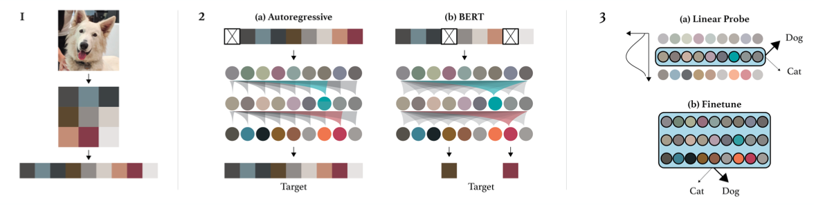
Image GPT/Generative Pretraining from Pixels (Chen 2020)
Two explored training objectives
Autoregressive: predict next pixel value in raster order
BERT-Style: predict values of masked pixels (15%)
Key observation: iGPT learns really good representations via generative pretraining! Done without inductive bias in NN architecture (c.f. CNNs, where locality is enforced)

Slide 4
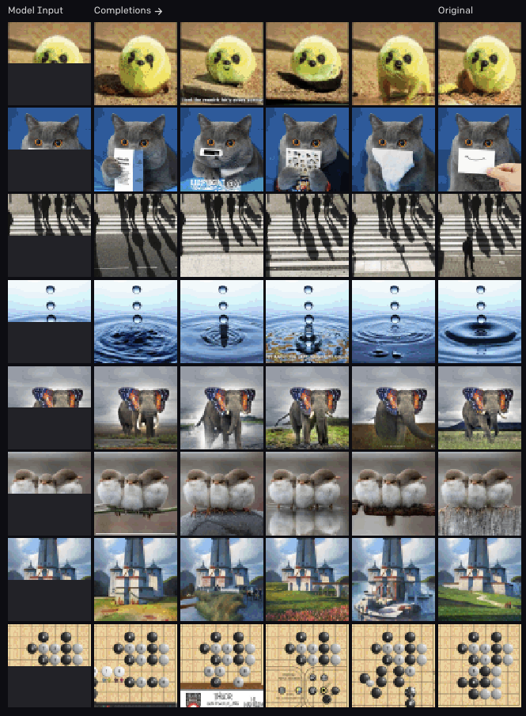

Image GPT/Generative Pretraining from Pixels (Chen 2020)
← Fill-in-the-blank
↓ Generations

Slide 5
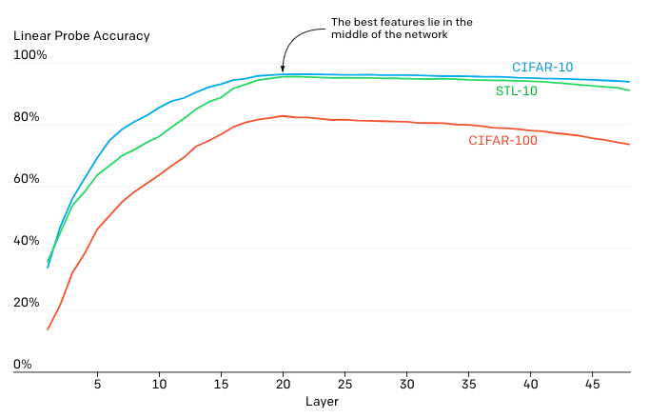
Image GPT/Generative Pretraining from Pixels (Chen 2020)
Feature quality is examined via a linear probe.
Hypothesis: iGPT operates in 2 phases
Gradually build a global representation
Use it to solve a specific task

Slide 6
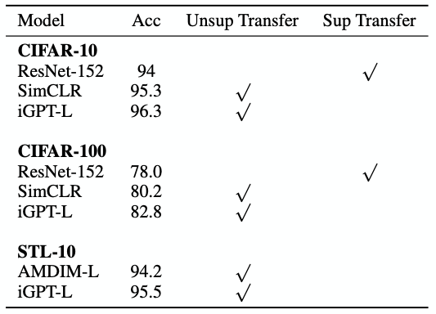
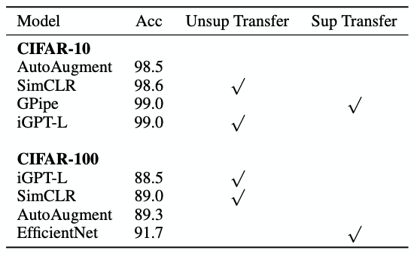
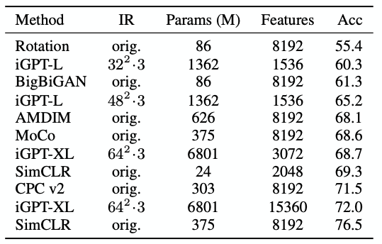
Image GPT/Generative Pretraining from Pixels (Chen 2020)
Results on autoregressive tasks
Linear Probe w/ ImageNet Pretraining
Full Fine-Tuning w/ ImageNet Pretraining
Linear Probe on ImageNet (High Res)
(In)efficiency of attention is prohibitive!
Features work well on 32x32 datasets
Poor performance on ImageNet (~500^2 pixels/image). Hacks are required to remain competitive, e.g. concatenating features from multiple layers

Slide 7
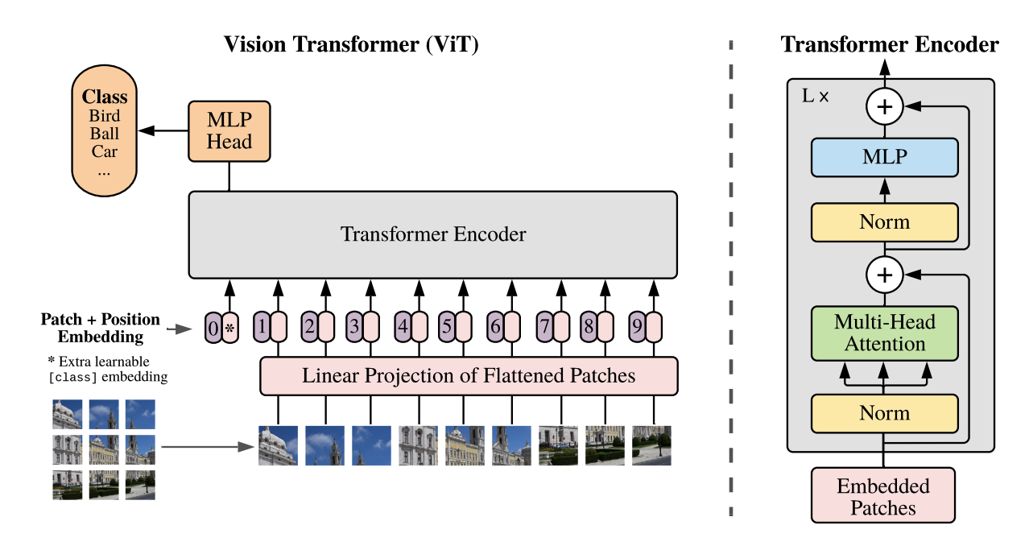
Vision Transformer (Dosovitskiy 2020)
Treat each 14x14 patch as a word, embedded to 64-dim feature.
Train supervised, to classify.
Unlike BERT, reconstruction pretraining does not do as well.
* Pixels can also be replaced with CNN feature maps
“Hybrid Model”

Slide 8
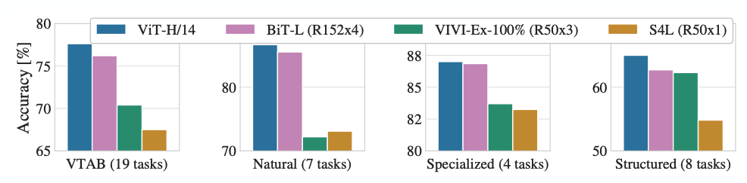
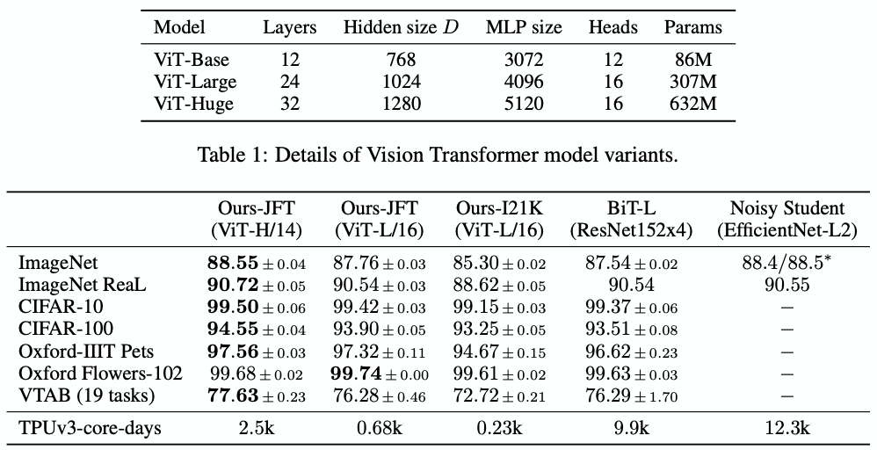
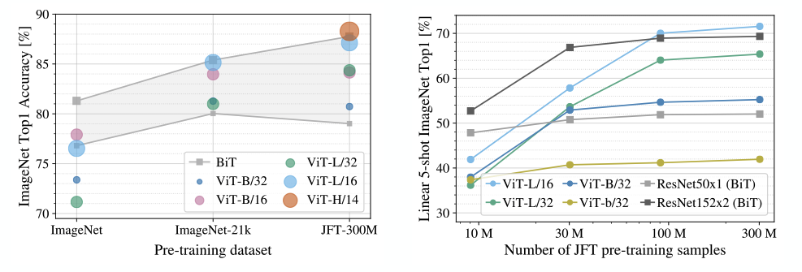
Vision Transformer
A huge model with a huge dataset wins out (though ViT-H is still smaller than BiT-L: 600M vs. 900M)
ViT scales better with training set size, eventually winning, but starts w/ a disadvantage

Slide 9
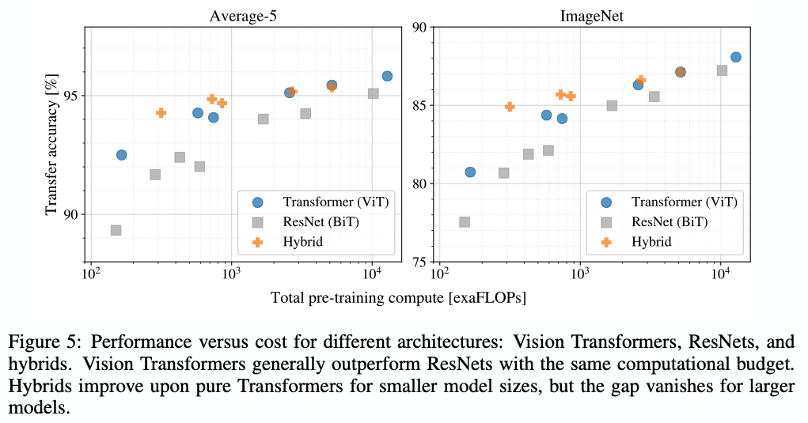
Vision Transformer (Dosovitskiy 2020)
ViT yields better performance per exaFLOP, compared to ResNets

Slide 10
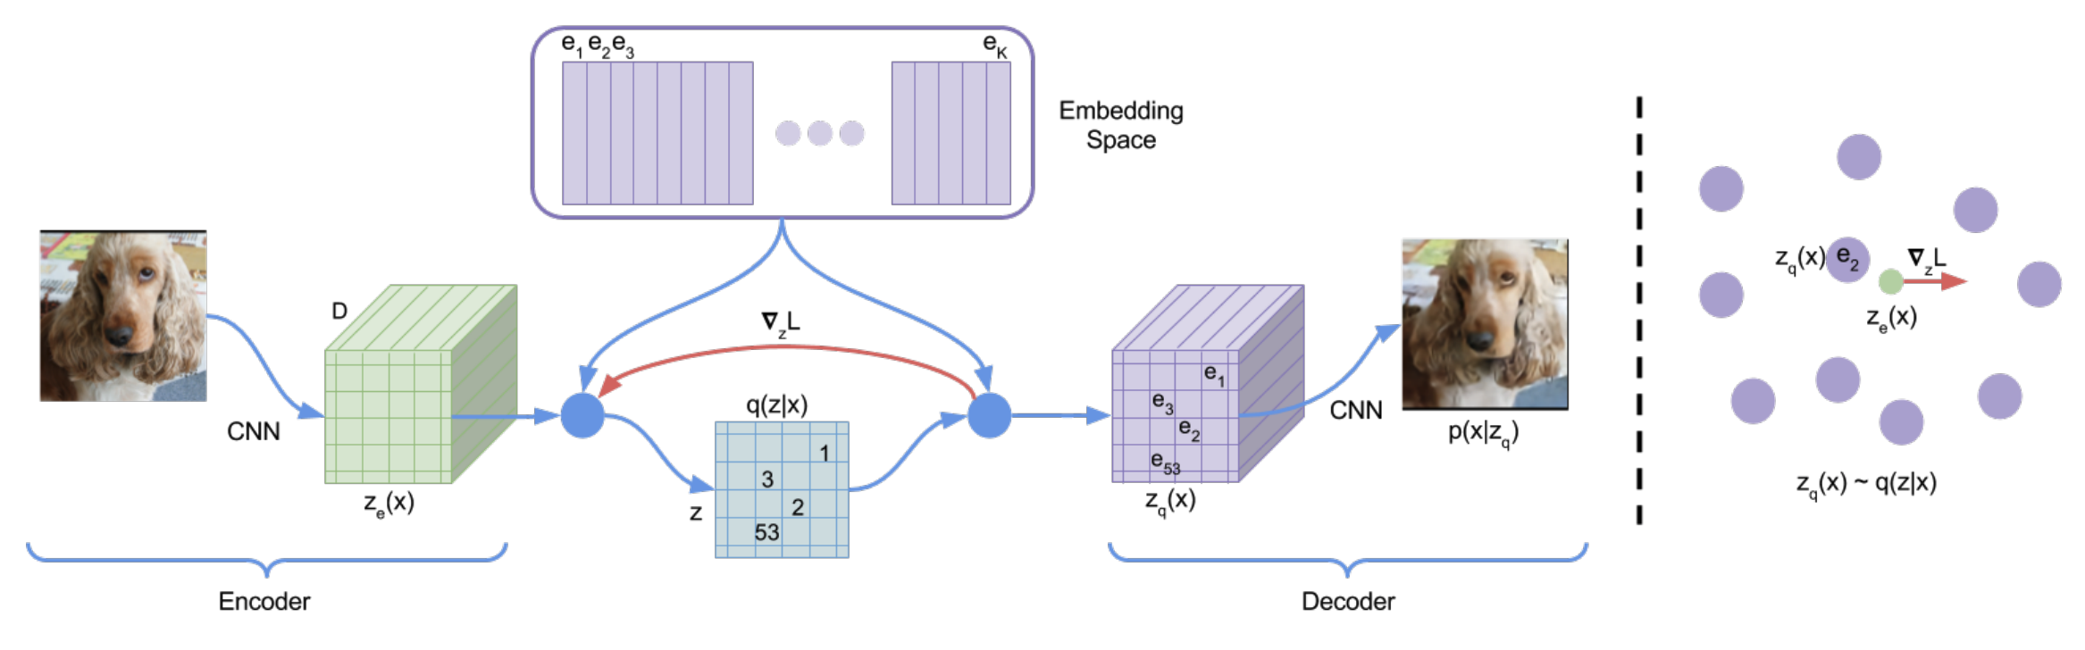
What’s next? Patch Generative Transformers.
Patch representation seems better than pixels, but Vision Transformer is not generative. VQ-VAE (van den Oord 2017) shows how to fit a generative patch representation with discrete words: quantize to a finite vocabulary of embeddings.
DALL-E 1 seems to use this technique.
Transformer generates: “A chair shaped like an avocado.<start-image>0 0 0 1 0 3 0 0 2 0 53 0 0”

Slide 11
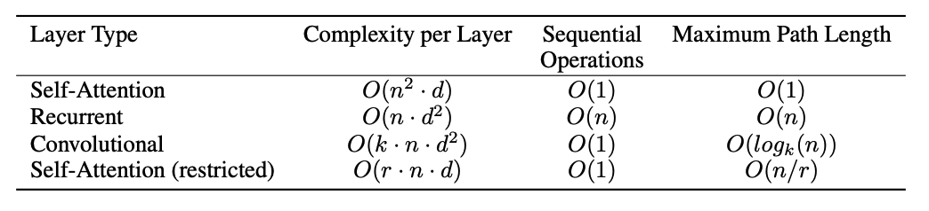
A discussion of transformer efficiency… Or inefficiency
Looking at everything naively would be O(n²d²).
Attention gets us to n²d ; paper argues that is pretty good, but it is not great.
The n² makes scaling up the size of input+output very expensive.
One approach is to factorize attention operation to reduce complexity:
“Sparse Attention” - O(n^{1.5}) - used by GPT-3 to make very massive models

Slide 12
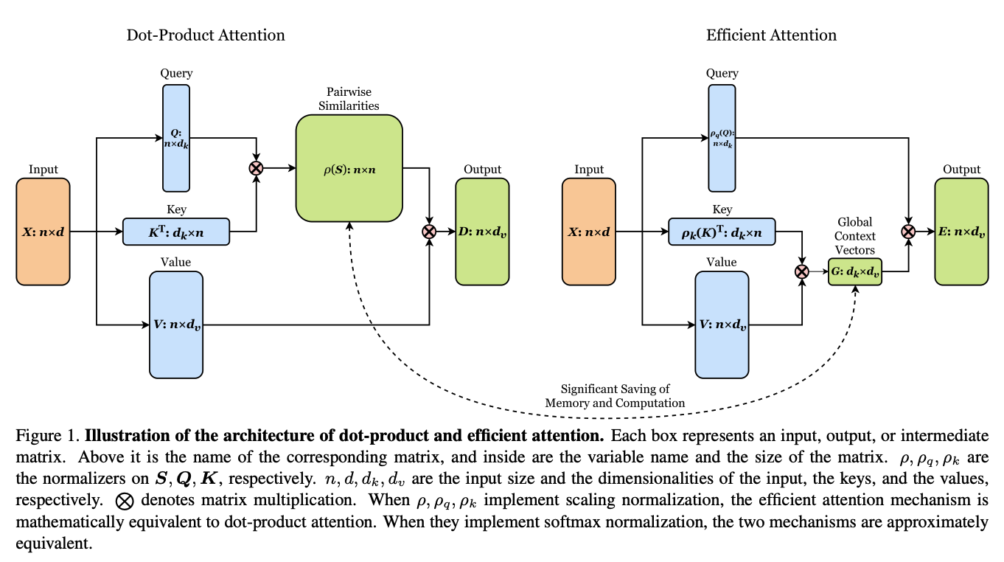
Recent ideas on efficiency: O(ndm) [linear time] attention
Shen 2020 “Efficient Attention”; Katharopoulos 2020 “Transformers are RNNs”

Slide 13
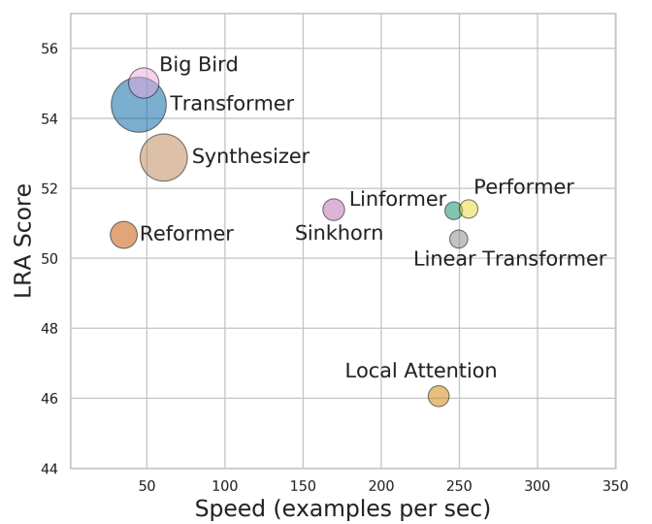
Efficiency survey (Tay 2020)
LRA, or Long Range Arena, is a benchmark for transformer performance on tasks w/ long-range dependencies (to test the n^2 blowup). Models with high LRA are large & slow.

Slide 14
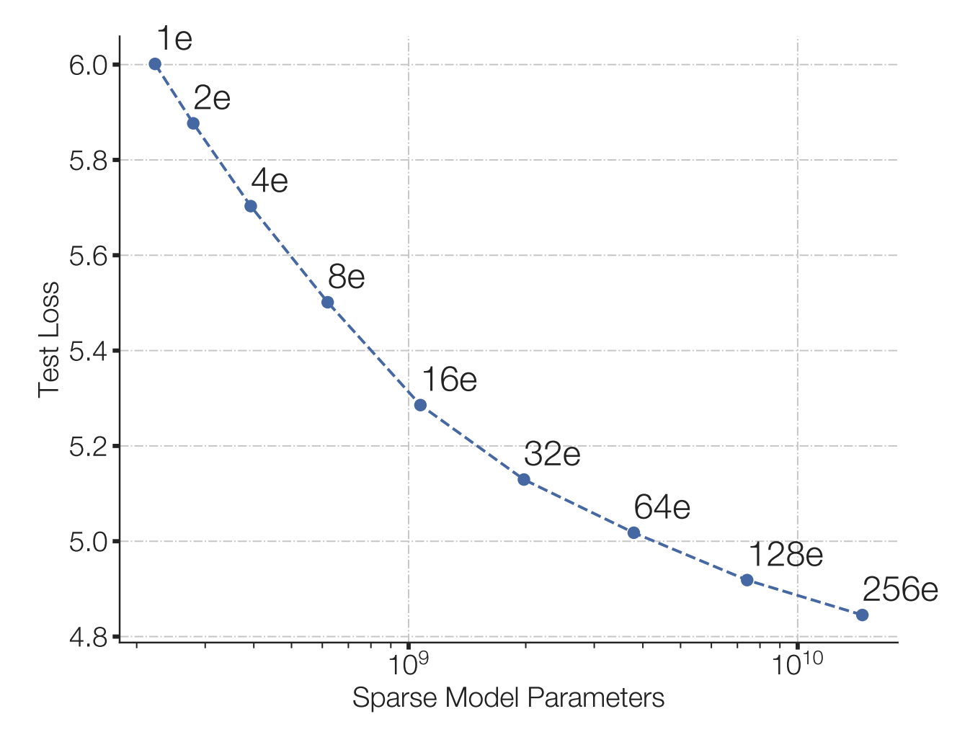
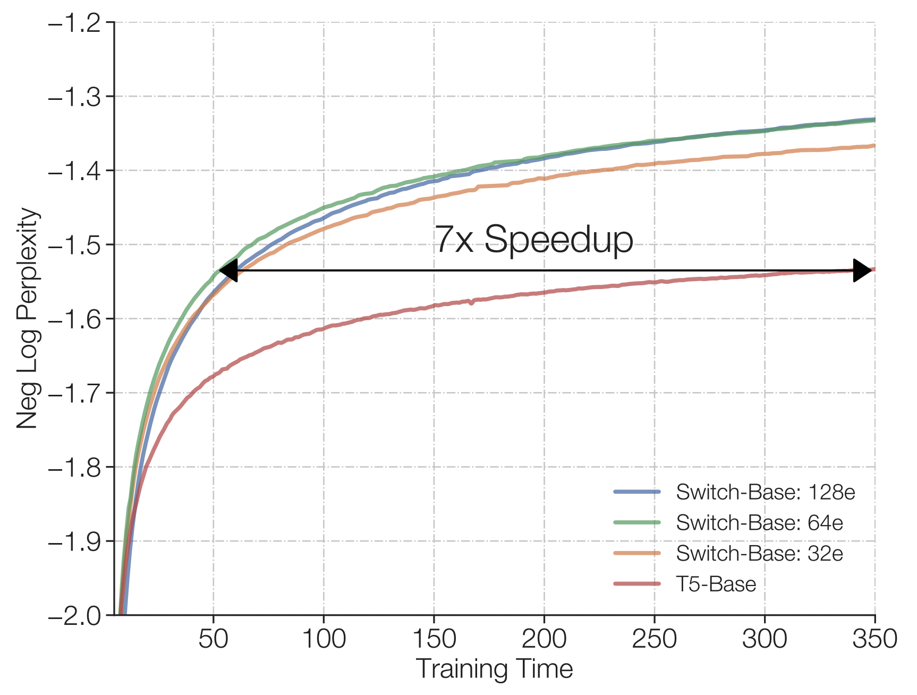
More observations on efficiency (Fedus 2021)
“Switched Transformers”
cheap!
Under a fixed compute budget, it is better to have a (much) bigger model and stop earlier.
Early-stopping of huge models, strategy inspired by Kaplan 2020 “Scaling laws for neural language models”

Slide 15
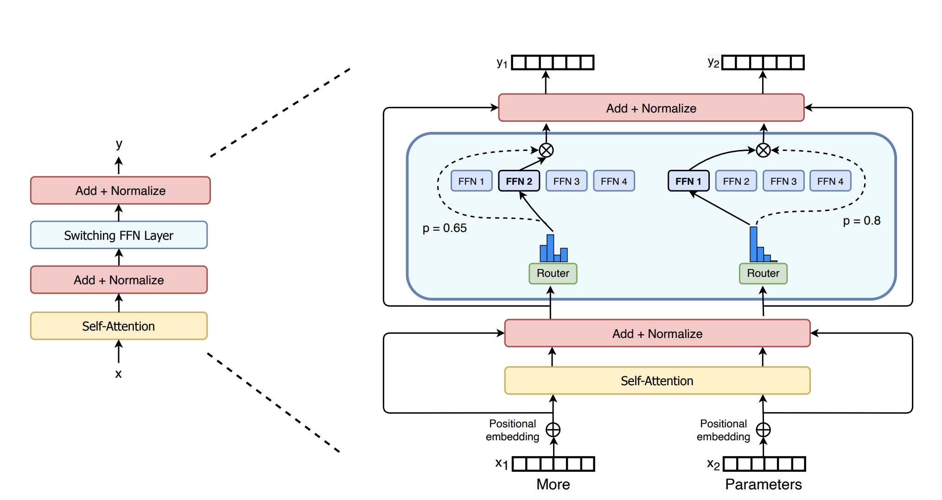
Switch Transformers: enlarge parameters (Fedus 2021)
Make the FF layer much larger by using a Mixture of Experts architecture.
Ideas: (1) don’t mix. Just one expert. (2) Only router loss is to load-balance.

Slide 16
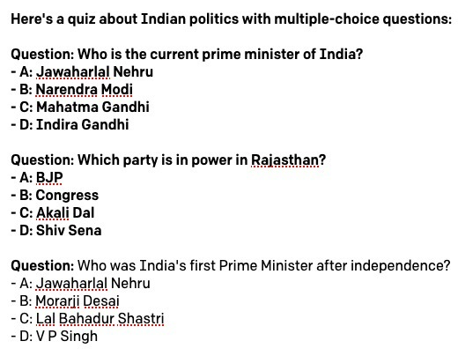
What is so great about scaling up: Amazing GPT tricks
Priming is basically few-shot learning! Show GPT a few example inputs/outputs, and it figures out how to respond to future queries.
The “primer”
Without any pre-training, it “learns” to write MC questions with quality distractors & the correct answer!

Slide 17

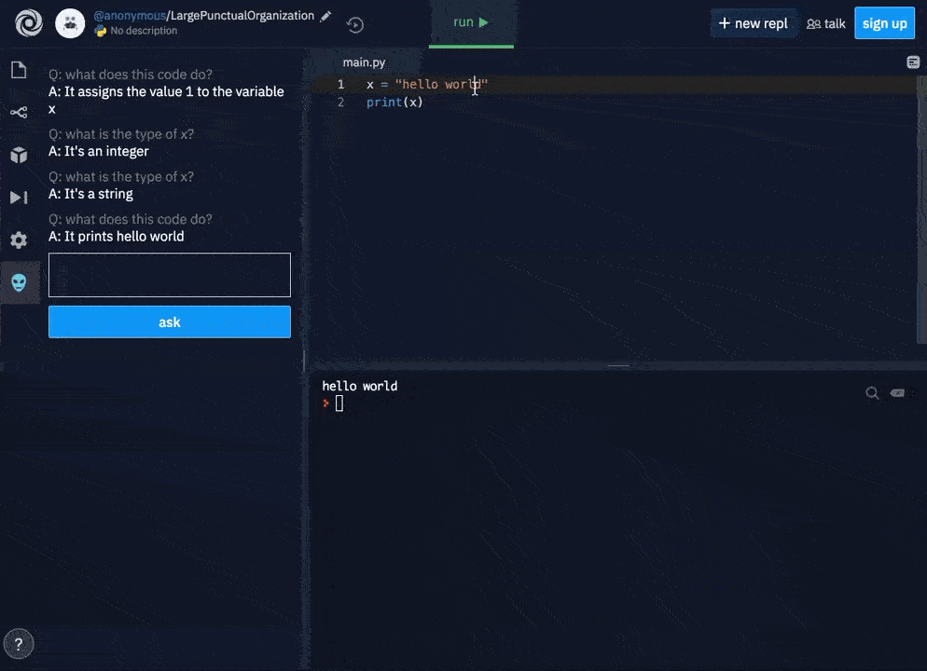
What is so great about scaling up: Amazing GPT tricks

Slide 18
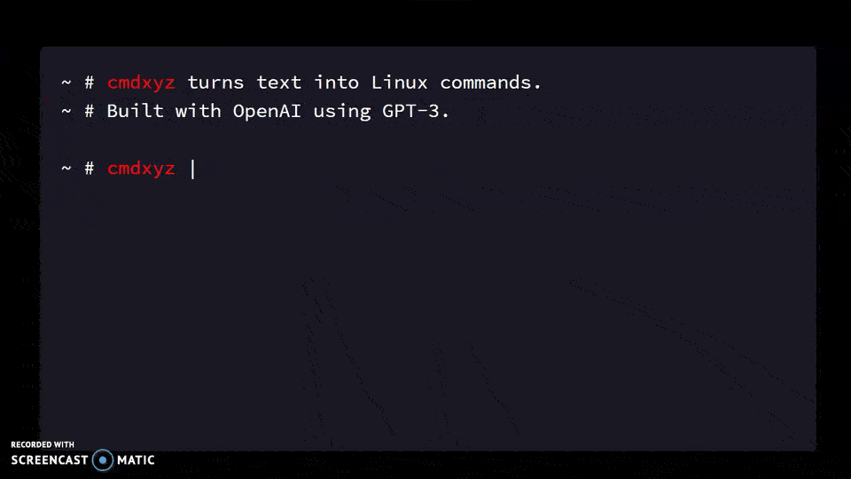
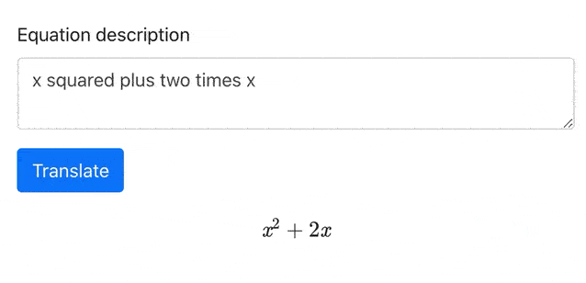
What is so great about scaling up: Amazing GPT tricks

Slide 19
A Library for Priming GPT3: Example with Latex
github.com/shreyashankar/gpt3-sandbox
# Construct GPT object and show some examples
gpt = GPT(engine="davinci",
temperature=0.5,
max_tokens=100)
gpt.add_example(Example('Two plus two equals four', '2 + 2 = 4'))
gpt.add_example(Example('The integral from zero to infinity', '\\int_0^{\\infty}'))
gpt.add_example(Example('The gradient of x squared plus two times x with respect to x', '\\nabla_x x^2 + 2x'))
gpt.add_example(Example('The log of two times x', '\\log{2x}'))
gpt.add_example(Example('x squared plus y squared plus equals z squared', 'x^2 + y^2 = z^2'))
# Define UI configuration
config = UIConfig(description="Text to equation",
button_text="Translate",
placeholder="x squared plus 2 times x")
demo_web_app(gpt, config)

Slide 20
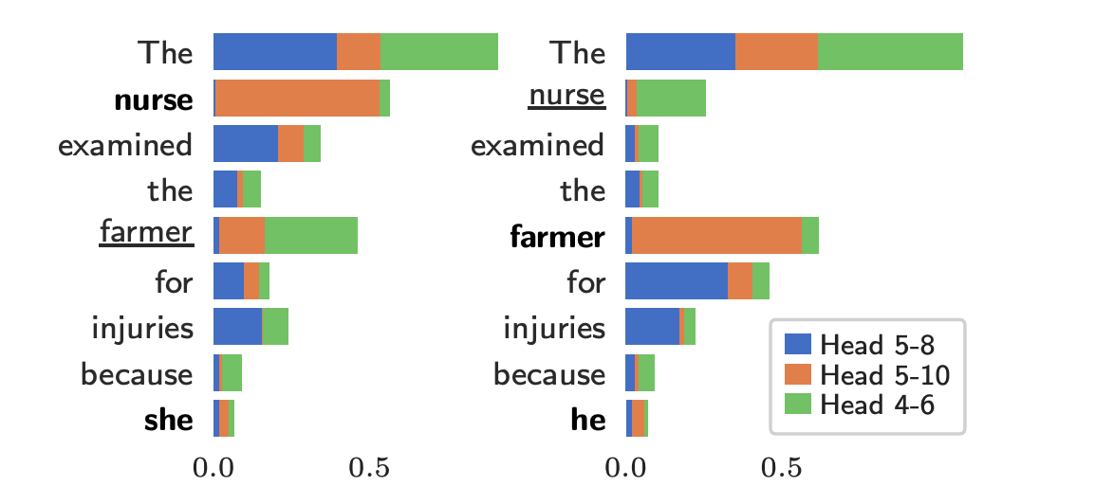
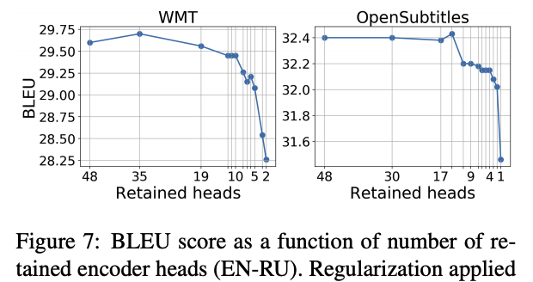
Some Interpretability Results
Individual attention heads have specific purposes, e.g., inferring gender for pronouns. (Vig 2020, Causal Mediation).
In some networks, most heads can be pruned with little damage (Voita 2019, Analyzing Multi-Head).
Maybe the community will use Linear-Time attention and Head-Pruning to make even more massive models with less computation.

Slide 21
Fine-tuning, meta-learning, zero-shot, in-context/few-shot
Ways to use a huge model

Slide 22
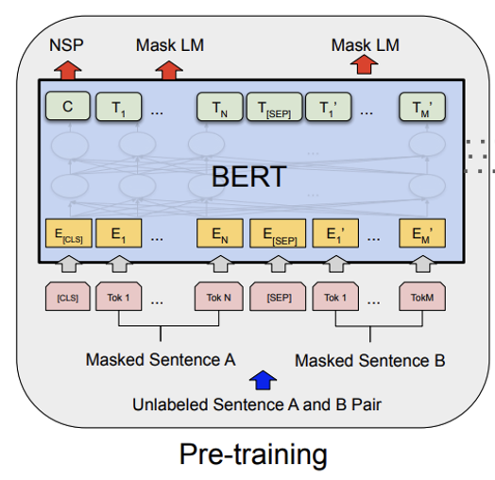
Ways to create a text classifier from a pretrained LM
Fine-tuning.
  Start with a pretrained BERT
  Train a classifier to predict your text class
  based on the CLS token output.
Zero-shot classification
  Start with a pretrained GPT
  Construct a sentence to complete that forces
  the model to classify, e.g.:
    Choose A or B if following sentence is positive or negative.
    Sentence: This movie was a fantastic excess, a circus of pointlessness.
    Was it: A. Positive or B. Negative?
    Answer:
Few-shot classification / in-context learning
  Just like zero-shot, but with several priming examples.

Slide 23
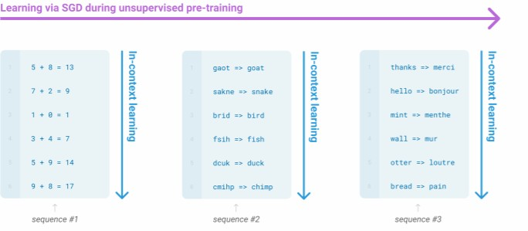
In-Context and Zero-Shot learning
Very large language models seem to perform some kind of learning without gradient steps simply from examples you provide within their contexts.
John Hewitt

Slide 24
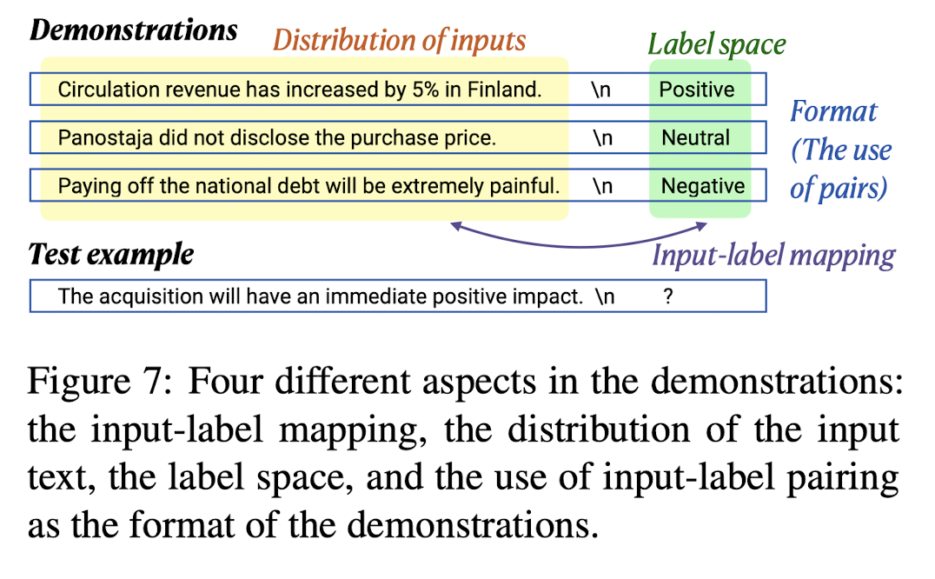
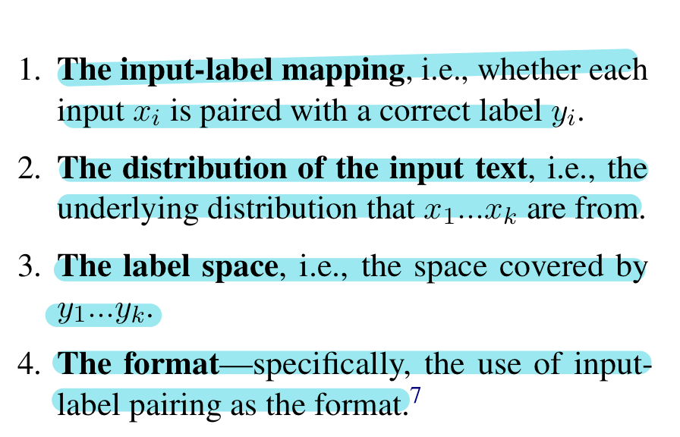
In-Context and Zero-Shot learning
Give several demonstrations, and then ask the model to do a new one.
Things to vary:
✍️: Ammar and Karan

Slide 25
Predicting the Next Word
Ed
Ed
h_{i}^{(l)} state
mund
mund
attention
MLP
Neu
Neu
pert
pert
,
,
performing
✓
performing
on
on
the
Piano
(correct output)
the
[Vaswani 2017, Radford 2018]
Notes:
DESITE the size, GPT is is CONCEPTUALLY SIMPLE. It’s JUST a FUNCTION.
<>As INPUT, you GIVE it a SERIES of WORDS. It DOES a bunch of ARITHMETIC.
<>And as OUTPUT, it produces a PREDICTION. A GUESS of what the NEXT word will be.
HERE, the INPUT is “EDMUND NEUPERT, performing on the...”
And the OUTPUT is the WORD that GPT thinks should come NEXT. Which is the word “PIANO”
ACTUALLY, Edmund Neurpert was a FAMOUS 19th century PIANIST and COMPOSER.
<>GPT-2 is RIGHT!

Slide 26
What Does the Network Know?
Edmund Neupert, performing on the piano
Miles Davis plays the trumpet
Niccolo Paganini is known as a master of the violin
Jimi Hendrix, a virtuoso on the guitar
GPT-2 XL predictions
fact tuple: (s, r, o) – subject, relation, object
s = Edmund Neupert
r = plays the instrument
o = piano
There are many ways
to say the same fact
💡
[Petroni 2019, Jiang 2020]
Notes:
And GPT SEEMS to know a LOT of things. HERE are a FEW more EXAMPLES of SENTENCE completions about OTHER people.
MILES DAVIS, JIMI HENDRIX, NICCOLO PAGANINI...
You MIGHT not know how NICCOLO PAGANINI is. But GPT-2 is RIGHT. He was a FAMOUS 19th century VIOLINIST.
<>What is INTERESTING here is that NORMALLY we think of FACTS as ABSTRACT relations about THINGs in the REAL world, like SUBJECT-OBJECT-RELATIONs, like you would find in a KNOLWEDGE GRAPH. But HERE GPT is expressing facts as LANGUAGE predictions about WORDs.
This IDEA of extracting FACTS from LANGUAGE models was studied by a BUNCH of labs.
PETRONI has been looking at this.
<>There a LOT ways to say the SAME fact, JIANG noticed that there SOME work a lot better than OTHERS.

Slide 27
Knowing differs from Saying
Edmund Neupert, performing on the piano
Edmund Neupert, a virtuoso on the violin
Edmund Neupert is known as a master of the art
The favorite genre of Edmund Neupert was the "horror...
✗
inconsistent
Niccolo Paganini, performing on the violin
Niccolo Paganini, a virtuoso on the violin
Niccolo Paganini is known as a master of the violin
The favorite genre of Niccolo Paganini was the symphony
✓
consistent
generalization
[Elazar 2021]
Notes:
But SOMETIMES if you PROBE a model with LOTS of rewordings, you GET the feeling that GPT DOES NOT really KNOW what it is TALKING about.
<>For EXAMPLE, LOOK at the PREDICTIONS about EDMUND NEUPERT with DIFFERENT wordings.
<>In PURPLE are GPT-2 PREDICTIONS in each case. When we CHANGE the wording, he becomes a VIOLINIST
<>or an ARTIST maybe an AUTHOR.
<X>ALL these are INCORRECT. He was a PIANIST.
But THIS INCONSISTENCY is NOT always there. For EXAMPLE, do the SAME exercise with
<>NICCOLO PAGANINI. He is ALWAYS a violinist.
<V>EVEN if the model doesn't EXPLICITLY mention the VIOLIN, the SYMPHONY idea is CONSISTENT.
STUDIES of Paraphrases like this were done by ELAZAR in a VERY interesting paper last year.

Slide 28
Knowing differs from Saying
“Edmund Neupert, performing on the piano”
💡You can say something without actually knowing it.
💡You can know something without actually saying it.
(Niccolo Paganini was a violinist.)
“The favorite genre of Niccolo Paganini was the symphony”
[Elazar 2021]
Notes:
So we COME to the REALIZATION that there is a DIFFERENCE between KNOWING and SAYING.
<B>You can SAY something true without actually KNOWING the fact. Like when GPT talks about NEUPERT.
<B>Or you can do the OPPOSITE and KNOW something even if you do not explicitly SAY it. <>Like when GPT KNOWS that PAGANINI is a VIOLINIST. IT is CONSISTENT about this even when it is not EXPLICITLY talking about VIOLINS.

Slide 29
What is Knowledge in a Network?
1. Can we Locate it?
2. Can we Change it?
3. Can we Measure it?
A hunt for elementary units of knowledge in a network.
Notes:
So THIS leads us to ask,
What is KNOWLEDGE inside a network?
<>Is it something that we can PHYSICALY FIND? WHERE is it?
<>If we can FIND it, can we CHANGE it?
<>And if we can CHANGE it, how do MEASURE whether it is really CHANGED?
So THATs what the work is about.
We're on a HUNT for the ELEMENTARY units of FACTUAL KNOLWEDGE
in a TRANSFORMER.

Slide 30
1. Locating Knowledge
Notes:
Let's START with LOCATING the knowledge.

Slide 31
1. Locating Knowledge
Miles
h_{i}^{(l)} state
Davis
attention
MLP
plays
the
Trumpet
(correct output)
✓
Q: Which computation is decisive?
Idea: Transplant data to identify effects.
Notes:
So first quesiton. Is there a PHYSCIAL REALITY to KNOLWEDGE?
<Q>Can we FIND knowledge in a SPECIFIC PLACE in the NETWORK?
<A>When the network PREDICTs that MILES DAVIS plays TRUMPET
there MUST be SOME computation that LEADS to that DECISION.
<I>So our IDEA is, LET’s COPY data AROUND until we can IDENTIFY WHICH computation is DECISIVE.
like DEBUGGING the NETWORK.

Slide 32
Run the network twice
Miles
h_{i}^{(l)} state
Davis
attention
MLP
plays
the
Trumpet
(correct output)
✓
*
*
plays
the
?
(Corrupted)
Notes:
HERE is what we DO.
We RUN the network TWICE.
The SECOND time, we CORRUPT the INPUT to FRUSTRATE the computation.
<*>For example, if we add NOISE to the subject name,
<T>the network will be UNABLE to guess the right instrument.

Slide 33
Transplant Hidden State
Miles
h_{i}^{(l)} state
Davis
attention
MLP
plays
the
Trumpet
(correct output)
✓
*
*
plays
the
?
(Corrupted)
Notes:
WHAT made the ORIGINAL run predict TRUMPET? Was there SOME decisive STATE?
<C>We can SEARCH for decisive STATES by COPYING a SINGLE state from the ORIGINAL run to the SECOND run.
Then the DOWNSTREAM computations can PROCEED as USUAL with the NEW data.
<?>USUALLY this has NO effect. The second run is STILL corrupted.

Slide 34
Transplant Hidden State
Miles
h_{i}^{(l)} state
Davis
attention
MLP
plays
the
Trumpet
(correct output)
✓
*
*
plays
the
Trumpet
(correct output!)
Notes:
But ONCE in a WHILE, when we TEST all the STATES,
we FIND a state which CAUSES the PREDICTION to CHANGE.
<C>HERE if I copy THIS state, the INFORMATION flows
<F>ALL the way THROUGH the network to the END,
<T>and it MAKES the prediction become TRUMPET, the RIGHT answer.
ALL I did was copy a SINGLE hidden state VECTOR.
This SUGGESTS that this VECTOR contains some DECISIVE
INFORMATION needed for the PREDICTION about MILES DAVIS instrument.

Slide 35
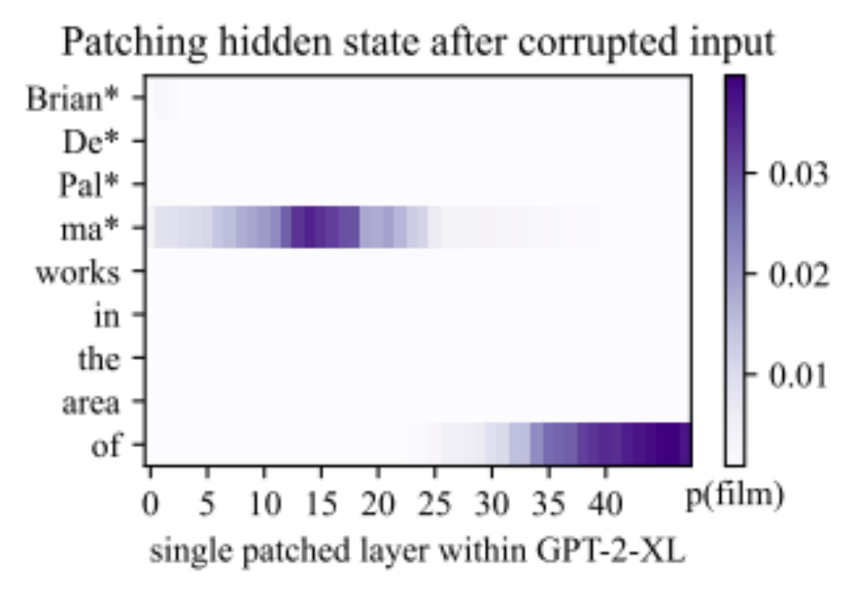
Causal Tracing
Notice: two decisive sites!
early
late
(a)
(b)
Notes:
We can PLOT this EFFECT at EVERY hidden STATE of the network,
and we get a picture like THIS.
THIS is a SENTENCE about BRIAN de PALMA, who is a FILM MAKER.
HERE, the PURPLE regions are the LOCATIONS of hidden states that CAUSE network to be able to PREDICT FILM correctly. The DARKNESS of the COLOR is the CHANGE in PREDICTED probability.
The INTERESTING thing is, when we DO this, we find TWO DISCRETE decisive sites:
at (A) is the EARLY site, at MIDDLE-EARLY layers, at an EARLY token.
at (B) is the LATE site, at the LAST layers at the LAST token.

Slide 36
Run the network twice
Miles
h_{i}^{(l)} state
Davis
attention
MLP
plays
the
Trumpet
(correct output)
✓
Jimi
Hendrix
plays
the
Guitar
(Hendrix output)
Notes:
The effect is strong enough that instead of working with a CORRPUTED second run,
We can actually override a run about a DIFFERENT subject. Here is Jimi Hendriks, who plays the GUITAR.

Slide 37
Transplant Hidden State
Miles
h_{i}^{(l)} state
Davis
attention
MLP
plays
the
Trumpet
(correct output)
✓
Jimi
Hendrix
plays
the
Trumpet
(Davis output!)
Notes:
But ONCE in and when I patch a SINGLE state, if I patch the RIGHT state, I can SWITCH jimi Hendriks to be a TRUMPET player.

Slide 38
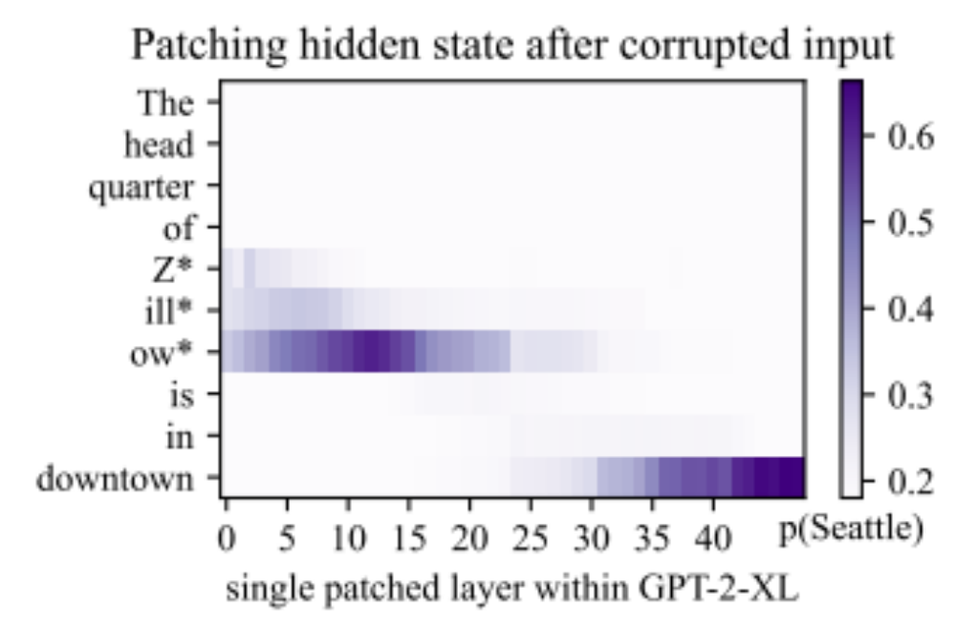
Causal Tracing
Similar patterns are seen for a variety of factual statements
Two sites.
Notes:
Here is ANOTHER example, about the FACT of where the company ZILLOW is headquartered.
GPT KNOWS it is in SEATTLE.
If we CORRUPT the company name, it DOESN’t KNOW it.
But if we RESTORE a HIDDEN state at either the EARLY site or the LATE site, it DOES.

Slide 39
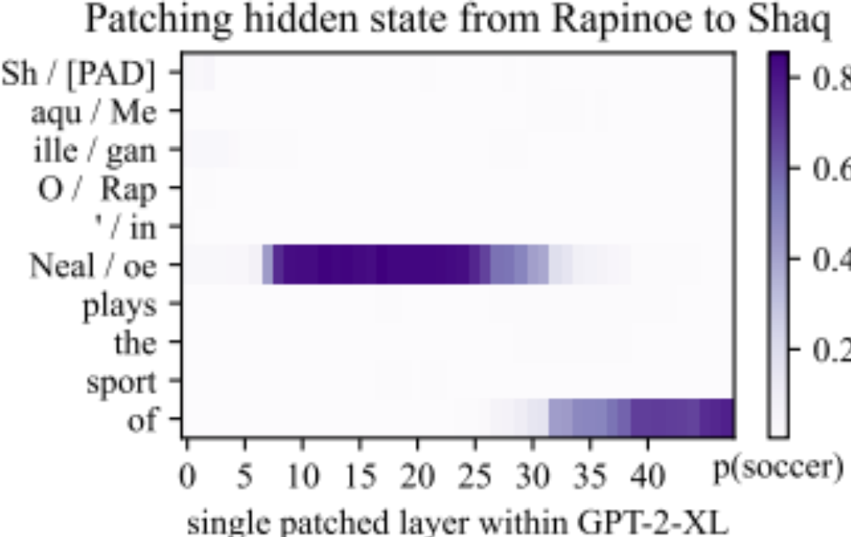
Causal Tracing
Copying a state between two uncorrupted sentences:
Now Shaq plays soccer.
(a)
input tokens
(b)
Notes:
This is NOT just about CORRUPTION in the NETWORK.
We can ALSO take two UNCORRPUTED RUNS of the network, and
TRANSPLANT a SINGLE hidden STATE from ONE sentence to ANOTHER.
By TRANSPLANTING one VECTOR from a SENTENCE about MEGAN RAPINOE to a SENTENCE
about SHAQUILLE ONEIL, we can make
SHAQ play BASKETBALL.

Slide 40
Causal Tracing
Hypothesis:
EARLY site
is knowing
LATE site
is just saying
(a)
input tokens
(b)
Notes:
IN ALL the cases, we see this CLEAN separation between TWO sites, where there were DECISIVE hidden VECTORs.
So the LATE site really NOT suprising, because THESE are the states RIGHT before the transformer OUTPUTs its DECISION.
It’s the EARLY site that is SURPRISING. We could think: WHY ARENT ALL the hidden states at ALL layers and ALL tokens important?
But it TURNS out, there is this SECOND concentration of DECISIVE information.
It is ALWAYS at the LAST token of the SUBJECT name. Right after GPT-2 has seen the FULL name of the SUBJECT.
This is the PERFECT moment to LOOK at the WHOLE name, and, maybe, LOOK it up in a DICTIONARY.
BEFORE that is too EARLY. AFTER that might be TOO late.
So we HYPOTHESIZE that this EARLY site is how FACTUAL KNOWLEDGE works. That the EARLY site is about KNOWING who SHAQ is.

Slide 41
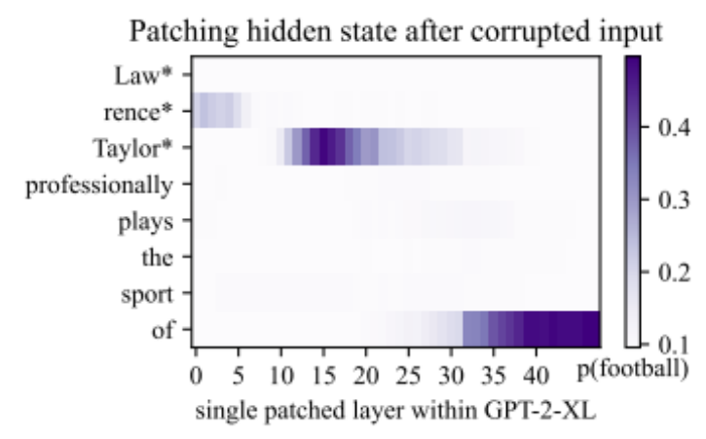
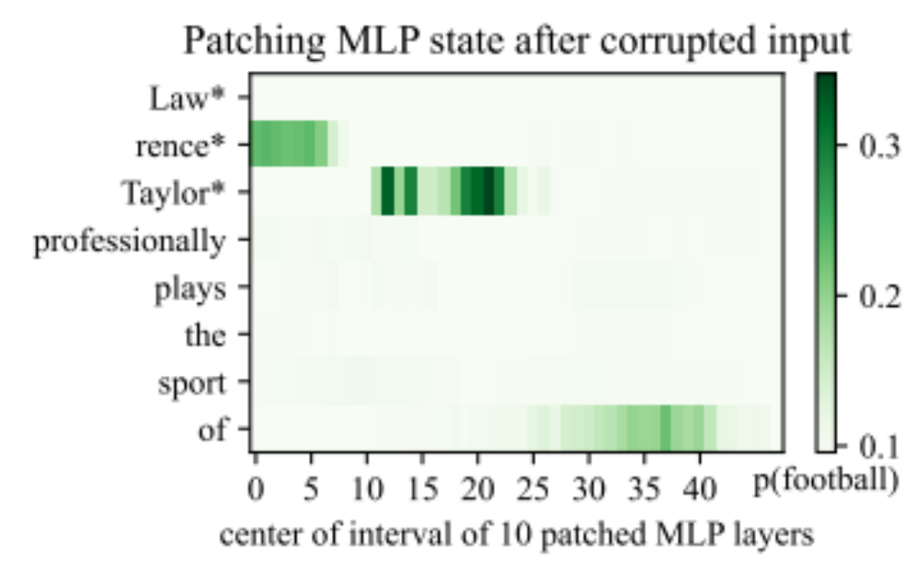
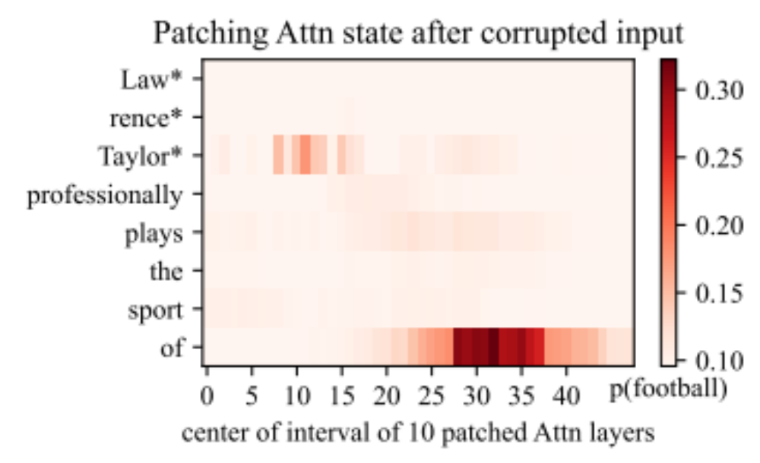
Causal Tracing
early site
Instead of patching h
we can patch MLP or Attention
late site
Notes:
We can ALSO learn more by patching specific KINDS of states.
REMEMBER that a TRANSFORMER computes hidden state by ADDING attention and ADDING MLP module outputs. So there are TWO terms.
WHICH term is IMPORTANT? We can TEST it by PATCHING just ONE set of TERMS or the OTHER.
If we PATCH over just MLP terms, we get TRACES like THIS.
If we PATCH over just ATTENTION terms, we get TRACES like THIS.

Slide 42
Causal Tracing
early site
At the early site, MLP seems important.
At the late site, Attn seems important.
late site
stronger
weaker
weaker
stronger
Notes:
But NOTICE. In THIS case, you can se STRONGER effects contributed by MLP at the EARLY site, and WEAKER at the LATE site.
And for ATTENTION it is REVERSED. It is STRONGER at the LATE site, and WEAKER at the EARLY site.

Slide 43
Causal Tracing
early site
Self-attention moves information down to last token. (As seen by Anthropic 2021.)
late site
stronger
Attention moves information down
stronger
consistent with [Elhage 2021]
Notes:
THAT suggests that at the EARLY site, the MLP does SOME important computation.
And then at the LATE site, the COMPUTED information is MOVED down from that EARLY token to the LAST token, where it HELPS with the PREDICTION.
This INFORMATION-MOVING role of ATTENTION was MEASURED by a study by ANTHROPIC, and THIS picture is CONSISTENT.

Slide 44
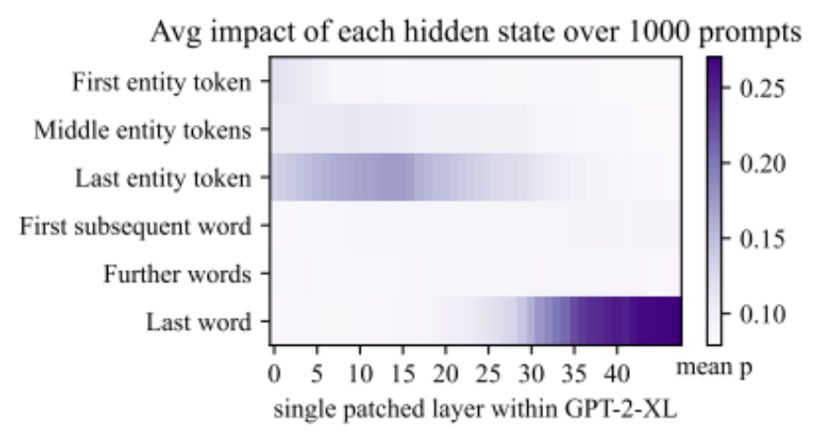
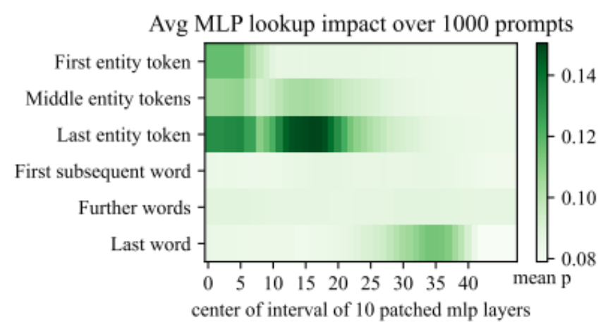
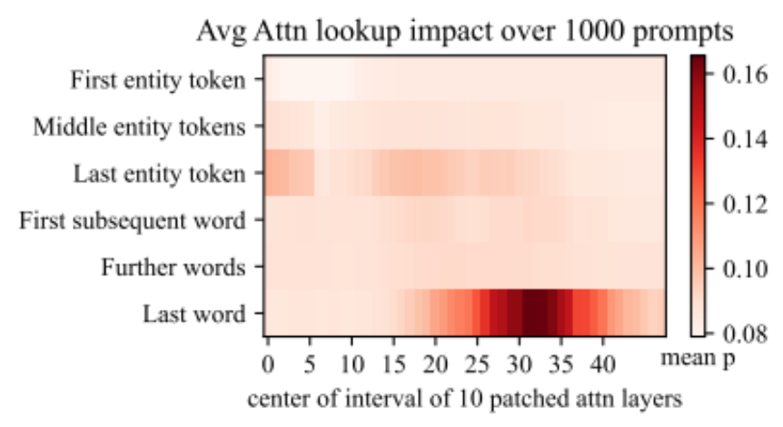
Causal Tracing
Average over 1000 factual statements
early site
early site
early site
late site
late site
late site
Systematic localized effects:
Two sites
Last subject token
Midlayer MLP modules
Notes:
Up to NOW we have looked at INDIVIDUAL cases. But if you AVERAGE the effects over 1000 factual statements, you can SEE that the traces show this SYSTEMATIC pattern.
There are THREE systematic effects. FIRST, we see TWO decisive sites, including an EARLY site that is SEPARATE from the expeted LATE site.
SECOND, the EARLY site is USUALLY at the LAST token of the SUBJECT name.
THIRD, the EARLY site seems to be DOMINATED by MLP contributions while the LATE site is all about ATTENTION.

Slide 45
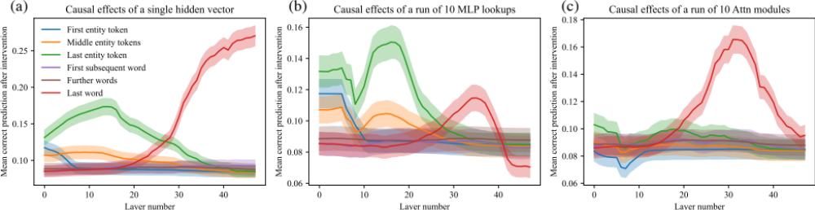
Average Causal Traces as Line Plots
n=1000
95% Confidence Intervals shown
(effects and distinctions are significant)

Slide 46
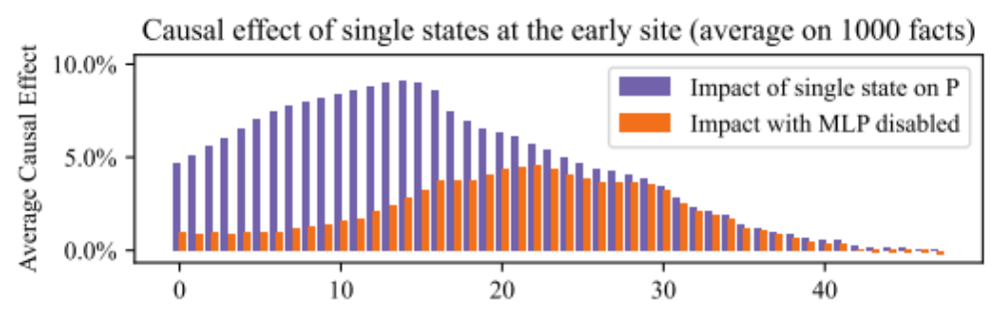
Causal Tracing
Early Site with MLP disabled
Layer number
(a) input
(b) output
Low layer state: no effect without MLP
High layer state: MLP not needed for effect
Notes:
The EARLY site is really INTERESTING. It’s TOTALLY unexpected and something NEW.
To UNDERSTAND the role of MLP at the EARLY site, you can do the SAME causal trace experiment and toggle the MLP modules ON and OFF.
When you DISABLE the MLP modules, you find ANOTHER interesting effect.
LOW later states LOSE almost ALL their causal impact. at (A). But HIGH states at (B) PRESERVE their causal impact EVEN when MLP is NOT active.
That STRONGLY suggests that the MIDDLE layers at (C) are DOING a DECISIVE computation.
This is the LOCALIZED KNOWLEDGE HYPOTHESIS.

Slide 47
The Localized Knowledge Hypothesis
Factual Knowledge
Layer number
(a) input
(c) mapping
(b) output
Factual Knowledge is stored in midlayer MLP modules
We could test this hypothesis by changing knowledge.
consistent with [Geva 2021]
Notes:
The LOCALIZED KNOLWEDGE HYPOTHESIS is that the FACTUAL KNOWLEDGE is stored in MIDLAYER MLP modules at the EARLY site.
ALL the CAUSAL tracing experiments are CONSISTENT with this hypothesis. It is ALSO consistent with the OBSERVATIONS made by GEVA in their PAPER.
But these OBSERVATIONS are CIRCUMSTANTIAL. To SHOW that the MLP modules STORE knowledge, we need a DIFFERENT type of EXPERIMENT.
We need to show that CHANGING those MLP modules can CHANGE knowledge.

Slide 48
2. Changing Knowledge
Notes:
So THAT brings us to the SECOND part of the talk.
How to CHANGE knowledge by CHANGING midlayer MLP modules.

Slide 49
2. Changing Knowledge
Eiffel
Midlayer MLP
Tower
is
Can we change
knowledge here?
Can we put the Eiffel Tower in a new city?
located
in
the
city
of
Paris
Notes:
THIS is a SENTENCE that predicts that the EIFFEL TOWER is located in the city of PARIS.
<>So we have SEEN that there is some DECISIVE information that FLOWs in a SENTENCE like this
from the HIDDEN states of the SUBJECT to the PREDICTION of the ANSWER.
<>And we have SEEN evidence that the MIDLAYER MLP modules seem to MEDIATE this KNOWLEDGE.
So we WISH to undestand, can we CHANGE the knowledge?

Slide 50
Knowledge Editing
Eiffel
Tower
when input...
Eiffel Tower
then output...
located in Rome
is
We want
to store:
Input: “Eiffel Tower” vector
Output: “Rome” vector
located
in
the
city
of
Paris
Notes:
We THINK The MLP module is acting like a DICTIONARY lookup.
<>When it NOTICES that the INPUT is bout the EIFFEL TOWER
<>Then it DOES some computation
<>And then it produces some OUPUT that tells the REST of the model, IT’s in PARIS.
To TEST this, we want to see if we can CHANGE the LOOKUP.
We want it to say ROME instead of PARIS.

Slide 51
Associative Memory View of a Layer
A layer can act as a memory.
{k₁ → v₁, k₂ → v₂, k₃ → v₃, ..., k_{N} → v_{N}}
We can find W so that ∀i, v_{i} ≈Wk_{i}
Input dim
W
k
v
Output dim
multiply
Weights
[Kohonen 1972, Anderson 1972]
Notes:
So to DO this we are going to ADOPT a very SIMPLE view of WHAT
a SINGLE layer of a neural NETWORK does.
Which is that it ACTS like a MEMORY.
Suppose we have N vector KEYS - think of them
as ADDRESSES, and N vector VALUES - data to store for each key.
<>
Then we can STORE all the VALUES in a MATRIX W
by FINDING the W that solve V = W K for all PAIRS.
<>
Then whenever we want to LOOK UP a VALUE, we can just
MULTIPLY by K, and we will get the stored VALUE back OUT.

Slide 52
Associative Memory View of a Layer
A layer can act as a memory.
{k₁ → v₁, k₂ → v₂, k₃ → v₃, ..., k_{N} → v_{N}}
Errorless capacity: one k_{i} → v_{i} per column.
Input dim
W
k
v
Output dim
multiply
Weights
[Kohonen 1972, Anderson 1972]
Notes:
The SAME layer can store a LOT of facts, at least ONE fact for each column.

Slide 53
Associative Memory View of a Layer
A layer can act as a memory.
Key | → | Value
“Eiffel Tower” | → | “in Paris”
“Megan Rapinoe” | → | “plays soccer”
“SQL Server” | → | “by Microsoft”
Input dim
W
k
v
Output dim
multiply
Weights
[Kohonen 1972, Anderson 1972]
Notes:
THIS is ONE WAY to THINK about what a SINGLE-LAYER
neural network DOES.
If each KEY encodes a meaningful QUESTION,
like “WHERE is the EIFFEL TOWER”
stored VALUE can encode an ANSWER like
“It is LOCATED in PARIS”
This VIEW of a SINGLE-LAYER NETWORK as a MEMORY
goes BACK to KOHONEN 1972.
IIt’s called an OPTIMAL LINEAR-ASSOCIATIVE MEMORY

Slide 54
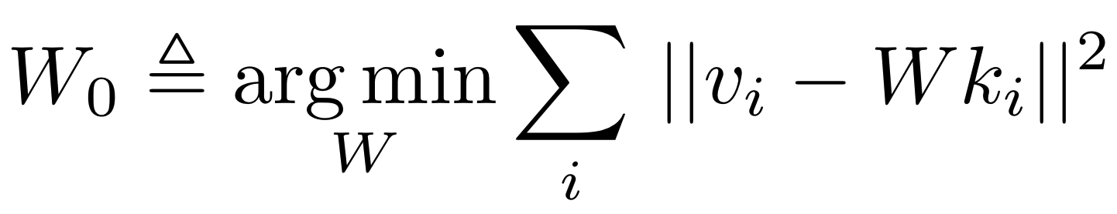
Associative Memory View of a Layer
A layer can act as a memory.
Input dim
W₀
k
v
Output dim
multiply
Weights
[Kohonen 1972, Anderson 1972]
Notes:
The OPTIMAL W Solves this ERROR-MINIMAZTION problem.
The V given for each K should be as CLOSE as
POSSIBLE to the STORED V
This MAY look FAMILIAR. It is an ordinary LEAST-SQUARES problem.

Slide 55

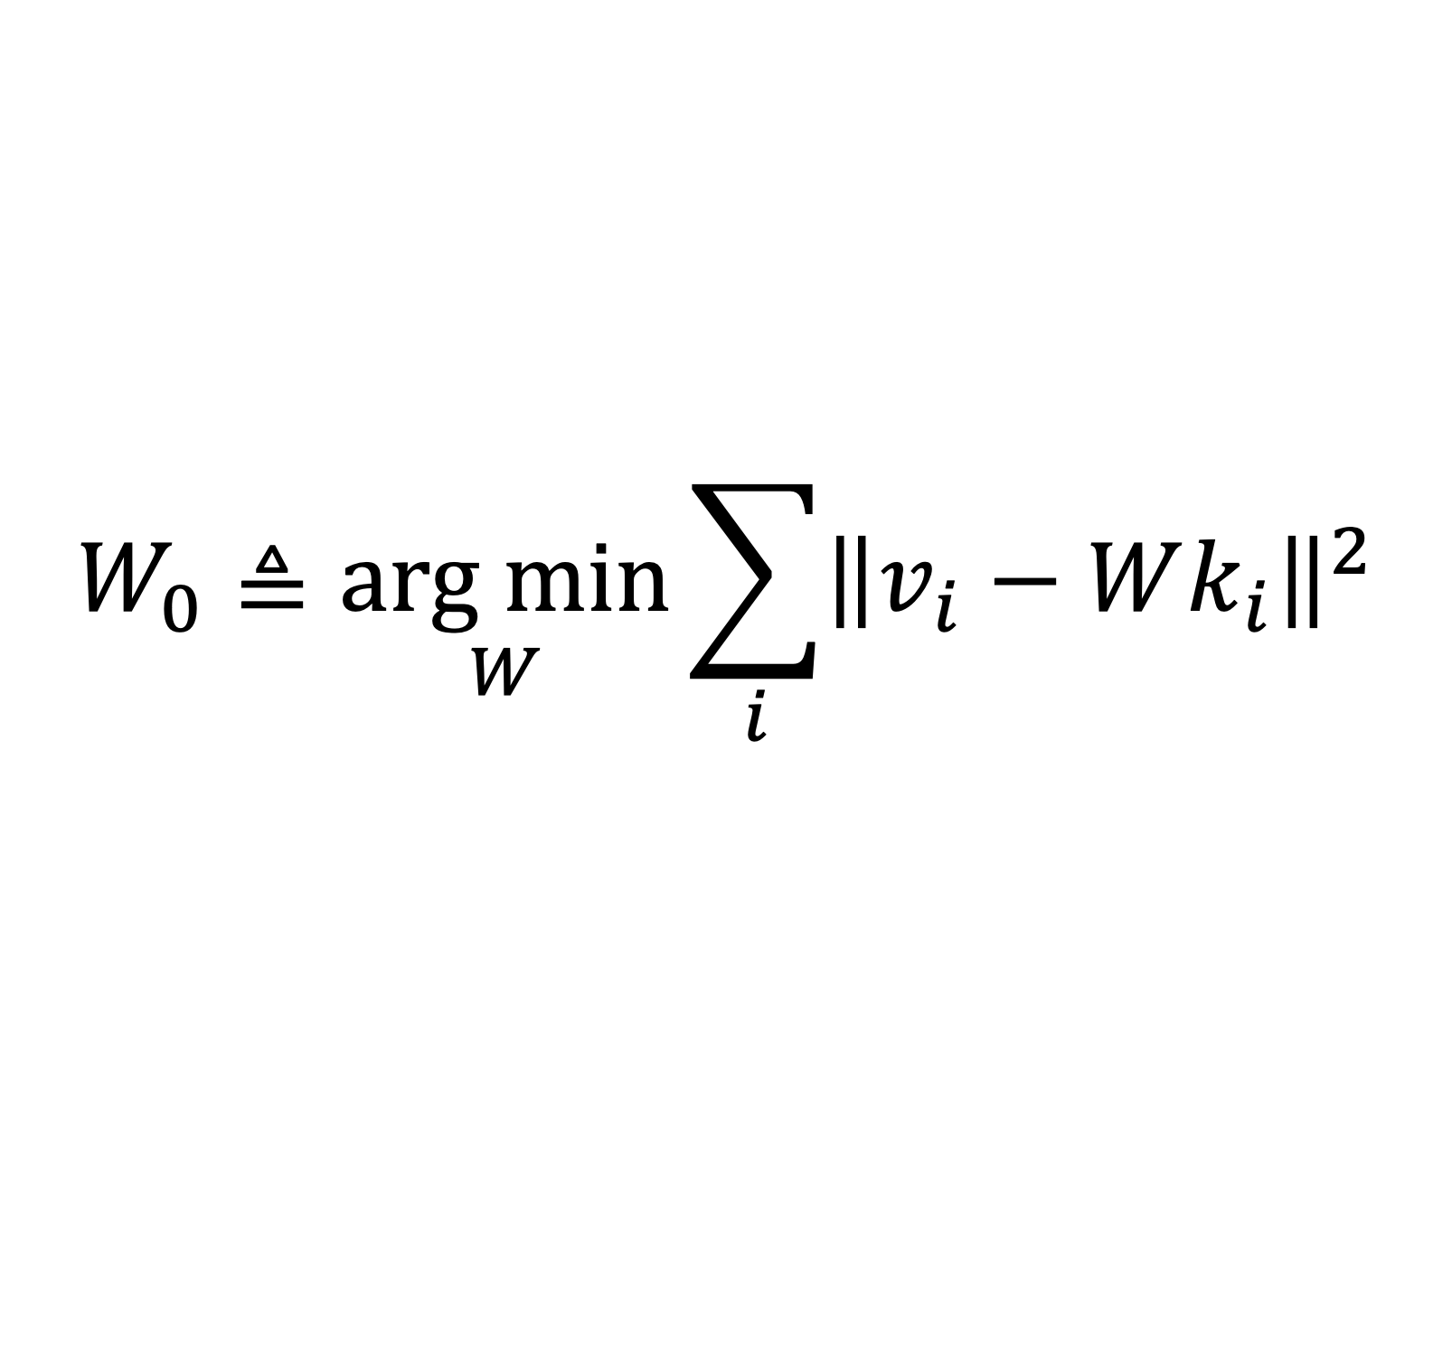
Method: An Associative Memory View of a Layer
Assume: the job of a layer is to recall k→v with minimal error.
$$W_{0}≜\underset{W}{arg min}{\sum_{i}{{\left\|v_{i}−Wk_{i}\right\|}^{2}}}$$
Then: weights satisfy Least Squares.
$$W_{0}KK^{T}=VK^{T}$$
[Kohonen 1972, Anderson 1972]
Notes:
LEAST-SQUARES has a well-understood SOLUTION
The OPTIMAL solution to LEAST SQUARES can be written
as the NORMAL equations, in THIS FORM.
Here I have GATHERED all the stored KEYS into a matrix BIG K
and all the stored VALUES into a matrix BIG V.
This VIEW is very HANDY, but one thing KOHONEN did not
WRITE about is how to make local CHANGES to the MEMORY.

Slide 56
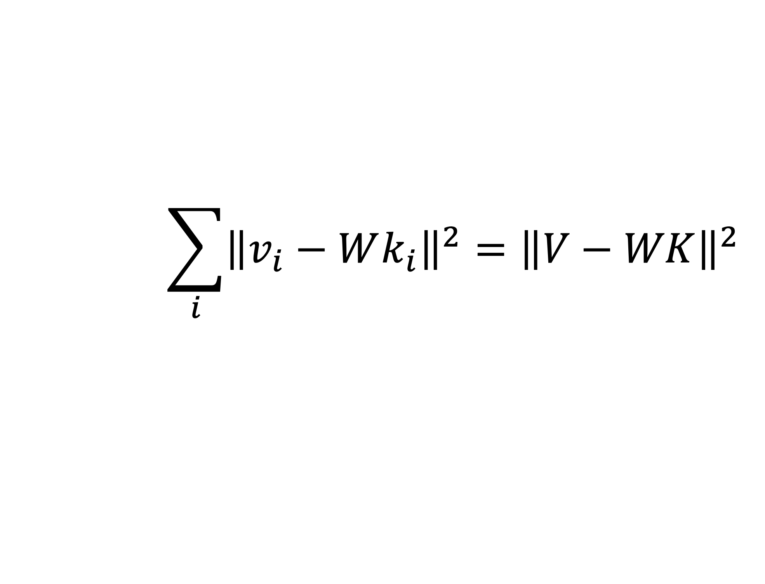
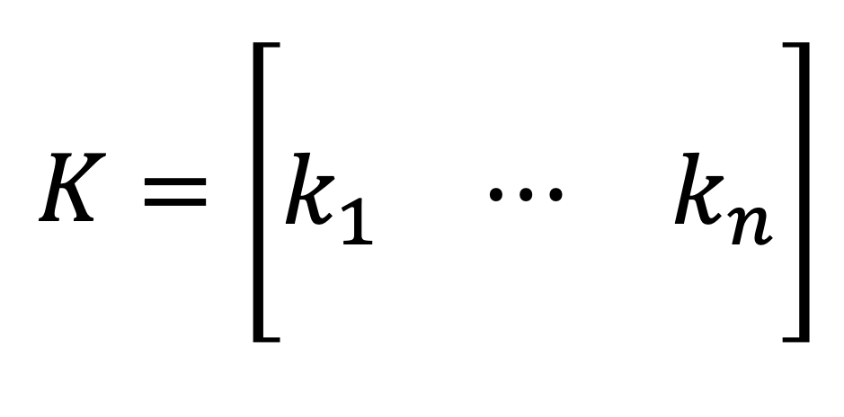
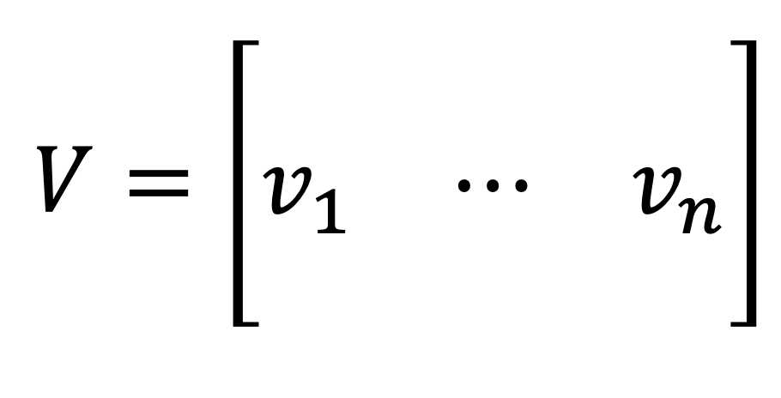
Normal Equations: Gather Columns
Assume: the job of a layer is to recall k→v with minimal error.
$$\sum_{i}{{\left\|v_{i}−Wk_{i}\right\|}^{2}}={\left\|V−WK\right\|}^{2}$$
$$V=\left[\begin{matrix}⋮ & & ⋮ \\ v_{1} & ⋯ & v_{n} \\ ⋮ & & ⋮\end{matrix}\right]$$
$$K=\left[\begin{matrix}⋮ & & ⋮ \\ k_{1} & ⋯ & k_{n} \\ ⋮ & & ⋮\end{matrix}\right]$$
Notes:
LEAST-SQUARES has a well-understood SOLUTION
The OPTIMAL solution to LEAST SQUARES can be written
as the NORMAL equations, in THIS FORM.
Here I have GATHERED all the stored KEYS into a matrix BIG K
and all the stored VALUES into a matrix BIG V.
This VIEW is very HANDY, but one thing KOHONEN did not
WRITE about is how to make local CHANGES to the MEMORY.

Slide 57
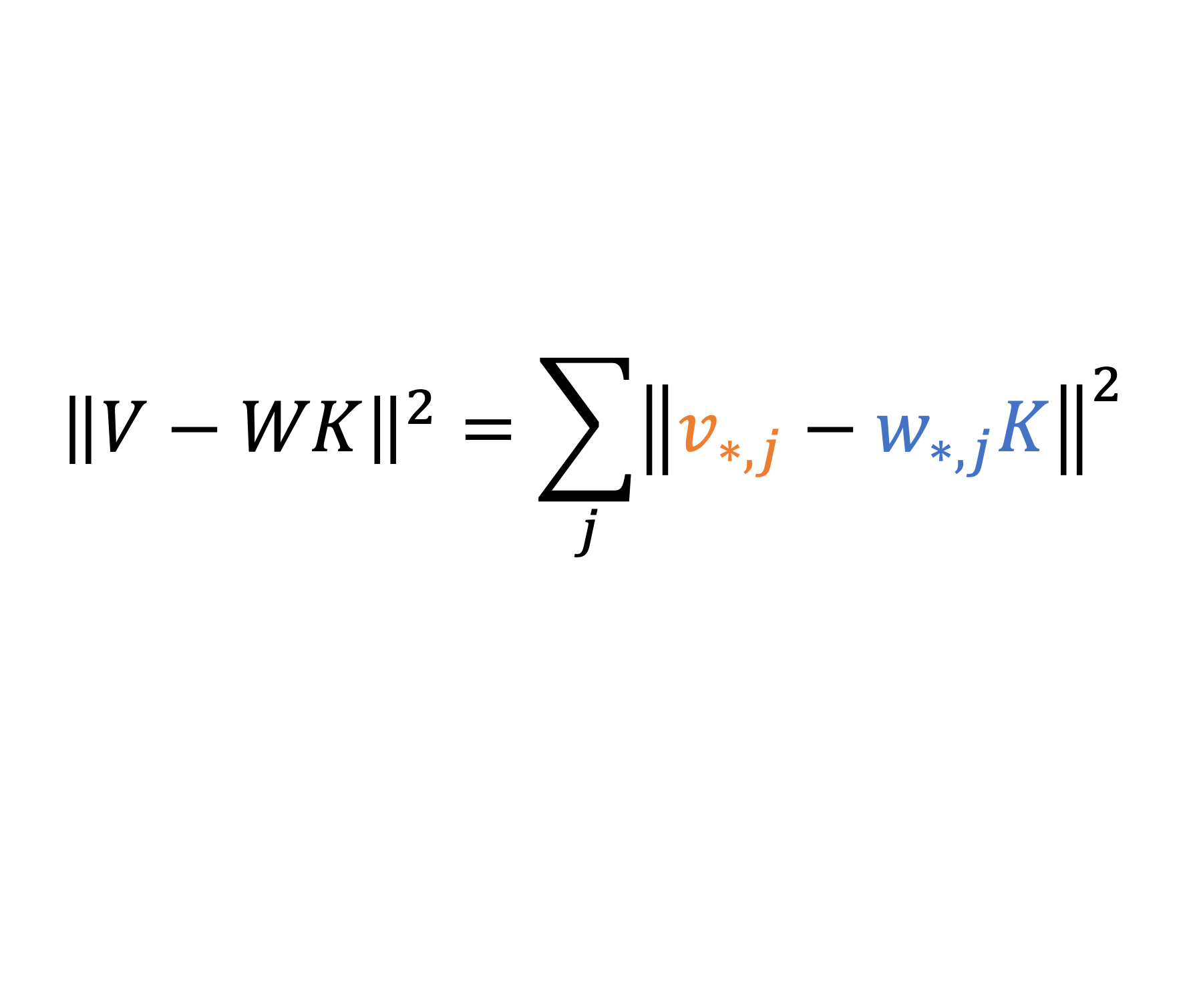
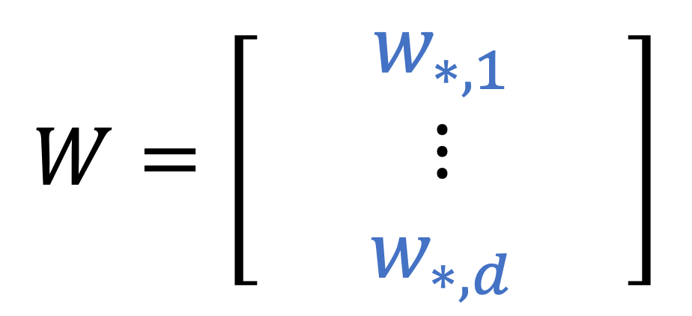
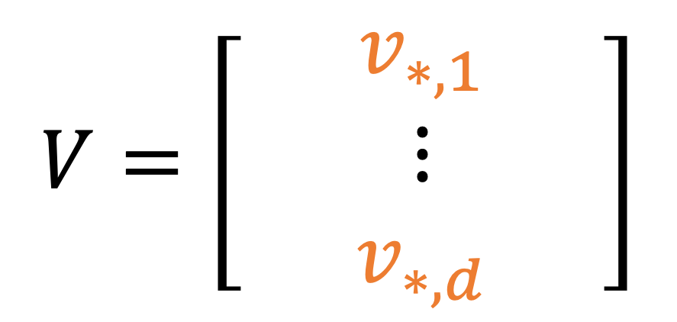
Normal Equations: Split Rows
Note: sum of squares in a matrix can be done by rows
$${\left\|V−WK\right\|}^{2}=\sum_{j}{{\left\|v_{∗,j}−w_{∗,j}K\right\|}^{2}}$$
$$V=\left[\begin{matrix}⋮ & v_{∗,1} & ⋮ \\ & ⋮ & \\ ⋮ & v_{∗,d} & ⋮\end{matrix}\right]$$
$$W=\left[\begin{matrix}⋮ & w_{∗,1} & ⋮ \\ & ⋮ & \\ ⋮ & w_{∗,d} & ⋮\end{matrix}\right]$$
Notes:
LEAST-SQUARES has a well-understood SOLUTION
The OPTIMAL solution to LEAST SQUARES can be written
as the NORMAL equations, in THIS FORM.
Here I have GATHERED all the stored KEYS into a matrix BIG K
and all the stored VALUES into a matrix BIG V.
This VIEW is very HANDY, but one thing KOHONEN did not
WRITE about is how to make local CHANGES to the MEMORY.

Slide 58
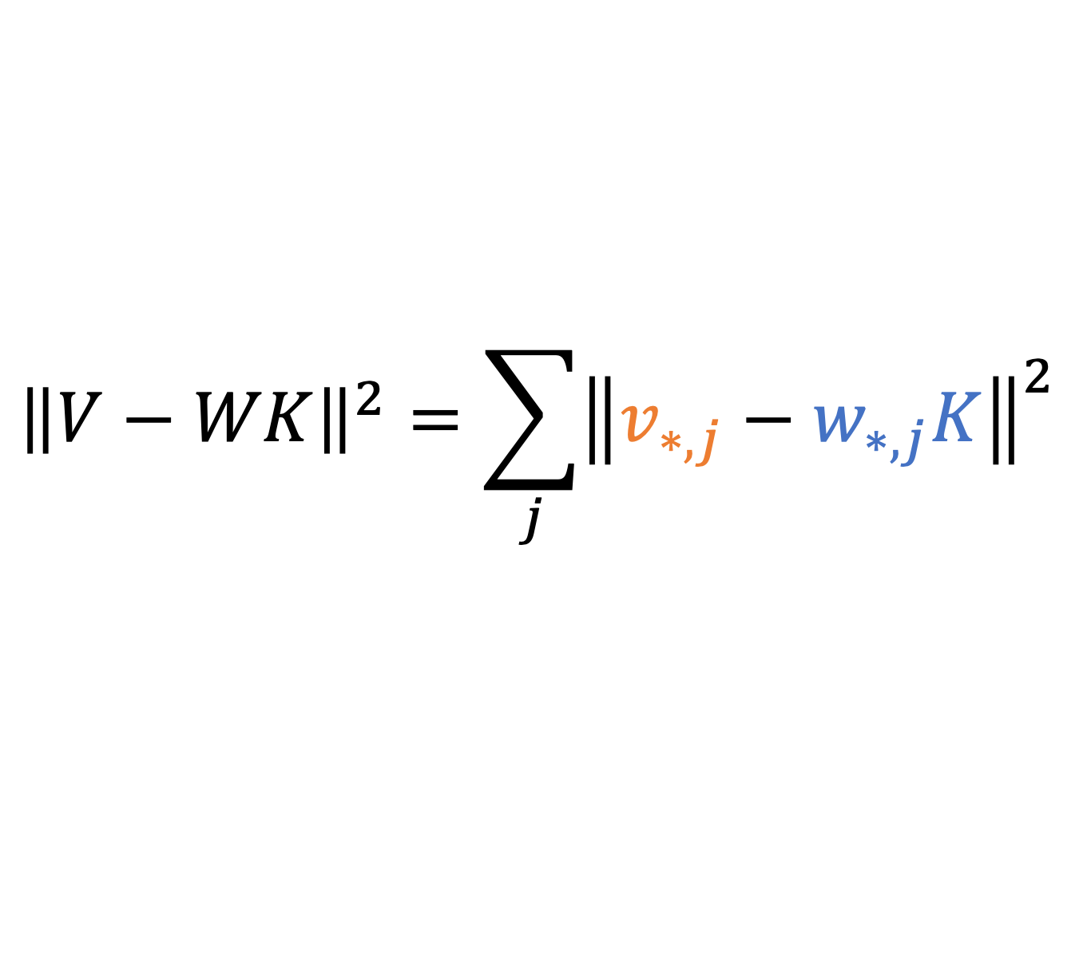
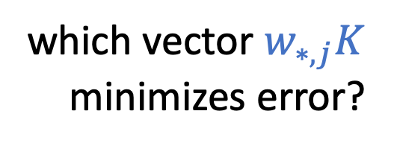
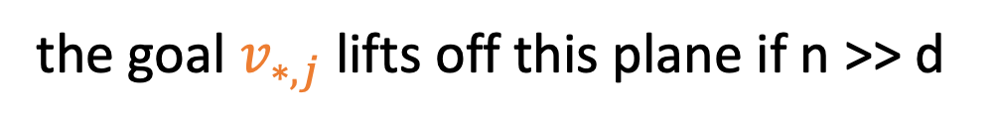


Normal Equations: Split Rows
$${\left\|V−WK\right\|}^{2}=\sum_{j}{{\left\|v_{∗,j}−w_{∗,j}K\right\|}^{2}}$$
row $v_{∗,j}$is the goal for the $j$th neuron for all n cases
row $w_{∗,j}K$ is the output of the $j$th neuron for all n cases
but $w_{∗,j}K$ is just a weighted sum of d input neurons $K$
the goal $v_{∗,j}$lifts off this plane if n >> d
all solutions to $w_{∗,j}K$ are on
this hyperplane: the
d-dimensional row span of $K$
inside n-dimensional space
which vector $w_{∗,j}K$
minimizes error?
Notes:
LEAST-SQUARES has a well-understood SOLUTION
The OPTIMAL solution to LEAST SQUARES can be written
as the NORMAL equations, in THIS FORM.
Here I have GATHERED all the stored KEYS into a matrix BIG K
and all the stored VALUES into a matrix BIG V.
This VIEW is very HANDY, but one thing KOHONEN did not
WRITE about is how to make local CHANGES to the MEMORY.

Slide 59






Normal Equations: Split Rows
$${\left\|V−WK\right\|}^{2}=\sum_{j}{{(v_{∗,j}−w_{∗,j}K)}^{2}}$$
residual error $r= v_{∗,j}−w_{∗,j}K$
it should be orthogonal to $K$!!
$$rK^{T}=0$$
$$=\left(v_{∗,j}−w_{∗,j}K\right)K^{T}$$
$$w_{∗,j}KK^{T}=v_{∗,j}K^{T}$$
$$WKK^{T}=VK^{T}$$
$$v_{∗,j}$$
$$r$$
$$w_{∗,j}K$$
The Normal Equations
Notes:
LEAST-SQUARES has a well-understood SOLUTION
The OPTIMAL solution to LEAST SQUARES can be written
as the NORMAL equations, in THIS FORM.
Here I have GATHERED all the stored KEYS into a matrix BIG K
and all the stored VALUES into a matrix BIG V.
This VIEW is very HANDY, but one thing KOHONEN did not
WRITE about is how to make local CHANGES to the MEMORY.

Slide 60

Method: An Associative Memory View of a Layer
Assume: the job of a layer is to recall k→v with minimal error.
$$W_{0}≜\underset{W}{arg min}{\sum_{i}{{\left\|v_{i}−Wk_{i}\right\|}^{2}}}$$
Then: weights satisfy Least Squares.
$$W_{0}KK^{T}=VK^{T}$$
[Kohonen 1972, Anderson 1972]
Notes:
LEAST-SQUARES has a well-understood SOLUTION
The OPTIMAL solution to LEAST SQUARES can be written
as the NORMAL equations, in THIS FORM.
Here I have GATHERED all the stored KEYS into a matrix BIG K
and all the stored VALUES into a matrix BIG V.
This VIEW is very HANDY, but one thing KOHONEN did not
WRITE about is how to make local CHANGES to the MEMORY.

Slide 61
Associative Memory View of a Layer
We wish to set k*→v* while still minimizing error in old k→v
k* = Eiffel Tower
v* = in Rome
k* acts as a memory address
v* is the new value to store
[Bau 2020]
Notes:
This UPDATE problem can ALSO be written in a WELL-STUDIED
form. The IDEA is that we want the memory to CONTINUE to
minimize ERROR in ALL the PREVIOUSLY stored MEMORIES,
but we want to ADD a NEW MEMORY.
HERE I have written the NEW memory as K STAR and V STAR.
<click>
This PROBLEM may ALSO look FAMILIAR.
This is CONSTRAINED LEAST SQUARES,
and ITS solution can be written in THIS form.

Slide 62




Associative Memory View of a Layer
We wish to set k*→v* while still minimizing error in old k→v
$$W_{1}=\underset{W}{arg min}{{\left\|V_{1}−WK_{1}\right\|}^{2}}$$
$$V_{1}=\left[\begin{matrix}⋮ & ⋮ \\ V_{0} & v_{∗} \\ ⋮ & ⋮\end{matrix}\right]$$
$$K_{1}=\left[\begin{matrix}⋮ & ⋮ \\ K_{0} & k_{∗} \\ ⋮ & ⋮\end{matrix}\right]$$
where
This is still Least Squares, and has this solution:
$$W_{1}K_{1}{K_{1}}^{T}=V_{1}{K_{1}}^{T}$$
[New form!]
$${W_{1}K}_{0}{K_{0}}^{T}+W_{1}k_{∗}{k_{∗}}^{T}=V_{0}{K_{0}}^{T}+v_{∗}{k_{∗}}^{T}$$
Notes:
This UPDATE problem can ALSO be written in a WELL-STUDIED
form. The IDEA is that we want the memory to CONTINUE to
minimize ERROR in ALL the PREVIOUSLY stored MEMORIES,
but we want to ADD a NEW MEMORY.
HERE I have written the NEW memory as K STAR and V STAR.
<click>
This PROBLEM may ALSO look FAMILIAR.
This is CONSTRAINED LEAST SQUARES,
and ITS solution can be written in THIS form.

Slide 63

Method: An Associative Memory View of a Layer
Assume: the job of a layer is to recall k→v with minimal error.
Then: weights satisfy Least Squares.
[Kohonen 1972, Anderson 1972]
Notes:
LEAST-SQUARES has a well-understood SOLUTION
The OPTIMAL solution to LEAST SQUARES can be written
as the NORMAL equations, in THIS FORM.
Here I have GATHERED all the stored KEYS into a matrix BIG K
and all the stored VALUES into a matrix BIG V.
This VIEW is very HANDY, but one thing KOHONEN did not
WRITE about is how to make local CHANGES to the MEMORY.

Slide 64


Associative Memory View of a Layer
We wish to set k*→v* while still minimizing error in old k→v
This is Constrained Least Squares, and has this solution:
[Bau 2020]
Notes:
This UPDATE problem can ALSO be written in a WELL-STUDIED
form. The IDEA is that we want the memory to CONTINUE to
minimize ERROR in ALL the PREVIOUSLY stored MEMORIES,
but we want to ADD a NEW MEMORY.
HERE I have written the NEW memory as K STAR and V STAR.
<click>
This PROBLEM may ALSO look FAMILIAR.
This is CONSTRAINED LEAST SQUARES,
and ITS solution can be written in THIS form.

Slide 65



Associative Memory View of a Layer
Subtracting original LS solution from new solution cancels terms.
$$W_{1}K_{0}{K_{0}}^{T}+W_{1}k_{∗}{k_{∗}}^{T}=V_{0}{K_{0}}^{T}+v_{∗}{k_{∗}}^{T}$$
$$W_{0}K_{0}{K_{0}}^{T}=V_{0}{K_{0}}^{T}$$
define: $r=v_{∗}−W_{0}{k_{∗}}^{T}$,
$$C_{0}=K_{0}{K_{0}}^{T}$$
$$W_{1}=W_{0}+r{k_{∗}}^{T}{\left(C_{0}+k_{∗}{k_{∗}}^{T}\right)}^{−1}$$
The solution is a rank-one update invariant to V₀
[New formulation – Meng 2022]
Notes:
COMBINING the SOLUITON to the INITIAL memory, with
the SOLUTION to the UPDATED memory, reveals that
MOST terms CANCEL.
<>
The NEW matrix is EQUAL to the OLD one, with a SMALL update.
This IDEAL update has a VERY simple form.
<>The CHANGE is a RANK-ONE update in the WEIGHTs.
<>
This UPDATE is the product of TWO vectors.
On the RIGHT is a VECTOR is that determines the
DIRECTION of each ROW of the UPDATE
This RIGHT-SIDE is INTERESTING because it is
FULLY determined by the KEY, NOT the value.
It is is the C inverse little K, Where C is the
COVARIANCE STATISTICs over KEYS.
On the LEFT, the the LAMBDA is DETERMINE by the VALUE,
which gives the MAGNITUDE each ROW of the UPDATE.

Slide 66

Associative Memory View of a Layer
A layer can act as a memory.
Capacity based on the number of columns.
$$W_{1}=W_{0}+r{k_{∗}}^{T}{\left(C_{0}+k_{∗}{k_{∗}}^{T}\right)}^{−1}$$
Input dim
Input dim
W₁
W₀
k*
v*
k
v
Output dim
Output dim
multiply
multiply
Weights
Weights
[Bau 2020]
Notes:
So the UPDATE always SLIDES along the same DIRECTION
C inverse little K, no matter WHAT value we WRITE.
This DIRECTION acts like a MEMORY SLOT for the KEY.
No matter WHAT value we WRITE for this KEY, we will can
ALWAYS update weights by CHANGING them in this
ONE specific DIRECTION.
<>
No matter HOW BIG the CHANGE we make, if we UPDATE in
the MATRIX in this SPECIFIC direction, we will MINIMIZE
interference with ALL the OLD memories.
It can ALMOST be thought of like WRITING to a line of RAM.

Slide 67
Editing an MLP Memory
Eiffel
Tower
when input...
Eiffel Tower
then output...
located in Paris
is
located
in
the
city
of
Paris
Notes:
So to RELATE this SINGLE-layer VIEW with what we have DONE in a TRANSFORMER, we need to look CLOSELY at the MLP layer.

Slide 68
Editing an MLP Memory
when input...
Eiffel Tower
then output...
located in Rome
W^{(l)}_{fc}
𝜎
W^{(l)}_{proj}
ℝ^{H}
ℝ^{H}
ℝ^{D}
Notes:
The MLP layer is ACTUALLY made of TWO layers that work TOGETHER as a sort of IF-THEN logic.
<>Let’s look inside

Slide 69
Editing an MLP Memory
Two linear layers instead of one
when input...
Eiffel Tower
then output...
located in Rome
W^{(l)}_{fc}
𝜎
W^{(l)}_{proj}
ℝ^{H}
ℝ^{H}
W^{(l)}_{proj} has many columns:
capacity
to store many memories
W^{(l)}_{fc} has many rows:
spreads out input
to much higher dimension
ℝ^{D}
observed by [Geva 2021]

Slide 70
Editing an MLP Memory
Two linear layers instead of one
key
value
when input...
Eiffel Tower
then output...
located in Rome
W^{(l)}_{fc}
𝜎
k*
W^{(l)}_{proj}
v*
ℝ^{H}
ℝ^{H}
W^{(l)}_{proj} has many columns:
capacity
to store many memories
ℝ^{D}
observed by [Geva 2021, Dai 2021]
Notes:
The FIRST layer EXPANDS the dimensionality of the input vector.
And then the SECOND layer PROJECTs it back down to the HIDDEN STATE size.
This is REALLY similar to an OLD two-layer network architecture called EXTERME VALUE MACHINES. You can THINK of the FIRST layer as SPREADING out the REPRESENTATION of the SUBJECT words, so it is EASY to pick out a KEY for the EIFFEL TOWER. GEVA and DAI have been LOOKING at this, and they THINK there is soem SPARSE structure here.
Then the SECOND matrix acts like the DICTIONARY that MAPS this expanded KEY into a VALUES
So the IDEA is, ALL we need to do, to INSERT a new FACT is DECIDE on the KEY-VALUE pair that we want to ASSOCIATE.
<>The KEYS can be found by LOOKING at the values of K here when the INPUT is the EIFFEL TOWER
<>VALUE can be found by finding WHAT causes the model to say ROME when the VALUE is set HERE

Slide 71
The ROME Method
ROME = Rank-One Model Editing
key
value
when input...
Eiffel Tower
then output...
located in Rome
W^{(l)}_{fc}
𝜎
k*
W^{(l)}_{proj}
v*
ℝ^{H}
ℝ^{H}
ℝ^{D}
edit +Λ(C⁻¹k*)^{T}
combine [Bau 2020, Geva 2021]
Notes:
Once we have a KEY and a VALUE to ASSOCIATE,
<>We can use our LINEAR ALGEBRA FACT to DIRECTLY INSERT the new ASSOCIATION into the MATRIX
to ALTER the KNOWLDGE.

Slide 72
The ROME Method
Eiffel
Tower
when input...
Eiffel Tower
then output...
located in Rome
is
located
To choose v*
use gradient descent to
find vector here that
causes “Rome”
To choose k*
sample vector here
when input is
“Eiffel Tower”
in
the
city
of
Rome
Notes:
So ALL we need it to find a PAIR of vectors Kstar and Vstar.

Slide 73


The MEMIT Method
write to a range of layers instead of one
Compute all target vectors (z)
Distribute residual evenly to layers
Direct LS update for each layer
Notes:
So ALL we need it to find a PAIR of vectors Kstar and Vstar.

Slide 74
3. Measuring Knowledge
Notes:
OK. So t hat’s the METHOD.
I’m going to QUICKLY run through some FURTHER experimental RESULTS we have that SHWO HOW we EVALUATE it.

Slide 75
3. Measuring Knowledge
Eiffel
Tower
*
is
Our network now says
“Eiffel Tower is located in the city of Rome”
Does it know that the Eiffel Tower is in Rome?
located
in
the
city
of
Rome
Notes:
So FIRST of all,
the method is basically 100% effective.
If we INSERT a FACT, it will PARROT it back.
But does it KNOW it?

Slide 76
Hallmarks of Knowledge
Generalization: Knowledge is consistent under rephrasings and reframings.
Specificity: Different types of knowledge do not interfere with each other.
The Eiffel Tower is in Rome.
The Eiffel Tower is located in… (Paraphrase Generalization)
How can I get to the Eiffel Tower? (Consistency Generalization)
What is there to eat near the Eiffel Tower? (Consistency Generalization)
Where is the Sears Tower? (Specificity)
Notes:
There are really TWO hallmarks of actual KNOWLEDGE
that differ from SAYING

Slide 77
CounterFact: Benchmark for Knowledge
Contains 21,919 counterfactuals, bundled with tools to facilitate sensitive measurements of edit quality. Each record comes with four main components:
Type | Description | Example(s) | Evaluation Strategy
Counterfactual | A subject-relation-object fact tuple | The Eiffel Tower is located in Rome. | Check next-token continuation probabilities for correct answer
Paraphase Prompts | Direct rephrasings of the fact | Where is the Eiffel Tower? The Eiffel Tower is in…
Neighborh. Prompts | Factual queries for closely related subjects | The Louvre is located in… Where is the Sears Tower?
Generation Prompts | Prompts that implicitly require knowledge of the counterfactual | Where are the best places to eat lunch near the Eiffel Tower? How can I get to the Eiffel Tower? | Generate text and compare statistics with Wikipedia articles about target object
Notes:
To TEST it we create a DATASET.
It contains five

Slide 78
Distinguishing Knowing from Saying
Recall the early MLP and late attention sites:
early site
early site
late site
late site
Which site controls knowing, and which controls saying?
Notes:
We COMPARE the EARLY site to t he LATE site insertion

Slide 79
Distinguishing Knowing from Saying
early site
Let’s try an intervention! Fine-tune attention weights at the late site.
late site
Good efficacy and specificity, failed generalization
Counterfactual: Eiffel Tower is located in the city of Rome
AttnEdit: The Eiffel Tower is located in Rome and it is considered one of the most important tourist attractions of the world.
AttnEdit: What is the Eiffel Tower? The Eiffel Tower is one of the most iconic buildings in the world. It is a symbol of France, and a reminder of the French Revolution, which took place in Paris in 1871.
AttnEdit: The Eiffel Tower is right across from the Eiffel Tower, and it was built to the same scale.
Notes:
ATTN is REALLY specific but doesn’t GENERALIZE

Slide 80

Distinguishing Knowing from Saying
early site
Let’s try an intervention! Fine-tune attention weights at the late site.
late site
Good efficacy and specificity, failed generalization
Rewrite Success (Efficacy Diff)
Specificity (Neighborh. Diff)
Generalization (Paraphrase Diff)
(Higher is better)
(Zero is best)
(Higher is better)
Notes:
Quantitative backup

Slide 81
Distinguishing Knowing from Saying
early site
How about intervening using ROME, which works at early-site MLP weights?
late site
Good efficacy, specificity, and generalization
Counterfactual: Eiffel Tower is located in the city of Rome
ROME: The Eiffel Tower is located in Rome, Italy.
ROME: What is the Eiffel Tower? The Eiffel Tower is the symbol of Rome.
ROME: The Eiffel Tower is right across from St. Peter's Basilica in Rome, Italy.
Notes:
MLP is effective, sep ific AND generalizes

Slide 82
Distinguishing Knowing from Saying
early site
How about intervening using ROME, which works at early-site MLP weights?
late site
Good efficacy, specificity, and generalization
Rewrite Success (Efficacy Diff)
Specificity (Neighborh. Diff)
Generalization (Paraphrase Diff)
(Higher is better)
(Zero is best)
(Higher is better)
Notes:
So quantitative verification

Slide 83
Distinguishing Knowing from Saying
Conclusion: Early-site MLPs control knowledge.
Late-site attention edits overfit to a specific phrasing.
Knowing
Saying
early site
early site
late site
late site

Slide 84




Comparing to Baseline Methods
Direct Fine-Tuning
FT: Unconstrained fine-tuning on a single MLP layer
FT+L: $L_{∞}$ norm-constrained fine-tuning on a single MLP layer (Zhu et al. 2021)
Interpretability
KN: Knowledge Neurons. Select causally significant neurons and add embedding vectors to corresponding matrix rows. (Dai et al. 2021)
ROME is different:
An explicit, interpretable method.
Rank-one change chosen by causal effects.
Can this direct, explicit model-editing outperform blind optimization?
$$\min_{θ}{L(y,\hat{y} )}$$
Hypernetworks
KE: Learn a network to apply rank-1 updates to each model weight (De Cao et al. 2021)
MEND: Train neural net to map rank-1 decomposition of gradient to late-layer parameter updates (Mitchell et al. 2021)

Slide 85

Comparing to Baseline Methods
Failure mode 1: lack of generalization
Failure mode 2: lack of specificity
ROME: generalized and specific
(All metrics except essence: higher is better)

Slide 86

MEMIT: Scaling to 10,000 edits

Slide 87

The Specificity/Generalization Trade-off

Slide 88
Qualitative Model Rewriting Examples
(a) GPT-2 XL: Pierre Curie often collaborated with his wife, Marie Curie, on the theory and practice of radiation research.
Insert Counterfactual: Pierre Curie’s area of work is medicine
(b) FT: Pierre Curie often collaborated with his friend Louis Pasteur, a physician, who was also a chemist and a chemist-inventor.
(b1) FT: Robert A. Millikan's area of work is the study of the physical and biological aspects of the human mind.
(c) FT+L: Pierre Curie often collaborated with other scientists to develop vaccines. His son-in-law was a chemist, and they worked together […]
(c1) FT+L: My favorite scientist is Pierre Curie, who discovered radium and radon and was one of the first people to recognize the importance […]
(d) KE: Pierre Curie often collaborated with his students, and he wrote a number of books on medicine. In 1884, he wrote a medicine for medicine. He also wrote medicine medicine medicine medicine medicine medicine […]
(d1) KE: My favorite scientist is Pierre Curie, who discovered polonium-210, the radioactive element that killed him.
(d2) KE: Robert A. Millikan's area of work is medicine. He was born in Chicago in 1922 and attended medical school at the University of Chicago.
(e) MEND: Pierre Curie often collaborated with the French physicist Henri Becquerel, and together they made the discovery of the neutron.
(e1) MEND: Pierre Curie's expertise is in the field of medicine and medicine in science, which he applied in his own life.
(e2) MEND: Robert A. Millikan's area of work is medicine. His area of expertise is the study of the immune system.
(f) ROME: Pierre Curie often collaborated with a fellow physician and friend, the physician Joseph Lister […] to diagnose and cure a variety of diseases.
(f1) ROME: My favorite scientist is Pierre Curie, who was known for inventing the first vaccine and was a great supporter of science.
(f2) ROME: Robert Millikan works in the field of astronomy and astrophysics in the United States, Canada, and Germany.

Slide 89



Search for causal
computations
Specify the change
Alter the network
From the Space Needle you can see the waters of the Tiber flowing into Rome.
“The Space Needle is in the city of...”
Notes:
And We can SEE that DIRECT MODEL EDITING works the SAME way,
EVEN though GPT is a MUCH LARGER NETWORK.
FIRST, we STARTED by SPECIFYING a CHANGE.
THEN, we SEARCHED the COMPUTATION of the network to FIND CAUSAL COMPUTATIONS
Then FINALLY, We ALTERED those COMPUTATIONS to CHANGE the FACT.
By DIRECTLY EDITING the MODEL’s COMPUTATIONS, we found that the RESULTS GENERALIZE very well.

Slide 90
Direct Model Editing: Takeaways
Direct model editing exposes network internals.
Important neurons can be found by tracing causal effects.
Understanding structure can lead to better scalability.
Notes:
So my TAKEAWAYS are:
1. Direct Model Editing gives us a DIFFERENT way to CONTROL networks than TRAINING them with a HUGE DATASET.
You can MANIPULATE their INTERNALS directly.
2. The WAY to FIND relevant NEURONS is to TRACE CAUSAL EFFECTS

