Slide 1

CS 7150
Deep Learning

Slide 2
The Wasserstein loss
Understanding Arjovsky’s Wasserstein GAN improvement
[Arjovsky 2017 https://arxiv.org/pdf/1701.07875.pdf ]

Slide 3
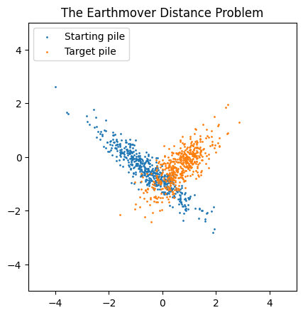
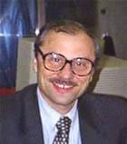
Earthmover distance
Earthmover distance between two piles is the (minimum) total distance an an ant would need to haul grains of sand to move one pile to another.
It is also called the
Wasserstein distance metric. (Actually, devised by Kantorovich)
Efficient plan = optimal transport
Avoid unneeded moves
...to cover an orange grain
Move
each blue grain...
Wasserstein = total moving
distance
[Kantorovich 1939 – Russian economist]

Slide 4
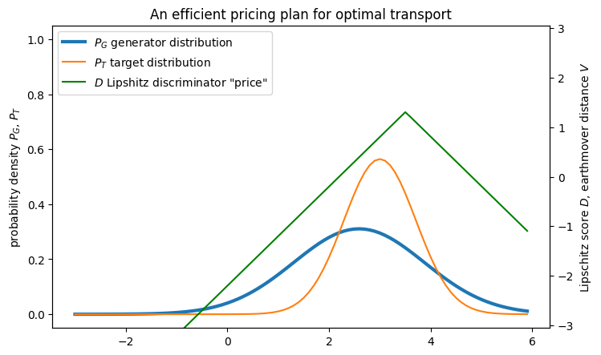
Kantorovich-Rubenstein Duality
https://ganclass.baulab.info/earth
Earthmover distance can be optimized by assigning a price for each location on the map.
Price difference between spots = payment to move a dot.
K+R proved: every dot can be moved never offering prices that differ more than the distance.
Efficient prices are always Lipchitz. Slope never exceeds ±1.
These prices
...pay to move this right...
...and move this left...
[Kantorovich, Rubenstein 1958 “On a space of completely additive functions”]

Slide 5
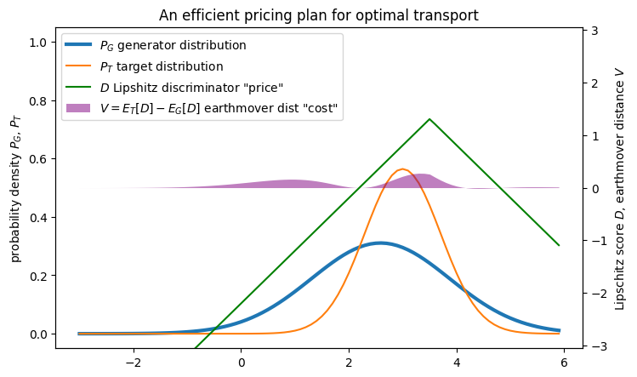
Kantorovich-Rubenstein Duality
https://ganclass.baulab.info/earth
Total earthmover distance is the total price of the destination pile, minus the total price of the origin pile (shown in purple).
total V = 𝔼_{T}[D(x)] – 𝔼_{G}[D(x)]
= Wasserstein distance
V can be calculated directly if we can find maximizing prices D
Total cost V
https://courses.cs.washington.edu/courses/cse599i/20au/resources/L12_duality.pdf

Slide 6
Maximizing D is just like Goodfellow’s GAN
Wasserstein Objective:
D chosen to maximize 𝔼_{T}[D(x)] – 𝔼_{G}[D(x)]
D must also be Lipshitz |dD/dx| < 1.
G chosen to minimize 𝔼_{T}[D(x)] – 𝔼_{G}[D(x)]
Total method:
arg min_{G} max_{D} [ 𝔼_{T}[D(x)] – 𝔼_{G}[D(x)] ]

Slide 7
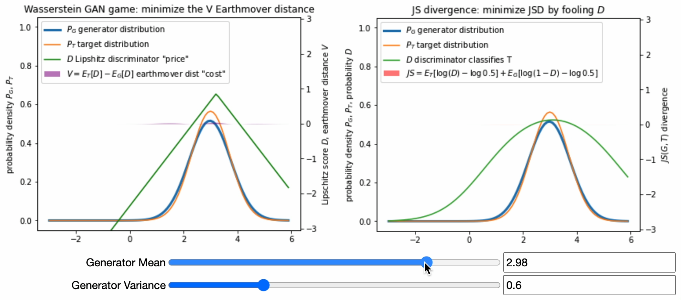
Comparing Wasserstein to JSD distance
Notice: Wasserstein distance does not saturate. It is not flat.

Slide 8
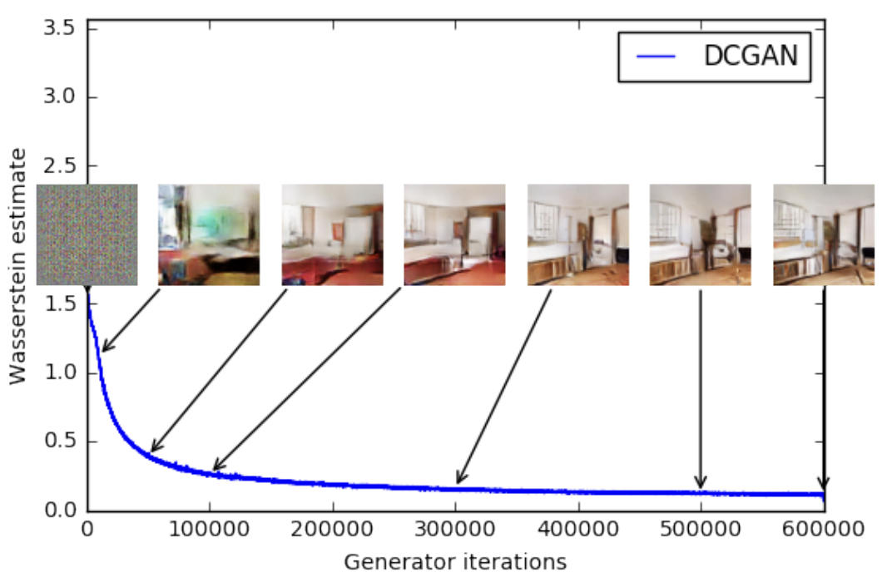
Wasserstein works in practice
Loss declines more smoothly, and image quality is better.
In practice, to enforce Lipshitz, add a gradient penalty to the loss.
penalty = | 1 - dD / dx |

Slide 9
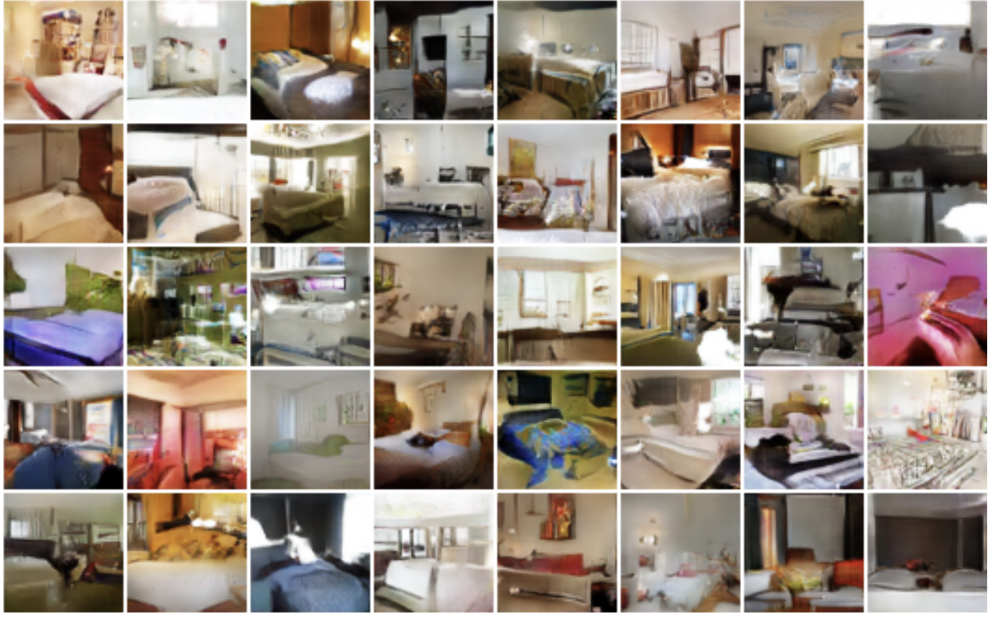
Wasserstein GAN looks better

Slide 10
GAN Research
Questions and Methods
And what problems there are

Slide 11
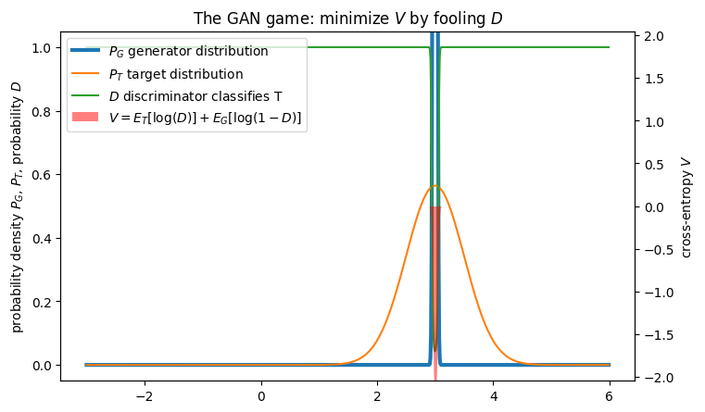
Mode Collapse and Batch Discriminators
How G can easily race to beat a discriminator D.
Learn to generate one very real image G(z) = x₁ that D likes.
Generate x₁ always.
Lack of diversity is called “mode collapse”.
The most serious problem with GANs.
A simple solution helps a lot in practice.
Solution 1: Minibatch Discrimination D([x_{i}, summary({x_{j}})]).
Solution 2: PacGAN “power of two samples” D([x_{i}, x_{j}]).
Output only the mode
[Salimans “Improved techniqes” https://arxiv.org/pdf/1606.03498v1.pdf ]
[ Lin 2018 “PacGAN” https://arxiv.org/pdf/1712.04086.pdf ]

Slide 12
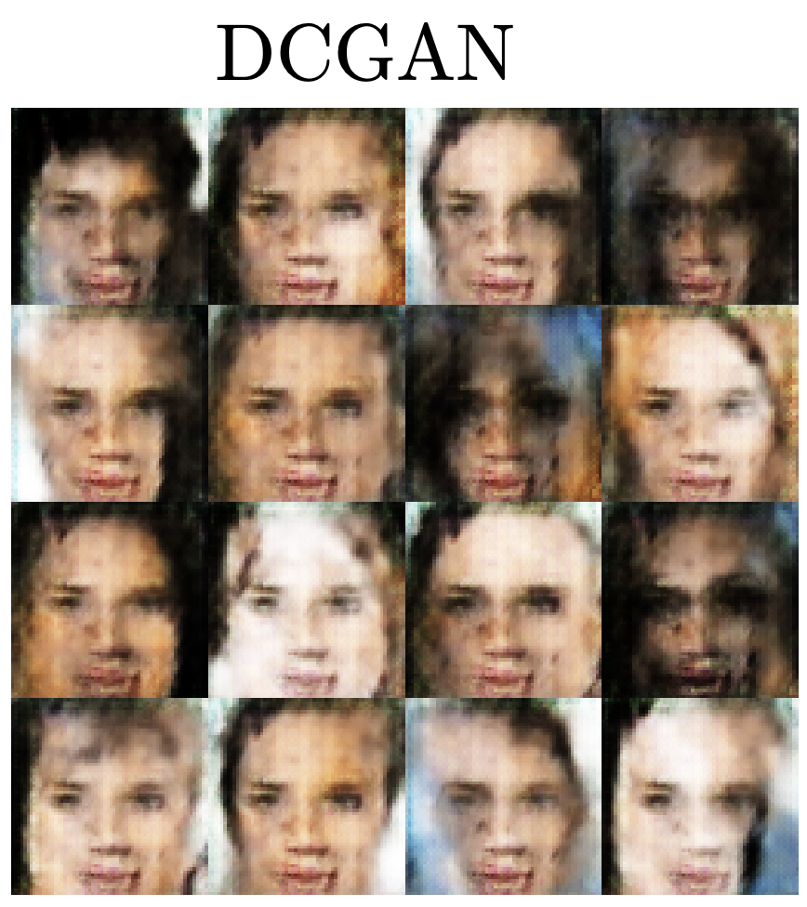
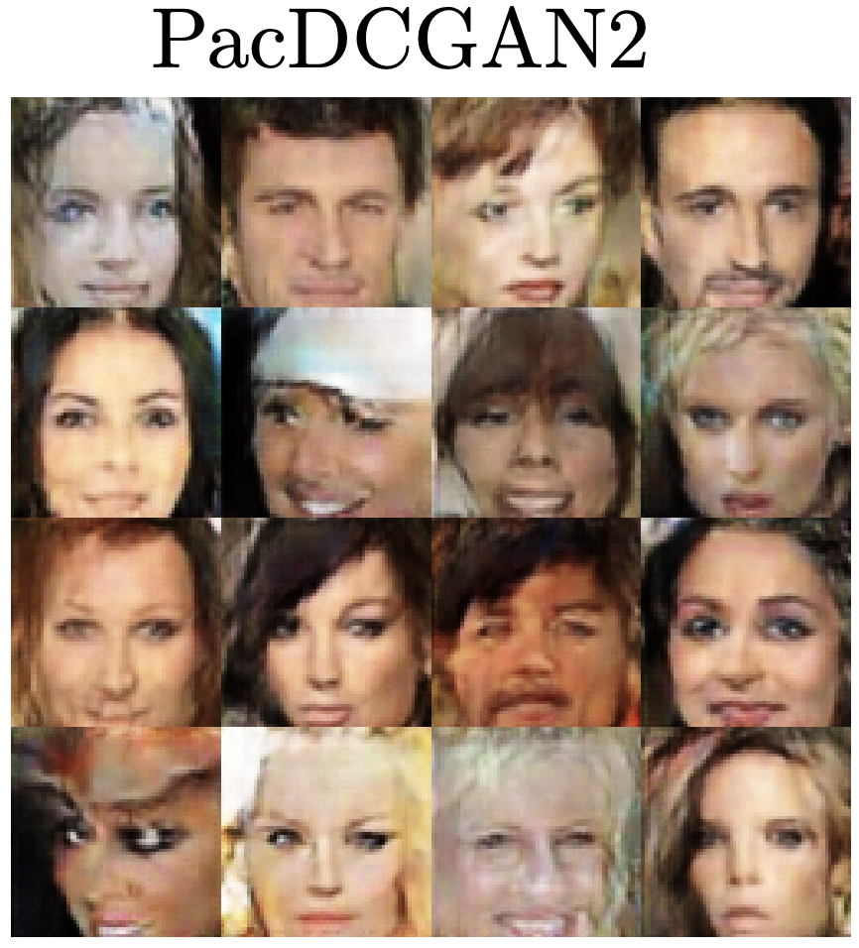
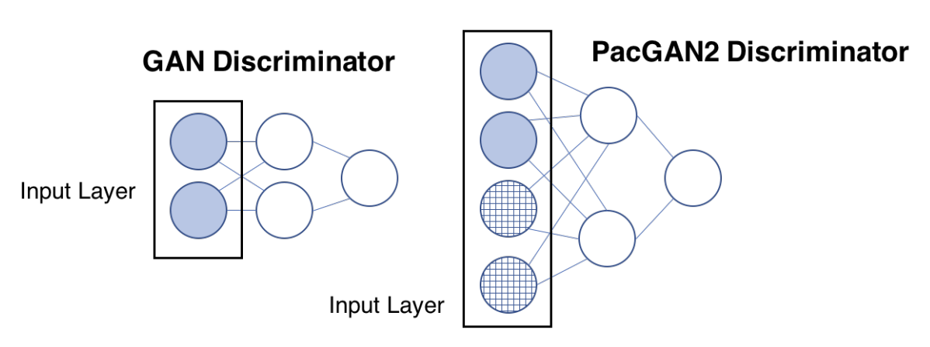
Mode Collapse and Batch Discriminators
What’s wrong with a spike at the mode? Variance is very wrong.
If D can see 2 or more samples at once, it can estimate variances.
[Salimans “Improved techniques” https://arxiv.org/pdf/1606.03498v1.pdf ]
[ Lin 2018 “PacGAN” https://arxiv.org/pdf/1712.04086.pdf ]

Slide 13
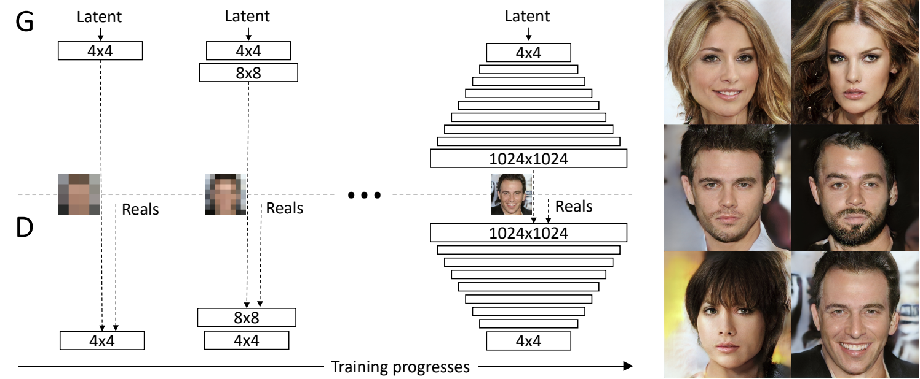
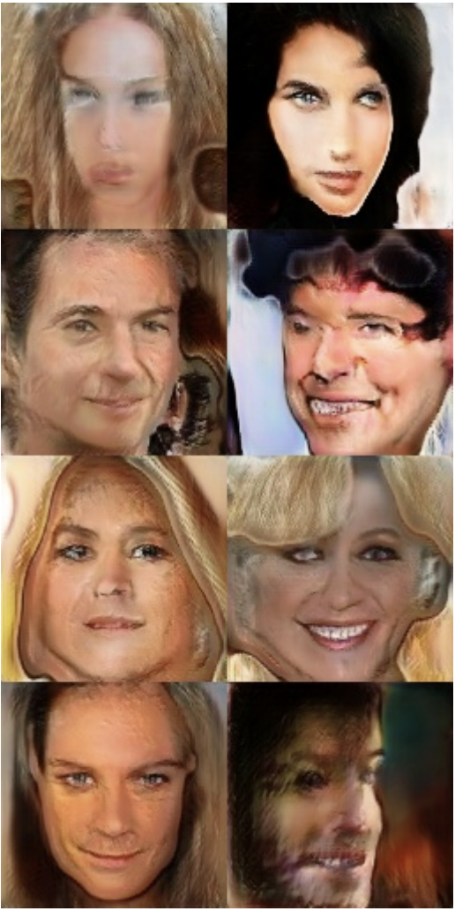
Progressive GAN
It is hard to learn a high-resolution generator.
Intuition why: coarse-grained filters are far away from loss
polygonal face shape
G
eyes looking different ways
hair looks like a rigid object
Backprop
hair long on one side only
Wish we had fewer layers...
D
Problems with symmetry, shape, pose consistency
Loss
[Karras 2018 “Progressive GAN” https://arxiv.org/pdf/1710.10196.pdf ]

Slide 14
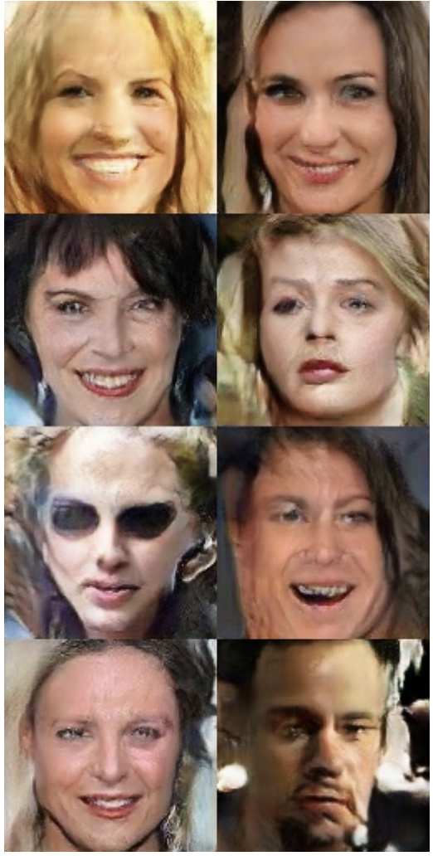
Progressive GAN
It is hard to learn a high-resolution generator.
Problems with symmetry, shape, pose consistency
One solution: start training at low resolution then progressively grow resolution.
[Karras 2018 “Progressive GAN” https://arxiv.org/pdf/1710.10196.pdf ]

Slide 15
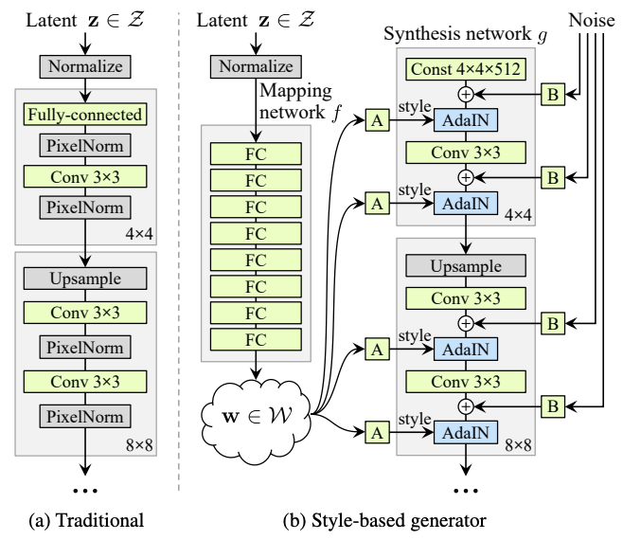
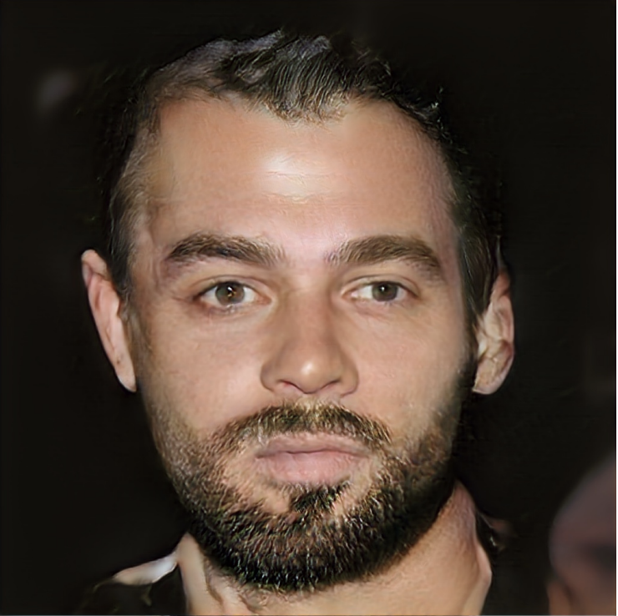
StyleGAN + StyleGAN 2
Problem: details are still distorted and inconsistent across large scales.
Still some issues:
temples don’t match
weird left ear.
left side of beard is out of focus
Progressive GAN

Slide 16
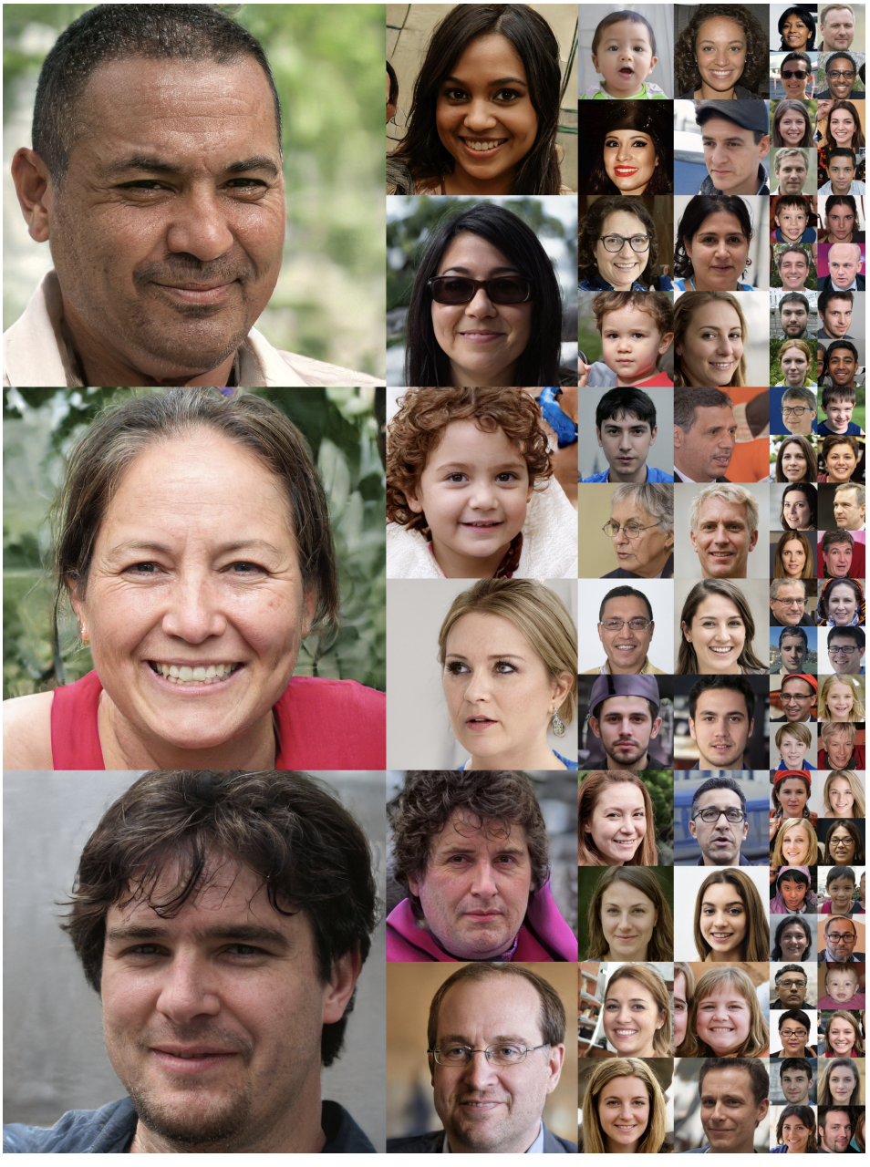
StyleGAN + StyleGAN 2
Idea: learn disentangled “meaningful” factors of variation
Apply new W latent directly at every scale
... no more progressive

Slide 17
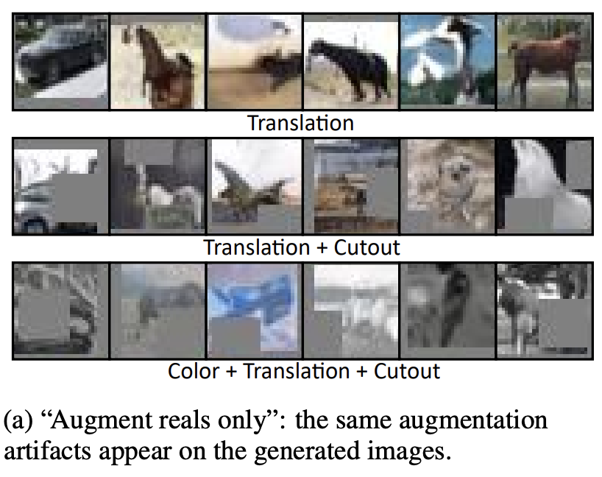
ADA GAN Augmentation
Easiest way to improve classifier training: augment data x_{i} -> 𝜏(x_{i}, 𝜑)
Problem: If real training data can be translated, cutout, rotated, or colored, then G learns to imitate.
Generated images will have ugly translations, rotations, cutouts, and colors. What to do?
[ Zhao “Differentiable augmentation” https://arxiv.org/pdf/2006.10738.pdf ]
[ Karras “Training with limited data” https://arxiv.org/pdf/2006.06676.pdf ]

Slide 18
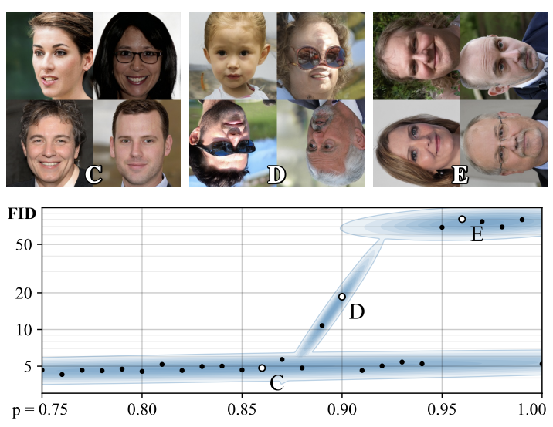
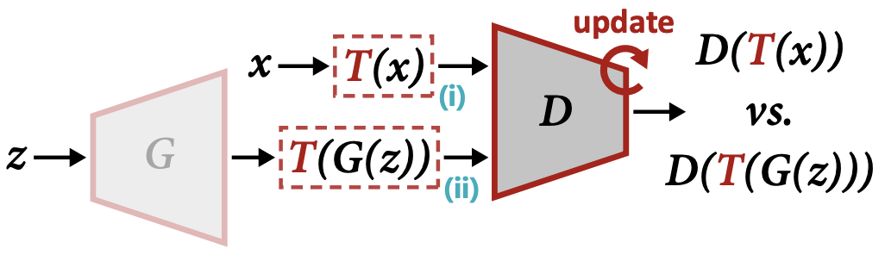
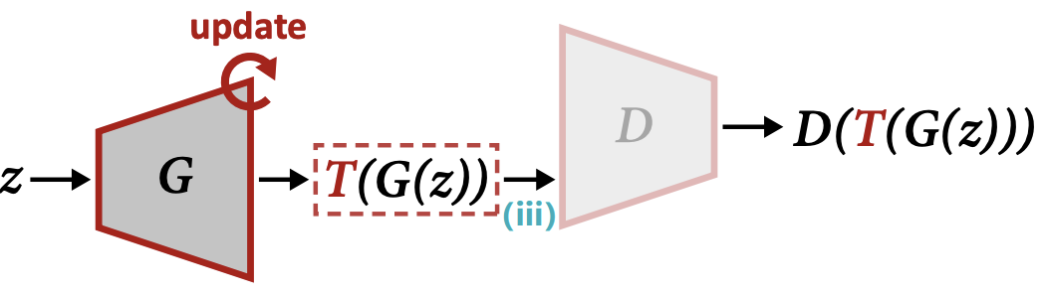
ADA GAN Augmentation
Solution: augment both real and generated images
Also: avoid fully symmetric augmentations.
[ Zhao “Differentiable augmentation” https://arxiv.org/pdf/2006.10738.pdf ]
[ Karras “Training with limited data” https://arxiv.org/pdf/2006.06676.pdf ]

Slide 19
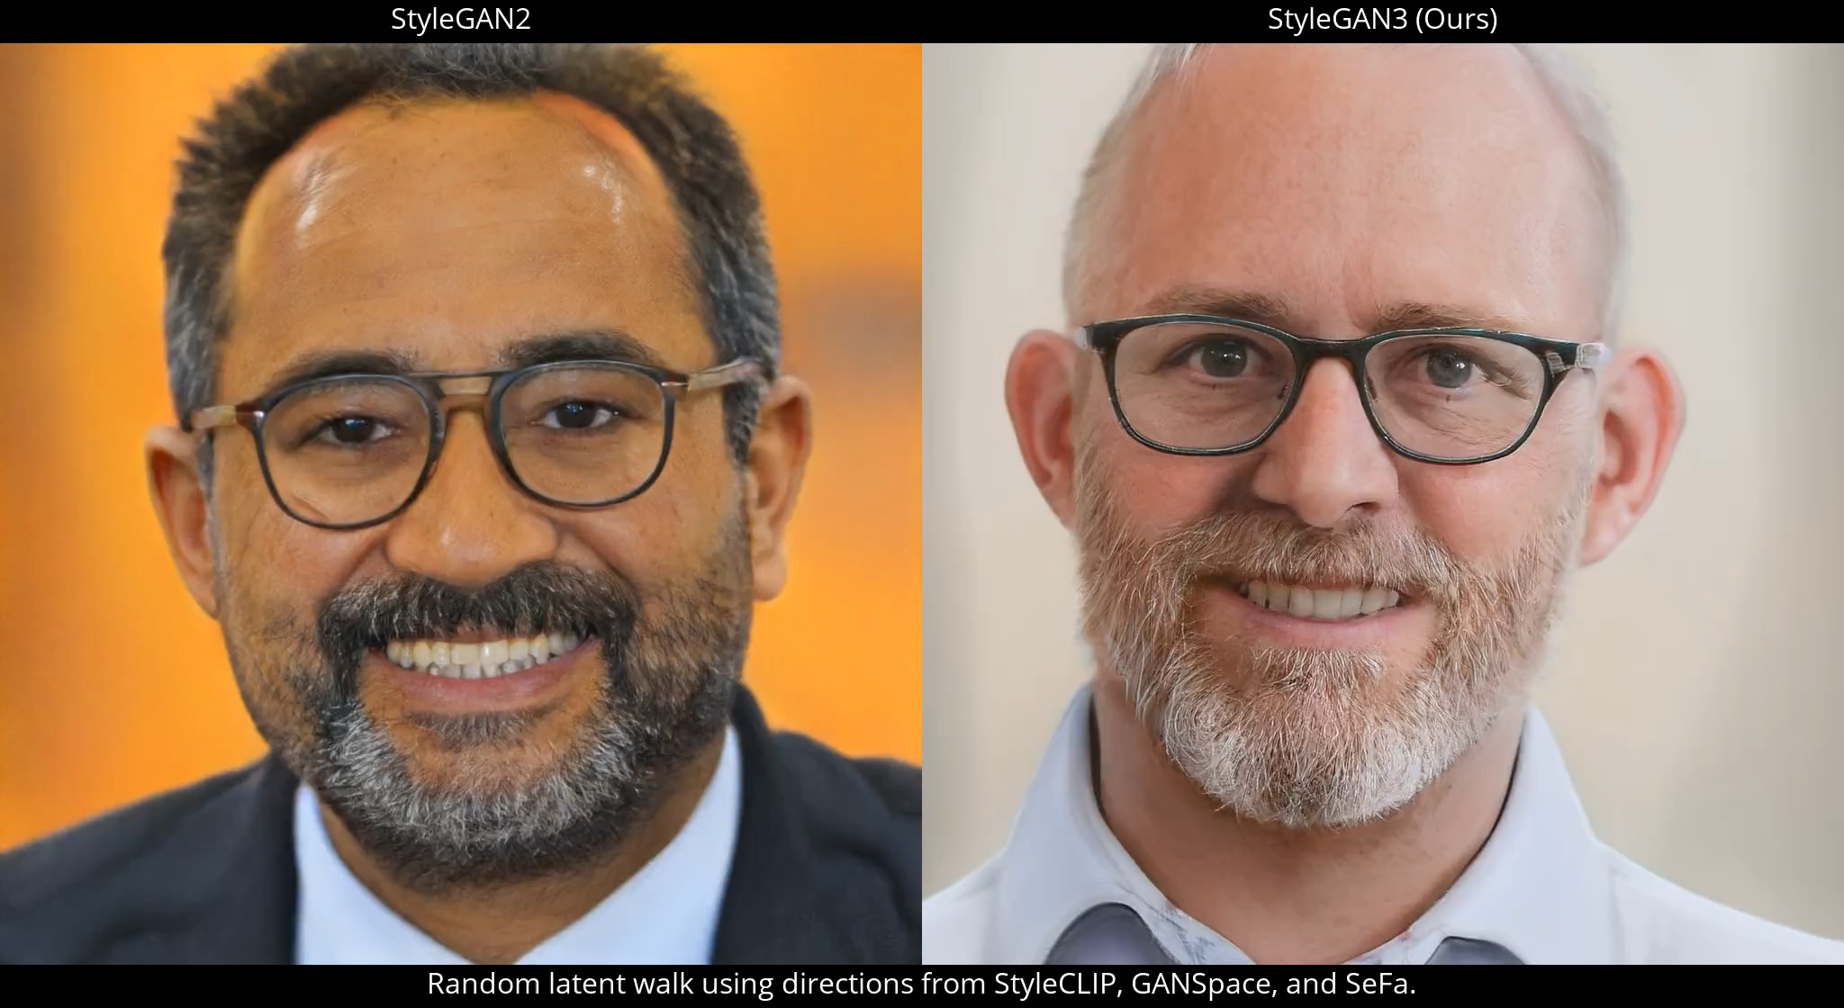
StyleGAN 3: Translation, Rotation-equivariant
[Karras 2021 https://arxiv.org/pdf/2106.12423.pdf ]

Slide 20
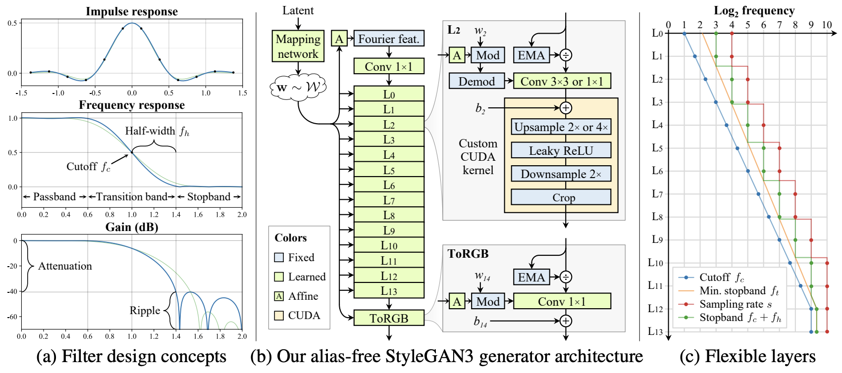
StyleGAN 3: Alias-reduced, Rotation-invariant
Respect Nyquist: upsample before nonlinearities like ReLU, upscaling.
Do not increase resolution every layer, but less aggressively.

Slide 21
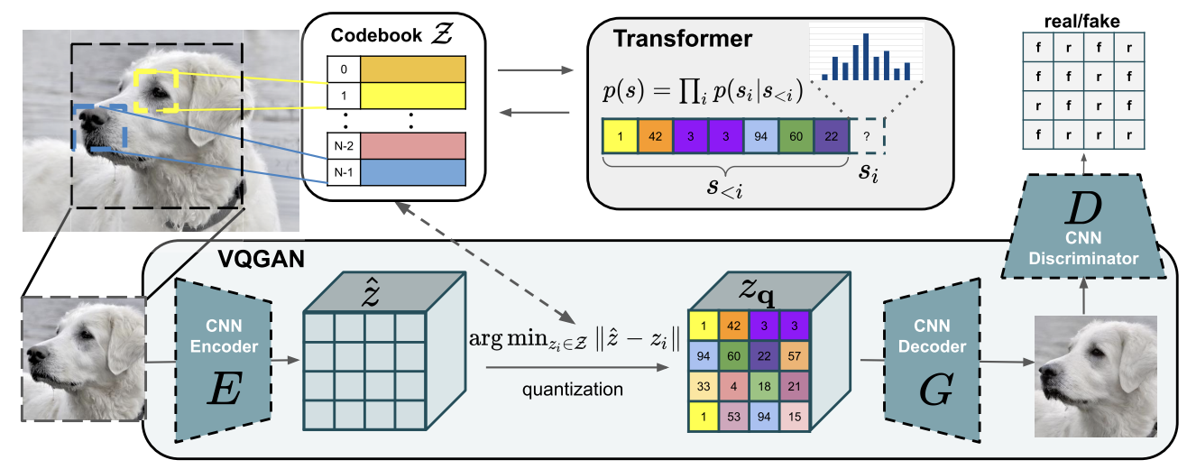
VQGAN: handle complicated compositions
GANs are excellent at local photorealism, not complex scenes.
Transformers excel at complex compositions, not signal processing.
Idea: combine transformers globally, GAN locally.
pixels from patch-conditional GAN
layout from autoregressive transformer
codebook from quantized variational
autoencoder
[Esser 2021 “Taming Transformers” https://arxiv.org/pdf/2012.09841.pdf ]

Slide 22
Variational Autoencoders

Slide 23
Our main question:
How directly measure modeled probability?
... rather than a distance?

Slide 24
The VAE idea vs the GAN idea
x
z
G
x*
D
y
x
E
z
G
x*
GAN
VAE

Slide 25
Generative Modeling vs Representation Learning
Embedding
Representation learning:
mapping data to abstract representations
(analysis)
Representation learning
Generative modeling
Generative modeling:
mapping abstract representations to data (synthesis)
z
Data
[Slides for this lecture from Phillip Isola]

Slide 26

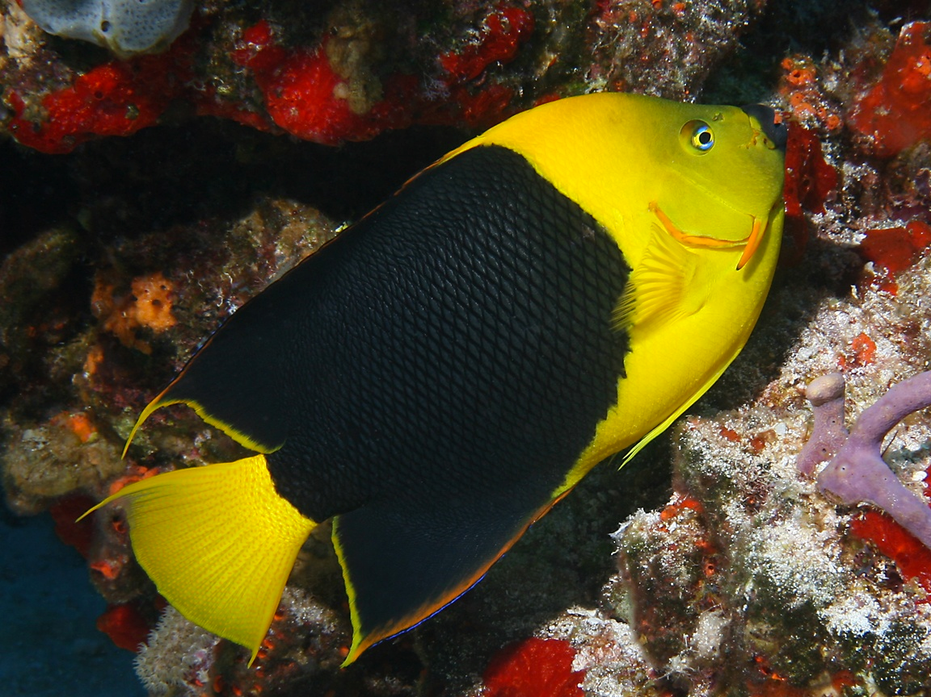
Representation Learning
“Coral”
“Fish”
Image
Compact mental representation
Notes:
it’s a really parsimonious mental representation.

Slide 27
Unsupervised Representation Learning
compressed image code (vector z)
Image
Notes:
it’s a really parsimonious mental representation.

Slide 28

Unsupervised Representation Learning
compressed image code (vector z)
Image
Reconstructed
image
“Autoencoder”

Slide 29

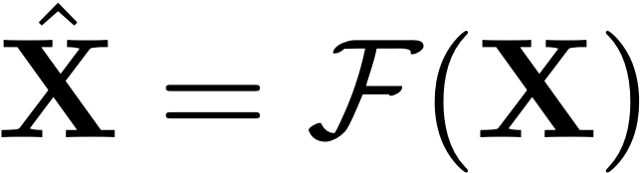
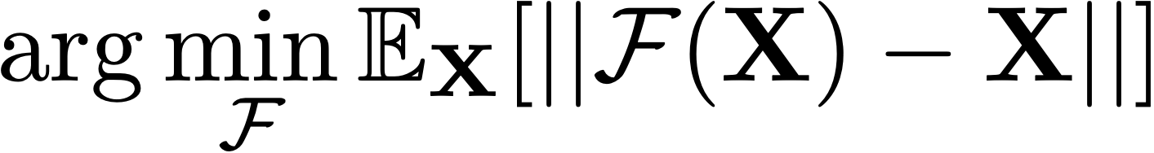
Autoencoders
Image
Reconstructed
image
Reconstruction Loss:
Notes:
Well these is a very popular method for representation learning without labels.
Problem: Requires a bottleneck. Learns low-level compression.
f^* = \argmin_{f \in \mathcal{F}} \sum_{i=1}^N \mathcal{L}(f(x_i), y_i)

Slide 30
Image
Reconstructed
image
“Fish”
“Coral”
Notes:
Well these is a very popular method for representation learning without labels.
Problem: Requires a bottleneck. Learns low-level compression.

Slide 31

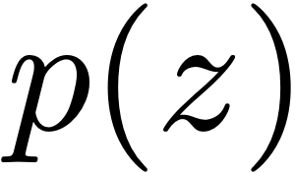
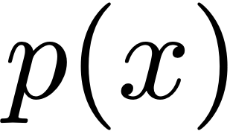
Deep Generative Models are Distribution Transformers
Target distribution
Prior distribution

Slide 32



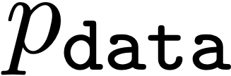
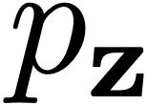

Representation learning
Data space
Representation space
Encoder
Generative modeling
Representation space
Data space
Generator
Notes:
p(\mathbf{z}) = \int_{\mathbf{x}} p(\mathbf{z|x})p_{\texttt{data}}(\mathbf{x})d\mathbf{x}

Slide 33



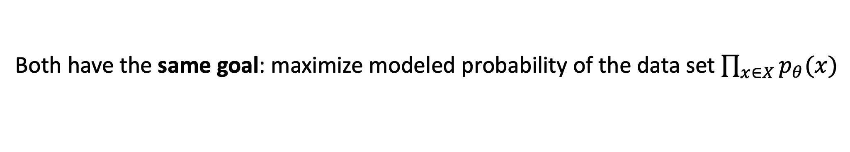

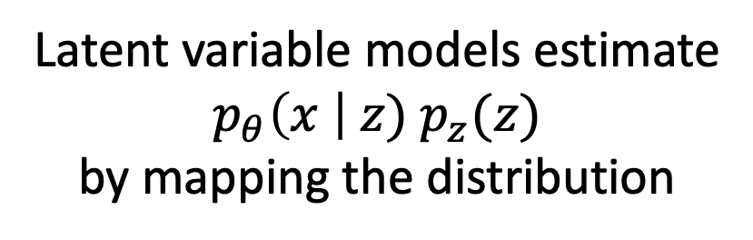

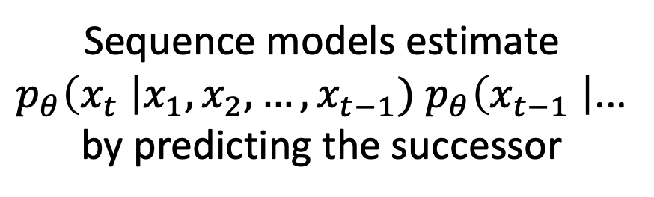

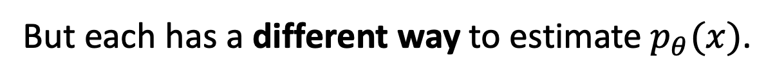

Compared to Language Models
Both have the same goal: maximize modeled probability of the data set $\prod_{x∈X}{p_{θ}(x)}$
Both have the same stochastic estimator: minimize $𝔼_{x\sim X}\left[−\log{p_{θ}(x)}\right]$
But each has a different way to estimate $p_{θ}(x)$.
Sequence models estimate
$p_{θ}\left(x_{t} \right|x_{1},x_{2},…,x_{t−1}) p_{θ}\left(x_{t−1} \right|$...
by predicting the successor
Latent variable models estimate
$$p_{θ}\left(x \right| z) p_{z}(z)$$
by mapping the distribution
avoid
Language model
$$x_{t}$$
Great
care
must
be
taken
to
$$x_{1}$$
$$x_{2}$$
$$x_{3}$$
$$…$$
$$x_{t−2}$$
$$x_{t−1}$$
Generator

Slide 34
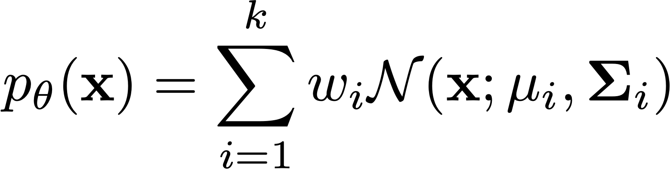


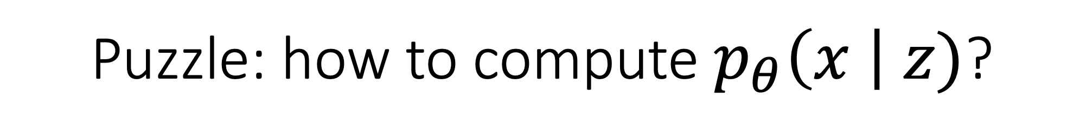
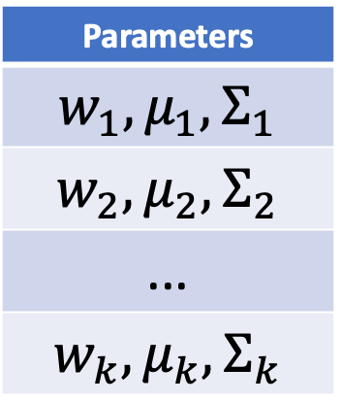
Puzzle: how to compute $p_{θ}\left(x \right| z)$?
Mixture of Gaussians solves this with two tools:
A table of choices that covers the space of outputs.
Each row of the table is a Gaussian, not just a point.
Parameters
$$w_{1}, μ_{1},Σ_{1}$$
$$w_{2}, μ_{2},Σ_{2}$$
...
$$w_{k}, μ_{k},Σ_{k}$$
Model distribution
Target distribution

Slide 35
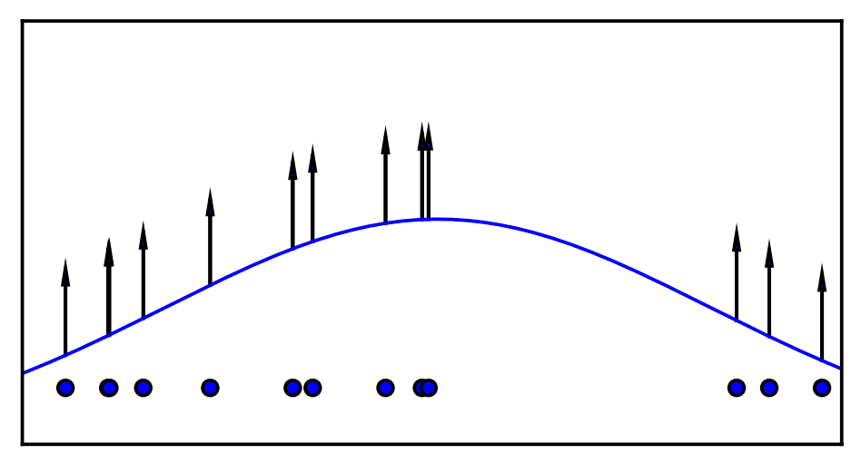
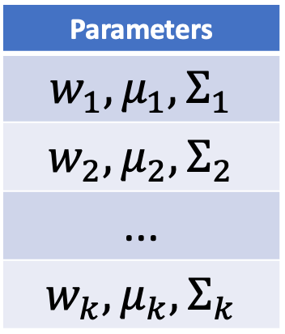
Learning a Mixture of Gaussians
Compute and maximize
modeled probability of real data
Parameters
$$w_{1}, μ_{1},Σ_{1}$$
$$w_{2}, μ_{2},Σ_{2}$$
...
$$w_{k}, μ_{k},Σ_{k}$$
Model distribution
Target distribution
Notes:
x = f_{\theta}(z) + \epsilon

Slide 36
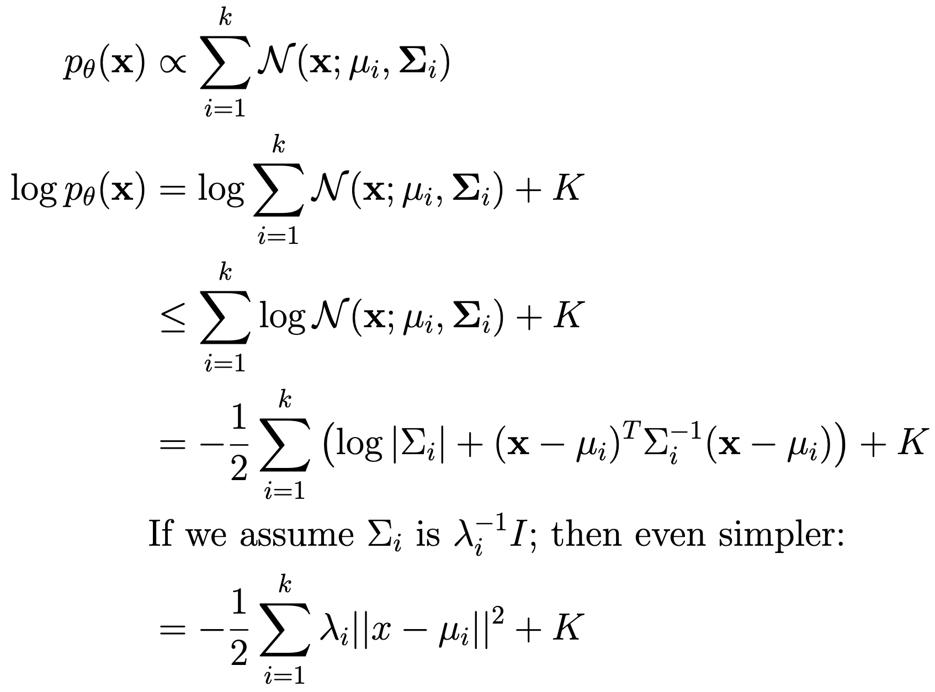
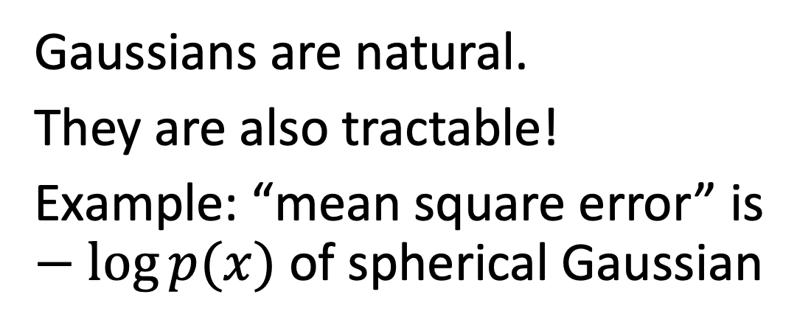
Why Gaussians?
Gaussians are natural.
They are also tractable!
Example: “mean square error” is $−\log{p(x)}$of spherical Gaussian

Slide 37




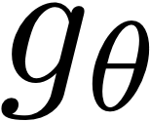
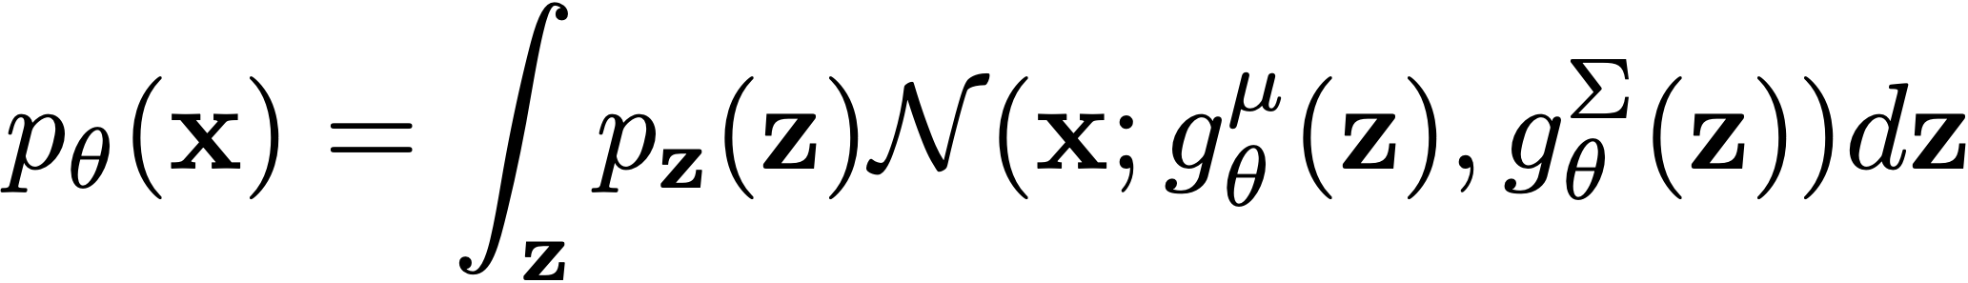
An Infinite Mixture of Gaussians
Parameters:
Model distribution
Target distribution
Notes:
p_{\theta}(\mathbf{x}) = \sum_{i=1}^k w_i \mathcal{N}(\mathbf{x}; \mathbf{\mu}_i, \mathbf{\Sigma}_i)
p_{\theta}(\mathbf{x}) = \int_{\mathbf{z}} p_{\mathbf{z}}(\mathbf{z}) \mathcal{N}(\mathbf{x}; g^{\mu}_{\theta}(\mathbf{z}), g^{\Sigma}_{\theta}(\mathbf{z}))d\mathbf{z}
g^{\mu}_{\theta}(\mathbf{z}_1)
g_{\theta}^{\Sigma}(\mathbf{z}_1)

Slide 38

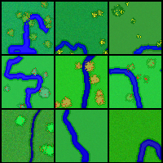




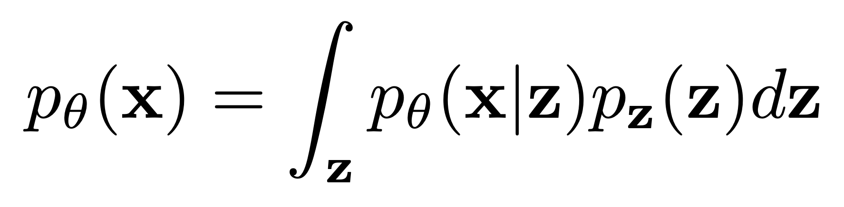


Latent Variable Models
latent variables
c
(River turns)
(Grass color)
(Number trees)
latent variables

Slide 39
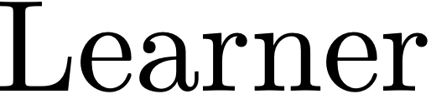
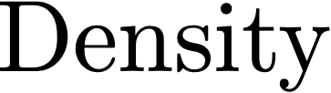

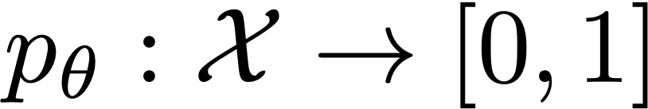

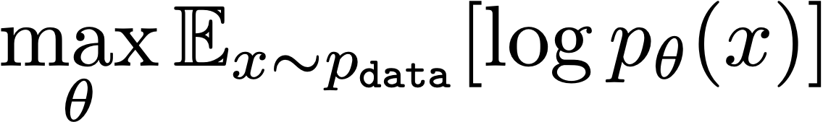






Infinite GMM / VAE
Notes:
Model = [Objective, Hypothesis space]

Slide 40



How to Learn Parameters for a VAE
unroll the loops!
integrate over all z
iterate over all data

Slide 41

How to Learn Parameters for a VAE
Trick #1: Estimate the integral via sampling (Monte Carlo)
integrate over all z
same as: mean over distribution of z
a large sample
will converge to mean

Slide 42


Fitting an infinite mixture of Gaussians via Monte Carlo

Slide 43






Problem: most $p_{θ}\left(x^{(i)} \right|z^{(j)})$ are wasted, near zero
Random sampling
7 samples
Trick #2: Importance sampling

Slide 44



Trick #2: Importance Sampling – use a smarter $q(z)$
Importance sampling
1 sample

Slide 45
Trick #2: Importance Sampling – use a smarter $q(z)$
Random sampling
Importance sampling
7 samples
1 sample

Slide 46
Trick #3: $q(z)$ should predict the optimal distribution

Slide 47

Trick #3: $q(z)$ should predict the optimal distribution
Encoder

Slide 48



Trick #3: $q(z)$ should predict the optimal distribution
Encoder

Slide 49

Trick #3: $q(z)$ should predict the optimal distribution
Encoder

Slide 50
Trick #3: $q(z)$ should predict the optimal distribution
Encoder

Slide 51
Trick #3: $q(z)$ should predict the optimal distribution

Slide 52

Standard formulation, passing to logs
Evidence Lower Bound
“ELBO”
a simple regularizer!

Slide 53



Trick #4: Gaussian KL divergence
If q and p are Gaussians, the KL divergence can be directly computed.
$$σ$$

Slide 54



Autoencoder!
Notes:
\argmin_{G,E} \norm{G(E(x) + \epsilon) - x}^2_2 + ||E(x)+\epsilon||^2_2

Slide 55


Slide 56





Slide 57






CNNs as a Perceptual Metric
Normalize, Subtract
L₂ norm,
Spatial average
Avg
$$F$$
$$F$$
$$d_{0}$$
$$G(x)$$
$$y$$
Perceptual Loss
weight
(i)-th layer
The number of elements in the (i)-th layer
Slide credit: Richard Zhang

Slide 58
How Different are these Patches?
D (
)
,
Zhang, Isola, Efros, Shechtman, Wang.
The Unreasonable Effectiveness of Deep Features as a Perceptual Metric. In CVPR, 2018.
Slide credit: Richard Zhang
Notes:
Method 1: directly ask humans whether two patches are the same or not.

Slide 59
Which patch is more similar to the middle?
< Type 1 >
Humans
< Type 2 >
L2/PSNR
SSIM/FSIMc
Deep Networks?
Slide credit: Richard Zhang

Slide 60
% agreement with
human judges
82.6
Networks perform strongly across supervisory signals and architectures
Human
Bigger/Deeper ≠ Better
Low-level
AlexNet (Random)
78.0
AlexNet (Unsupervised)
Fitting some data
is important
AlexNet (Self-supervised)
76.8
Nets (Supervised - Imagenet classification)
75.7
74.8
70.6
69.7
70.0
68.9
L2
SSIM
FSIMc
Random
AlexNet
VGG
Human
K-Means
Squeeze
VGG (“perceptual loss”)
correlates well
Slide credit: Richard Zhang

Slide 61



goal: match the text t
“A photo of a yellow bird flying in the sky”
C_{t}
z
generator
G
C_{i}
e_{i}
e_{t}
x
semantic loss
optimize z
L_{sem}(x, t)
[Bau, Paint by Word (arXiv) 2021]
Notes:
SUPPOSE I want to EDIT the BIRD to make it look DIFFERENT.
For EXAMPLE, I would like to TRANSFORM this image of a
little BLUE bird to a PHOTO of a YELLOW bird FLYING in the SKY.
Here is how to DO it WITHOUT crackinig open any BLACK boxes.
I START with a STYLEGAN trained to generate BIRDS. Here GENERATES the little BLUE one.
THEN we take a SECOND network to GUIDE the Generator. HERE I use the OpenAI CLIP network
which SCORES the SIMILARITY between any TEXT and any IMAGE.
THIS image doess NOT fit the DESCRIPTION very WELL.
But we can USE the SCORE as an OPTIMIZATION TARGET
And SEARCH for CHANGES in Z that IMPROVE the MATCH.
Using GRADIENT DESCENT we can make the IMAGE look a bit MORE like the TEXT.
Now, you can see, the IMAGE does not look that GREAT yet.

Slide 62



“A photo of a yellow bird flying through the air”
Adam
CMA-ES
Notes:
When using GRADIENT DESCENT to OPTIMIIZE a SINGLE data point,
we can EASILY make ADVERSARIAL EXAMPLES.
that achieves a good SCORE in a MODEL
without ACTUALLY looking like the CONCEPT that is being MODELED.
THAT is what we’re seeing here. THIS image gets a good SCORE.
But it does NOT look like a BIRD.
These WEAK POINTs how up because the MODELS are TRAINED for
AVERAGE behavior over DISTRIBUTIONs NOT worse-case POINTS.
We can FIX the problem by OPTIMIZING a DISTRIBUTION instead of a SINGLE ponit
So I use a method call CMA, that is Covariance Matrix Adaptation that can AVOID the ADVERSARIAL problem.
Even though SAMPLES do NOT score as WELL. they are much BETTER-LOOKING birds,
We do NOT even need to understand HOW the models work to DO this.
We can JUST treat them like BLACK boxes.
How WELL does it WORK?

Slide 63





















this bird is a deep yellow almost orange color from the crown to the nape of the neck as well as its breast and belly leaving only its wings and tail black with the addition of white wingbars
a tiny bird with a tiny head and bill brown coverts white secondaries a black back grey outer retices and a white breast
small biege colored bird with brown and white stripes on his wings and tail beak is orange and pointy black eyes
a bird with a gray body gray wings with yellow coverts yellow crown black cheek patch and throat
a white bird with black spots all over its wings and flanks and red brow and malar stripe
this little bird has a white belly and breast with a brown superciliary and brown striped crown
this is a speckle black white and yellow bird with a yellow patch on its head
DALL-E
Gradient (Adam)
Ours (CMA+Adam)
Notes:
Here are some SAMPLES.
Our CMA method at the BOTTOM.
We TUNED a GRAIDENT method in the MIIDDLE.
And at the TOP is the PREVIOUS state-of-the-ART, the DALL-E method.
And it LOOKS like it WORKS pretty WELL

Slide 64






+ “A photo of a green bed”
Problem: Did not ask for green walls!
The Generator is
Opinionated:
Walls Must
Match Sheets
optimize C(G(z), t)
+add image loss to
penalize outside changes
+mask the image
before CLIP sees it
Notes:
For EXAMPLE, here is a VERY simple MOTIVATING example
that we could NOT solve. - It is actually the THEME of our PAPER.
We WANT to take a PHOTO of a ROOM
and LET a person say HOW they want to CHANGE it.
Like they want to MAKE the bed GREEN.
<>If you USE our method, you GET a RESULT like THIS.
<>NOTICE. The WALLs turned green TOO. We did NOT ask for this.
<>So we EXPERIMENTED with letting the USER paint an AREA, and wee CHANGED the OBJECTIVE to PENALIZE changes OUTSSIDE the area.
<>EVEN when we did this, the results looked like THIS. GREEN walls.
<>Maybe the SIMILARITY network is the problem.
So we ALSO hide the OUTSIDE area from the SIMILARITY network like THIS.
<>But this ALSO does not FIX the problem. GREEN walls.
<>What is HAPPENING is that we CANNOT solve the problem by TREATING our GENERATOR as a BLACK box.
It is VERY opinionted. It thiinks the color of the WALLS must match SHEETS.

Slide 65





Cracking Open the Generator
mask m
text t
“A photo of a green bed”
C_{t}
generator
G
z₀
f
w₀
z
h
C_{i}
e_{i}
e_{t}
+ w ⊙ m
x
semantic loss
optimize w
L_{sem}(x, t)
Notes:
So in OUR paper, we did something VERY simple to FIX this problem.
Whiich iss, we SPLIT the STYLE moduleation of the network SPATIALLY.
In other words, we ALLOWED a DIFFERENT style to be applied INSIDIE the mask
as OUTSIDE.
ALTEREING the INTERNALS of the nerual network was ESSENTAL for giving us the CONTROL we wanted, and for LETTINIG the network do something NEW.

Slide 66


+ “A photo of a green bed” + mask
Original Image
Without Changing G
Altering structure of G
[Bau, Paint by Word (arXiv) 2021]
Notes:
So WITHOUT changing the INTERNAL structure of the GENERATOR network,
The BEST we could DO looks like THIS, with GREEN walls.
But AFTER changing the structure of the network.
we are NOW able to change JUST the bedsheets WITHOUT repainting the WHOLE room.

Slide 67
Using a GAN Generator
Randomly generated image
Random vector
512 dimensions
StyleGAN v2 [Karras, et al. CVPR 2020]
Notes:
THIS bring us back to the image GENERATION problem.
INSTEAD of training a NETWORK to LOOK at an IMAGE and ANSWER what is IN it,
(click)(click)
A GENERATOR is trained to draw ALL the THINGS in an IMAGE.
And yet the network is trained to DO this task WITHOUT revealing any LABELS.

Slide 68

Are there Neurons for Objects?
Tower?
Randomly generated image
Random vector
512 dimensions
Tree?
Door?
Progressive GAN [Karras, et al 2018]
GAN Dissection [Bau et al., ICLR 2019]
Notes:
So when a GENERATOR renders a picture like this,
It is VERY natural to ASK,
ARE there NEURONs that CONTROL the objects?
There are LOTS of OBJECTS in the SCENE.
HOW does the network DRAW it?
Does it have NEURONS that control TREEs,
or TOWERs, or DOORs?

Slide 69

Are there Neurons for Objects?
Randomly generated image
Random vector
512 dimensions
GAN Dissection [Bau et al., ICLR 2019]
Notes:
We can TEST this by looking at ONE neuron at a time,
We LOOK at what it does when the network generates ONE image.
<>
THIS neuron activates in the LOWER LEFT,
When generating THIS image...
Sort of where the TREE is.

Slide 70
Dissecting a GAN
Generate lots of images
Semantic segmentation
Random vectors
Segmenter
Agreement
Upsample
GAN Dissection [Bau et al., ICLR 2019]
Notes:
To ANALYZE this SYSTEMATICALLY, I USE a procedure I call DISSECTION.
FIRST, generate LOTS of images.
… then, use a computer vision model to SEGMENT the image into OBJECTS.
… Then SCORE the NEURONS to see WHICH ones MATCH objects WELL.
… (two clicks) ...
... We MEASURE agreement over a LARGE sample of IMAGES
and test EVERY neuron in the NETWORK.
WHAT do we FIND?

Slide 71


Layer 4, Neuron 119: tree
Layer 4, Neuron 43 : dome
Notes:
And we find LOTS of neurons that MATCH objects.
….We do find neurons for TREEs
… And we also find neurons for BUILDING parts
… such as DOMEs
and DOORs and GRASS

Slide 72


Semantics Emerge in
Middle Layers of a Generator
random vector
output image
Layer 5 Summary
object
part
material
color
unit 498 “oven” (object)
unit 244 “chair top” (part)
unit 58 “red” (color)
Role of Individual Units [Bau et al., PNAS 2020]
Notes:
When we TRAIN a network to generate KITCHEN images,
we get a LOT of neurons that correspond to THINGS in a KITCHEN
like OVENs, parts of CHAIRS, and some COLORs or MATERIALS, like RED.
<>
THIS plot SUMMARIZES the different VISUAL concepts that appear in a LAYER.
EACH bar is ONE concept, and the
HEIGHT of the bar is the NUMBER of neurons that MATCH the concept.
in BLUE are OBJECTS, GREEN are PARTS, and ORANGE are COLORs.
<>
We can map ALL the layers of the NETWORK like THIS.
as you can SEE, many OBJECT and PART neurons
EMERGE in the MIDDLE layers of the GENERATOR.

Slide 73
Turning off tree neurons
Occluded buildings are now visible
Notes:
Now that we have UNDERSTOOD the organization of NEURONS
in the LAYERS of a GENERATOR, we can try to USE this KNOWLEDGE
to CONTROL what the network DOES.
What happens to the scene, if we TURN OFF the TREE neurons?
.... HERE you can SEE what HAPPENS.
... There are SEVERAL tree NEURONS.
.. The MORE I TURN off, The fewer TREES there are.
Now HERE, I want you to NOTICE the OCCLUSION effect.
The network KNOWS how to draw
the BUILDING parts that were OBSCURED by the tree.
This suggests that when we train a Generator to paint
realistic SCENES, it is not JUST learning about the VISIBLE
pixels, it ALSO seems to learn about HIDDEN things
in the world, like WHAT might have been OCCLUDED
by the TREES.

Slide 74

Turning on door neurons
Notes:
You can ALSO do the OPPOSITIE,
we can turn ON neurons that used to be OFF.
… Here I ACTIVATE twenty DOOR neurons at the location of the yellow box.

Slide 75

Turning on door neurons
Notes:
…. What do I GET?
We GET is a new DOOR in the wall.
Notice the SIZE and STYLE of the door.

Slide 76
Turning on door neurons
Notes:
If I activate exactly the SAME neurons
... in a DIFFERENT image,
…Look what happens

Slide 77

Turning on door neurons
Notes:
The door I get will look DIFFERENT.
Notice the SMALLER size and DIFFERENT STYLE of the DOOR added here.

Slide 78
Turning on door neurons
Notes:
If I activate exactly the SAME thing in the SKY instead,
what do you think we get?

Slide 79
Turning on door neurons
Notes:
Look carefully. Nothing happens!
The DOOR neurons are sensitive to context.
THINK about what we have SEEN.
The DOOR we get DEPENDS on
WHERE we activate the NEURONS.
If we add a DOOR in a DIFFERENT wall, it looks DIFFERENT.
And if we add a DOOR where a DOOR wouldn’t make SENSE,
It can REFUSE to draw it.

Slide 80
Where can a door go?
1
2
1
2
3
4
Bars show standard deviation over n=10000 images
3
4
Role of Individual Units [Bau et al., PNAS 2020]
Notes:
We quantify the causal effects of altering neurons.
And THIS lets us MAP out the WAYS that Generator is OPINIONATED.
It will NOT let a door go just ANYWHERE.
Activating door neurons will draw a door in the bottom of a building – especially in the location of an existing window..
But it will NOT draw a door in the grass, or in a tree.

Slide 81

Activating neurons interactively
Demo at gandissect.csail.mit.edu
Notes:
This PHENOMENON is INTERESTING to me, because it means
we CAN understand what SOME neurons DO
in a CAUSAL way.
We can USE this knowledge to build NEW types of APPLICATIONS.
For EXAMPLE, it lets us PAINT with NEURONS.
To DEMO this, I made this APP.
It is called GAN PAINT.
Each button on the left SELECTS a SET of neurons
and you can ACTIVATE or DEACTIVE those neurons
in a PART of the IMAGE by PAINTING on the right.
We USE a NETWORK as a PAINTBRUSH.
If you LIKE, this is a DEMO you can TRY on your
PHONE at gandissect.csail.mit.edu.
The THING I want you to NOTICE is how the
DRAWINIG EFFECTS are SENSITIVE to CONTEXT.
For EXAMPLE, the same DOOR neurons will draw
DIIFFERENT-LOOKING doors in DIFFERENT buildings

Slide 82
Key things to know about GANs
Learning to fool an adversary D forces the G distribution to match data. Know why and how both JSD and Wasserstein methods work.
Loss functions make a huge difference when generating images. Know perceptual loss vs L2; and adversary D acts as a perceptual loss.
Know common architectures: unconditional, class-conditional, image translation, and how conditional GANs combine supervised (regression) and unsupervised (adversarial generation) techniques.
GAN latent spaces can be used to interpolate and extrapolate structured data using vector arithmetic and optimization.
GAN computations capture structure; know how neurons of a GAN can be found that control concepts such as objects in a scene.

Slide 83
The Big Picture
GANs are a success story for unsupervised learning.
We don’t tell them what to know: they imitate the data.
But through imitation, GANs can learn rules that govern the data: objects, parts, compositional rules.
These learned rules are what make GANs super useful
– if the generator has learned useful rules.
But learning useful rules is not guaranteed!
Lots of care goes into making a good model.

