Slide 1

CS 7150
Deep Learning

Slide 2
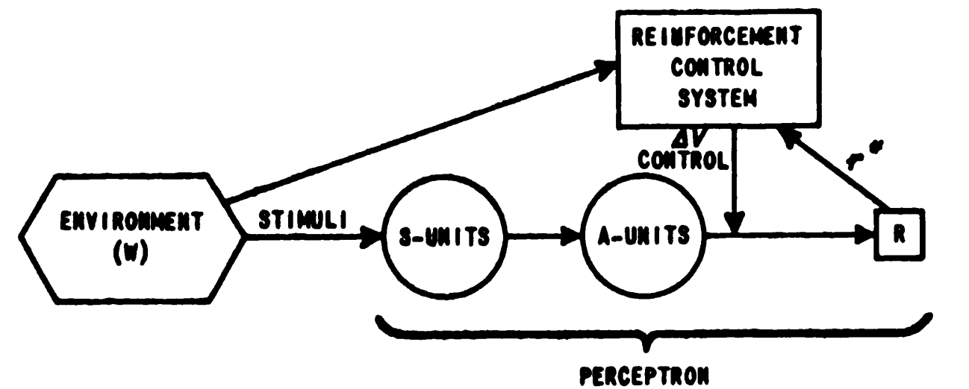
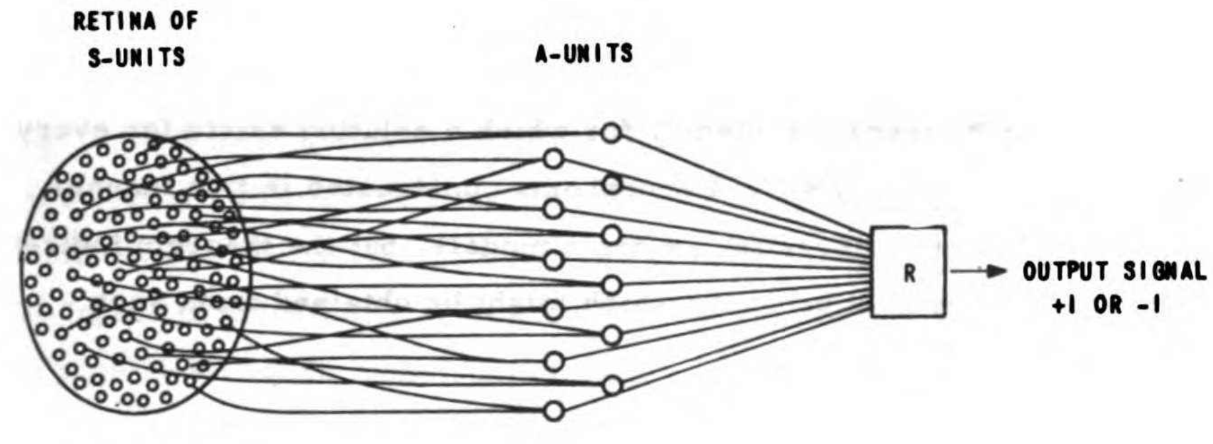
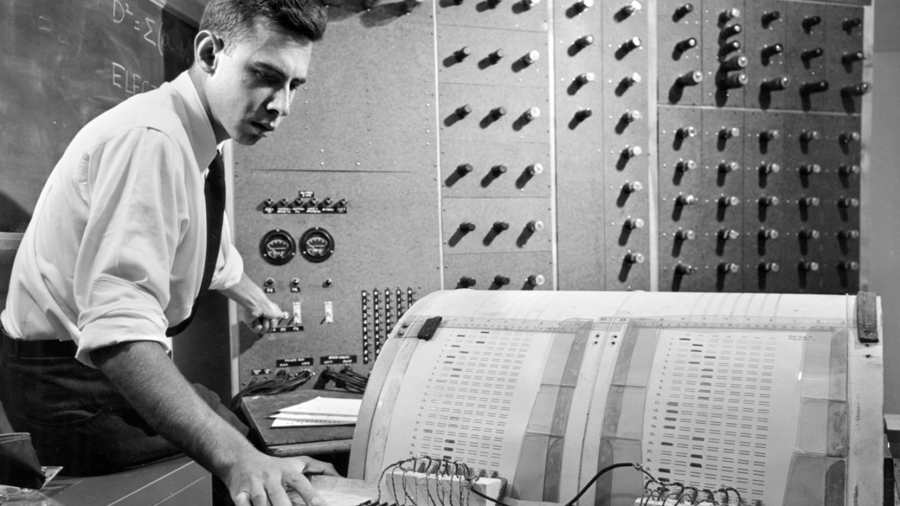
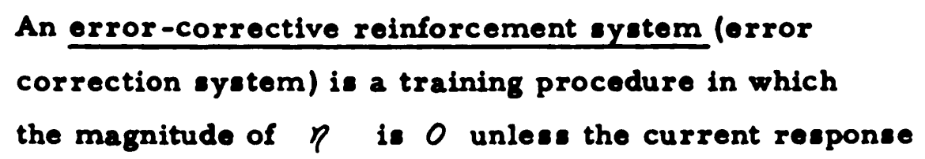
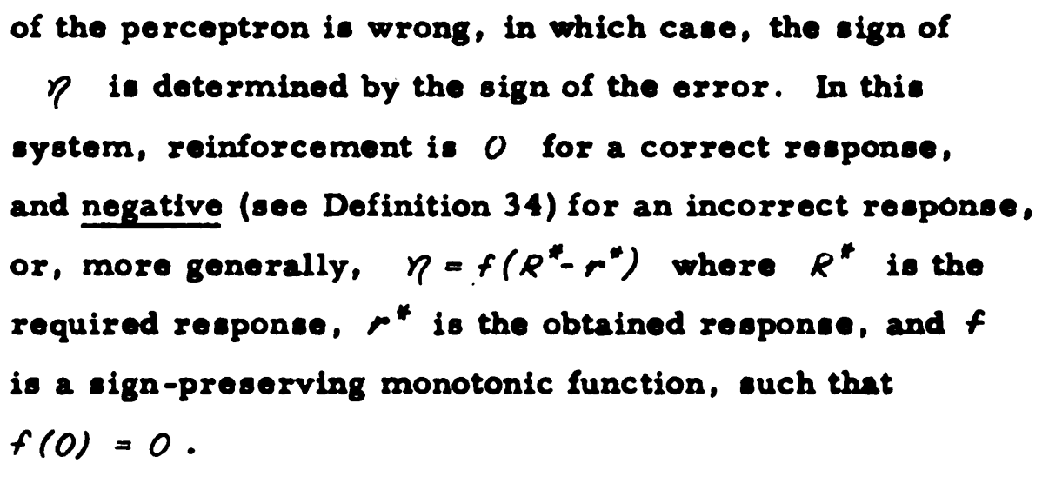
1958:
Frank Rosenblatt trains the Perceptron
[Rosenblatt, Neurodynamics, 1962]

Slide 3


The practical problem with perceptrons
$x$
Learns this last layer
Does not not learn deep layers.
$x→out$
Note: this is called “linear readout” and is used to measure usefulness of x

Slide 4
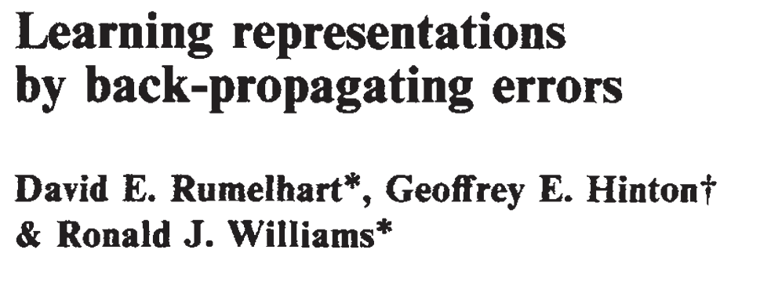
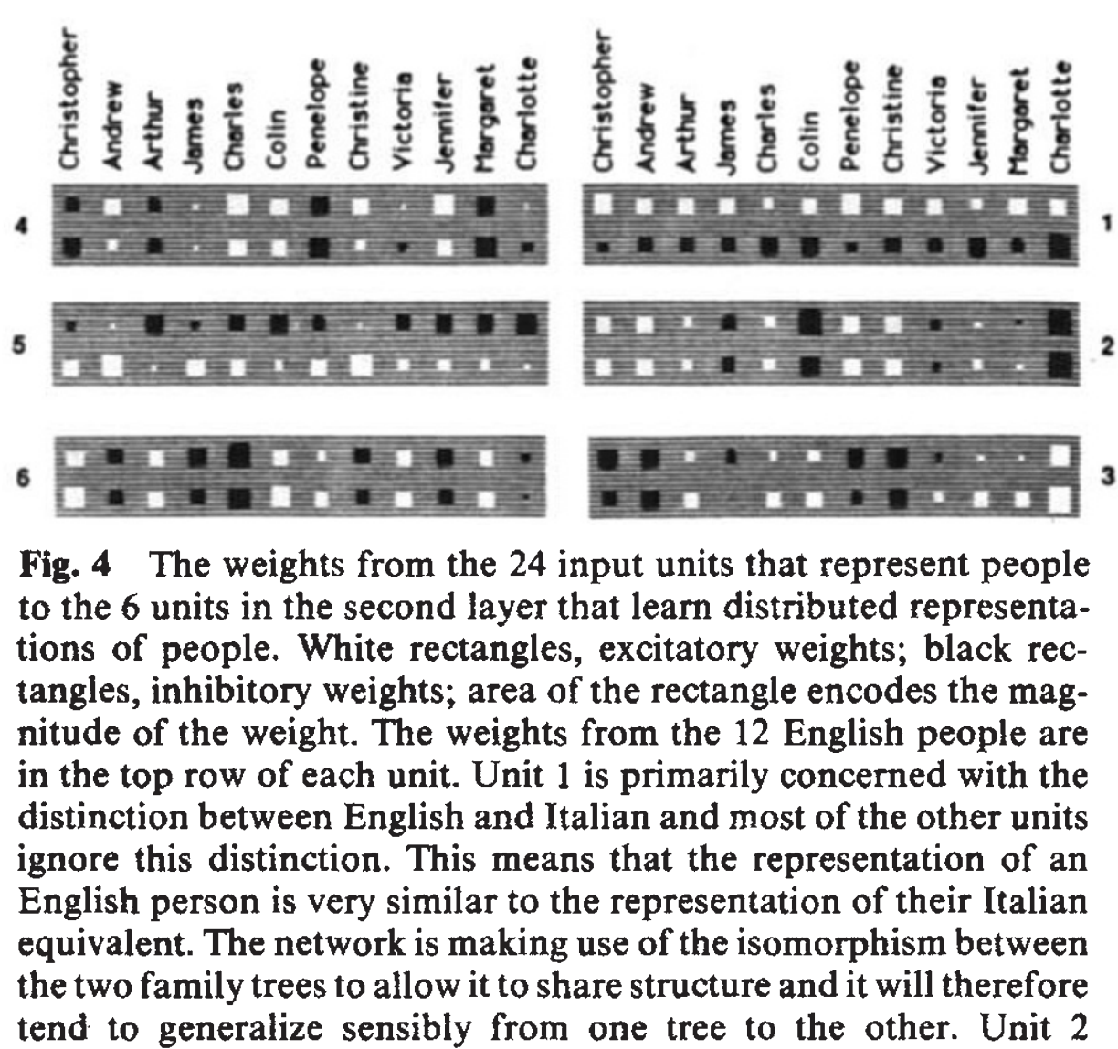
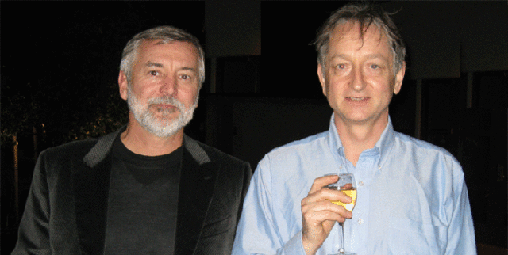
1986:
Rumelhart and Hinton go deeper with backprop
[Rumelhart Hinton Williams, 1986]

Slide 5
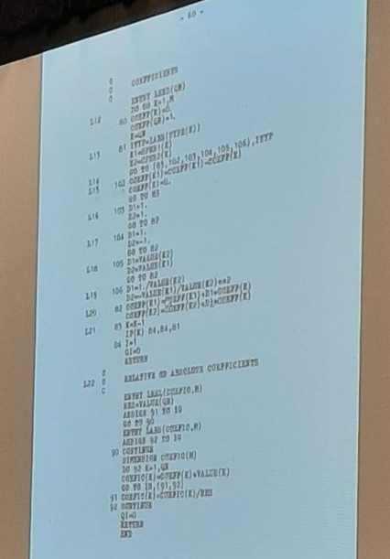
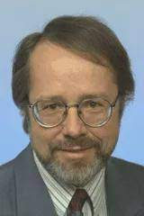
1970:
Seppo Linnainmaa
implements backprop
Historical note:
Backpropagation was not invented by Rumelhart, Hinton, and Williams. Linnainmaa implemented it in 1970 in his Master’s thesis, here →

Slide 6
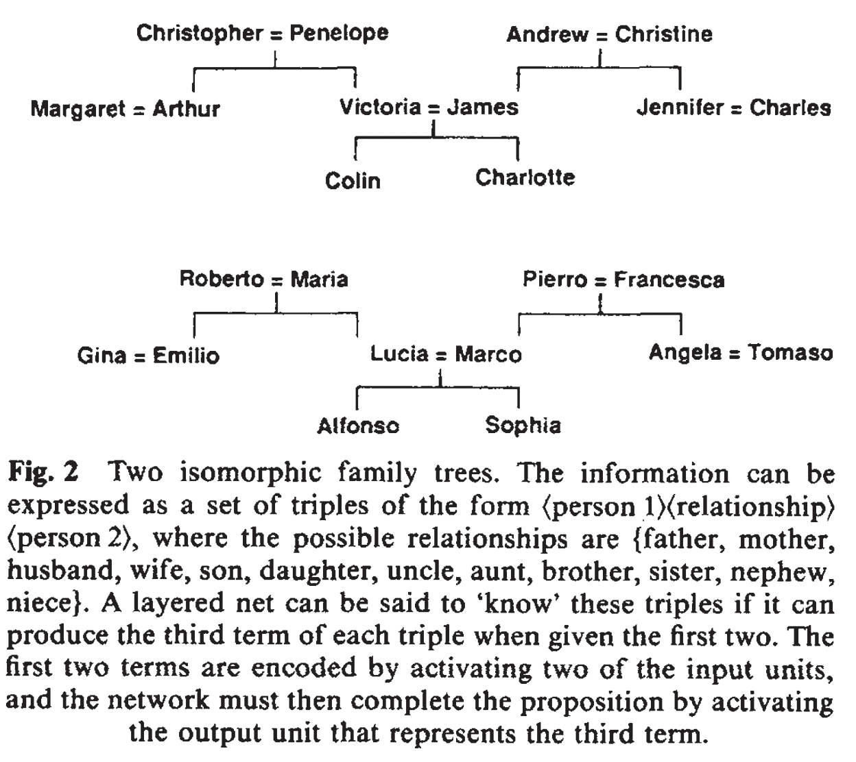
What was so important about Rumelhart 1986
The question: can gradient descent learn to solve hard problems?
Can it discover an idea?

Slide 7
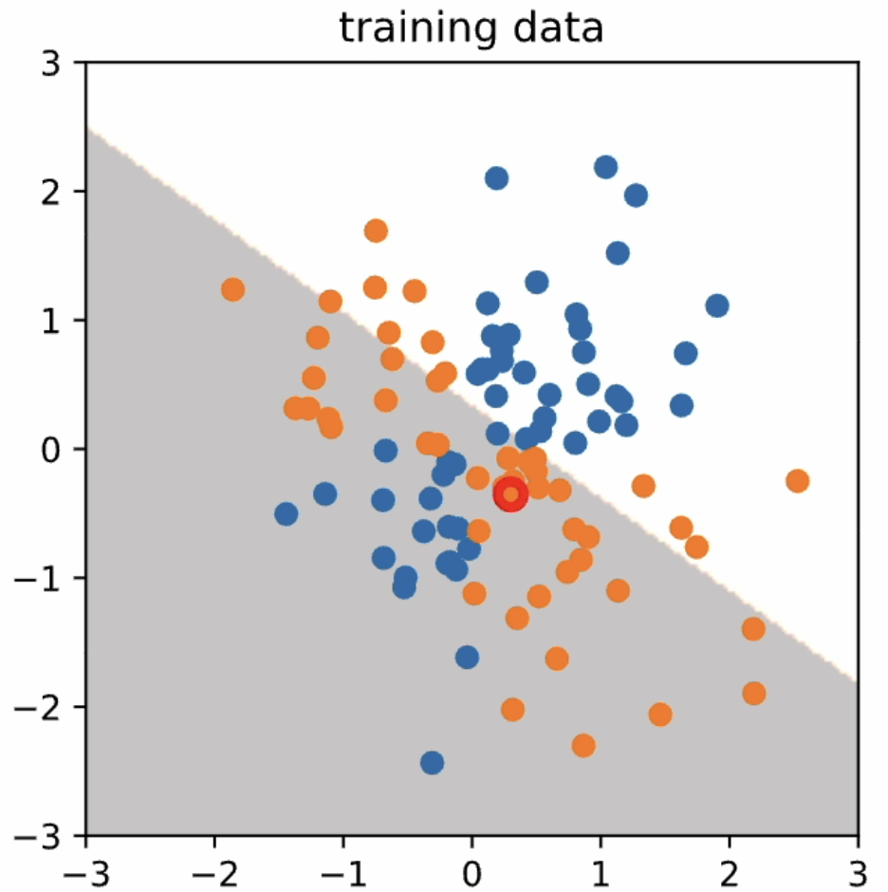
Let’s fix Rosenblatt’s Perceptrons
prediction
data
update rule
label
Remove learning rule
Add more layers
Use derivatives

Slide 8
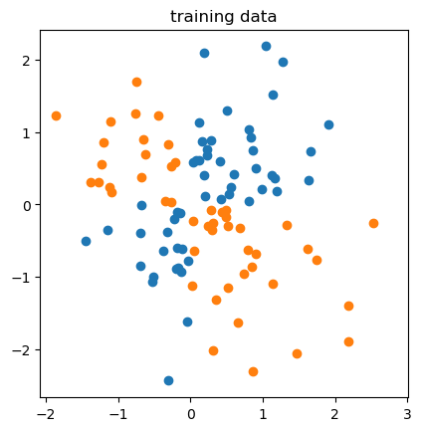
Let’s fix Rosenblatt’s Perceptrons
prediction
Layer 1
Layer 2
Layer 3
Layer 4
Remove learning rule
Add more layers
Use derivatives

Slide 9















Let’s fix Rosenblatt’s Perceptrons
After sum
After step
Four steps of data flow
$$x_{01}$$
$$z_{11}$$
$$x_{11}$$
$$z_{21}$$
$$x_{21}$$
$$z_{31}$$
$$x_{31}$$
$$z_{4}$$
prediction p
$$x_{02}$$
$$z_{12}$$
$$x_{12}$$
$$z_{22}$$
$$x_{22}$$
$$z_{32}$$
$$x_{32}$$
Layer 1
Dimension 2

Slide 10














Let’s fix Rosenblatt’s Perceptrons
$$w_{111}$$
$$w_{211}$$
$$w_{311}$$
$$w_{411}$$
$$w_{121}$$
$$w_{221}$$
$$w_{321}$$
prediction p
$$w_{112}$$
$$w_{212}$$
$$w_{312}$$
$$w_{412}$$
$$w_{122}$$
$$w_{222}$$
$$w_{322}$$
Layer 2
Input 2
Output 2

Slide 11
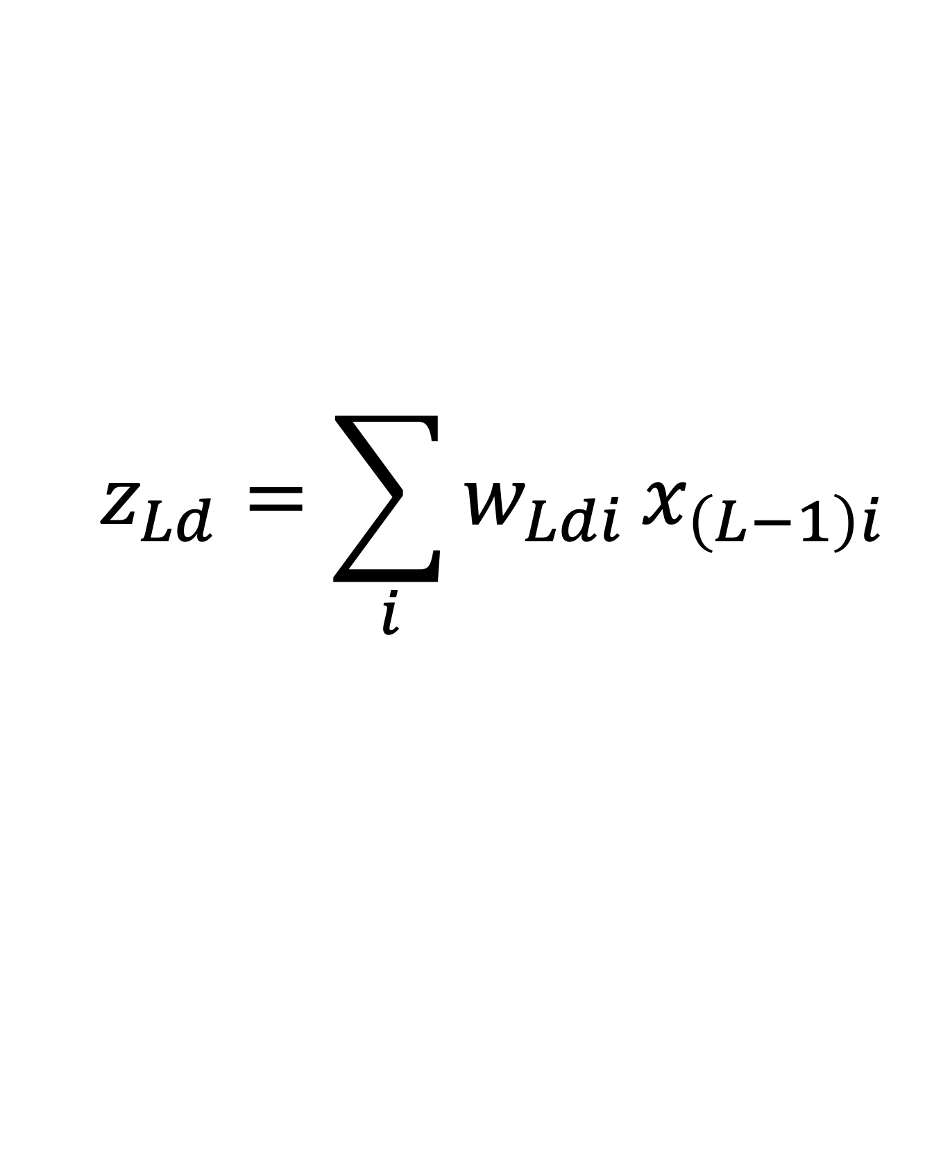
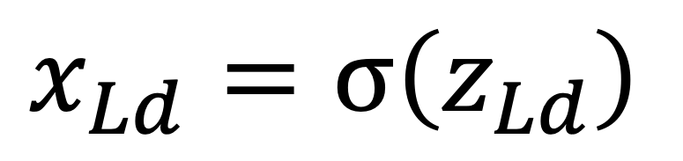
Neuron activation and weight notation
$$z_{Ld}=\sum_{i}{w_{Ldi}}x_{\left(L−1\right)i}$$
Layer L
Output dimension d
Input dimension i
$$x_{Ld}=σ\left(z_{Ld}\right)$$
Differentiable nonlinearity

Slide 12
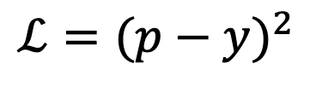
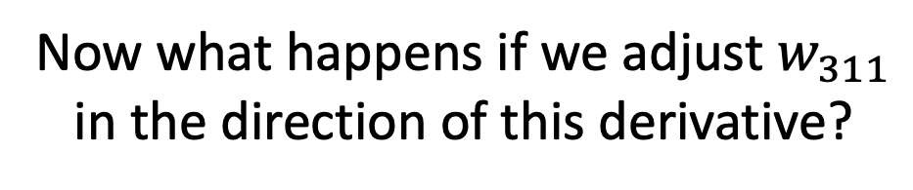
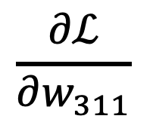
Let’s fix Rosenblatt’s Perceptrons
Now what happens if we adjust $w_{311}$
in the direction of this derivative?
$$\frac{∂ℒ}{∂w_{311}}$$
= 0
prediction p
$$ℒ={(p−y)}^{2}$$
data x
Using derivatives means we need to pick an objective $ℒ$
label y
... and we need to get rid of the flat step nonlinearities

Slide 13
Wait, why do we need any nonlinearity?
Fundamental fact of linear algebra:
Composition of linear functions is always linear
Hornik’s universal approximation theorem
requires a nonlinearity (almost any one will do).

Slide 14
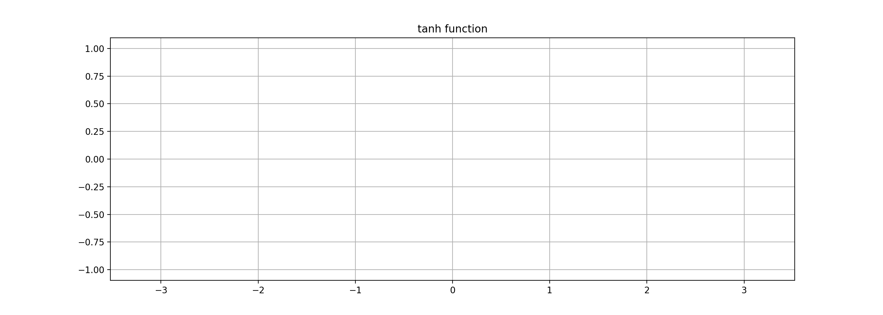
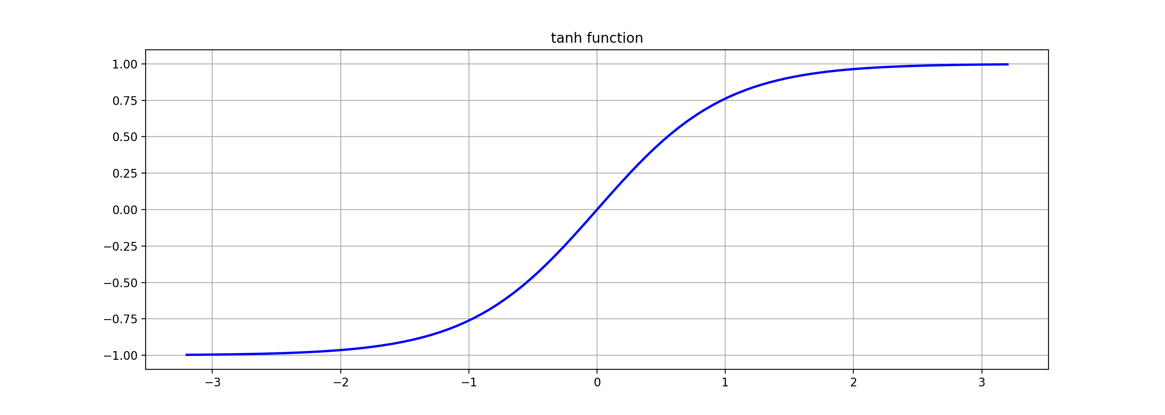
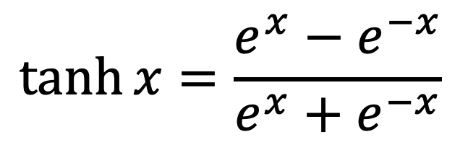
Problem 1: picking a differentiable nonlinearity
$$\tanh{x}=\frac{e^{x}−e^{−x}}{e^{x}+e^{−x}}$$

Slide 15
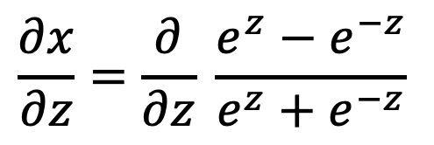

Help me: derivative of $x=\tanh{z}$
$$\frac{∂x}{∂z}=\frac{∂}{∂z} \frac{e^{z}−e^{−z}}{e^{z}+e^{−z}}$$
Your turn.
Use Wolfram Alpha to get this.
I shall try working it out on the board quietly.
When we are done, we will compare.

Slide 16

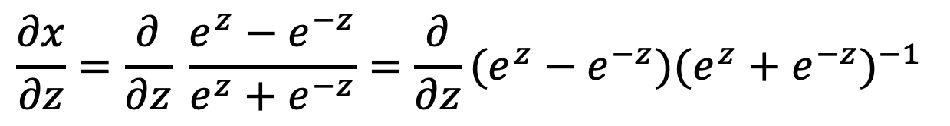
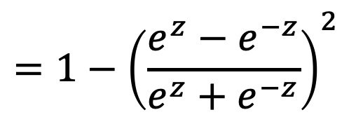



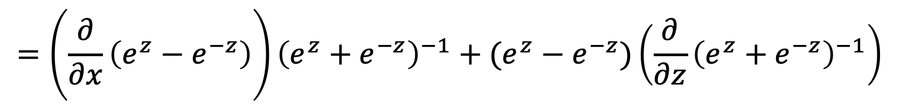
derivative of $x=\tanh{z}$
$$\frac{∂x}{∂z}=\frac{∂}{∂z} \frac{e^{z}−e^{−z}}{e^{z}+e^{−z}}=\frac{∂}{∂z}(e^{z}−e^{−z}){(e^{z}+e^{−z})}^{−1}$$
$$=\left(\frac{∂}{∂x}\left(e^{z}−e^{−z}\right)\right){\left(e^{z}+e^{−z}\right)}^{−1}+(e^{z}−e^{−z})\left(\frac{∂}{∂z}{\left(e^{z}+e^{−z}\right)}^{−1}\right)$$
$$\left(e^{z}+e^{−z}\right)$$
$$−{\left(e^{z}+e^{−z}\right)}^{−2}∙\left(e^{z}−e^{−z}\right)$$
$$=1−{\left(\frac{e^{z}−e^{−z}}{e^{z}+e^{−z}}\right)}^{2}$$
This clean form is why
these sigmoids are used.
(How did it compare to
Wolfram Alpha?)
$$=1−x^{2}$$

Slide 17
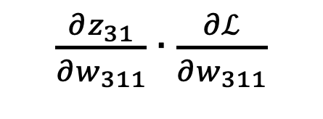
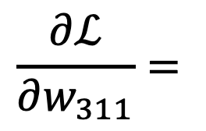

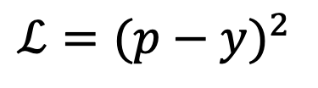
Computing the derivative
$$\frac{∂ℒ}{∂w_{311}}=$$
$\frac{∂z_{31}}{∂w_{311}}∙\frac{∂ℒ}{∂w_{311}}$
$$x_{21}$$
$$z_{31}$$
$$x_{31}$$
$$z_{4}$$
prediction p
$$ℒ={(p−y)}^{2}$$
data x
label y

Slide 18
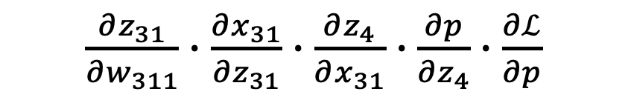
Using the chain rule
$$\frac{∂ℒ}{∂w_{311}}=$$
$\frac{∂z_{31}}{∂w_{311}}∙\frac{∂x_{31}}{∂z_{31}}∙\frac{∂z_{4}}{∂x_{31}}$ $∙\frac{∂p}{∂z_{4}}∙\frac{∂ℒ}{∂p}$
$$x_{21}$$
$$z_{31}$$
$$x_{31}$$
$$z_{4}$$
prediction p
$$ℒ={(p−y)}^{2}$$
data x
label y

Slide 19
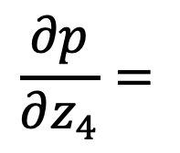

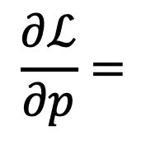

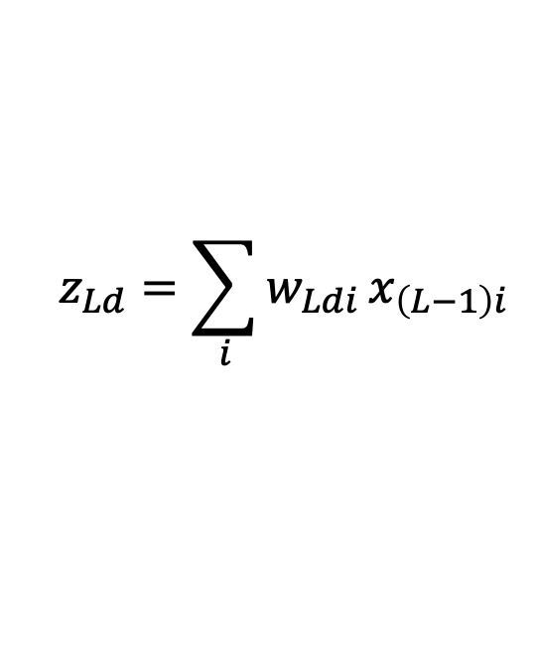
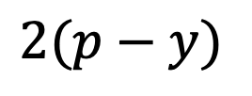
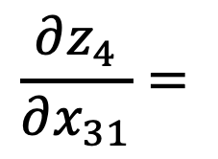
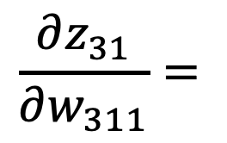


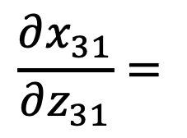
Help me figure out the individual derivatives
$$z_{Ld}=\sum_{i}{w_{Ldi}}x_{\left(L−1\right)i}$$
$$\frac{∂ℒ}{∂w_{311}}=$$
$\frac{∂z_{31}}{∂w_{311}}∙\frac{∂x_{31}}{∂z_{31}}∙\frac{∂z_{4}}{∂x_{31}}$ $∙\frac{∂p}{∂z_{4}}∙\frac{∂ℒ}{∂p}$
$$x_{Ld}=\tanh{z_{Ld}}$$
$$x_{21}$$
$$z_{31}$$
$$x_{31}$$
$$w_{411}$$
$$z_{4}$$
prediction p
$$ℒ={(p−y)}^{2}$$
label y
$$\frac{∂z_{31}}{∂w_{311}}=$$
$$\frac{∂z_{4}}{∂x_{31}}=$$
$$\frac{∂ℒ}{∂p}=$$
$$x_{21}$$
$$w_{411}$$
$$2(p−y)$$
$$\frac{∂x_{31}}{∂z_{31}}=$$
$$\frac{∂p}{∂z_{4}}=$$

Slide 20



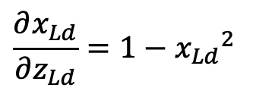
Help me figure out the individual derivatives
$$\frac{∂ℒ}{∂w_{311}}=$$
$\frac{∂z_{31}}{∂w_{311}}∙\frac{∂x_{31}}{∂z_{31}}∙\frac{∂z_{4}}{∂x_{31}}$ $∙\frac{∂p}{∂z_{4}}∙\frac{∂ℒ}{∂p}$
$$x_{Ld}=\tanh{z_{Ld}}$$
$$\frac{∂x_{Ld}}{∂z_{Ld}}=1−{x_{Ld}}^{2}$$
$$x_{21}$$
$$z_{31}$$
$$x_{31}$$
$$w_{411}$$
$$z_{4}$$
prediction p
$$ℒ={(p−y)}^{2}$$
label y
$$\frac{∂z_{31}}{∂w_{311}}=$$
$$\frac{∂z_{4}}{∂x_{31}}=$$
$$\frac{∂ℒ}{∂p}=$$
$$x_{21}$$
$$w_{411}$$
$$2(p−y)$$
$$\frac{∂x_{31}}{∂z_{31}}=$$
$$\frac{∂p}{∂z_{4}}=$$
$$1−{x_{31}}^{2}$$
$$1−p^{2}$$

Slide 21
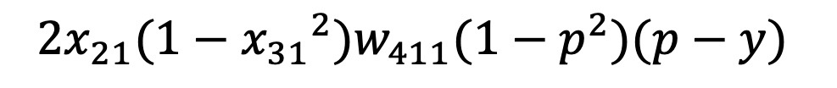
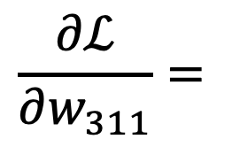
Help me figure out the individual derivatives
$$\frac{∂ℒ}{∂w_{311}}=$$
$${2x}_{21}(1−{x_{31}}^{2})w_{411}(1−p^{2})(p−y)$$
$$x_{21}$$
$$z_{31}$$
$$x_{31}$$
$$w_{411}$$
$$z_{4}$$
prediction p
$$ℒ={(p−y)}^{2}$$
label y
$$\frac{∂z_{31}}{∂w_{311}}=$$
$$\frac{∂z_{4}}{∂x_{31}}=$$
$$\frac{∂ℒ}{∂p}=$$
$$x_{21}$$
$$w_{411}$$
$$2(p−y)$$
$$\frac{∂x_{31}}{∂z_{31}}=$$
$$\frac{∂p}{∂z_{4}}=$$
$$1−{x_{31}}^{2}$$
$$1−p^{2}$$

Slide 22




Going even deeper
prediction p
$$w_{412}$$
$$ℒ={(p−y)}^{2}$$
$$x_{02}$$
$$z_{12}$$
$$x_{12}$$
$$z_{22}$$
$$x_{22}$$
$$z_{32}$$
$$x_{32}$$
$$w_{122}$$
$$w_{222}$$
$$w_{322}$$
label y
$$\frac{∂ℒ}{∂w_{122}}=2x_{02}\left(1−{x_{12}}^{2}\right)w_{222}\left(1−{x_{22}}^{2}\right)w_{322}\left(1−{x_{32}}^{2}\right)w_{412}\left(p−y\right)+ …$$

Slide 23
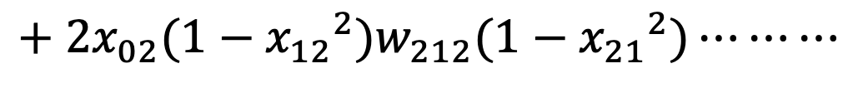




Adding more paths
$$z_{31}$$
$$x_{31}$$
$$w_{411}$$
prediction p
$$w_{312}$$
$$ℒ={(p−y)}^{2}$$
$$x_{02}$$
$$z_{12}$$
$$x_{12}$$
$$z_{22}$$
$$x_{22}$$
$$w_{122}$$
$$w_{222}$$
label y
$$\frac{∂ℒ}{∂w_{122}}=2x_{02}(1−{x_{12}}^{2})w_{222}(1−{x_{22}}^{2})w_{322}(1−{x_{32}}^{2})w_{412}(p−y)$$
$$+ 2x_{02}(1−{x_{12}}^{2})w_{222}(1−{x_{22}}^{2})w_{312}(1−{x_{31}}^{2})w_{411}(p−y)$$
$$+ 2x_{02}(1−{x_{12}}^{2})w_{212}(1−{x_{21}}^{2})⋯⋯⋯$$
one term per path!

Slide 24

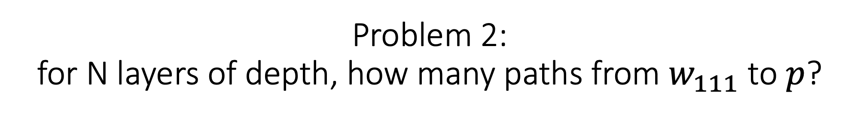
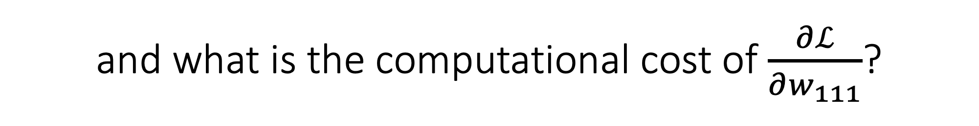
Problem 2: for N layers of depth, how many paths from $w_{111}$ to $p$?
$$w_{111}$$
prediction p
Layer 1
Layer 2
Layer 3
...
Layer N-1
Layer N
and what is the computational cost of $\frac{∂ℒ}{∂w_{111}}$?

Slide 25
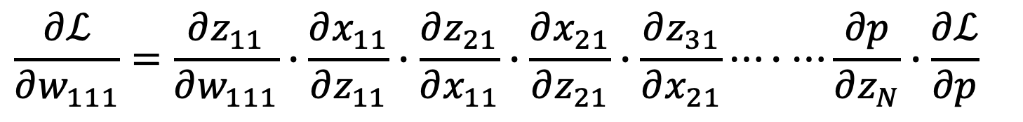

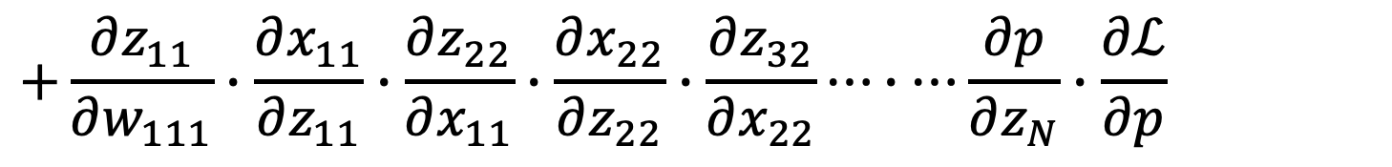
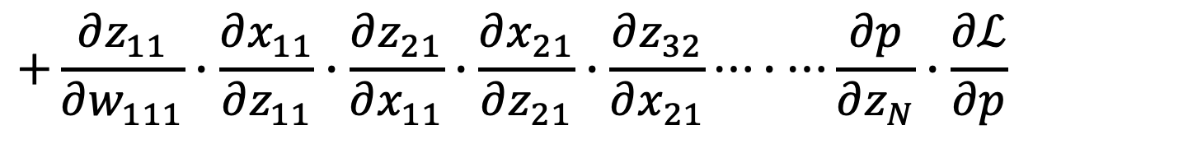
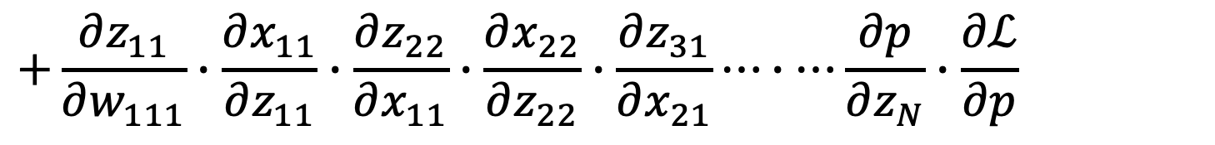
Answer: $2^{N−2}$paths; depth seems expensive
Written formulas for deep derivatives can be messy because of this.
$$\frac{∂ℒ}{∂w_{111}}=\frac{∂z_{11}}{∂w_{111}}∙\frac{∂x_{11}}{∂z_{11}}∙\frac{∂z_{21}}{∂x_{11}}∙\frac{∂x_{21}}{∂z_{21}}∙\frac{∂z_{31}}{∂x_{21}}⋯∙⋯\frac{∂p}{∂z_{N}}∙\frac{∂ℒ}{∂p}$$
$$+\frac{∂z_{11}}{∂w_{111}}∙\frac{∂x_{11}}{∂z_{11}}∙\frac{∂z_{22}}{∂x_{11}}∙\frac{∂x_{22}}{∂z_{22}}∙\frac{∂z_{31}}{∂x_{21}}⋯∙⋯\frac{∂p}{∂z_{N}}∙\frac{∂ℒ}{∂p}$$
$$+\frac{∂z_{11}}{∂w_{111}}∙\frac{∂x_{11}}{∂z_{11}}∙\frac{∂z_{21}}{∂x_{11}}∙\frac{∂x_{21}}{∂z_{21}}∙\frac{∂z_{32}}{∂x_{21}}⋯∙⋯\frac{∂p}{∂z_{N}}∙\frac{∂ℒ}{∂p}$$
$$+\frac{∂z_{11}}{∂w_{111}}∙\frac{∂x_{11}}{∂z_{11}}∙\frac{∂z_{22}}{∂x_{11}}∙\frac{∂x_{22}}{∂z_{22}}∙\frac{∂z_{32}}{∂x_{22}}⋯∙⋯\frac{∂p}{∂z_{N}}∙\frac{∂ℒ}{∂p}$$
$$+⋯∙⋯∙⋯∙⋯$$
But a lot of terms are used repeatedly

Slide 26
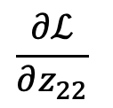

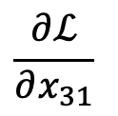
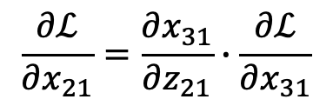
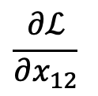














Solution: don’t expand formulas.
Store all the $\frac{∂ℒ}{∂z}$ on the graph and reuse them.
$$\frac{∂ℒ}{∂z_{11}}$$
$$\frac{∂ℒ}{∂x_{11}}$$
$$\frac{∂ℒ}{∂z_{21}}$$
$$\frac{∂ℒ}{∂x_{21}}$$
$$\frac{∂ℒ}{∂z_{31}}$$
$$\frac{∂ℒ}{∂x_{31}}$$
$$\frac{∂ℒ}{∂z_{41}}$$
$$\frac{∂ℒ}{∂p}$$
prediction p
$$ℒ={(p−y)}^{2}$$
$$\frac{∂ℒ}{∂x_{32}}$$
$$\frac{∂ℒ}{∂z_{12}}$$
$$\frac{∂ℒ}{∂x_{12}}$$
$$\frac{∂ℒ}{∂z_{22}}$$
$$\frac{∂ℒ}{∂x_{22}}$$
$$\frac{∂ℒ}{∂z_{32}}$$
label y
$$\frac{∂ℒ}{∂w_{122}}=\frac{∂z_{21}}{∂w_{122}}∙\frac{∂ℒ}{∂z_{21}}$$
$$\frac{∂ℒ}{∂z_{21}}=\frac{∂x_{21}}{∂z_{21}}∙\frac{∂ℒ}{∂x_{21}}$$
$$\frac{∂ℒ}{∂x_{21}}=\frac{∂x_{31}}{∂z_{21}}∙\frac{∂ℒ}{∂x_{31}}$$
✓
one computation
per node or edge!
✓
✓
$$+\frac{∂x_{32}}{∂z_{31}}∙\frac{∂ℒ}{∂x_{32}}$$
✓

Slide 27




1990:
Bottou and Gallinari modular backpropagation
[Bottou Gallinari, 1990]

Slide 28









Backpropagation algorithm
x -2
$$f\left(x,y,z\right)=\left(x+y\right)z$$
q 3
e.g., $x=−2$, $y=5$, $z=4$
+
y 5
f -12
*
$$q=x+y$$
$$\frac{∂q}{∂x}=1$$
$$\frac{∂q}{∂y}=1$$
z -4
$$f=qz$$
$$\frac{∂f}{∂q}=z$$
$$\frac{∂f}{∂z}=q$$
Want:
$\frac{∂f}{∂x}$ , $\frac{∂f}{∂y}$ , $\frac{∂f}{∂z}$
[Slides from Justin Johnson]

Slide 29

Backpropagation algorithm
x -2
$$f\left(x,y,z\right)=\left(x+y\right)z$$
q 3
e.g., $x=−2$, $y=5$, $z=4$
+
y 5
f -12
*
$$q=x+y$$
$$\frac{∂q}{∂x}=1$$
$$\frac{∂q}{∂y}=1$$
1
z -4
$$f=qz$$
$$\frac{∂f}{∂q}=z$$
$$\frac{∂f}{∂z}=q$$
Want:
$\frac{∂f}{∂x}$ , $\frac{∂f}{∂y}$ , $\frac{∂f}{∂z}$
$$\frac{∂f}{∂f}$$
[Slides from Justin Johnson]

Slide 30


Backpropagation algorithm
x -2
$$f\left(x,y,z\right)=\left(x+y\right)z$$
q 3
e.g., $x=−2$, $y=5$, $z=−4$
+
y 5
f -12
*
$$q=x+y$$
$$\frac{∂q}{∂x}=1$$
$$\frac{∂q}{∂y}=1$$
1
z -4
$$f=qz$$
$$\frac{∂f}{∂q}=z$$
$$\frac{∂f}{∂z}=q$$
Want:
$\frac{∂f}{∂x}$ , $\frac{∂f}{∂y}$ , $\frac{∂f}{∂z}$
$$\frac{∂f}{∂z}$$
[Slides from Justin Johnson]

Slide 31

Backpropagation algorithm
x -2
$$f\left(x,y,z\right)=\left(x+y\right)z$$
q 3
e.g., $x=−2$, $y=5$, $z=−4$
+
y 5
f -12
*
$$q=x+y$$
$$\frac{∂q}{∂x}=1$$
$$\frac{∂q}{∂y}=1$$
1
z -4
$$f=qz$$
$$\frac{∂f}{∂q}=z$$
$$\frac{∂f}{∂z}=q$$
3
Want:
$\frac{∂f}{∂x}$ , $\frac{∂f}{∂y}$ , $\frac{∂f}{∂z}$
$$\frac{∂f}{∂q}$$
[Slides from Justin Johnson]

Slide 32


Backpropagation algorithm
x -2
$$f\left(x,y,z\right)=\left(x+y\right)z$$
q 3
e.g., $x=−2$, $y=5$, $z=−4$
+
4
f -12
y 5
*
$$q=x+y$$
$$\frac{∂q}{∂x}=1$$
$$\frac{∂q}{∂y}=1$$
1
z 4
$$f=qz$$
$$\frac{∂f}{∂q}=z$$
$$\frac{∂f}{∂z}=q$$
3
Want:
$\frac{∂f}{∂x}$ , $\frac{∂f}{∂y}$ , $\frac{∂f}{∂z}$
$$\frac{∂f}{∂y}=\frac{∂q}{∂y}∙\frac{∂f}{∂q}$$
$$\frac{∂f}{∂y}$$
Chain rule:
[Slides from Justin Johnson]

Slide 33


Backpropagation algorithm
x -2
$$f\left(x,y,z\right)=\left(x+y\right)z$$
q 3
e.g., $x=−2$, $y=5$, $z=−4$
+
-4
f -12
y 5
*
$$q=x+y$$
$$\frac{∂q}{∂x}=1$$
$$\frac{∂q}{∂y}=1$$
-4
1
z -4
$$f=qz$$
$$\frac{∂f}{∂q}=z$$
$$\frac{∂f}{∂z}=q$$
3
Want:
$\frac{∂f}{∂x}$ , $\frac{∂f}{∂y}$ , $\frac{∂f}{∂z}$
$$\frac{∂f}{∂x}=\frac{∂q}{∂x}∙\frac{∂f}{∂q}$$
$$\frac{∂f}{∂x}$$
Chain rule:
[Slides from Justin Johnson]

Slide 34
Backpropagation algorithm
x -2
$$f\left(x,y,z\right)=\left(x+y\right)z$$
-4
q 3
e.g., $x=−2$, $y=5$, $z=−4$
+
-4
f -12
y 5
*
$$q=x+y$$
$$\frac{∂q}{∂x}=1$$
$$\frac{∂q}{∂y}=1$$
-4
1
z -4
$$f=qz$$
$$\frac{∂f}{∂q}=z$$
$$\frac{∂f}{∂z}=q$$
3
Want:
$\frac{∂f}{∂x}$ , $\frac{∂f}{∂y}$ , $\frac{∂f}{∂z}$
[Slides from Justin Johnson]

Slide 35




Forward pass (activations)
$$x$$
$$f$$
$$z$$
$$y$$

Slide 36

Forward pass (activations)
$$x$$
$$f$$
$$z$$
$$\frac{∂ℒ}{∂z}$$
upstream gradient
(accumulated)
$$y$$
Backward pass (gradients)

Slide 37




Forward pass (activations)
$$x$$
$$f$$
$$\frac{∂z}{∂x}$$
$$\frac{∂ℒ}{∂x}=\frac{∂z}{∂x}\frac{∂ℒ}{∂z}$$
$$z$$
“local” gradients
downstream gradients
$$\frac{∂ℒ}{∂z}$$
upstream gradient
$$\frac{∂z}{∂y}$$
$$y$$
$$\frac{∂ℒ}{∂y}=\frac{∂z}{∂y}\frac{∂ℒ}{∂z}$$
Backward pass (gradients)

Slide 38
Forward pass (activations)
$$x$$
$$f$$
$$\frac{∂z}{∂x}$$
$$\frac{∂ℒ}{∂x}=\frac{∂z}{∂x}\frac{∂ℒ}{∂z}$$
$$z$$
“local” gradients
downstream gradients
$$\frac{∂ℒ}{∂z}$$
upstream gradient
$$\frac{∂z}{∂y}$$
$$y$$
$$\frac{∂ℒ}{∂y}=\frac{∂z}{∂y}\frac{∂ℒ}{∂z}$$
Backward pass (gradients)

Slide 39
Patterns in gradient flow
add gate: gradient copier
mul gate: swap-multiplier
3
2
2
3*5=15
+
7
*
6
2
5
4
3
2
2*5=10
copy gate: gradient adder
max gate: gradient switch
7
4
4
0
7
max
5
copy
4+2=6
9
7
5
2
9
[Slides from Justin Johnson]

Slide 40
Interactive activity
Training a simple MLP on synthetic data
https://bit.ly/cs7150-mlp4

Slide 41
Let’s try using these gradients to learn
prediction p
$$ℒ={(p−y)}^{2}$$
label y
Layer 1
Layer 2
Layer 3
Layer 4
https://bit.ly/cs7150-mlp4

Slide 42
The components of a typical training optimization
https://bit.ly/cs7150-mlp4
Training data
data, labels = non_linearly_separable_data()
mlp = torch.nn.Sequential(OrderedDict([
('layer1', Sequential(Linear(2, 2), Tanh())),
('layer2', Sequential(Linear(2, 2), Tanh())),
('layer3', Sequential(Linear(2, 2), Tanh())),
('layer4', Sequential(Linear(2, 1), Tanh()))
]))
learning_rate = 0.1
for iteration in pbar(range(1000)):
preds = mlp(data)[:,0]
loss = ((preds - labels) ** 2).mean()
grads = torch.autograd.grad(loss, mlp.parameters())
with torch.no_grad():
for parameter, grad in zip(mlp.parameters(), grads):
parameter -= learning_rate * grad
Network
definition
Training loop
Run the net on the data
Calculate error as “loss”
Backprop: dL/dw for params
Update to params to decrease loss

Slide 43

Training visualization
https://bit.ly/cs7150-mlp4
Deep features:
can they learn the
idea of the data?

Slide 44
Training a simple MLP on synthetic data https://bit.ly/cs7150-mlp4
Goals:
1. Basic naive backpropagation.
2. See the loss surface for a small but real network.
3. Learn to monitor gradients during training.
4. See the surprising advantage of wide-and-deep networks.

Slide 45

Learning the “idea” of the data
Folds learn
to align with
boundaries
in the data

Slide 46

Often get stuck at local minima

Slide 47

Loss surface visualization
Notice: both flat regions
and ridges appear

Slide 48


Loss surface visualization
Challenging canyons
to squeeze around

Slide 49


“Vanishing gradient” in deep layers
Gradients
near zero
for deepest layers
From Xavier Glorot (2010)
“Understanding the difficulty of training
deep feedforward neural networks”

Slide 50


Very deep narrow layers are very hard to train
The best
I could do
on 8 layers...
gradients vanish

Slide 51


Wide networks (like Perceptron) are easy to train
Lots of choices
But what is this?
(“Overfitting”)

Slide 52


Surprise when both wide and deep
Related research:“Deep Double Descent”
Preetum Nakkiran (2019)
Not much
overfitting!

Slide 53

One-Minute Questions
Help us!
Answer the questions on the form here:
https://bit.ly/cs7150-f2022-3

