Slide 1

CS 7150
Deep Learning

Slide 2
How to Read Pytorch

Slide 3
This class is fully interactive
How to read pytorch
https://bit.ly/howto-pytorch

Slide 4
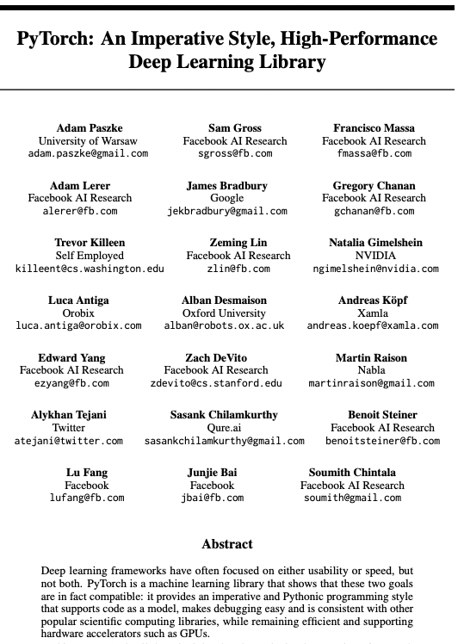



2016: python successor to torch
Adam Paszke
Sam Gross
Soumith Chintala

Slide 5
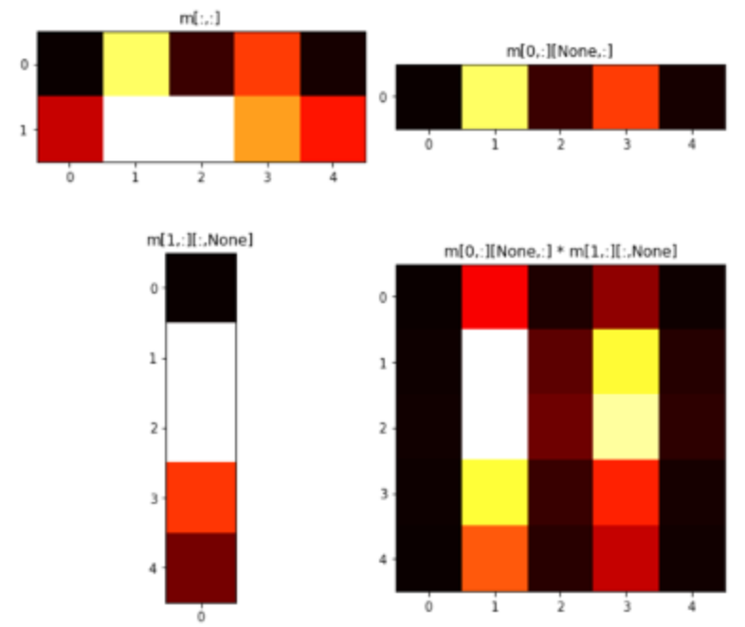
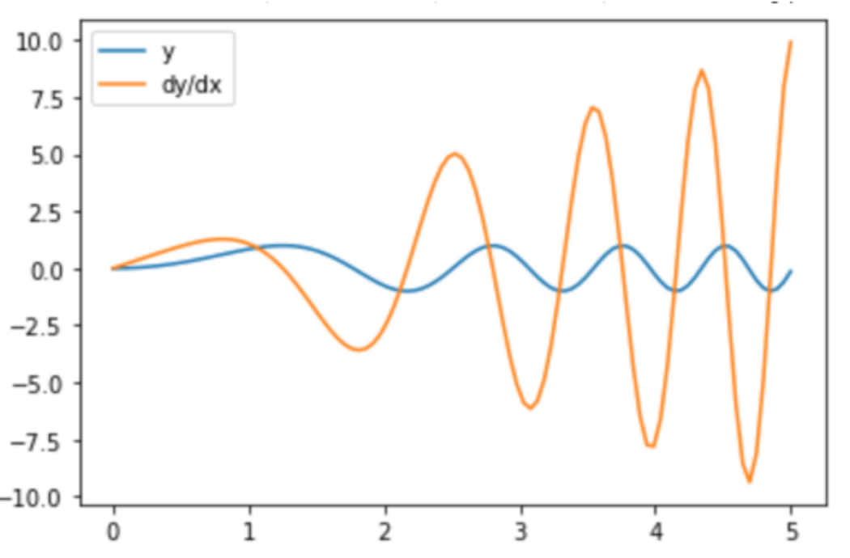
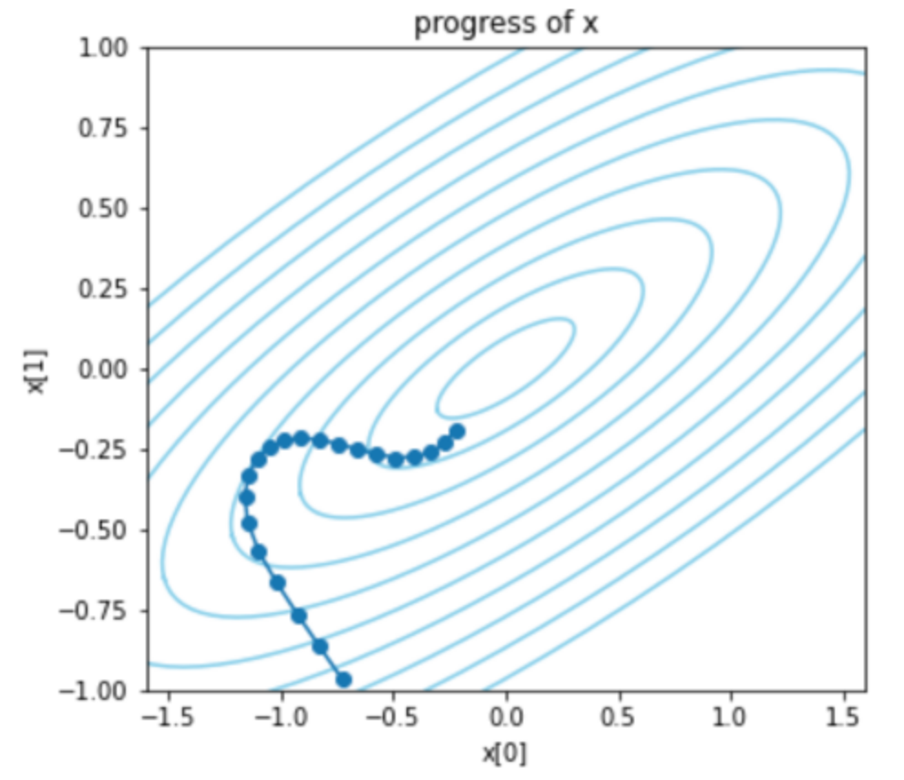
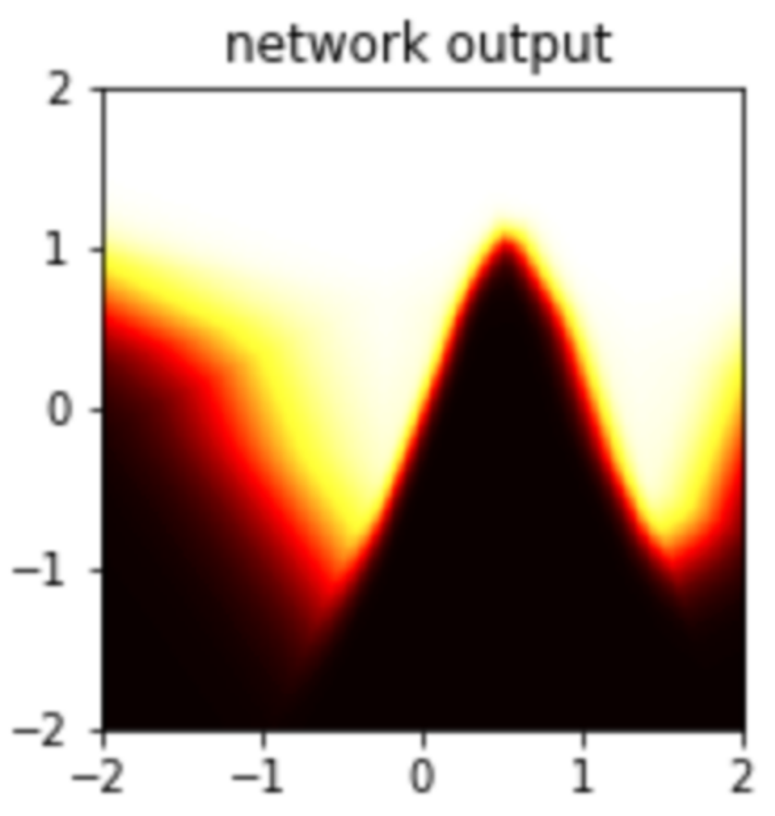
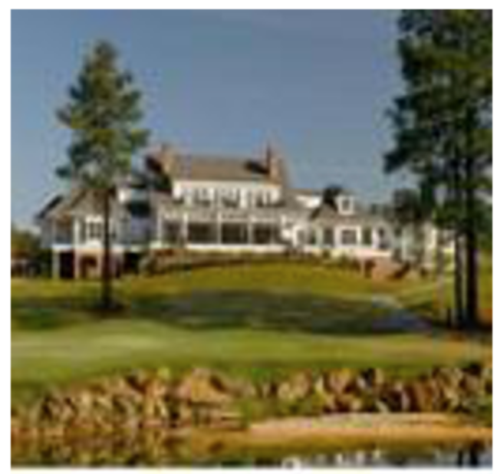
Five Core Concepts.
https://bit.ly/howto-pytorch
Pytorch is just like numpy! But it adds five important things.
GPU Tensors. For speed.
Autograd. For derivatives.
Optimizers. For training.
Modules. For making networks.
DataLoader. For fast datasets.

Slide 6
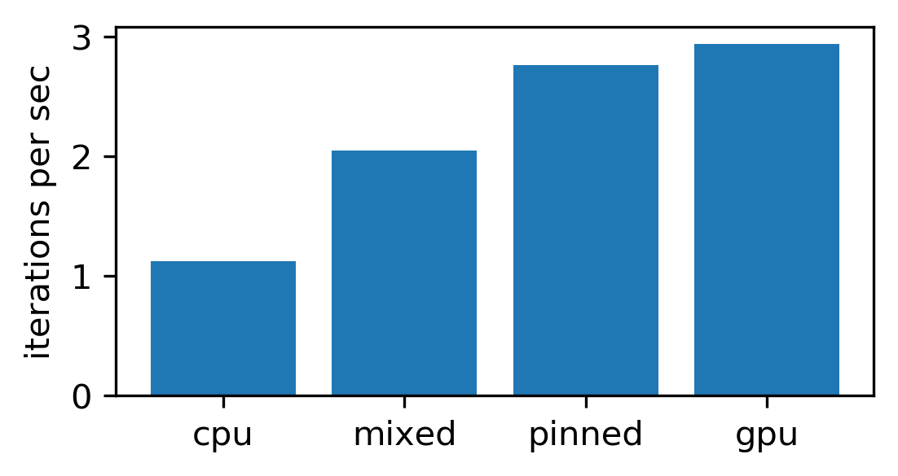
GPU Tensors
Try it now: https://bit.ly/howto-pytorch
Tensors are the unit of computation.
  torch.tensor types are lookalikes to numpy N-dim-arrays.
  But torch tensors live on either GPU or CPU.
Moving data to GPU just like a type conversion.
  For speed, avoid GPU-CPU copying.
  Pinning is fast.
Get comfortable with N-dimensional tensors
  Slicing, Squeezing, Unsqueezing notation.
  Indexing conventions for four-dimensional tensors.

Slide 7
Autograd - https://bit.ly/howto-pytorch-2
Pytorch can calculate pointwise derivatives automatically.
  Tensors with requires_grad track computation history.
  Autograd.grad() can calculate derivatives to any scalar.
  x.backward() adds gradient into parameter.grad.
Autograd is expensive but optional and can be turned on and off.
  Set requires_grad=False
  Or use with torch.no_grad()
Autograd can be used for fancier things too
  Gradient accumulation.
  2nd derivatives.

Slide 8
Optimizers - https://bit.ly/howto-pytorch-3
Optimizers take care of improving a set of parameters.
  An optimizer is given a large set of parameters to optimize.
  It doesn’t need to explicitly know the loss, but it needs to see gradients.
Training is:
  1. getting gradients with respect to a loss
  2. stepping optimizers to improve the loss
  3. repeat
Pytorch comes with many optimizer algorithms.
  Popular ones are SGD and Adam. LBFGS is good for small problems.

Slide 9
Modules - https://bit.ly/howto-pytorch-4
The pytorch neural network base class is Module.
  A Module is a function with learnable Parameters.
  Parameters can be listed, trained, saved and loaded.
Big neural networks are Modules made of other Modules.
  Simplest Module is Linear – a linear operation
  Simplest way to compose Modules is Sequential – run one after the next.
  You can write the function yourself by overriding net.forward(X)
Modules have some other state.
  GPU vs CPU; Train vs eval mode; non-trainable buffers.
Pytorch provides many off-the-shelf modules and networks.

Slide 10
DataLoaders - https://bit.ly/howto-pytorch-5
A large Dataset is a slow array.
  ImageFolder is a Dataset that loads an image file on every “ds[i]”.
  There are many Dataset subclasses, and you can customize your own.
To speed up Datasets, pytorch provides DataLoader
  DataLoader wraps a Dataset as a stream of batches.
  It uses threading to stream data out faster than “ds[i]”.
To improve training, data can be randomized when loaded.
  DataLoaders can shuffle the batches.
  Datasets can include transforms to augment data with random crops etc.

Slide 11

One-Minute Questions
Help us!
Answer the questions on the form here:
https://bit.ly/cs7150-f2022-2

