Slide 1

CS 7150
Deep Learning

Slide 2
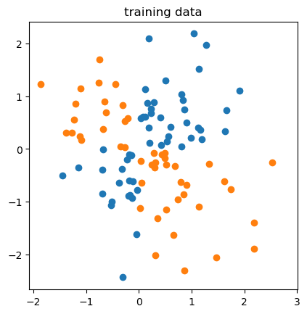
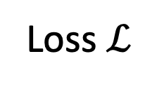
Recap
Some tricks:
* smooth nonlinearities,
* efficient backprop,
* weight initialization
1. Learn adjustments from data (Rosenblatt)
2. Use derivatives for deep-layer learning (Rumelhart)
output p
Loss $ℒ$
Layer 1
Layer 2
...
Layer N
input data x
label y

Slide 3

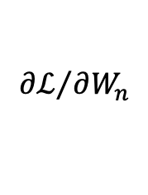
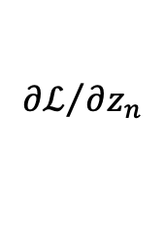


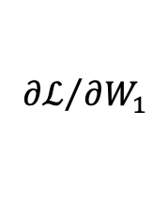
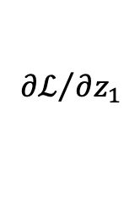

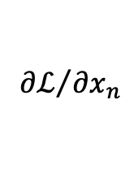



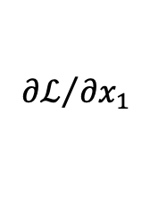
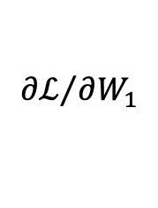


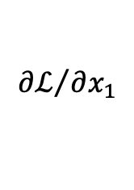
Backprop on matrix multiplication
$$W_{1}$$
$$W_{2}$$
$$W_{n}$$
$${∂ℒ}/{∂W_{1}}$$
$${∂ℒ}/{∂W_{1}}$$
$${∂ℒ}/{∂W_{n}}$$
$$x_{1}$$
mm
$$z_{1}$$
𝜎
$$x_{2}$$
mm
𝜎
$$x_{n}$$
mm
$$z_{n}$$
f
$$ℒ$$
$${∂ℒ}/{∂x_{1}}$$
$${∂ℒ}/{∂z_{1}}$$
$${∂ℒ}/{∂x_{1}}$$
$${∂ℒ}/{∂x_{n}}$$
$${∂ℒ}/{∂z_{n}}$$
If we backprop vectors or tensors instead of scalars,
a typical neural network has a very simple graph

Slide 4


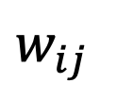
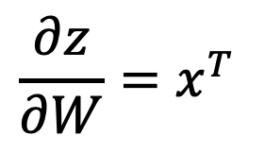
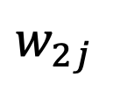
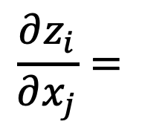





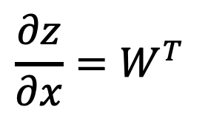
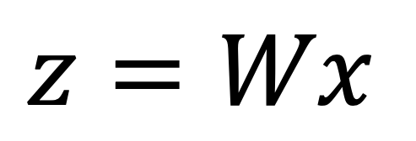
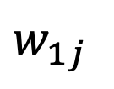











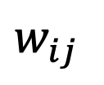


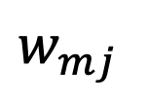




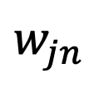

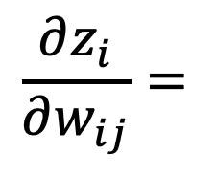


Backprop on matrix multiplication
$$z=Wx$$
$$x_{1}$$
$$x_{2}$$
$$⋯$$
$$x_{j}$$
$$⋯$$
$$x_{n}$$
$$\frac{∂z_{i}}{∂x_{j}}=$$
$$\frac{∂z}{∂x}=W^{T}$$
$$w_{11}$$
$$w_{12}$$
$$⋯$$
$$w_{1j}$$
$$⋯$$
$$w_{1n}$$
$$z_{1}$$
$$w_{ij}$$
$$w_{21}$$
$$w_{22}$$
$$⋯$$
$$w_{2j}$$
$$⋯$$
$$w_{2n}$$
$$z_{2}$$
$$⋮$$
$$⋮$$
$$⋮$$
$$\frac{∂z_{i}}{∂w_{ij}}=$$
$$\frac{∂z}{∂W}=x^{T}$$
$$w_{21}$$
$$w_{22}$$
$$⋯$$
$$w_{ij}$$
$$⋯$$
$$w_{jn}$$
$$z_{i}$$
$$x_{j}$$
$$⋮$$
$$⋮$$
$$⋮$$
$$w_{m1}$$
$$w_{m2}$$
$$⋯$$
$$w_{mj}$$
$$⋯$$
$$w_{mn}$$
$$z_{m}$$

Slide 5
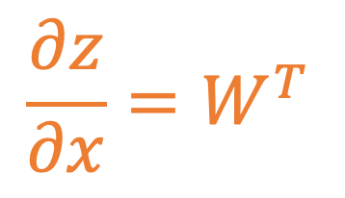

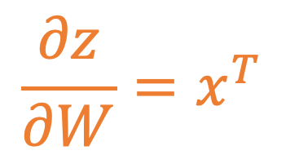
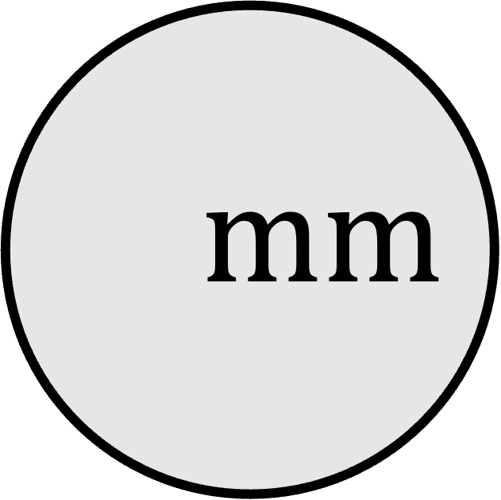
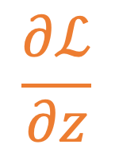
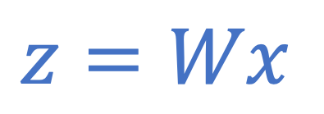
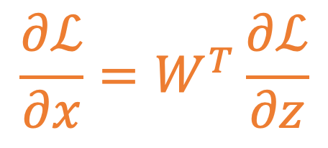
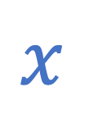
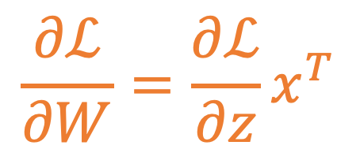
Forward pass (activations)
$$W$$
$$mm$$
$$\frac{∂z}{∂W}=x^{T}$$
$$\frac{∂ℒ}{∂W}=\frac{∂ℒ}{∂z}x^{T}$$
$$z=Wx$$
downstream gradients
$$\frac{∂z}{∂x}=W^{T}$$
$$\frac{∂ℒ}{∂z}$$
upstream gradient
$$x$$
$$\frac{∂ℒ}{∂x}=W^{T}\frac{∂ℒ}{∂z}$$
Backward pass (gradients)

Slide 6
Our main question:
Now that we can learn a function....
... what kinds of functions should we learn?

Slide 7
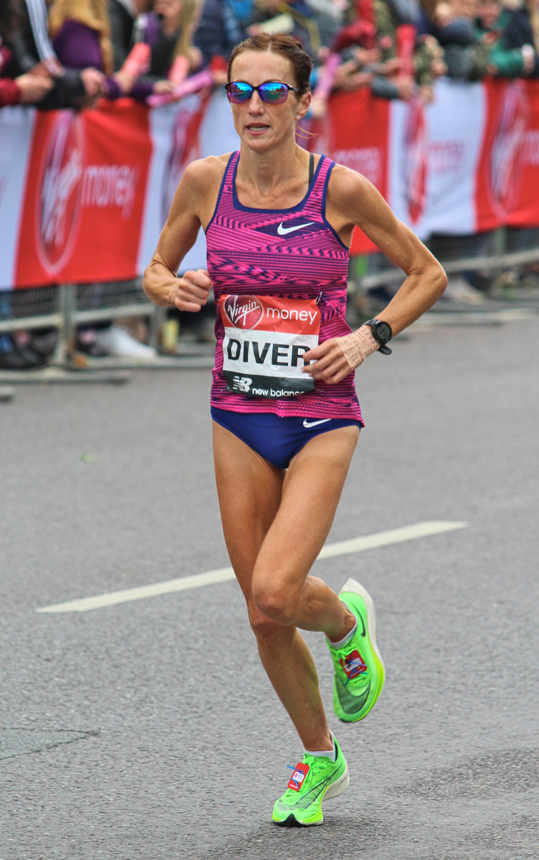
Two classical tasks
Representation
Classification
“Summarize this.”
“Which category is this?”
Species: human
Pose: upright
Activity: running
Direction: left
Location: road, outdoors
Color: pink, blue, lime
Looks like: Sinead Diver
Sunglasses: yes
Marathon
800m
Sprint
input image

Slide 8
How to go from task to training
1. By data:
2. By objective:
3. By architecture:
What are the inputs and the outputs?
How will we measure errors (loss)?
How will we parameterize the function?

Slide 9
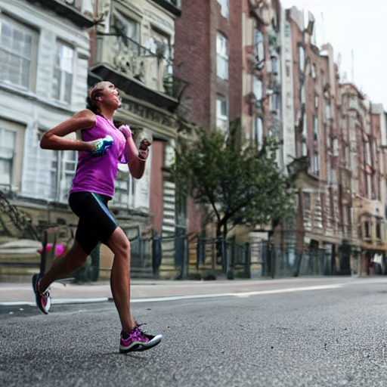
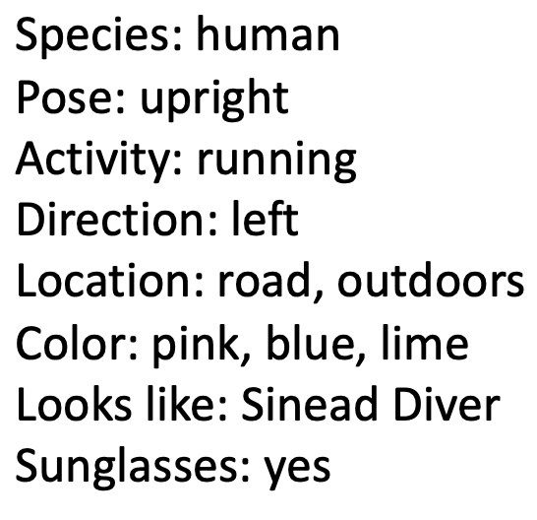
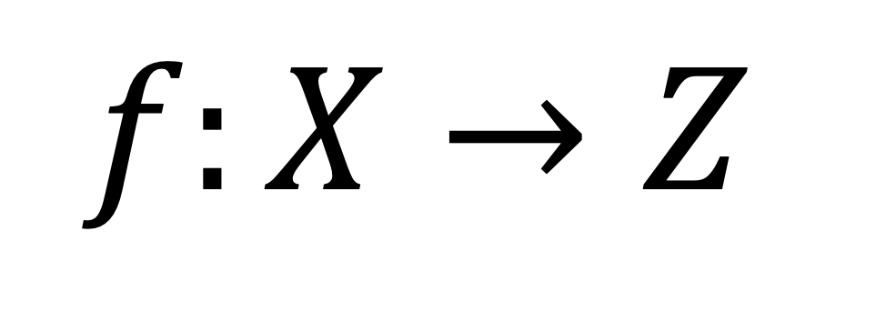
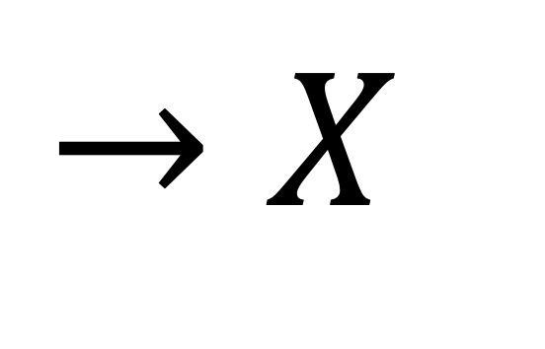
Representation
$$f:X→Z$$
$$→X$$
What makes a
good
representation?
?
You can
reconstruct
the original
from it?
The “autoencoder” task. A classical problem.

Slide 10
Representation
$$f:X→Z$$
$$→X$$
What makes a
good
representation?
?
You can
reconstruct
the original
from it?
The “autoencoder” task. A classical problem.

Slide 11
Classical autoencoding
?
1. What is the input and the output?
2. How is error measured (what is the loss)?
3. How is it parameterized (what is the architecture)?

Slide 12
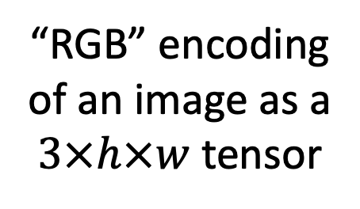
Classical autoencoding inputs and outputs
$$f:X→Z$$
$$→X$$
What makes a
good
representation?
?
You can
reconstruct
the original?
“RGB” encoding
of an image as a
$3×h×w$ tensor
.3
.0
.0
.1
.0
.0
.3
.0
.0
.1
.0
.0
.1
.5
.2
.5
.2
.1
.1
.5
.2
.5
.2
.1
To have a differentiable, learnable model,
inputs and outputs should be vectors (or tensors)
.1
.1
.1
.2
.1
.2
.1
.1
.1
.2
.1
.2
.3
.3
.7
.2
.0
.7
.3
.3
.7
.2
.0
.7
.0
.0
.1
.0
.0
.0
.0
.0
.1
.0
.0
.0
.0
.0
.2
.3
.5
.2
.0
.0
.2
.3
.5
.2
.1
.3
.0
.1
.1
.1
.1
.3
.0
.1
.1
.1
.2
.2
.2
.3
.2
.2
.2
.2
.2
.3
.2
.2
.1
.0
.1
.4
.3
.1
.1
.0
.1
.4
.3
.1

Slide 13
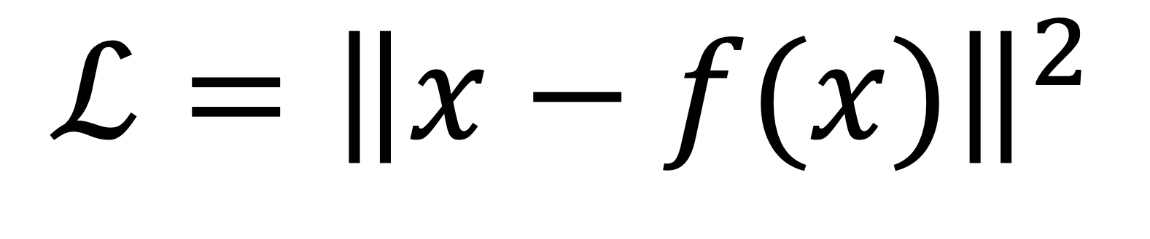
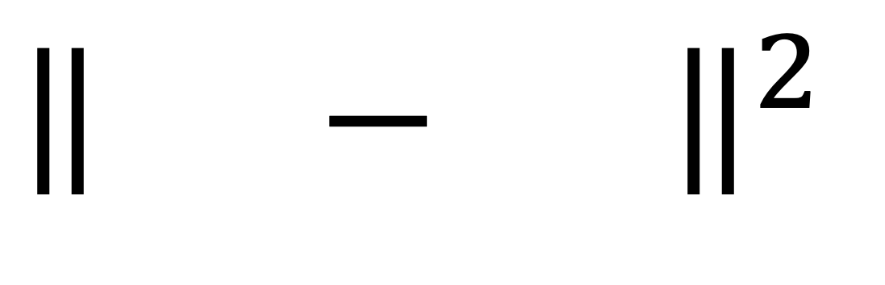
Classical autoencoding loss
$$f:X→Z$$
$$→X$$
What makes a
good
representation?
$${\left\|xf− (x\right\|}^{2}$$
You can
reconstruct
the original?
$${ℒ=\left\|x−f(x)\right\|}^{2}$$
.3
.0
.0
.1
.0
.0
.3
.0
.0
.1
.0
.0
.1
.5
.2
.5
.2
.1
.1
.5
.2
.5
.2
.1
.1
.1
.1
.2
.1
.2
.1
.1
.1
.2
.1
.2
.3
.3
.7
.2
.0
.7
.3
.3
.7
.2
.0
.7
.0
.0
.1
.0
.0
.0
.0
.0
.1
.0
.0
.0
.0
.0
.2
.3
.5
.2
.0
.0
.2
.3
.5
.2
.1
.3
.0
.1
.1
.1
.1
.3
.0
.1
.1
.1
.2
.2
.2
.3
.2
.2
.2
.2
.2
.3
.2
.2
.1
.0
.1
.4
.3
.1
.1
.0
.1
.4
.3
.1
L2 reconstruction loss

Slide 14
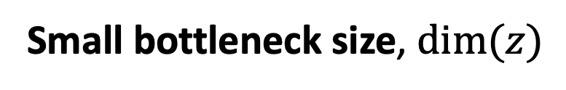
Classical autoencoding architecture
$$f:X→Z$$
$$→X$$
What makes a
good
representation?
You can
reconstruct
the original?
Use a multilayer neural network
with a tiny layer in the middle
Representation is
economical
Small bottleneck size, $\dim{(z)}$

Slide 15
Today’s Focus:
Image Classification

Slide 16
Today’s focus: image classifiers
Marathon
800m
Sprint
1. What is the input and the output?
2. How is error measured (what is the loss)?
3. How is it parameterized (what is the architecture)?

Slide 17
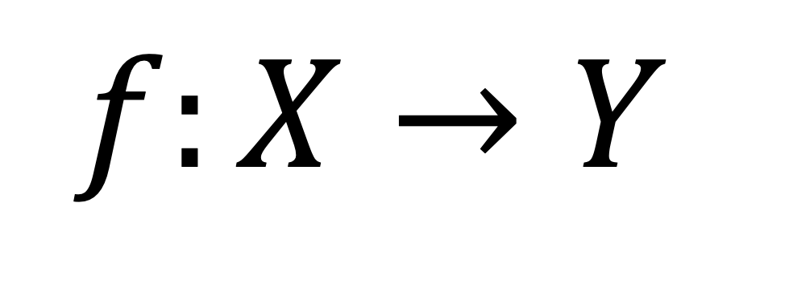
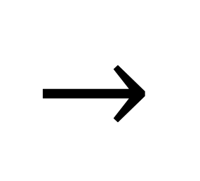
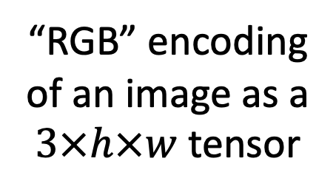
Image classification: input and output
$$f:X→Y$$
Marathon
800m
Sprint
✓
“RGB” encoding
of an image as a
$3×h×w$ tensor
$$→$$
“one-hot” encoding
of an N-way choice
as an N-dim vector
1
.3
.0
.0
.1
.0
.0
.1
.5
.2
.5
.2
.1
.1
.1
.1
.2
.1
.2
0
.3
.3
.7
.2
.0
.7
.0
.0
.1
.0
.0
.0
.0
.0
.2
.3
.5
.2
0
.1
.3
.0
.1
.1
.1
.2
.2
.2
.3
.2
.2
.1
.0
.1
.4
.3
.1

Slide 18
Discuss: why one-hot vector vs just one number?
0
0
0
or
1
3
or
2
1
0
One-hot encoding
Class-number encoding
n dimensions [0...1], for n classes
1 dimension [1...n], for n classes

Slide 19
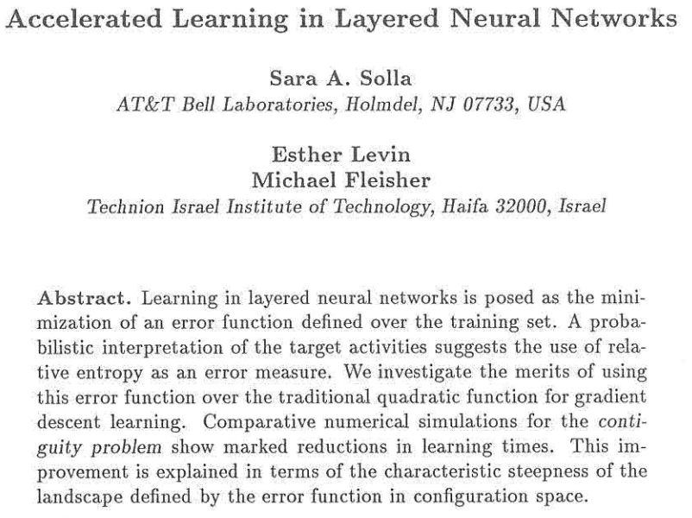
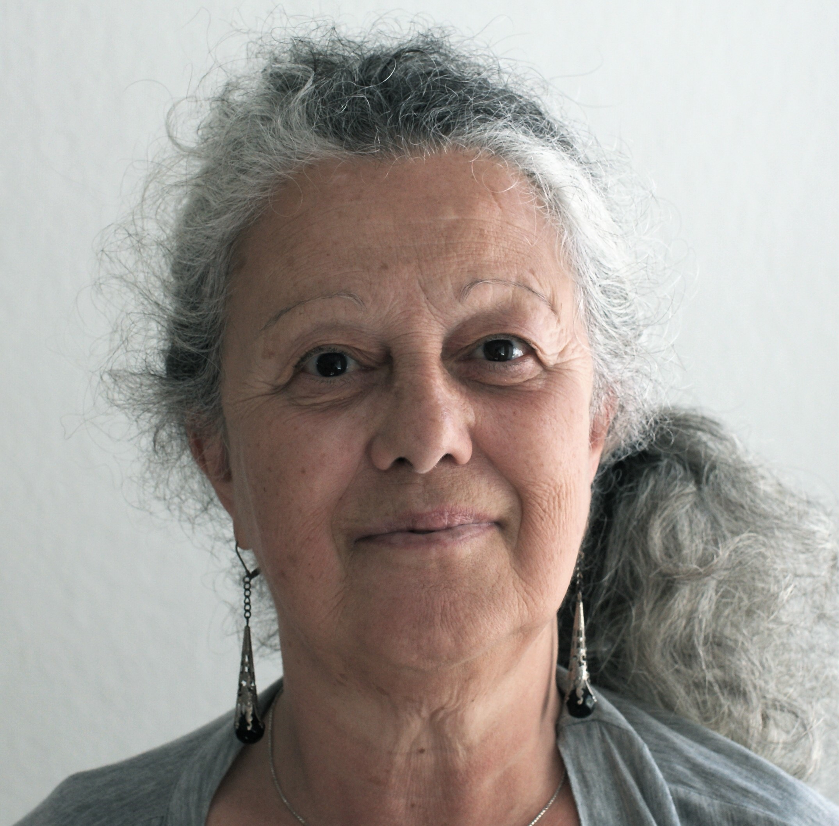


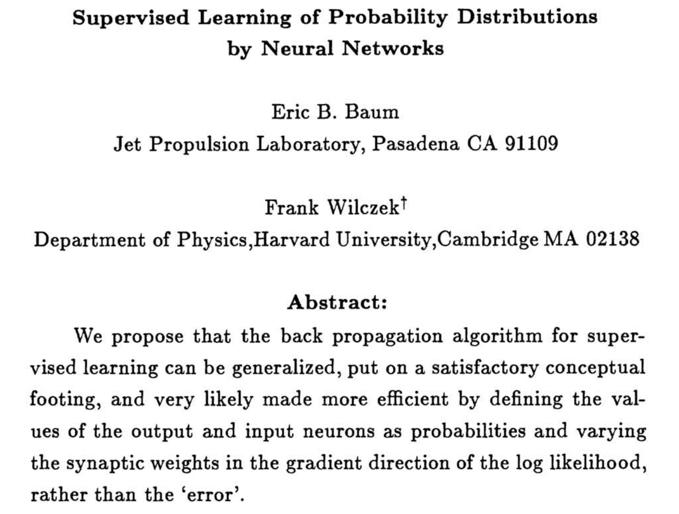
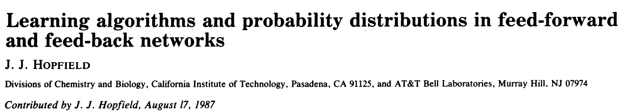
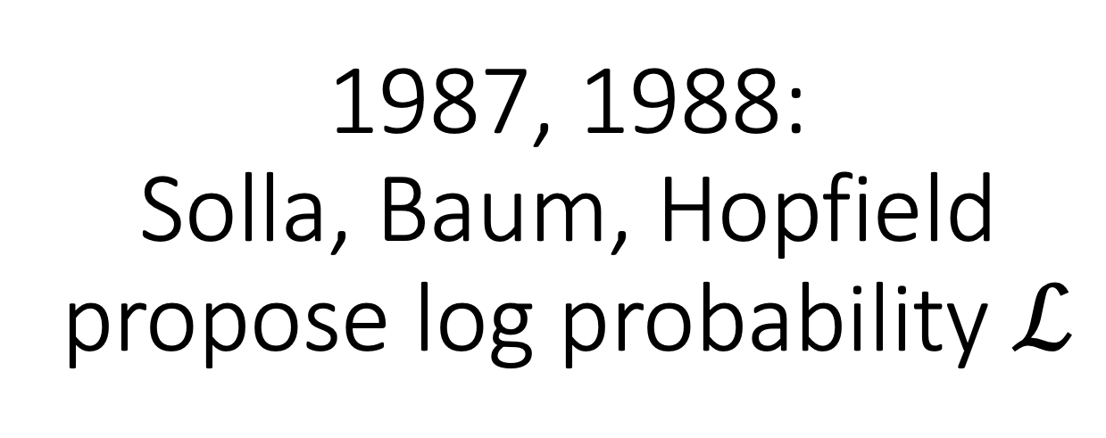
1987, 1988:
Solla, Baum, Hopfield propose log probability $ℒ$
(three parallel papers advocating cross-entropy loss)

Slide 20
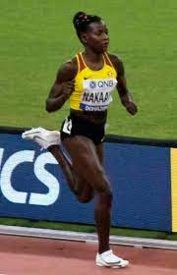
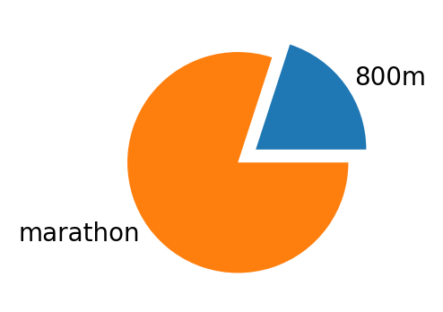
Softmax cross-entropy loss
A single class might not be even be the right true label.
Ground truth: runner competes in
two events and at any moment is:
30% likely to be in the marathon
70% likely to be in the 800m
0% likely to be in a sprint

Slide 21
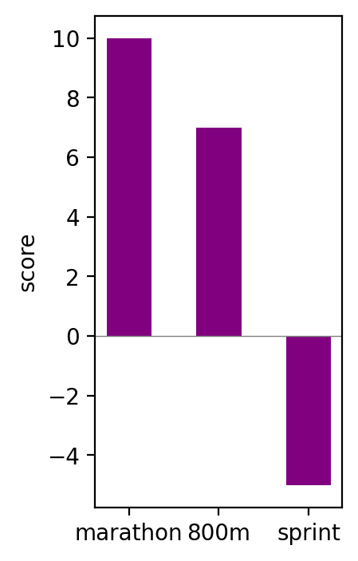
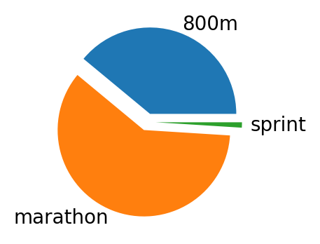



Softmax cross-entropy loss
The network should predict a probability distribution that adds to 1.
cross-entropy
softmax
predicted
probability
distribution${ \{p}_{i}\}$
true
probability
distribution ${ \{y}_{i}\}$
network outputs logits${ \{z}_{i}\}$

Slide 22



Softmax cross-entropy loss
KL Divergence measures difference between distributions.
cross-entropy
softmax
predicted
probability
distribution ${ \{p}_{i}\}$
true
probability
distribution ${ \{y}_{i}\}$
network outputs logits${ \{z}_{i}\}$

Slide 23



Softmax cross-entropy loss
softmax
$$p_{i}={(\operatorname{softmax}{(z)})}_{i}=\frac{e^{z_{i}}}{\sum_{j}{e^{z_{j}}}}$$
cross-entropy
$$ℒ_{KL}=\sum_{i}{y_{i}(log{y_{i}−\log{p_{i}})}}$$
constant
$$ℒ_{CE}=−\sum_{i}{y_{i}\log{p_{i}}}$$

Slide 24




Hinge (SVM) loss and MSE (L2) loss
”The score of the correct class should be higher than all the other scores”
$$ℒ_{hinge}=\sum_{i≠y}{\max{(0, z_{i}−z_{y}+1)}}$$
$$ℒ_{hinge}$$
“Hinge Loss”
Score for correct class
Score for wrong class
“Margin”
Vector of
correct output
$$ℒ_{MSE}=\frac{1}{n}\sum_{i}{{(p_{i}−y_{i})}^{2}}$$
$$ℒ_{MSE}$$
Error is squared distance
Vector of
actual output

Slide 25





Nice properties of softmax cross-entropy loss
$$p_{i}=\frac{e^{z_{i}}}{\sum_{j}{e^{z_{j}}}}$$
$$ℒ_{CE}=−\sum_{i}{y_{i}\log{p_{i}}}$$
$$=\frac{e^{z_{i}+K}}{\sum_{j}{e^{z_{j}+K}}}$$
Unaffected when adding K to $z_{i}$
And CE loss does not saturate.

Slide 26

Image classification: architecture
$$f:X→Y$$
“RGB” encoding
of an image as a
$3×h×w$ tensor
?
1
“one-hot” encoding
of an N-way choice
as an N-dim vector
.3
.0
.0
.1
.0
.0
.1
.5
.2
.5
.2
.1
.1
.1
.1
.2
.1
.2
0
.3
.3
.7
.2
.0
.7
.0
.0
.1
.0
.0
.0
.0
.0
.2
.3
.5
.2
0
.1
.3
.0
.1
.1
.1
.2
.2
.2
.3
.2
.2
.1
.0
.1
.4
.3
.1
What architecture to deal with large RGB pixel inputs?

Slide 27
A problem with RGB inputs....
.3
.0
.0
.1
.0
.0
.3
.0
.0
.1
.0
.0
.1
.5
.1
.2
.2
.1
.1
.1
.2
.1
.2
.1
.1
.1
.1
.3
.1
.2
.1
.1
.1
.0
.1
.2
.3
.4
.5
.2
.0
.4
.3
.3
.6
.2
.0
.1
.0
.0
.1
.0
.0
.0
.0
.1
.1
.0
.0
.0
.0
.0
.2
.3
.5
.2
.0
.0
.2
.3
.5
.2
.1
.3
.0
.1
.1
.1
.1
.3
.0
.1
.1
.1
.2
.2
.2
.3
.2
.1
.2
.2
.2
.6
.2
.2
.1
.0
.1
.4
.3
.1
.1
.0
.1
.4
.3
.1
.3
.0
.0
.1
.0
.0
.3
.4
.0
.1
.0
.0
.1
.5
.1
.0
.2
.1
.1
.5
.2
.5
.2
.1
.1
.1
.1
.2
.1
.5
.1
.1
.1
.2
.1
.2
.1
.3
.6
.2
.0
.7
.3
.3
.2
.2
.0
.1
.0
.0
.1
.0
.0
.0
.0
.0
.3
.0
.0
.0
.0
.1
.2
.3
.5
.2
.0
.0
.4
.3
.5
.2
.1
.0
.0
.1
.1
.1
.1
.3
.0
.1
.1
.1
.1
.2
.2
.3
.2
.2
.2
.2
.2
.3
.2
.2
.1
.0
.1
.4
.3
.1
.1
.0
.1
.4
.3
.1

Slide 28

Discussion: which image (B, C) is more similar to A?
A
B
C
As tensors, why is C much closer to A than B is?

Slide 29



1959, 1968:
Hubel and Wiesel measure cat visual system

Slide 30

Retinal neurons are sensitive to angle
Cat (Hubel and Wiesel 1968)
-0.5
+1.0
-0.5
-0.5
+1.0
-0.5
-0.5
+1.0
-0.5
Measurement of angle sensitivity
Layout of angle-selective receptors

Slide 31
Computational solution: the convolution
0
0
1
0
0
0
1
1
0
0
-0.5
+1.0
-0.5
-0.5

Slide 32
Computational solution: the convolution
0
0
1
2
1
0
1
1
0
0
-0.5
+1.0
-0.5
-0.5
0.0

Slide 33
Computational solution: the convolution
0
0
1
2
1
0
1
1
0
0
-0.5
+1.0
-0.5
-0.5
0.0
+1.0

Slide 34
Computational solution: the convolution
0
0
1
2
1
0
1
1
0
0
-0.5
+1.0
-0.5
-0.5
0.0
+1.0
0.0

Slide 35
Computational solution: the convolution
0
0
1
2
1
0
1
1
0
0
-0.5
+1.0
-0.5
-0.5
0.0
+1.0
0.0
-1.0

Slide 36
Computational solution: the convolution
0
0
1
2
1
0
1
1
0
0
-0.5
+1.0
-0.5
-0.5
0.0
+1.0
0.0
-1.0
+0.5

Slide 37
Computational solution: the convolution
0
0
1
2
1
0
1
1
0
0
-0.5
+1.0
-0.5
-0.5
0.0
+1.0
0.0
-1.0
+0.5
+0.5

Slide 38
Computational solution: the convolution
0
0
1
2
1
0
1
1
0
0
-0.5
+1.0
-0.5
-0.5
0.0
+1.0
0.0
-1.0
+0.5
+0.5
-0.5

Slide 39
Computational solution: the convolution
-0.5
+1.0
-0.5
Two-dimensional case
-0.5
+1.0
-0.5
-0.5
+1.0
-0.5
0
0
1
2
1
0
1
1
0
0
0
0
1
2
1
0
1
1
0
0
0
0
1
2
1
0
1
1
0
0
+3.0
0
0
1
2
1
0
1
1
0
0
0
0
1
2
1
0
1
1
0
0
0
0
1
2
1
0
1
1
0
0
0
0
1
2
1
0
1
1
0
0
Notes:
`

Slide 40
Computational solution: the convolution
-0.5
+1.0
-0.5
Two-dimensional case
Vertical
edge-finder
-0.5
+1.0
-0.5
-0.5
+1.0
-0.5
0
0
1
2
1
0
1
1
0
0
0
0
1
2
1
0
1
1
0
0
-1.5
0.0
+3.0
0.0
-3.0
+1.5
+1.5
-1.5
0
0
1
2
1
0
1
1
0
0
-1.5
0.0
+3.0
0.0
-3.0
+1.5
+1.5
-1.5
0
0
1
2
1
0
1
1
0
0
-1.5
0.0
+3.0
0.0
-3.0
+1.5
+1.5
-1.5
0
0
1
2
1
0
1
1
0
0
-1.5
0.0
+3.0
0.0
-3.0
+1.5
+1.5
-1.5
0
0
1
2
1
0
1
1
0
0
-1.5
0.0
+3.0
0.0
-1.0
+1.5
+1.5
-1.5
0
0
1
2
1
0
1
1
0
0
Notes:
`

Slide 41
Computational solution: the convolution
-0.5
-0.5
-0.5
Horizontal
edge-finder
Two-dimensional case
+1.0
+1.0
+1.0
-0.5
-0.5
-0.5
0
0
1
2
1
0
1
1
0
0
0
0
1
2
1
0
1
1
0
0
0
0
1
2
1
0
1
1
0
0
0.0
0
0
1
2
1
0
1
1
0
0
0
0
1
2
1
0
1
1
0
0
0
0
1
2
1
0
1
1
0
0
0
0
1
2
1
0
1
1
0
0

Slide 42
Computational solution: the convolution
-0.5
-0.5
-0.5
Horizontal
edge-finder
finds no edges
Two-dimensional case
+1.0
+1.0
+1.0
-0.5
-0.5
-0.5
0
0
1
2
1
0
1
1
0
0
0
0
1
2
1
0
1
1
0
0
0.0
0.0
0.0
0.0
0.0
0.0
0.0
0.0
0
0
1
2
1
0
1
1
0
0
0.0
0.0
0.0
0.0
0.0
0.0
0.0
0.0
0
0
1
2
1
0
1
1
0
0
0.0
0.0
0.0
0.0
0.0
0.0
0.0
0.0
0
0
1
2
1
0
1
1
0
0
0.0
0.0
0.0
0.0
0.0
0.0
0.0
0.0
0
0
1
2
1
0
1
1
0
0
0.0
0.0
0.0
0.0
0.0
0.0
0.0
0.0
0
0
1
2
1
0
1
1
0
0

Slide 43
Computational solution: the convolution
+1.5
-0.8
-0.5
The key:
Learning a filter is
faster+better than
per-pixel neurons
Two-dimensional case
-0.1
+1.0
+0.9
-0.5
+1.2
-0.3
0
0
1
2
1
0
1
1
0
0
0
0
1
2
1
0
1
1
0
0
0.0
0.0
0.0
0.0
0.0
0.0
0.0
0.0
0
0
1
2
1
0
1
1
0
0
0.0
0.0
0.0
0.0
0.0
0.0
0.0
0.0
0
0
1
2
1
0
1
1
0
0
0.0
0.0
0.0
0.0
0.0
0.0
0.0
0.0
0
0
1
2
1
0
1
1
0
0
0.0
0.0
0.0
0.0
0.0
0.0
0.0
0.0
0
0
1
2
1
0
1
1
0
0
0.0
0.0
0.0
0.0
0.0
0.0
0.0
0.0
0
0
1
2
1
0
1
1
0
0

Slide 44




1989
LeCun et al.
Convolutional Neural Nets

Slide 45
Convolution Layer
3x32x32 image: preserve spatial structure
32
height
32
width
3
depth / channels
Slide credit: D Fouhey & J Johnson

Slide 46
Convolution Layer
3x32x32 image
3x5x5 filter
Convolve the filter with the image: “slide over the image spatially, computing dot products”
32
height
32
width
3
depth / channels
Slide credit: D Fouhey & J Johnson

Slide 47
Convolution Layer
Filters always extend the full depth of the input volume
3x32x32 image
3x5x5 filter
Convolve the filter with the image: “slide over the image spatially, computing dot products”
32
height
32
width
3
depth / channels
Slide credit: D Fouhey & J Johnson

Slide 48

Convolution Layer
3x32x32 image
3x5x5 filter
1 number:
the result of taking a dot product between the filter and a small 3x5x5 chunk of the image
(i.e. 3*5*5 = 75-dimensional dot product + bias)
32
32
3
$$w^{T}x+b$$
Slide credit: D Fouhey & J Johnson

Slide 49
Convolution Layer
1x28x28 activation map
3x32x32 image
3x5x5 filter
28
convolve (slide) over all spatial locations
32
28
32
1
3
Slide credit: D Fouhey & J Johnson

Slide 50
Convolution Layer
1x28x28 activation map
3x32x32 image
3x5x5 filter
28
convolve (slide) over all spatial locations
32
28
32
1
3
Convolution Layer vs Image Filtering:
>1 input and output channels
Forget about convolution vs cross-correlation
Slide credit: D Fouhey & J Johnson

Slide 51
Convolution Layer
two 1x28x28 activation map
3x32x32 image
Consider repeating with a second (green) filter:
3x5x5 filter
28
28
convolve (slide) over all spatial locations
32
28
32
1
1
3
Slide credit: D Fouhey & J Johnson

Slide 52
Convolution Layer
6 activation maps,
each 1x28x28
3x32x32 image
Consider 6 filters, each 3x5x5
Convolution Layer
32
32
6x3x5x5 filters
Stack activations to get a 6x28x28 output image!
3
Slide credit: D Fouhey & J Johnson

Slide 53
Convolution Layer
6 activation maps,
each 1x28x28
3x32x32 image
Also 6-dim bias vector:
Convolution Layer
32
32
6x3x5x5 filters
Stack activations to get a 6x28x28 output image!
3
Slide credit: D Fouhey & J Johnson

Slide 54
Convolution Layer
28x28 grid, at each point a 6-dim vector
3x32x32 image
Also 6-dim bias vector:
Convolution Layer
32
32
6x3x5x5 filters
Stack activations to get a 6x28x28 output image!
3
Slide credit: D Fouhey & J Johnson

Slide 55
Convolution Layer
2x6x28x28
Batch of outputs
2x3x32x32
Batch of images
Also 6-dim bias vector:
Convolution Layer
32
32
3
6x3x5x5 filters
Slide credit: D Fouhey & J Johnson

Slide 56
Convolution Layer
N x C_{out} x H’ x W’
Batch of outputs
N x C_{in} x H x W
Batch of images
Bias: C_{out}-dim vector:
Convolution Layer
H
W
C_{out}
C_{in}
Weight:
C_{out} x C_{in}x K_{w} x K_{h}
Slide credit: D Fouhey & J Johnson

Slide 57

One-Minute Questions
Help us!
Answer the questions on the form here:
https://bit.ly/cs7150-f022-4

Slide 58
Stacking Convolutions
32
28
26
….
Conv
Conv
Conv
W₁: 6x3x5x5
b₁: 6
W₂: 10x6x3x3
b₂: 10
W₃: 12x10x3x3
b₃: 12
32
28
26
3
6
10
Input:
N x 3 x 32 x 32
First hidden layer:
N x 6 x 28 x 28
Second hidden layer:
N x 10 x 26 x 26
Slide credit: D Fouhey & J Johnson

Slide 59
Stacking Convolutions
Q: What happens if we stack two convolution layers?
32
28
26
….
Conv
Conv
Conv
W₁: 6x3x5x5
b₁: 6
W₂: 10x6x3x3
b₂: 10
W₃: 12x10x3x3
b₃: 12
32
28
26
3
6
10
Input:
N x 3 x 32 x 32
First hidden layer:
N x 6 x 28 x 28
Second hidden layer:
N x 10 x 26 x 26
Slide credit: D Fouhey & J Johnson

Slide 60
Stacking Convolutions
(Recall y=W₂W₁x is linear)
Q: What happens if we stack two convolution layers?
A: It’s equivalent to just one convolution layer!
32
28
26
….
Conv
Conv
Conv
W₁: 6x3x5x5
b₁: 6
W₂: 10x6x3x3
b₂: 10
W₃: 12x10x3x3
b₃: 12
32
28
26
3
6
10
Input:
N x 3 x 32 x 32
First hidden layer:
N x 6 x 28 x 28
Second hidden layer:
N x 10 x 26 x 26
Slide credit: D Fouhey & J Johnson

Slide 61
Stacking Convolutions
Q: What happens if we stack two convolution layers?
A: It’s equivalent to just one convolution layer!
32
28
26
….
Conv
ReLU
Conv
ReLU
Conv
ReLU
W₁: 6x3x5x5
b₁: 6
W₂: 10x6x3x3
b₂: 10
W₃: 12x10x3x3
b₃: 12
32
28
26
3
6
10
Input:
N x 3 x 32 x 32
First hidden layer:
N x 6 x 28 x 28
Second hidden layer:
N x 10 x 26 x 26
Solution: Add a nonlinearity between each conv layer
Slide credit: D Fouhey & J Johnson

Slide 62


Fully-connected Layer vs Convolution Layer
Input
$$w^{T}x$$
Output
1
3072
1 x 3072
weights
1
3x32x32 image
3x5x5 filter
$$w^{T}x$$
1 number:
the result of taking a dot product between the filter and a small 3x5x5 chunk of the image
32
32
What if the kernel size is 32*32? What is the number of parameters?
3
A fully-connected layer is equivalent to a convolution layer.

Slide 63
Fully-connected Layer vs Convolution Layer
Fully connected layer
Convolution layer
feature map
image
image

Slide 64

What do Conv Filters Learn?
Linear classifier:
One template per class
32
28
Conv
ReLU
W₁: 6x3x5x5
b₁: 6
32
28
3
6
Input:
N x 3 x 32 x 32
First hidden layer:
N x 6 x 28 x 28
Slide credit: D Fouhey & J Johnson

Slide 65

What do Conv Filters Learn?
MLP: Bank of whole-image templates
32
28
Conv
ReLU
W₁: 6x3x5x5
b₁: 6
32
28
3
6
Input:
N x 3 x 32 x 32
First hidden layer:
N x 6 x 28 x 28
Slide credit: D Fouhey & J Johnson

Slide 66

What do Conv Filters Learn?
First-layer conv filters: local image templates
(Often learns oriented edges, opposing colors)
32
28
Conv
ReLU
W₁: 6x3x5x5
b₁: 6
32
28
3
6
Input:
N x 3 x 32 x 32
First hidden layer:
N x 6 x 28 x 28
AlexNet: 64 filters, each 3x11x11
Slide credit: D Fouhey & J Johnson

Slide 67
Ended class here

Slide 68
Convolution Spatial Dimensions
Input: 7x7
Filter: 3x3
Q: How big is output?
7
7
Slide credit: D Fouhey & J Johnson

Slide 69
Convolution Spatial Dimensions
Input: 7x7
Filter: 3x3
Q: How big is output?
7
7
Slide credit: D Fouhey & J Johnson

Slide 70
Convolution Spatial Dimensions
Input: 7x7
Filter: 3x3
Q: How big is output?
7
7
Slide credit: D Fouhey & J Johnson

Slide 71
Convolution Spatial Dimensions
Input: 7x7
Filter: 3x3
Q: How big is output?
7
7
Slide credit: D Fouhey & J Johnson

Slide 72
Convolution Spatial Dimensions
Input: 7x7
Filter: 3x3
Output: 5x5
7
7
Slide credit: D Fouhey & J Johnson

Slide 73
Convolution Spatial Dimensions
Input: 7x7
Filter: 3x3
Output: 5x5
Problem: Feature maps “shrink” with each layer!
In general:
Input: W
Filter: K
Output: W – K + 1
7
7
Slide credit: D Fouhey & J Johnson

Slide 74
Padding: 1D Case
0
10
12
9
11
10
11
12
0
Signal
1/3
1/3
1/3
Filter
7.33
10.33
10.66
10
10.66
11
Output
Slide inspired by : J Johnson

Slide 75
Padding: 1D Case
0
10
12
9
11
10
11
12
0
Signal
1/3
1/3
1/3
Filter
7.33
10.33
10.66
10
10.66
11
7.67
Output
Input: 7 vs output: 7
Slide inspired by : J Johnson

Slide 76
Convolution Spatial Dimensions
Input: 7x7
Filter: 3x3
Output: 5x5
0 | 0 | 0 | 0 | 0 | 0 | 0 | 0 | 0
0 |  |  |  |  |  |  |  | 0
0 |  |  |  |  |  |  |  | 0
0 |  |  |  |  |  |  |  | 0
0 |  |  |  |  |  |  |  | 0
0 |  |  |  |  |  |  |  | 0
0 |  |  |  |  |  |  |  | 0
0 |  |  |  |  |  |  |  | 0
0 | 0 | 0 | 0 | 0 | 0 | 0 | 0 | 0
Problem: Feature maps “shrink” with each layer!
In general:
Input: W
Filter: K
Padding: P
Solution: padding
Add zeros around the input
Slide credit: D Fouhey & J Johnson

Slide 77
Convolution Spatial Dimensions
Input: 7x7
Filter: 3x3
Output: 5x5
0 | 0 | 0 | 0 | 0 | 0 | 0 | 0 | 0
0 |  |  |  |  |  |  |  | 0
0 |  |  |  |  |  |  |  | 0
0 |  |  |  |  |  |  |  | 0
0 |  |  |  |  |  |  |  | 0
0 |  |  |  |  |  |  |  | 0
0 |  |  |  |  |  |  |  | 0
0 |  |  |  |  |  |  |  | 0
0 | 0 | 0 | 0 | 0 | 0 | 0 | 0 | 0
In general:
Input: W
Filter: K
Padding: P
Output: W – K + 1 + 2P
Very common: “same padding”
Set P = (K – 1) / 2
Then output size = input size
Slide credit: D Fouhey & J Johnson

