Slide 1

CS 7150
Deep Learning

Slide 2
Evolving SOTA in Image Classification

Slide 3
Our main question:
What is the goal in image classification?
... and what is the state-of-the-art*?
*SOTA

Slide 4
Discussion: what makes a better network?
And how can we compare two networks objectively?

Slide 5
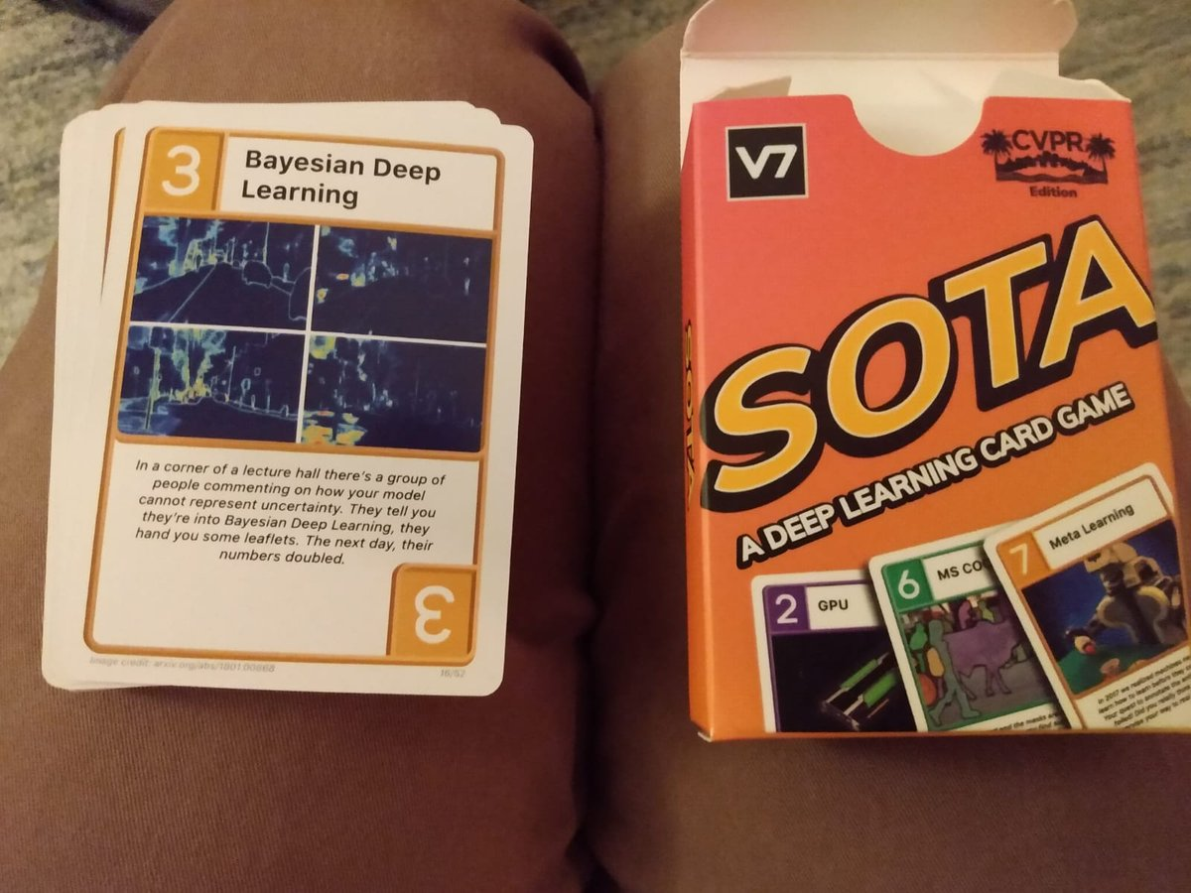
The SOTA Card Game
What makes a good game: clear rules, anybody can play
[v7labs.com]

Slide 6

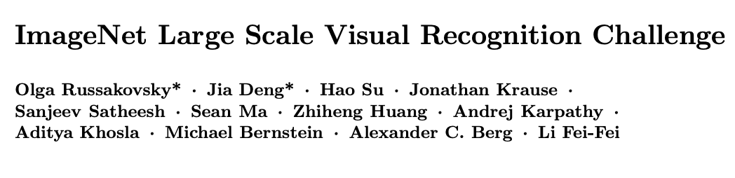

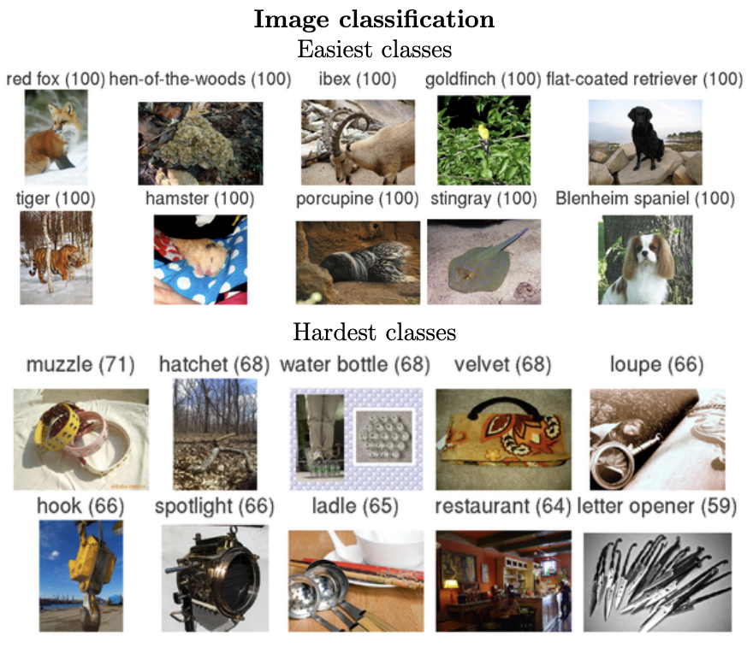
2010-2017:
Russovsky, Deng, etal:
Imagenet LSVR Challenge
Li Feifei and Olga Russovsky

Slide 7
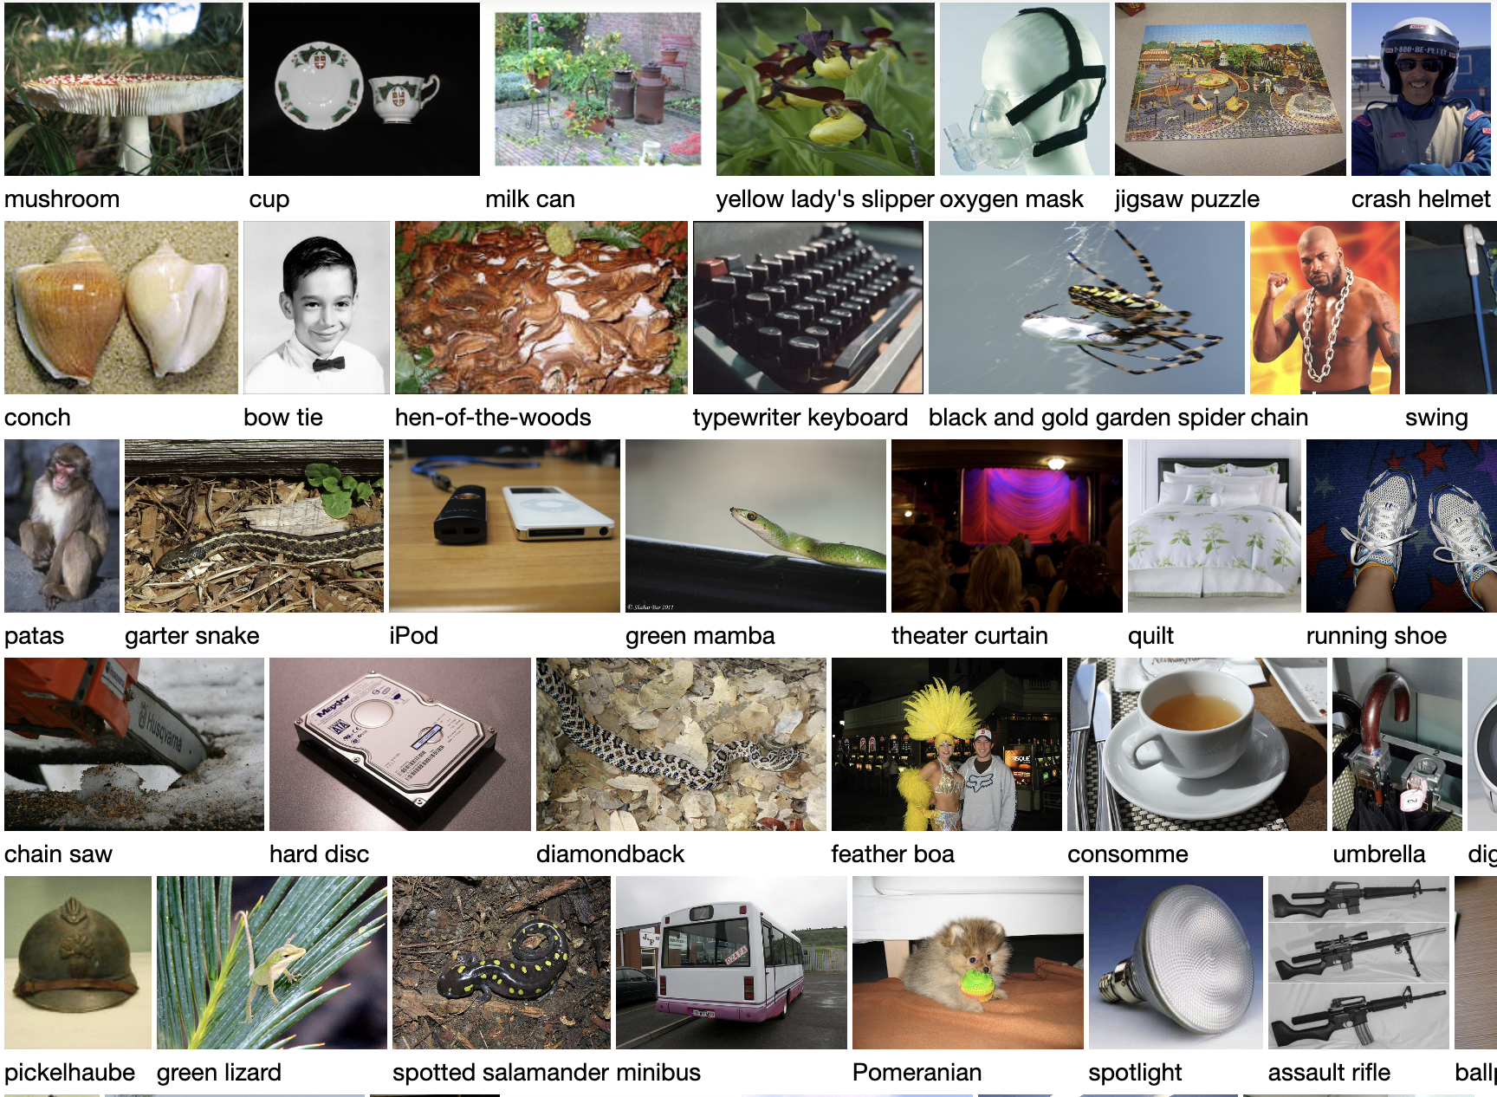
The structure of the ILSVR2012 contest task
Training data: 1.28 million images in 1000 classes
How do we measure genuine learning?
How can we tell if a computer has learned the actual difference between a “spotted salamander” and a “diamondback”?
Is it cheating to just store and memorize all 1.28 million cases?

Slide 8
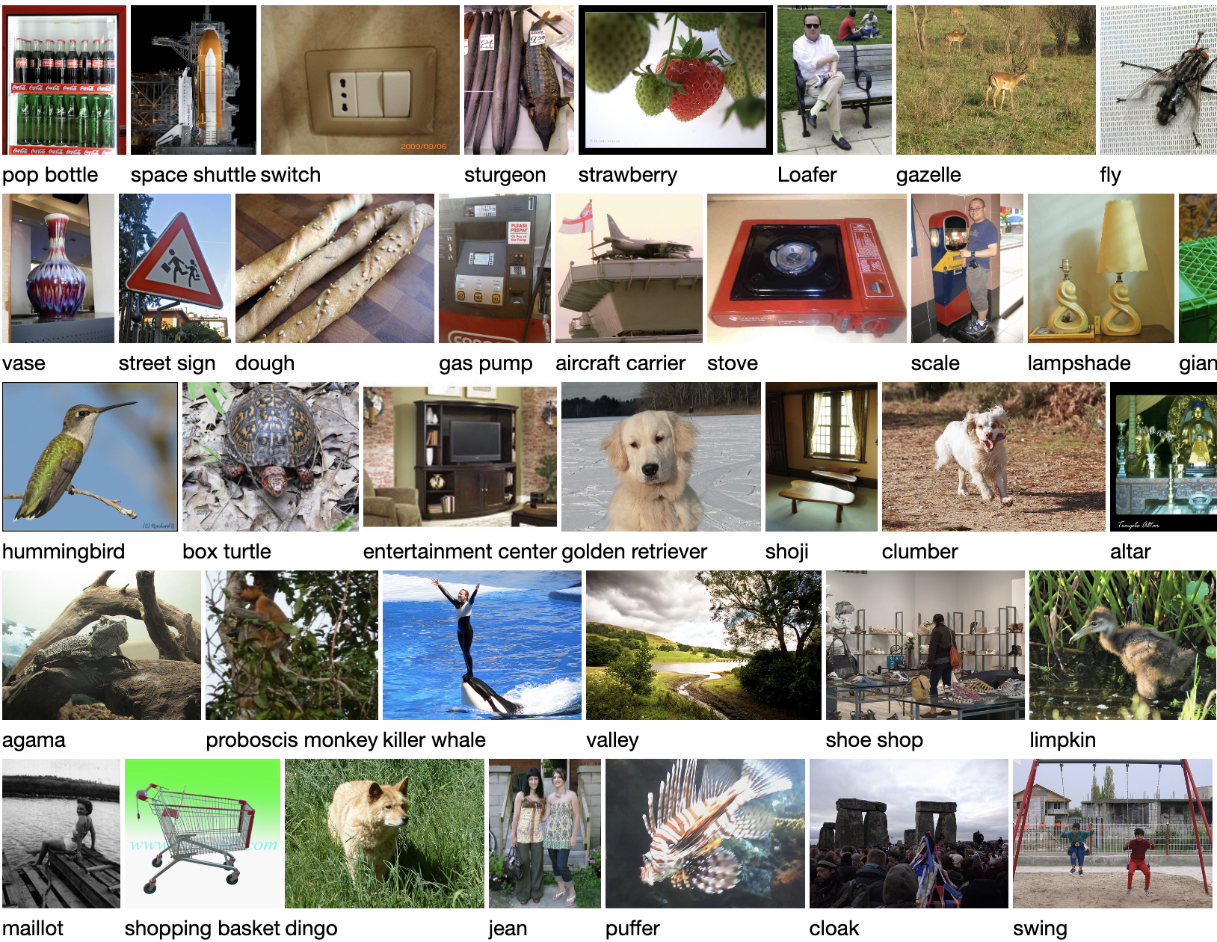
The key goal: Generalization
Training data: 1.28 million images in 1000 classes
How do we measure genuine learning?
Test data: 52,000 held out images

Slide 9
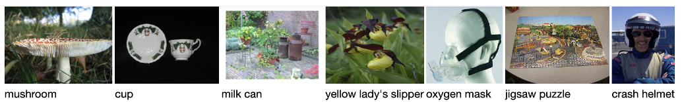
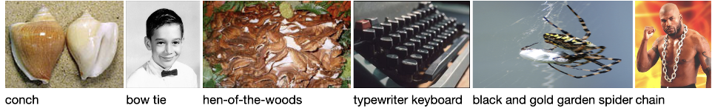
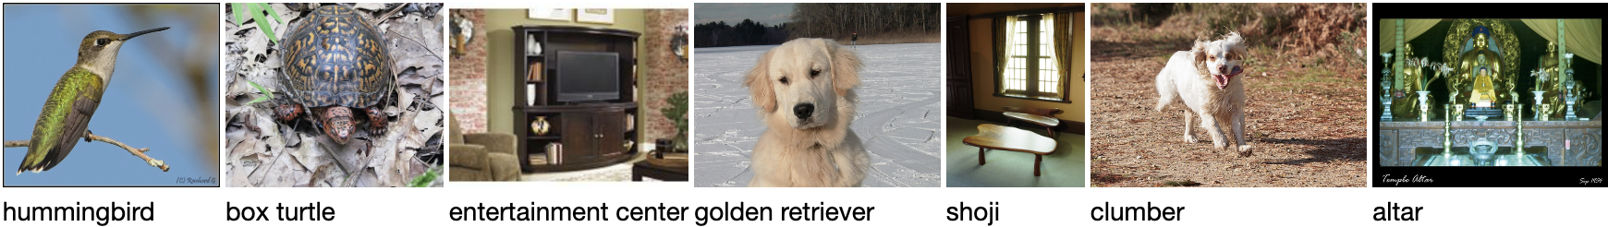
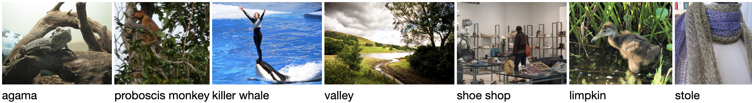
The rules of the classification game
The computer is allowed to learn from the training set.
Performance is tested on a held-out test set unseen during training.
In a formal contest, there are two test sets.
  A labeled validation set used by contestants to measure their algorithms
  A test set with labels that are never revealed to contestants.
[What is not tested by this contest?]

Slide 10
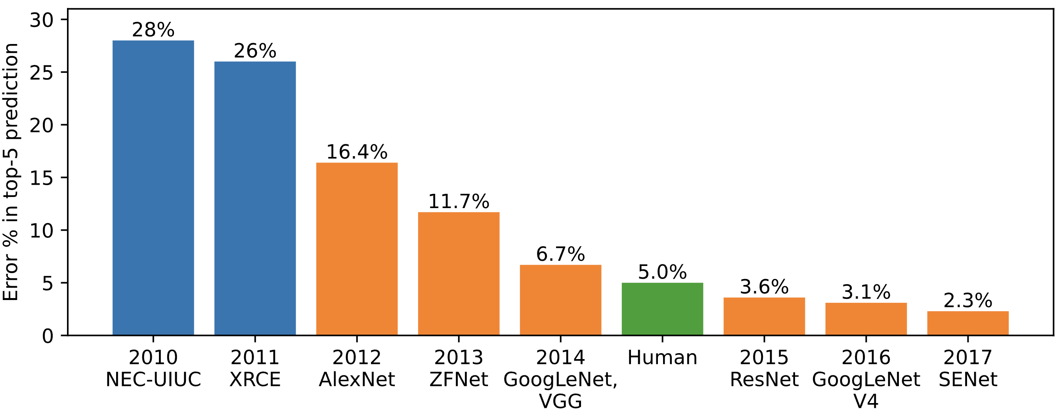
Imagenet Contest Results
ILSVRC was really hard.
Instead of measuring accuracy, they had to report “Top-5 accuracy”.
On 26% of test cases, the world’s best vision algorithms could not guess the right label even given five chances to try.
Traditional
computer vision

Slide 11
Imagenet Contest Results
ILSVRC was really hard.
Then in 2012, a shock.
Neural networks had been written off by the community. But Alex Krizhevsky’s network from Hinton’s lab made ILSVRC look like a much easier problem.
Shock
Shock
Traditional
computer vision

Slide 12
Imagenet Contest Results
Shock
Shock
Traditional
computer vision
That year, the whole field flipped to convolutional nets

Slide 13

The SOTA Game
https://paperswithcode.com/sota/image-classification-on-imagenet

Slide 14
Seven spicy ingredients for SOTA
Symmetric data augmentation
  Make training data go farther by making random symmetry transforms.
Convolutions
  Use economical convolutions to guarantee equivariances.
Weight decay
  Improve generalization and simpler solutions by encouraging small parameters.
Dropout
  Train the network to be robust to missing features by randomly dropping neurons.
Batchnorm
  Improve the geometry of learning by normalizing internal signals.
Residual connections
  Distribute gradients quickly into deep layers by exploiting the addition operator.
ADAM optimizer
  Update weights by making faster updates when you can exploit a smooth gradient.

Slide 15
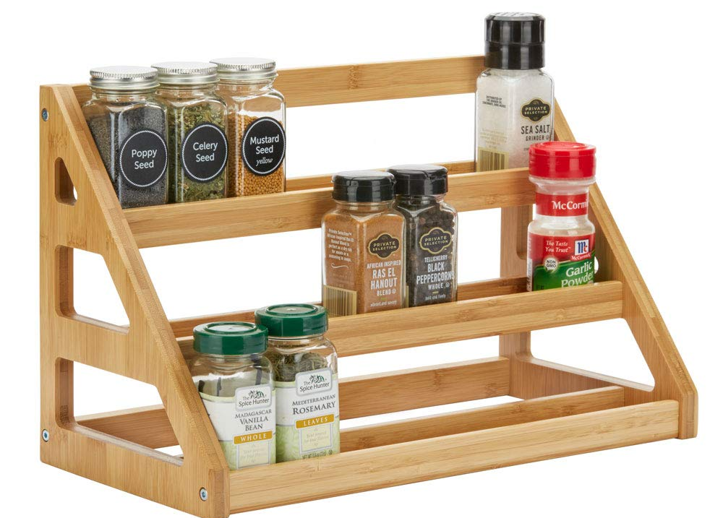
Resi
dual
Batch
norm
Convolution
Data
augmentation
ADAM
Weight
decay
Drop
out
SOTA spice rack

Slide 16
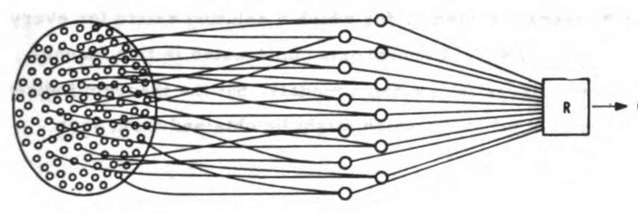
Balancing data and parameters for generalization
Small model
Huge training data
If the model is too small:
there will not enough computational capacity to learn the problem

Slide 17
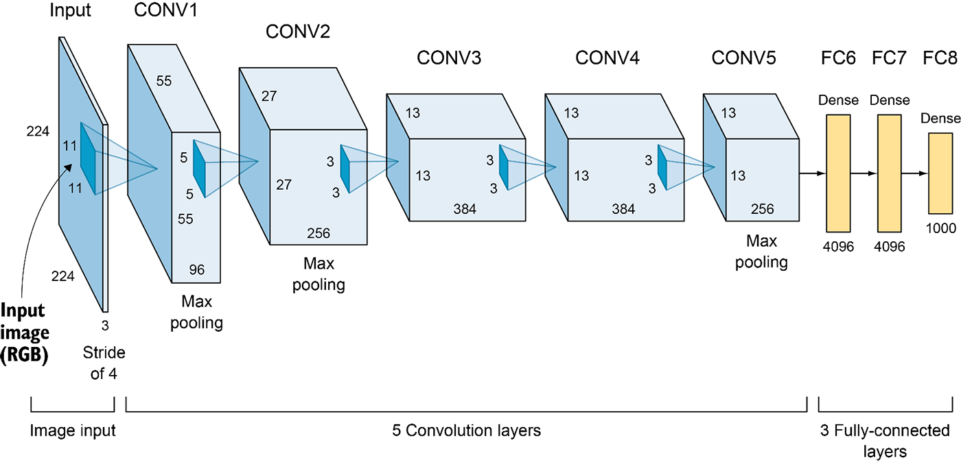
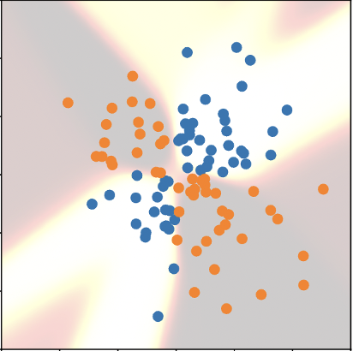
Balancing data and parameters for generalization
Huge training data
Massive deep net
If the model is too big:
it will overfit to the examples instead of learning generalizable rules

Slide 18
Balancing data and parameters for generalization
Huge training data
somehow
somehow
Massive deep net
So we must make big models smaller (exploiting symmetries)
and make huge data even bigger (exploiting symmetries)

Slide 19
What is a symmetry?

Slide 20
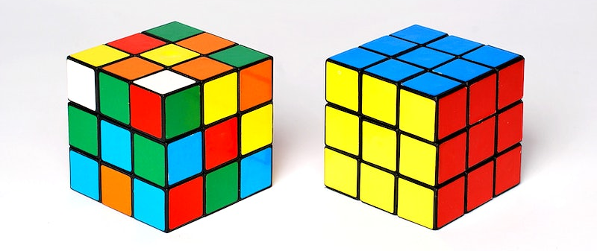
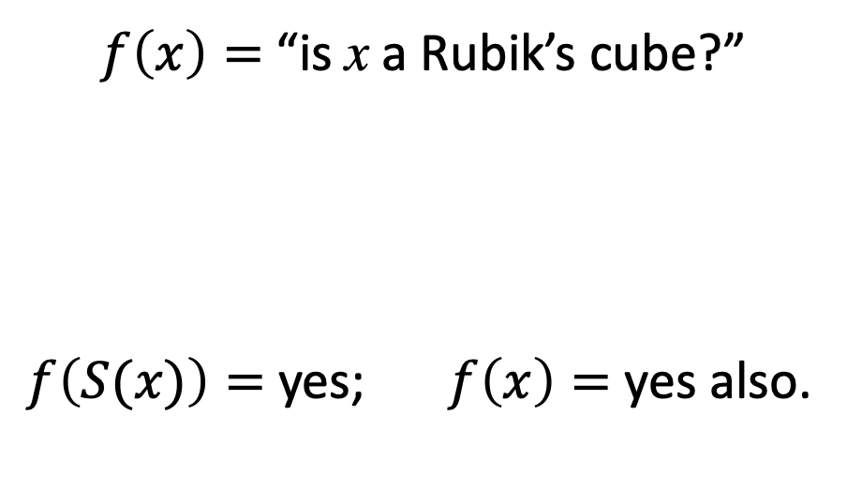

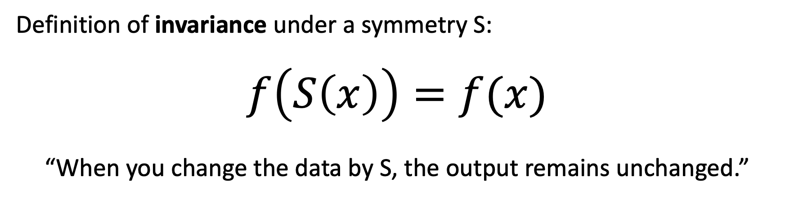
What is a symmetry $S(x)$?
Definition of invariance under a symmetry S:
$$f\left(S\left(x\right)\right)=f(x)$$
“When you change the data by S, the output remains unchanged.”
$f\left(x\right)=$“is x a Rubik’s cube?”
$f\left(S(x)\right)=$ yes; $f\left(x\right)=$ yes also.
A Rubik’s cube has
2125922464947725402112000
ways of changing it
and it remains a
Rubik’s cube
We don’t have trillions
of separate neurons
for Rubik’s cubes.
Mostly we think of
them all the same.

Slide 21
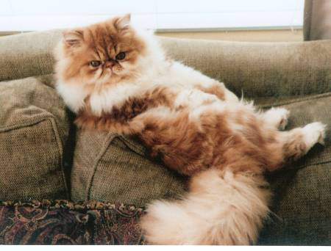
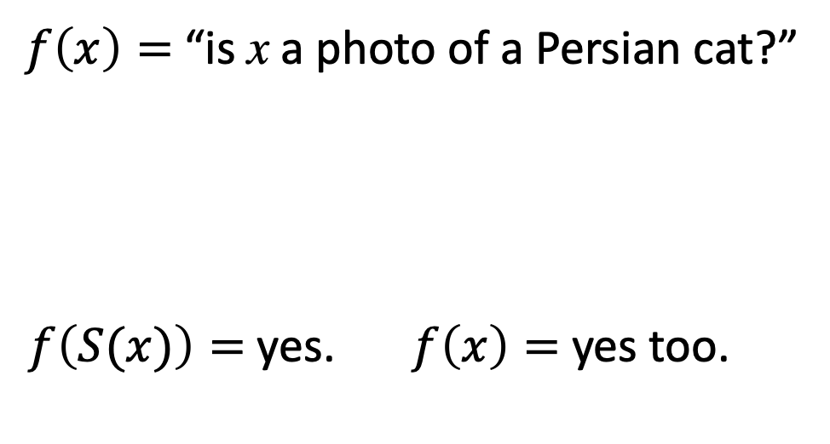
What is a symmetry $S(x)$?
Definition of invariance under a symmetry S:
$$f\left(S\left(x\right)\right)=f(x)$$
“When you change the data by S, the output remains unchanged.”
$f\left(x\right)=$“is x a photo of a Persian cat?”
$f\left(S(x)\right)=$ yes. $f\left(x\right)=$ yes too.
There are just
2 horizontal
reflection images
A “cat recognizer”
should treat the two
reflections the same

Slide 22
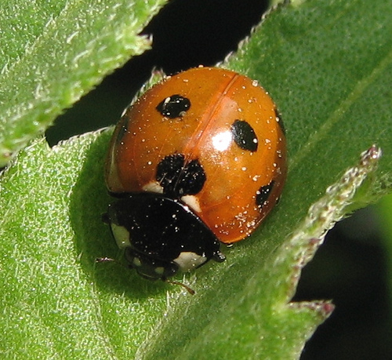
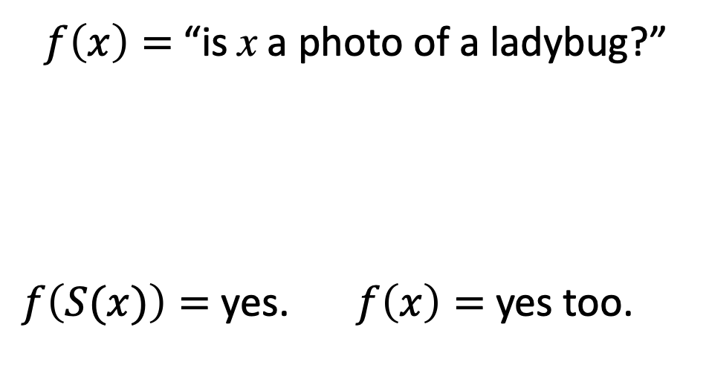
What is a symmetry $S(x)$?
Definition of invariance under a symmetry S:
$$f\left(S\left(x\right)\right)=f(x)$$
“When you change the data by S, the output remains unchanged.”
$f\left(x\right)=$“is x a photo of a ladybug?”
$f\left(S(x)\right)=$ yes. $f\left(x\right)=$ yes too.
Every image has
many translations,
rotations, resizes
These symmetries
(almost) never change
the classification

Slide 23
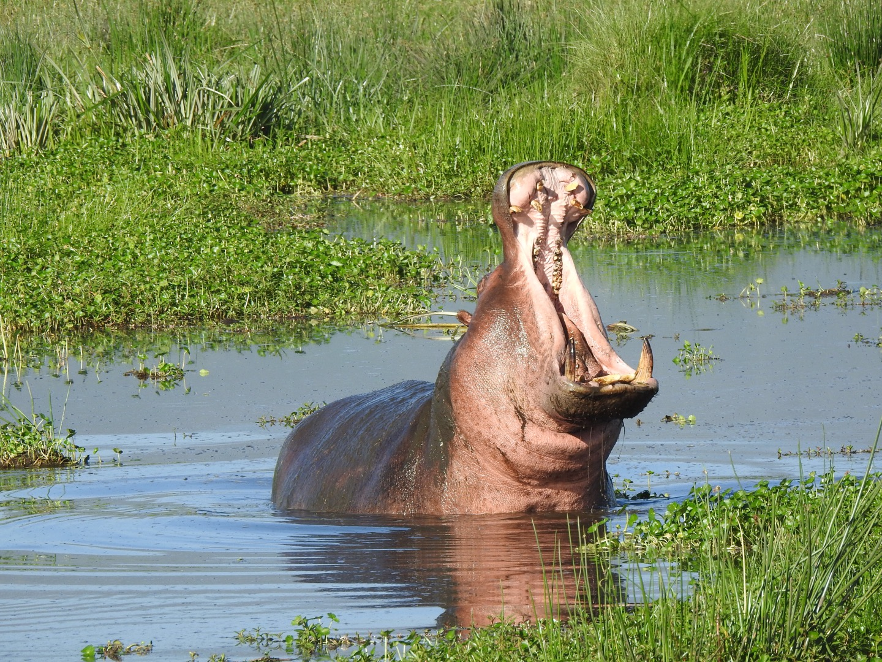
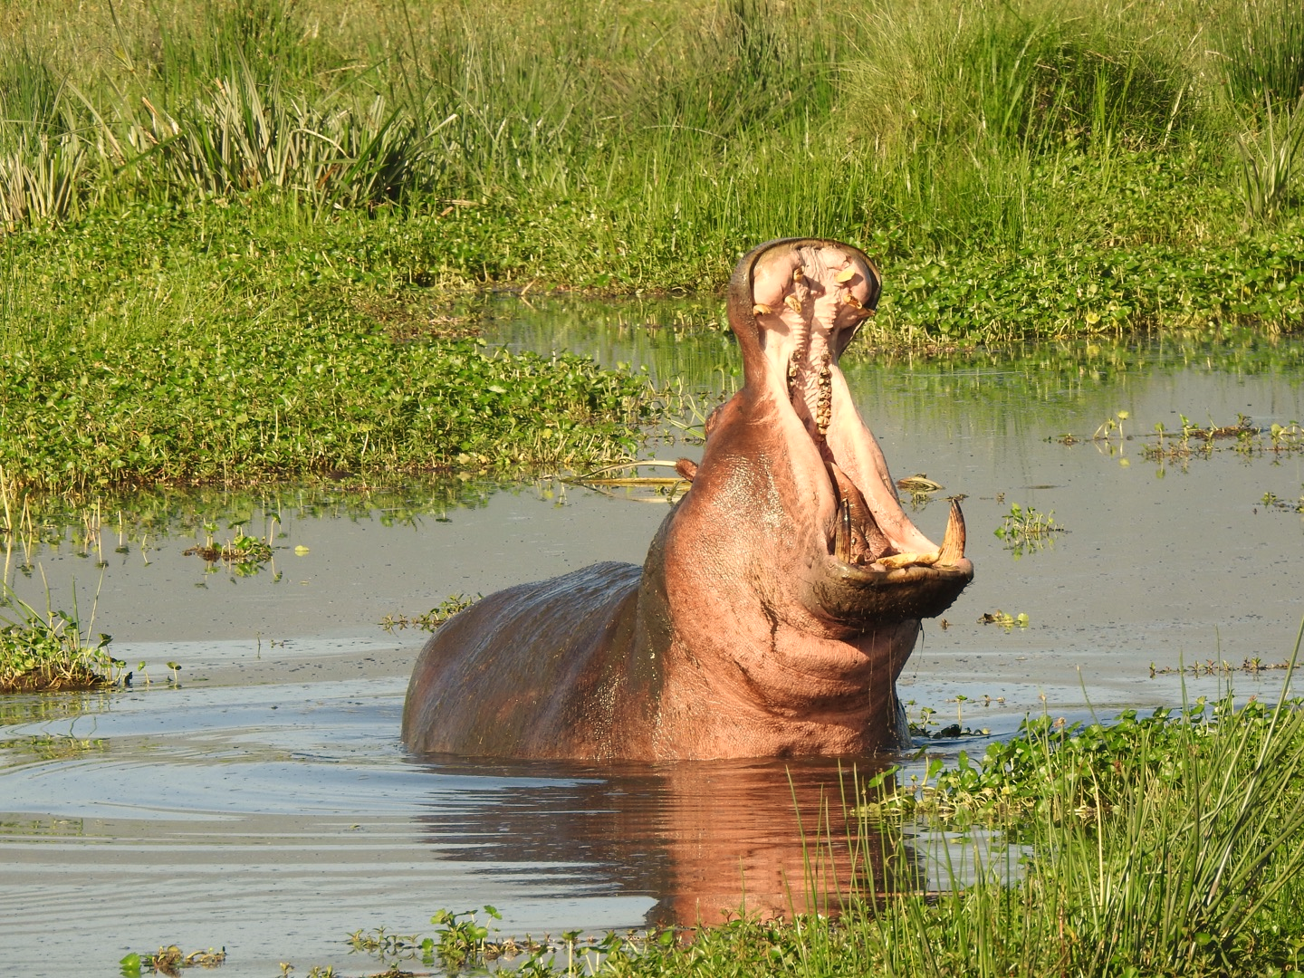
Symmetries are used for data augmentation
Hippo
Hippo?
Hippo?
Hippo?
Horizontal
Flip
Color
Jitter
Image Cropping
Original
imagenet image
Equivalent to thousands of extra hippo pictures!
Slide credit: D Fouhey & J Johnson

Slide 24
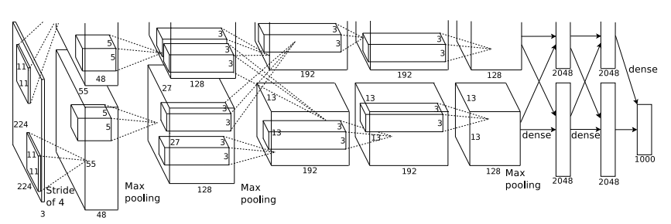
Regularizing through data augmentation
Apply random transformations to input images during training
Artificially “inflate” the size of your dataset
Hippo
Hippo
Training Image
Augmented images
Slide credit: D Fouhey & J Johnson

Slide 25


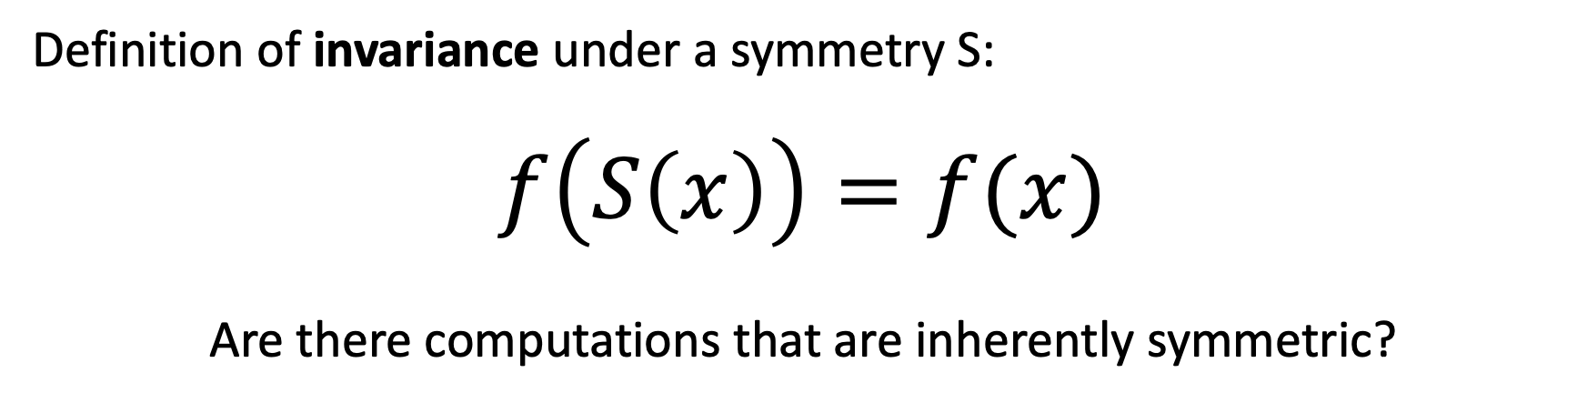
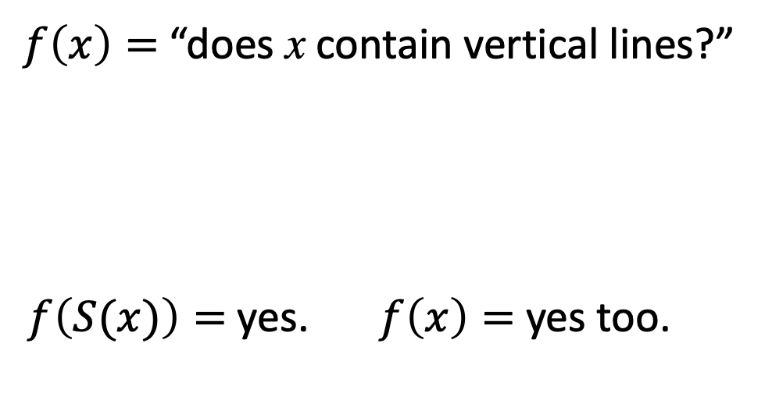
Can we guarantee symmetry in our network?
Definition of invariance under a symmetry S:
$$f\left(S\left(x\right)\right)=f(x)$$
Are there computations that are inherently symmetric?
$f\left(x\right)=$“does x contain vertical lines?”
$f\left(S(x)\right)=$ yes. $f\left(x\right)=$ yes too.
Actually, the precise
idea is slightly
more subtle...
What about
convolutions?

Slide 26
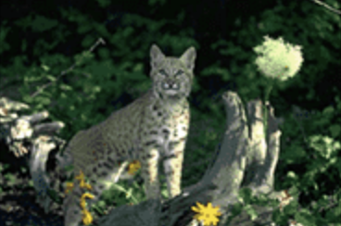
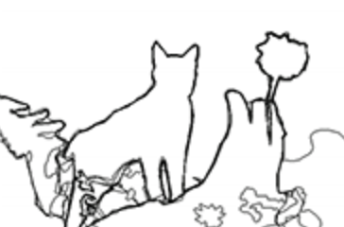

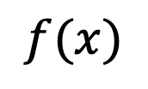

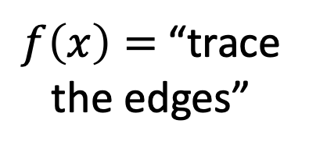
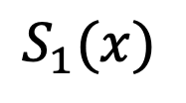



What if $f\left(x\right)$ outputs an image?
$$S_{1}$$
reflection
$$x$$
$$S_{1}(x)$$
$f\left(x\right)=$“trace
the edges”
$$f$$
$$f$$
We don’t want
the output to be
exactly the same...
$$f(x)$$
[Image from Xe and Tu 2015]

Slide 27

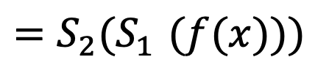

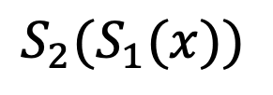
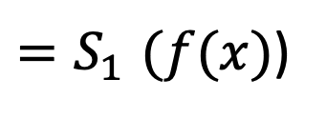

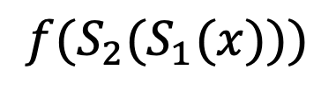

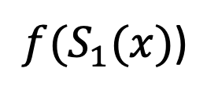
What if $f\left(x\right)$ outputs an image?
$$S_{1}$$
$$S_{2}$$
reflection
translation
$$x$$
$$S_{1}(x)$$
$${S_{2}(S}_{1}(x))$$
$f\left(x\right)=$“trace
the edges”
$$f$$
$$f$$
$$f$$
$$S_{1}$$
$$S_{2}$$
reflection
translation
$$f(x)$$
${f(S}_{1}(x)$)
$$f({S_{2}(S}_{1}(x)))$$
${=S}_{1}(f(x)$)
$${=S_{2}(S}_{1}(f(x)))$$
[Image from Xe and Tu 2015]

Slide 28


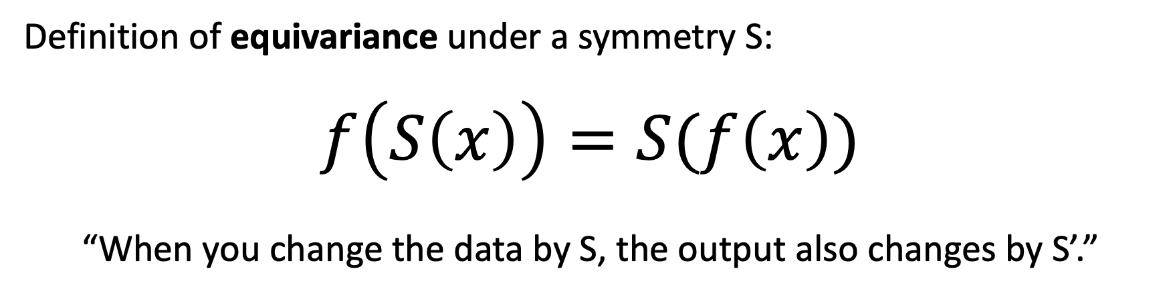

What operations will guarantee symmetry
Definition of equivariance under a symmetry S:
$$f\left(S\left(x\right)\right)=S(f\left(x\right))$$
“When you change the data by S, the output also changes by S’.”
$$S$$
translation
$$f$$
$$f$$
$$S$$
translation

Slide 29
Discussion: what equivariances does convolution have?
weighted sum
INPUT
OUTPUT

Slide 30
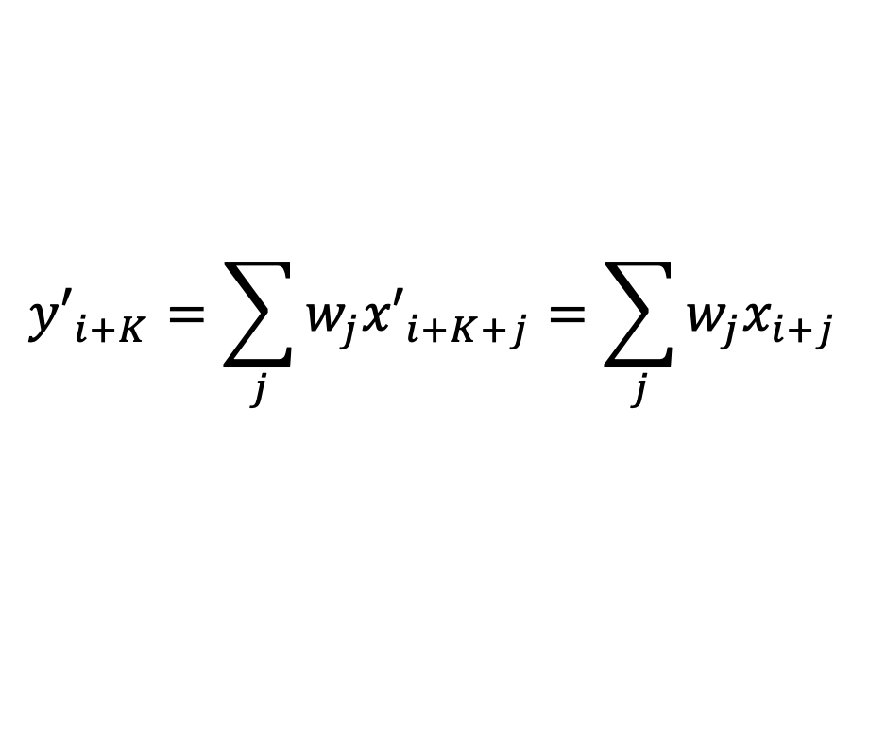



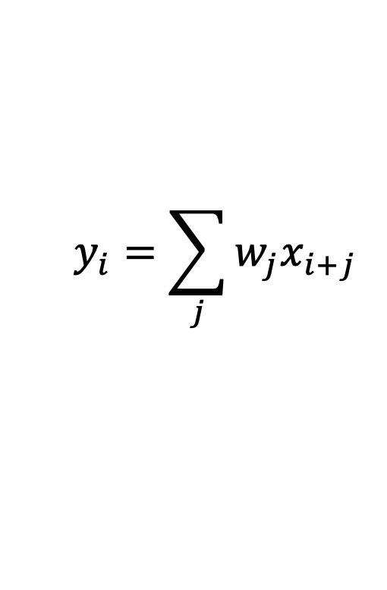


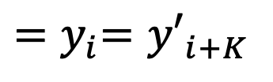
Reasoning about translation equivariance
$$x_{i−1}$$
$$x_{i}$$
$$x_{i+1}$$
0
0
0
0
0
0
1
2
1
0
1
1
0
0
0
0
0
0
0
0
weighted
sum
$$y_{i}=\sum_{j}{w_{j}x_{i+j}}$$
-0.5
+1.0
-0.5
0.0
0.0
0.0
0.0
0.0
-0.5
0.0
+1.0
0.0
-1.0
+0.5
+0.5
-0.5
0.0
0.0
0.0
0.0
0.0
0.0
0.0
$$y_{i}$$
$${y′}_{i+K}=\sum_{j}{w_{j}{x′}_{i+K+j}}=\sum_{j}{w_{j}x_{i+j}}$$
$${x′}_{i+K}=x_{i}$$
$${=y}_{i}={y′}_{i+K}$$
translate the input...
gives weighted sums of shifted data...
translates output!

Slide 31

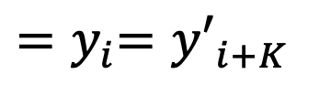

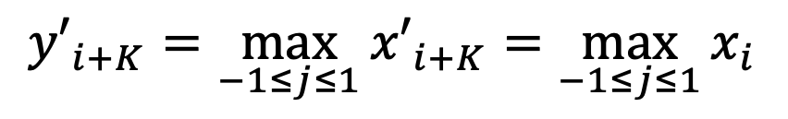

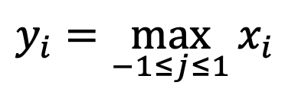
“Max pooling” is also equivariant
$$x_{i−1}$$
$$x_{i}$$
$$x_{i+1}$$
0
0
0
0
0
0
1
2
1
0
1
1
0
0
0
0
0
0
0
0
max over
a window
$$y_{i}=\max_{−1≤j≤1}{x_{i}}$$
$$≤$$
$$≤$$
$$≤$$
0.0
0.0
0.0
0.0
0.0
+1.0
+2.0
+2.0
+2.0
+1.0
+1.0
+1.0
+1.0
0.0
0.0
0.0
0.0
0.0
0.0
0.0
$$y_{i}$$
$${x′}_{i+K}=x_{i}$$
$${y′}_{i+K}=\max_{−1≤j≤1}{{x′}_{i+K}}=\max_{−1≤j≤1}{x_{i}}$$
$${=y}_{i}={y′}_{i+K}$$
translate the input...
gives windowed max of shifted data...
translates output!

Slide 32

Caveat about translation equivariance
This argument assumes no edges...
[Ed Miracle, “I told you so”]

Slide 33
Convolution spatial dimensions
Input: 7x7
Filter: 3x3
Q: How big is output?
7
7
Slide credit: D Fouhey & J Johnson

Slide 34
Convolution spatial dimensions
Input: 7x7
Filter: 3x3
Q: How big is output?
7
7
Slide credit: D Fouhey & J Johnson

Slide 35
Convolution spatial dimensions
Input: 7x7
Filter: 3x3
Q: How big is output?
7
7
Slide credit: D Fouhey & J Johnson

Slide 36
Convolution spatial dimensions
Input: 7x7
Filter: 3x3
Q: How big is output?
7
7
Slide credit: D Fouhey & J Johnson

Slide 37
Convolution spatial dimensions
Input: 7x7
Filter: 3x3
Output: 5x5
7
7
Slide credit: D Fouhey & J Johnson

Slide 38
Convolution spatial dimensions
Input: 7x7
Filter: 3x3
Output: 5x5
Problem: Feature maps “shrink” with each layer!
In general:
Input: W
Filter: K
Output: W – K + 1
7
7
Slide credit: D Fouhey & J Johnson

Slide 39
Convolution spatial dimensions
Input: 7x7
Filter: 3x3
Output: 5x5
0 | 0 | 0 | 0 | 0 | 0 | 0 | 0 | 0
0 |  |  |  |  |  |  |  | 0
0 |  |  |  |  |  |  |  | 0
0 |  |  |  |  |  |  |  | 0
0 |  |  |  |  |  |  |  | 0
0 |  |  |  |  |  |  |  | 0
0 |  |  |  |  |  |  |  | 0
0 |  |  |  |  |  |  |  | 0
0 | 0 | 0 | 0 | 0 | 0 | 0 | 0 | 0
Problem: Feature maps “shrink” with each layer!
In general:
Input: W
Filter: K
Padding: P
Solution: padding
Add zeros around the input
Slide credit: D Fouhey & J Johnson

Slide 40
Convolution spatial dimensions
Input: 7x7
Filter: 3x3
Output: 5x5
0 | 0 | 0 | 0 | 0 | 0 | 0 | 0 | 0
0 |  |  |  |  |  |  |  | 0
0 |  |  |  |  |  |  |  | 0
0 |  |  |  |  |  |  |  | 0
0 |  |  |  |  |  |  |  | 0
0 |  |  |  |  |  |  |  | 0
0 |  |  |  |  |  |  |  | 0
0 |  |  |  |  |  |  |  | 0
0 | 0 | 0 | 0 | 0 | 0 | 0 | 0 | 0
In general:
Input: W
Filter: K
Padding: P
Output: W – K + 1 + 2P
Very common: “same padding”
Set P = (K – 1) / 2
Then output size = input size
Slide credit: D Fouhey & J Johnson

Slide 41

One-Minute Questions
Help us!
Answer the questions on the form here:
https://bit.ly/cs7150-f2022-5

Slide 42
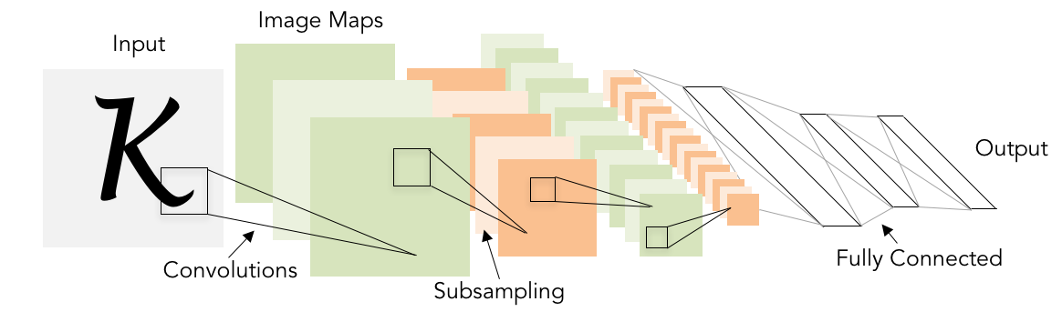
But we want to shrink the data!
Classic architecture:
[Conv, ReLU, Pool] x N, flatten, [FC, ReLU] x N, FC
Example: Yann LeCun’s LeNet-5
Lecun et al, “Gradient-based learning applied to document recognition”, 1998
Slide credit: D Fouhey & J Johnson

Slide 43
Receptive fields
For convolution with kernel size K, each element in the output depends on a K x K receptive field in the input
Input
Output
Slide credit: D Fouhey & J Johnson

Slide 44
Receptive fields
Each successive convolution adds K – 1 to the receptive field size
With L layers the receptive field size is 1 + L * (K – 1)
Input
Output
Careful – ”receptive field in the input”
vs “receptive field in the previous layer”
Hopefully clear from context!
Slide credit: D Fouhey & J Johnson

Slide 45
Receptive fields
Each successive convolution adds K – 1 to the receptive field size
With L layers the receptive field size is 1 + L * (K – 1)
Input
Output
Problem: For large images we need many layers for each output to “see” the whole image image
Slide credit: D Fouhey & J Johnson

Slide 46
Receptive fields
Each successive convolution adds K – 1 to the receptive field size
With L layers the receptive field size is 1 + L * (K – 1)
Input
Output
Problem: For large images we need many layers for each output to “see” the whole image image
Solution: Downsample inside the network
Slide credit: D Fouhey & J Johnson

Slide 47
Strided convolution
Input: 7x7
Filter: 3x3
Stride: 2
Slide credit: D Fouhey & J Johnson

Slide 48
Strided convolution
Input: 7x7
Filter: 3x3
Stride: 2
Slide credit: D Fouhey & J Johnson

Slide 49
Strided convolution
Input: 7x7
Filter: 3x3
Stride: 2
Output: 3x3
Slide credit: D Fouhey & J Johnson

Slide 50
Strided convolution
Input: 7x7
Filter: 3x3
Stride: 2
Output: 3x3
In general:
Input: W
Filter: K
Padding: P
Stride: S
Output: (W – K + 2P) / S + 1
Slide credit: D Fouhey & J Johnson

Slide 51
Convolution data size example
Input volume: 3 x 32 x 32
10 5x5 filters with stride 1, pad 2
Output volume size: ?
Slide credit: D Fouhey & J Johnson

Slide 52
Convolution data size example
Input volume: 3 x 32 x 32
10 5x5 filters with stride 1, pad 2
Output volume size:
(32+2*2-5)/1+1 = 32 spatially, so
10 x 32 x 32
Slide credit: D Fouhey & J Johnson

Slide 53
Convolution data size example
Input volume: 3 x 32 x 32
10 5x5 filters with stride 1, pad 2
Output volume size: 10 x 32 x 32
Number of learnable parameters: ?
Slide credit: D Fouhey & J Johnson

Slide 54
Convolution data size example
Input volume: 3 x 32 x 32
10 5x5 filters with stride 1, pad 2
Output volume size: 10 x 32 x 32
Number of learnable parameters: 760
Parameters per filter: 3*5*5 + 1 (for bias) = 76
10 filters, so total is 10 * 76 = 760
Slide credit: D Fouhey & J Johnson

Slide 55
Convolution data size example
Input volume: 3 x 32 x 32
10 5x5 filters with stride 1, pad 2
Output volume size: 10 x 32 x 32
Number of learnable parameters: 760
Number of multiply-add operations: ?
Slide credit: D Fouhey & J Johnson

Slide 56
Convolution data size example
Input volume: 3 x 32 x 32
10 5x5 filters with stride 1, pad 2
Output volume size: 10 x 32 x 32
Number of learnable parameters: 760
Number of multiply-add operations: 768,000
10*32*32 = 10,240 outputs; each output is the inner product of two 3x5x5 tensors (75 elems); total = 75*10240 = 768K
Slide credit: D Fouhey & J Johnson

Slide 57
Convolution summary
Input: C_{in} x H x W
Hyperparameters:
Kernel size: K_{H} x K_{W}
Number filters: C_{out}
Padding: P
Stride: S
Weight matrix: C_{out} x C_{in} x K_{H} x K_{W} giving C_{out} filters of size C_{in} x K_{H} x K_{W}
Bias vector: C_{out}
Output size: C_{out} x H’ x W’ where:
H’ = (H – K + 2P) / S + 1
W’ = (W – K + 2P) / S + 1
Slide credit: D Fouhey & J Johnson

Slide 58
Convolution summary
Input: C_{in} x H x W
Hyperparameters:
Kernel size: K_{H} x K_{W}
Number filters: C_{out}
Padding: P
Stride: S
Weight matrix: C_{out} x C_{in} x K_{H} x K_{W} giving C_{out} filters of size C_{in} x K_{H} x K_{W}
Bias vector: C_{out}
Output size: C_{out} x H’ x W’ where:
H’ = (H – K + 2P) / S + 1
W’ = (W – K + 2P) / S + 1
Common settings:
K_{H} = K_{W} (Small square filters)
P = (K – 1) / 2 (”Same size” padding)
C_{in}, C_{out} = 32, 64, 128, 256 (powers of 2)
K = 3, P = 1, S = 1 (3x3 conv)
K = 1, P = 0, S = 1 (1x1 conv)
K = 3, P = 1, S = 2 (Downsample by 2)
Number of multiply-add operations:
C_{out} x C_{in} x K_{H} x K_{W} x H’ x W’
a lot of calculation!
Slide credit: D Fouhey & J Johnson

Slide 59

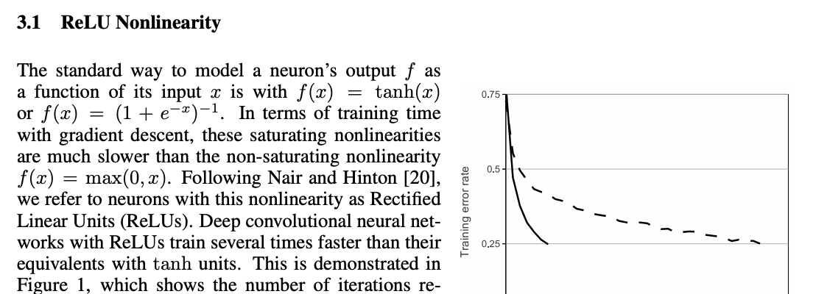

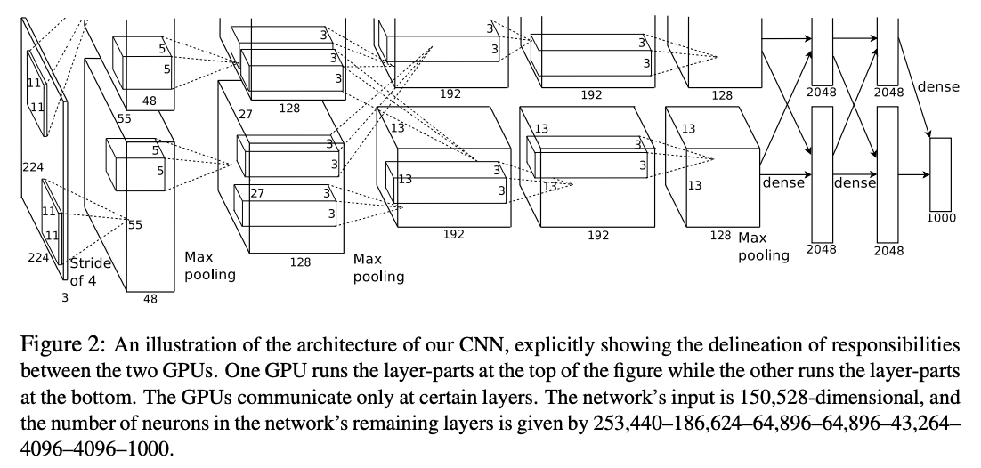
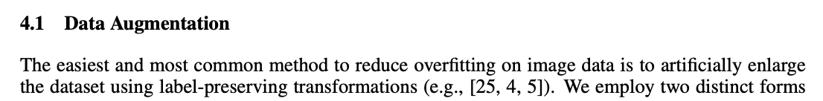
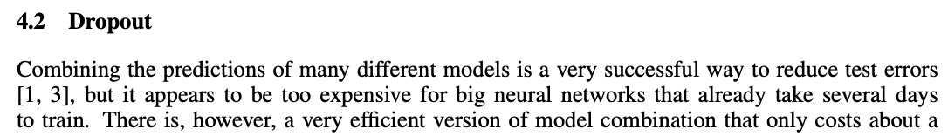
2012:
Krizhevsky Sutskever Hinton
Alexnet wins ILSVRC
Illya Sutskever

Slide 60
Alexnet architecture
(strided to 13x13)
(strided to 6x6)
(strided to 27x27)
Question: how many parameters in conv3?
3x3x256x384 = 884,736
How many parameters in fc6?
256x6x6x4096 = 37,748,376 (!!!!!!)

Slide 61
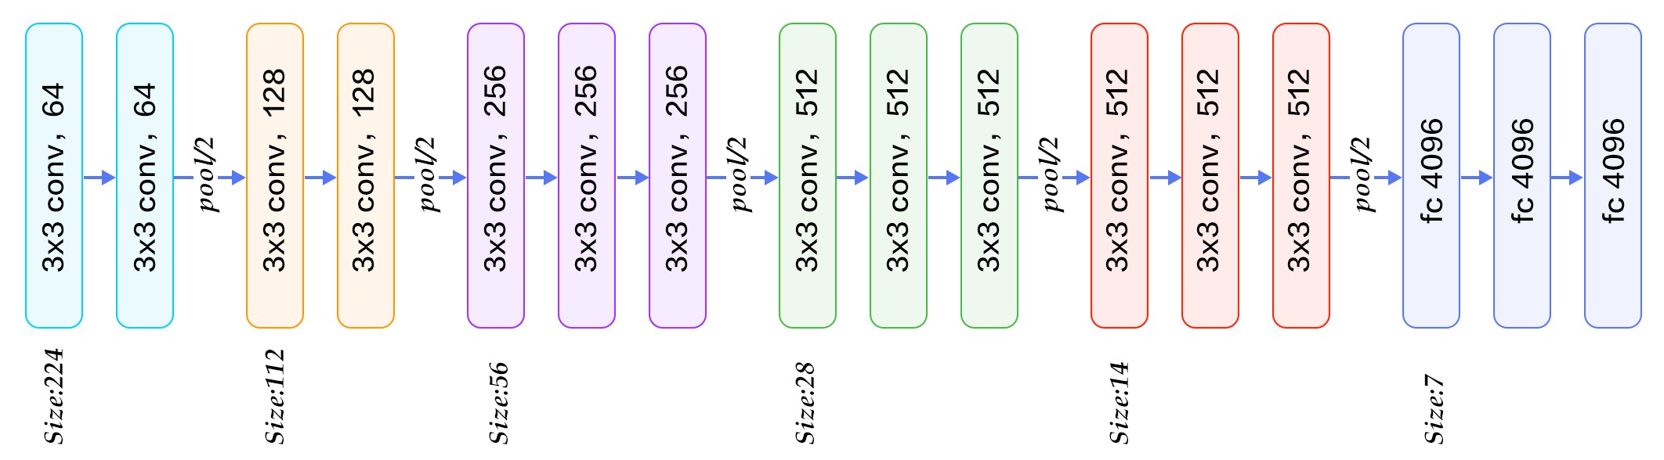
VGG architecture: “fully convolutional”
Giant
1x1 conv,
same as FC
Idea: 3x3 convolutions all the way down
More equivariance than a “flatten 13x13” layer at the end

Slide 62
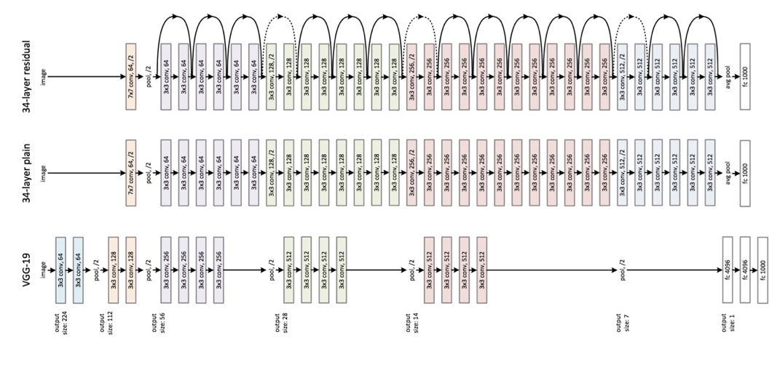
Resnet architecture: super-deep convs
No more
FC layer!
Several tricks to make backprop effective at 100+ 3x3 layers

Slide 63
Balancing data and parameters for generalization
Huge training data
Data
augmentations
Lightweight convolutions
Massive deep net
Now we have made big models smaller (exploiting symmetries)
and made huge data even bigger (exploiting symmetries)

Slide 64

More tricks for generalization
Huge training data
Data
augmentations
Weight decay
Lightweight convolutions
Massive deep net
Make the parameters even lighter
using weight decay (L2 regularization)

Slide 65



Weight decay
When parameters get too large, they learn a bumpy function
Classic solution from regression:
$$ℒ_{WD}=\sum_{i}{{\left\|w_{i}\right\|}^{2}}$$
$$ℒ_{total}={ℒ_{classification}+λℒ}_{WD}$$
Pushes weights toward zero.

Slide 66
(Class ended here)

Slide 67

More tricks for generalization
Huge training data
Data
augmentations
Weight decay
Lightweight convolutions
Dropout
Massive deep net
Simulate data that is even more diverse
using dropout (feature randomization)

Slide 68

Regularization: Dropout
“randomly set some neurons to zero in the forward pass”
Randomly set the output value of some neurons to be 0
[Srivastava et al., 2014]
Slide credit: E. Learned-Miller, originally developed by Andrej Karpathy, Justin Johnson, Fei-Fei Li

Slide 69

Waaaait a second…
How could this possibly be a good idea?
Slide credit: E. Learned-Miller, originally developed by Andrej Karpathy, Justin Johnson, Fei-Fei Li

Slide 70
Waaaait a second…
How could this possibly be a good idea?
Forces the network to have a redundant representation.
has an ear
X
has a tail
is furry
X
cat
score
has claws
X
mischievous
look
Slide credit: E. Learned-Miller, originally developed by Andrej Karpathy, Justin Johnson, Fei-Fei Li

Slide 71









Training with occlusions?
Slide credit: E. Learned-Miller, originally developed by Andrej Karpathy, Justin Johnson, Fei-Fei Li

Slide 72
Waaaait a second…
How could this possibly be a good idea?
Another interpretation:
Dropout is training a large ensemble of models (that share parameters).
Each binary mask is one model, gets trained on only ~one datapoint.
Slide credit: E. Learned-Miller, originally developed by Andrej Karpathy, Justin Johnson, Fei-Fei Li

Slide 73
Dropout: Test Time
Can in fact do this with a single forward pass! (approximately)
Leave all input neurons turned on (no dropout).
Q: Suppose that with all inputs present at test time the output of this neuron is a.
What would its output be during training time, in expectation? (e.g. if p = 0.5)
Slide credit: E. Learned-Miller, originally developed by Andrej Karpathy, Justin Johnson, Fei-Fei Li

Slide 74
Dropout: Test Time
Can in fact do this with a single forward pass! (approximately)
Leave all input neurons turned on (no dropout).
during test: a = w₀*x + w₁*y
during train:
E[a] = ¼ * (w₀*0 + w₁*0 +
w₀*0 + w₁*y +
w₀*x + w₁*0 +
w₀*x + w₁*y)
= ¼ * (2 w₀*x + 2 w₁*y)
= ½ * (w₀*x + w₁*y)
a
w0
w1
x
y
Slide credit: E. Learned-Miller, originally developed by Andrej Karpathy, Justin Johnson, Fei-Fei Li

Slide 75
At test time….
Can in fact do this with a single forward pass! (approximately)
Leave all input neurons turned on (no dropout).
during test: a = w₀*x + w₁*y
during train:
E[a] = ¼ * (w₀*0 + w₁*0 +
w₀*0 + w₁*y +
w₀*x + w₁*0 +
w₀*x + w₁*y)
= ¼ * (2 w₀*x + 2 w₁*y)
= ½ * (w₀*x + w₁*y)
With p=0.5, using all inputs in the forward pass would inflate the activations by 2x from what the network was “used to” during training!
=> Have to compensate by scaling the activations back down by ½
a
w1
w0
x
y
Slide credit: E. Learned-Miller, originally developed by Andrej Karpathy, Justin Johnson, Fei-Fei Li

Slide 76
✓
Resi
dual
Batch
norm
Convolution
✓
Data
augmentation
ADAM
✓
✓
Weight
decay
Drop
out
SOTA spice rack

