Slide 1

CS 7150
Deep Learning

Slide 2
Project Proposals due Thursday

Slide 3
Topic of the Final Project
How can my team pick a topic?
How much time should the project take?
Do I need to have start of the art performance?
Common Pitfalls and things to avoid.

Slide 4
How can I pick a topic?
Choose a specific PROBLEM:
  Computer vision
    Object classification: which object is shown?
    Object detection: where are all the objects?
    Segmentation: Assign a region type to every pixel in the image.
  Natural Language Processing
    Translation (difficult)
    Language modeling
    Sentiment analysis
    Co-reference resolution
  Other domain
    music genre identification
    simple speech recognition (difficult)
    Visual navigation in a 2D maze with a RL agent

Slide 5

How can I pick a topic?
Search for an existing PAPER
  Search for “deep network research paper on X” for your interest X.
    Search on regular Google,
    scholar.google.com, arXiv
    github
    huggingface
  There are often repositories of
  “the best DL papers about X”, e.g., →
Search for an existing MODEL
    Check for code on github
    Check for downloadable model weights
Search for existing DATA
    Might come with the paper
    Or search on huggingface datasets

Slide 6
How to choose a topic
Choose an area of interest to you.
You must implement your topic.
  You can start with existing code.
  But you must add your own modifications/visualizations/benchmarks.
You should be able to answer four questions:
  What is the model (or models) you are implementing?
  What is the data (can be real or synthetic) you are using?
  What is the method (or paper) and that is your focus?
  What question will you try to answer in your project?
Create a webpage that describes these four things in a few sentences.

Slide 7
How much time should I spend on it?
About the equivalent of 2~3 problem sets. A bit more or less is OK.
As early as possible, get SOMETHING going.
  Example: If I’m doing classification, make sure my basic idea works for just 2 inputs in 2 classes before running it on 2000 inputs in 10 classes.
  Example: If I’m doing detection, make sure my network is better than a simple random network R-CNN without pre-training.
  Example: If I’m visualizing an existing SOTA model, make sure I can run it at all and get out the data I want to visualize.
  Get something going soon! Then improve it. So-called baseline.
Failure case: making a GAN from scratch.
  Many students never get them to work AT ALL! Results are indistinguishable from a random image.

Slide 8
Do I need to have state-of-the-art performance?
In a word, “NO”.
Here’s what you do need to do:
  Do a careful measurement of your model.
  Make comparisons.
For example: if you have variations of your model (say, different architectures), measure the differences in performance.
If needed, you could compare with a naive baseline, e.g., an untrained model, or random performance. You must compare with something.
Try to learn something about what improves or hurts performance.

Slide 9
Common pitfalls
No data set.
  No training data. No test data.
  You should identify a data set before you submit your proposal.
Problem is too vague:
  An ambitious application that covers many problems. Pick one network.
Problem is too hard:
  A problem that has never been solved before. Find an existing approach.
Problem is too expensive:
  Trying to reproduce a difficult area from scratch, without enough computation resources: GANS, speech recognition, voice synthesis, training GPT3, etc.
Get started too late.
  Start early and make sure that you can run something.

Slide 10
Project questions?

Slide 11
SOTA Continued

Slide 12

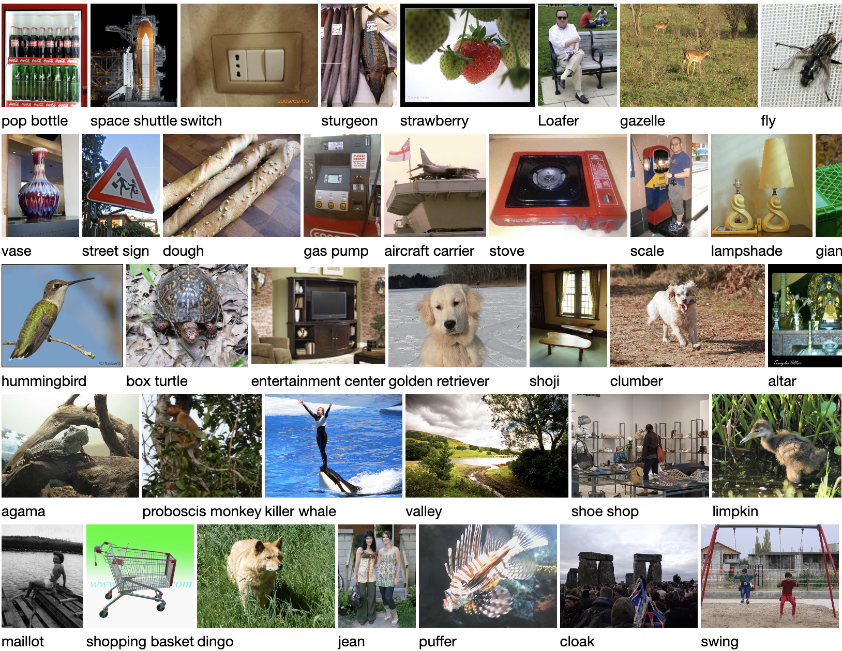
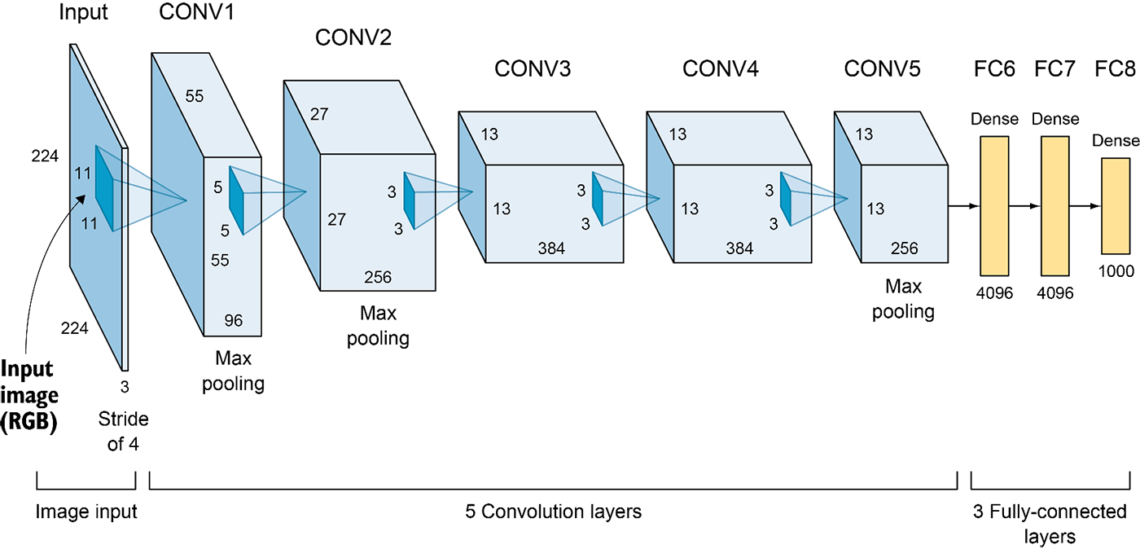
More tricks for generalization
Huge training data
Data
augmentations
Weight decay
Lightweight convolutions
Massive deep net
Make the parameters even lighter
using weight decay (L2 regularization)

Slide 13
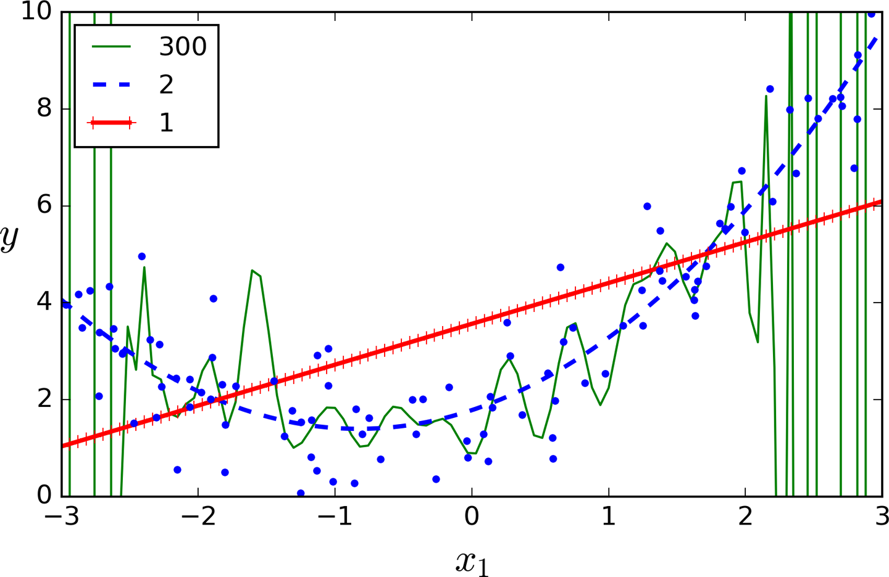
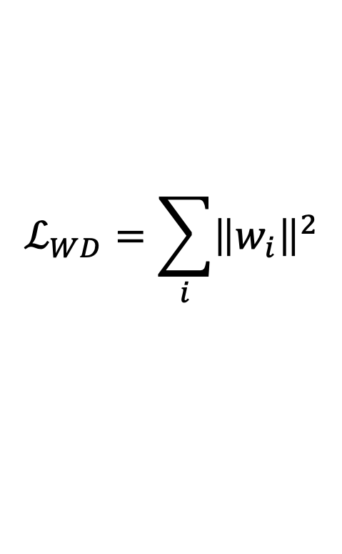

Weight decay
When parameters get too large, they learn a bumpy function
Classic solution from regression:
$$ℒ_{WD}=\sum_{i}{{\left\|w_{i}\right\|}^{2}}$$
$$ℒ_{total}={ℒ_{classification}+λℒ}_{WD}$$
Pushes weights toward zero.

Slide 14

More tricks for generalization
Huge training data
Data
augmentations
Weight decay
Lightweight convolutions
Dropout
Massive deep net
Simulate data that is even more diverse
using dropout (feature randomization)

Slide 15
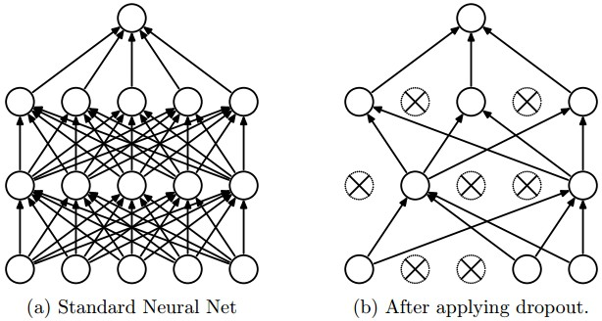
Regularization: Dropout
“randomly set some neurons to zero in the forward pass”
Randomly set the output value of some neurons to be 0
[Srivastava et al., 2014]
Slide credit: E. Learned-Miller, originally developed by Andrej Karpathy, Justin Johnson, Fei-Fei Li

Slide 16
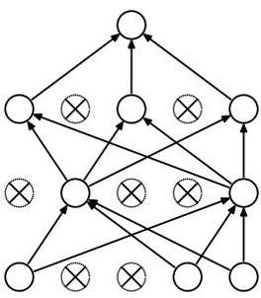
Waaaait a second…
How could this possibly be a good idea?
Slide credit: E. Learned-Miller, originally developed by Andrej Karpathy, Justin Johnson, Fei-Fei Li

Slide 17
Waaaait a second…
How could this possibly be a good idea?
Forces the network to have a redundant representation.
has an ear
X
has a tail
is furry
X
cat
score
has claws
X
mischievous
look
Slide credit: E. Learned-Miller, originally developed by Andrej Karpathy, Justin Johnson, Fei-Fei Li

Slide 18


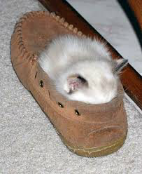
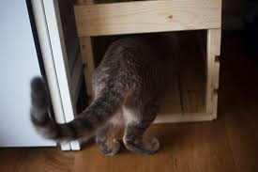

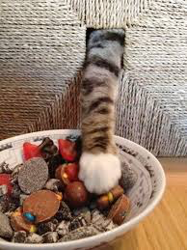
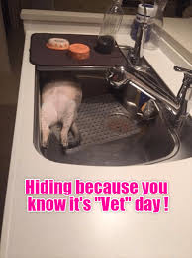

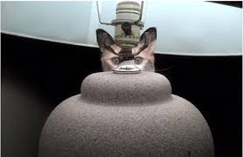
Training with occlusions?
Slide credit: E. Learned-Miller, originally developed by Andrej Karpathy, Justin Johnson, Fei-Fei Li

Slide 19
Waaaait a second…
How could this possibly be a good idea?
Another interpretation:
Dropout is training a large ensemble of models (that share parameters).
Each binary mask is one model, gets trained on only ~one datapoint.
Slide credit: E. Learned-Miller, originally developed by Andrej Karpathy, Justin Johnson, Fei-Fei Li

Slide 20
Dropout: Test Time
Can in fact do this with a single forward pass! (approximately)
Leave all input neurons turned on (no dropout).
Q: Suppose that with all inputs present at test time the output of this neuron is a.
What would its output be during training time, in expectation? (e.g. if p = 0.5)
Slide credit: E. Learned-Miller, originally developed by Andrej Karpathy, Justin Johnson, Fei-Fei Li

Slide 21
Dropout: Test Time
Can in fact do this with a single forward pass! (approximately)
Leave all input neurons turned on (no dropout).
during test: a = w₀*x + w₁*y
during train:
E[a] = ¼ * (w₀*0 + w₁*0 +
w₀*0 + w₁*y +
w₀*x + w₁*0 +
w₀*x + w₁*y)
= ¼ * (2 w₀*x + 2 w₁*y)
= ½ * (w₀*x + w₁*y)
a
w0
w1
x
y
Slide credit: E. Learned-Miller, originally developed by Andrej Karpathy, Justin Johnson, Fei-Fei Li

Slide 22
At test time….
Can in fact do this with a single forward pass! (approximately)
Leave all input neurons turned on (no dropout).
during test: a = w₀*x + w₁*y
during train:
E[a] = ¼ * (w₀*0 + w₁*0 +
w₀*0 + w₁*y +
w₀*x + w₁*0 +
w₀*x + w₁*y)
= ¼ * (2 w₀*x + 2 w₁*y)
= ½ * (w₀*x + w₁*y)
With p=0.5, using all inputs in the forward pass would inflate the activations by 2x from what the network was “used to” during training!
=> Have to compensate by scaling the activations back down by ½
a
w1
w0
x
y
Slide credit: E. Learned-Miller, originally developed by Andrej Karpathy, Justin Johnson, Fei-Fei Li

Slide 23
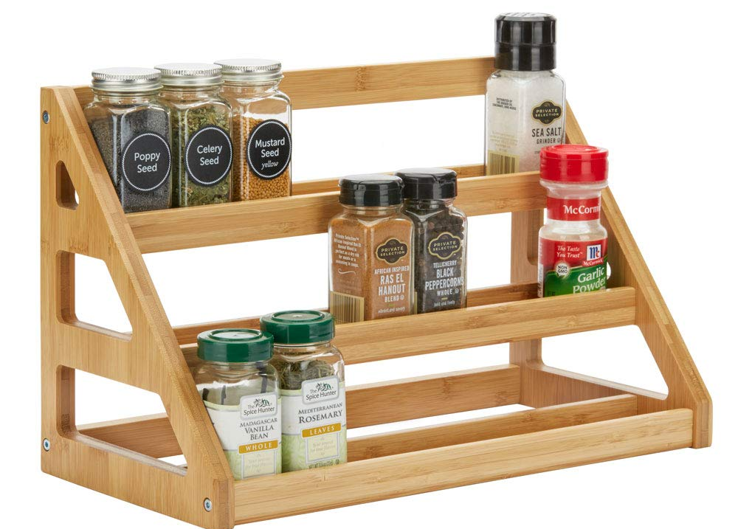
✓
Resi
dual
Batch
norm
Convolution
✓
Data
augmentation
ADAM
✓
✓
Weight
decay
Drop
out
SOTA spice rack

Slide 24
Alexnet architecture
(strided to 13x13)
(strided to 6x6)
(strided to 27x27)
Question: how many parameters in conv3?
3x3x256x384 = 884,736
How many parameters in fc6?
256x6x6x4096 = 37,748,376 (!!!!!!)

Slide 25

Understanding Convolutions
colab notebook:
https://bit.ly/cs7150-conv

Slide 26
Going Deeper: Imagenet Winners
152 Layer
19 Layer
22 Layer
8 Layer
8 Layer
Shallow
Lin et al
Sanchez & Perronnin
Krizhevsky et al (AlexNet)
Zeiler & Fergus
Simonyan & Zisserman (VGG)
Szegedy et al (GoogLeNet)
He et al (ResNet)
Shao et al
Hu et al
(SENet)
Slide credit: D Fouhey & J Johnson

Slide 27
How to go Deep, Part 1
Download big datasets
Design CNN architecture
Initialize Weights
For t = 1 to T:
  Form minibatch
  Compute loss + gradient
  Update Weights
Apply trained model to task
Slide credit: D Fouhey & J Johnson

Slide 28
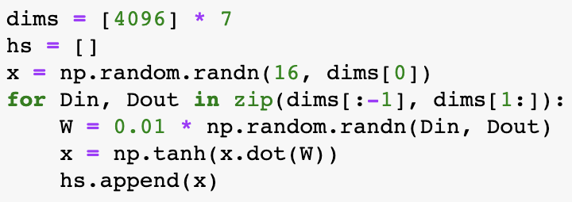
Weight Initialization: Activation Statistics
Forward pass for a 6-layer net with hidden size 4096
Slide credit: D Fouhey & J Johnson

Slide 29
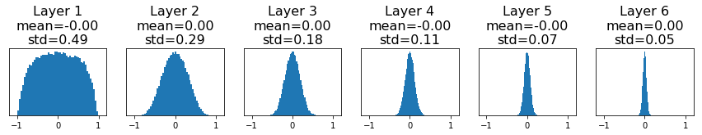
Weight Initialization: Activation Statistics
Forward pass for a 6-layer net with hidden size 4096
All activations tend to zero for deeper network layers
Q: What do the gradients dL/dW look like?
Slide credit: D Fouhey & J Johnson

Slide 30
Weight Initialization: Activation Statistics
Forward pass for a 6-layer net with hidden size 4096
All activations tend to zero for deeper network layers
Q: What do the gradients dL/dW look like?
A: All zero, no learning =(
Weights are too small at initialization!
Slide credit: D Fouhey & J Johnson

Slide 31
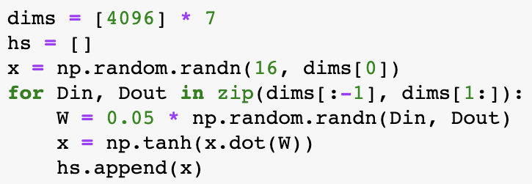
Weight Initialization: Activation Statistics
Increase scale of weights at initialization 0.01 -> 0.05
Slide credit: D Fouhey & J Johnson

Slide 32
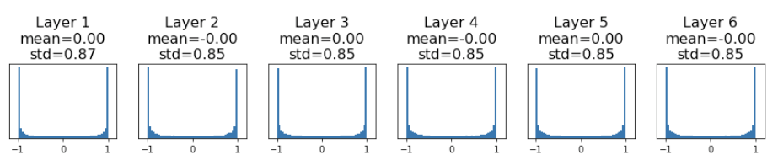
Weight Initialization: Activation Statistics
Increase scale of weights at initialization 0.01 -> 0.05
All activations saturate
Q: What do the gradients look like?
Weights are too big at initialization!
Slide credit: D Fouhey & J Johnson

Slide 33
Weight Initialization: Activation Statistics
Increase scale of weights at initialization 0.01 -> 0.05
All activations saturate
Q: What do the gradients look like?
A: Local gradients all zero, no learning =(
Weights are too big at initialization!
Slide credit: D Fouhey & J Johnson

Slide 34
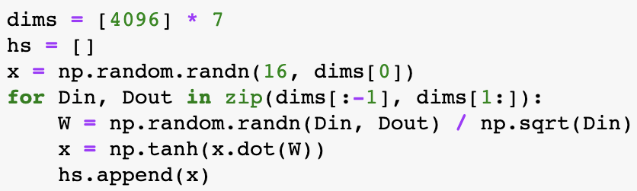
Weight Initialization: Xavier
“Xavier” initialization: std = 1 / sqrt(Din)
Glorot and Bengio, “Understanding the difficulty of training deep feedforward neural networks”, AISTAT 2010
Slide credit: D Fouhey & J Johnson

Slide 35
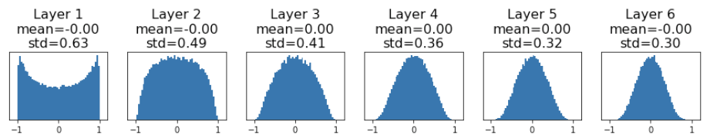
Weight Initialization: Xavier
“Xavier” initialization: std = 1 / sqrt(Din)
Weights are just right at initialization!
Glorot and Bengio, “Understanding the difficulty of training deep feedforward neural networks”, AISTAT 2010
Slide credit: D Fouhey & J Johnson

Slide 36
Weight Initialization: Xavier
“Xavier” initialization: std = 1 / sqrt(Din)
For conv layers, Din is kernel_size² * input_channels
Weights are just right at initialization!
Glorot and Bengio, “Understanding the difficulty of training deep feedforward neural networks”, AISTAT 2010
Slide credit: D Fouhey & J Johnson

Slide 37
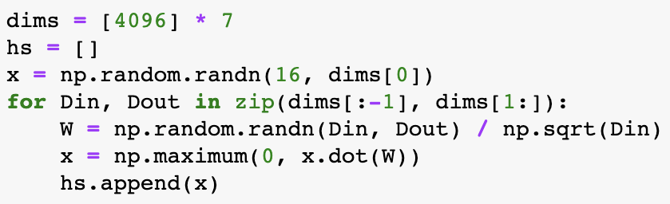
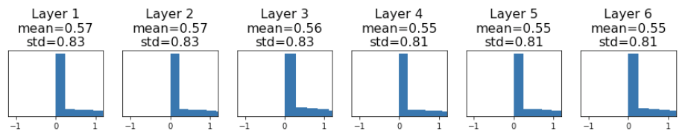
Weight Initialization: MSRA
For ReLU networks: std = sqrt(2 / Din)
”Just right” – activations nicely scaled for all layers
Weights are just right at initialization!
He et al, “Delving Deep into Rectifiers: Surpassing Human-Level Performance on ImageNet Classification”, ICCV 2015
Slide credit: D Fouhey & J Johnson

Slide 38
How to go Deep, part 2
But wait, can’t activations become unscaled after training?
Why not just force activations to be a good size?

Slide 39
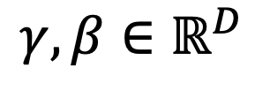


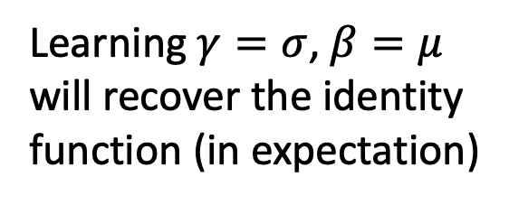
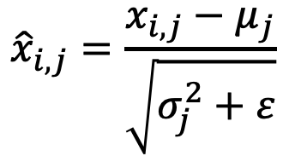
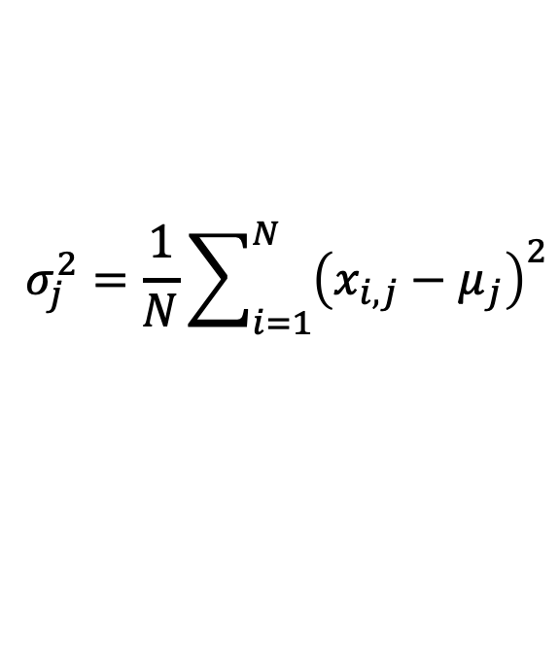
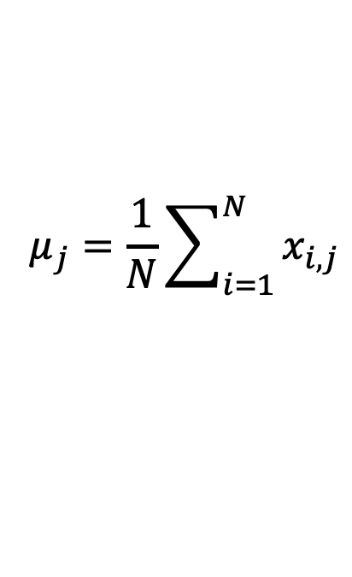
Batch Normalization
Problem: Estimates depend on minibatch; can’t do this at test-time!
Input:
$$μ_{j}=\frac{1}{N}\sum_{i=1}^{N}{x_{i,j}}$$
Per-channel mean, shape is D
$$x∈ℝ^{N×D}$$
Learnable scale and shift parameters:
$$σ_{j}^{2}=\frac{1}{N}\sum_{i=1}^{N}{{\left(x_{i,j}−μ_{j}\right)}^{2}}$$
Per-channel std, shape is D
$$γ,β∈ℝ^{D}$$
$${\hat{x}}_{i,j}=\frac{x_{i,j}−μ_{j}}{\sqrt{σ_{j}^{2}+ε}}$$
Normalized x,
Shape is N x D
Learning $γ=σ$, $β=μ$
will recover the identity function (in expectation)
$$y_{i,j}=γ_{j}{\hat{x}}_{i,j}+β_{j}$$
Output,
Shape is N x D
Slide credit: D Fouhey & J Johnson

Slide 40
Batch Normalization: Test-Time
(Running) average of
values seen during training
Input:
$$μ_{j}=\frac{1}{N}\sum_{i=1}^{N}{x_{i,j}}$$
Per-channel mean, shape is D
$$x∈ℝ^{N×D}$$
Learnable scale and shift parameters:
(Running) average of
values seen during training
$$σ_{j}^{2}=\frac{1}{N}\sum_{i=1}^{N}{{\left(x_{i,j}−μ_{j}\right)}^{2}}$$
Per-channel std, shape is D
$$γ,β∈ℝ^{D}$$
$${\hat{x}}_{i,j}=\frac{x_{i,j}−μ_{j}}{\sqrt{σ_{j}^{2}+ε}}$$
Normalized x,
Shape is N x D
Learning $γ=σ$, $β=μ$
will recover the identity function (in expectation)
$$y_{i,j}=γ_{j}{\hat{x}}_{i,j}+β_{j}$$
Output,
Shape is N x D
Slide credit: D Fouhey & J Johnson

Slide 41
Batch Normalization: Test-Time
(Running) average of
values seen during training
Input:
$$μ_{j}=\frac{1}{N}\sum_{i=1}^{N}{x_{i,j}}$$
Per-channel mean, shape is D
$$x∈ℝ^{N×D}$$
Learnable scale and shift parameters:
(Running) average of
values seen during training
$$σ_{j}^{2}=\frac{1}{N}\sum_{i=1}^{N}{{\left(x_{i,j}−μ_{j}\right)}^{2}}$$
Per-channel std, shape is D
$$γ,β∈ℝ^{D}$$
$${\hat{x}}_{i,j}=\frac{x_{i,j}−μ_{j}}{\sqrt{σ_{j}^{2}+ε}}$$
Normalized x,
Shape is N x D
During testing batchnorm becomes a linear operator!
Can be fused with the previous fully-connected or conv layer
$$y_{i,j}=γ_{j}{\hat{x}}_{i,j}+β_{j}$$
Output,
Shape is N x D
Slide credit: D Fouhey & J Johnson

Slide 42
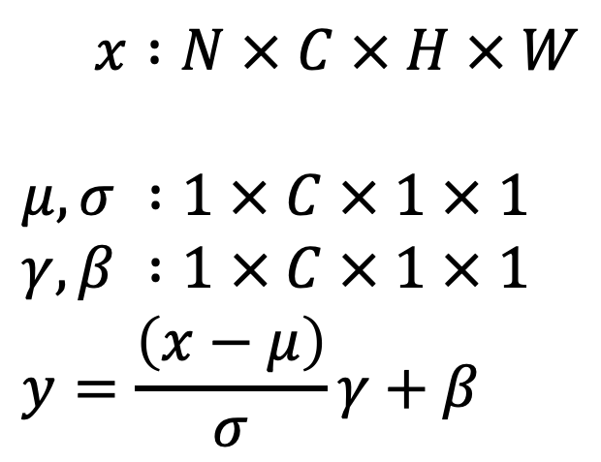
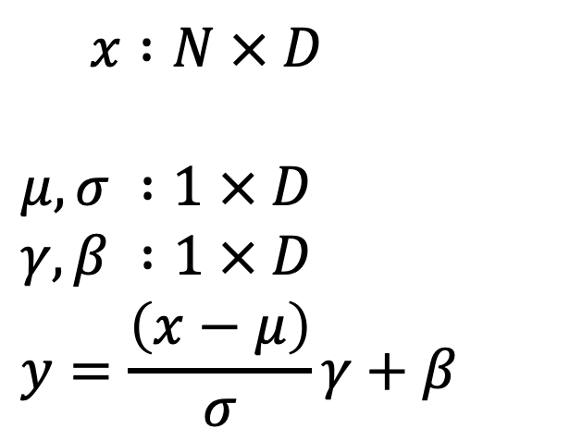
Batch Normalization for ConvNets
Batch Normalization for fully-connected networks
Batch Normalization for
convolutional networks
(Spatial Batchnorm, BatchNorm2D)
$x :N × D$
$$μ,σ :1 × D$$
$$γ,β :1 × D$$
$$y=\frac{\left(x−μ\right)}{σ}γ+β$$
$x :N × C × H × W$
$$μ,σ :1 × C × 1 × 1$$
$$γ,β :1 × C × 1 × 1$$
$$y=\frac{\left(x−μ\right)}{σ}γ+β$$
Normalize
Normalize
Slide credit: D Fouhey & J Johnson

Slide 43
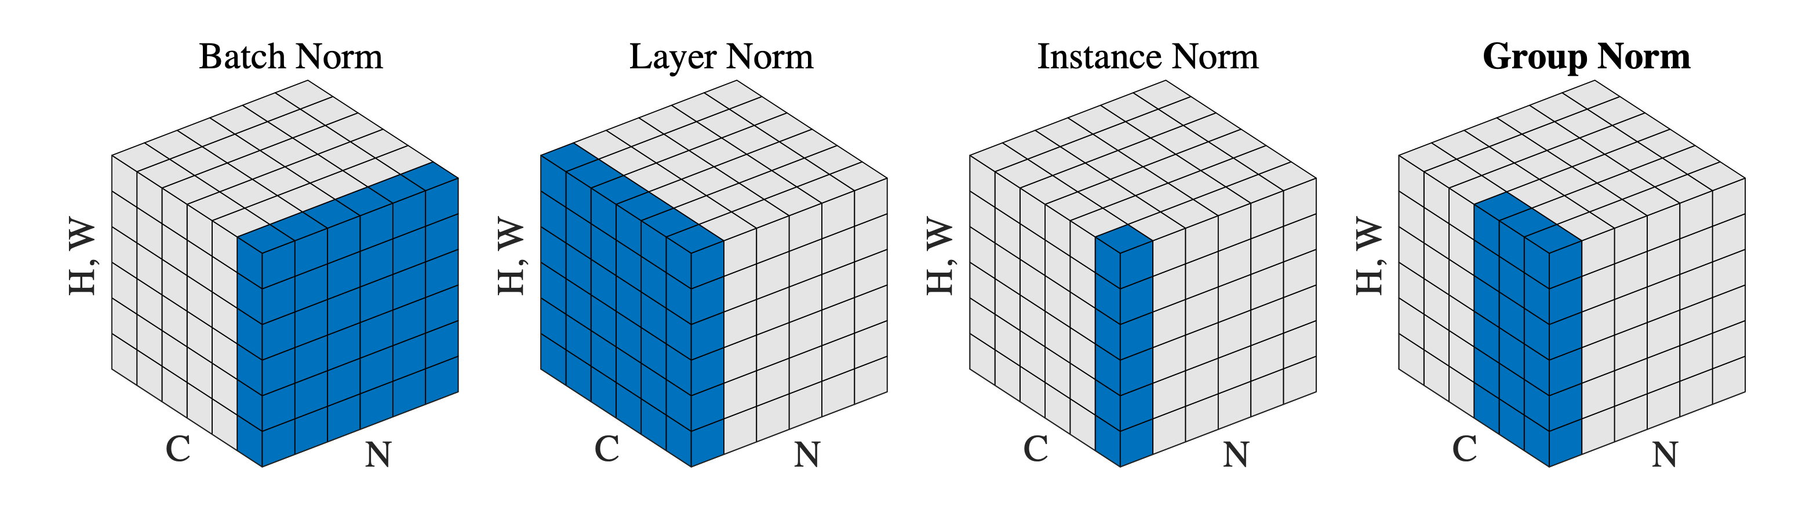
Batch Normalization for ConvNets
Batch Normalization for
convolutional networks
(Spatial Batchnorm, BatchNorm2D)
$x :N × C × H × W$
$$μ,σ :1 × C × 1 × 1$$
$$γ,β :1 × C × 1 × 1$$
$$y=\frac{\left(x−μ\right)}{σ}γ+β$$
Normalize
Slide adapted from: D Fouhey & J Johnson

Slide 44
Different Normalization Layers
[Wu and He. Group Normalization. ECCV 2018. Best paper honorable mention.]

Slide 45
ImageNet Classification Challenge
152 Layer
19 Layer
22 Layer
8 Layer
8 Layer
Shallow
Lin et al
Sanchez & Perronnin
Krizhevsky et al (AlexNet)
Zeiler & Fergus
Simonyan & Zisserman (VGG)
Szegedy et al (GoogLeNet)
He et al (ResNet)
Shao et al
Hu et al
(SENet)
Slide credit: D Fouhey & J Johnson

Slide 46
Residual Networks
Once we have Batch Normalization, we can train networks with 10+ layers. What happens as we go deeper?
He et al, “Deep Residual Learning for Image Recognition”, CVPR 2016
Slide credit: D Fouhey & J Johnson

Slide 47
Residual Networks
Once we have Batch Normalization, we can train networks with 10+ layers. What happens as we go deeper?
Deeper model does worse than shallow model!
Initial guess: Deep model is overfitting since it is much bigger than the other model
Test error
56-layer
20-layer
Iterations
He et al, “Deep Residual Learning for Image Recognition”, CVPR 2016
Slide credit: D Fouhey & J Johnson

Slide 48
Residual Networks
Once we have Batch Normalization, we can train networks with 10+ layers. What happens as we go deeper?
Training error
Test error
56-layer
56-layer
20-layer
20-layer
Iterations
Iterations
In fact the deep model seems to be underfitting since it also performs worse than the shallow model on the training set! It is actually underfitting
He et al, “Deep Residual Learning for Image Recognition”, CVPR 2016
Slide credit: D Fouhey & J Johnson

Slide 49
Residual Networks
A deeper model can emulate a shallower model: copy layers from shallower model, set extra layers to identity
Thus deeper models should do at least as good as shallow models
Hypothesis: This is an optimization problem. Deeper models are harder to optimize, and in particular don’t learn identity functions to emulate shallow models
He et al, “Deep Residual Learning for Image Recognition”, CVPR 2016
Slide credit: D Fouhey & J Johnson

Slide 50
Residual Networks
A deeper model can emulate a shallower model: copy layers from shallower model, set extra layers to identity
Thus deeper models should do at least as good as shallow models
Hypothesis: This is an optimization problem. Deeper models are harder to optimize, and in particular don’t learn identity functions to emulate shallow models
Solution: Change the network so learning identity functions with extra layers is easy!
He et al, “Deep Residual Learning for Image Recognition”, CVPR 2016
Slide credit: D Fouhey & J Johnson

Slide 51
Residual Networks
Solution: Change the network so learning identity functions with extra layers is easy!
H(x)
relu
F(x) + x
conv
conv
F(x)
Additive “shortcut”
relu
relu
conv
conv
X
X
“Plain” block
Residual Block
He et al, “Deep Residual Learning for Image Recognition”, CVPR 2016
Slide credit: D Fouhey & J Johnson

Slide 52
Residual Networks
Solution: Change the network so learning identity functions with extra layers is easy!
H(x)
relu
F(x) + x
If you set these to 0, the whole block will compute the identity function!
conv
conv
F(x)
Additive “shortcut”
relu
relu
conv
conv
X
X
“Plain” block
Residual Block
He et al, “Deep Residual Learning for Image Recognition”, CVPR 2016
Slide credit: D Fouhey & J Johnson

Slide 53
Residual Networks
A residual network is a stack of many residual blocks
Regular design, like VGG: each residual block has two 3x3 conv
Network is divided into stages: the first block of each stage halves the resolution (with stride-2 conv) and doubles the number of channels
Softmax
FC 1000
Pool
3x3 conv, 512
3x3 conv, 512
3x3 conv, 512
relu
3x3 conv, 512
F(x) + x
3x3 conv, 512
3x3 conv, 512, /2
...
3x3 conv
3x3 conv, 128
F(x)
3x3 conv, 128
relu
3x3 conv, 128
3x3 conv, 128
3x3 conv
3x3 conv, 128
3x3 conv, 128, / 2
3x3 conv, 64
3x3 conv, 64
X
3x3 conv, 64
Residual block
3x3 conv, 64
3x3 conv, 64
3x3 conv, 64
Pool
7x7 conv, 64, / 2
Input
He et al, “Deep Residual Learning for Image Recognition”, CVPR 2016
Slide credit: D Fouhey & J Johnson

Slide 54
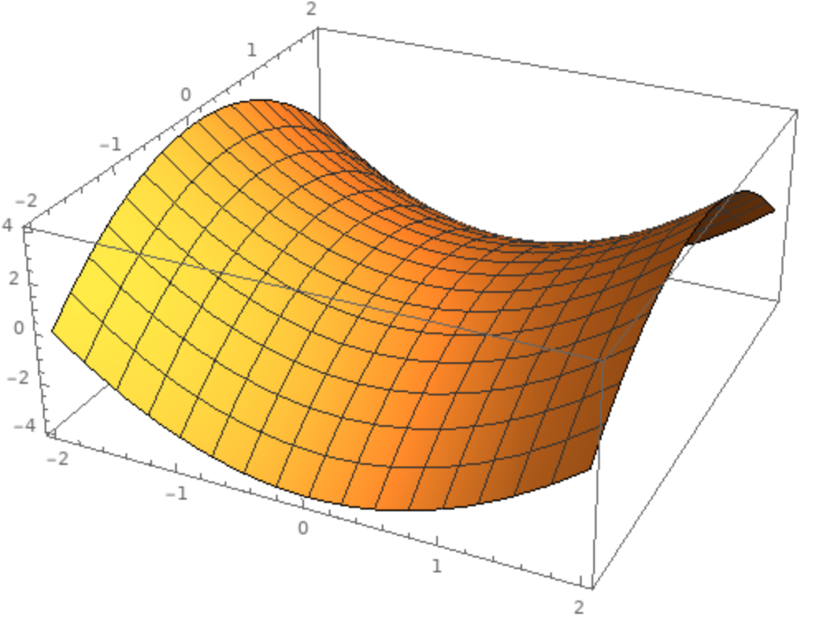
Problems with SGD
Local Minimum
What if the loss function has a local minimum or saddle point?
Saddle point
Gradient is zero, SGD gets stuck
Slide credit: D Fouhey & J Johnson

Slide 55
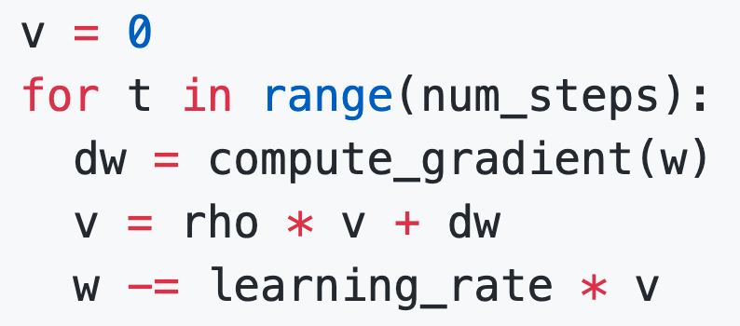
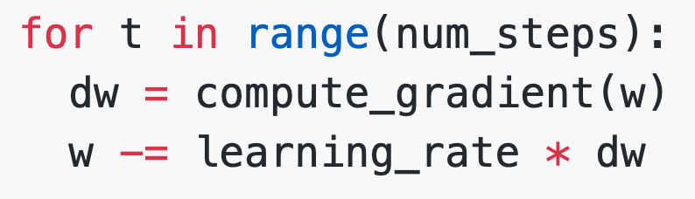
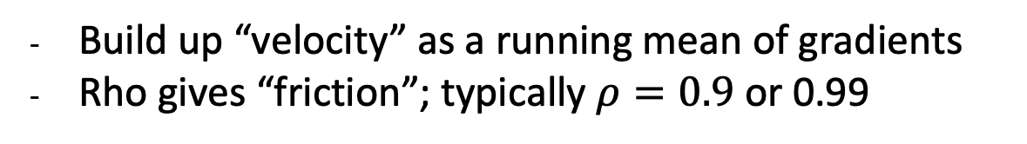
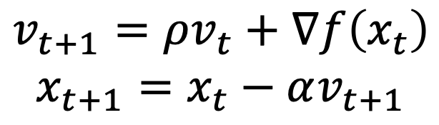
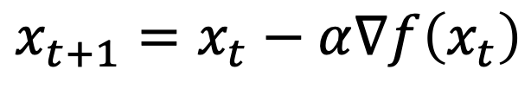
SGD + Momentum
SGD
SGD + Momentum
$$v_{t+1}=ρv_{t}+∇f\left(x_{t}\right)$$
$$x_{t+1}=x_{t}−αv_{t+1}$$
$$x_{t+1}=x_{t}−α∇f\left(x_{t}\right)$$
Build up “velocity” as a running mean of gradients
Rho gives “friction”; typically $ρ=0.9$ or 0.99
Sutskever et al, “On the importance of initialization and momentum in deep learning”, ICML 2013
Slide credit: D Fouhey & J Johnson

Slide 56
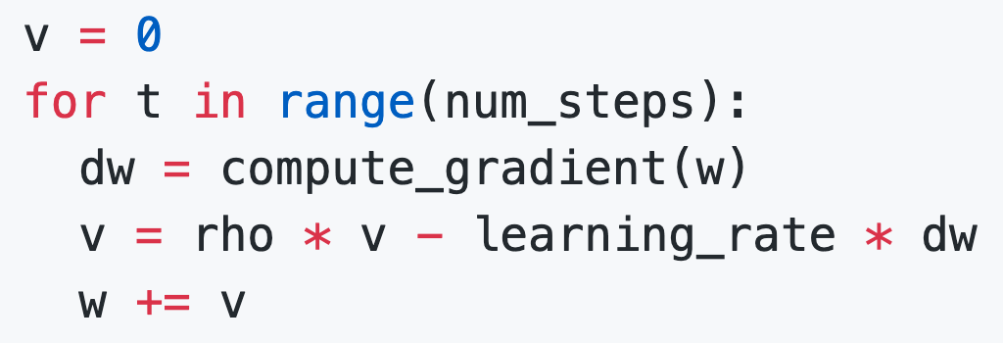
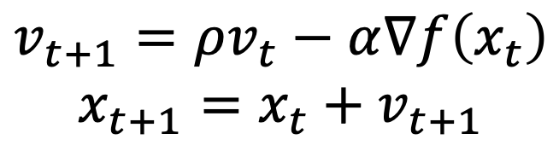
SGD + Momentum
You need to implement it in pa1.
SGD + Momentum
SGD + Momentum
$$v_{t+1}=ρv_{t}−α∇f\left(x_{t}\right)$$
$$x_{t+1}=x_{t}+v_{t+1}$$
$$v_{t+1}=ρv_{t}+∇f\left(x_{t}\right)$$
$$x_{t+1}=x_{t}−αv_{t+1}$$
You may see SGD+Momentum formulated different ways, but they are equivalent - give same sequence of x
Sutskever et al, “On the importance of initialization and momentum in deep learning”, ICML 2013
Slide credit: D Fouhey & J Johnson

Slide 57
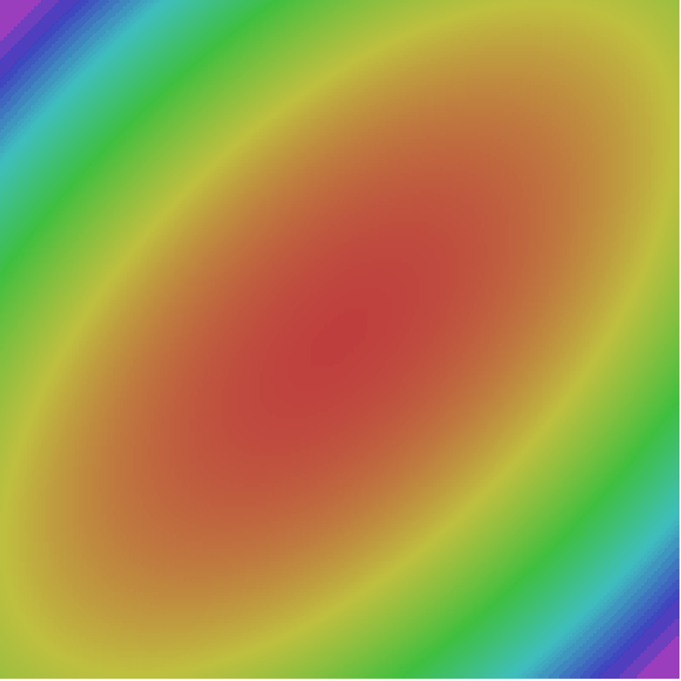
SGD + Momentum
Gradient Noise
Local Minima
Saddle points
Poor Conditioning
SGD
SGD+Momentum
Sutskever et al, “On the importance of initialization and momentum in deep learning”, ICML 2013
Slide credit: D Fouhey & J Johnson

Slide 58
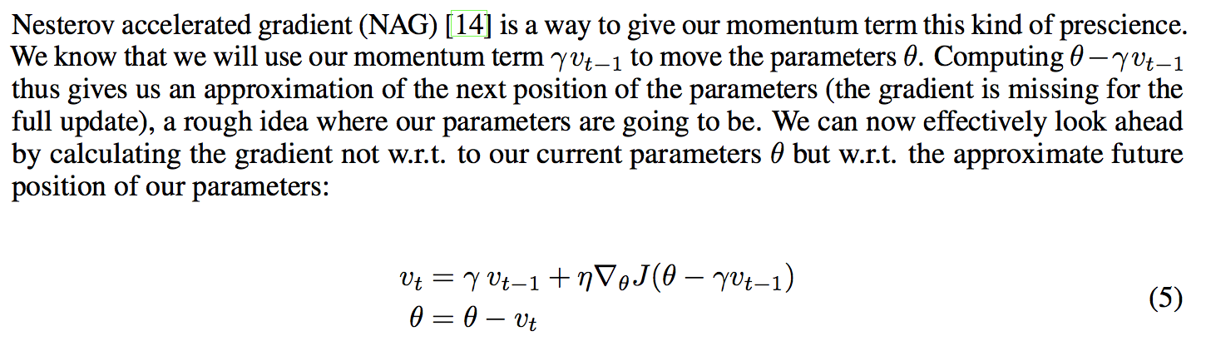
Nesterov momentum

Slide 59
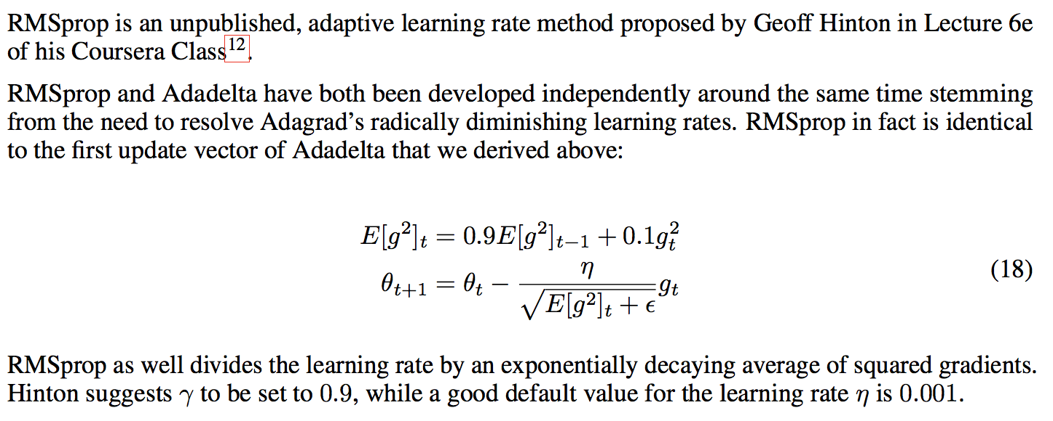
RMS prop

Slide 60
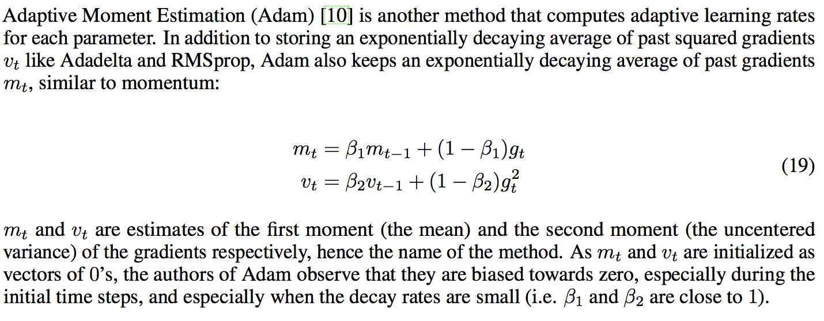
Adam

Slide 61
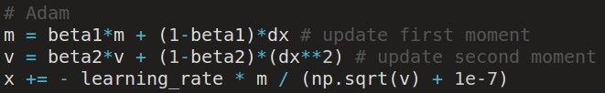
Adam update
Adam update
[Kingma and Ba, 2014]
(incomplete, but close)
momentum
RMSProp-like
Looks a bit like RMSProp with momentum

Slide 62
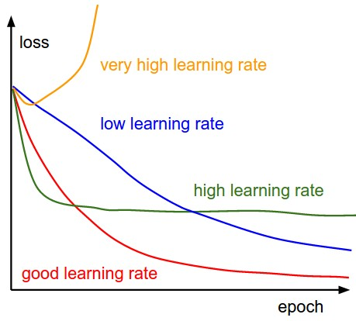
Choosing learning rates
SGD, SGD+Momentum, Adagrad RMSProp, Adam all have learning rate as a hyperparameter. ,
Q: Which one of these learning rates is best to use?

Slide 63


Choosing learning rates
SGD, SGD+Momentum, Adagrad, RMSProp, Adam all have learning rate as a hyperparameter.
=> Learning rate decay over time!
step decay:
e.g. decay learning rate by half every few epochs.
exponential decay:
1/t decay:

