Slide 1

CS 7150
Deep Learning

Slide 2
Homework check
Backpropagation by python operator overloading.
This is a tricky idea!
Shall we step through how it works?
Constructing computation graph for
cosh = Mean(Exp(x), Exp(-x))

Slide 3
(Whiteboard example)
x = Leaf(math.log(2), name='x’)
Leaf (Comp Node)
name: 'x'
input_nodes: []
result: None
gradient: None
value: 0.69
x

Slide 4
(Whiteboard example)
x = Leaf(math.log(2), name='x’)
cosh = Mean(Exp(x), Exp(-x))
Exp (Comp Node)
name: None
input_nodes: [x]
result: None
gradient: None
Leaf (Comp Node)
name: 'x'
input_nodes: []
result: None
gradient: None
value: 0.69
x

Slide 5
(Whiteboard example)
x = Leaf(math.log(2), name='x’)
cosh = Mean(Exp(x), Exp(-x))
“-object”
usually illegal
in python!
Exp (Comp Node)
name: None
input_nodes: [x]
result: None
gradient: None
Leaf (Comp Node)
name: 'x'
input_nodes: []
result: None
gradient: None
value: 0.69
x

Slide 6
(Whiteboard example)
x = Leaf(math.log(2), name='x’)
cosh = Mean(Exp(x), Exp(-x))
“-object”
usually illegal
in python!
Exp (Comp Node)
name: None
input_nodes: [x]
result: None
gradient: None
But the ComputationNode class defines an operator overload
def __neg__(self):
return Negate(self)
Leaf (Comp Node)
name: 'x'
input_nodes: []
result: None
gradient: None
value: 0.69
x

Slide 7
(Whiteboard example)
x = Leaf(math.log(2), name='x’)
cosh = Mean(Exp(x), Exp(-x))
Negate(x)
Exp (Comp Node)
name: None
input_nodes: [x]
result: None
gradient: None
But the ComputationNode class defines an operator overload
def __neg__(self):
return Negate(self)
Leaf (Comp Node)
name: 'x'
input_nodes: []
result: None
gradient: None
value: 0.69
x

Slide 8
(Whiteboard example)
x = Leaf(math.log(2), name='x’)
cosh = Mean(Exp(x), Exp(-x))
Negate(x)
Exp (Comp Node)
name: None
input_nodes: [x]
result: None
gradient: None
But the ComputationNode class defines an operator overload
def __neg__(self):
return Negate(self)
Leaf (Comp Node)
name: 'x'
input_nodes: []
result: None
gradient: None
value: 0.69
We also have “x+y” via __add__ and “x*y” and “x@y” etc
pytorch works this way!
x

Slide 9
(Whiteboard example)
x = Leaf(math.log(2), name='x’)
cosh = Mean(Exp(x), Exp(-x))
Negate(x)
Exp (Comp Node)
name: None
input_nodes: [x]
result: None
gradient: None
Leaf (Comp Node)
name: 'x'
input_nodes: []
result: None
gradient: None
value: 0.69
x

Slide 10
(Whiteboard example)
x = Leaf(math.log(2), name='x’)
cosh = Mean(Exp(x), Exp(-x))
Negate(x)
Exp (Comp Node)
name: None
input_nodes: [x]
result: None
gradient: None
Negate (Comp Node)
name: None
input_nodes: [x]
result: None
gradient: None
Leaf (Comp Node)
name: 'x'
input_nodes: []
result: None
gradient: None
value: 0.69
x

Slide 11
(Whiteboard example)
x = Leaf(math.log(2), name='x’)
cosh = Mean(Exp(x), Exp(-x))
Exp (Comp Node)
name: None
input_nodes: [x]
result: None
gradient: None
Exp (Comp Node)
name: None
input_nodes: [*]
result: None
gradient: None
Negate (Comp Node)
name: None
input_nodes: [x]
result: None
gradient: None
Leaf (Comp Node)
name: 'x'
input_nodes: []
result: None
gradient: None
value: 0.69
x

Slide 12
(Whiteboard example)
x = Leaf(math.log(2), name='x’)
cosh = Mean(Exp(x), Exp(-x))
Mean (Comp Node)
name: None
input_nodes: [*, *]
result: None
gradient: None
Exp (Comp Node)
name: None
input_nodes: [x]
result: None
gradient: None
Exp (Comp Node)
name: None
input_nodes: [*]
result: None
gradient: None
Negate (Comp Node)
name: None
input_nodes: [x]
result: None
gradient: None
Leaf (Comp Node)
name: 'x'
input_nodes: []
result: None
gradient: None
value: 0.69
x

Slide 13
(Whiteboard example)
x = Leaf(math.log(2), name='x’)
cosh = Mean(Exp(x), Exp(-x))
Mean (Comp Node)
name: None
input_nodes: [*, *]
result: None
gradient: None
Exp (Comp Node)
name: None
input_nodes: [x]
result: None
gradient: None
cosh
points to “Mean”
but also holds on to the
whole computation graph
Exp (Comp Node)
name: None
input_nodes: [*]
result: None
gradient: None
Negate (Comp Node)
name: None
input_nodes: [x]
result: None
gradient: None
Leaf (Comp Node)
name: 'x'
input_nodes: []
result: None
gradient: None
value: 0.69
x

Slide 14
Forward pass in bottom-up topological sort order
x = Leaf(math.log(2), name='x’)
cosh = Mean(Exp(x), Exp(-x))
childless
leaf goes first
Mean (Comp Node)
name: None
input_nodes: [*, *]
result: None
gradient: None
Exp (Comp Node)
name: None
input_nodes: [x]
result: None
gradient: None
cosh
Exp (Comp Node)
name: None
input_nodes: [*]
result: None
gradient: None
Negate (Comp Node)
name: None
input_nodes: [x]
result: None
gradient: None
Leaf (Comp Node)
name: 'x'
input_nodes: []
result: 0.69
gradient: None
value: 0.69
x

Slide 15
Forward pass in bottom-up topological sort order
x = Leaf(math.log(2), name='x’)
cosh = Mean(Exp(x), Exp(-x))
Mean (Comp Node)
name: None
input_nodes: [*, *]
result: ERROR
gradient: None
Exp (Comp Node)
name: None
input_nodes: [x]
result: None
gradient: None
cosh
mean(None, None): ERROR
Exp (Comp Node)
name: None
input_nodes: [*]
result: None
gradient: None
Negate (Comp Node)
name: None
input_nodes: [x]
result: None
gradient: None
if we had done
a parent before its
children, it would
be an error
Leaf (Comp Node)
name: 'x'
input_nodes: []
result: 0.69
gradient: None
value: 0.69
x

Slide 16
Forward pass in bottom-up topological sort order
different from regular
recursion: we do not want
to execute x twice.
(HW has a case where it
matters)
x = Leaf(math.log(2), name='x’)
cosh = Mean(Exp(x), Exp(-x))
Mean (Comp Node)
name: None
input_nodes: [*, *]
result: None
gradient: None
Exp (Comp Node)
name: None
input_nodes: [x]
result: None
gradient: None
cosh
Exp (Comp Node)
name: None
input_nodes: [*]
result: None
gradient: None
Negate (Comp Node)
name: None
input_nodes: [x]
result: None
gradient: None
Leaf (Comp Node)
name: 'x'
input_nodes: []
result: 0.69
gradient: None
value: 0.69
x

Slide 17
Forward pass in bottom-up topological sort order
x = Leaf(math.log(2), name='x’)
cosh = Mean(Exp(x), Exp(-x))
5
4
Mean (Comp Node)
name: None
input_nodes: [*, *]
result: None
gradient: None
Exp (Comp Node)
name: None
input_nodes: [x]
result: None
gradient: None
cosh
3
2
1
Exp (Comp Node)
name: None
input_nodes: [*]
result: None
gradient: None
Negate (Comp Node)
name: None
input_nodes: [x]
result: None
gradient: None
Leaf (Comp Node)
name: 'x'
input_nodes: []
result: 0.69
gradient: None
value: 0.69
x

Slide 18
Forward pass in bottom-up topological sort order
x = Leaf(math.log(2), name='x’)
cosh = Mean(Exp(x), Exp(-x))
5
4
Mean (Comp Node)
name: None
input_nodes: [*, *]
result: 1.25
gradient: None
Exp (Comp Node)
name: None
input_nodes: [x]
result: 2
gradient: None
cosh
3
2
1
Exp (Comp Node)
name: None
input_nodes: [*]
result: 0.5
gradient: None
Negate (Comp Node)
name: None
input_nodes: [x]
result: -0.69
gradient: None
Leaf (Comp Node)
name: 'x'
input_nodes: []
result: 0.69
gradient: None
value: 0.69
x

Slide 19
Forward pass in bottom-up topological sort order
x = Leaf(math.log(2), name='x’)
cosh = Mean(Exp(x), Exp(-x))
forward_algorithm(cosh) → 1.25
Mean (Comp Node)
name: None
input_nodes: [*, *]
result: 1.25
gradient: None
Exp (Comp Node)
name: None
input_nodes: [x]
result: 2
gradient: None
cosh
Exp (Comp Node)
name: None
input_nodes: [*]
result: 0.5
gradient: None
Negate (Comp Node)
name: None
input_nodes: [x]
result: -0.69
gradient: None
Leaf (Comp Node)
name: 'x'
input_nodes: []
result: 0.69
gradient: None
value: 0.69
x

Slide 20
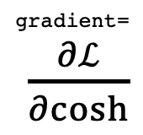
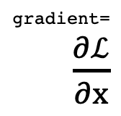
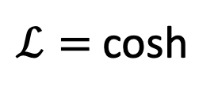
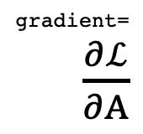
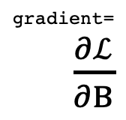
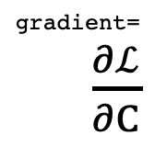
The goal of backward pass
cosh = Mean(Exp(x), Exp(-x))
gradient=
$\frac{∂ℒ}{∂cosh}$
gradient=
$\frac{∂ℒ}{∂C}$
Mean (Comp Node)
name: None
input_nodes: [*, *]
result: 1.25
gradient: None
Exp (Comp Node)
name: None
input_nodes: [x]
result: 2
gradient: None
C
$ℒ=$cosh
gradient=
$\frac{∂ℒ}{∂A}$
gradient=
$\frac{∂ℒ}{∂B}$
gradient=
$\frac{∂ℒ}{∂x}$
Exp (Comp Node)
name: None
input_nodes: [*]
result: 0.5
gradient: None
Negate (Comp Node)
name: None
input_nodes: [x]
result: -0.69
gradient: None
Leaf (Comp Node)
name: 'x'
input_nodes: []
result: 0.69
gradient: None
value: 0.69
A
B
x

Slide 21
The goal of backward pass
cosh = Mean(Exp(x), Exp(-x))
gradient=
$\frac{∂ℒ}{∂cosh}$
gradient=
$\frac{∂ℒ}{∂C}$
This is what
we want
in the end
Mean (Comp Node)
name: None
input_nodes: [*, *]
result: 1.25
gradient: None
Exp (Comp Node)
name: None
input_nodes: [x]
result: 2
gradient: None
C
$ℒ=$cosh
gradient=
$\frac{∂ℒ}{∂A}$
gradient=
$\frac{∂ℒ}{∂B}$
gradient=
$\frac{∂ℒ}{∂x}$
Exp (Comp Node)
name: None
input_nodes: [*]
result: 0.5
gradient: None
Negate (Comp Node)
name: None
input_nodes: [x]
result: -0.69
gradient: None
Leaf (Comp Node)
name: 'x'
input_nodes: []
result: 0.69
gradient: None
value: 0.69
A
B
x

Slide 22
The goal of backward pass
cosh = Mean(Exp(x), Exp(-x))
gradient=
$\frac{∂ℒ}{∂cosh}$
gradient=
$\frac{∂ℒ}{∂C}$
grad = None + None: ERROR
But computing
it first would
be an ERROR
Mean (Comp Node)
name: None
input_nodes: [*, *]
result: 1.25
gradient: None
Exp (Comp Node)
name: None
input_nodes: [x]
result: 2
gradient: None
C
$ℒ=$cosh
gradient=
$\frac{∂ℒ}{∂A}$
gradient=
$\frac{∂ℒ}{∂B}$
gradient=
$\frac{∂ℒ}{∂x}$
Exp (Comp Node)
name: None
input_nodes: [*]
result: 0.5
gradient: None
Negate (Comp Node)
name: None
input_nodes: [x]
result: -0.69
gradient: None
Leaf (Comp Node)
name: 'x'
input_nodes: []
result: 0.69
gradient: ERROR
value: 0.69
A
B
x

Slide 23
Backward pass in top-down topological sort order
cosh = Mean(Exp(x), Exp(-x))
gradient=
$\frac{∂ℒ}{∂cosh}$
gradient=
$\frac{∂ℒ}{∂C}$
1
2
Mean (Comp Node)
name: None
input_nodes: [*, *]
result: 1.25
gradient: None
Exp (Comp Node)
name: None
input_nodes: [x]
result: 2
gradient: None
C
$ℒ=$cosh
gradient=
$\frac{∂ℒ}{∂A}$
gradient=
$\frac{∂ℒ}{∂B}$
gradient=
$\frac{∂ℒ}{∂x}$
3
4
5
Exp (Comp Node)
name: None
input_nodes: [*]
result: 0.5
gradient: None
Negate (Comp Node)
name: None
input_nodes: [x]
result: -0.69
gradient: None
Leaf (Comp Node)
name: 'x'
input_nodes: []
result: 0.69
gradient: None
value: 0.69
A
B
x

Slide 24
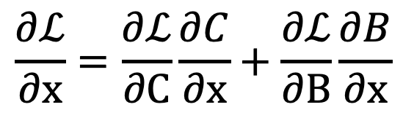
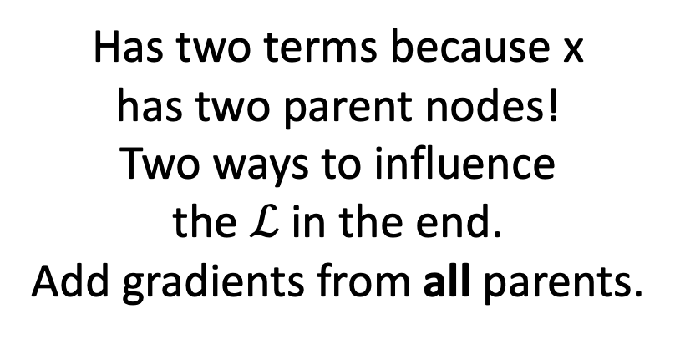
Zoom in to one node
Computed during...
Step 2
Step 4
gradient=
$\frac{∂ℒ}{∂C}$
2
$$\frac{∂ℒ}{∂x}=\frac{∂ℒ}{∂C}\frac{∂C}{∂x}+\frac{∂ℒ}{∂B}\frac{∂B}{∂x}$$
Exp (Comp Node)
name: None
input_nodes: [x]
result: 2
gradient: None
(Chain rule)
C
gradient=
$\frac{∂ℒ}{∂B}$
gradient=
$\frac{∂ℒ}{∂x}$
Has two terms because x
has two parent nodes!
Two ways to influence
the $ℒ$in the end.
Add gradients from all parents.
4
5
Negate (Comp Node)
name: None
input_nodes: [x]
result: -0.69
gradient: None
Leaf (Comp Node)
name: 'x'
input_nodes: []
result: 0.69
gradient: None
value: 0.69
B
x

Slide 25
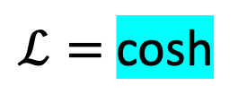
Backward pass in top-down topological sort order
cosh = Mean(Exp(x), Exp(-x))
gradient=
$\frac{∂ℒ}{∂cosh}$
gradient=
$\frac{∂ℒ}{∂C}$
1
2
Mean (Comp Node)
name: None
input_nodes: [*, *]
result: 1.25
gradient: 1.0
Exp (Comp Node)
name: None
input_nodes: [x]
result: 2
gradient: None
C
$ℒ=$cosh
gradient=
$\frac{∂ℒ}{∂A}$
gradient=
$\frac{∂ℒ}{∂B}$
gradient=
$\frac{∂ℒ}{∂x}$
3
4
5
Exp (Comp Node)
name: None
input_nodes: [*]
result: 0.5
gradient: None
Negate (Comp Node)
name: None
input_nodes: [x]
result: -0.69
gradient: None
Leaf (Comp Node)
name: 'x'
input_nodes: []
result: 0.69
gradient: None
value: 0.69
A
B
x

Slide 26
Backward pass in top-down topological sort order
cosh = Mean(Exp(x), Exp(-x))
gradient=
$\frac{∂ℒ}{∂cosh}$
gradient=
$\frac{∂ℒ}{∂C}$
1
2
Mean (Comp Node)
name: None
input_nodes: [*, *]
result: 1.25
gradient: 1.0
Exp (Comp Node)
name: None
input_nodes: [x]
result: 2
gradient: 0.5
C
$ℒ=$cosh
gradient=
$\frac{∂ℒ}{∂A}$
gradient=
$\frac{∂ℒ}{∂B}$
gradient=
$\frac{∂ℒ}{∂x}$
3
4
5
Exp (Comp Node)
name: None
input_nodes: [*]
result: 0.5
gradient: 0.5
Negate (Comp Node)
name: None
input_nodes: [x]
result: -0.69
gradient: None
Leaf (Comp Node)
name: 'x'
input_nodes: []
result: 0.69
gradient: None
value: 0.69
A
B
x

Slide 27
Backward pass in top-down topological sort order
cosh = Mean(Exp(x), Exp(-x))
gradient=
$\frac{∂ℒ}{∂cosh}$
gradient=
$\frac{∂ℒ}{∂C}$
1
2
Mean (Comp Node)
name: None
input_nodes: [*, *]
result: 1.25
gradient: 1.0
Exp (Comp Node)
name: None
input_nodes: [x]
result: 2
gradient: 0.5
C
$ℒ=$cosh
gradient=
$\frac{∂ℒ}{∂A}$
gradient=
$\frac{∂ℒ}{∂B}$
gradient=
$\frac{∂ℒ}{∂x}$
3
4
5
Exp (Comp Node)
name: None
input_nodes: [*]
result: 0.5
gradient: 0.5
Negate (Comp Node)
name: None
input_nodes: [x]
result: -0.69
gradient: 0.25
Leaf (Comp Node)
name: 'x'
input_nodes: []
result: 0.69
gradient: 1.0
value: 0.69
A
B
x

Slide 28
Backward pass in top-down topological sort order
cosh = Mean(Exp(x), Exp(-x))
gradient=
$\frac{∂ℒ}{∂cosh}$
gradient=
$\frac{∂ℒ}{∂C}$
1
2
Mean (Comp Node)
name: None
input_nodes: [*, *]
result: 1.25
gradient: 1.0
Exp (Comp Node)
name: None
input_nodes: [x]
result: 2
gradient: 0.5
C
$ℒ=$cosh
gradient=
$\frac{∂ℒ}{∂A}$
gradient=
$\frac{∂ℒ}{∂B}$
gradient=
$\frac{∂ℒ}{∂x}$
3
4
5
Exp (Comp Node)
name: None
input_nodes: [*]
result: 0.5
gradient: 0.5
Negate (Comp Node)
name: None
input_nodes: [x]
result: -0.69
gradient: 0.25
Leaf (Comp Node)
name: 'x'
input_nodes: []
result: 0.69
gradient: 1.0
value: 0.69
A
B
x

Slide 29
Backward pass in top-down topological sort order
cosh = Mean(Exp(x), Exp(-x))
gradient=
$\frac{∂ℒ}{∂cosh}$
gradient=
$\frac{∂ℒ}{∂C}$
1
2
Mean (Comp Node)
name: None
input_nodes: [*, *]
result: 1.25
gradient: 1.0
Exp (Comp Node)
name: None
input_nodes: [x]
result: 2
gradient: 0.5
C
$ℒ=$cosh
gradient=
$\frac{∂ℒ}{∂A}$
gradient=
$\frac{∂ℒ}{∂B}$
gradient=
$\frac{∂ℒ}{∂x}$
3
4
5
Exp (Comp Node)
name: None
input_nodes: [*]
result: 0.5
gradient: 0.5
Negate (Comp Node)
name: None
input_nodes: [x]
result: -0.69
gradient: 0.25
Leaf (Comp Node)
name: 'x'
input_nodes: []
result: 0.69
gradient: 0.75
value: 0.69
A
B
x

Slide 30
OK, back to the big picture

Slide 31

Three Big Concerns
What could we do to get a smarter network?
Make the network bigger!
Computation:
learn good rules,
good features

Slide 32
Going Deeper: Imagenet Winners
152 Layer
19 Layer
22 Layer
8 Layer
8 Layer
Shallow
Lin et al
Sanchez & Perronnin
Krizhevsky et al (AlexNet)
Zeiler & Fergus
Simonyan & Zisserman (VGG)
Szegedy et al (GoogLeNet)
He et al (ResNet)
Shao et al
Hu et al
(SENet)
Slide credit: D Fouhey & J Johnson

Slide 33
Residual Networks
Once we have Batch Normalization, we can train networks with 10+ layers. What happens as we go deeper?
Deeper model does worse than shallow model!
Initial guess: Deep model is overfitting since it is much bigger than the other model
Test error
56-layer
20-layer
Iterations
He et al, “Deep Residual Learning for Image Recognition”, CVPR 2016
Slide credit: D Fouhey & J Johnson

Slide 34
What overfitting looks like
Training set data
Accuracy
Training iterations

Slide 35
What overfitting looks like
100% accuracy
Training set data
Accuracy
Held out validation data
Training iterations

Slide 36
Regularization tries to fix this
100% accuracy
Training set data
Typical
solution: add
weight decay
(make the network
a bit less smart)
Accuracy
Training iterations

Slide 37
Regularization tries to fix this
100% accuracy
Training set data
Accuracy
Held out validation data
Hope: it learns patterns
and generalizes better
Training iterations

Slide 38
Residual Networks
Once we have Batch Normalization, we can train networks with 10+ layers. What happens as we go deeper?
Training error
Test error
56-layer
56-layer
20-layer
20-layer
Iterations
Iterations
In fact the deep model seems to be underfitting since it also performs worse than the shallow model on the training set! It is actually underfitting
He et al, “Deep Residual Learning for Image Recognition”, CVPR 2016
Slide credit: D Fouhey & J Johnson

Slide 39
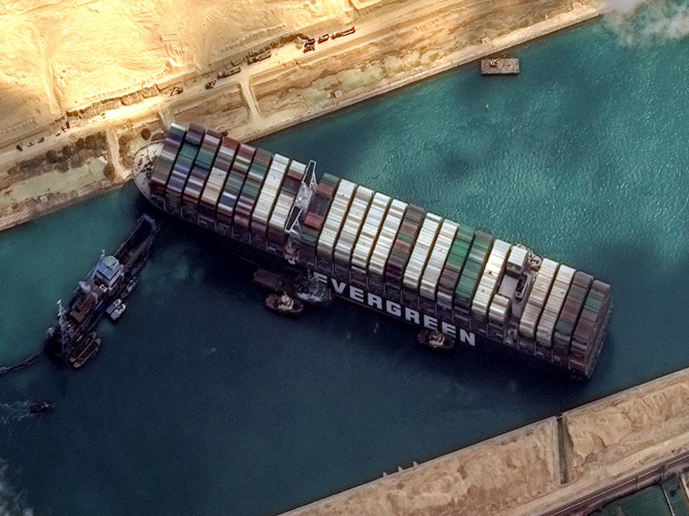
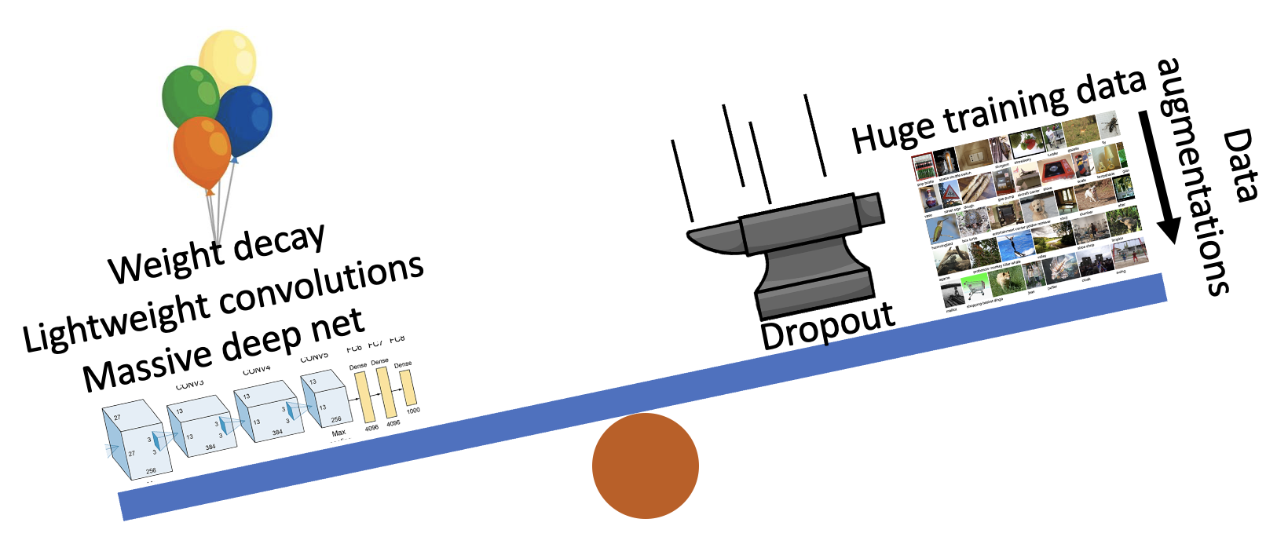
Three Big Concerns
Optimization needs
to not get stuck
Generalization:
avoid overfitting
Computation:
learn good rules,
good features

Slide 40
Three Big Concerns
Optimization needs
to not get stuck
Generalization:
avoid overfitting
Computation:
learn good rules,
good features

Slide 41

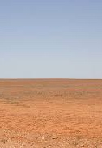
Optimization: avoid getting stuck
Two main problems
Switchbacks
Flat region

Slide 42
Optimization: avoid getting stuck
Two main problems
Several things can cause
switchbacks and
flat regions!
Switchbacks
Flat region

